Slide 1

Deep learning
Week 6, Lecture 6
Muhammad Saqib Sohail
Fall 2025

Slide 2

Attendance
Make sure your attendance is $≥75\%$

Slide 3
Regularization for Neural Networks

Slide 4
Regularization
Regularization is not a single technique, rather a collection of several techniques
Why Regularization is Needed?
Controlling complexity
Preventing overfitting (too many parameters, memorization of training data)
Improving generalization (enhance performance on unseen/test data)

Slide 5
Various types of Regularization
Weight-Based Regularization
L1 (Lasso): sparsity, i.e., select few parameters
L2 (Ridge regression/ Weight decay): keeps weights (parameters) small
Data-Based Regularization
Data augmentation: synthetic variations of input data
Noise injection: adding noise to inputs, hidden layers, or weight
Architectural Regularization
Dropout: randomly dropping neurons during training
Batch Normalization: stabilizing training, acting as implicit regularizer
Early stopping: halting training when validation error starts increasing

Slide 6
Various types of Regularization
Regularization via Model Complexity Control
Reducing network size (fewer layers/neurons)
Weight sharing (e.g., CNN filters)
Advanced Regularization Techniques
Label smoothing
Stochastic depth / DropPath (ResNets, transformers)
Mixup, Cutout, CutMix (modern augmentation tricks)
Adversarial training (robustness + regularization)

Slide 7
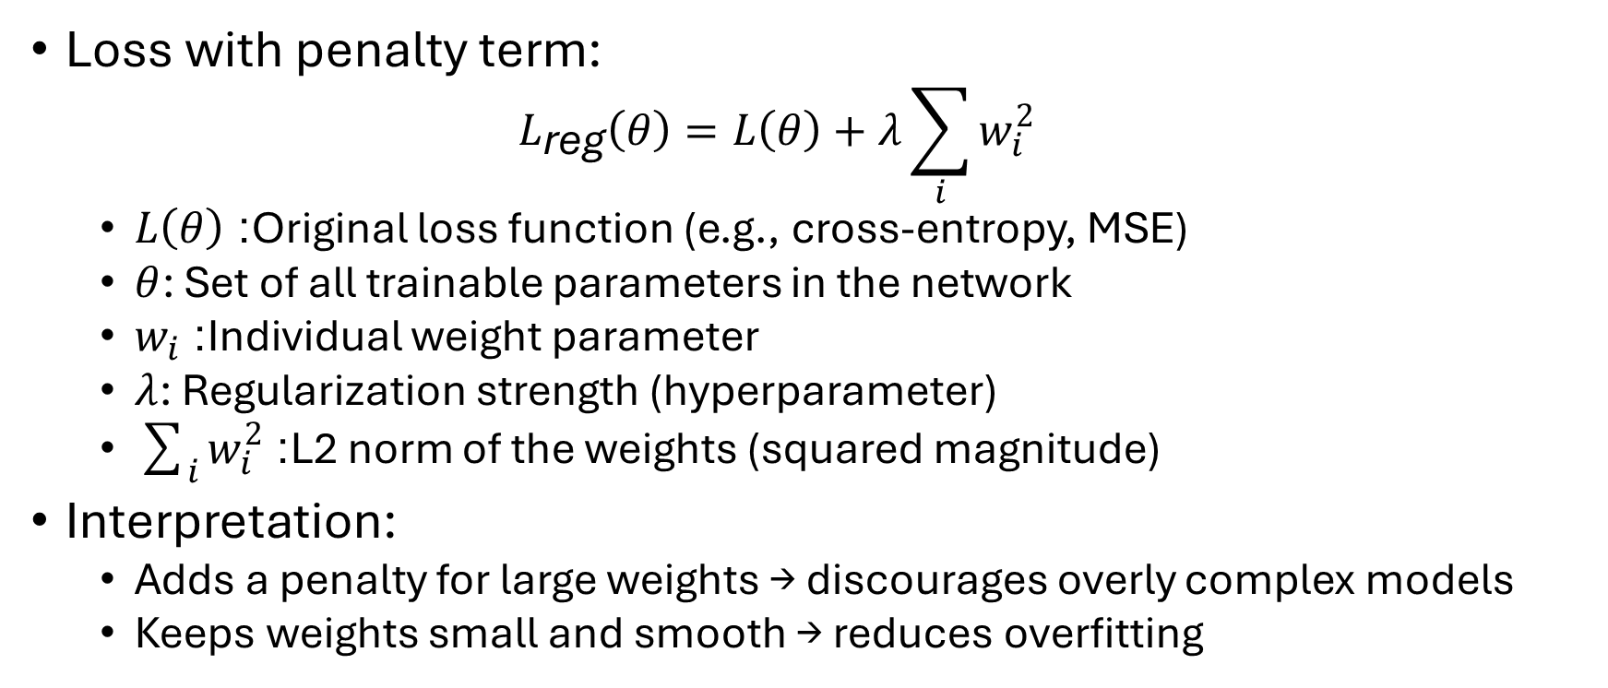
Weight decay (L2 regularization)
Loss with penalty term:
$$L_{\text{reg}}\left(θ\right)=L\left(θ\right)+λ\sum_{i}{w_{i}^{2}}$$
$L\left(θ\right)$: Original loss function (e.g., cross-entropy, MSE)
$θ$: Set of all trainable parameters in the network
$w_{i}$: Individual weight parameter
$λ$: Regularization strength (hyperparameter)
$\sum_{i}{w_{i}^{2}}$: L2 norm of the weights (squared magnitude)
Interpretation:
Adds a penalty for large weights → discourages overly complex models
Keeps weights small and smooth → reduces overfitting

Slide 8
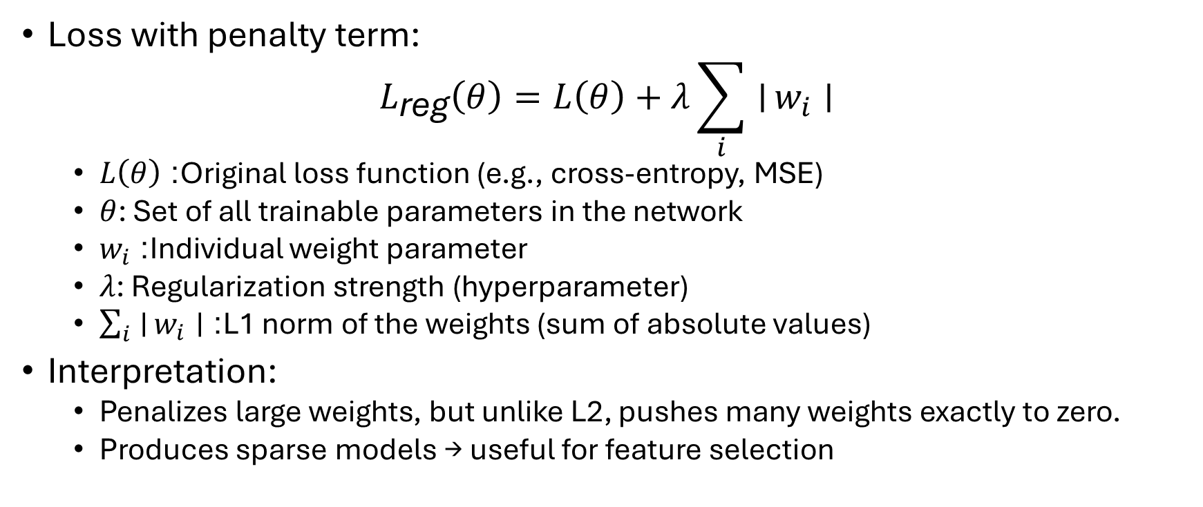
LASSO (L1 regularization)
Loss with penalty term:
$$L_{\text{reg}}\left(θ\right)=L\left(θ\right)+λ\sum_{i}{∣}w_{i}∣$$
$L\left(θ\right)$: Original loss function (e.g., cross-entropy, MSE)
$θ$: Set of all trainable parameters in the network
$w_{i}$: Individual weight parameter
$λ$: Regularization strength (hyperparameter)
$\sum_{i}{∣}w_{i}∣$: L1 norm of the weights (sum of absolute values)
Interpretation:
Penalizes large weights, but unlike L2, pushes many weights exactly to zero.
Produces sparse models → useful for feature selection

Slide 9
Data Augmentation
Expands training set artificially
Examples:
Images: rotation, scaling, flipping
Text: synonym replacement, back-translation
Audio: time-shift
Structured data: Bootstrapping approaches
Improves robustness

Slide 10
Noise Injection
Add random noise to:
Inputs → robustness
Hidden activations → less co-adaptation
Weights → stability
Forces learning of stable patterns

Slide 11
Co-adaptation
Occurs when multiple hidden neurons rely on each other’s presence and develop interdependent representations instead of learning independently useful features
Example: instead of neuron A learning a robust edge detector and neuron B learning a shape detector, they might “team up” so that A’s output only makes sense if B is also active
Why it’s a problem:
Reduces robustness → the network “memorizes” training patterns through joint dependencies
Harms generalization → if one neuron’s behavior shifts (due to noise, missing input, or dropout), the others can’t function properly

Slide 12
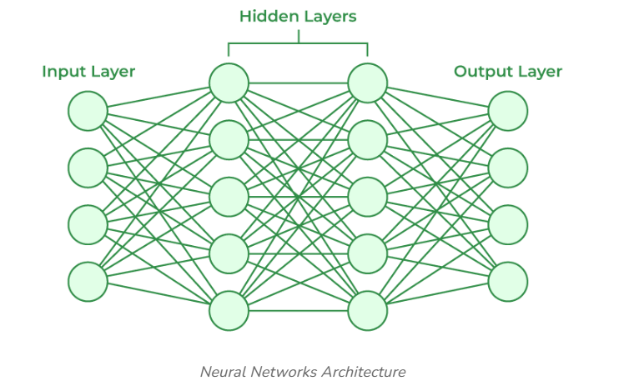

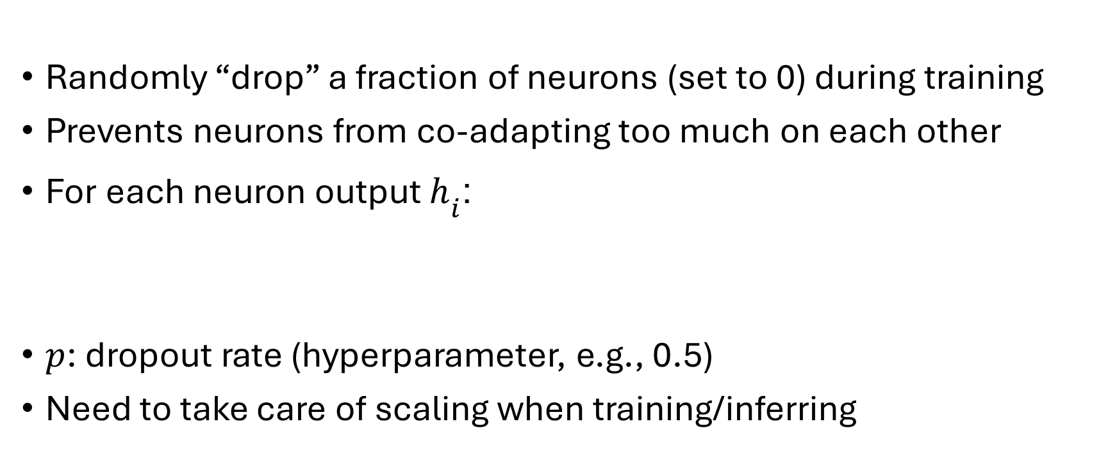
Dropout
Randomly “drop” a fraction of neurons (set to 0) during training
Prevents neurons from co-adapting too much on each other
For each neuron output $h_{i}$:
$p$: dropout rate (hyperparameter, e.g., 0.5)
Need to take care of scaling when training/inferring

Slide 13
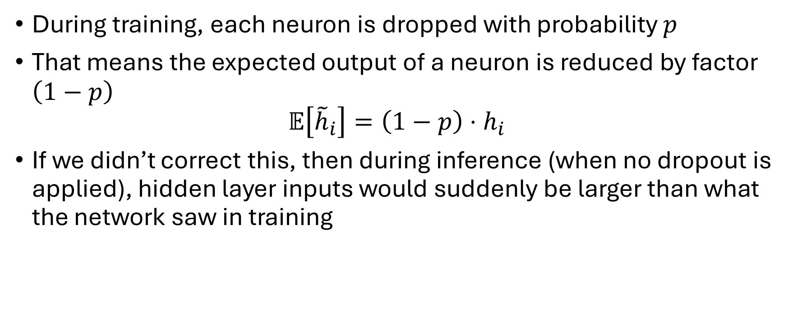
Dropout
During training, each neuron is dropped with probability $p$
That means the expected output of a neuron is reduced by factor $\left(1−p\right)$
$$𝔼\left[{\tilde{h}}_{i}\right]=\left(1−p\right)⋅h_{i}$$
If we didn’t correct this, then during inference (when no dropout is applied), hidden layer inputs would suddenly be larger than what the network saw in training

Slide 14
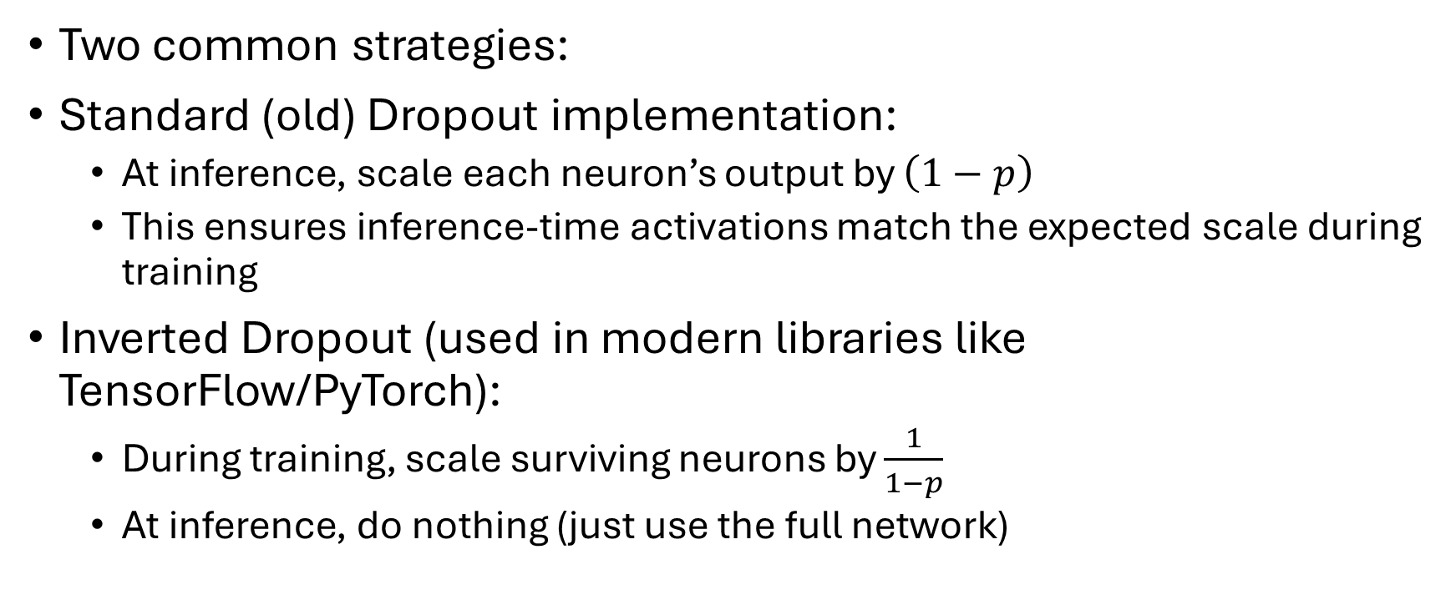
Dropout
Two common strategies:
Standard (old) Dropout implementation:
At inference, scale each neuron’s output by $\left(1−p\right)$
This ensures inference-time activations match the expected scale during training
Inverted Dropout (used in modern libraries like TensorFlow/PyTorch):
During training, scale surviving neurons by $\frac{1}{1−p}$
At inference, do nothing (just use the full network)

Slide 15
Typical dropout rates
Layer Type | Typical Dropout Rate | Notes
Input layer | 0.1 – 0.2 | Use a small rate here: dropping too many inputs hurts learning
Convolutional layers | 0.2 – 0.3 | Conv layers already have fewer parameters, so don’t need much dropout
Fully connected layers | 0.5 (sometimes 0.4–0.6) | Heavily used here: large number of parameters makes them prone to overfitting
Very deep networks | 0.3 – 0.5 | Often apply progressively higher dropout deeper in the network

Slide 16
Practical tips for using Dropout
Dropout is usually not used after every layer
Typically, dropout is used just after fully connected layers (particularly in CNNs)
If you’re also using Batch Normalization, you might reduce dropout or even skip it (BN itself has a mild regularizing effect)
When your dataset is very large, you may not need much dropout at all

Slide 17
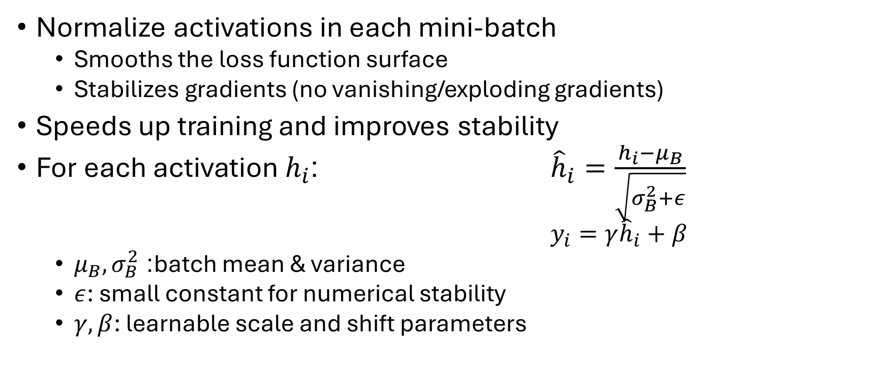
Batch Normalization (BatchNorm)
Normalize activations in each mini-batch
Smooths the loss function surface
Stabilizes gradients (no vanishing/exploding gradients)
Speeds up training and improves stability
For each activation $h_{i}$: ${\hat{h}}_{i}=\frac{h_{i}−μ_{B}}{\sqrt{σ_{B}^{2}+ε}}$
$y_{i}=γ{\hat{h}}_{i}+β$
$μ_{B},σ_{B}^{2}$: batch mean & variance
$ε$: small constant for numerical stability
$γ,β$: learnable scale and shift parameters

Slide 18


Batch Normalization (BatchNorm)
In case of fully connected Layer
BatchNorm is applied per neuron
For each mini batch $m$
Without BatchNorm:
$z_{j}=\sum_{i=1}^{J}{w_{i}x_{i}}+b$
$a_{j}=φ\left(z_{j}\right)$
With BatchNorm
${\hat{z}}_{j}=\frac{z_{j}−μ_{j}}{\sqrt{σ_{j}^{2}+ε}}$​​
${\tilde{z}}_{j}=γ_{j}{\hat{z}}_{j}+β_{j}$
$a_{j}=φ({\tilde{z}}_{j})$

Slide 19
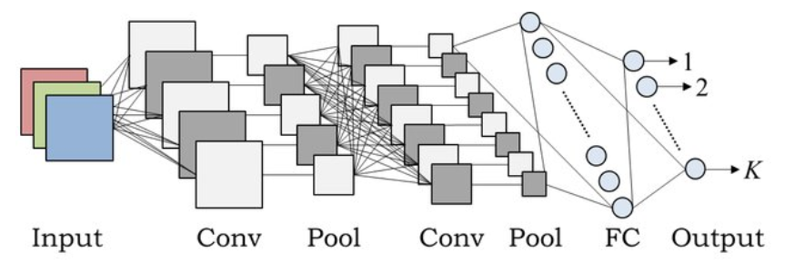
Batch Normalization (BatchNorm)
In case of Convolution Layer
BatchNorm is applied per channel
BatchNorm normalizes activations (zero mean, unit variance) at each layer

Slide 20
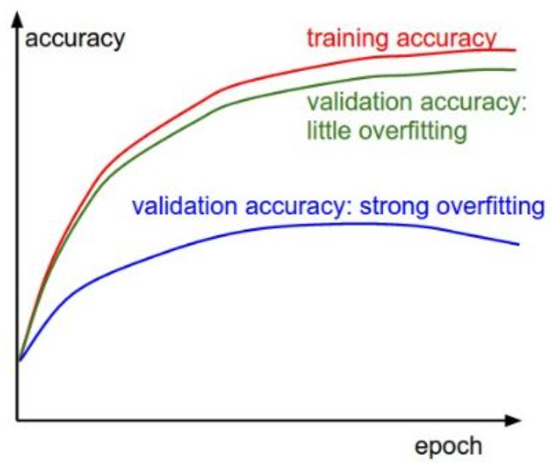
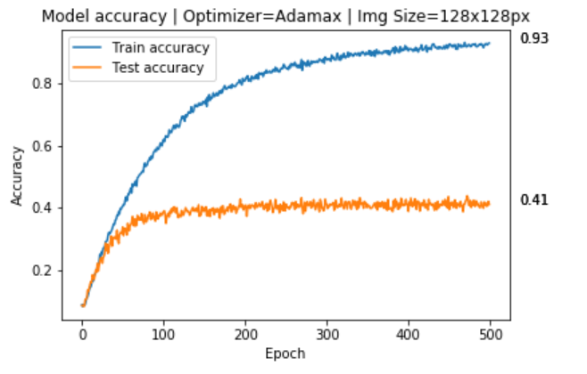
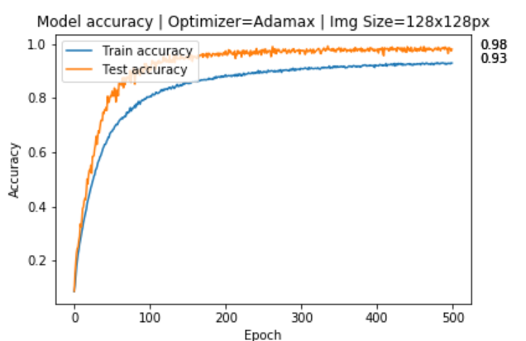
Overfitting
Unacceptable overfitting
Acceptable overfitting

Slide 21
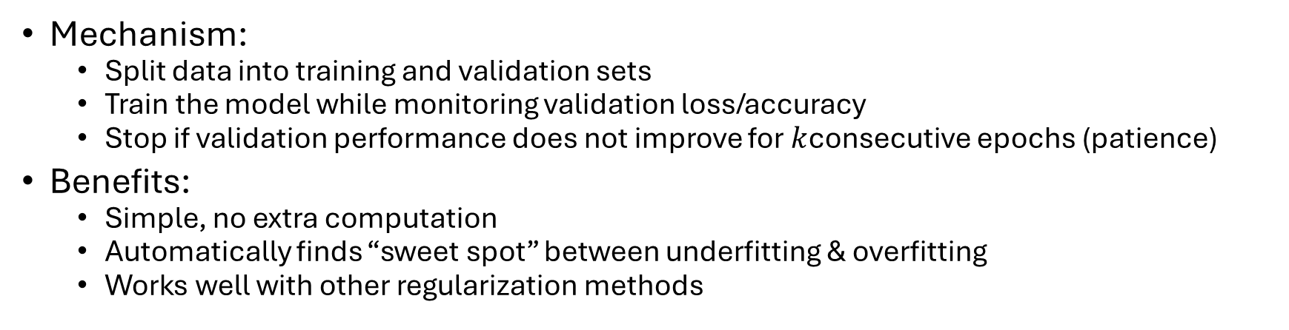
Early stopping
Stop training when validation performance stops improving
Prevents the model from overfitting by halting before it memorizes noise
Mechanism:
Split data into training and validation sets
Train the model while monitoring validation loss/accuracy
Stop if validation performance does not improve for $k$consecutive epochs (patience)
Benefits:
Simple, no extra computation
Automatically finds “sweet spot” between underfitting & overfitting
Works well with other regularization methods

Slide 22
Label smoothing
Prevent model from becoming overconfident by softening labels
Instead of
one-hot labels [ 0, 1, 0, 0]
use smooth labels [0.03, 0.91, 0.03, 0.03]
Benefits:
Reduces overconfidence in predictions
Improves calibration of probabilities
Acts as regularization → better generalization

Slide 23
Label smoothing
Normally, training uses one-hot labels:
Example for 3 classes: True label = Class 2 → [0, 1, 0]
Problem with one-hot labels:
The model is pushed to be 100% confident in the correct class
This can cause overfitting and overconfidence in predictions
It makes the model less tolerant to small errors or label noise

Slide 24
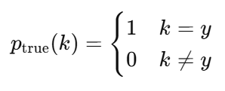
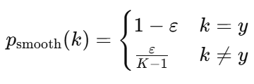
Label smoothing
Instead of using a perfect 1 for the correct class, we use a slightly lower value (e.g., 0.9)
The remaining probability (ε = 0.1) is spread across the other classes
Example for smoothing factor ε = 0.1 and 3 classes:
Target label for Class 3 becomes → [0.05, 0.90, 0.05]
ε is a small number (e.g., 0.1)
K = number of classes

Slide 25
Label smoothing
Why it helps
Prevents the model from becoming overconfident
Makes training more robust to noisy labels
Improves generalization as the model doesn’t memorize exact labels but learns better decision boundaries
Acts like a form of regularization

Slide 26
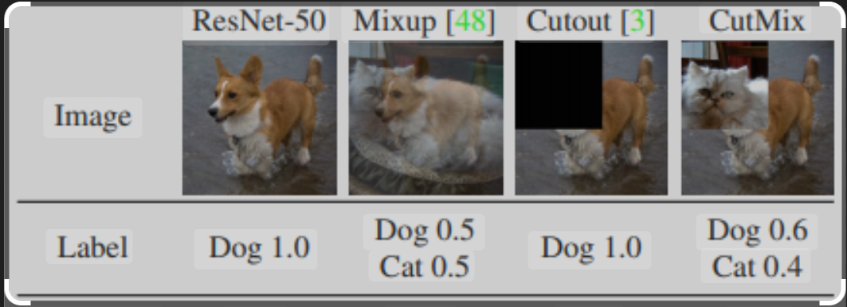
Modern Data Augmentation
Idea: Artificially enlarge dataset & improve robustness by modifying inputs
Classical methods: Flips, rotations, crops, color jitter
Modern techniques:
Mixup
Cutout
CutMix

Slide 27
Modern Data Augmentation
Mixup
Create new training samples by linearly blending two images and their labels
Helps model learn smoother decision boundaries
Cutout
Randomly mask out rectangular regions of an image
Forces the model to rely on multiple parts of the object, not just one feature
CutMix
Replace a patch of one image with a patch from another
Labels are also mixed proportionally to the patch size
Overall Benefit
Improves robustness
Reduces overfitting
Enhances generalization to unseen data

Slide 28
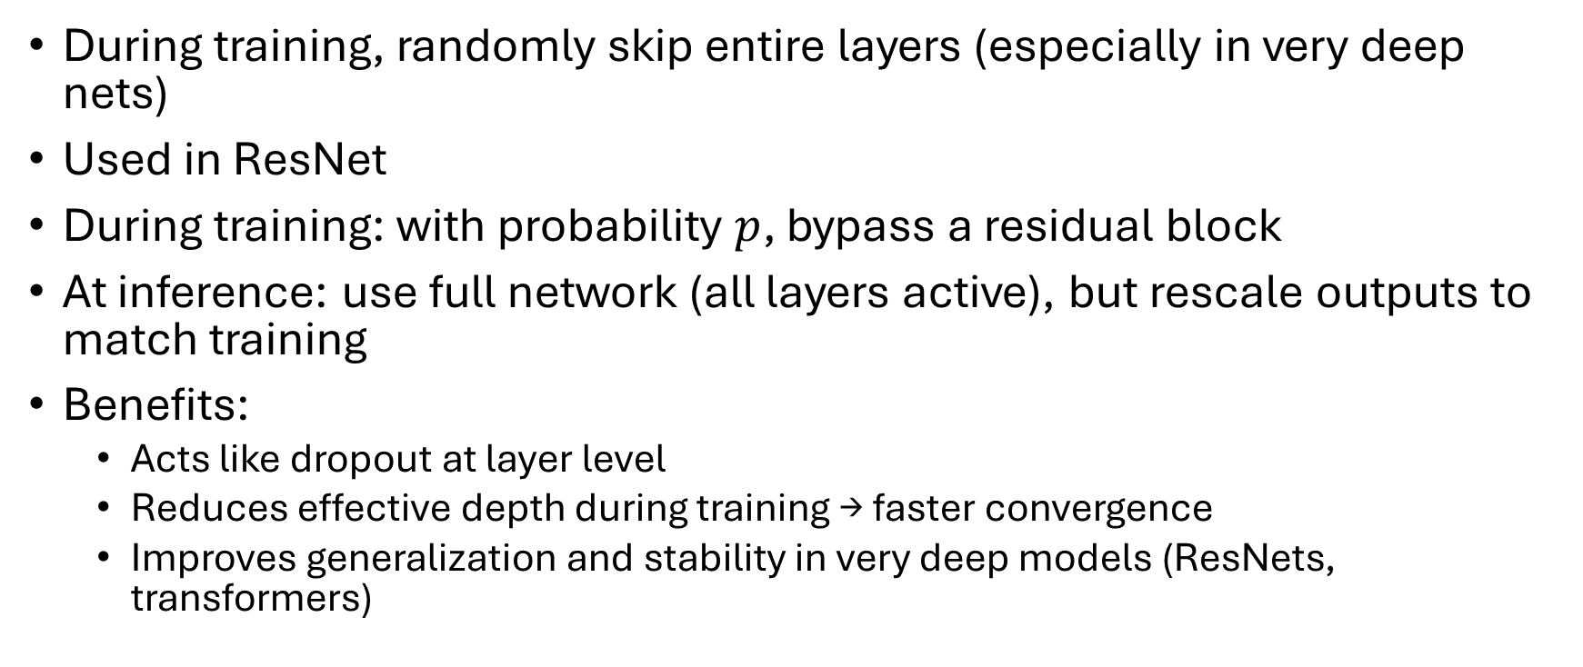
Stochastic depth
During training, randomly skip entire layers (especially in very deep nets)
Used in ResNet
During training: with probability $p$, bypass a residual block
At inference: use full network (all layers active), but rescale outputs to match training
Benefits:
Acts like dropout at layer level
Reduces effective depth during training → faster convergence
Improves generalization and stability in very deep models (ResNets, transformers)

Slide 29
Practical guidelines - Based on dataset size
Small dataset:
Strong regularization (augmentation, dropout)
Large dataset:
Mild regularization (weight decay, BatchNorm)

Slide 30
Practical guidelines - Based on architecture
Feed-Forward NNs
Weight decay
Dropout
Batch normalization
CNNs
Weight decay
Batch normalization
Data augmentation
(Dropout less common)
Transformers
Dropout
Label smoothing
Stochastic depth
Weight decay

Slide 31
Reference
Batch Norm (D2L Chapter 8.5)
Weight Decay (D2L Chapter 3.7)
Early stopping (D2L Chapter 5.5.3)
Dropout (D2L Chapter 5.6)
Also see Chapter 7 of Ian Goodfellow for a detailed discussion of various regularization techniques

Slide 32
Landmark CNN Architectures

Slide 33
Influential CNN Architectures
LeNet (1998) → early digit recognition
AlexNet (2012) → breakthrough in ImageNet competition
VGG (2014) → deep network with small 3×3 kernels
ResNet (2015) → solved vanishing gradients with skip connections

Slide 34
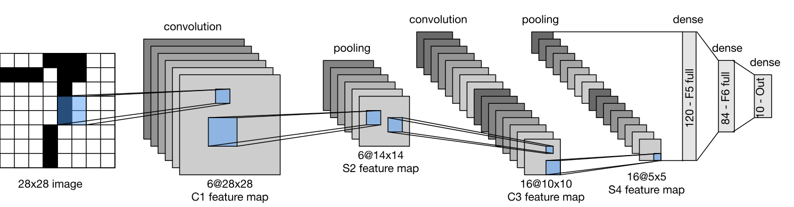
LeNet (1998)
Early CNN for handwritten digit recognition
Developed for the MNIST digit dataset
Architecture:
Conv → Pool → Conv → Pool → FC → FC → Softmax
Used tanh activation and average pooling (not ReLU, not max pooling)
~60k parameters, trained on grayscale 32×32 images
First proof that CNNs can learn spatial hierarchies of features
Key innovation: Introduced the basic CNN building block design
About 60,000 parameters total (conv layer ~49,000, ~11,000 FC layer)

Slide 35
ImageNet: A Game Changer
ImageNet is a massive labelled image dataset
~14 million images, 20,000+ categories (1,000 used for competition)
Hosted annual ImageNet Large Scale Visual Recognition Challenge (ILSVRC)
Standard benchmark for image classification and detection
Encouraged rapid progress in computer vision research

Slide 36
Role in CNN Evolution
In 2012, AlexNet achieved a huge accuracy jump using deep CNNs → shocked the ML community
Sparked a wave of CNN architecture innovations (VGG, GoogLeNet, ResNet etc)
Provided a common ground for fair model comparison and ranking
Models pre-trained on ImageNet became standard for transfer learning in vision tasks

Slide 37
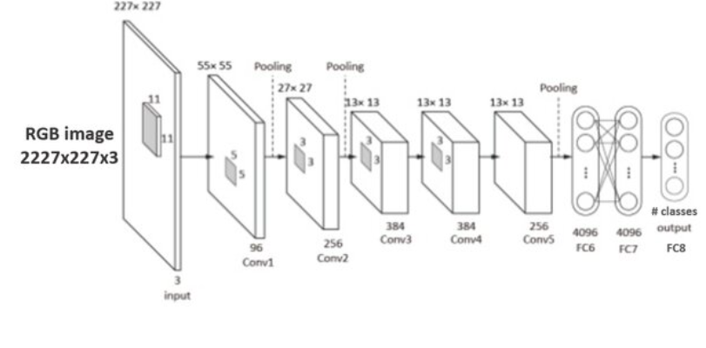
AlexNet (2012)
Parameters:
60 million to 61 million
Conv layer: 3-4 million, FC: 57-58 million
Breakthrough in ImageNet competition
8 layers (5 Conv + 3 FC), 60M parameters
Used ReLU activations (instead of tanh/sigmoid)
Introduced Dropout to reduce overfitting
Used GPU training to handle large computation
Top-5 error on ImageNet dropped from 26% → 15%
Key innovation: Showed that deep CNNs + GPU + ReLU can scale to large datasets

Slide 38
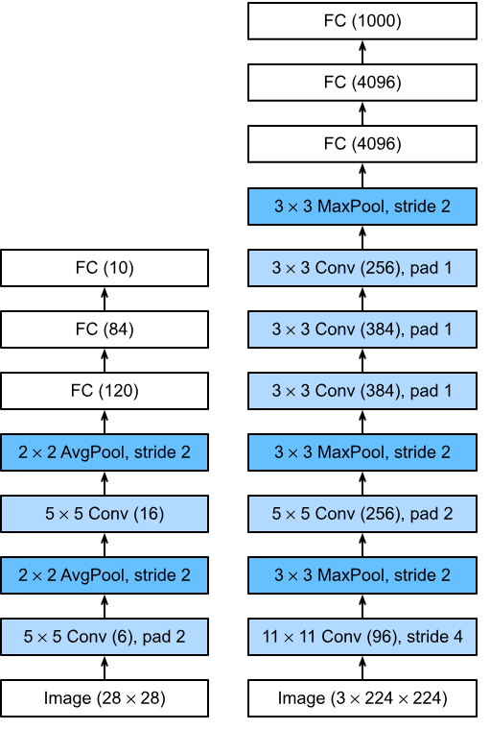
Designs of LeNet and AlexNet
Comparison:
LeNet (left)
AlexNet (right)

Slide 39
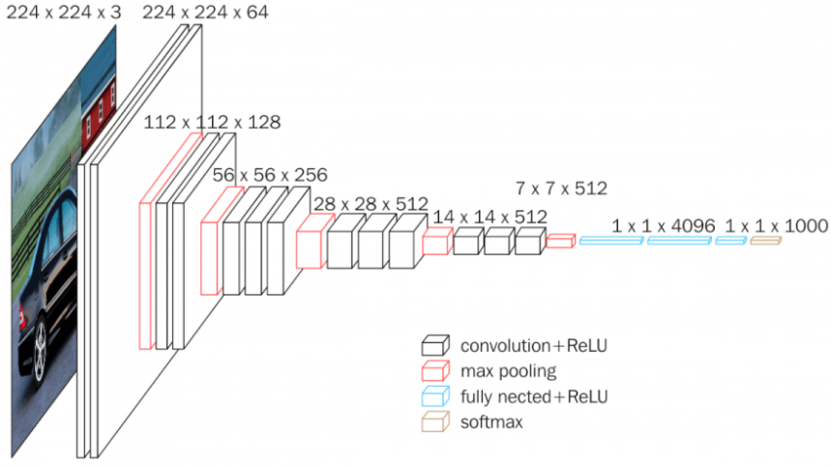
VGG (2014)
Very deep, simple architecture
16–19 weight layers
Stacked 3×3 (filter size) convolutions to achieve deep receptive fields
Used max pooling (2×2) for downsampling
Very uniform architecture, easy to replicate
Very large number of parameters (~138M: Conv layer ~15M, FC layer ~123M)
Key innovation: Showed that depth + small kernels improves performance
The region of the input image that influences the value of a particular neuron (activation) in a feature map

Slide 40
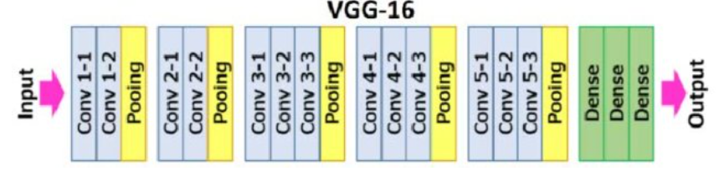
VGG (2014)
ImageNet 2014 with a top-5 error of 7.5%
Every convolution is 3x3, with zero padding
Every convolution followed by ReLU

Slide 41
VGG (2014)
ConvNet is divided into “stages”
Layers within a stage: no subsampling
Subsampling by 2 at the end of each stage
Layers within stage have same number of channels
Every subsampling → double the number of channels
You should be able ot calculate the number of parameters in a given ConvBlock, Given ConvLayer, FC layer, FC block etc.

Slide 42
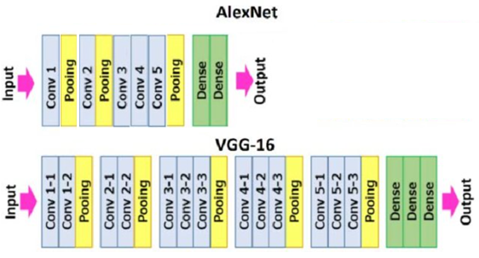
Designs of AlexNet and VGG

Slide 43
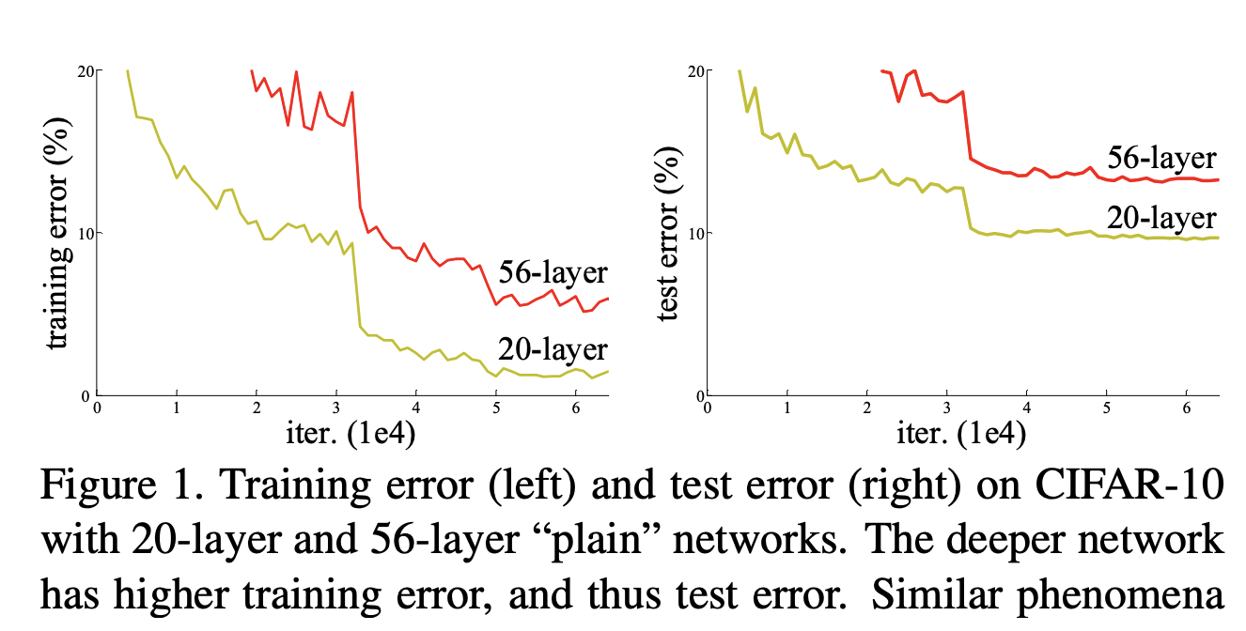
What problem ResNet addressed
Deeper networks should → better representations
But simply stacking more layers led to:
Higher training error (not just test error!)
Optimization difficulty → gradients vanished / exploded
Empirical finding:
20-layer plain CNN trained better than 56-layer plain CNN
Needed a way to train very deep networks effectively

Slide 44
Vanishing gradient problem with ReLU
In deep networks, gradients are backpropagated through many layers
With ReLU, negative inputs → 0 output → 0 gradient
Repeated multiplications by small update terms (Jacobian) → Gradients shrink exponentially
Result:
Early layers learn very slowly
Network fails to converge as depth increases

Slide 45
Residual Networks – ResNet (2015)
Up to 152 layers deep
Introduced skip (residual) connections
Allowed gradients to flow directly across many layers
Solved vanishing gradient problem in deep networks
Won ImageNet 2015 with a top-5 error of 3.57%
Key innovation: Enabled very deep CNNs to train effectively
Inspired later architectures (DenseNet, Transformers…)

Slide 46
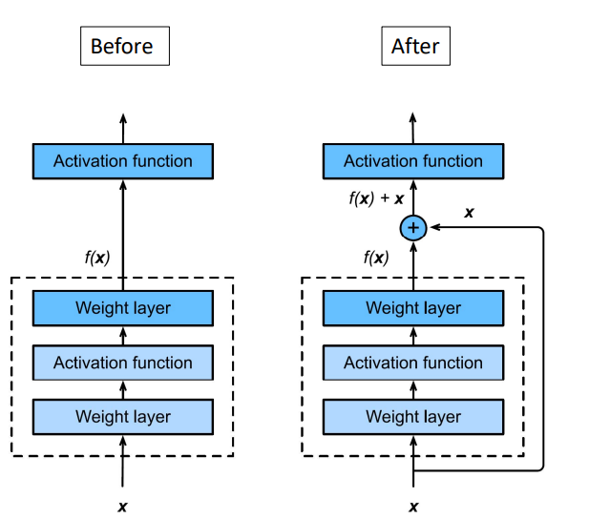
ResNet: Basic idea
Layer output is f(x) + x
Even if f(x) is 0, we have useful signal

Slide 47
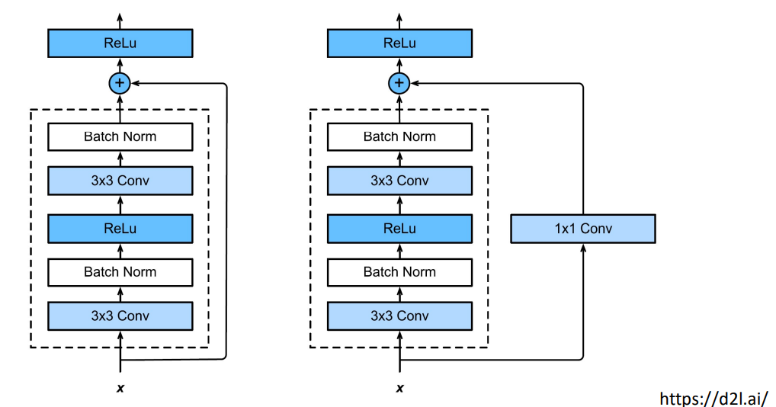
Residual block
When residual block input and out are of same size
When residual block input and out are of different size

Slide 48
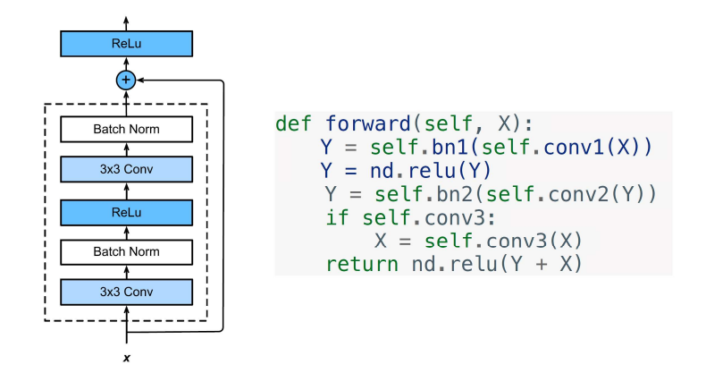
How Residual Block is coded?

Slide 49
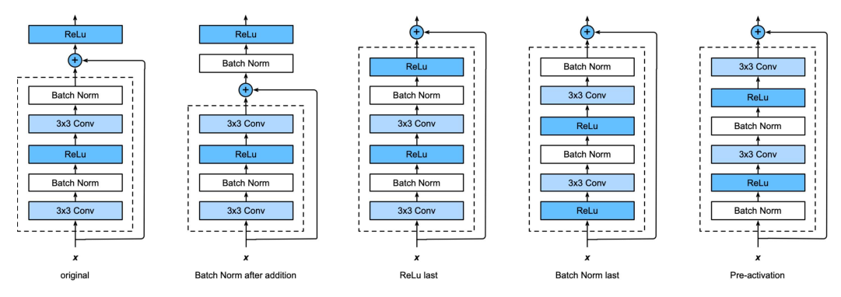
ResNet block flavours: Searching for the best combination
Trial and error of every permutation

Slide 50









Residual block
$$a^{l+1}$$
$$a^{l}$$
$$a^{l+2}$$
Plain NN
Direct path is also called a ‘skip connection’
$a^{l}$→ Linear → ReLU → $a^{l+1}$→ Linear → ReLU → $a^{l+2}$
$$z^{l+1}=W^{l+1}a^{l}+b^{l+1}$$
$$a^{l+1}=f(z^{l+1})$$
$$z^{l+2}=W^{l+2}a^{l+1}+b^{l+2}$$
$$a^{l+2}=f(z^{l+2})$$
$$a^{l+2}=f(z^{l+2}+a^{l})$$

Slide 51
Basic ResNet Architecture (ResNet 18/34)
Keep it simple, just deep
Design based on VGG style
All 3*3 conv (almost)
Batch normalization and ReLU
Downsampling: cov with stride of 2
Spatial size/2 => # filters *2
No dropout

Slide 52
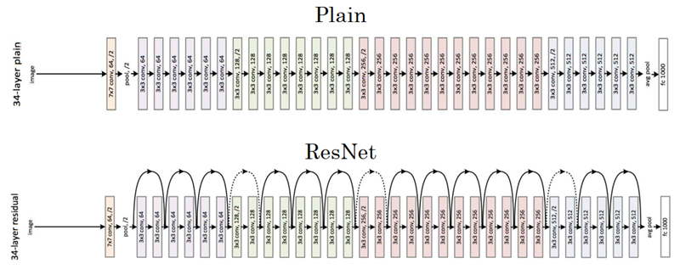
ResNet
3x3 same filters
Strided convolution, Stride=2

Slide 53
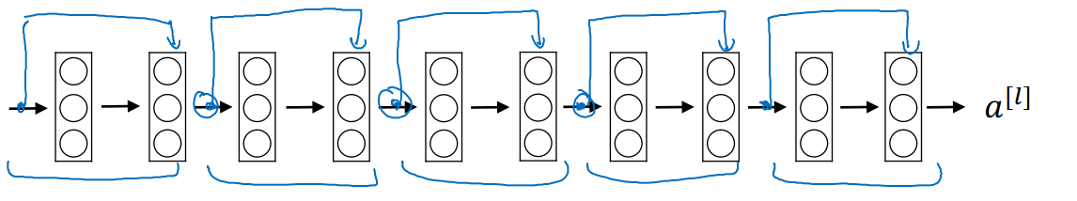
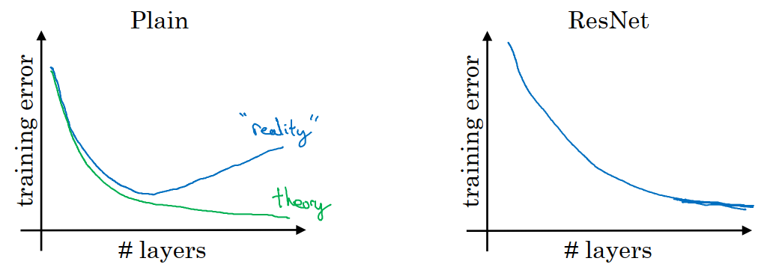
Residual Network

Slide 54
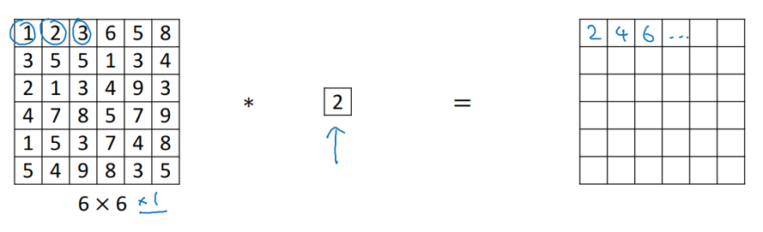
1x1 Convolution

Slide 55
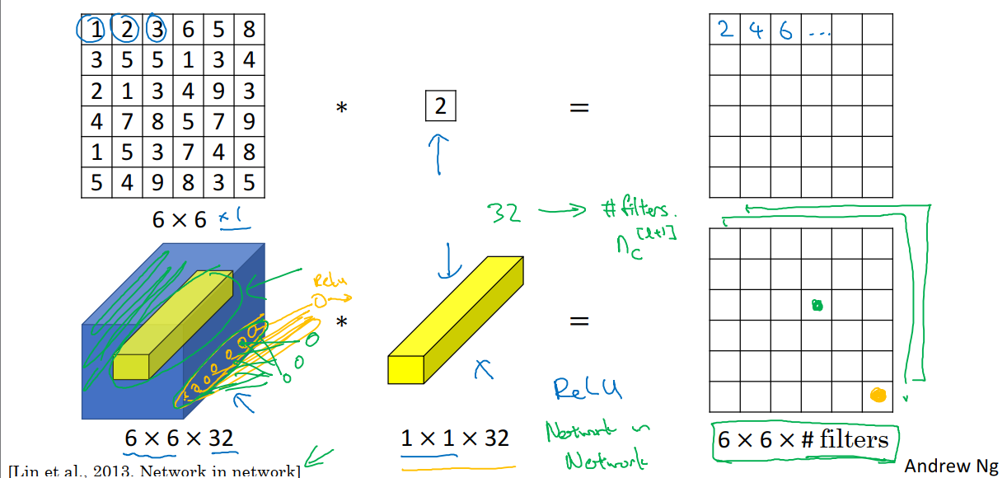
1x1 Convolution

Slide 56
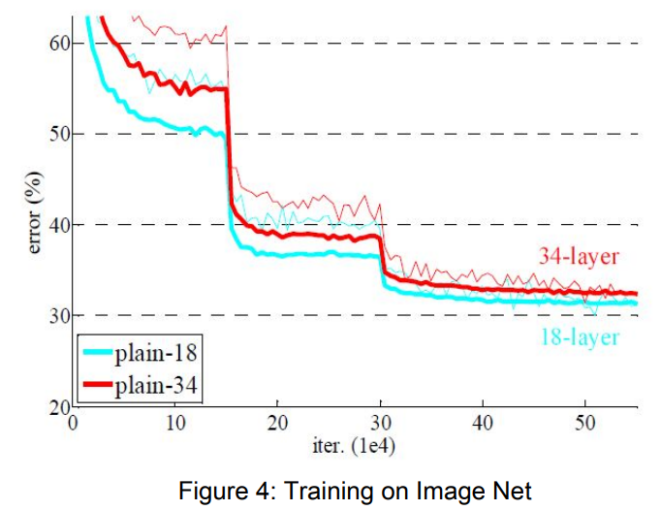
Experiment results: Plain Net
Deeper 34-layer plain net has higher validation error than 18 layer plain net
34-layer plain net has higher training error through the whole training procedure
Degradation problem

Slide 57
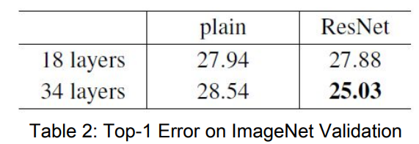
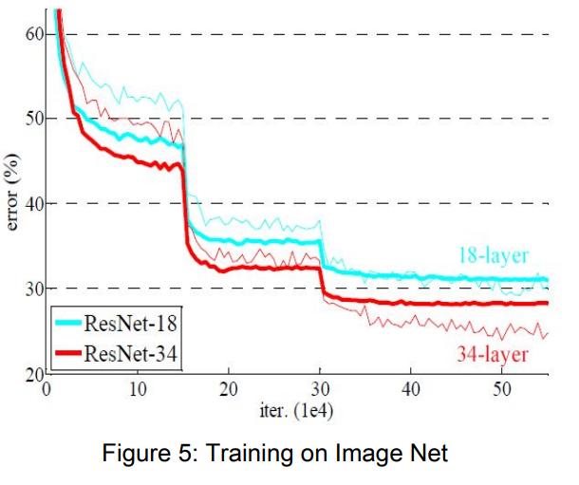
Experiment results: ResNet
34-Layer ResNet is better than 18-layer ResNet (by 2.8%)
lower training error
Degradation problem is addressed
34-layer ResNet reduced top-1 error by 3.5 percent compared to Plain Net
18-layer plain/residual nets are comparably accurate, but…
18-layer Resnet converges faster
ResNet eases optimization by providing faster convergences

Slide 58
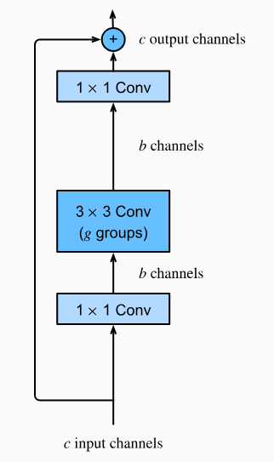
Bottleneck blocks for larger ResNets 50/101/152
Let
c=256
b=64
Regular ResNet
Param. per layer: 3x3x256
Total = 3x3x256 x (num layers )
With Bottlenect block
1x1x256 + 3x3x64 + 1x1x256

Slide 59
Notable architectures
Early / Landmark
LeNet-5
AlexNet
ZFNet
VGGNet
GoogLeNet (Inception v1)
Later notable networks
ResNet (Microsoft)
Inception v2, v3, v4 (Google)
ResNetX (Facebook)
DenseNet
Xception (Google) SqueezeNet

Slide 60
Notable architectures
Lightweight
MobileNet v1, v2, v3 (Google)
ShuffleNet
EfficientNet v1, v2 (Google)
RegNet (Facebook)
ConvNeXt v1, v2 (Facebook)
RepVGG
Modern Hybrid variants
RegNet (Facebook)
RepVGG
ConvNeXt v1, v2 (Facebook)

Slide 61
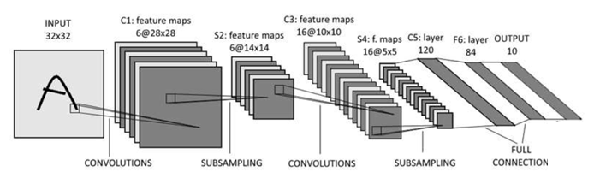
First CNN for images
Dates back to 1989 (LeCun)
Subsampling → pooling

Slide 62
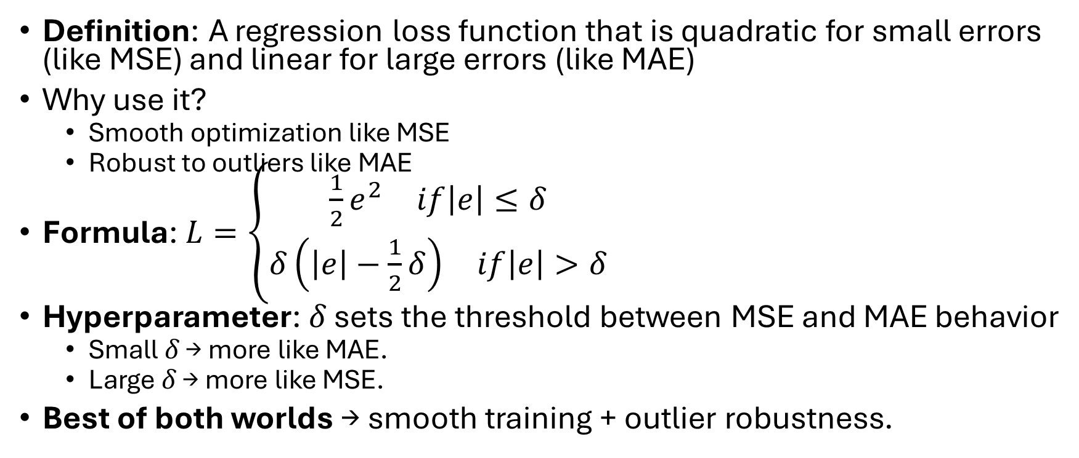
Huber loss
Definition: A regression loss function that is quadratic for small errors (like MSE) and linear for large errors (like MAE)
Why use it?
Smooth optimization like MSE
Robust to outliers like MAE
Formula: $L=\left\{\begin{aligned}\begin{matrix}\frac{1}{2}e^{2} & if\left|e\right|≤δ\end{matrix} \\ \begin{matrix}δ\left(\left|e\right|−\frac{1}{2}δ\right) & if\left|e\right|>δ\end{matrix}\end{aligned}\right.$
Hyperparameter: 𝛿 sets the threshold between MSE and MAE behavior
Small 𝛿 → more like MAE.
Large 𝛿 → more like MSE.
Best of both worlds → smooth training + outlier robustness.

Slide 64
Problem: Internal co-variate shift
The distribution of activations (inputs to a given layer) changes because earlier layers keep updating during training
Why it happens:
In deep NNs, each layer’s output becomes the next layer’s input
As weights update during training, the distribution of activations (mean/variance) in hidden layers keeps shifting
This forces later layers to constantly readjust, slowing training and making optimization harder

