Slide 1
Student Interest System

Slide 2
Table OF Contents
01
06
11
Conclusion
Introduction
Use Case Diagram
02
07
12
Thank You
Objectives
Data Flow Diagram
03
08
Tools and Platforms
Application Flow
04
09
ERD Diagram
Screenshots
05
10
Hardware and Software Requirements
Database Design

Slide 3
01
Introduction

Slide 4
Welcome to the unveiling of the Student Interests System, a groundbreaking web project meticulously crafted to redefine the management of student information and interests. Developed with precision using C#, HTML, and Bootstrap, this system goes beyond the ordinary, offering a sophisticated yet user-friendly interface..

Slide 5
02
OBJECTIVES

Slide 6
User-Friendly System
Develop a user-friendly system for efficient management of student information and interests
CRUD Operations and User Management
Implement screens for essential CRUD operations on student entities and create a user management system with roles and permissions
Comprehensive Dashboard
Design a comprehensive dashboard with widgets and visualizations to showcase key statistics and insights.
Notes:
Certainly! Here are the main and important objectives for the Student Interests System project:
2. **Mandatory Student Addition Screen:** Implement a screen for adding students with mandatory fields, adhering to a provided wireframe.
3. **Dynamic Interest Dropdown:** Include a dynamic dropdown for entering student interests, allowing users to add new interests on-the-fly.
4. **Redirection and Navigation:** Ensure seamless redirection to the Students List View after successful actions, providing a smooth user experience.
5. **Paginated List View:** Implement paginated data display, sorting functionality, and page navigation in the list view for easy data exploration.
6. **:** 7. **User Activity Logging:** Record and log user activities to maintain accountability and monitor system usage.
8. **Implement screens for essential CRUD operations on student entities and create a user management system with roles and permissions.
9. **Creativity and Flexibility:** Encourage individual creativity in UI/UX design, providing flexibility in choosing frontend, backend, and database technologies.
10. **Data Visualization:** Use dummy data to visually represent statistics on the dashboard, providing an informative and engaging user interface.
11. **Documentation and Presentation:** Emphasize the importance of proper documentation, including naming conventions and folder structure. Require PowerPoint presentations for effective project showcasing.
These objectives aim to ensure the development of a robust, user-centric system with key features and a visually appealing dashboard.

Slide 7
Mandatory Student Addition Screen
User Activity Logging
Develop a user-friendly system for efficient management of student information and interests
Record and log user activities to maintain accountability and monitor system usage.
Dynamic Interest Dropdown
Include a dynamic dropdown for entering student interests, allowing users to add new interests on-the-fly.
Redirection and Navigation
Ensure seamless redirection to the Students List View after successful actions, providing a smooth user experience.
Notes:
5. **Paginated List View:** Implement paginated data display, sorting functionality, and page navigation in the list view for easy data exploration.
6. **:** 7. **:** 8. **Implement screens for essential CRUD operations on student entities and create a user management system with roles and permissions.
9. **Creativity and Flexibility:** Encourage individual creativity in UI/UX design, providing flexibility in choosing frontend, backend, and database technologies.
10. **Data Visualization:** Use dummy data to visually represent statistics on the dashboard, providing an informative and engaging user interface.
11. **Documentation and Presentation:** Emphasize the importance of proper documentation, including naming conventions and folder structure. Require PowerPoint presentations for effective project showcasing.
These objectives aim to ensure the development of a robust, user-centric system with key features and a visually appealing dashboard.

Slide 8
Paginated List View
Creativity and Flexibility
Implement screens for essential CRUD operations on student entities and create a user management system with roles and permissions.
Encourage individual creativity in UI/UX design, providing flexibility in choosing frontend, backend, and database technologies.
.
Data Visualization
Use dummy data to visually represent statistics on the dashboard, providing an informative and engaging user interface
Documentation and Presentation
Emphasize the importance of proper documentation, including naming conventions and folder structure. Require PowerPoint presentations for effective project showcasing

Slide 9
03
TOOLS AND PLATFORMS

Slide 10
Tools and Platforms
Backend Development
Database Management
C# MVC (Model-View-Controller) was utilized for robust backend development, ensuring a scalable and organized architecture
MySQL database was chosen to securely store and manage student data.
Frontend Technologies
HTML, CSS, and JavaScript were employed to craft an intuitive and responsive user interface for an enhanced user experience.
Notes:
Database Management: Server Environment:
Cross-Browser Compatibility: The website is accessible through any modern web browser, providing flexibility and convenience for users.

Slide 11
Tools and Platforms
Cross-Browser Compatibility
Server Environment
The website is designed to be accessible through a variety of web browsers, ensuring a broad user reach.
The entire website operates seamlessly on the XAMPP server, ensuring a reliable and integrated development environment.

Slide 12
04
Entity Relationship Diagram

Slide 13
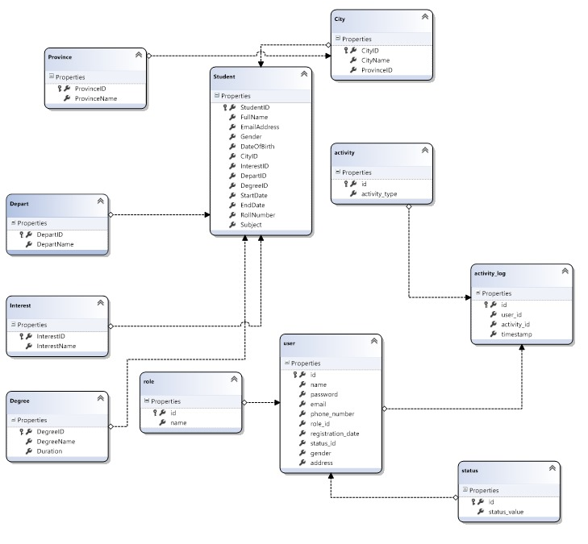

Slide 14
05
Database DESIGN
Proposed Database Tables

Slide 15
STUDENT

Slide 16
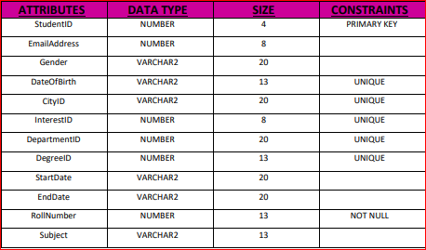

Slide 17
DEPARTMENT

Slide 18
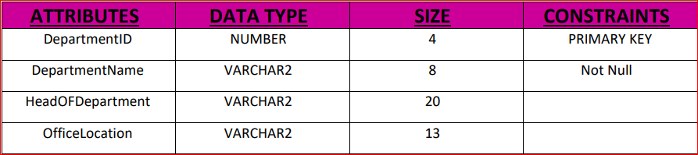

Slide 19
DEGREE

Slide 20
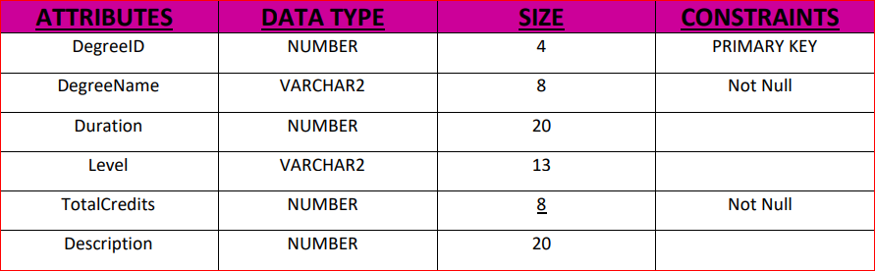

Slide 21
INTEREST

Slide 22
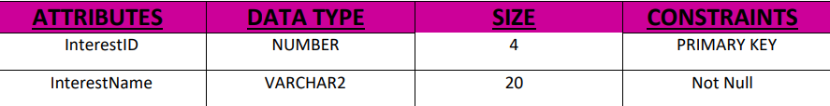

Slide 23
CITY

Slide 24
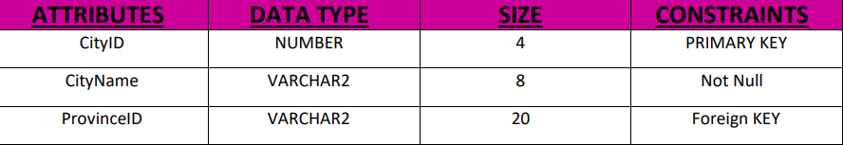

Slide 25
PROVINCE

Slide 26
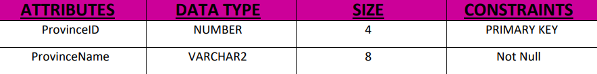

Slide 27
USER

Slide 28
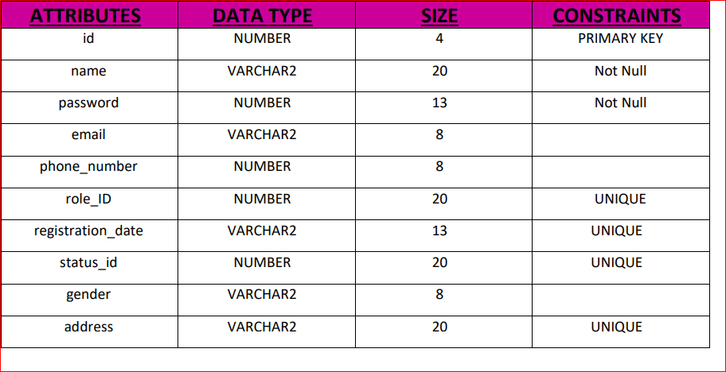

Slide 29
ROLE

Slide 30
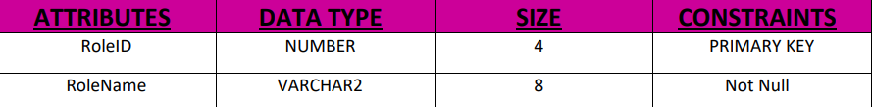

Slide 31
STATUS

Slide 32
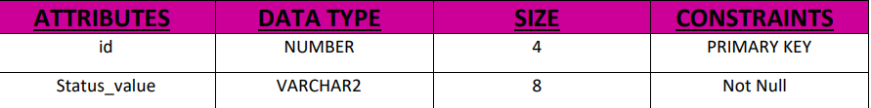

Slide 33
ACTIVITY LOG

Slide 34
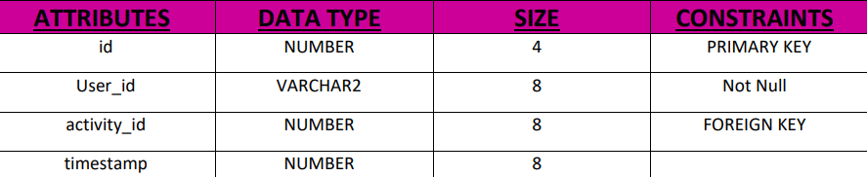

Slide 35
ACTIVITY

Slide 36
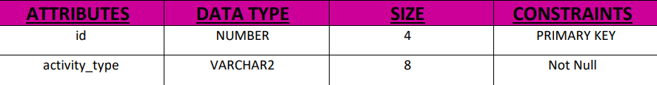

Slide 37
06
USECASE DIAGRAM

Slide 38
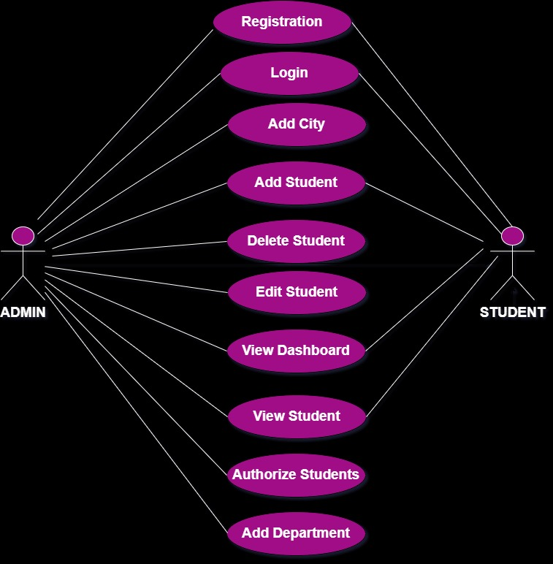

Slide 39
07
DATA FLOW DIAGRAM

Slide 40
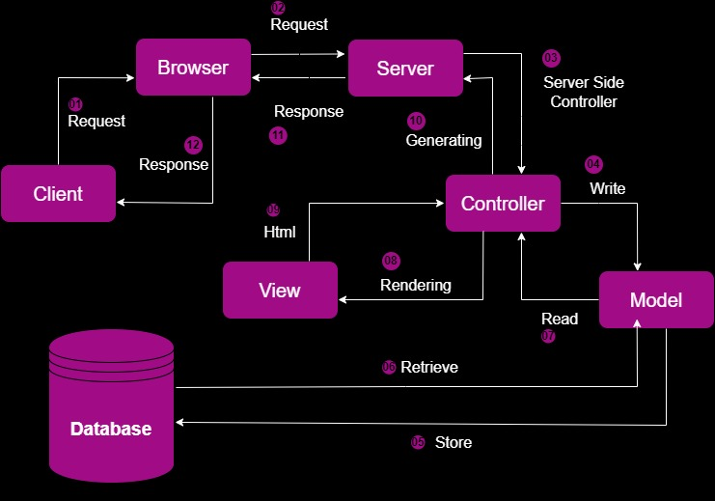

Slide 41
08
Application FLOW

Slide 42
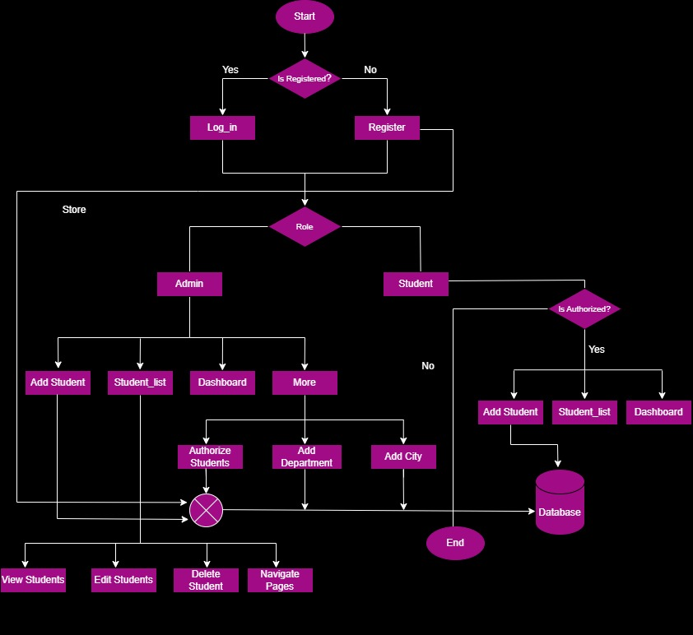

Slide 43
9
SCREENSHOTS

Slide 44
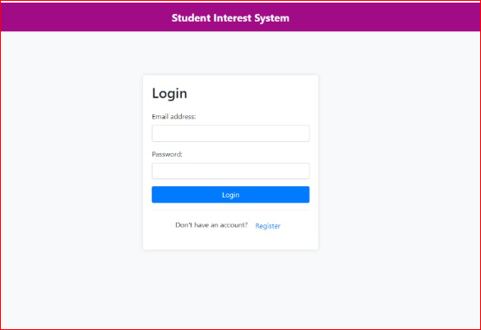

Slide 45
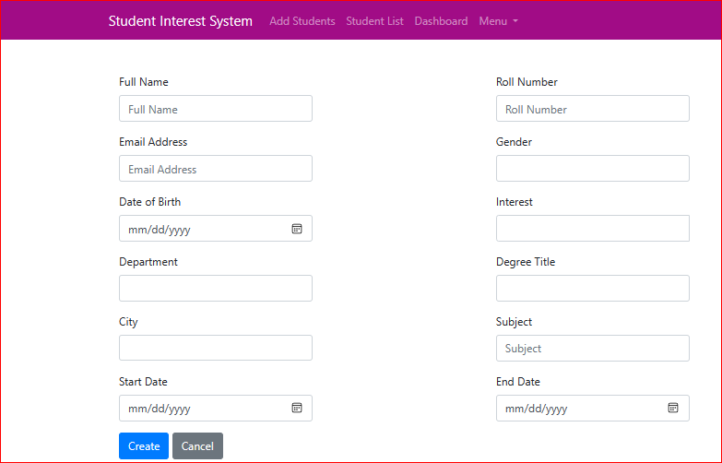

Slide 46
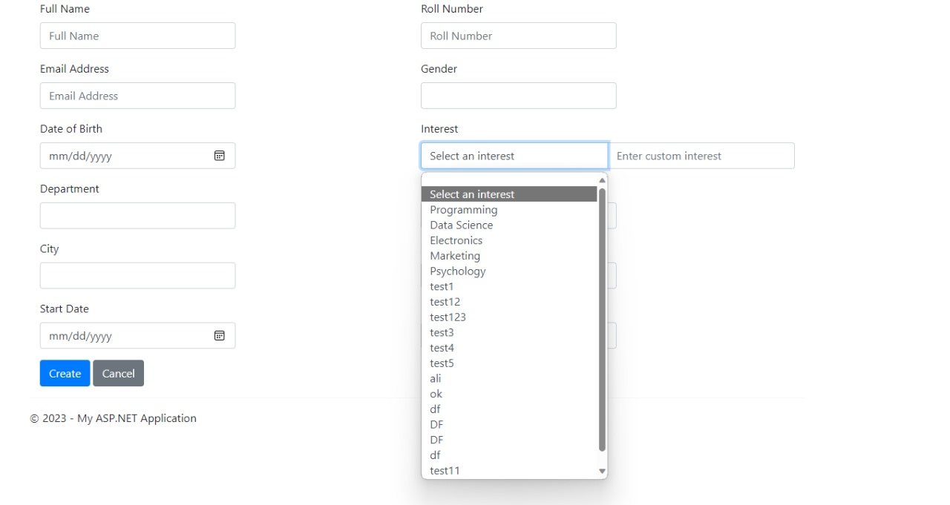

Slide 47
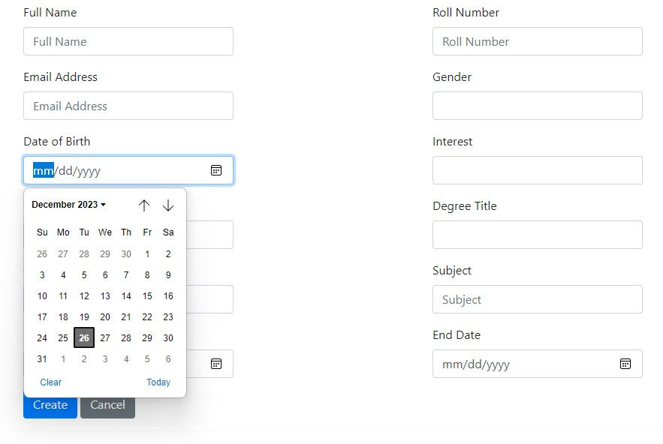

Slide 48
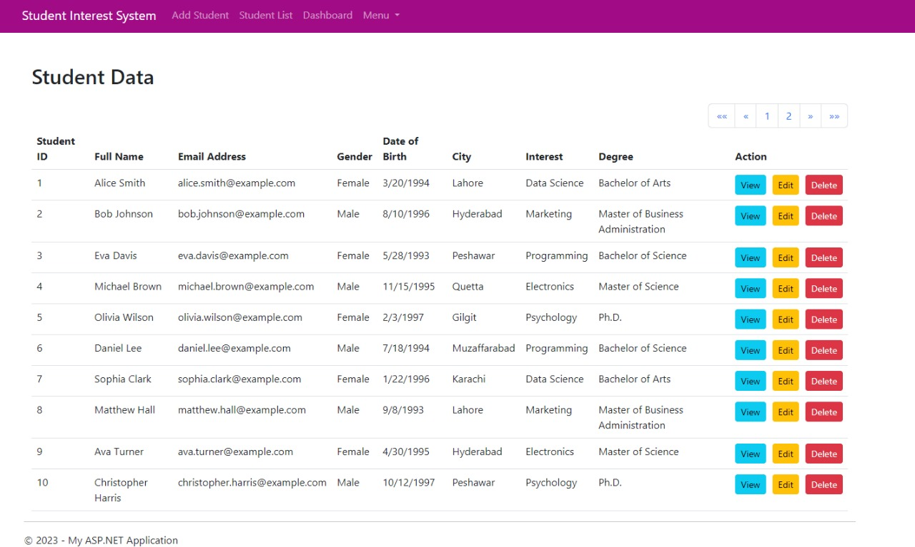

Slide 49


Slide 50
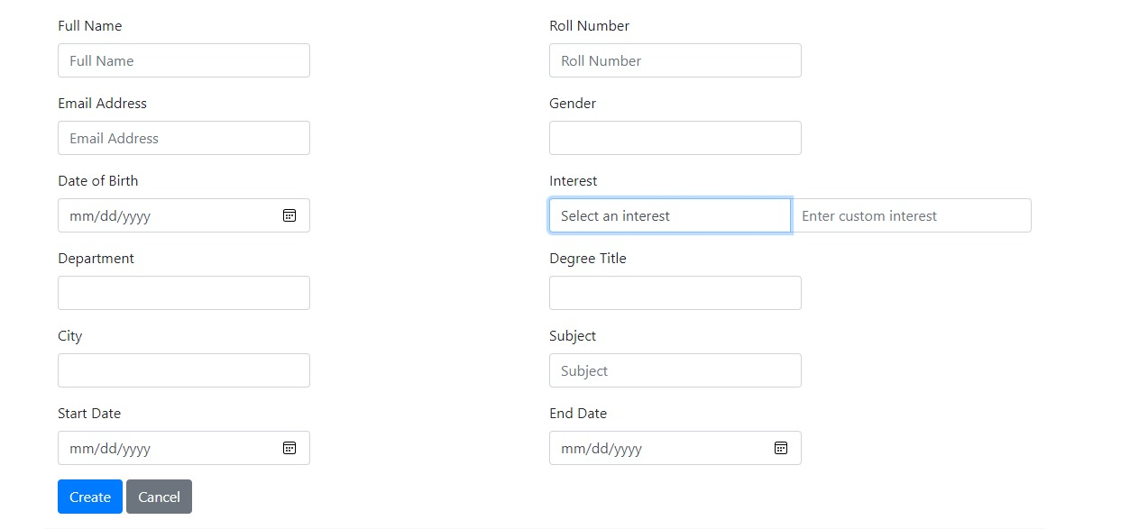


Slide 51
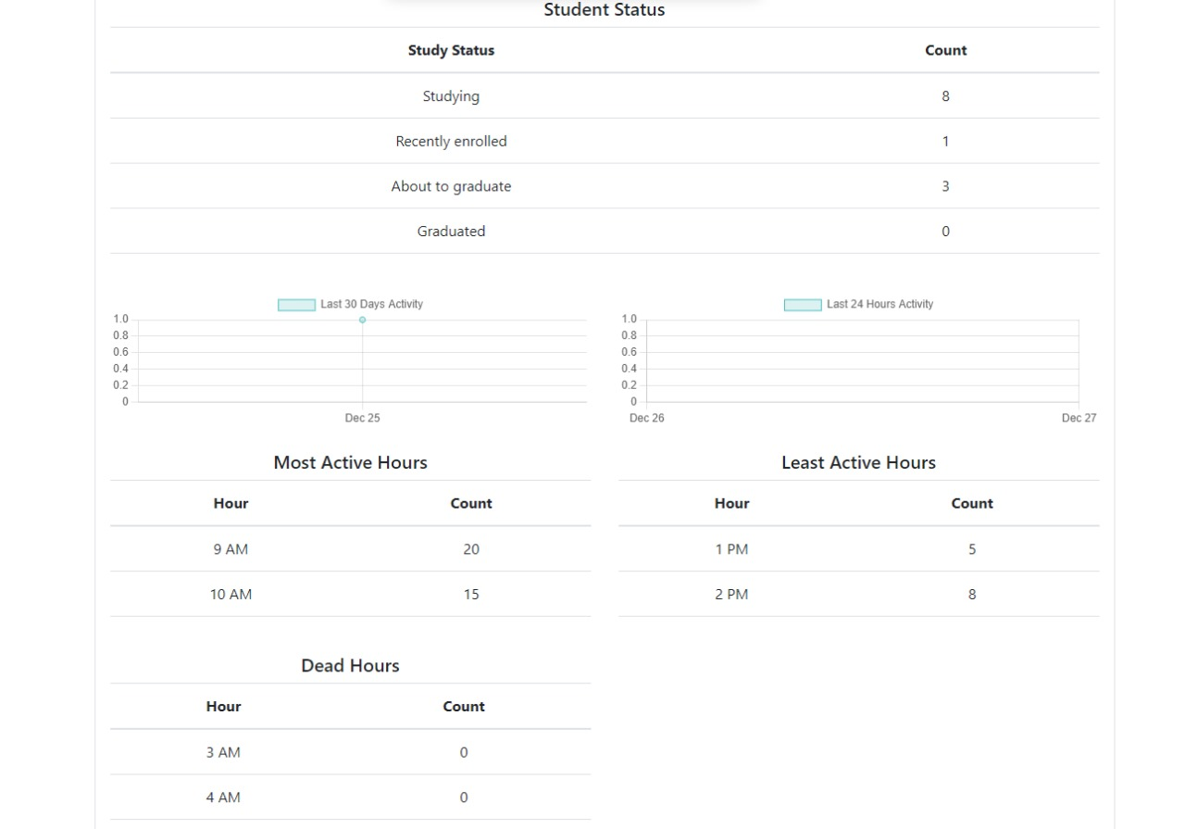

Slide 52
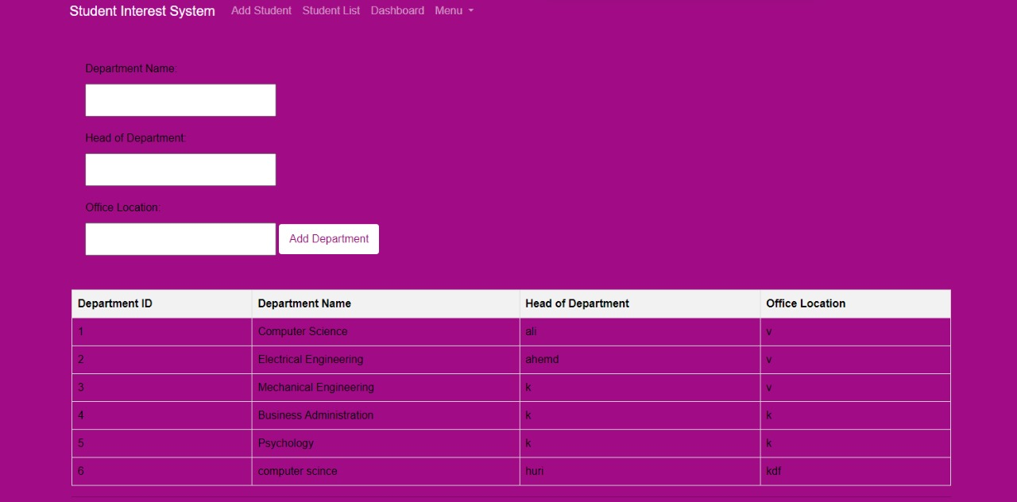


Slide 53
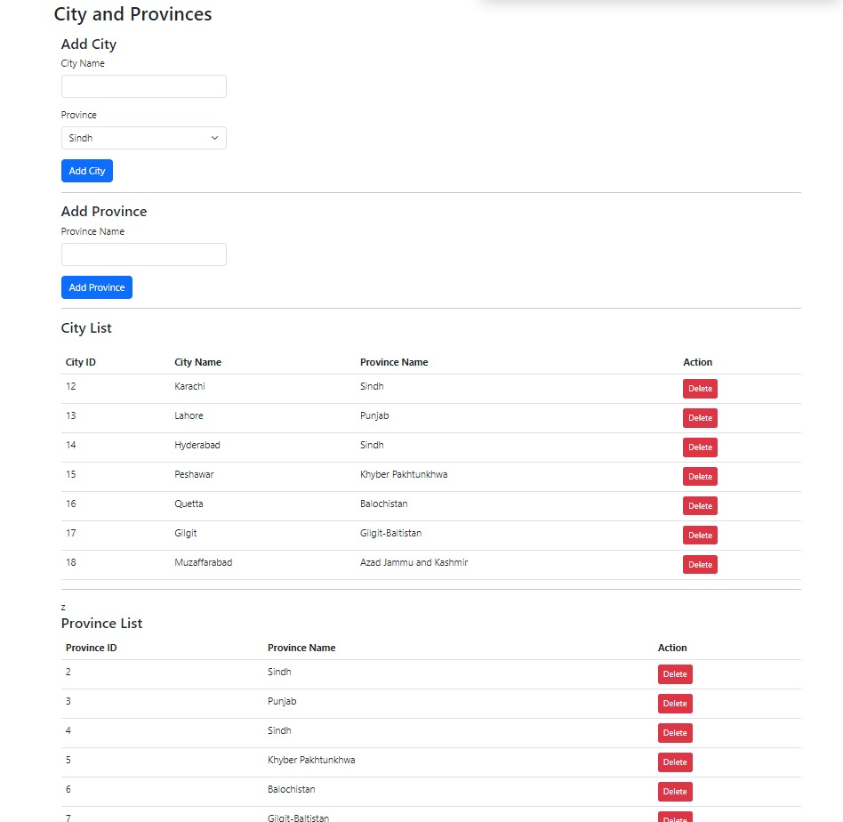

Slide 54
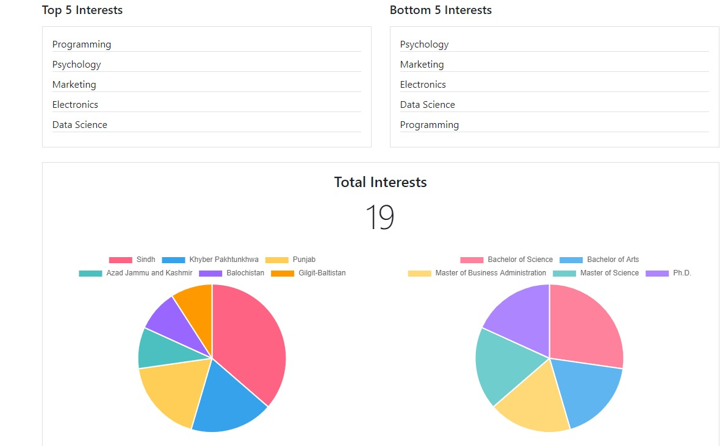

Slide 55
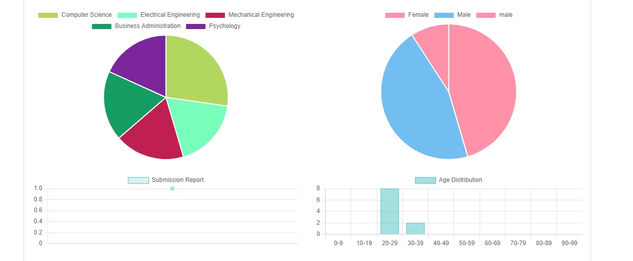

Slide 56
10
HARDWARE AND SOFTWARE REQUIREMENTS

Slide 57
Hardware Requirements
Single Core 2.4 GHz or equivalent.
Minimum 512 MB
CPU
RAM
Graphics Card
Network
Intel or Nvidia.
Broadband connection recommended.
Notes:
Certainly! Based on the provided content, here's a refined version for the "Hardware & Software Requirements" slide for your Student Interests System project:
---
## Hardware & Software Requirements
### Software Requirements:
- **Web Browsers:**
- Most recent version of Google Chrome, Firefox, Internet Explorer, or Safari.
### Hardware Requirements:
- **CPU:**
- Single Core 2.4 GHz or equivalent.
- **RAM:**
.
- **Graphics Card:**
- Intel or Nvidia.
- **Hard Drive:**
- Minimum 5 Gigabytes of available space.
- **Network:**
- Broadband connection recommended.
- **Processor:**
- Pentium or equivalent.
- **Operating System:**
- Windows (XP, Vista, 7, 8, 10), Mac OS, Linux, Unix.
- **Internet Connection:**
- Internet connection with good speed.
---
Feel free to customize these details based on the specific requirements and compatibility of your Student Interests System.

Slide 58
Hardware Requirements
Minimum 5 Gigabytes of available space
Pentium or equivalent
Hard Drive
Processor
Operating System
Internet Connection
Windows (XP, Vista, 7, 8, 10), Mac OS, Linux, Unix.
Internet connection with good speed.
Notes:
Certainly! Based on the provided content, here's a refined version for the "Hardware & Software Requirements" slide for your Student Interests System project:
---
## Hardware & Software Requirements
### Software Requirements:
- - **:**
-
- **:**
-
---
Feel free to customize these details based on the specific requirements and compatibility of your Student Interests System.

Slide 59
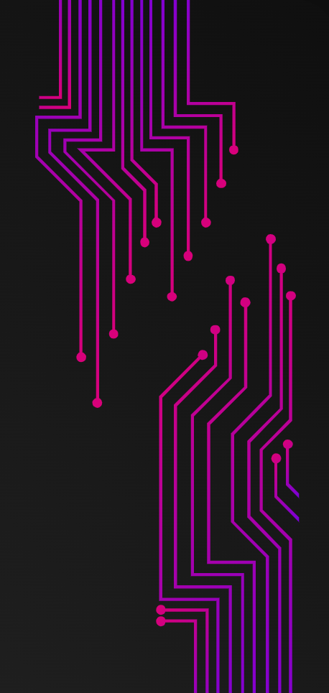

SOFTWARE REQUIREMENTS
Web Browsers
Most recent version of Google Chrome, Firefox, Internet Explorer, or Safari.

Slide 60
11
CONCLUSION

Slide 61
11
CONCLUSION

Slide 62
In summary, this Student Interests System stands as a testament to effective student data management and insightful analytics. Leveraging C# MVC, HTML, CSS, and JavaScript, the project delivers a user-friendly interface, dynamic dropdowns, paginated views, and a comprehensive dashboard. This initiative represents a harmonious blend of functionality and aesthetics, ensuring an efficient and engaging platform for both administrators and users.

Slide 63
Thanks!
Do you have any questions?
bcsf20m039@pucit.edu.pk
03174836661

