Slide 1

Predict the Churning Customer

Slide 2
Predict the Churning Customer
Binary classification problem.
Objectives:
Predict churning customers in the bank to know who is going to be churned so they can proactively provide them with better services and influence customers' decisions to use the bank services and improve their performance.

Slide 3
Predict the Churning Customer
Data
The dataset is credit card customers from Kaggle that contains 10128 customers with 21 features, 6 are nominal and ordinal categorical feature, such as: Attrition Flag our target variable, Education, Marital Status, Card Category exc.. Also, 15 numerical features highlight Age, Credit Limit, Total Revolving Balance, Average Card Utilization Ratio exc.., To answer the question I selected some of relevant categorical and numerical features that may affect the prediction.

Slide 4
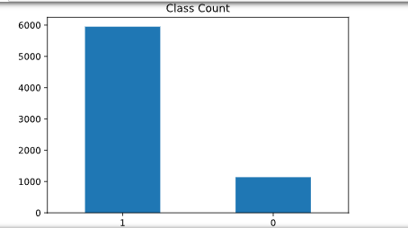

Data engineering
Encoding categorical features to ordinal and dummy variables.
Oversample negative class to balance the dataset.
Class 1 (Existing customer): 5949
Class 0 (Attired customer): 1139
Proportion: 5.22 : 1
Percentage of Majority Class: 83.93

Slide 5
Data engineering
Identify and drop highly correlated features using correlation function.
Used SelectKBest and chi2 to calculate relevance scores of each feature to the target variable.
categorical features, fixed imbalance in the dataset and future selection, exploring models such as logistic regression, KNN and random forest and perform GridSearchCV to choose hyperparameters, to sum up, { model} was the best model to achieve promising results for this binary classification problem.

Slide 6
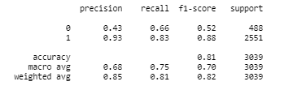

Logistic regression model
Model Accuracy: 80.65
Logistic Regression on Train Data; Test F1: 0.879, Test AUC: 0.826
Confusion Report
Confusion Matrix

Slide 7
KNN model
Model Accuracy: 80.65
Logistic Regression on Train Data; Test F1: 0.879, Test AUC: 0.826
Confusion Report
Confusion Matrix

Slide 8
RANDOM FOREST model - BEST MODEL
Model Accuracy: 80.65
Logistic Regression on Train Data; Test F1: 0.879, Test AUC: 0.826
Confusion Report
Confusion Matrix

Slide 9
exploratory data analysis (EDA)
Using Python and Tableau for better visualization

Slide 10
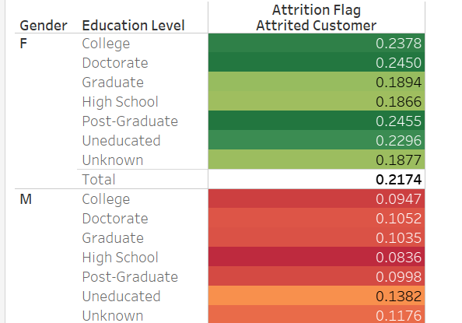

Slide 11
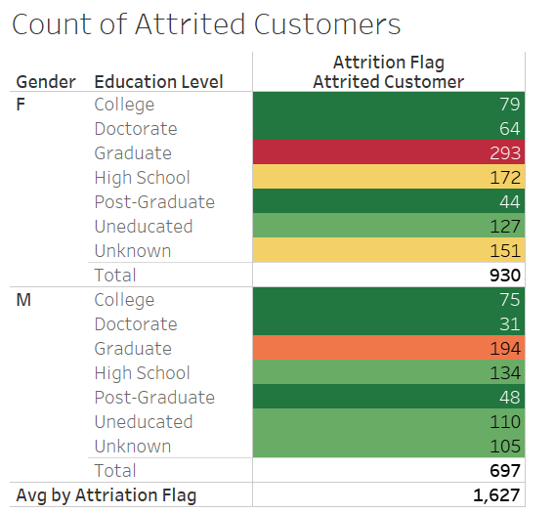

Slide 12
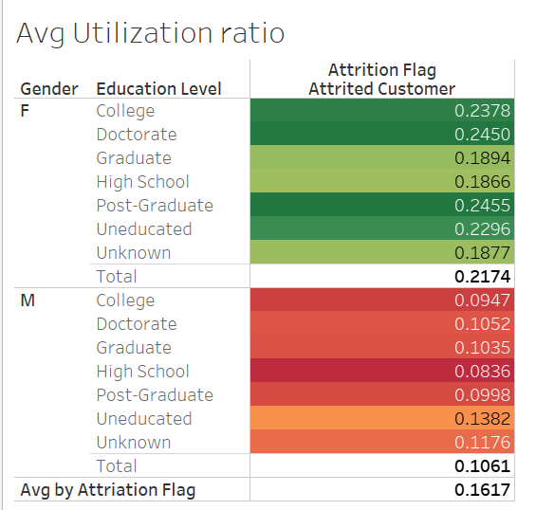

Slide 13
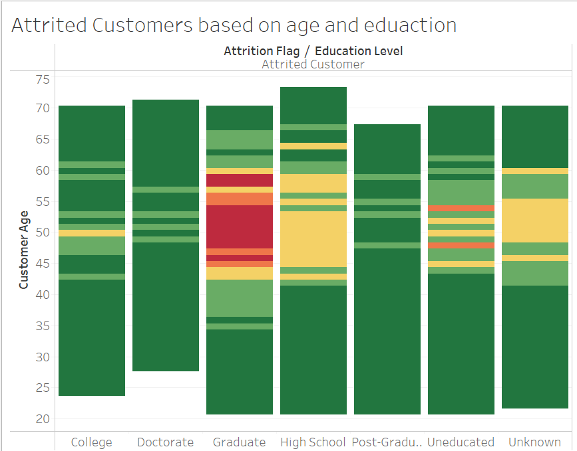

Slide 14
