Slide 1

Predict the Churning Customer

Slide 2
Predict the Churning Customer
Binary classification problem.
Objectives / goals:
Predict churning customers to the bank to know who is going to be churned so they can proactively provide them with better services and influence customers' decisions to reuse the bank services and improve their performance.

Slide 3
Predict the Churning Customer
Data
The dataset is credit card customers from Kaggle that contains 10128 customers with 21 features, 6 are nominal and ordinal categorical feature, such as: Attrition Flag our target variable, Education, Marital Status, Card Category exc.. Also, 15 numerical features highlight Age, Credit Limit, Total Revolving Balance, Average Card Utilization Ratio exc..

Slide 4
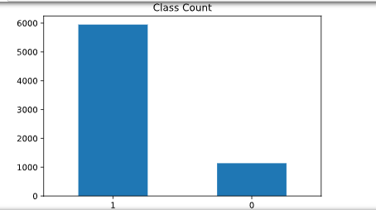

Data engineering
Encoding categorical features to ordinal and dummy variables.
Oversample negative class to balance the dataset.
Before oversample:
Class 1 (Existing customer): 5949
Class 0 (Attired customer): 1139
Proportion: 5.22 : 1
Percentage of Majority Class: 83.93%
After oversample:
Class 1 (Existing customer): 5949
Class 0 (Attired customer): 4556

Slide 5
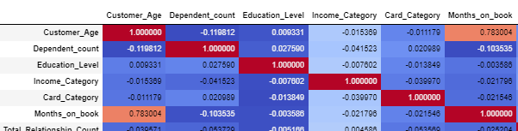
Data engineering
Identify and drop highly correlated features using correlation function.
Eg: Months on book, Avg Open To Buy, Total Transaction Count

Slide 6
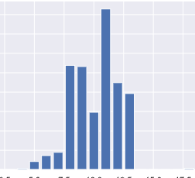
Data engineering
Used SelectKBest and chi2 to calculate relevance scores of each feature to the target variable.
The most relevant feature for predicting attrition flag, is Total Transaction Amount (Last 12 months), Credit Limit and Total Revolving Balance on the Credit Card.
.

Slide 7
Modeling
Logistic regression
k-nearest neighbors algorithm (KNN)
Random Forest

Slide 8
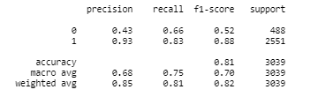

Logistic regression model
Model Accuracy: 80.65
Logistic Regression on Train Data; Test F1: 0.879, Test AUC: 0.826
Hyperparameters
C': 1.1, 'solver': 'liblinear
Confusion Report
Confusion Matrix

Slide 9
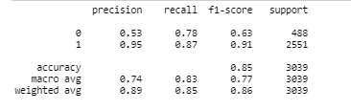

KNN model
Hyperparameters
n_neighbors=5
Model Accuracy:85.46
KNN on Train Data; Test F1: 0.909, Test AUC: 0.875
Confusion Report
Confusion Matrix

Slide 10
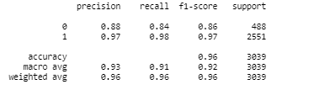

RANDOM FOREST model - BEST MODEL
Hyperparameters
'n_estimators': 10000
Model Accuracy:95.59
Random forest on Train Data; Test F1: 0.974, Test AUC: 0.749
Confusion Report
Confusion Matrix

Slide 11
Tools
Numpy and Pandas for data manipulation.
Scikit-learn for modeling, encoding and future selection and metrics.
Matplotlib and Seaborn for plotting
imblearn for oversampling.
Tableau for interactive visualizations

Slide 12
insights

Slide 13
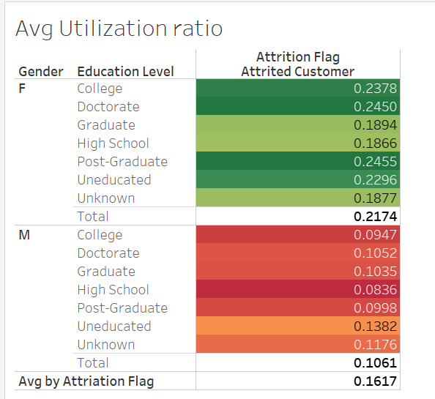

Slide 14
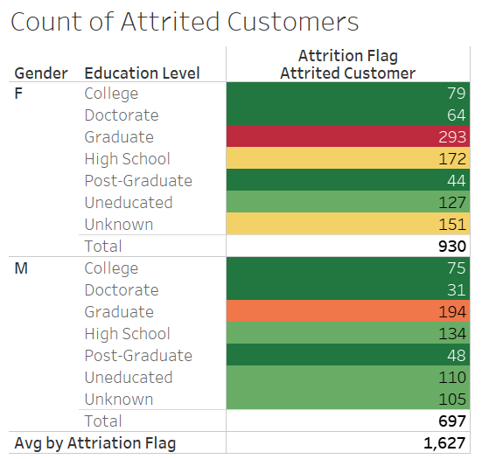

Slide 15
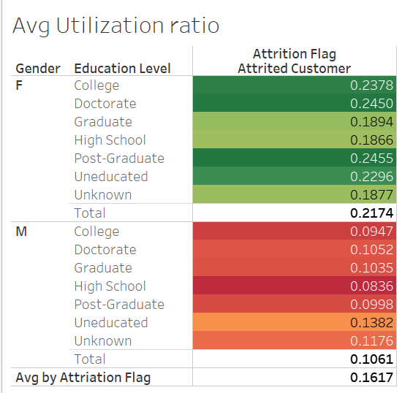
Notes
- Although customer with high average utilization for example Graduate Female also have high attriation.

Slide 16
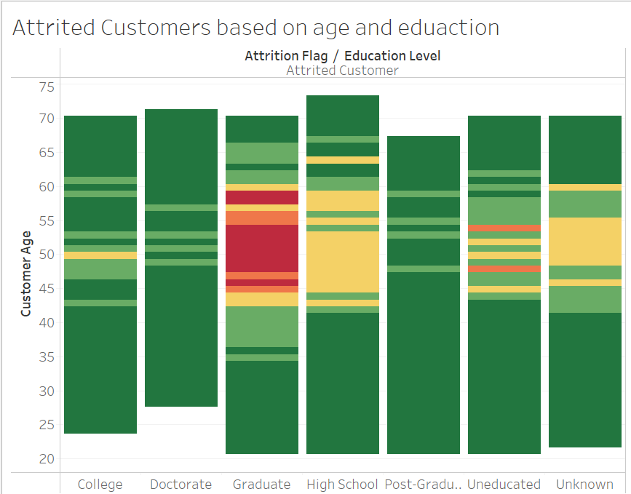
- In the Gantt chart it shows that there's high attrition customers from the age range of 40 to 60 and especially who are graduated or in high school education level.

Slide 17
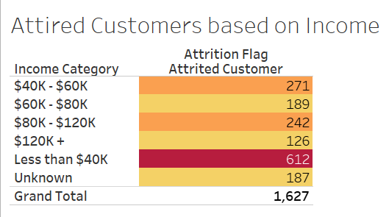

Slide 18
Future work
Resample using SMOT.
Deploy the model.

Slide 19
appendix
Dataset

Slide 20
Thank You
Samaher turki almalki

