Slide 1




Football Data Analysis
Capstone Project
By Samaita Majumder
Mentor – Munna Pandey

Slide 2

INTRODUCTION
1
Objective: This project aims to uncover actionable insights from extensive football datasets, spanning player performance, team strategies, market trends, and player attributes.
Methodology: A combination of descriptive statistics, hypothesis testing, machine learning (KNN and clustering), and visual dashboards in Tableau and Python was employed to extract meaningful patterns and insights.
The focus areas:
Player Profiles and Market Value: Evaluating performance and valuation trends.
Team Comparisons: Understanding team dynamics and competitive edge.
Attendance and Stadium Analysis: Assessing fan engagement and stadium utilization.
Event and Referee Analysis: Highlighting key influencers in match outcomes.
Contract Management and Substitution Patterns: Informing tactical and operational decisions.
Competition Analysis: Examining trends across competition types.

Slide 3

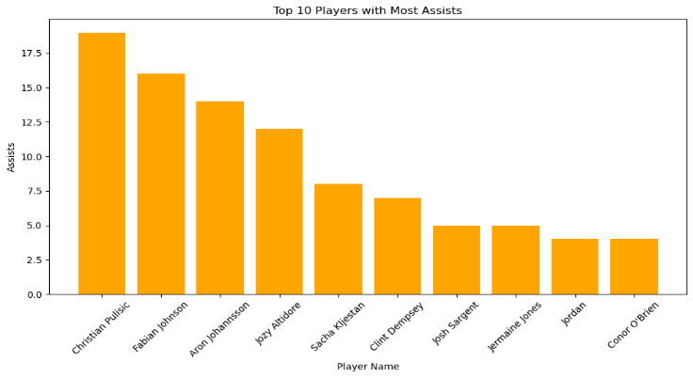
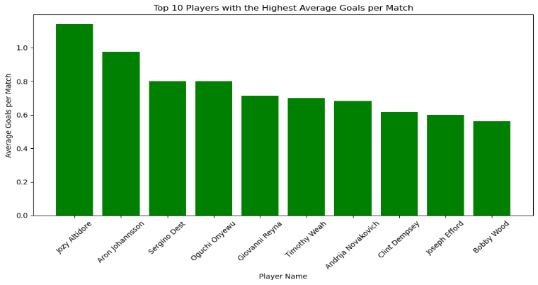
PERFORMANCE ANALYSIS
2
This slide focuses on analyzing player and match performance using descriptive analysis and visualizations. Insights include the top players with the most assists and the average scores per player.
1. Who were the top players with the most assists during the season?
2. What is the average number of goals scored per player across all matches?
The top player with the highest number of assists was ‘Christian Pulisic’ during the season, significantly outpacing others.
The highest average number of goals is scored by ‘Jozy Altidore’. The top 10 players are listed above.

Slide 4
PERFORMANCE ANALYSIS (cont..)
3
3 ) What is the probability that a player who scored a goal in a season also received at-least one yellow card?
Conditional Probability – Measure the likelihood of one event given the occurrence of another.
Calculated the likelihood of an event happening given a condition, like how likely a player who scored a goal also received at-least one yellow card. The answer is 0.14. which is very less.
4 ) What is the probability that a match with a high attendance (more than 30,000) also had a player who scored at-least one goal?
Joint Probability: Measures the likelihood of two events occurring simultaneously.
Calculated the likelihood of two events happening together, like the probability of a high-attendance match also having a player who scored at-least one goal. The answer is 0.275 which is again very low.
5) Can we predict the outcome of a match based on the positions of the home and away teams?
Features Used: home_club_position and away_club_position
Target Variable: home_win
Logistic Regression Metrics:
Accuracy – 0.65
Precision:
Class 0: 0.64 (Non-Home Win)
Class 1: 0.66( Home Win)
Recall:
Class 0 (Non-Home Win): 0.76
Class 1 (Home Win): 0.52
Confusion Matrix:
True Positives (TP) = 94 (Home win predicted correctly as home win) False Positives (FP) = 53 (Non-home win predicted as home win) True Negatives (TN) = 169 (Non-home win predicted correctly as non-home win) False Negatives (FN) = 86 (Home win predicted as non-home win

Slide 5
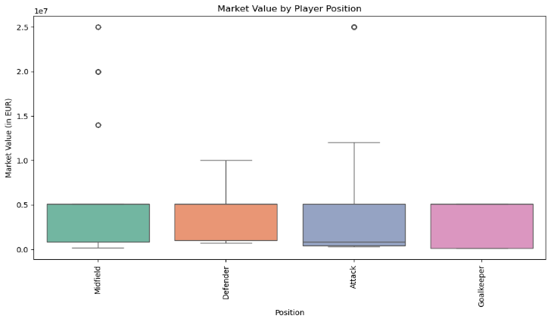
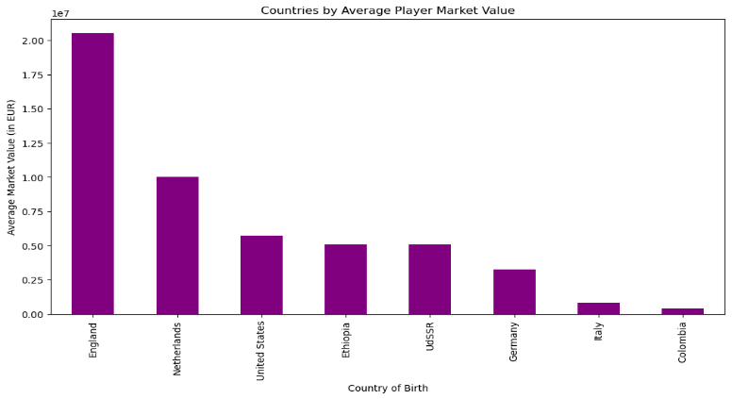
PLAYER PROFILE AND MARKET VALUE
4
What is the average market value of players by position?
2) What is the average market value of players based on their birth country?
Midfielders tend to have market values concentrated around 0.1- 0.5 EUR, with some high-value players skewing the distribution upwards. Defenders generally have lower market values compared to midfielders. Attackers have moderately high market values. Goalkeepers have the lowest and most consistent market values among all positions.
This analysis will help us understand how players' market values vary based on their country of birth. England is leading in average market value for the players in the country.

Slide 6
PLAYER PROFILE AND MARKET VALUE (cont…)
5
3) How does the highest market value of a player impact their current market value?
4) How do a player's highest market value and age influence their current market value?
Model Overview
Model Used: Simple Linear Regression
Features Used: highest_market_value_in_eur
Target Variable: market_value_in_eur
Model Overview
Model Used: Multiple Linear Regression
Features Used: highest_market_value_in_eur’ and 'age
Target Variable: market_value_in_eur
Evaluation results
Mean Squared Error (MSE): 0.2009
R-squared (R2) Score: 0.7793
The low MSE indicates that the model predictions are relatively accurate. The highest market value of a player is a strong predictor of their current market value. This suggests that a player's market value tends to remain relatively consistent over time, and their peak value is a good benchmark for estimating their current worth.
Evaluation results
Mean Squared Error (MSE): 0.1972
R-squared (R2) Score: 0.7834
Coefficients (highest_market_value_in_eur, age): [0.8723 -0.0120]
Highest Market Value: This is likely the most significant predictor given from the coefficient. Age: The relationship with age is slightly negative, as older players generally see a decline in market value.

Slide 7
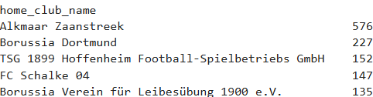
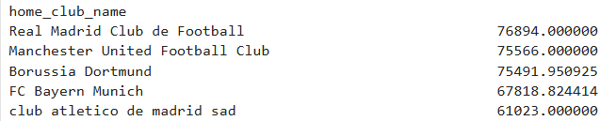
TEAM COMPARISON
6
1) Which team has scored the highest number of total goals?
The top 5 teams are given here with highest total goals.
2) Which teams have the highest average attendance at their home matches?
Here the top 5 home teams with highest average attendance is presented.
3) Does the home team have a significantly higher number of goals scored than the away team?
Null hypothesis (H0): The number of goals scored by the home team is equal to the number of goals scored by the away team. Alternative hypothesis (H1): The number of goals scored by the home team is significantly higher than the away team
T-statistic: 3.44
Critical T-value: 1.71
P-value: 0.002
Reject Null Hypothesis: "The home team scores significantly more goals than the away team."
4) Does the average number of goals scored by home teams differ significantly from the population mean?
Null Hypothesis (H0): The average number of goals scored by home teams is equal to the population mean (μ). Alternative Hypothesis (H1): The average number of goals scored by home teams is not equal to the population mean (μ).
T-statistic: 2.07
Critical T-value: 2.06
P-value: 0.049
Reject Null: "There is some significant difference between the average goals scored by home teams and the population mean."

Slide 8
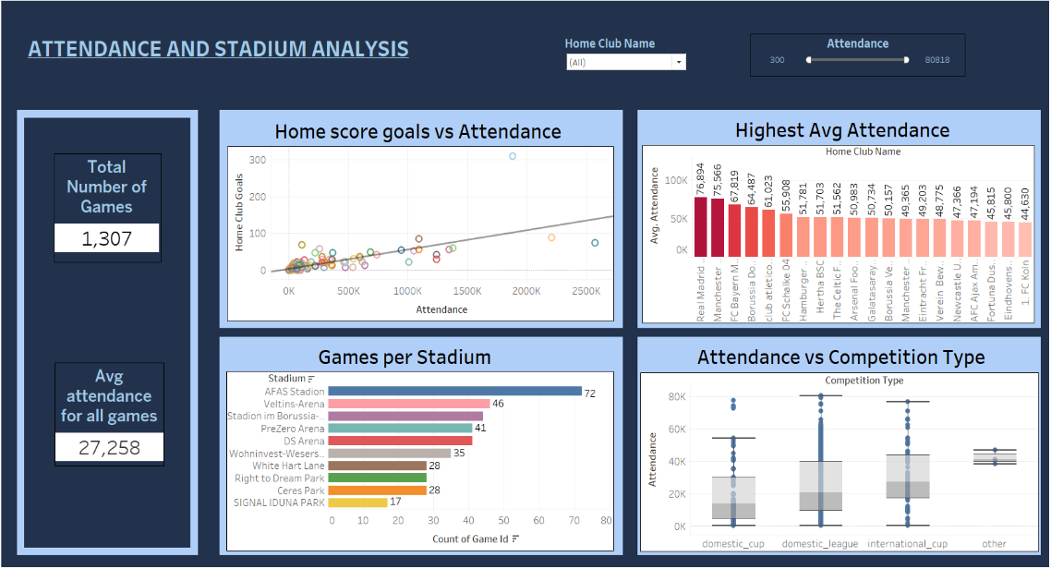
ATTENDANCE AND STADIUM ANALYSIS
7
Descriptive Analysis :-
Visual 1: The scatter plot shows the relationship between home goals scored and attendance. A strong positive correlation suggests that games with more goals scored attract more fans.
Visual 2: The bar chart will show the home teams with the highest average attendance at their home matches. This indicates which teams have the strongest fan engagement at home.
Visual 2: Shows the games for each stadium. ‘AFAS Stadium’ has the highest games conducted.
Visual 3: The box plot helps visualize the spread and variation of attendance for each competition type
KNN Classification - Can we classify the type of stadium based on the attendance?
Accuracy – 0.9851
The model is highly accurate at classifying stadiums as "Large" or "Small" based on attendance. A high accuracy of 98.5% suggests that attendance is an excellent predictor of stadium type. This makes sense since the stadium's classification ("Large" or "Small") is inherently tied to the attendance capacity.

Slide 9
EVENT AND REFEREE ANALYSIS
8
How Many Games Were Officiated by Each Referee?
This shows the top 5 referee officiating games. Felix Zwayer officiated the highest number of games. This can indicate his experience and demand.
2. What is the Distribution of Yellow and Red Cards per Referee?
Referees differ in their strictness, with some issuing more yellow or red cards, suggesting variability in officiating styles. Felix Zwayer is the one who has given out the maximum yellow cards.
3) What is the Total Number of Events by Type?
Events are dominated by Substitutions, reflecting the typical actions in matches, followed by goals and cards.
2) Which Players Are Most Frequently Involved in Events?
Certain players stand out for being frequently involved in match events, likely due to their playing style or role on the field. The player who has been involved the most is ‘Aron Johannsson’.

Slide 10
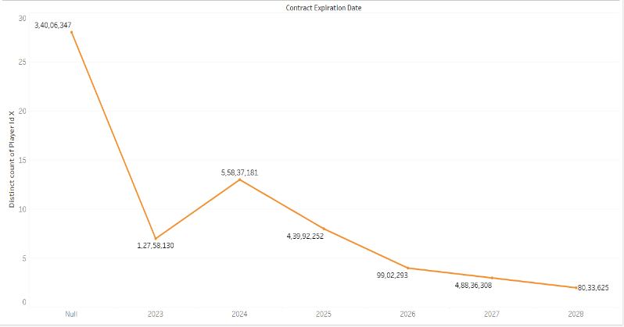
SUBSTITUTION PATTERN AND CONTRACT MANAGEMENT
9
1. What is the Total Number of Substitutions Across All Games?
Substitutions are a key strategy, with 744 substitutions recorded across all games, reflecting active player management during matches.
2. Which Players Have the Most Substitutions?
Players like Aron Johannsson and Fabian Johnson frequently appear in substitution statistics
3. What is the trend of contract expirations over the years?
The line chart shows trends in contract expirations, helping to identify whether expirations are concentrated in specific years. It is seen that in 2024 the number of expiration contracts are the highest following which there is a downward trend. There are a lot of unknowns.
Row Labels | Count of type_x
Aron Johannsson | 57
Fabian Johnson | 56
Christian Pulisic | 52
Emmanuel Sabbi | 36
Bobby Wood | 34

Slide 11
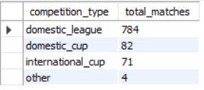
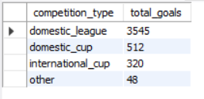
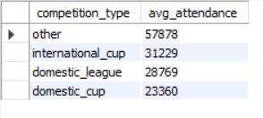
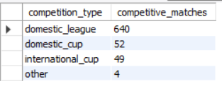
COMPETITIVE ANALYSIS
10
1. What is the Total Number of Matches Played in Each Competition?
Competitions like [insert competition] have the highest number of matches played, showing their extensive formats or participation.
2. What Is the Average Attendance Per Competition?
The highest average attendance is observed in competitions like international cup and others, indicating their popularity among people.
3. What Is the Total Number of Goals Scored in Each Competition?
Competitions like domestic league showcase the highest number of total goals followed by the domestic cup.
4. Which Competition Has the Most Competitive Matches (Small Goal Differences)?
Competitions like the domestic league exhibit the narrowest goal differences. This can indicate that there was a balanced strength for the participating teams.

Slide 12
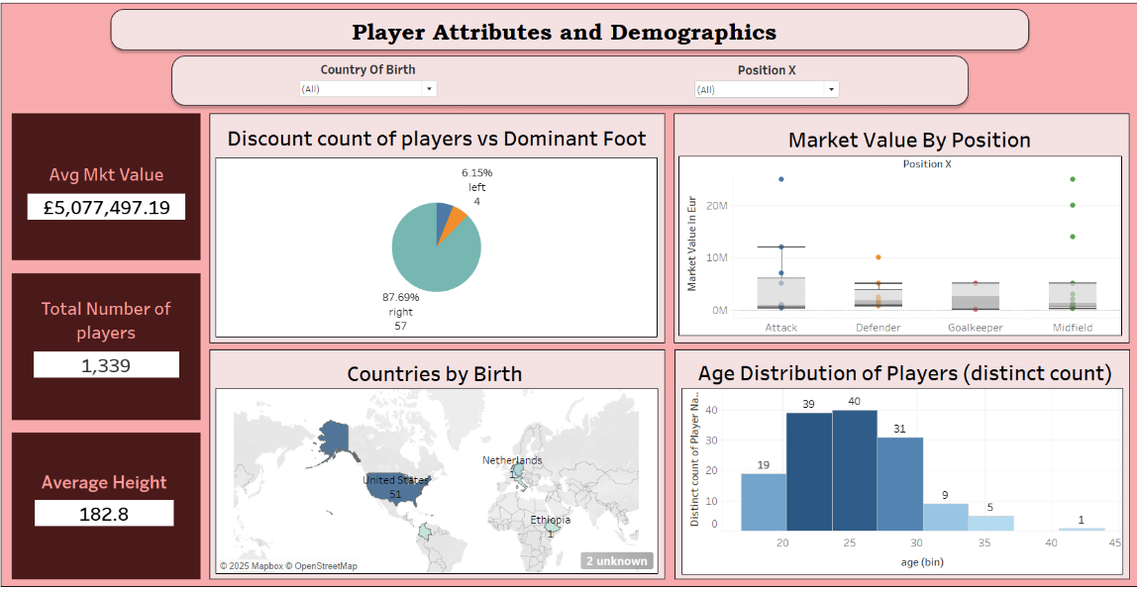
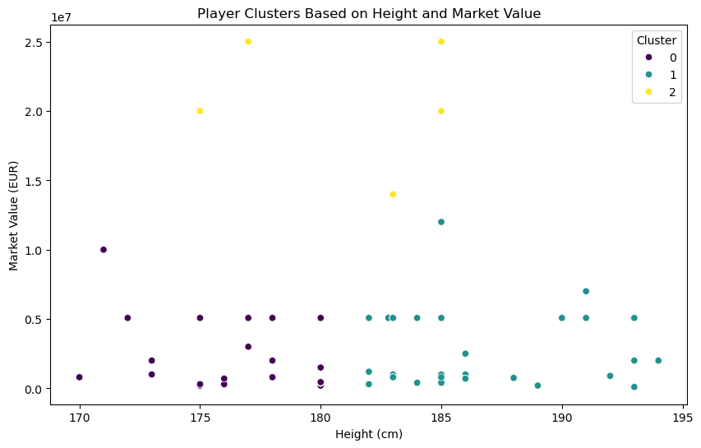
PLAYER ATTRIBUTES AND DEMOGRAPHICS
11
Visual 1 - The pie chart will show the proportion of players using their left foot vs. right foot. It provides insights into the dominance of playing styles.
Visual 2 - The box plot visualizes the spread of market values for players in each position. It highlights the median, interquartile range, and outliers.
Visual 3 - The world map shows the geographical distribution of players' birthplaces, highlighting countries with the most football talent (like United States).
Visual 4 - The histogram shows the frequency of players by age. Most of the players are between 20-26 during the time of the games.
K Mean Clustering Analysis:
Optimal Clusters (Using Elbow Method): 3
Clusters represent: High-value average height players. Short players with moderate market value. Low-value taller players.

Slide 13
CONCLUSION
12
Performance Analysis: Through performance analysis, top players were identified based on their goals and assists, providing a clear understanding of the key contributors to team success. It was also observed that home teams tend to have a significant scoring advantage over away teams, confirmed through hypothesis testing.
Player Profile and Market Value: Players’ market values were analyzed across positions and countries of birth, revealing trends that can inform recruitment strategies. A strong correlation was identified between a player's highest recorded market value and their current valuation, with age having a moderate influence.
Team Comparison: Analysis revealed teams with the most goals scored and the highest average attendance at home matches. Additionally, hypothesis testing confirmed that home teams significantly outscore away teams.
Attendance and Stadium Analysis: Teams with high average attendance were highlighted. Using KNN classification, stadiums were accurately classified as "Large" or "Small" with 98.5% accuracy
Referee Analysis: Referees’ roles were analyzed based on their officiated matches and card distribution patterns. Felix Zwayer was seen leading in both the charts.

Slide 14
CONCLUSION (cont…)
13
Event Analysis: Players frequently involved in game events were identified, highlighting their impact on match outcomes.
Substitution Patterns: Substitution data revealed tactical insights, including the total number of substitutions and the players most frequently substituted.
Contract Management: Contract expiration trends over the years were analyzed, enabling clubs to anticipate and prepare for future negotiations and renewals. 2024 was the year with the most expiration dates.
Competition Analysis: The analysis explored the total matches played, average attendance, and goals scored across competitions. Additionally, the most competitive matches, characterized by small goal differences, were identified.
Player Attributes and Demographics: The distribution of players’ dominant foot, average market values by position, and countries with the highest player representation were analyzed. K-means clustering grouped players based on performance metrics like height and market value, offering insights into player segmentation.

Slide 15
Thank You

