Slide 1

WIRESHARK
Name: SAMAKSH BANSAL
Regno.: 11912543
Roll no.: 35

Slide 2
Objective :
In this project, the objective is to inspect HTTP traffic and retrieve the username and password from the BSNL website using an appropriate tool. The project aims to demonstrate how an attacker can exploit the security vulnerabilities in the website and gain access to sensitive information.

Slide 3
Description Of The Project
The project involves the use of Wireshark, a popular network protocol analyzer tool, to capture and analyze HTTP traffic between the user's computer and the BSNL website. The tool will allow us to inspect the packets and extract the username and password sent by the user to the website. The project will focus on identifying the security weaknesses in the website's login process that allow an attacker to intercept and steal the user's credentials. It will involve analyzing the HTTP packets for any unencrypted data and looking for patterns that indicate the username and password.

Slide 4
Assumptions And Dependencies
The assumptions for this project include: i. The user is using an unsecured Wi-Fi network, which can be intercepted by an attacker. ii. The website does not use any encryption or security protocols to protect the user's credentials during transmission. iii. The user's computer is not infected with any malware that can intercept and steal their credentials. iv. The dependencies for this project include: v. Wireshark, the network protocol analyzer tool used to capture and analyze the website's traffic. vi. An internet connection to access the BSNL website. vii. A web browser to access the BSNL website and enter the login credentials

Slide 5
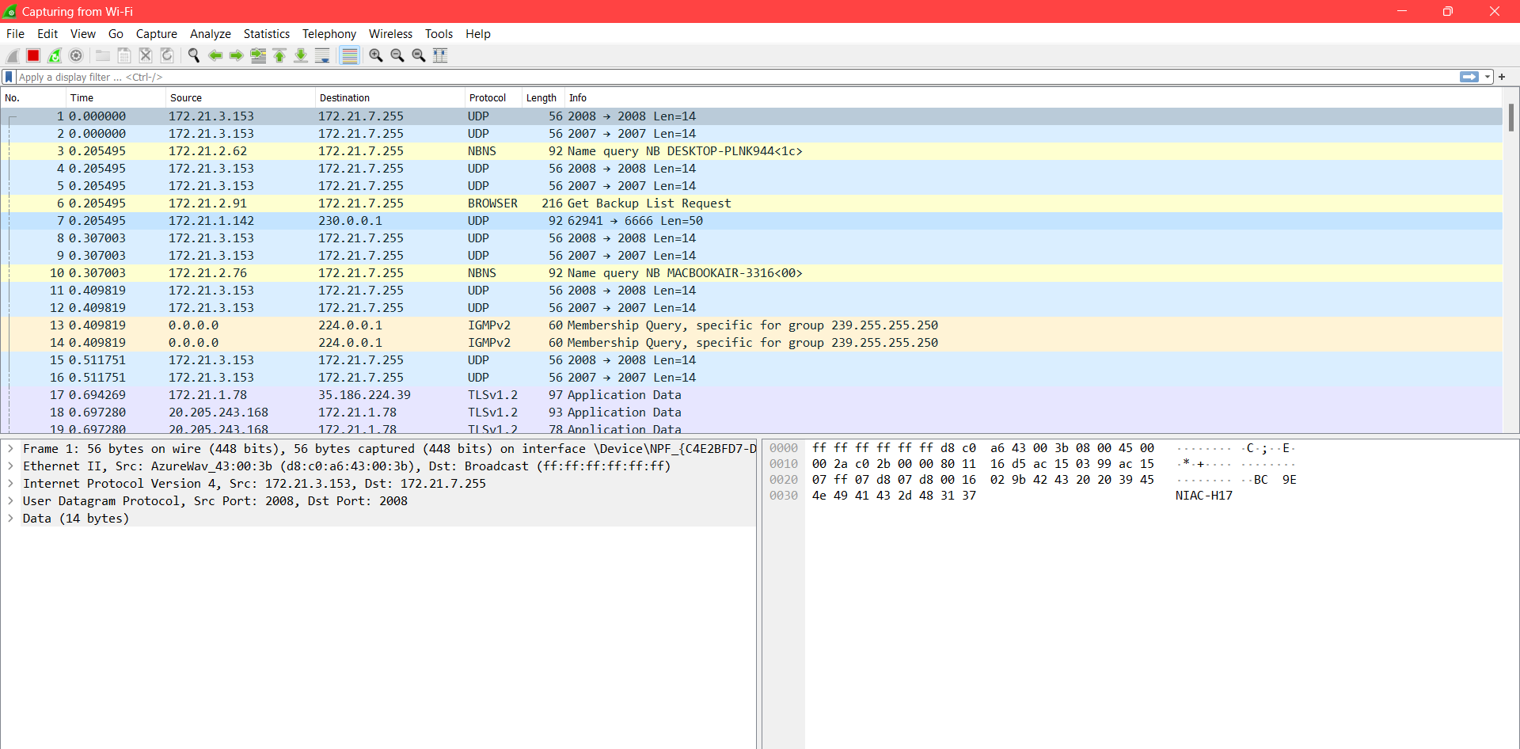

Slide 6
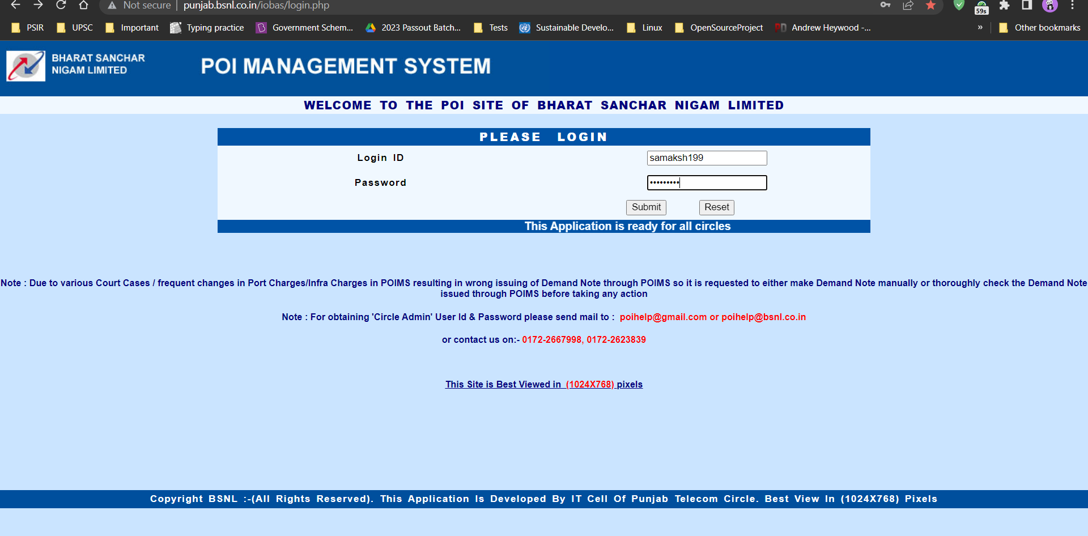

Slide 7
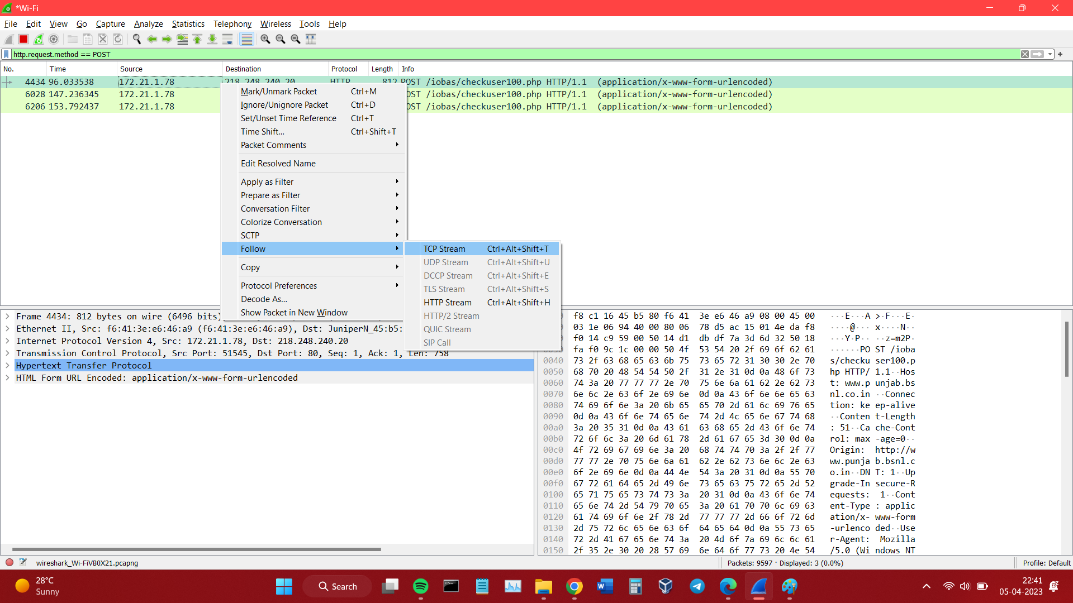

Slide 8
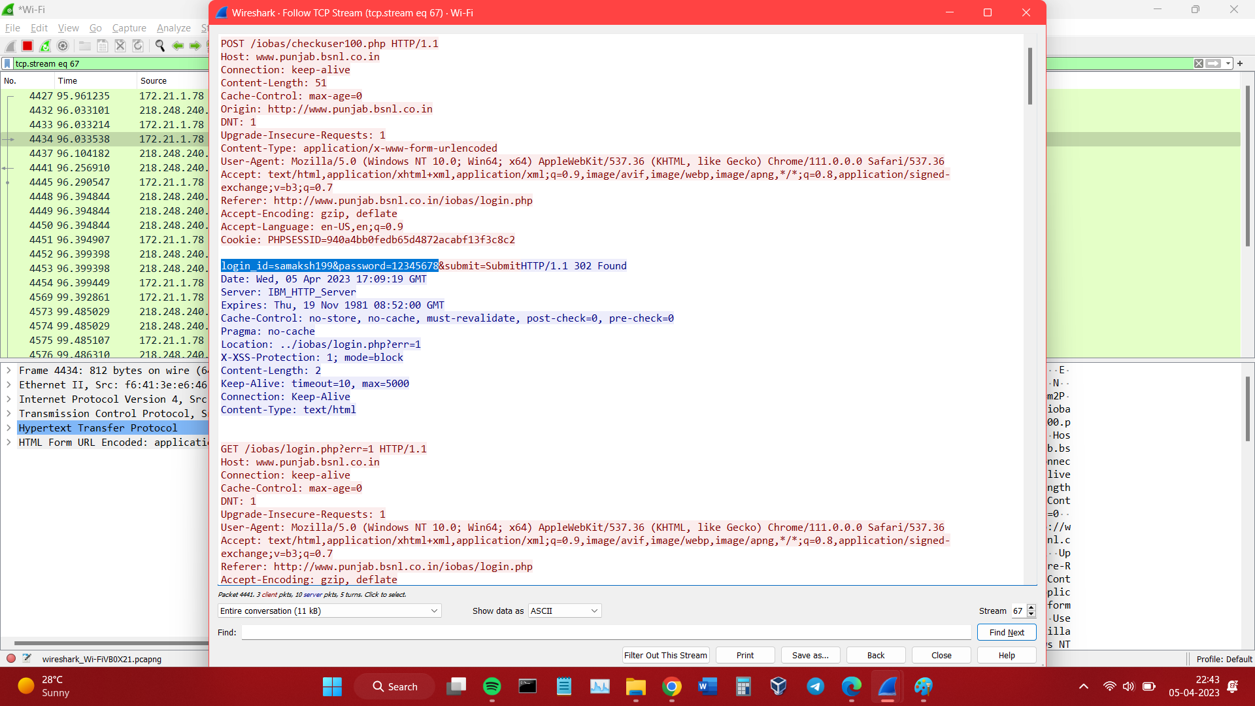

Slide 9

THANK YOU

