Slide 1
📦 INVENTORY STOCK MANAGEMENT SYSTEM
A Modern Full-Stack Python, MongoDB & Web SPA Solution
College Assignment & Enterprise Grade Architecture
Developed by: Samaksh Garg

Slide 2
1. Project Overview & Problem Statement
Addressing retail inefficiencies with a digital, real-time inventory engine
• The Challenge:
Small retail shops and college stores manually track inventory in paper registers or basic spreadsheets, leading to frequent stockouts, tied-up capital from overstocking, and zero audit trails.
• The Solution:
A robust, full-stack Inventory Management System featuring a high-performance Python/MongoDB backend, interactive CLI interface, and a modern glassmorphism web dashboard.
• Core Objectives:
Provide real-time stock tracking, atomic stock operations, comprehensive MongoDB-powered reporting, and seamless data portability via CSV export.

Slide 3
2. Architecture & Technology Stack
Clean separation of concerns across a 3-tier architecture
• 3-Tier Architecture: — Strict separation across Presentation (CLI/Web SPA), Business Service Layer, and MongoDB Database Layer with singleton connection pooling.
• Python (3.10+): — Modern type-hinted application core delivering clean, maintainable, PEP 8 compliant code with zero circular dependencies.
• MongoDB 6.x & PyMongo 4.7.3: — Flexible document model with atomic updates, robust indexing, and powerful aggregation pipelines.
• Supporting Ecosystem: — Flask & Flask-CORS for REST API, tabulate for CLI tables, faker for realistic seed data, and pytest for comprehensive unit testing.

Slide 4
3. Core Features & Capabilities
Comprehensive toolkit for day-to-day store operations
✓ Product Management:
Add, paginated view, text/regex search, category filter, update, and delete products by SKU.
✓ Supplier Management:
Complete supplier lifecycle with referential integrity checks preventing deletion of active suppliers.
✓ Stock Operations (IN / OUT):
Atomic stock updates with guard conditions ensuring zero negative stock.
✓ Transaction Audit Trail:
Every stock movement is permanently recorded with timestamp, direction, quantity, and notes.
✓ CSV Export & Seeding:
Instant timestamped CSV export and idempotent bulk upsert for 10 suppliers and 40 demo products.

Slide 5
4. Advanced MongoDB Concepts Demonstrated
Leveraging enterprise database features for academic credit
• Atomic $inc Updates:
Stock IN and OUT use atomic `$inc` operators to guarantee thread-safe operations under concurrency.
• $gte Guard Filter:
Stock OUT query includes `quantity: {'$gte': requested}` ensuring inventory never drops below zero.
• Indexes & Constraints:
Unique indexes on `sku` and `email`, text index on product `name`, and compound index on transactions.
• Aggregation Framework:
Advanced pipelines utilizing `$group`, `$lookup` (joins), `$match`, `$sort`, and `$limit` for rich analytics.

Slide 6
5. Analytics & Aggregation Reports
Five powerful reporting pipelines for business intelligence
📊 1. Low Stock Report:
Identifies items where quantity <= reorder level for proactive replenishment.
📊 2. Category-wise Stock Value:
Groups products by category calculating total quantity and total inventory valuation.
📊 3. Supplier Summary ($lookup):
Joins suppliers with products to show product counts and valuation per vendor.
📊 4. Monthly Stock Movement:
Aggregates transaction logs by month and movement type (IN vs OUT).
📊 5. Top 5 Best-Selling Products:
Calculates highest total Stock OUT quantity using pipeline sorting and limiting.

Slide 7
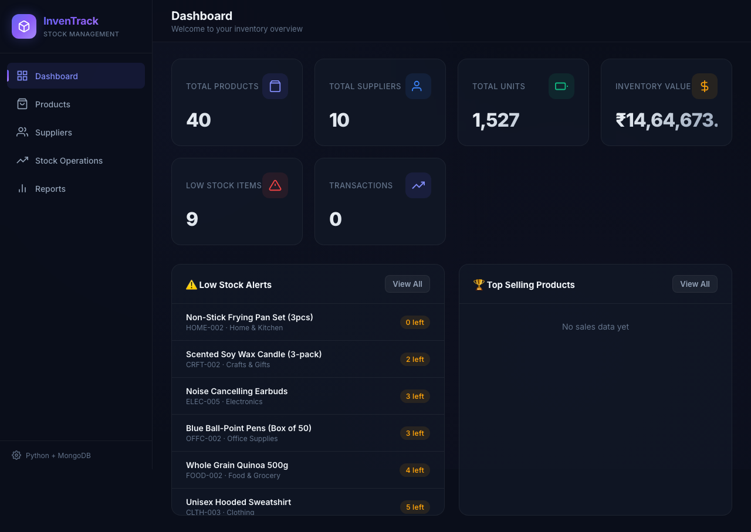
6. Live UI: Modern Dashboard
Glassmorphism SPA dashboard displaying live KPI metrics and stock valuation

Slide 8
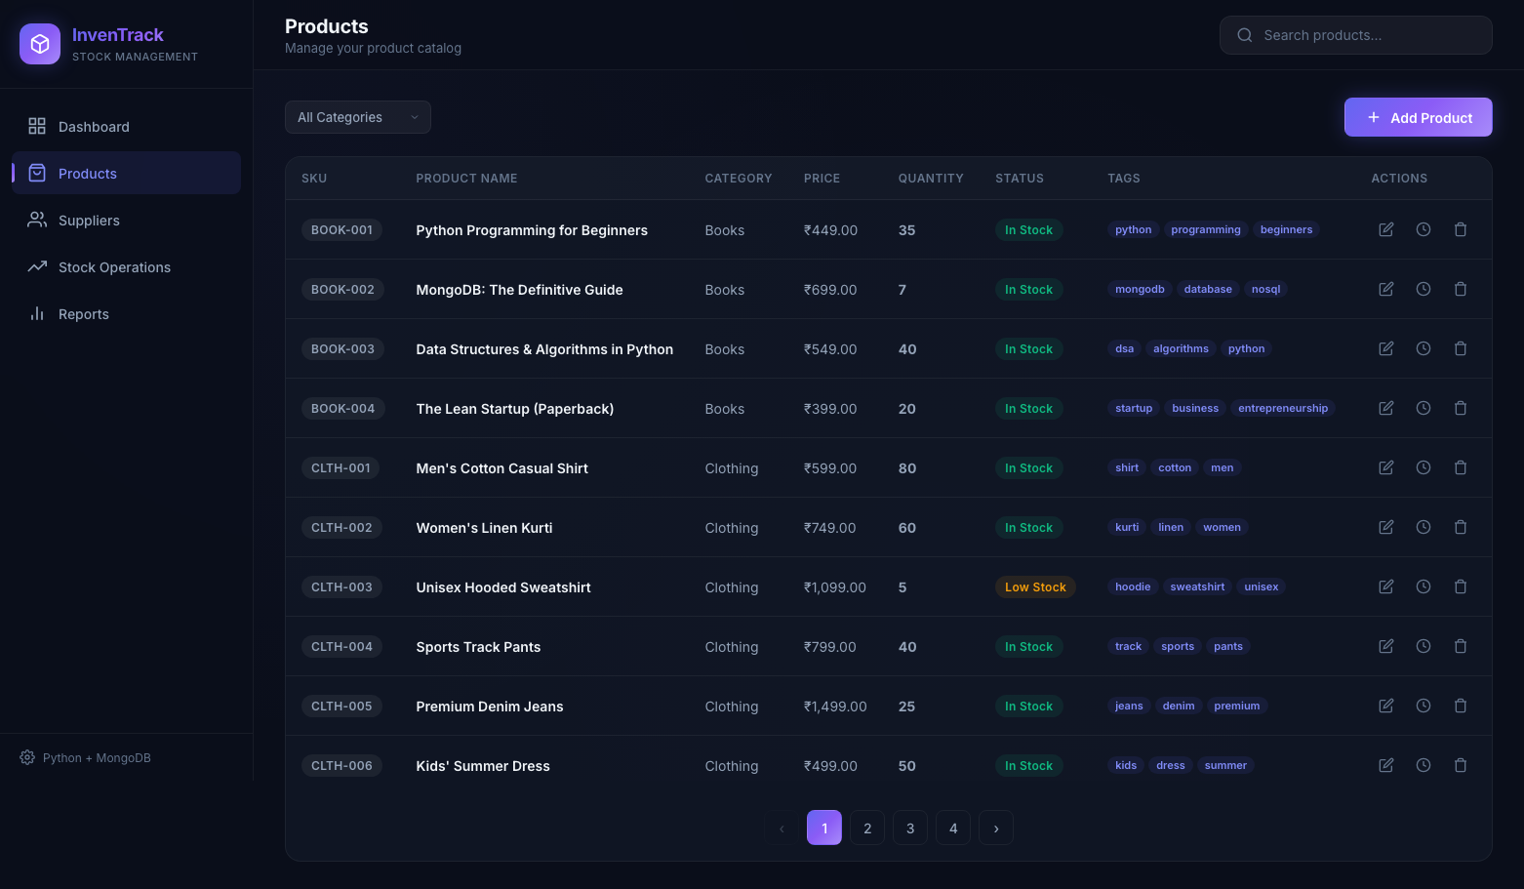
7. Live UI: Product Management
Paginated product catalog with category filtering and real-time search

Slide 9
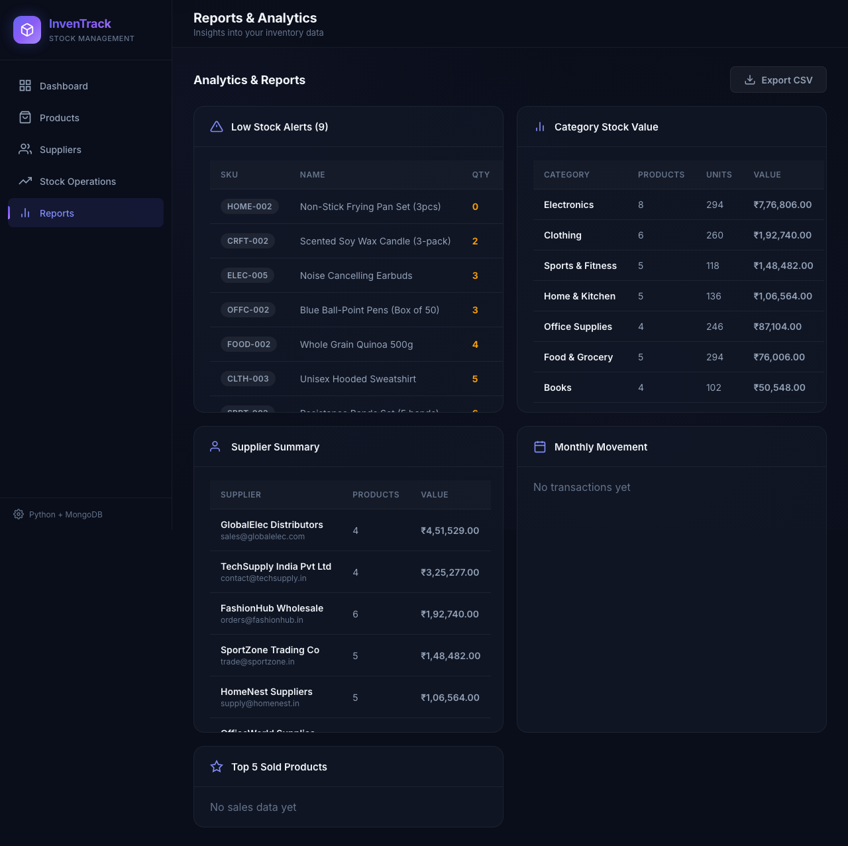
8. Live UI: Stock Operations & Analytics
Atomic stock IN/OUT logging and advanced aggregation reports

Slide 10
9. Testing & Quality Assurance
Robust test suite ensuring absolute reliability
✓ Comprehensive Test Suite:
37 unit tests covering product CRUD, stock operations, and aggregation reports.
✓ Isolated Test Database:
Tests run against a dedicated `inventory_test_db` with automated fixture teardown ensuring production data is untouched.
✓ Robust Error Handling:
Graceful handling of duplicate SKUs, invalid ObjectIds, connection failures, and insufficient stock without raw tracebacks.
✓ Input Validation:
Strict validation layer verifying prices > 0, quantities >= 0, and valid email formats before database interaction.

Slide 11
10. Conclusion & Future Roadmap
Project success and scalable expansion path
🚀 Project Success:
Successfully delivered a complete, tested, and polished inventory management system combining CLI and modern web UI.
🚀 Future Enhancement 1:
Role-based authentication (Admin vs. Operator permissions).
🚀 Future Enhancement 2:
Barcode scanner integration for lightning-fast stock check-in/out.
🚀 Future Enhancement 3:
Automated email/SMS alerts when stock drops below reorder levels.
🚀 Future Enhancement 4:
Cloud migration from local MongoDB to MongoDB Atlas.

