Slide 1
SMART STUDY PLANNER
CAPSTONE PROJECT
Presented By:
AICTE ID: STU664b45d349dca1716209107
Madhumitha Samala
Malla Reddy Engineering College for Women
Computer Science and Engineering

Slide 2
OUTLINE
Problem Statement
System Development Approach
Algorithm & Deployment
Result
Conclusion
Future Scope
References

Slide 3
Problem Statement
Students often find it difficult to manage multiple study tasks, track deadlines, and prioritize work. Traditional methods like notebooks are hard to organize and do not provide a clear overview of progress, leading to missed deadlines and low productivity.

Slide 4
System Approach
Frontend Technologies:
HTML5 – Structure of the planner, task forms, task list, progress bar and timeline
CSS3 – Styling, card layouts, gradient headers, responsive design for mobile and desktop
JavaScript – Dynamic interactivity: adding, editing, deleting tasks, marking tasks as completed, updating progress bar, and timeline view
Design Approach:
Clean and user-friendly interface with clear task cards and visual timeline
Mobile-responsive design for seamless access on phones and tablets
Modular separation of HTML, CSS, and JS for easier maintenance and scalability

Slide 5
Algorithm & Deployment
Smart Study Planner Project Plan
Task Management
Define tasks with title, subject, due date, and priority.
Store tasks locally in the browser using Local Storage.
Frontend Design
Layout using HTML and CSS (cards, timeline, progress bar).
Gradient headers and card-based task display for a modern look.
Responsive design for mobile and desktop.
Interactive Features
Add, Edit, Delete, and Complete/Undo tasks using JavaScript.
Progress bar updates dynamically based on completed tasks.
Timeline view to display tasks chronologically.
Reminders for tasks due today.
Testing
Ensure cross-browser compatibility (Chrome, Firefox, Edge).
Verify mobile responsiveness on phones and tablets.
Check task persistence on page reload using Local Storage.
Deployment
Host on GitHub Pages or Netlify for free and easy access.
Ensure all files (HTML, CSS, JS) are properly linked and functional.

Slide 6
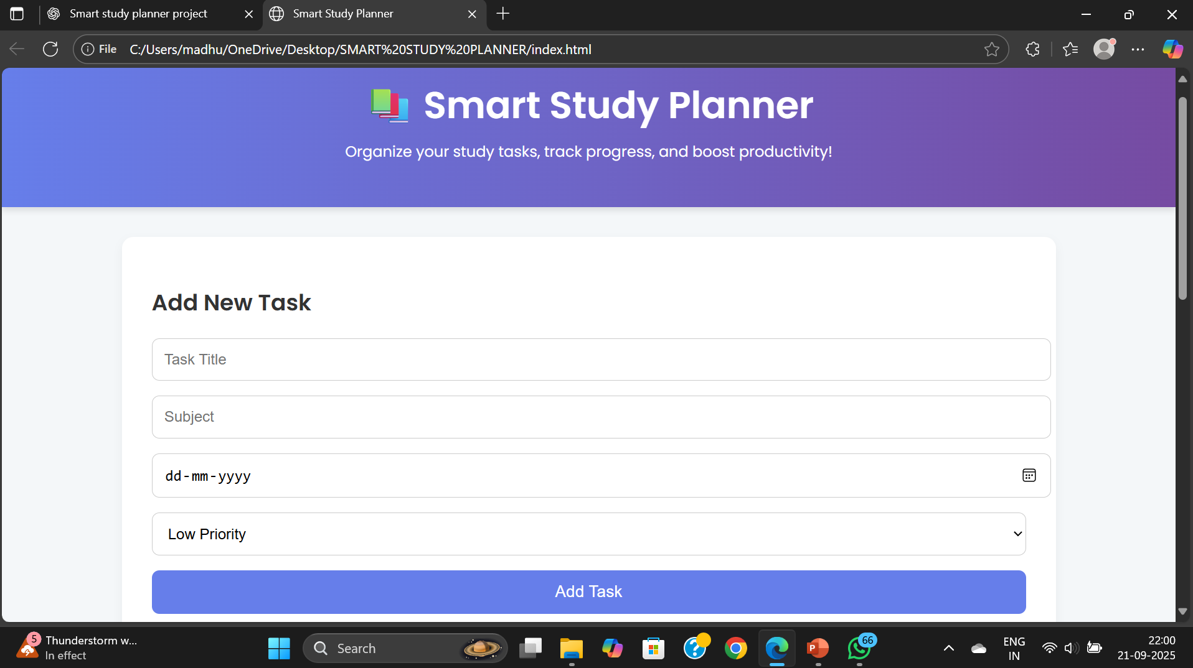
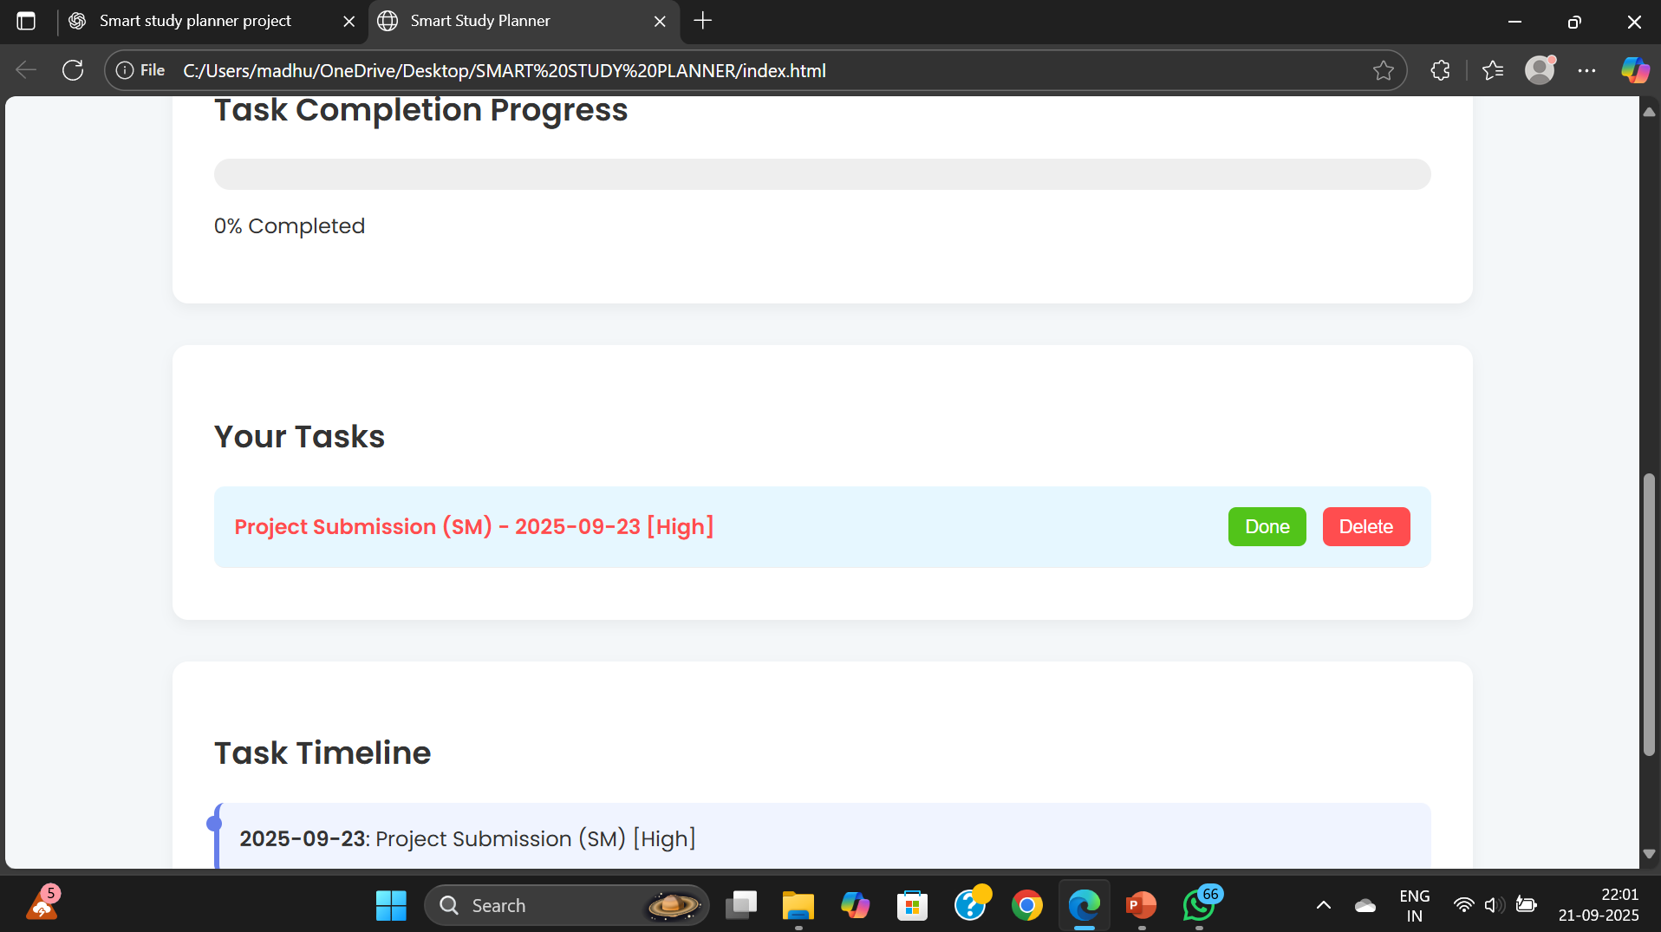
Result
GITHUB: SamalaMadhumitha/Smart-Study-Planner

Slide 7
Conclusion
The Smart Study Planner is a cost-effective tool that helps students organize their study schedules with ease. It removes the need for complex apps and offers an engaging, personalized learning experience.

Slide 8
Future scope
AI-Powered Suggestions – Integrate machine learning to recommend personalized study plans and time management strategies.
Collaboration Features – Enable group study planning, shared calendars, and peer progress tracking.
Cross-Platform Integration – Expand to mobile apps and sync with tools like Google Calendar, MS Teams, or Zoom.

Slide 9
References
W3Schools. HTML, CSS, and JavaScript Tutorials. Available at: https://www.w3schools.com
Bootstrap Documentation → https://getbootstrap.com

Slide 10
THANK YOU

