Slide 1
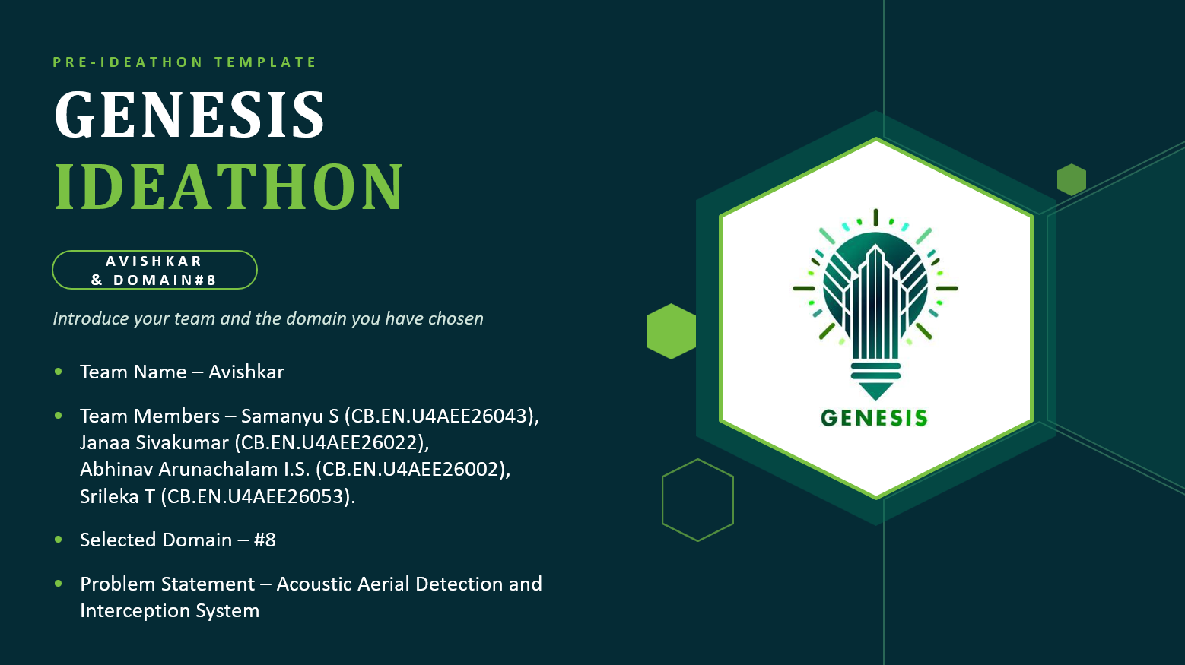

Slide 2
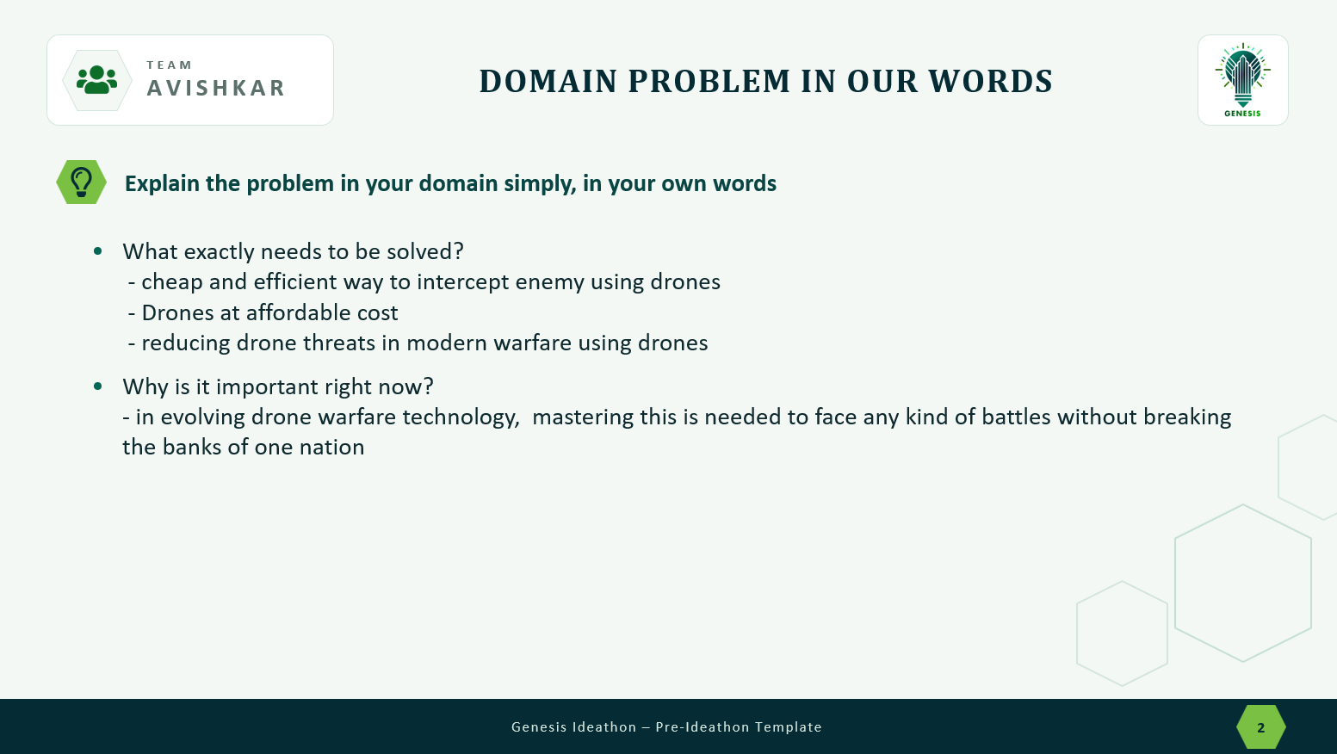

Slide 3

WHO IS AFFECTED?
TEAM
AVISHKAR
PRIMARY USERS
Airport Security Teams – To monitor and respond to unauthorized drone activity.
Military and Defense Personnel – To protect sensitive areas from potential drone threats.
Security and Counter-Drone Operators – To detect, track, and manage unauthorized drones.
Critical Infrastructure Security Teams – To protect important facilities and restricted zones.
SECONDARY STAKEHOLDERS
Government Agencies – Responsible for public safety and airspace security.
Airport Authorities – To maintain safe flight operations.
Industrial Organizations – To protect important facilities and equipment.
Emergency Services – To reduce disruptions during emergency operations.
Drone Manufacturers and Developers – To improve drone safety and counter-drone technologies.
WHO BENEFITS IF THE PROBLEM IS SOLVED?
Airline Passengers – Fewer disruptions caused by unauthorized drone activity.
Businesses and Industries – Better protection of important infrastructure.
Security Personnel – Improved support for detecting and tracking drones.
Government and Defense Organizations – Better monitoring of sensitive areas.

Slide 4
CURRENT SITUATION & CONTEXT
TEAM
AVISHKAR
GROWING DRONE THREAT
HOW CURRENT SYSTEMS RESPOND
EXISTING CHALLENGE
• Drones are becoming smaller, more capable, and easily accessible.
• Unauthorized drones can enter restricted or sensitive areas.
• Detection can use Radar, RF sensors, Cameras, Infrared, and Acoustic sensors.
• The drone is then tracked and an appropriate response is selected.
• Small drones can be difficult to detect and track.
• Noise, interference, and false detections can affect performance.
• Many existing systems can be expensive or complex.
DETECT → IDENTIFY → TRACK → RESPOND
This creates a need for a cost-effective, agile and reliable counter-drone solution.

Slide 5
KEY CHALLENGES
TEAM
AVISHKAR
MAIN DIFFICULTIES
BOTTLENECKS
• Small drones are difficult to detect reliably.
• Tracking can become difficult in crowded environments.
• Limited detection range and noisy environments.
• Real-time localization and tracking can be challenging.
ROOT CAUSES
CONSEQUENCES
• Small size and low visibility of drones.
• Acoustic/RF signals can be affected by interference and surroundings.
• Delayed detection and response.
• Higher risk of unauthorized drone activity going unnoticed.
• Conventional solutions may be costly or complex.

Slide 6
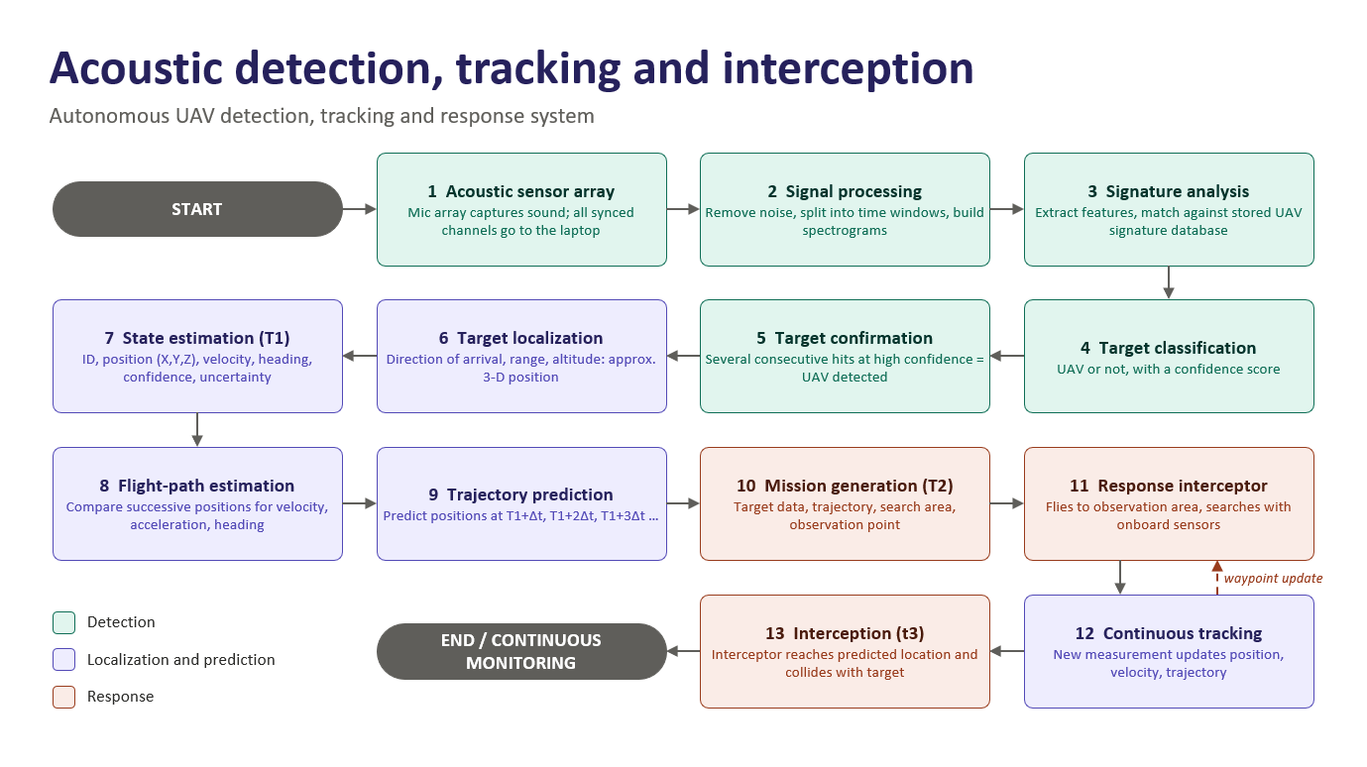
EXISTING SOLUTIONS / APPROACHES
A
TEAM
AVISHKAR
Existing methods:Acoustic Detection Systems Ground-based microphone arrays detect drone motor and propeller sounds, even when visual detection is difficult.
Limitations:
High Cost: Some advanced counter-drone systems are expensive to deploy and maintain.
Detection Difficulties: Small drones can be difficult to detect reliably in certain environments. Environmental Interference: Noise, obstacles, and poor visibility can affect detection
Ref:Claude

Slide 7
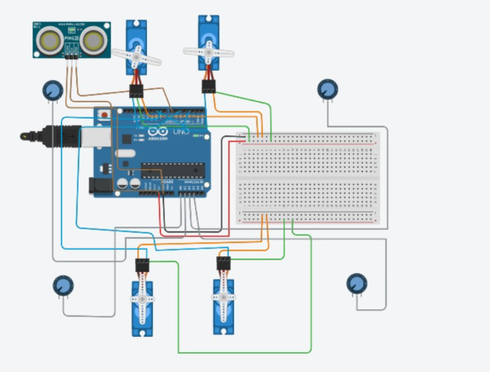
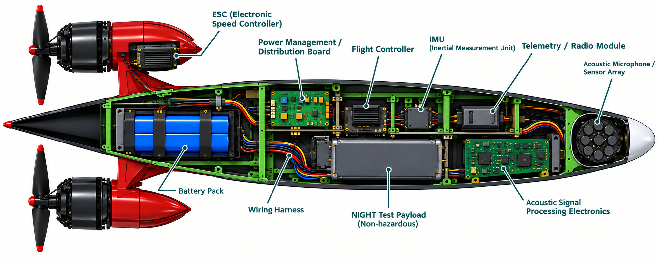
PROBLEM INSIGHTS & OPPORTUNITY AREAS
TEAM
AVISHKAR
HARDWARE REQUIREMENTS
UAV Frame: Lightweight frame with four arms.
Motors and Propellers: For generating lift and movement.
Flight Controller: To maintain stability and control the UAV.
Sensors: Gyroscope, accelerometer, barometer, and position sensor.
Acoustic Sensors: Microphones to capture sounds from nearby drones.
Power Supply: Battery and power distribution components.
Electronic Components: Wiring, connectors, and a suitable microcontroller.
SOFTWARE REQUIREMENTS
Programming: C/C++ or Python for control logic and data processing.
Flight-Control Software: For monitoring orientation and maintaining stable flight.
Signal Processing: To analyze acoustic signals and explore drone detection.
Simulation Tools: MATLAB/Simulink or a suitable flight simulator for testing the concept.
Ref:ChatGPT

Slide 8
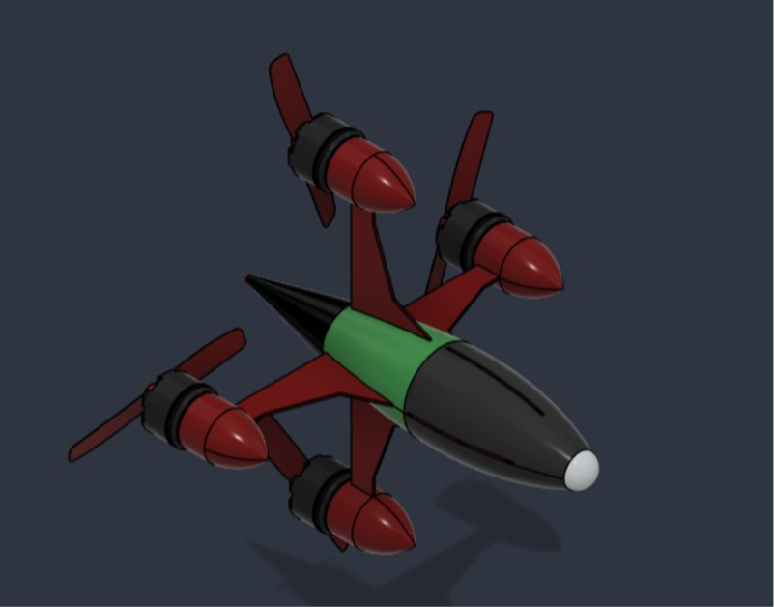
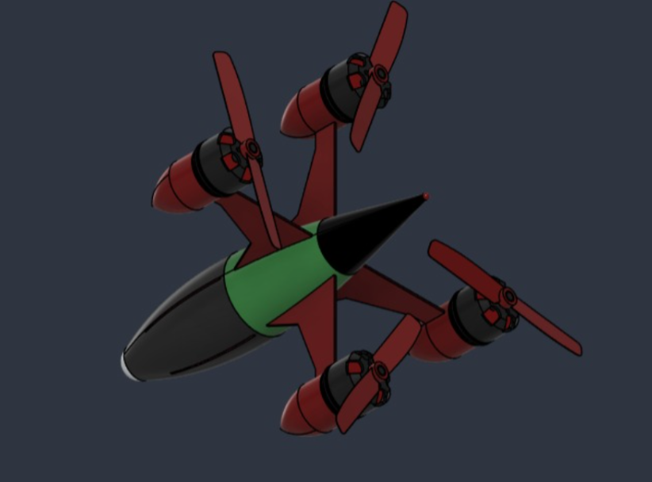
INITIAL DIRECTION & EXPECTED OUTCOME
TEAM
AVISHKAR
WHAT OUR TEAM INTENED TO DO
Develop a low-cost UAV-based counter-drone concept.
Explore acoustic detection to identify nearby drones through their sound.
Integrate sensors with a flight controller for stable and controlled flight.
Design a compact UAV model with suitable electronic components.
WHAT WE WANT TO EXPLORE
Reduce the overall system cost.
Explore more reliable drone detection using acoustic sensors.
Improve coordination between detection and flight-control systems.
Simplify the design while maintaining flight stability.
EXPECTED IMPROVEMENTS FOR SUCCESS
Demonstrate the basic UAV design through modelling or simulation.
Evaluate acoustic detection under different background-noise conditions.
Show stable flight-control behavior in simulation or controlled testing.

