Slide 1
Interpretable Vision Transformers for Motion Analysis
Stage 1 — Observation: what the multimodal model learns, and where it looks
vit_motion · ViT-tiny + temporal fusion · tracked-vehicle motion prediction
Internship research presentation
Notes:
This is the first of a three-stage story: (1) observe what the model does and where it looks, (2) quantify a weakness, (3) intervene with a method from the literature and measure the effect.

Slide 2
The model and how we open it up
A multimodal regression transformer — not a plain image classifier
What it is
Grad-CAM
1
Where in the RGB frame the prediction comes from
Visual branch: ViT-tiny encoder (avg-pooled) → 1 image token
Numeric branch: K=6 steps × 5 signals (pose deltas + track speeds)
Fusion: 2-layer Transformer encoder over [1 image + 6 numeric] tokens
Output: regression of next-step motion [dx, dy, dyaw] — no class logit
Selvaraju 2017
Integrated Gradients
2
Per-channel attribution over the numeric sequence
Sundararajan 2017
Because it is regression + multimodal, standard ViT saliency tools don't apply directly — every method is reduced to a scalar target (dx / dy / yaw / ‖·‖).
Attention Rollout
3
Image token vs. the 6 numeric tokens in the fusion encoder
Abnar & Zuidema 2020
Notes:
The key architectural point: the image is average-pooled to a single token before fusion. So 'image vs numeric' is answered by attention (token level), and 'where in the image' by Grad-CAM. They are complementary.

Slide 3
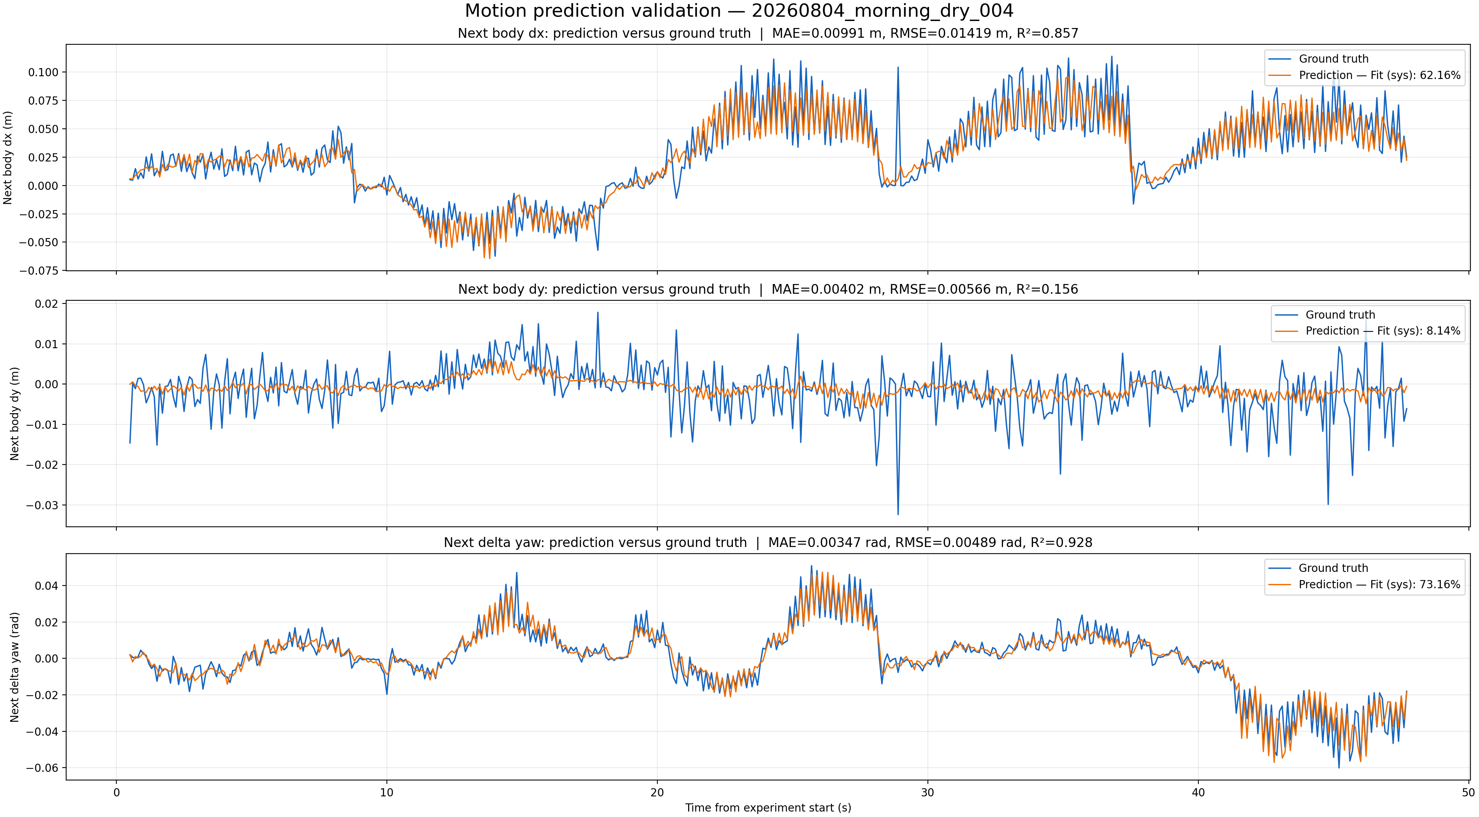
Finding 1 — the model predicts forward motion and turning well
Held-out test experiment (473 samples)
dx (forward)
R² 0.86
MAE 9.9 mm
yaw (turning)
R² 0.93
MAE 0.20°
dy (lateral)
R² 0.16
MAE 4.0 mm
dy has low R² not because the model fails, but because lateral body-frame motion here is near-zero noise (little variance to explain); its 4 mm error is already at the noise floor.
Notes:
dx and yaw track ground truth tightly. dy is high-frequency noise around zero — the model correctly predicts ~0. Frame low-R² honestly as a property of the signal, not a defect.

Slide 4
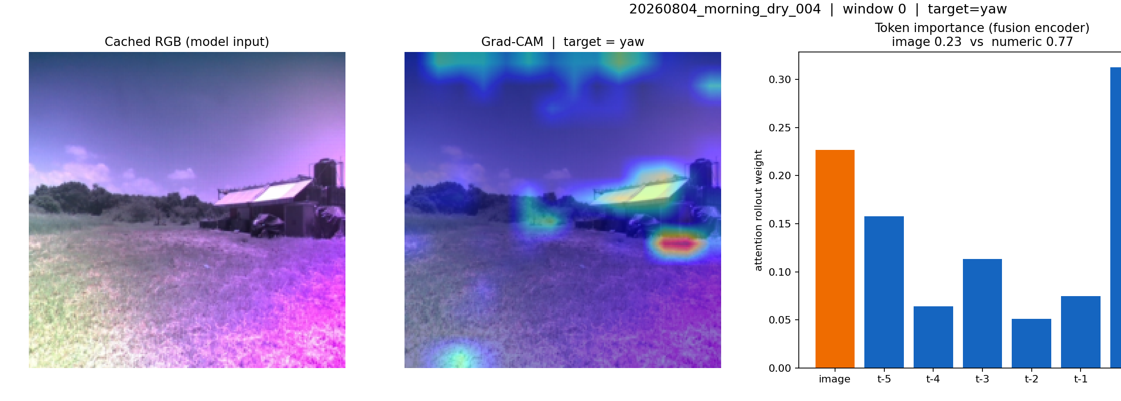
Finding 2 — the vision branch is used, but numerics dominate
Attention rollout inside the fusion encoder
~24%
of the decision weight goes to the image token
The most recent numeric step (t-0) carries the most weight — the model is strongly autoregressive.
But the image is not ignored: it is the 2nd-heaviest token, evidence the model is genuinely multimodal.
Notes:
Attention is the principled way to compare image vs numeric here, because the image is exactly one token vs six numeric tokens — genuinely comparable. Across samples the image share is a stable ~23-25%.

Slide 5
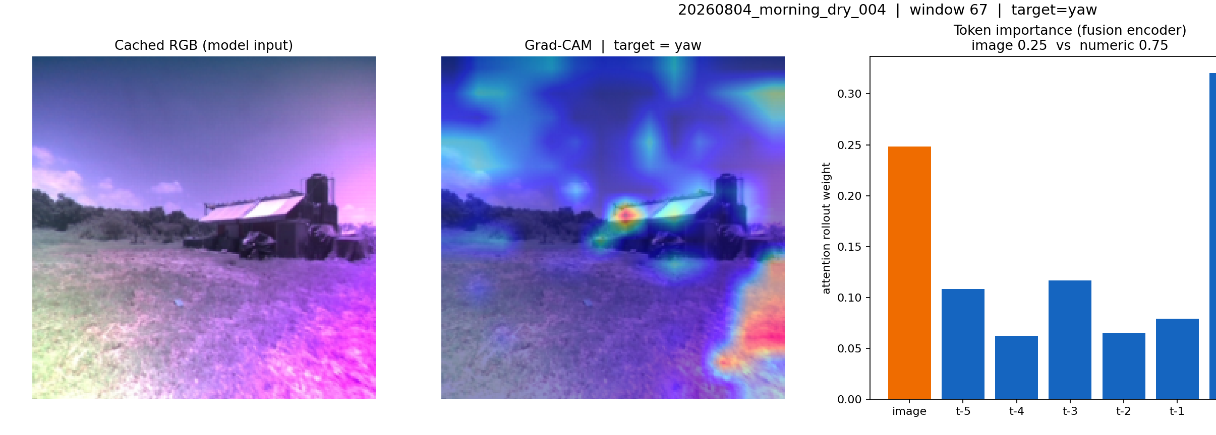
Finding 3 — but WHERE in the image does it look?
Grad-CAM for the turning (yaw) prediction
The observation
Saliency is split between the man-made structure, the horizon/trees, and patches of the sky.
For a ground vehicle, the motion-relevant cue is the ground/terrain — yet a visible share of attention lands above the horizon.
Hypothesis: focusing the model on the ground should make it "right for the right reasons" and improve robustness.
Notes:
This is the pivot of the whole story: a qualitative observation that the model over-attends to irrelevant sky. Next stage turns this into a number and tests the hypothesis.

Slide 6
The research arc
From qualitative observation to a measured intervention
1
Observe
2
Quantify
3
Intervene
Built 3 interpretability views. Model is accurate on dx/yaw, uses the image ~24%, but attention leaks onto the sky.
Measure the fraction of Grad-CAM mass in the sky vs. ground over many samples — a single number, a saliency-to-area ratio.
Attention-guided fine-tune (RobustViT / Right-for-Right-Reasons) that minimizes sky saliency; re-measure focus and accuracy.
DONE
BUILT, READY TO RUN
IMPLEMENTED
Notes:
Stage 2 code and Stage 3 fine-tune are already implemented and tested; they run on Kaggle in one pass on the existing checkpoint. Present Stage 1 as complete, Stage 2-3 as results-in-progress.

Slide 7
Summary
1
Accurate where it counts
R² 0.86 (dx) and 0.93 (yaw) on held-out data; dy is signal-limited noise.
2
Genuinely multimodal
The vision branch carries ~24% of the decision weight — not a token passenger.
3
A concrete weakness to fix
Grad-CAM shows attention leaking onto the sky; the plan quantifies and corrects it.
Methods: Grad-CAM (Selvaraju 2017) · Integrated Gradients (Sundararajan 2017) · Attention Rollout (Abnar 2020) · RobustViT (Chefer, NeurIPS 2022)
Notes:
Close by restating the arc: observation done, quantification and intervention are the next milestones with code already in place.

