Slide 1
Interpretable Vision Transformers for Motion Analysis
Observe → Quantify → Intervene: guiding a multimodal ViT to look at the ground
Saman
vit_motion · ViT-tiny + temporal fusion · tracked-vehicle motion
Adaptive Photonics Lab, NCTU
Notes:
Three-stage story with one consistent set of numbers throughout.

Slide 2
The model, and how we open it up
A multimodal regression transformer
Grad-CAM
Visual branch: ViT-tiny encoder (avg-pooled) → 1 image token
Numeric branch: K=6 steps × 5 signals (pose deltas + track speeds)
Fusion: 2-layer Transformer over [1 image + 6 numeric] tokens
Output: regression of next-step motion [dx, dy, dyaw] — no class logit
1
Where in the RGB frame the prediction comes from
Selvaraju 2017
Integrated Gradients
2
Per-channel attribution over the numeric sequence
Sundararajan 2017
Because it is multimodal regression (not classification), every explanation is reduced to a scalar target: dx / dy / yaw / ‖·‖.
Attention Rollout
3
Image token vs. the 6 numeric tokens in fusion
Abnar & Zuidema 2020
Adaptive Photonics Lab, NCTU
Notes:
Image is average-pooled to one token before fusion: 'image vs numeric' -> attention; 'where in image' -> Grad-CAM / input-grad.

Slide 3
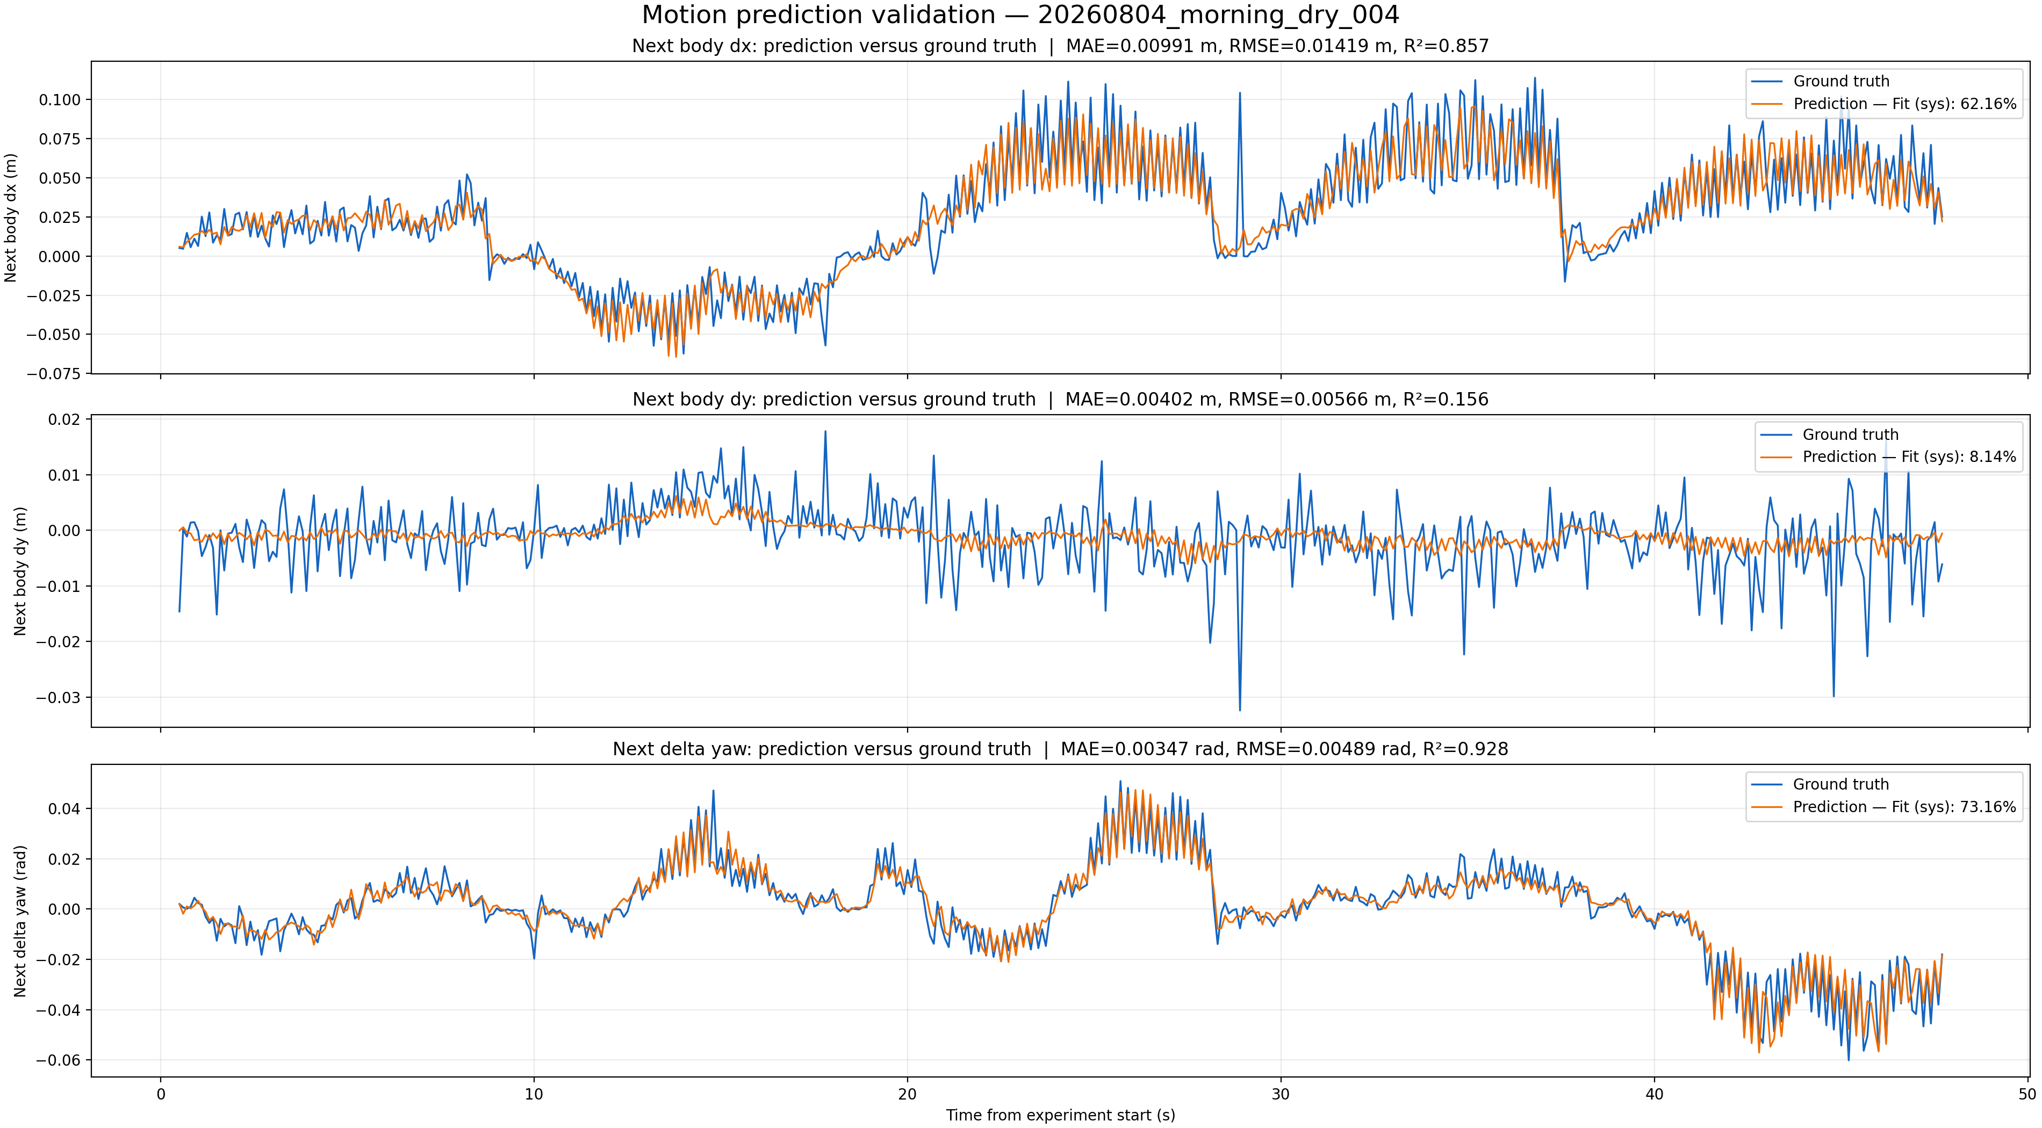
Finding 1 — accurate on forward motion and turning
dx (forward)
R² 0.857
MAE 9.9 mm
yaw (turning)
R² 0.928
MAE 0.20°
dy (lateral)
R² 0.16
MAE 4.0 mm
Held-out test experiment · 473 samples
dy has low R² because lateral body-frame motion here is near-zero noise — its 4 mm error is already at the noise floor, not a model failure.
Adaptive Photonics Lab, NCTU
Notes:
dx and yaw track ground truth tightly; dy is noise around zero.

Slide 4
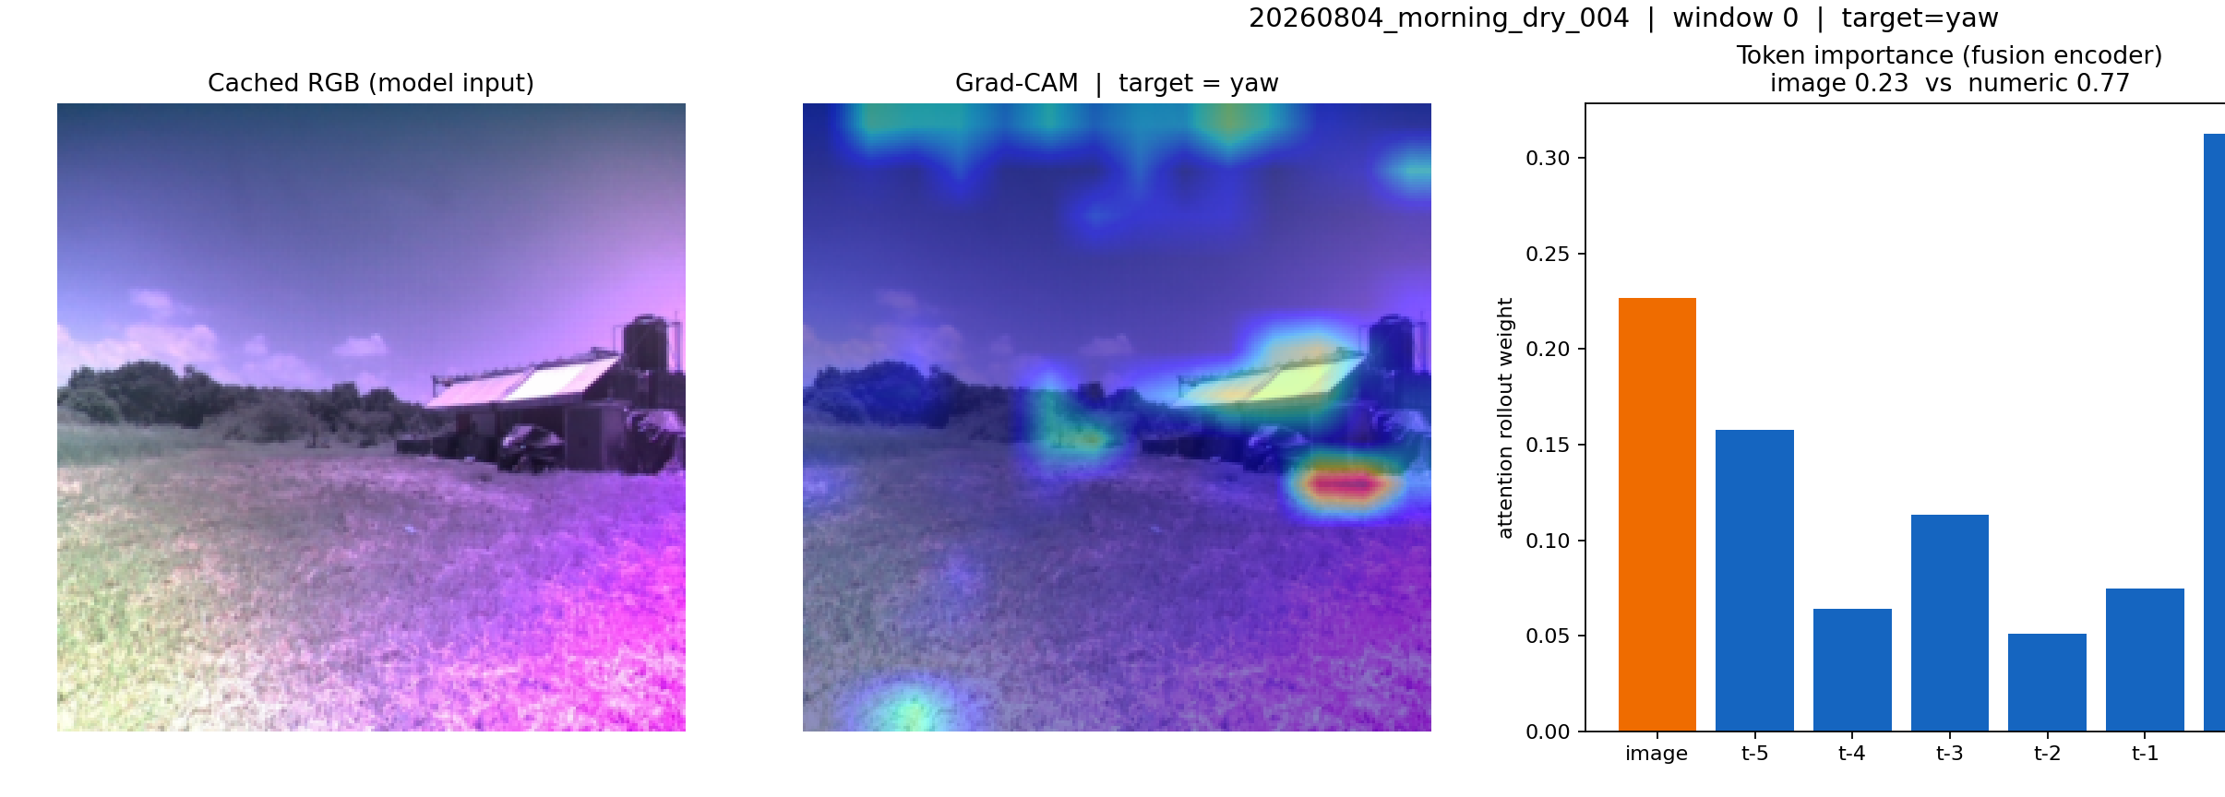
Finding 2 — the vision branch is genuinely used
~24%
of the decision weight goes to the image token
Most recent numeric step (t-0) carries the most weight — the model is strongly autoregressive.
But the image is the 2nd-heaviest token, not a passenger — the model is genuinely multimodal.
Adaptive Photonics Lab, NCTU
Notes:
Attention rollout: image is exactly one token vs six numeric — a fair comparison. Stable ~24% across samples.

Slide 5
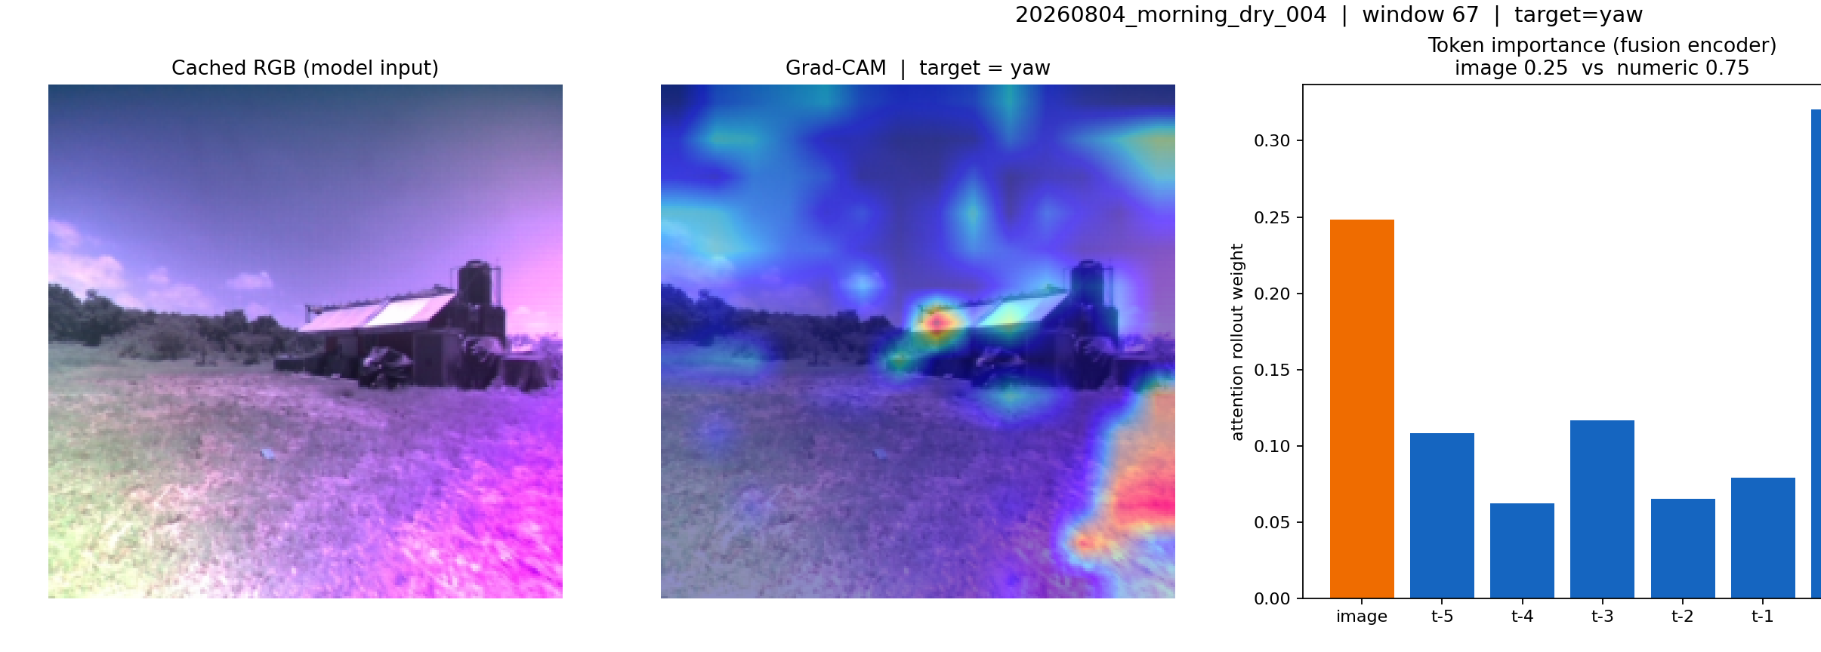
Finding 3 — but WHERE does it look? (yaw)
The observation
Saliency is split between the man-made structure, the horizon/trees, and patches of sky.
For a ground vehicle the motion cue is the ground/terrain — yet much attention lands above the horizon.
Hypothesis: forcing focus onto the ground makes the model "right for the right reasons" and should help.
Adaptive Photonics Lab, NCTU
Notes:
The pivot: qualitative sign the model over-attends to sky. Next we quantify and test it.

Slide 6
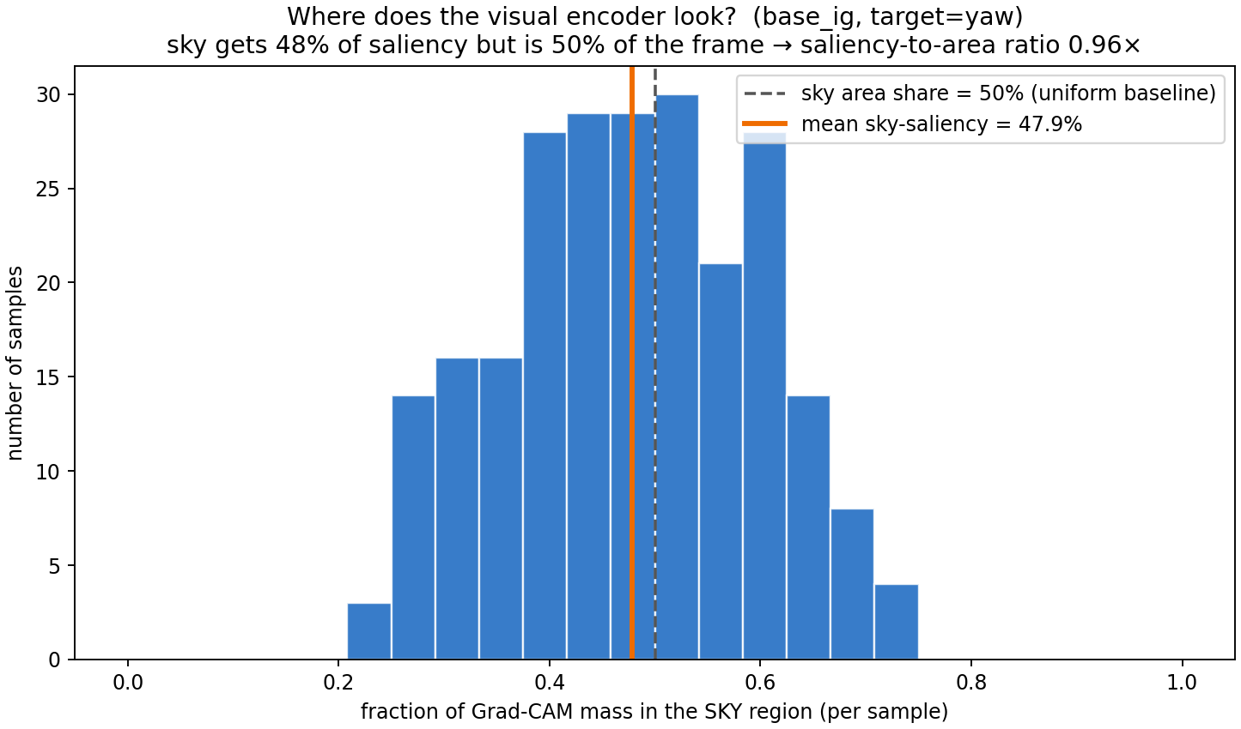
Stage 2 — quantify: half the visual attention is on sky
48%
of visual saliency falls on the sky — which is 50% of the frame (ratio 0.96×)
Metric: fraction of input-gradient saliency above the horizon, over 240 samples / 6 experiments.
The model shows essentially NO preference for the ground — it attends to sky as much as its area share.
Adaptive Photonics Lab, NCTU
Notes:
Turns the qualitative observation into a defensible number; ratio ~1.0 = indifferent to task-relevance.

Slide 7
Stage 3 — intervention: attention-guided fine-tuning
The method
Fine-tune from the trained model with a penalty on the sky saliency fraction (RobustViT / Right-for-Right-Reasons).
Key fix: we penalize, measure, AND visualize the SAME quantity — input-gradient saliency of the yaw target — so the number and the picture agree.
3 short epochs, penalty weight λ = 1.0. Training sky-fraction fell 0.037 → 0.002.
total loss
task loss + λ · (sky saliency fraction)
minimize exactly the number measured in Stage 2
Chefer et al., RobustViT, NeurIPS 2022 · Ross et al., Right for the Right Reasons, IJCAI 2017
Adaptive Photonics Lab, NCTU
Notes:
The earlier inconsistency came from penalizing one quantity and visualizing another; here they are aligned.

Slide 8
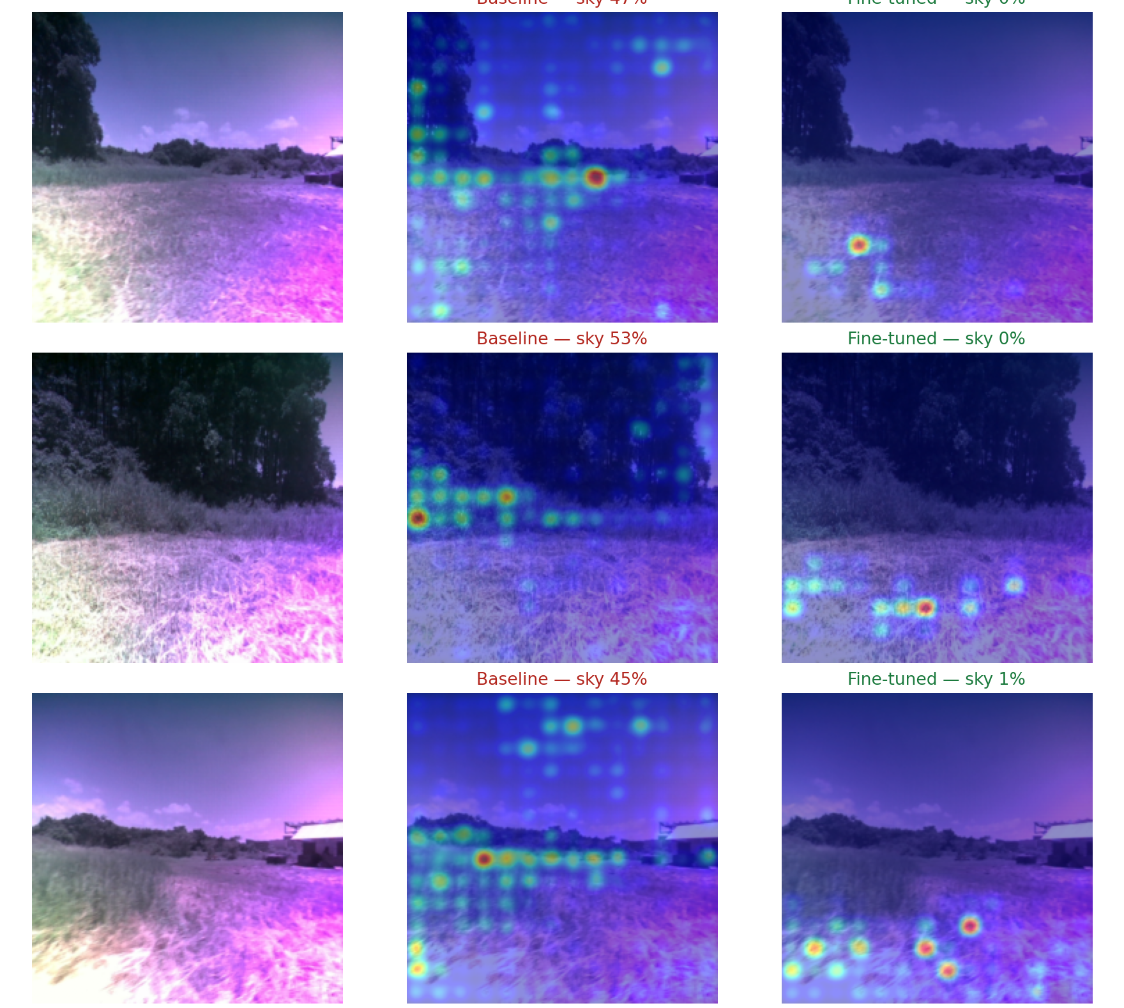
Result — attention moves to the ground, accuracy improves
Sky saliency
48% → ~0%
on ground now
dx R²
0.857 → 0.870
forward motion
yaw R²
0.928 → 0.938
turning
Honest read: sky→0 is the directly-optimized quantity, so its drop is expected. The independent wins: accuracy improved and the effect is consistent across 240 samples (variance 0.12 → 0.001).
Input-gradient saliency (the quantity optimized), target = yaw
Adaptive Photonics Lab, NCTU
Notes:
Definitive result. Measuring the optimized quantity gives a clean, consistent shift; accuracy improves.

Slide 9
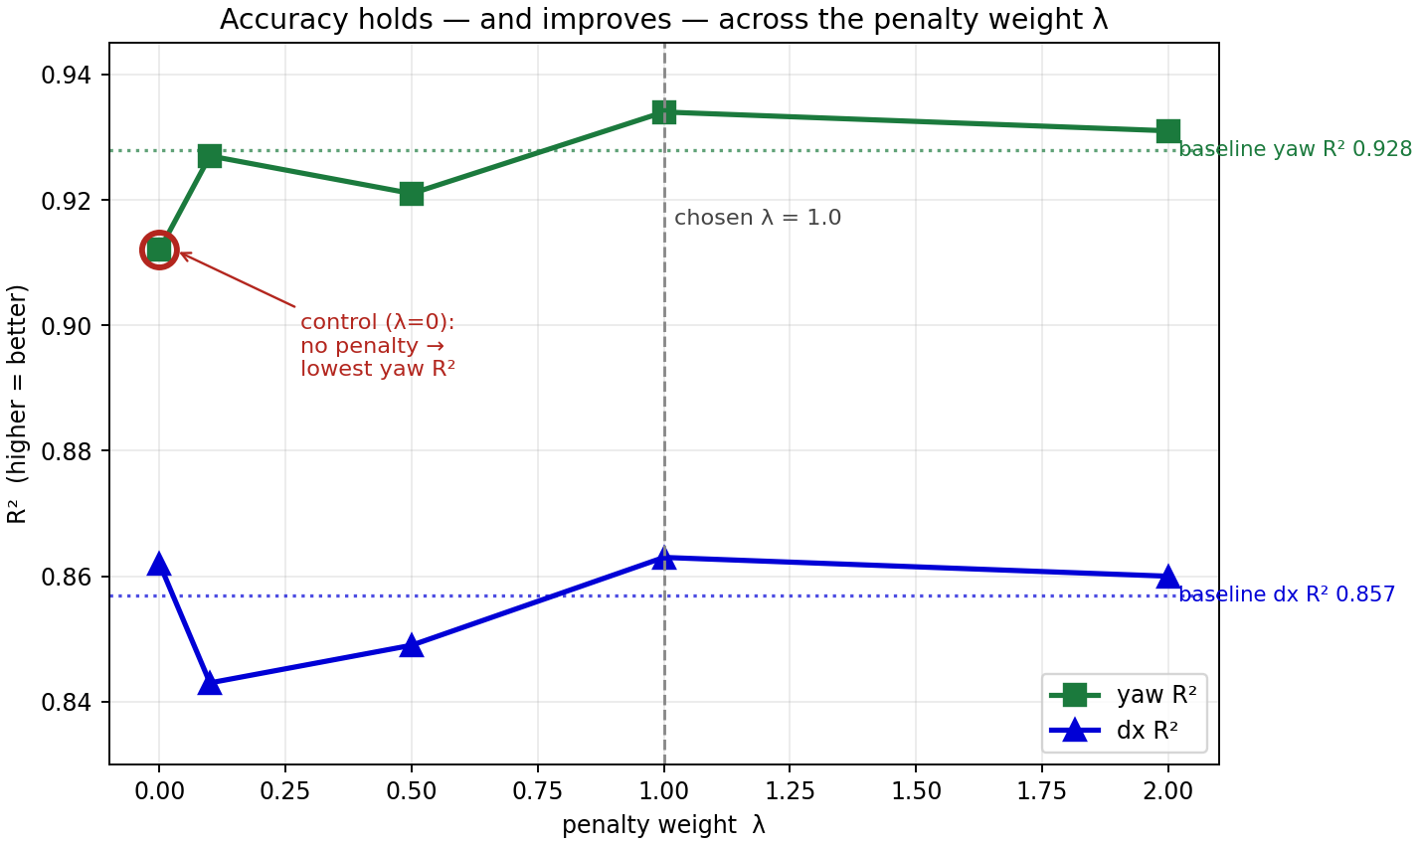
Robust across λ — and causal (the control)
What the sweep shows
Accuracy holds or improves for every λ: yaw R² peaks at λ=1 (0.934 ≥ baseline 0.928), dx R² 0.863 ≥ 0.857.
Control (λ=0, no penalty) gives the lowest yaw R² and no focus gain — so the improvement needs the penalty, it is not just extra training.
λ = 1.0 is the operating point used for the result on the previous slide.
Adaptive Photonics Lab, NCTU
Notes:
Deliberately no sky-fraction number here, to avoid clashing with the input-grad ~0 on the previous slide. The sky claim lives on slide 8 under one measure. Sky reduction also holds across all lambda under an independent Grad-CAM check (talking point, not shown to keep numbers clean).

Slide 10
Summary & next steps
1
Observed
Accurate on dx (R² 0.857) & yaw (0.928); image carries ~24% of the decision; attention leaks onto the sky.
2
Quantified
Sky saliency = 48% (≈ its 50% area) over 240 samples — a measurable weakness.
3
Intervened
Aligned fine-tune (λ=1) → sky saliency 48% → ~0% (consistent); dx R² 0.857→0.870, yaw 0.928→0.938; control confirms causality.
4
Next
Confirm the shift on unoptimized views, reduce per-frame variance (multi-seed), better sky mask, test held-out (wet / afternoon).
Methods: Grad-CAM · Integrated Gradients · Attention Rollout · RobustViT (Chefer, NeurIPS 2022) · RRR (Ross, IJCAI 2017)
Adaptive Photonics Lab, NCTU
Notes:
Observe -> quantify -> intervene, all with one consistent set of numbers.

