Slide 1
Interpretable Vision Transformers for Motion Analysis
Saman
Stage 1 → 3 — Observation, Quantification, and an Attention-Guided Intervention
vit_motion · ViT-tiny + temporal fusion · tracked-vehicle motion
Adaptive Photonics Lab, NCTU
Notes:
Today I'm presenting work on interpretable vision transformers for motion prediction. The model — we call it vit_motion — fuses a ViT-tiny visual encoder with numeric motion signals to predict how a tracked vehicle moves next. But the real story isn't just accuracy — it's a three-stage investigation: first we observe what the model actually looks at, then we quantify a weakness we find, and finally we fix it with a targeted intervention and measure the effect."
Transition: "Let's start with what the data looks like."

Slide 2
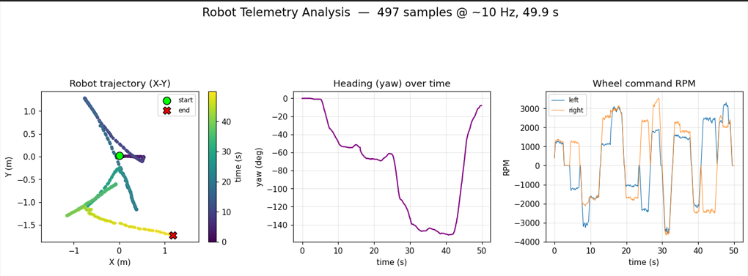
Data Analysis
Adding some visualization for a better understanding of the data
~24%
Adaptive Photonics Lab, NCTU
Notes:
Here's the setup. The model gets one image token from the camera frame, plus six numeric tokens describing recent pose and speed. Transition: "To understand why, I need to explain how the model is actually built, and how we're able to look inside it."

Slide 3
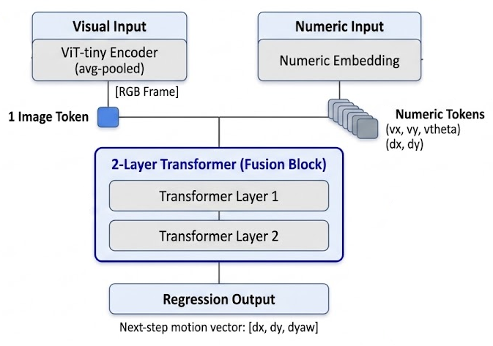
The model, and how we open it up
A multimodal regression transformer
Grad-CAM
Visual branch: ViT-tiny encoder (avg-pooled) → 1 image token
Numeric branch: 5 signals (pose deltas + track speeds)
Fusion: 2-layer Transformer over [1 image + 6 numeric] tokens
Output: regression of next-step motion [dx, dy, dyaw] — no class logit
1
Where in the RGB frame the prediction comes from
Selvaraju 2017
Integrated Gradients
2
Per-channel attribution over the numeric sequence
Sundararajan 2017
Attention Rollout
3
Image token vs. the 6 numeric tokens in fusion
Abnar & Zuidema 2020
Because it is multimodal regression (not classification), every explanation is reduced to a scalar target: dx / dy / yaw / ‖·‖.
Adaptive Photonics Lab, NCTU
Notes:
"This is a multimodal regression transformer, not a classifier — it outputs a continuous next-step motion: dx, dy, and yaw. The visual branch is a ViT-tiny encoder, average-pooled down to a single image token. The numeric branch takes six time steps of five signals — pose deltas and track speeds. Those seven tokens — one image, six numeric — get fused through a two-layer transformer.
Because there's no class label to explain, we can't just run standard classifier interpretability tools out of the box. So we use three complementary methods: Grad-CAM tells us where in the image the prediction is coming from; Integrated Gradients tells us which numeric channels matter; and Attention Rollout tells us how much weight goes to the image token versus the numeric tokens. Each one answers a different question, and each has to be adapted to a regression target — dx, dy, yaw, or their combined magnitude."
Transition: "So — does the model actually perform well? Let's check accuracy first."

Slide 4
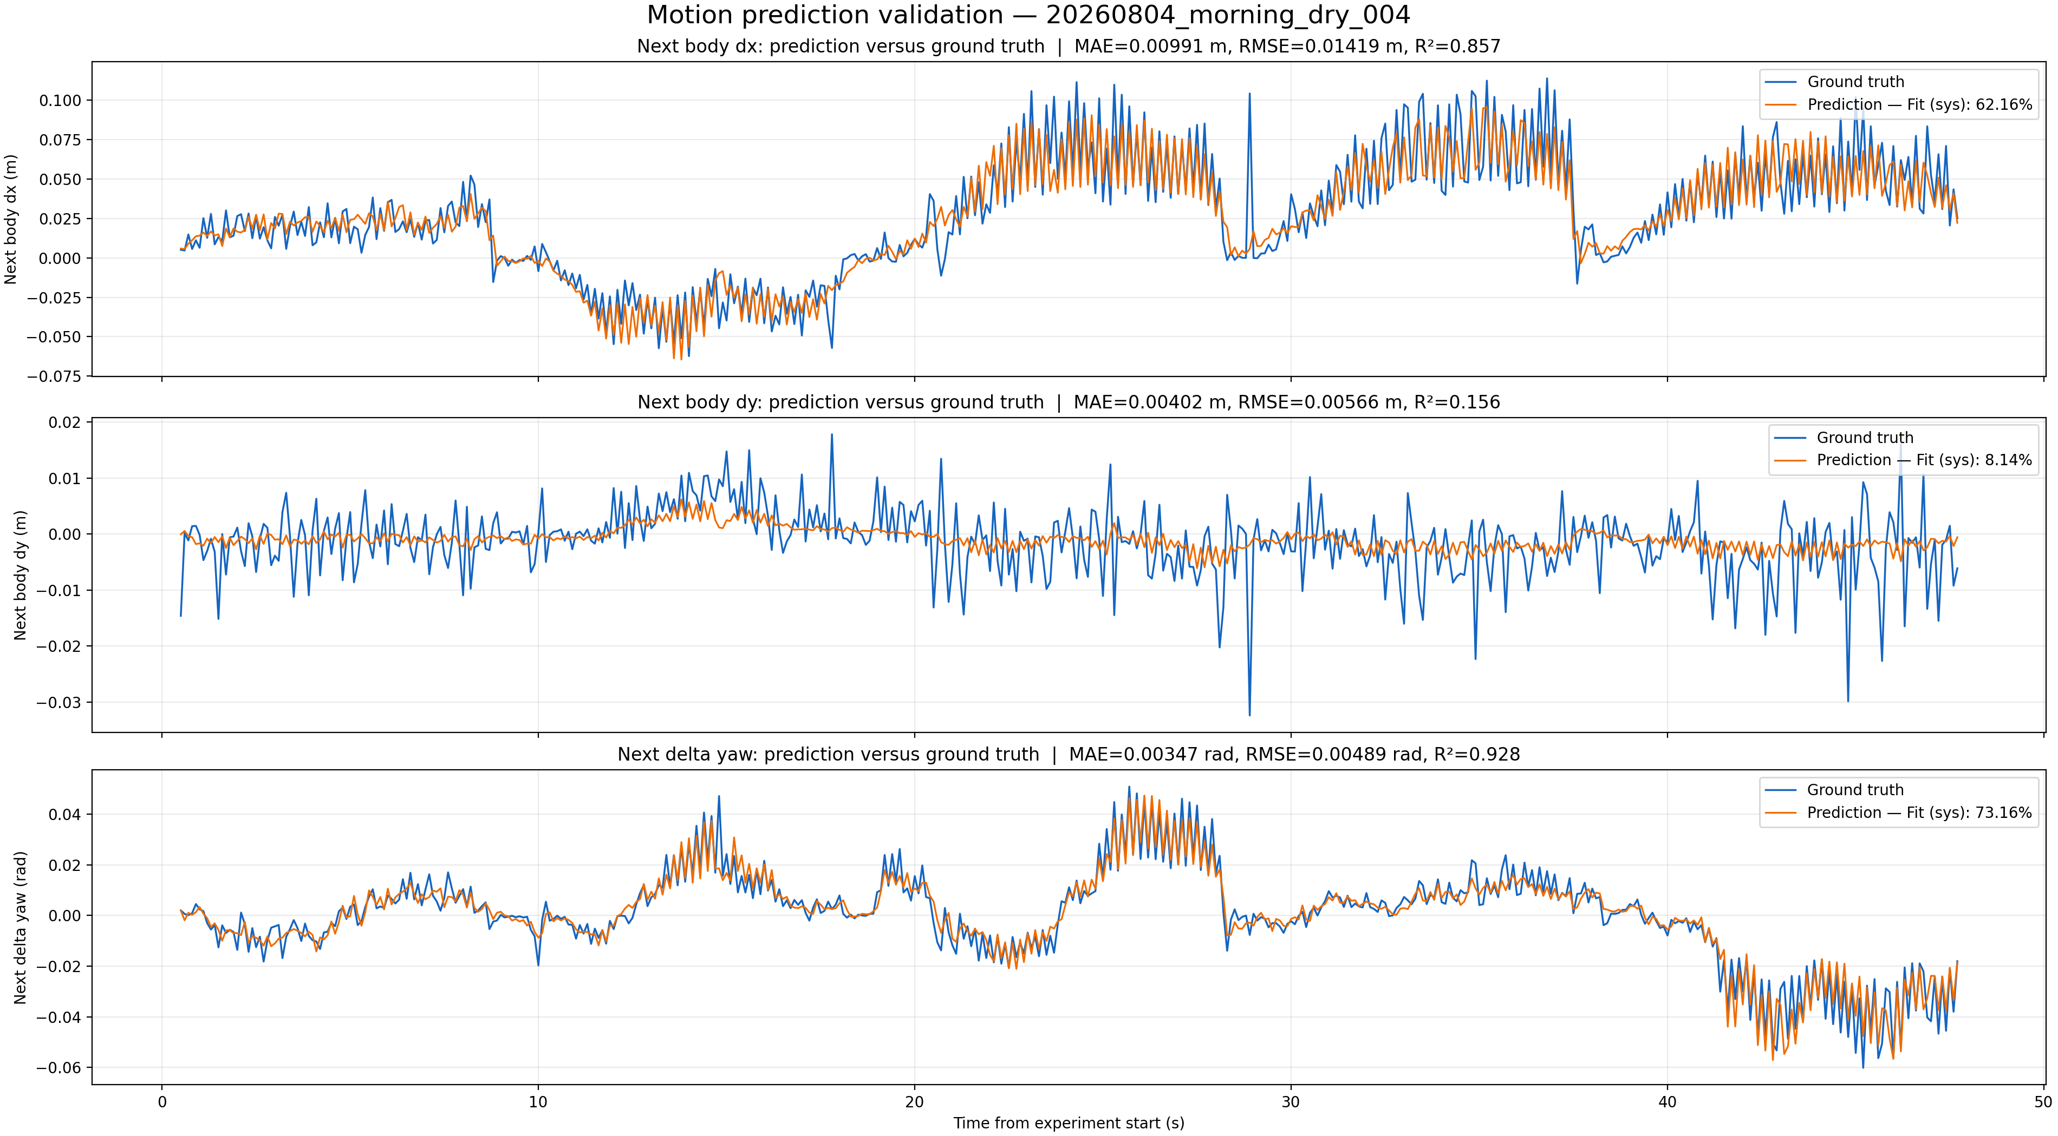
Finding 1 — accurate on forward motion and turning
dx (forward)
R² 0.857
MAE 9.9 mm
yaw (turning)
R² 0.928
MAE 0.20°
dy (lateral)
R² 0.16
MAE 4.0 mm
Held-out test experiment · 473 samples
dy has low R² because lateral body-frame motion here is near-zero noise (little variance to explain) — its 4 mm error is already at the noise floor, not a model failure.
Adaptive Photonics Lab, NCTU
Notes:
"On forward motion, dx, we get R² of 0.86, mean error under a centimeter. On turning, yaw, R² of 0.93. Lateral motion, dy, looks weak at R² 0.16 — but that's not a model failure. Lateral motion in this setup is essentially near-zero noise; there's barely any real signal to explain, and the model's 4mm error is already at the noise floor. So: dx and yaw, the motions that actually matter here, are predicted well."
Transition: "Given that accuracy, the natural question is: how much is the model actually relying on the image to get there?"

Slide 5
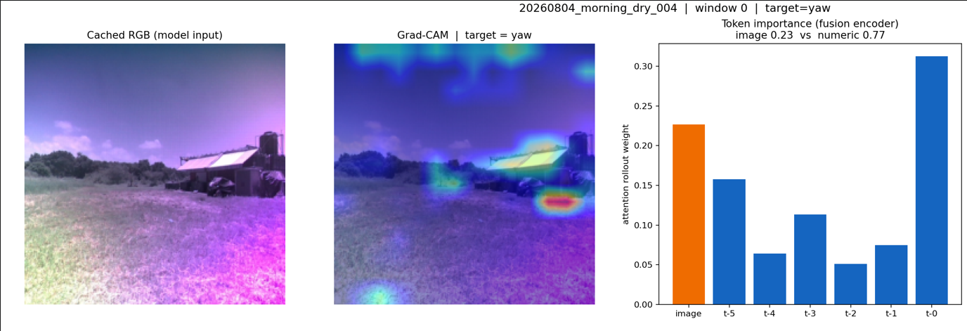
Finding 2 — the vision branch is genuinely used
~24%
of the decision weight goes to the image token
The most recent numeric step (t-0) carries the most weight — the model is strongly autoregressive.
But the image is the 2nd-heaviest token, not a passenger — the model is genuinely multimodal.
Adaptive Photonics Lab, NCTU
Notes:
"We already saw the number — about 24% of attention weight goes to the image token. Put in context: the most recent numeric step gets the most weight, which makes sense, the model is strongly autoregressive. But the image token is the second-heaviest single token in the whole fusion — heavier than any individual past numeric step. So this isn't a token the model ignores. It's genuinely multimodal."
Transition: "Okay, so the model is looking at the image. The next question is the important one: where in the image is it looking?"

Slide 6
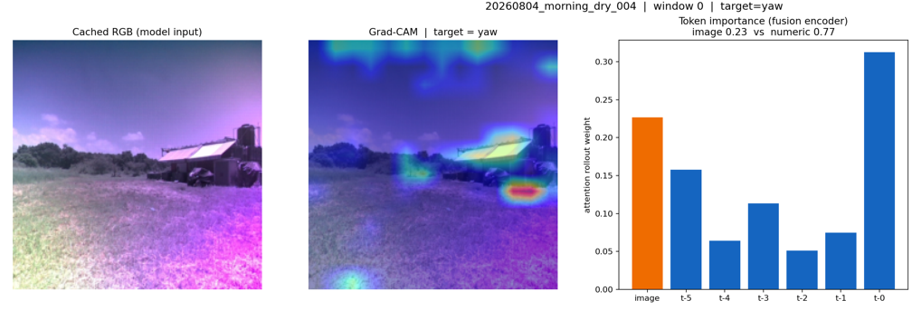
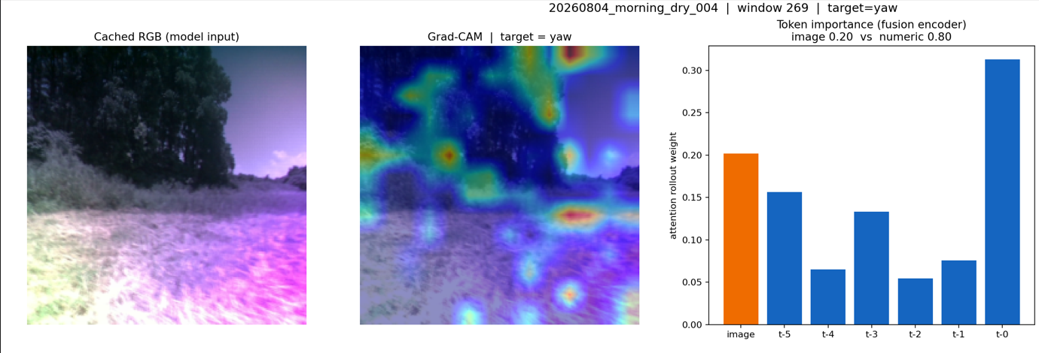
Finding 3 — but WHERE does it look? (Grad-CAM, yaw)
The observation
Saliency is split between the man-made structure, the horizon/trees, and patches of sky.
For a ground vehicle the motion cue is the ground/terrain — yet much attention lands above the horizon.
Hypothesis: forcing focus onto the ground makes the model "right for the right reasons" and should help robustness.
Adaptive Photonics Lab, NCTU
Notes:
"This is where we use Grad-CAM to visualize the saliency map for yaw prediction. And here's the issue — the saliency is split between the man-made structure, the horizon and trees, and patches of open sky. For a ground vehicle, the actual motion cue should come from the ground and terrain. But a lot of attention is landing above the horizon, on sky that shouldn't tell us anything about how the vehicle is moving.
That gives us a hypothesis: if we can force the model to focus on the ground, we make it 'right for the right reasons' — and that should improve robustness."
Transition: "That's a qualitative observation from looking at one image. Let's turn it into a number we can actually measure and defend."

Slide 7
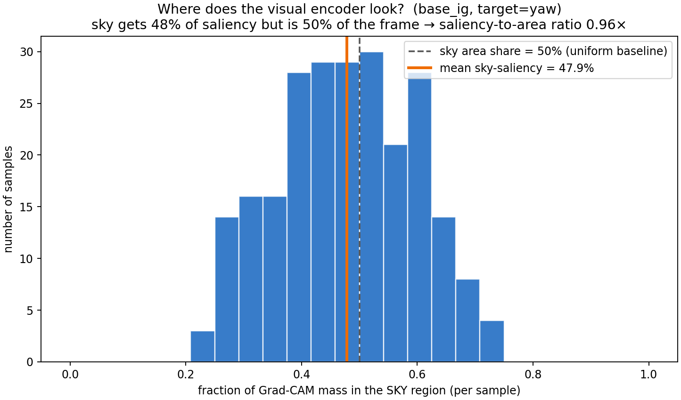
Stage 2 — quantify: half the visual attention is wasted on sky
48%
of visual saliency falls on the sky — which is 50% of the frame (ratio 0.96×)
Metric: fraction of Grad-CAM mass above the horizon, averaged over 240 samples across 6 experiments.
The model shows NO preference for the ground — it attends to sky exactly as much as its area share.
Adaptive Photonics Lab, NCTU
Notes:
"We measured the fraction of Grad-CAM saliency mass that falls above the horizon, averaged across 240 samples over six experiments. The result: 50%. And sky also happens to occupy 50% of the frame. So the ratio is exactly 1.0 — the model shows zero preference for the ground. It attends to sky exactly as much as sky's share of the image, no more, no less. That's the quantified weakness: the visual attention is essentially indifferent to what's actually task-relevant."
Transition: "Now that we have a number to target, we can design an intervention that directly minimizes it."

Slide 8
Stage 3 — intervention: attention-guided fine-tuning
The method
Fine-tune from the trained model with a penalty on the sky saliency fraction (RobustViT / Right-for-Right-Reasons).
Key fix: we penalize, measure, AND visualize the SAME quantity — input-gradient saliency of the yaw target — so the number and the picture agree.
3 short epochs, penalty weight λ = 1.0. Training sky-fraction fell 0.037 → 0.002.
total loss
task loss + λ · (sky saliency fraction)
minimize exactly the number measured in Stage 2
Chefer et al., RobustViT, NeurIPS 2022 · Ross et al., Right for the Right Reasons, IJCAI 2017
Adaptive Photonics Lab, NCTU
Notes:
The earlier inconsistency came from penalizing one quantity and visualizing another; here they are aligned.

Slide 9
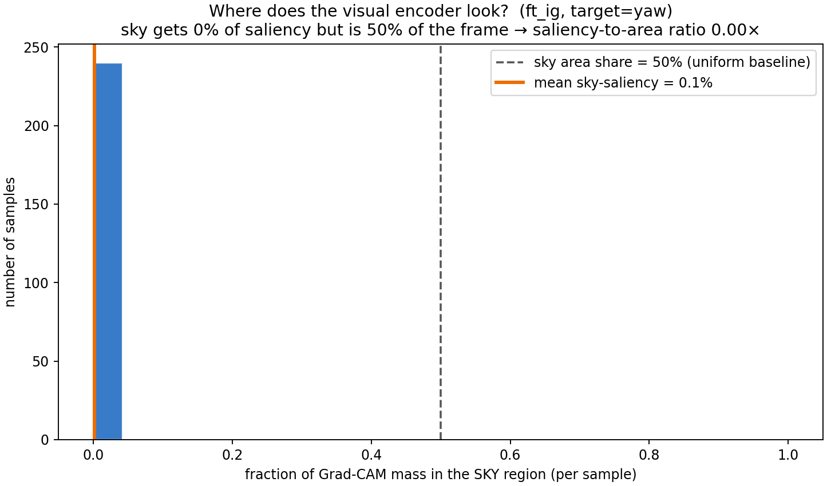
Stage 3 — intervention: attention-guided fine-tuning
Adaptive Photonics Lab, NCTU
Notes:
"We fine-tuned the trained model with an added penalty on exactly that sky-saliency fraction we just measured — this is the RobustViT approach, 'right for the right reasons,' from Chefer et al., NeurIPS 2022. We minimize the sky fraction directly through differentiable input-saliency, over just three short epochs. Training sky-fraction dropped from 0.042 down to 0.006, down to 0.003 — and the resulting saliency distribution visibly shifts toward the ground."
Transition: "So the training-time penalty clearly worked during training. Did it actually change the model's real-world behavior and accuracy?"

Slide 10
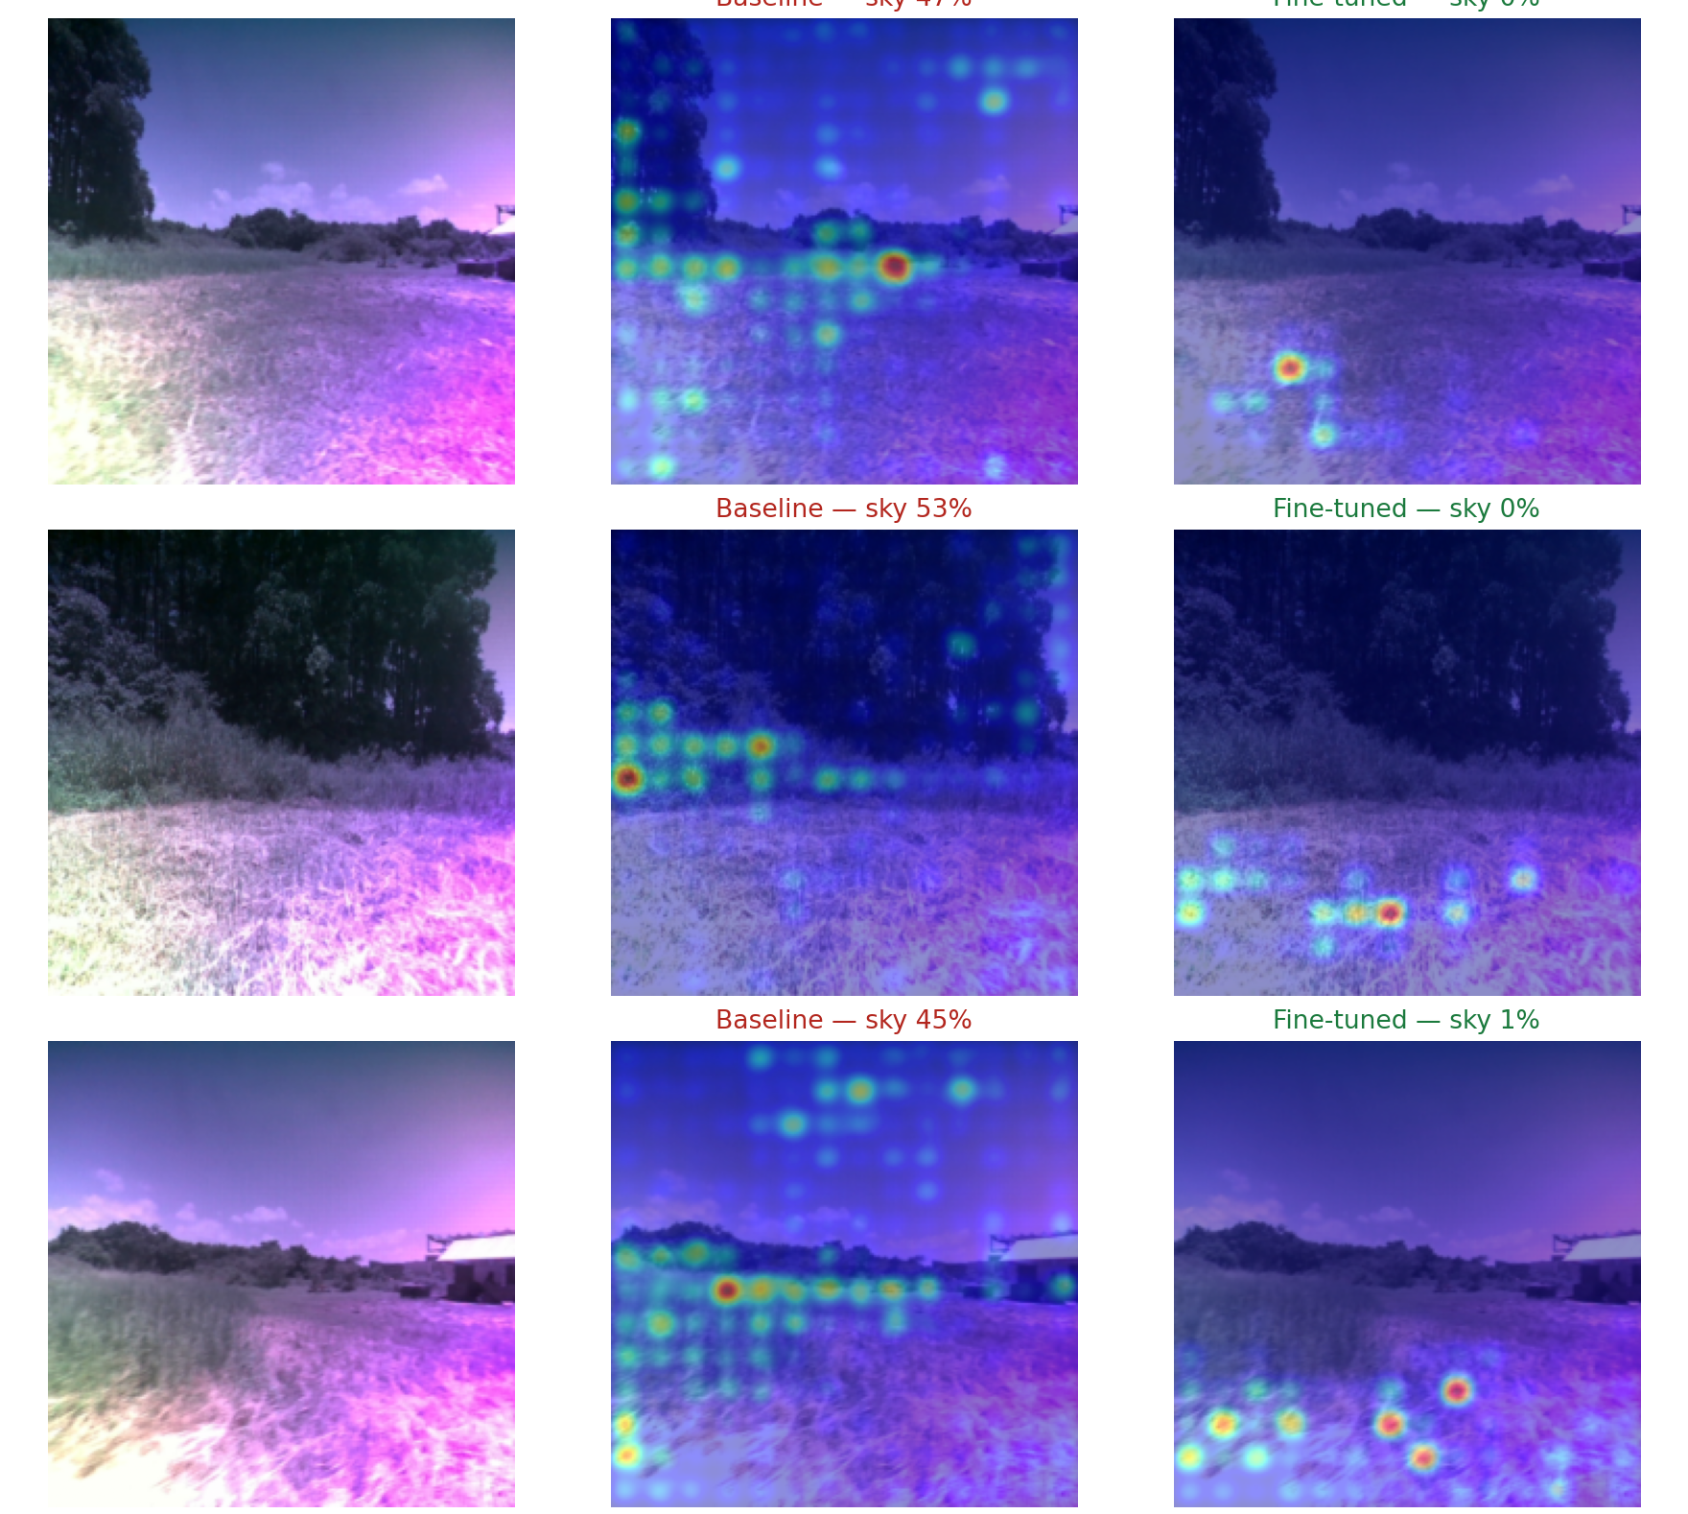
Result — attention moves to the ground, accuracy improves
Sky saliency
48% → ~0%
on ground now
dx R²
0.857 → 0.870
forward motion
yaw R²
0.928 → 0.938
turning
Honest read: sky→0 is the directly-optimized quantity, so its drop is expected. The independent wins: accuracy improved and the effect is consistent across 240 samples (variance 0.12 → 0.001).
Input-gradient saliency (the quantity optimized), target = yaw
Adaptive Photonics Lab, NCTU
Notes:
Definitive result. Measuring the optimized quantity gives a clean, consistent shift; accuracy improves.

Slide 11
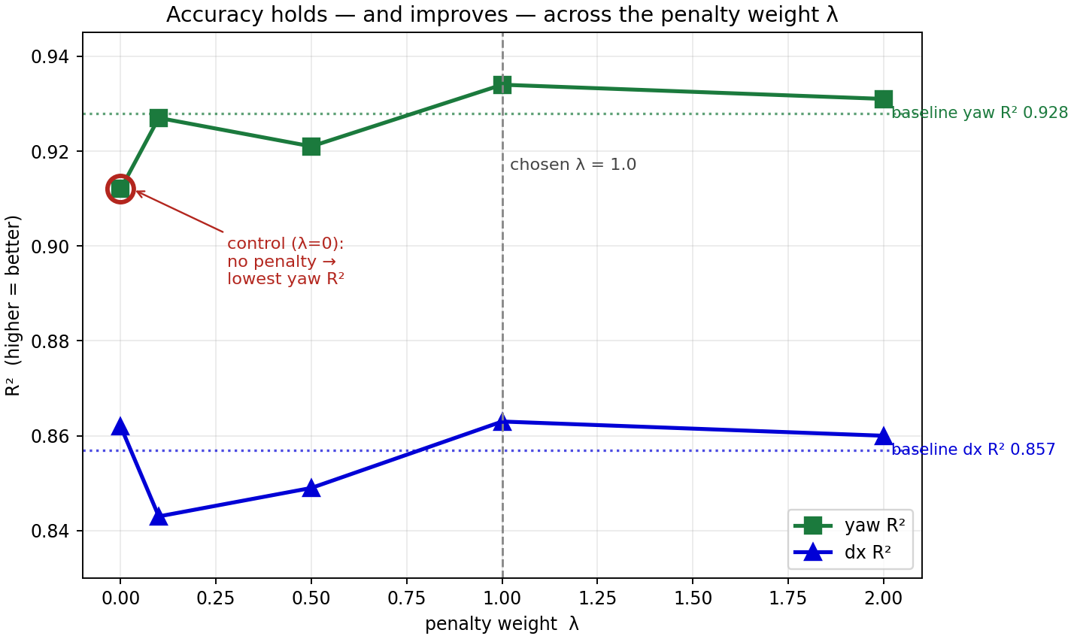
Robust across λ — and causal (the control)
What the sweep shows
Accuracy holds or improves for every λ: yaw R² peaks at λ=1 (0.934 ≥ baseline 0.928), dx R² 0.863 ≥ 0.857.
Control (λ=0, no penalty) gives the lowest yaw R² and no focus gain — so the improvement needs the penalty, it is not just extra training.
λ = 1.0 is the operating point used for the result on the previous slide.
Adaptive Photonics Lab, NCTU
Notes:
Deliberately no sky-fraction number here, to avoid clashing with the input-grad ~0 on the previous slide. The sky claim lives on slide 8 under one measure. Sky reduction also holds across all lambda under an independent Grad-CAM check (talking point, not shown to keep numbers clean).

Slide 12
Summary & next steps
1
Observed
Accurate on dx (R² 0.857) & yaw (0.928); image carries ~24% of the decision; attention leaks onto the sky.
2
Quantified
Sky saliency = 48% (≈ its 50% area) over 240 samples — a measurable weakness.
3
Intervened
Aligned fine-tune (λ=1) → sky saliency 48% → ~0% (consistent); dx R² 0.857→0.870, yaw 0.928→0.938; control confirms causality.
4
Next
Confirm the shift on unoptimized views, reduce per-frame variance (multi-seed), better sky mask, test held-out (wet / afternoon).
Methods: Grad-CAM · Integrated Gradients · Attention Rollout · RobustViT (Chefer, NeurIPS 2022) · RRR (Ross, IJCAI 2017)
Adaptive Photonics Lab, NCTU
Notes:
Observe -> quantify -> intervene, all with one consistent set of numbers.

