Slide 1
Making a Motion Transformer focus on the Ground
Saman
v0.3 — region-guided attention with a spread constraint, and an honest re-test of v1
vit_motion · ViT-tiny + temporal fusion · tracked-vehicle motion
Adaptive Photonics Lab, NCTU
Notes:
One collection, 63 runs, 31,864 rows. Every number in this deck is measured on 4,927 held-out rows the model never saw.

Slide 2
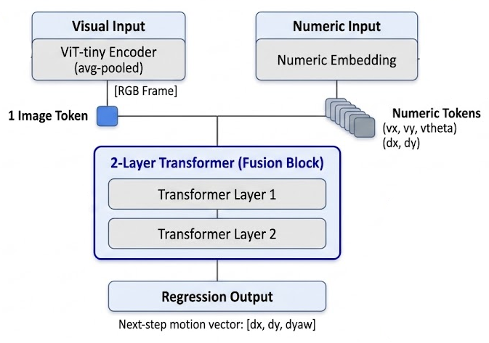
The model, and the one quantity we probe it with
1
Visual branch
The probe
ViT-tiny encoder, average-pooled to a single image token, refreshed every 4th step.
saliency = | ∂ target / ∂ image |
2
Numeric branch
summed over colour channels, target = yaw.
K = 6 past steps × 5 signals — pose deltas and track speeds.
This is the SAME quantity we penalize, measure and draw. In v1 the penalty and the picture were different quantities, so the number and the heatmap could disagree without either being wrong.
3
Fusion & head
2-layer transformer over [1 image + 6 numeric] tokens → regression of [dx, dy, dyaw].
Because this is multimodal regression and not classification, every explanation is reduced to one scalar target.
Grad-CAM (Selvaraju 2017) · Integrated Gradients (Sundararajan 2017) · Attention Rollout (Abnar & Zuidema 2020)
Adaptive Photonics Lab, NCTU
Notes:
The alignment point matters: penalize, measure and visualize the same scalar. Everything downstream depends on it.

Slide 3
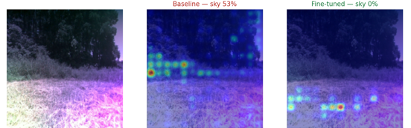
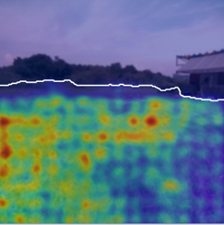
What v1 claimed, and what the re-test found
v1 claimed
v0.3 finds
Sky saliency 48% → ~0%
True — but that region was never the ground
Accuracy improves: yaw R² 0.928 → 0.938
Does not survive. A no-penalty control with the same extra epochs scores 0.852, the best of six arms
The control confirms the penalty caused it
The control confirms the opposite: the movement comes from the extra epochs
“The top half of the frame” ≈ the useless region
Audited against depth: 24% of that half is near ground, and its IoU with the sky is 0.19
And one failure v1 never measured: driving the sky share to zero collapsed the attention onto a handful of ground pixels — coverage 0.89 → 0.25.
Adaptive Photonics Lab, NCTU
Notes:
Lead with this. The advisor trusts the rest of the deck more once the previous claim has been retracted explicitly.

Slide 4
One collection, and a held-out design that names its runs
63
82 / 18
45 / 55
runs / 31,864 rows
wet / dry split
dry / wet per epoch
four days, every run with aligned depth
dry numbers reported apart, never pooled into a headline
hierarchical balanced sampling — no runs deleted
held-out group | runs | rows | what it tests
unseen_day_wet | 4 | 1,947 | a whole wet day the model never saw
unseen_runs_dry | 2 | 966 | dry runs from days it did train on
unseen_runs_wet | 4 | 2,014 | the same for wet
validation | 6 | 3,016
train | 47 | 23,871
No whole dry day is held out: the only pure dry day carries 75% of all the dry data, and removing it would leave 1.5k dry rows to train on.
Adaptive Photonics Lab, NCTU
Notes:
Groups are reported apart because they fail for different reasons: a new day tests appearance shift, new runs test trajectory variety.

Slide 5
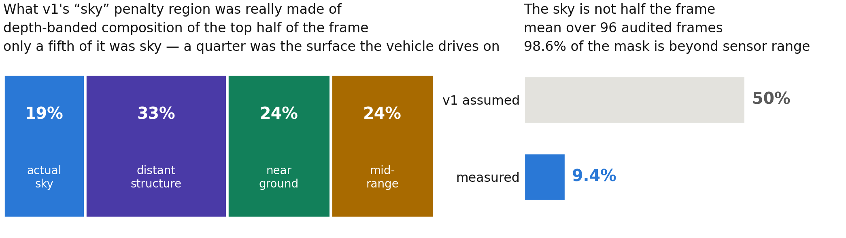
“The top half” was never “the useless part”
1.00
0.19
24%
0.986
of the sky IS inside the top half
IoU between the top half and the sky
of the top half is near ground
of our sky mask is beyond sensor range
Depth gives a check no learned mask can give itself: real sky must return nothing. It cannot separate sky from a distant tower — so it is used as an upper bound, not a label.
Adaptive Photonics Lab, NCTU
Notes:
half_recall_of_sky = 1.00 with IoU 0.19 means the top half contains all the sky and is five times too big. 24% of it is the surface the vehicle drives on.

Slide 6
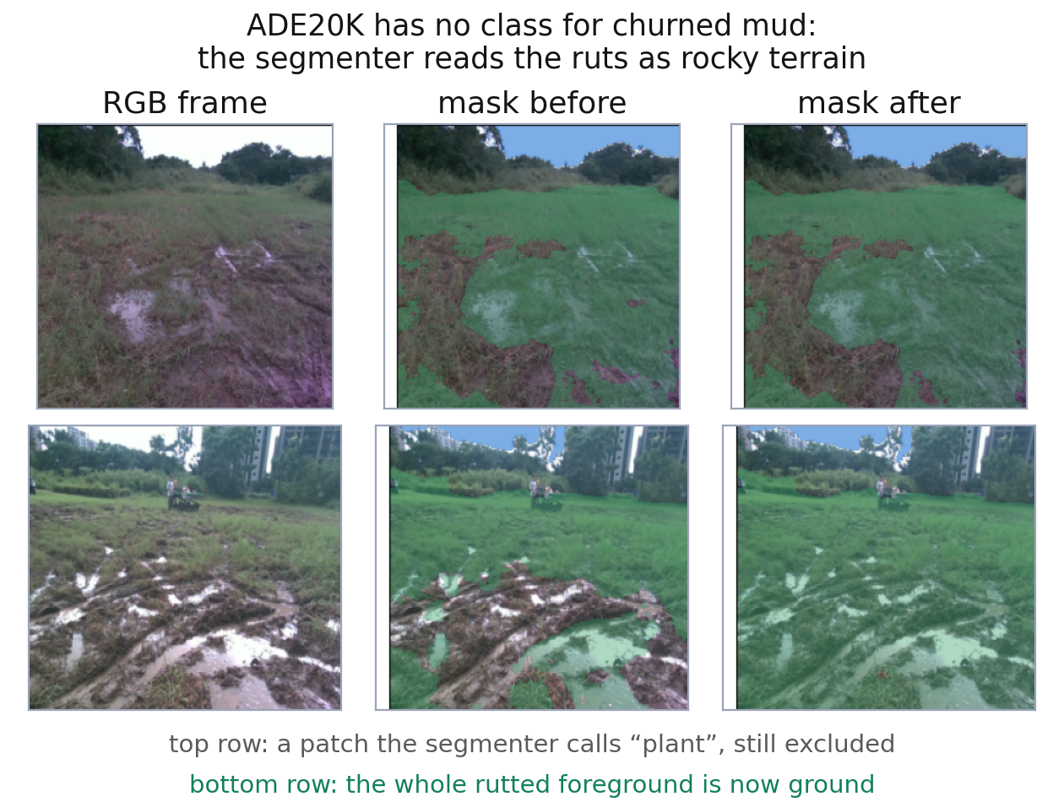
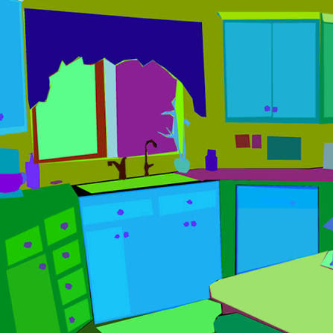
The ground class list is diagnosed, not guessed
SegFormer-b0 on ADE20K → sky / ground / other, cached once per frame at 224×224.
Only a semantic segmenter can say “this is drivable terrain”. A sky detector can only say “this is not sky”, which lumps trees and buildings in with the grass.
The code refuses a non-ground penalty on a cache without a real ground channel.
The class list is measured, not guessed.
Sampling 189 frames and asking the segmenter what it calls the terrain band: mountain and rock fire on the ruts in front of the vehicle — 2.0% and 1.5% of the lower band, and 0.06% / 0.04% of the upper band. There is no mountain in these scenes.
Adaptive Photonics Lab, NCTU
Notes:
The bias test is the control: tree scores 0.0 and building 0.0 because they belong at the top of the frame. plant scores 1.3 and was deliberately NOT added.

Slide 7
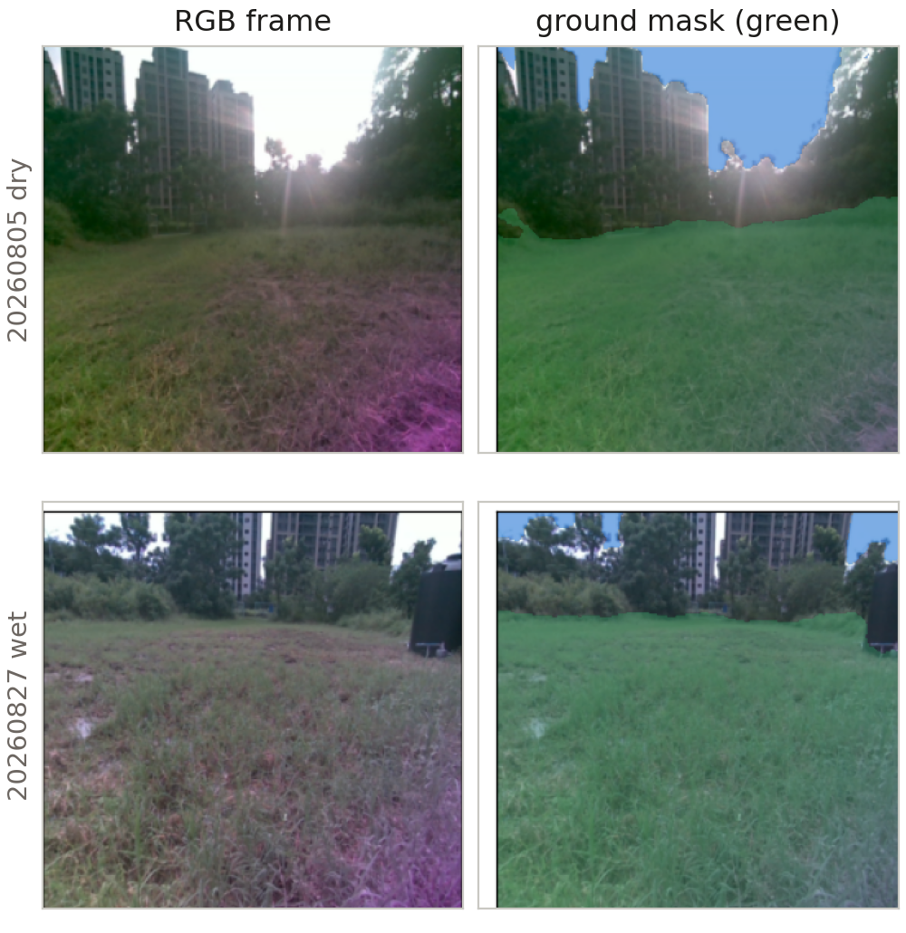
The mask is gated before any GPU time is spent
1.2%
of frames untrusted
excluded from the guidance — never from training
52
frames rescued
white-balanced and contrast-equalised, then re-masked
68.2%
of a frame is ground
predicted 0.68 from the class diagnosis, before measuring
Penalizing “everything except this 4% sliver” is worse than not guiding that frame at all — so implausible masks are marked and skipped, and the count is reported.
Adaptive Photonics Lab, NCTU
Notes:
The gate ran before training: mean ground area, untrusted share, per-day trusted fraction. All passed.

Slide 8
Two terms: where to look, and how widely
total loss = task loss + λ_rrr · placement + λ_spread · spread
placement
spread
the share of saliency that falls outside the ground mask
λ _spread = 1 − H(saliency | ground) / log N_ground
What v1 optimized — with a better region. On its own it is satisfiable by looking at one blade of grass.
The term v1 was missing. It says be spread out INSIDE, not just don’t be outside.
We optimize the entropy and report coverage = exp(H) / N , the effective share of the terrain the attention covers. The split is deliberate: coverage’s gradient vanishes in exactly the collapsed regime we need to escape.
Ross et al., Right for the Right Reasons, IJCAI 2017 · Chefer et al., RobustViT, NeurIPS 2022
Adaptive Photonics Lab, NCTU
Notes:
The two-term split is the contribution. Everything else is machinery to make it measurable.

Slide 9
Five fine-tunes from one base model
run | penalty region | λ_rrr | λ_spread | what it isolates
v1_tophalf | fixed top half | 1.0 | 0 | reproduces v1 — so its collapse is measured, not asserted
sky_only | sky | 1.0 | 0 | is removing the sky enough?
nonground | everything not ground | 1.0 | 0 | the right region, without the spread term
guided | everything not ground | 1.0 | 0.5 | the proposed method
control | — | 0 | 0 | the same 3 extra epochs, no penalty at all
control is the arm that makes the accuracy claim falsifiable.
Without it, any accuracy movement over the base model would be credited to the penalty, when three extra epochs would have produced it anyway. v1 had no such arm.
Adaptive Photonics Lab, NCTU
Notes:
All five start from the same base checkpoint, 3 epochs, 200 steps, target = yaw. The base model never sees a mask.

Slide 10
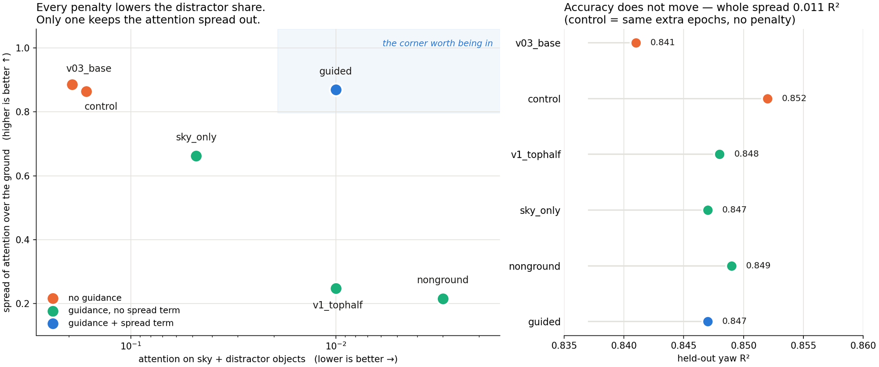
Lowering the distractor share is easy. Keeping the spread is not.
Left: up and to the right is “looks at the terrain, and at all of it”. Right: the whole accuracy span across six arms is 0.011 R².
Adaptive Photonics Lab, NCTU
Notes:
Read the left panel first. Lowering the distractor share is not the finding — a penalty on a region always does that. The finding is what it cost.

Slide 11
The numbers for every model
run | distractor ↓ | concentrate ↑ | Coverage of ground ↑ | top 10% ↓ | yaw R²
v03_base | 0.193 | 1.34 | 0.886 | 0.217 | 0.841
control | 0.165 | 1.38 | 0.864 | 0.234 | 0.852
v1_tophalf | 0.010 | 1.65 | 0.248 | 0.666 | 0.848
sky_only | 0.048 | 1.58 | 0.662 | 0.354 | 0.847
nonground | 0.003 | 1.66 | 0.215 | 0.737 | 0.849
guided | 0.010 | 1.65 | 0.869 | 0.197 | 0.847
guided, against the base model
19×
less attention on sky and objects
0.869
coverage kept — base is 0.886
0.197
top-decile share, BELOW the base model’s 0.217
nonground and v1_tophalf win the distractor column and lose the experiment: 74% and 67% of all their attention sits in a tenth of the pixels. guided is not merely as spread as the unguided model — it is slightly more so.
Adaptive Photonics Lab, NCTU
Notes:
240 samples per arm, 8 held-out experiments, 30 frames each. Untrusted frames are excluded.

Slide 12
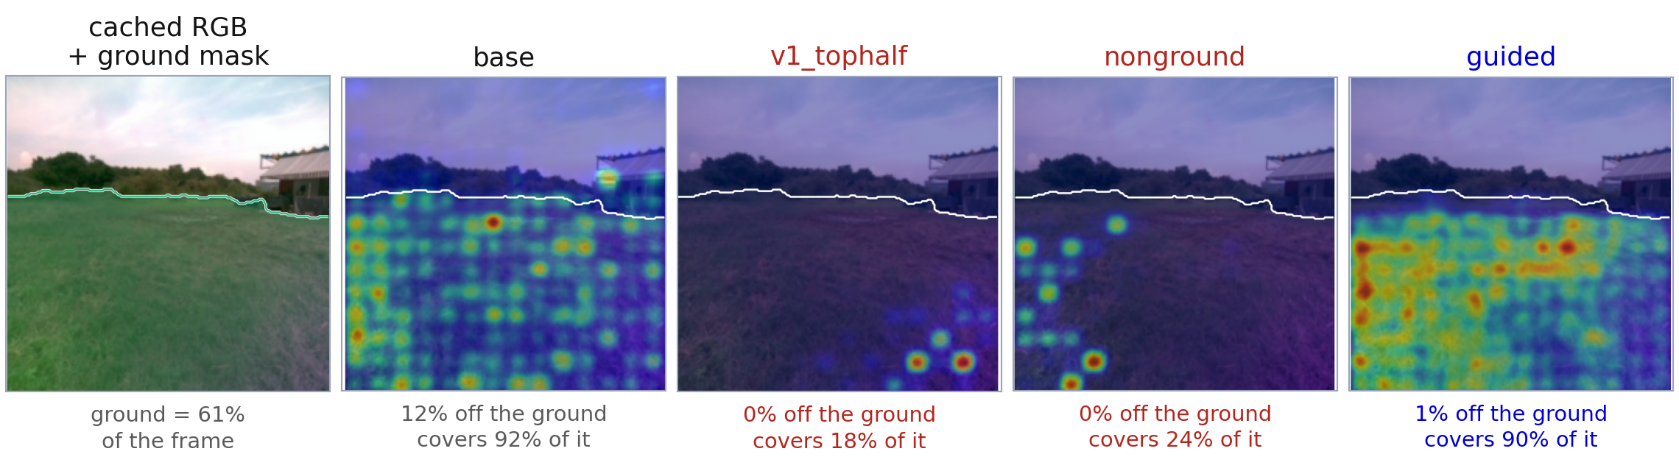
What it looks like on a day the model never saw
base
v1_tophalf · nonground
guided
Already looks downward — but 12% of the saliency sits on the roof and the treeline.
Zero on distractors, bought by collapsing onto six or seven spots.
The same 0–1% on distractors, spread across 90% of the ground.
20260812_afternoon_wet_027 · target = yaw · white contour = the ground mask. The other two held-out groups give the same picture.
Adaptive Photonics Lab, NCTU
Notes:
Same frame, same saliency, same mask, four models. The collapse in the middle two panels is visible without reading a caption.

Slide 13
Accuracy does not move — and that is the honest headline
0.011
0.004
0.852
0.847
total spread in yaw R²
total spread in dx R²
best yaw R² — control
guided
across all six arms
across all six arms
the arm with no penalty at all
inside the noise
What this rules out
What survives
The v1 claim that attention guidance improves accuracy.
Any reading in which the ranking of these arms by R² is meaningful — the whole span is smaller than the gap between two held-out runs.
The intervention is free: it redirects where the model looks without paying for it in accuracy.
That is the claim an interpretability method should be making. Accuracy was never the mechanism it acts on.
The claim to make: the intervention moves WHERE the model looks, measurably and reproducibly, and costs nothing in accuracy. Not: it makes the model better.
Adaptive Photonics Lab, NCTU
Notes:
Say this out loud rather than letting the advisor find it. A negative result reported deliberately is stronger than a positive one a control would have killed.

Slide 14
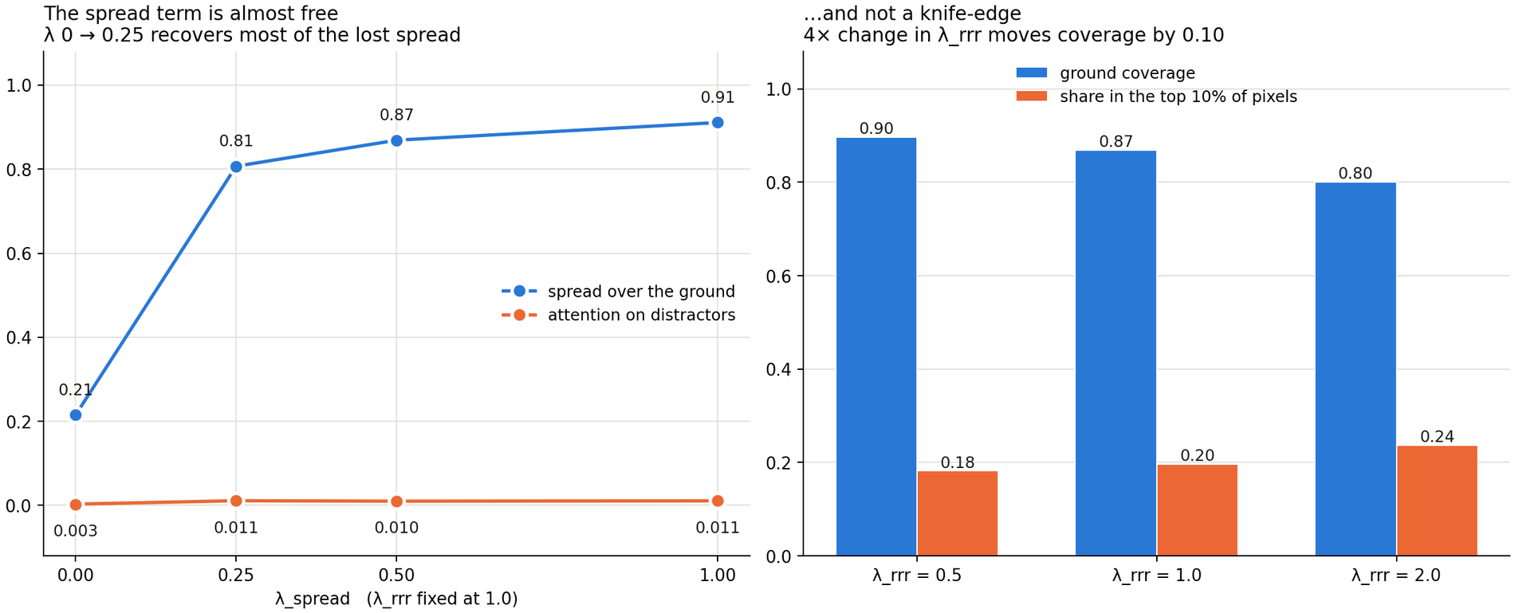
The spread term is almost free, and λ is not a knife-edge
λ_spread = 0.25 already recovers three quarters of the lost spread while the distractor share stays under 1.3%. A fourfold change in λ_rrr moves coverage by 0.10. Nothing here rests on a tuned constant.
Adaptive Photonics Lab, NCTU
Notes:
This answers “where did that number come from?” before it is asked.

Slide 15
What was checked, and what still limits the result
The whole study was run twice, under two different definitions of “ground”
Limitations, stated up front
coverage | first mask (65.6%) | corrected (68.2%)
guided | 0.837 | 0.869
nonground | 0.182 | 0.215
v1_tophalf | 0.240 | 0.248
Every wet training row comes from one day — “wet” and that day cannot be told apart by this model.
The collection is 82% wet. The dry numbers rest on 966 held-out rows and are never pooled into a headline.
The ground mask still assigns ~2% of the terrain band to “plant”. It was deliberately not folded into ground: that class appears just as often at the horizon, where it really is vegetation.
The base model stopped at epoch 10 with its best validation at epoch 6; epochs 7–12 were all worse.
Three extra epochs is a short fine-tune. Nothing here says the effect would survive a full retrain from scratch.
The ordering is identical under both. The conclusion does not depend on where exactly the mud boundary is drawn.
Also checked
Depth audit of the sky mask: 98.6% containment, 0.01% leak into near ground.
Image-quality screening of all 63 runs — none flagged.
Adaptive Photonics Lab, NCTU
Notes:
Volunteering the limitations is what makes the positive claims credible. Each one has a number attached.

Slide 16
Summary & next steps
1
The region
A per-frame segmentation mask replaces “the top half”, audited against depth and diagnosed class by class.
2
The missing term
Penalizing the outside alone collapses the attention. The entropy term is what makes the intervention work.
3
The honest result
19× less attention on distractors, spread slightly wider than the unguided model, at no accuracy cost.
4
What is not claimed
Attention guidance does not improve accuracy here. The no-penalty control matches every guided arm.
Next: collect dry data on a second day so “wet” and 20260827 can be separated · repeat the sweep with multiple seeds · test whether a model guided this way degrades more gracefully when the terrain changes
Adaptive Photonics Lab, NCTU
Notes:
Close on the negative result, not away from it. The next step that matters most is a second dry day.

