Slide 1
Graph
Dr. Inayat-ur-Rehman
COMSATS Institute of Information Technology,
Islamabad

Slide 2
What is a Graph?
A graph G = (V,E) is composed of:
V: set of vertices
E: set of edges connecting the vertices in V
An edge e = (u,v) is a pair of vertices
Example:
a
b
V= {a,b,c,d,e}
E= {(a,b),(a,c),(a,d),
(b,e),(c,d),(c,e),
(d,e)}
c
d
e

Slide 3
Applications
electronic circuits
networks (roads, flights, communications)
CS16
Abbott
LAX
Haripur
Islamabad
Lahore
Taxila
khanpur

Slide 4

Terminology:
Adjacent and Incident
If (v0, v1) is an edge in an undirected graph,
  v0 and v1 are adjacent
  The edge (v0, v1) is incident on vertices v0 and v1
If <v0, v1> is an edge in a directed graph
  v0 is adjacent to v1, and v1 is adjacent from v0
  The edge <v0, v1> is incident on v0 and v1

Slide 5
Terminology:
Degree of a Vertex
The degree of a vertex is the number of edges incident to that vertex
For directed graph,
  the in-degree of a vertex v is the number of edges
  that have v as the head
  the out-degree of a vertex v is the number of edges
  that have v as the tail

Slide 6
Examples
0
3
2
0
1
2
3
3
3
1
2
3
3
4
5
6
G1
1
1
1
3
G2
1
3
0
in:1, out: 1
directed graph
in-degree
out-degree
1
in: 1, out: 2
2
in: 1, out: 0
G3

Slide 7
Terminology:
Path
path: sequence of vertices v₁,v₂,. . .v_{k} such that consecutive vertices v_{i} and v_{i+1} are adjacent.
3
2
3
3
3
a
b
a
b
c
c
d
e
d
e
a b e d c
b e d c

Slide 8
Graphs: Example
1
6
2
3
7
4
5
8
Legend
Directional path
Bi-directional paths

Slide 9
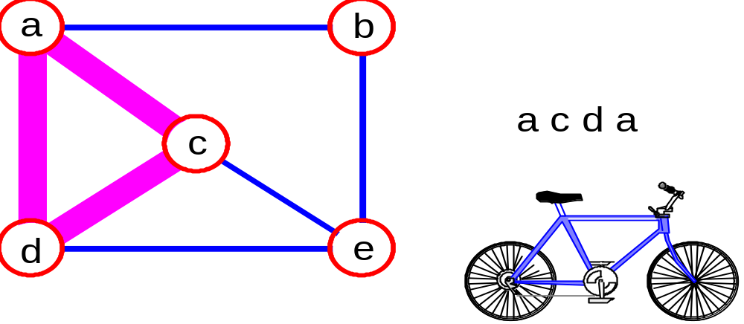
More Terminology
simple path: no repeated vertices
cycle: simple path, except that the last vertex is the same as the first vertex
a
b
b e c
c
d
e

Slide 10
Even More Terminology
connected graph: any two vertices are connected by some path
connected
not connected
subgraph: subset of vertices and edges forming a graph
connected component: maximal connected subgraph. E.g., the graph below has 3 connected components.

Slide 11
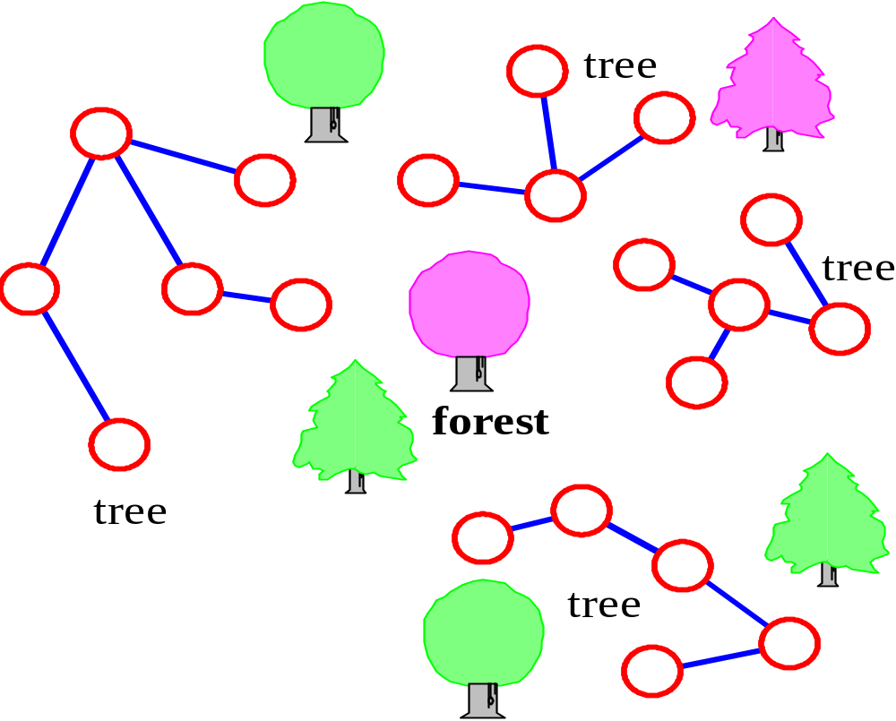
More…
tree - connected graph without cycles
forest - collection of trees

Slide 12
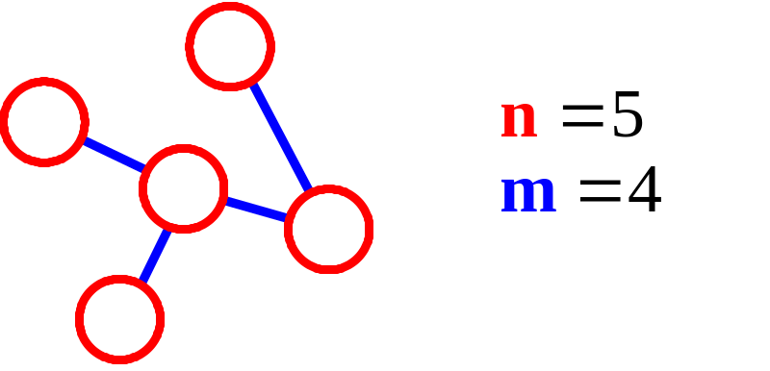
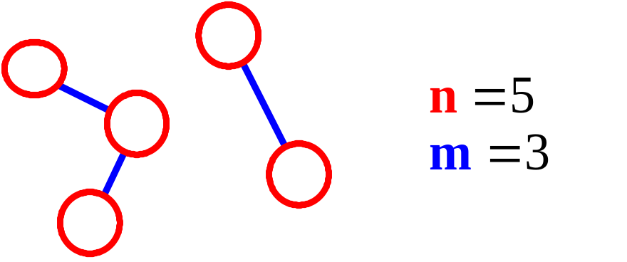
More Connectivity
n = #vertices
m = #edges
For a tree m = n - 1
If m < n - 1, G is not connected

Slide 13
Oriented (Directed) Graph
A graph where edges are directed

Slide 14
Directed vs. Undirected Graph
An undirected graph is one in which the pair of vertices in a edge is unordered, (v0, v1) = (v1,v0)
A directed graph is one in which each edge is a directed pair of vertices, <v0, v1> != <v1,v0>
tail
head

Slide 15
Graph Representations
Adjacency Matrix
Adjacency Lists

Slide 16
Adjacency Matrix
Let G=(V,E) be a graph with n vertices.
The adjacency matrix of G is a two-dimensional
n by n array, say adj_mat
If the edge (vi, vj) is in E(G), adj_mat[i][j]=1
If there is no such edge in E(G), adj_mat[i][j]=0
The adjacency matrix for an undirected graph is symmetric; the adjacency matrix for a digraph
need not be symmetric

Slide 17
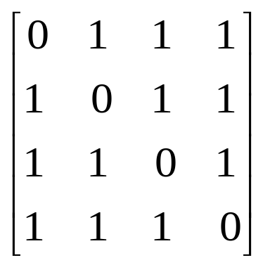
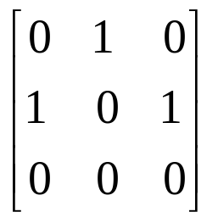
Examples for Adjacency Matrix
0
0
1
2
3
1
2
G2
G1

Slide 18
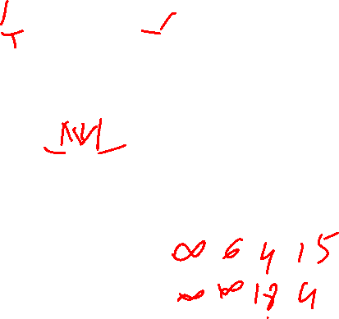
Examples for Adjacency Matrix
0
6
4
18
0
1
2
15
4
2
1
3
2
G2
G1

Slide 19
0
0
4
2
1
5
1
2
3
6
3
7
0
1
2
3
1
2
3
0
1
2
3
4
5
6
7
1
2
0
2
3
0
3
0
1
3
0
3
0
1
2
1
2
G1
0
5
4
6
0
1
2
1
5
7
0
2
1
6
G3
G4
2
An undirected graph with n vertices and e edges ==> n head nodes and 2e list nodes

Slide 20
Single-Source Shortest Paths
We wish to find the shortest route between Islamabad and A bbottabad. Given a road map with all the possible routes how can we determine our shortest route?
We could try to enumerate all possible routes.

Slide 21
Modeling Problem
We can model this problem with a directed graph. Intersections correspond to vertices, roads between intersections correspond to edges and distance corresponds to weights. One way roads correspond to the direction of the edge.
The problem:
  Given a weighted digraph and a vertex s in the graph: find a shortest path from s to t

Slide 22
The distance of a shortest path
  Case: The graph may have negative edges but no negative cycles. The shortest distance from s to t can be computed.
s
1
8
t
d(s,t)=6
A
B
-3

Slide 23
Shortest Path Algorithms
Dijkstra’s algorithm does NOT allow negative edges.

Slide 24
Dijkstra’s shortest path algorithm
Dijkstra’s algorithm solves the single source shortest path problem in 2 stages.
  Stage1: A greedy algorithm computes the shortest distance from s to all other nodes in the graph and saves a data structure.
  Stage2 : Uses the data structure for finding a shortest path from s to t.

Slide 25
Main idea
Assume that the shortest distances from the starting node s to the rest of the nodes are
  d(s, s) ≤ d(s, s₁) ≤ d(s, s₂) ≤ … ≤ d(s, s_{n-1})
In this case a shortest path from s to s_{i} may include any of the vertices {s₁, s₂ … s_{i-1}} but cannot include any s_{j} where j > i.
Dijkstra’s main idea is to select the nodes and compute the shortest distances in the order s, s₁, s₂ ,…, s_{n-1}

Slide 26
Example
s₄
  d(s, s) =0 ≤
  d(s, s₁)=5 ≤
  d(s, s₂)=6 ≤
  d(s, s₃)=8 ≤
  d(s, s₄)=15
15
8
s₃
2
10
s
3
4
s₂
5
Note: The shortest path from s to s₂ includes s₁ as an intermediate node but cannot include s₃ or s₄.
s₁
1

Slide 27
Dijkstra’s greedy selection rule
Assume s₁, s₂ … s_{i-1} have been selected, and their shortest distances have been stored in Solution
Select node s_{i} and save d(s, s_{i}) if s_{i} has the shortest distance from s on a path that may include only s₁, s₂ … s_{i-1} as intermediate nodes. We call such paths special
To apply this selection rule efficiently, we need to maintain for each unselected node v the distance of the shortest special path from s to v, D[v].

Slide 28
Application Example
Solution = {(s, 0)}
D[s₁]=5 for path [s, s₁]
D[s₂]= ∞ for path [s, s₂]
D[s₃]=10 for path [s, s₃]
D[s₄]=15 for path [s, s₄].
Solution = {(s, 0), (s₁, 5) }
D[s₂]= 6 for path [s, s₁, s₂]
D[s₃]=9 for path [s, s₁, s₃]
D[s₄]=15 for path [s, s₄]
Solution = {(s, 0), (s₁, 5), (s₂, 6) }
D[s₃]=8 for path [s, s₁, s₂, s₃]
D[s₄]=15 for path [s, s₄]
Solution = {(s, 0), (s₁, 5), (s₂, 6),(s₃, 8), (s₄, 15) }
s₄
15
8
s₃
2
10
s
3
4
s₂
5
s₁
1

Slide 29
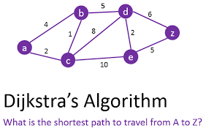

Slide 30
Graph Traversal
Problem: Search for a certain node or traverse all nodes in the graph
Depth First Search
  Once a possible path is found, continue the search until the end of the path
Breadth First Search
  Start several paths at a time, and advance in each one step at a time

Slide 31
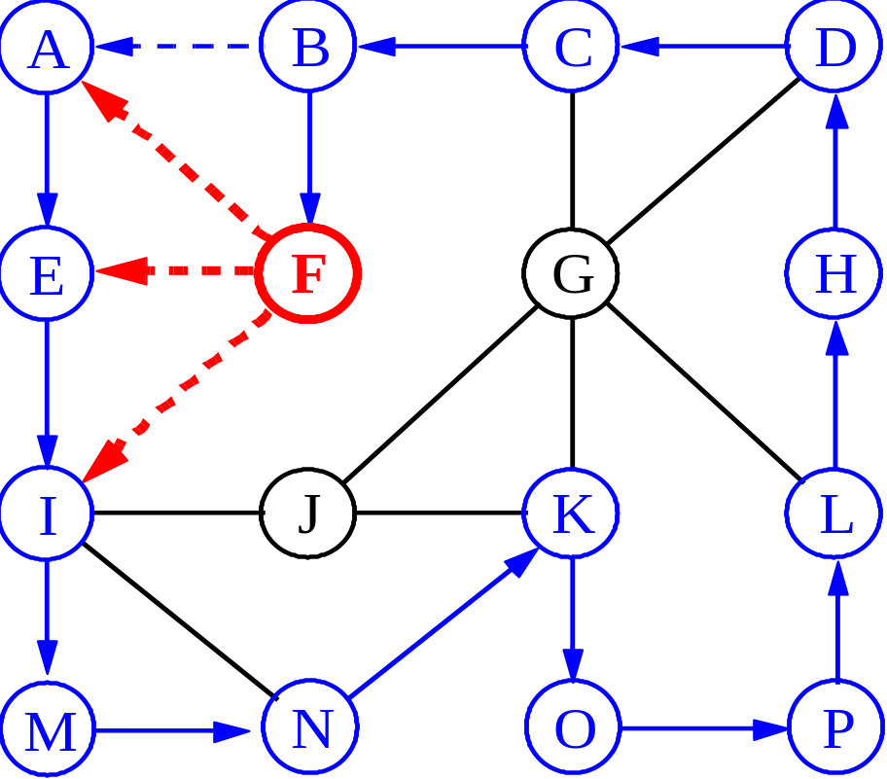
Depth-First Search

Slide 32
Exploring a Labyrinth
Without Getting Lost
A depth-first search (DFS) in an undirected graph G is like wandering in a labyrinth with a string and a can of red paint without getting lost.
We start at vertex s, tying the end of our string to the point and painting s “visited”. Next we label s as our current vertex called u.
Now we travel along an arbitrary edge (u, v).
If edge (u, v) leads us to an already visited vertex v we return to u.
If vertex v is unvisited, we unroll our string and move to v, paint v “visited”, set v as our current vertex, and repeat the previous steps.

Slide 33
Depth-First Search
Algorithm DFS(v); Input: A vertex v in a graph
Output: A labeling of the edges as “discovery” edges and “backedges”
for each edge e incident on v do
if edge e is unexplored then let w be the other endpoint of e
if vertex w is unexplored then label e as a discovery edge
recursively call DFS(w)
else label e as a backedge

Slide 34
Breadth-First Search
Like DFS, a Breadth-First Search (BFS) traverses a connected component of a graph, and in doing so defines a spanning tree with several useful properties.
The starting vertex s has level 0, and, as in DFS, defines that point as an “anchor.”
In the first round, the string is unrolled the length of one edge, and all of the edges that are only one edge away from the anchor are visited.
These edges are placed into level 1
In the second round, all the new edges that can be reached by unrolling the string 2 edges are visited and placed in level 2.
This continues until every vertex has been assigned a level.
The label of any vertex v corresponds to the length of the shortest path from s to v.

Slide 35
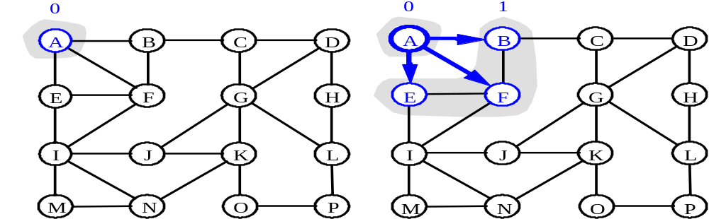
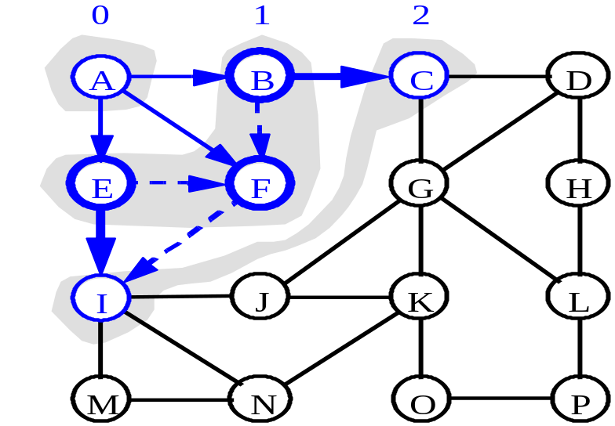
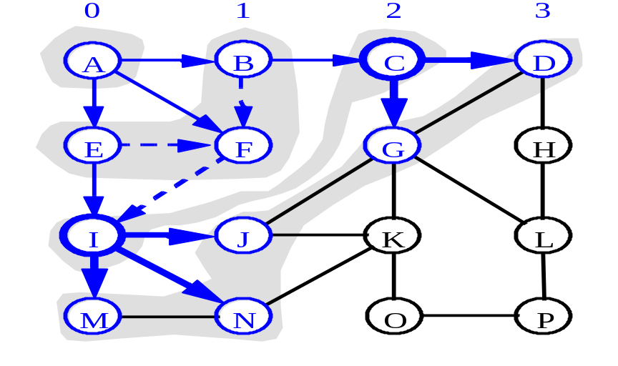
BFS - A Graphical Representation
a)
b)
c)
d)

Slide 36
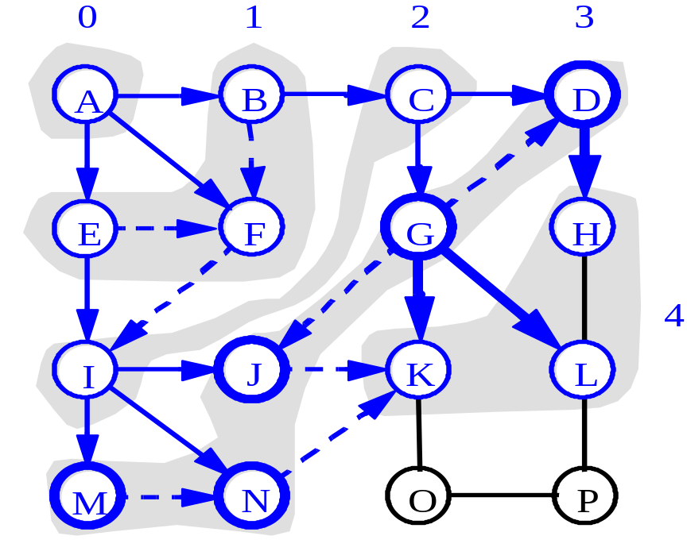
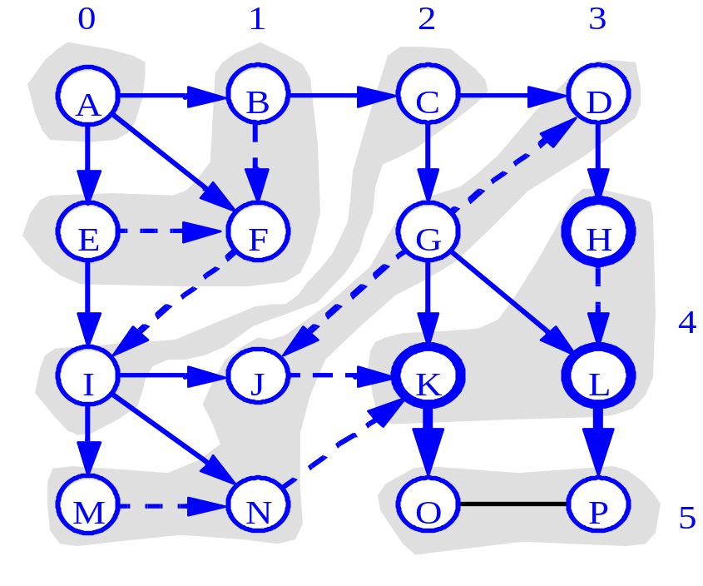
More BFS

Slide 37
BFS Pseudo-Code
Algorithm BFS(s): Input: A vertex s in a graph
Output: A labeling of the edges as “discovery” edges and “cross edges”
initialize container L₀ to contain vertex s
i ← 0
while L_{i} is not empty do
create container L_{i+1} to initially be empty
for each vertex v in L_{i} do
if edge e incident on v do
let w be the other endpoint of e
if vertex w is unexplored then
label e as a discovery edge
insert w into L_{i+1}
else label e as a cross edge
i ← i + 1

Slide 38
Applications: Finding a Path
Find path from source vertex s to destination vertex d
Use graph search starting at s and terminating as soon as we reach d
  Need to remember edges traversed
Use depth – first search ?
Use breath – first search?

Slide 39
DFS vs. BFS
DFS Process
F
B
A
start
E
G
D
C
destination
C
DFS on C
D
Call DFS on D
B
DFS on B
B
B
Return to call on B
A
DFS on A
A
A
A
G
Call DFS on G
found destination - done!
Path is implicitly stored in DFS recursion
Path is: A, B, D, G
D
B
A

Slide 40
DFS vs. BFS
F
B
A
start
E
BFS Process
G
D
C
destination
rear
front
rear
front
rear
front
rear
front
A
B
D
C
D
Initial call to BFS on A
Add A to queue
Dequeue A
Add B
Dequeue B
Add C, D
Dequeue C
Nothing to add
rear
front
G
found destination - done!
Path must be stored separately
Dequeue D
Add G

Slide 41
Reference
Rada Mihalcea
John Lewis and William Loftus
Data structure through C in depth
Data Structure through C

