Slide 1


16SrRNA Intermediate Bioinformatics Online Course: Int_BT_2019
Introduction to R

Slide 2
Why you’re going to love R…

Slide 3

What is R?
R is an open source programming language used for statistical analyses and graphics
RStudio is the user-friendly interface commonly used when programming in R
Allows you to see your R script, console and graphics all on one screen
Easy package installation & updates & help
Reproducibility
Notes:
Learning objectives and outcomes per session, from the ‘IBT 2016 - active learning outcomes’ google doc
Include this so that the participants are aware of what skills they can expect to gain from your module

Slide 4
Why learn R?
Non-programming point-and-click software can be dangerous..
Are you sure you know what you’re doing or what it is doing?
R = written commands which has several advantages:
You have to think about what you’re writing and know what each command is doing
Your analysis is now reproducible because you’ve written each command in an R script file (more and more journals require this)
Easy collaboration – share your R scripts
Specialized software packages that are likely only available through R
E.g. you’re working on 16S microbiome data: custom R packages (phyloseq, metagenomeSeq…)
Publication quality graphics, customizable (fun)

Slide 5
Customizable, publication-quality graphics

Slide 6
Customizable, publication-quality graphics

Slide 7
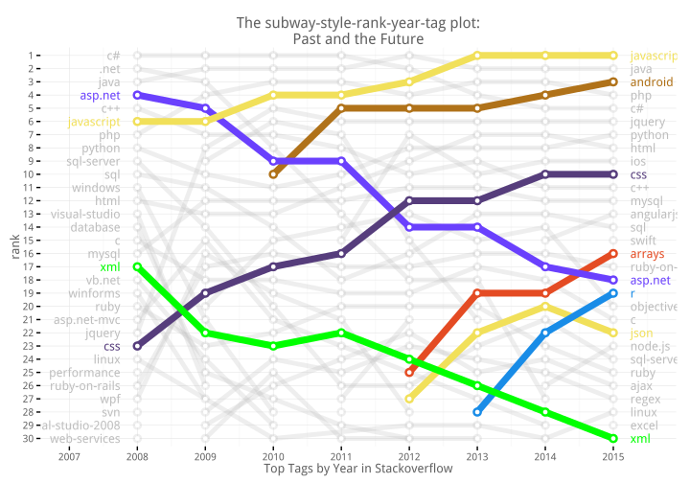
R help?!
Just ask uncle Google…
If you get an error someone else has had it too (and posted about it)
Large R community, plenty user forums
stackoverlow example
R
https://blog.revolutionanalytics.com/2015/12/r-is-the-fastest-growing-language-on-stackoverflow.html

Slide 8
Syllabus (learning objectives)
Introduction to RStudio
Define the following terms as they relate to R: object, assign, function, arguments
Importing data into R as dataframes
Subsetting, indexing of dataframes
Best practices for writing R code

Slide 9
Learning Outcomes
Comfortable navigating RStudio
Comfortable with basic R operations and syntax
Importing data from .csv or .txt files into R as dataframes
Notes:
Learning objectives and outcomes per session, from the ‘IBT 2016 - active learning outcomes’ google doc
Include this so that the participants are aware of what skills they can expect to gain from your module

Slide 10
Introduction to R website

