Slide 1


16SrRNA Intermediate Bioinformatics Online Course: Int_BT_2019
Introduction to R: importing data, data frames

Slide 2
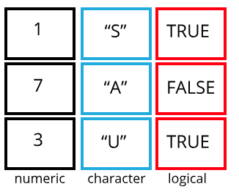
Intro to R: what is a data frame?
A list of vectors of equal length
Clinical data: sample = rows and variables of interest = columns
Functions to examine data frames
str()
head()
dim()
rownames() colnames()

Slide 3
Working with data frames
Load external data from a .csv file into a data frame
read.csv() read.table()
Subsetting
[rows , columns] ‘comma-first-for-columns’ [,1]
Select a range: [,1:10]
Exclusion: [,-1]
Many ways to select a column: e.g. surveys[,2] == surveys[,"month”] == surveys$month

Slide 4
R factors, data types, data frames
course material

Slide 5
R data types useful links
R data types and structures: additional hands on

