Slide 1


16SrRNA Intermediate Bioinformatics Online Course: Int_BT_2019
Introduction to R: best practices for coding

Slide 2
Intro to R: good coding practices
Start each program with a description of what it does.
Then load all required packages.
Improve reproducibility/usability by limiting ‘hard-coding’
Keep all of the source files for a project in one directory and use relative paths to access them
Define all user-specific code and functions at the start of your script

Slide 3
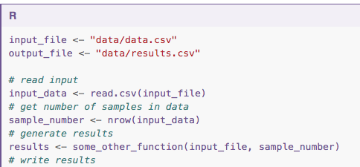
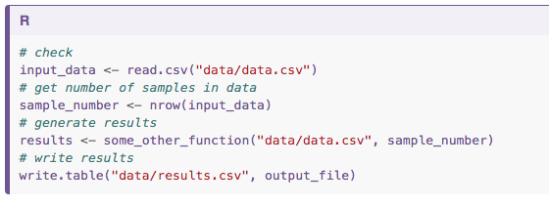
Intro to R: good coding practices

Slide 4
Intro to R: good coding practices
Break code into logical sections with comments to inform script
Ctr/Cmd + shift + R
Create functions for repeated code rather than copy-paste over and over – makes script long and error-prone
Record sessionInfo()
Get someone else to review your code
Use version control, or Github gists!

Slide 5
Good coding practices – useful links
Good enough practices in scientific computing
The tidyverse R style guide

