Slide 1



16S rRNA Intermediate Bioinformatics Online Course: Int_BT_2019
Building portable, user-friendly pipelines using …………….

Slide 2
Module website

Slide 3
About ………….
Scalable and reproducible scientific workflows using software containers
Built-in GitHub support
Compatibility with virtually all computational infrastructures, including all major cluster job schedulers
Integrated software dependency management (Docker, Singularity, Conda)
Portability so you can run your pipeline anywhere: laptop, cluster or cloud
Reproducibility of analyses independent of time and computing platform

Slide 4
Why Nextflow will save you time
Reuse your existing scripts and tools (and you don't need to learn a new language or API to start using it)
Workflow ‘processes’ can be written in common scripting languages (R, python, bash, etc.)
Resume pipeline execution from the last successfully executed step
All the intermediate results produced during the pipeline execution are automatically tracked
Super easy setup
Check prerequisites (`java –version` ≥ Java 8)
Download Nextflow (curl -s https://get.nextflow.io | bash)
Hello world! (./nextflow run hello)

Slide 5
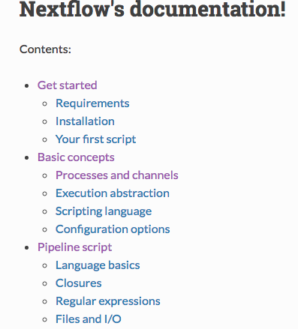
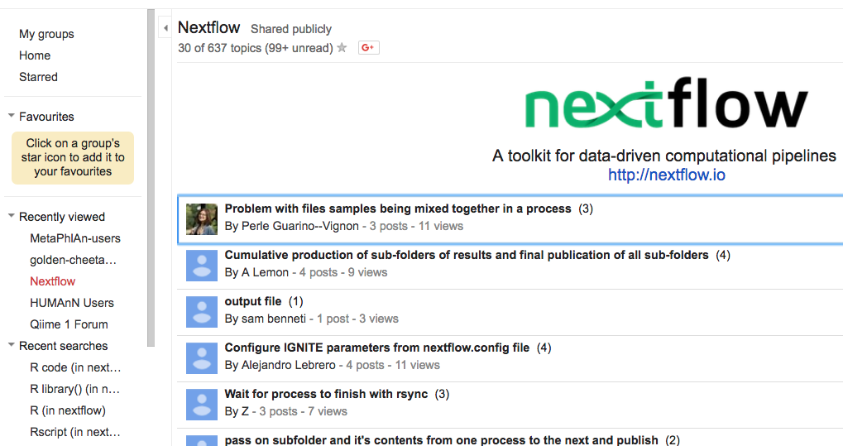
Why Nextflow will save you time
Good documentation
Google group support
Existing pipelines & templates

Slide 6
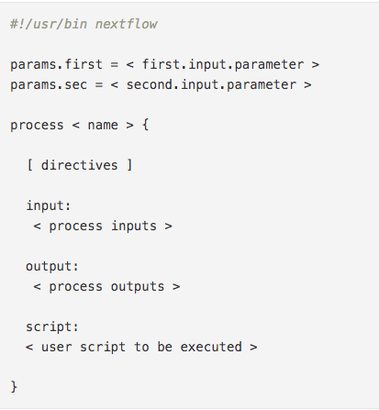
: the basics
Nextflow terminology:
‘process’: one (independent) step in the pipeline
‘channel’: information flows from one process to another via ‘channels’ as defined in the input and output sections of each process
‘script’: each process contains a ‘script block’. This is where the executable coding happens
‘executor’: the component that determines the system where a pipeline process is run and supervises its execution
easy to change via config files

Slide 7
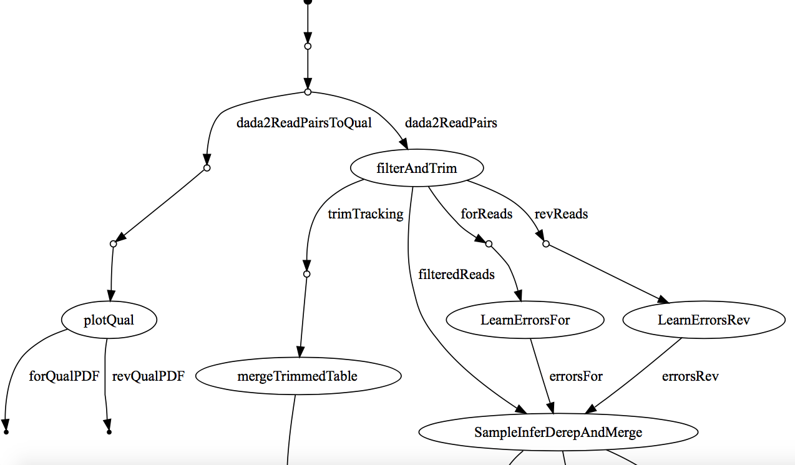
nextflow automatically creates a DAG of your pipeline

Slide 8
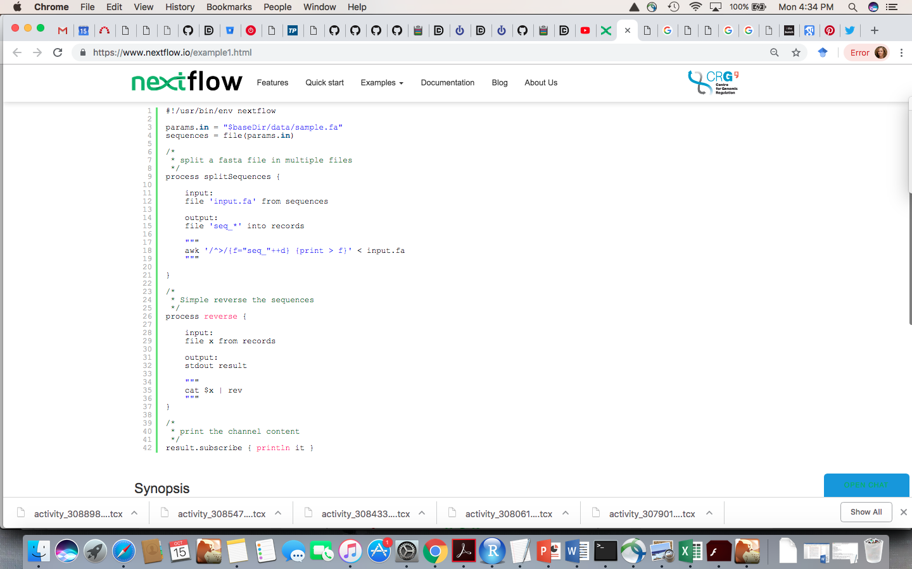
A nextflow script example
Notes:
Line 1: The script starts with a shebang declaration. This allows you to launch your pipeline, as any other BASH script.
Line 3: Declares a pipeline parameter named params.in that is initialized with the value $HOME/sample.fa.This value can be overridden when launching the pipeline, by simply adding the option --in <value> to the script command line.
Line 4: Defines a variable sequences holding a reference for the file whose name is specified by the params.in parameter.
Lines 9-21: The process that splits the provided file.
Line 11: Opens the input declaration block. The lines following this clause are interpreted as input definitions.
Line 12: Defines the process input file. This file is received from the variable sequences and will be named input.fa.
Line 14: Opens the output declaration block. Lines following this clause are interpreted as output definitions.
Line 15: Defines that the process outputs files whose names match the pattern seq_*. These files are sent over the channel records.
Lines 17-19: The actual script executed by the process to split the provided file.
Lines 26-37: Defines the second process, that receives the splits produced by the previous process and reverses their content.
Line 28: Opens the input declaration block. Lines following this clause are interpreted as input definitions.
Line 29: Defines the process input file. This file is received through the channel records.
Line 31: Opens the output declaration block. Lines following this clause are interpreted as output definitions.
Line 32: The standard output of the executed script is declared as the process output. This output is sent over the channel result.
Lines 34-36: The actual script executed by the process to reverse the content of the received files.
Line 42: Prints a result each time a new item is received on the result channel.

Slide 9
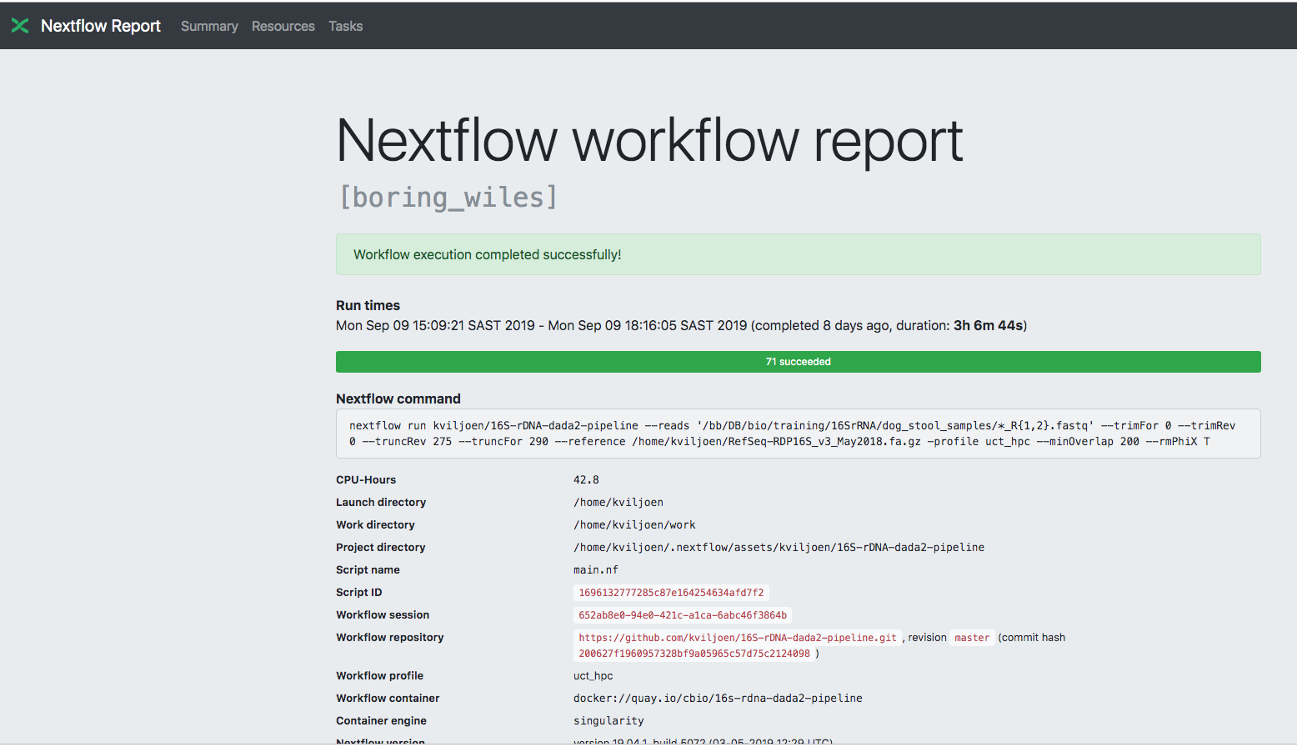
Nextflow workflow reports

