Slide 1



16S rRNA Intermediate Bioinformatics Online Course: Int_BT_2019
: a hands on demonstration

Slide 2
Let’s process reads with dada2, as a Nextflow pipeline
Data: Illumina paired reads .fastq files (Dog microbiome)
Pipeline: https://github.com/grbot/16S-rDNA-dada2-pipeline

Slide 3
Running the DADA2 Nextflow pipeline on test data
Log onto the cluster with your username e.g.
ssh gerrit@154.114.37.238
Start an interactive job from a worker node
NB: Do not launch Nextflow from the head node (high java memory requirements)
Instead start an Interactive job on a worker node:
srun --nodes=1 --ntasks 1 --mem=8g --pty bash
Pull the nextflow pipeline from Github
cd $HOME
git clone https://github.com/grbot/16S-rDNA-dada2-pipeline
cd $HOME/16S-rDNA-dada2-pipeline

Slide 4
Running the DADA2 Nextflow pipeline on test data
Now launch the pipeline from your interactive session as follows
nextflow run main.nf -profile training --reads="/cbio/data/test-data/*_R{1,2}.fastq.gz" --trimFor 24 --trimRev 25 --reference="/cbio/data/ref-data/silva_nr_v132_train_set.fa.gz" --species="/cbio/data/ref-data/silva_species_assignment_v132.fa.gz" --outdir="$HOME/out"

Slide 5
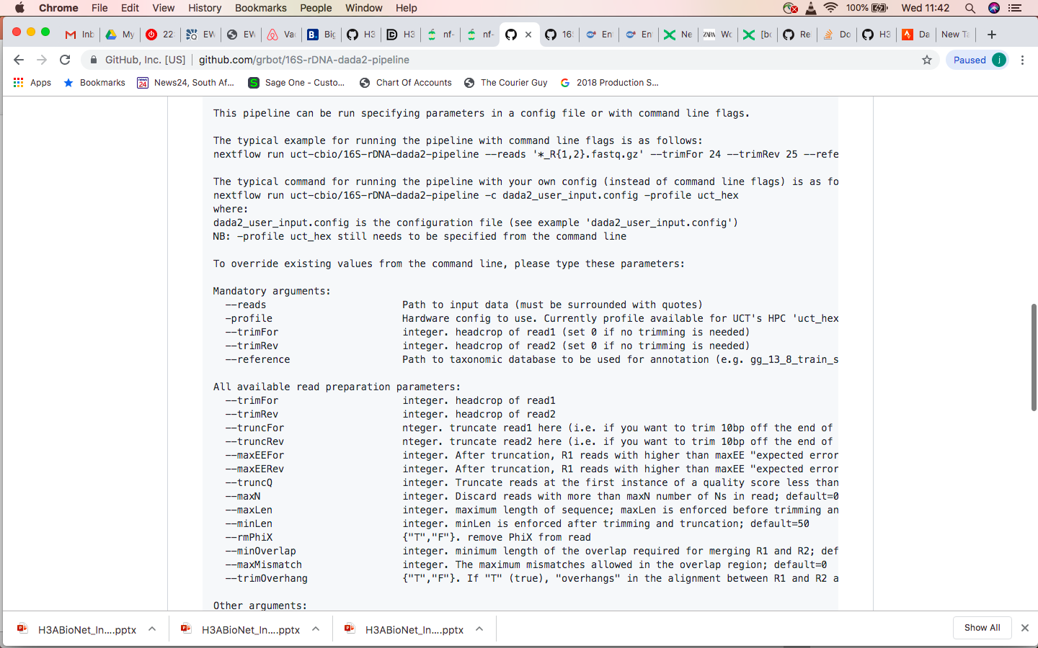
Nextflow pipeline parameter specification
Input parameters can be specified as
Command line flags, OR
In a user-defined config file

Slide 6
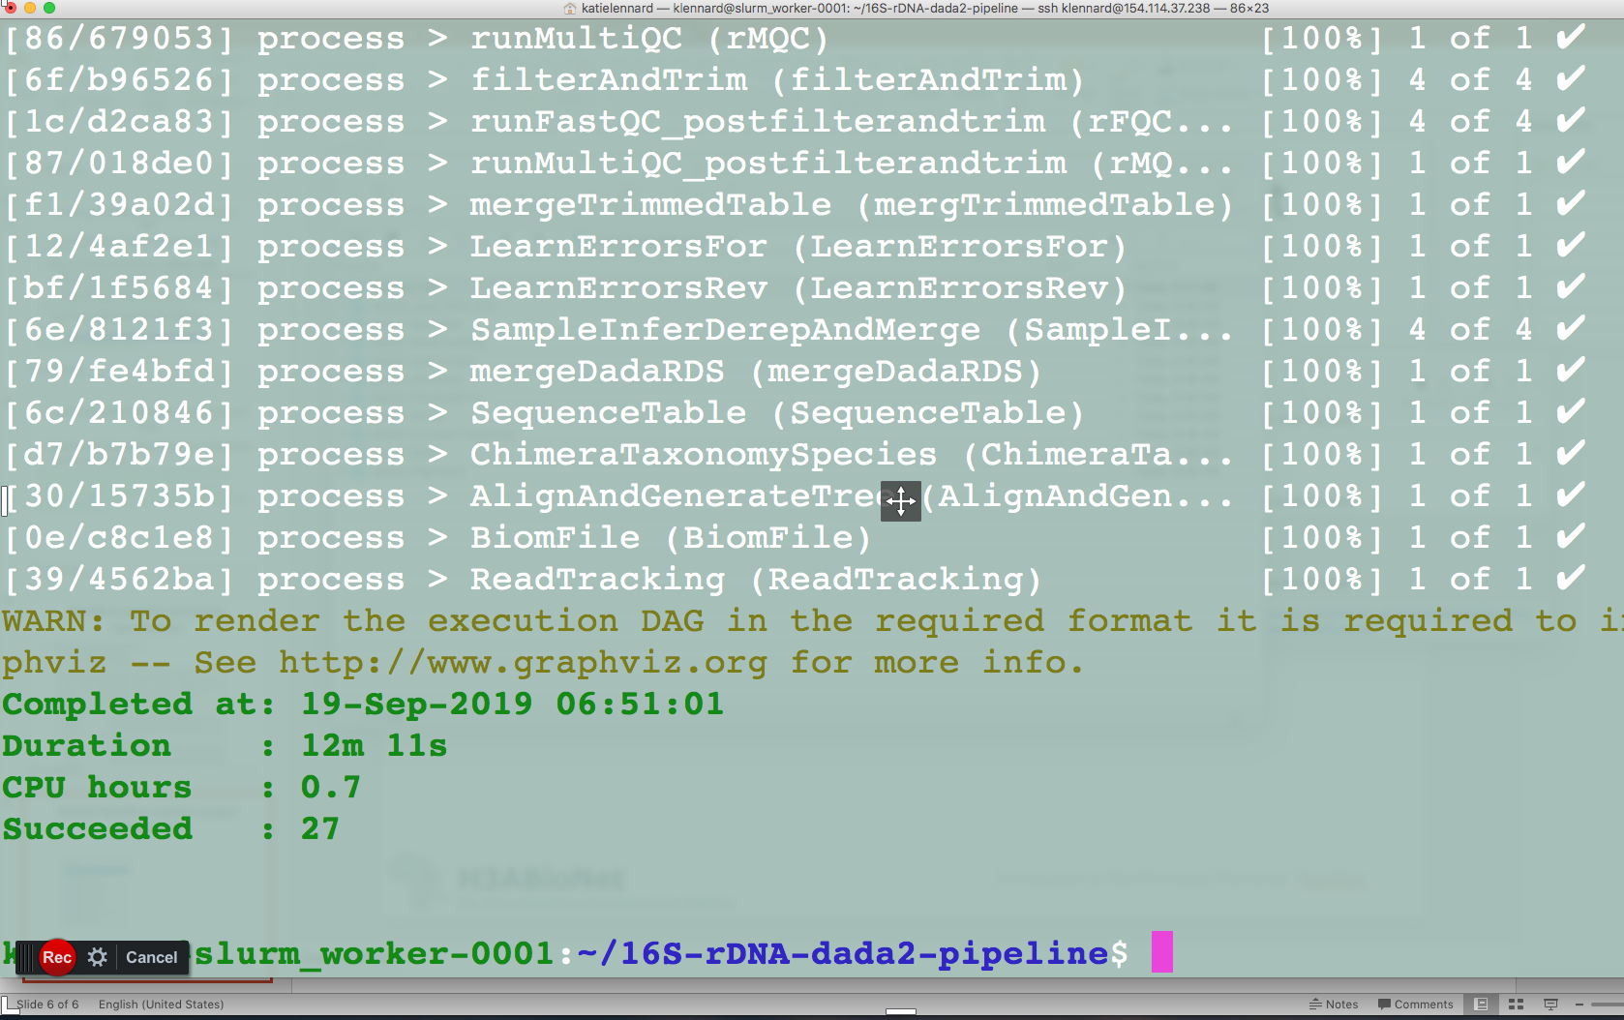
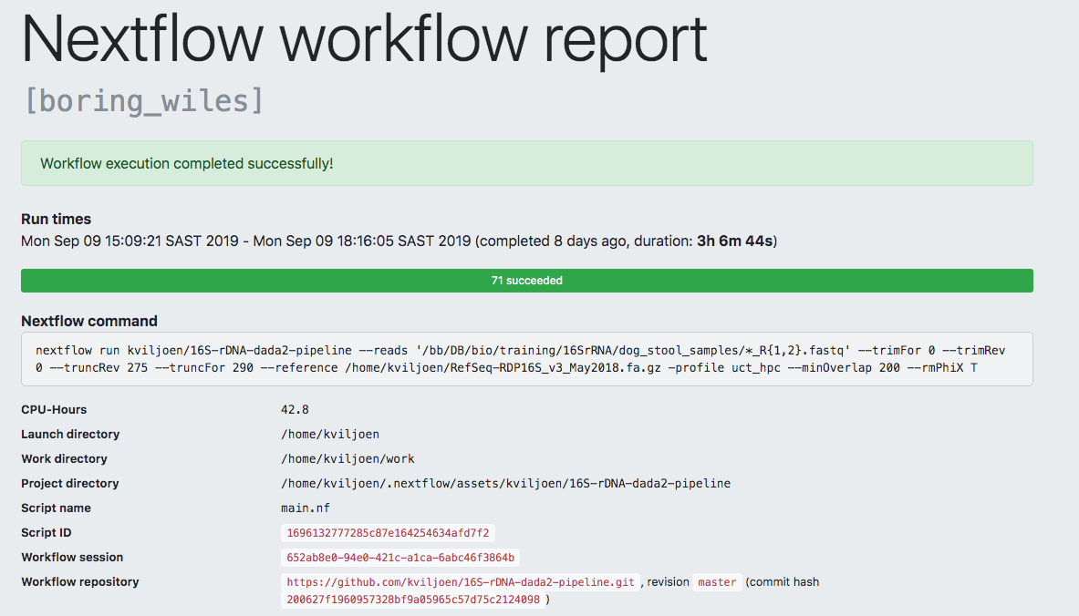
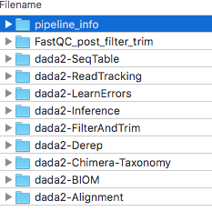
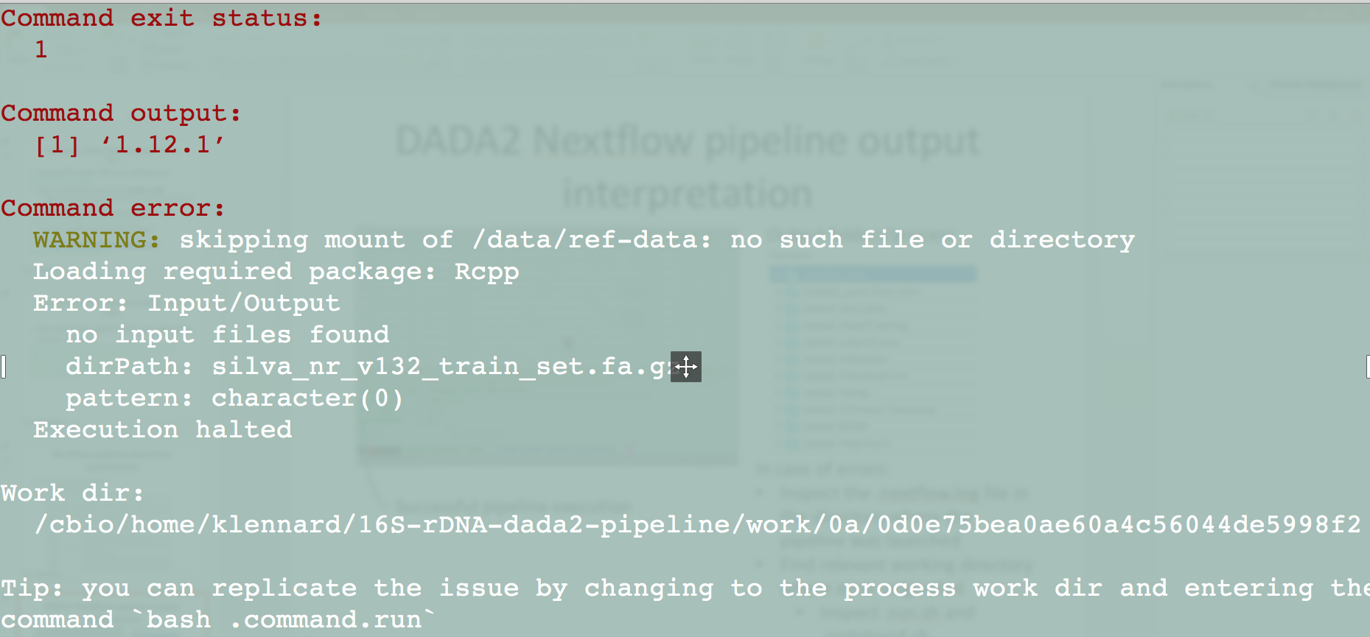
DADA2 Nextflow pipeline output interpretation
Successful pipeline execution
Output folders/process
Failed pipeline execution
In case of errors:
Inspect the .nextflow.log file in the directory where the pipeline was launched
Find relevant working directory where error originated
Inspect/run individual .run.sh, .command.sh, command.log

