Slide 1


16SrRNA Intermediate Bioinformatics Online Course: Int_BT_2019
16S downstream analyses in R: importing data
16SrRNA Intermediate Bioinformatics Online Course: Int_BT_2019
Katie Lennard
Notes:
<number>

Slide 2
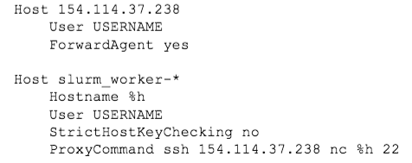
Start RStudio from the Ilifu SLURM cluster
Follow detailed instructions on Vula
Log in with ssh
ssh gerrit@xxx.xxx.xx.xxx
On your local machine add the following to your ~/.ssh
xxx.xxx.xx.xxx
xxx.xxx.xx.xxx
Introduction to Bioinformatics Workshop – 16S downstream R

Slide 3
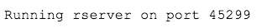
Start RStudio from the Ilifu SLURM cluster
Start an interactive job on a worker node
srun --nodes=1 --ntasks 1 --mem=8g --pty bash
Launch RStudio with:
USERNAME@slurm_worker-0002:~$ RSTUDIO_PASSWORD='Make your own secure password here' /cbio
Introduction to Bioinformatics Workshop - 16S downstream R

Slide 4
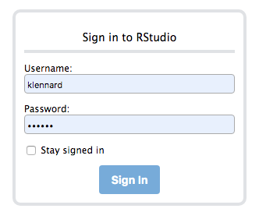
Start RStudio from the Ilifu SLURM cluster
From your local machine
$ ssh slurm_worker-0002 -L8082:localhost:45299
From your browser
http://localhost:8082
Enter your username and password
Introduction to Bioinformatics Workshop - 16S downstream R

Slide 5
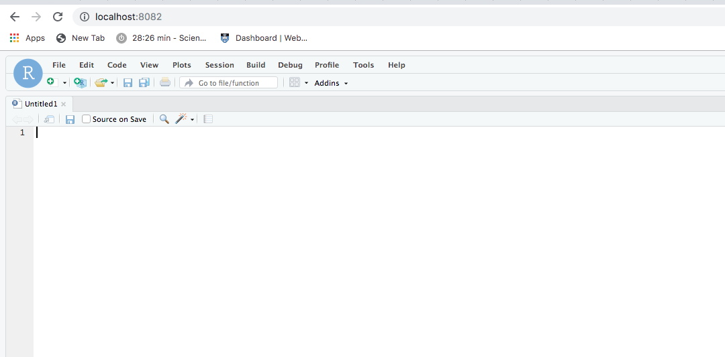
Start RStudio from the Ilifu SLURM cluster
Introduction to Bioinformatics Workshop - 16S downstream R

Slide 6
16S microbiome data characteristics
Count data: skewed, zero-inflated distribution
Differences in absolute read count between samples need normalization
Introduction to Bioinformatics Workshop - 16S downstream R

Slide 7
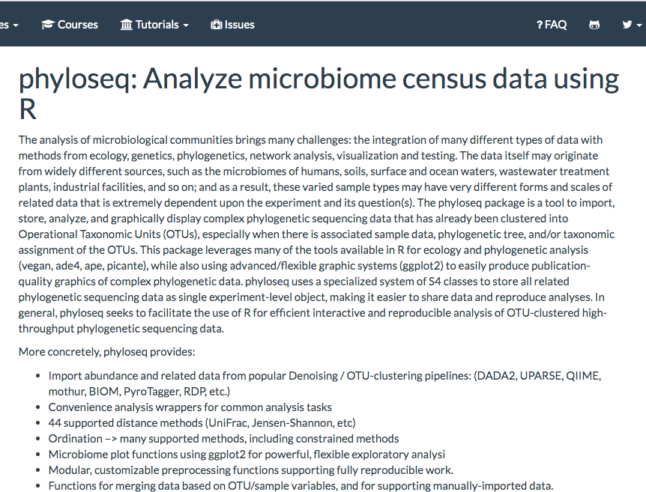
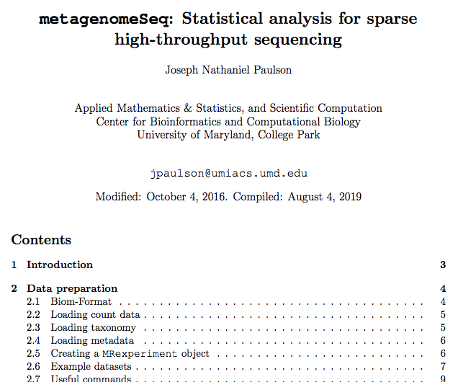
16S downstream analyses in R
Microbiome-specific packages in R
exploratory analyses: vegan, phyloseq
differential abundance testing:
Introduction to Bioinformatics Workshop – 16S downstream R

Slide 8
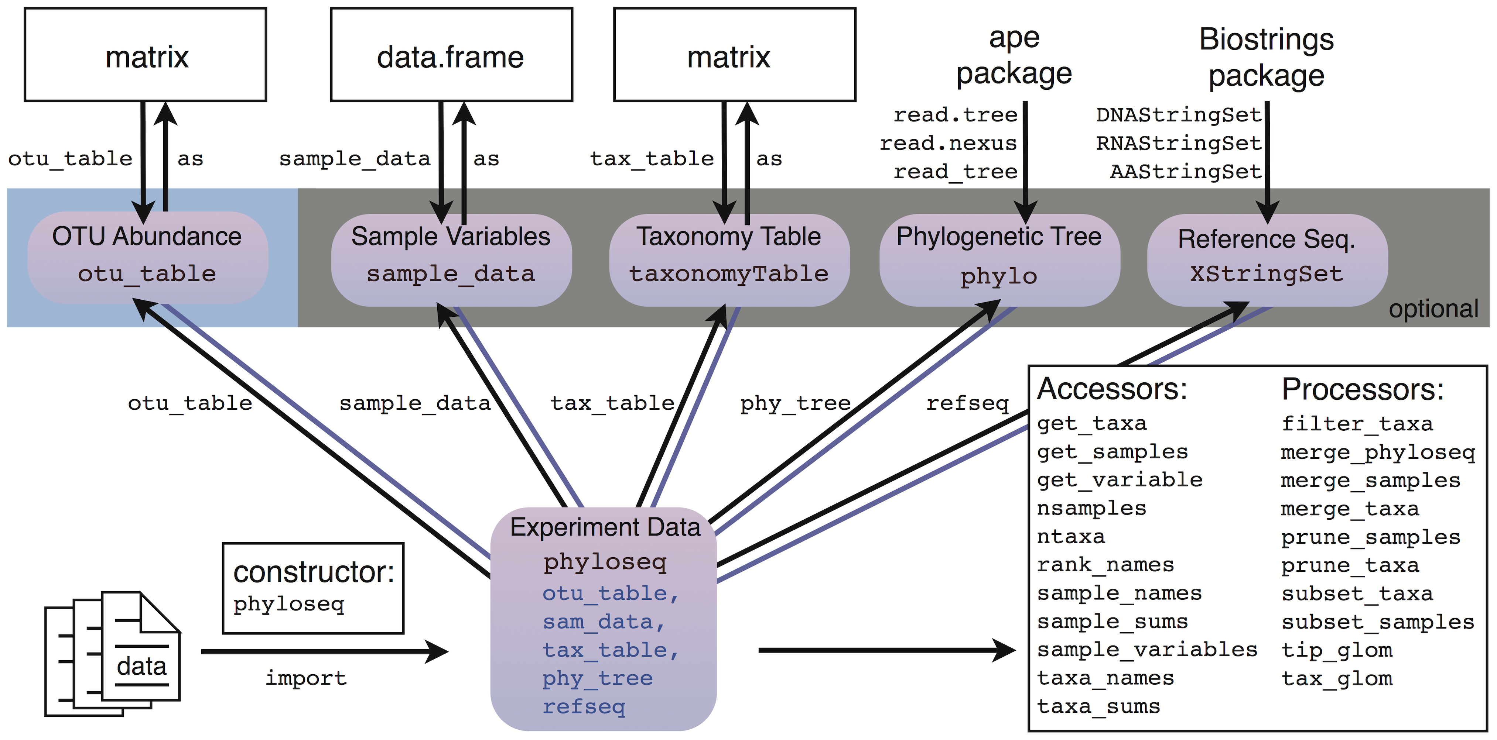
The R package ‘phyloseq’
phyloseq
Introduction to Bioinformatics Workshop - 16S downstream R

Slide 9
16S data import in R
To import:
dada2 output: ASV table, taxonomic annotation
Introduction to Bioinformatics Workshop - Module Name

