Slide 1
CLC Milestone Project
CST-361
Samantha Krall
IoT Weather Application

Slide 2

Milestone Project
Façade Pattern
Model View Controller Pattern
Data Access Object
Dependency Injection Pattern
Interceptor Pattern
Singleton Pattern
Decorator Pattern

Slide 3
Façade Pattern
Used to shield/ abstract the client from the business process
Hides complexities of the system and provides an interface to the client
Structural pattern

Slide 4
Model View Controller (MVC)
Separates applications concerns into the model, view and controller
  Model- carries data
  View- represents visual aspects
  Controller- controls data flow into model object and updates the view whenever data changes
Architectural pattern
Allows for multiple developers to simultaneously work on the model, view and controller

Slide 5
Data Access Object (DOA)
Structural pattern
Allows isolation of the application/ business layer from the persistence layer using an abstract API
API hides CRUD operations
Requires a data access object interface, data access object concrete class and a model object or value object

Slide 6
Context and Dependency Injection (CDI)
Dependency injection design pattern allows the removal of hard coded dependencies
Loosely coupled
Extendable
Maintainable

Slide 7
Interceptor Pattern
Part of Aspect Oriented Programming (AOP)
Aims to add behavior to existing code to solve cross cutting concerns (such as logging and security)
Business logic is kept separate from non business related concerns

Slide 8
Singleton Pattern
Creational pattern
Ensures only a single object is created

Slide 9
Decorator Pattern
Allows addition of new functionality to an existing object without altering its structure
Structural pattern
Acts as a wrapper to an existing class, allowing modification of functionality of an object at runtime

Slide 10
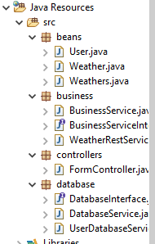

Slide 11
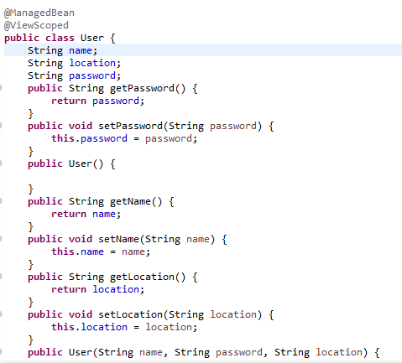
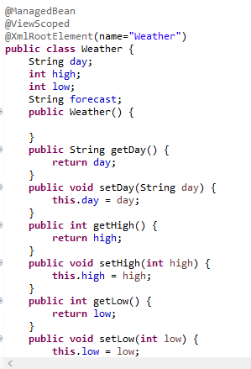
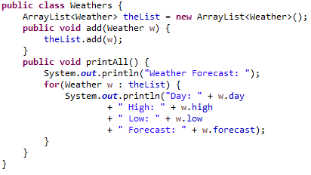
Beans

Slide 12
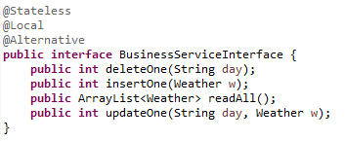
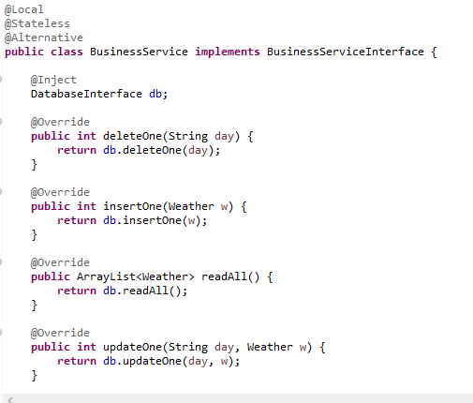
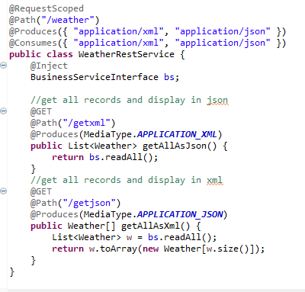
Business

Slide 13
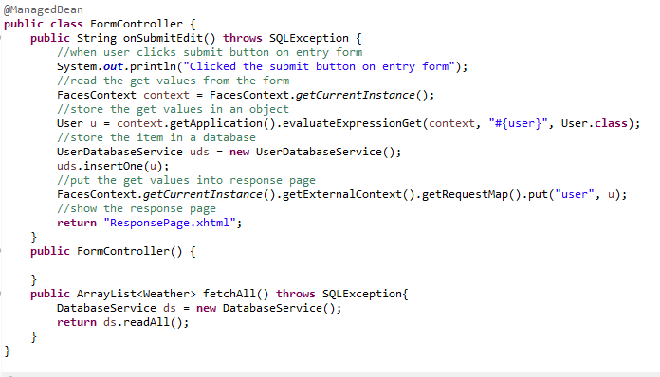
Controllers

Slide 14
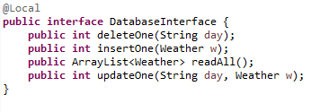
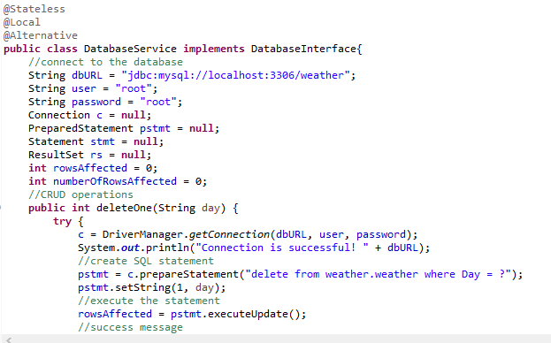
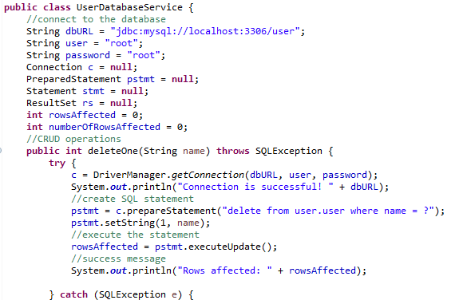
Database

