Slide 1
Aqua ShotLogger
2008-2014

Slide 2

Overview

Slide 3
Challenge – Flexibility
Data structure designed by customers
Interface designed by customers
User rights had to be considered
Auditing had to be considered

Slide 4
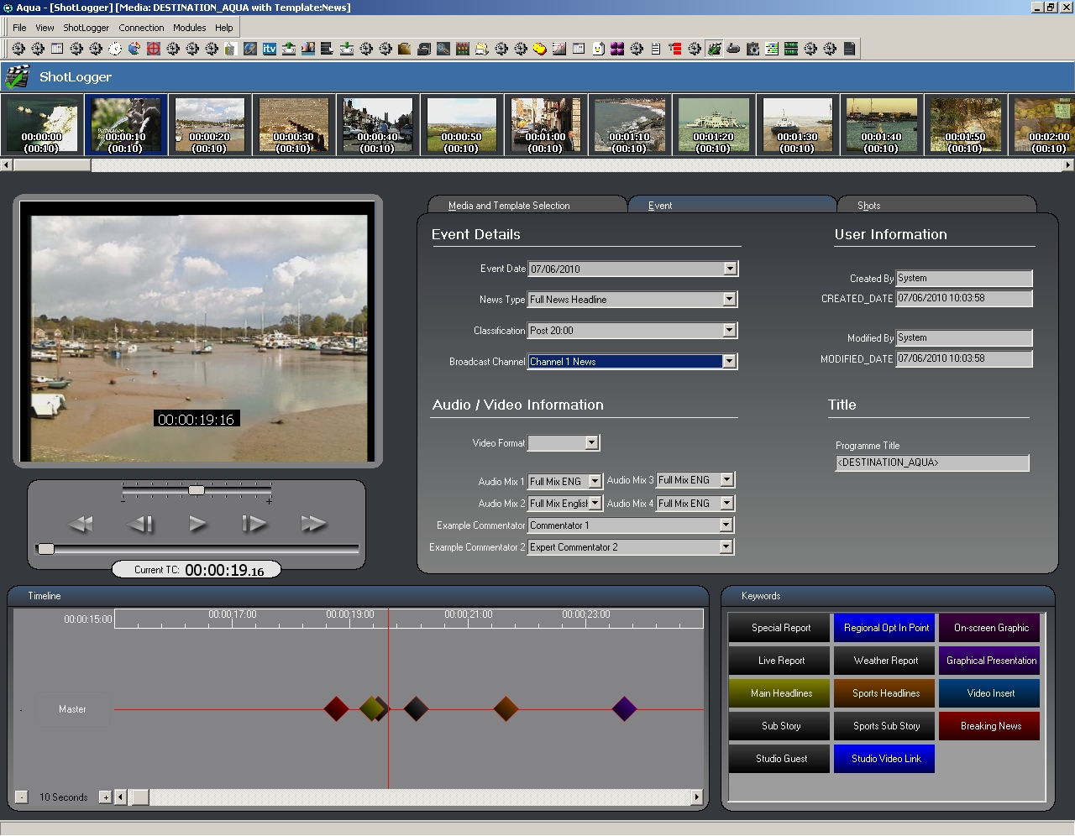
Solutions
Templates
Describe structure not content
Designed through a separate interface
Consider user rights
Dynamic Forms
Describe a piece of a user interface
Loaded from file or via SOAP
Contain references to the template

Slide 5
Solutions
Metadata Library
Load template instructions into dynamic forms
Load metadata into dynamic forms
Database
Normalised table structure for efficiency and flexibility
Template tables
Metadata storage tables linked to media records and templates
Auditing history

Slide 6
Teething Issues
Template complexity
Congested IP networks
Resolved through
Indexing components
Asynchronous communication to server

Slide 7
Product Evolution
Negative editing with metadata
Special effects & multi track editing
Live editing experiment

Slide 8
Product Spin Offs
MetaGenus – pre-media metadata editing
Clipper – standalone clip extraction

Slide 9
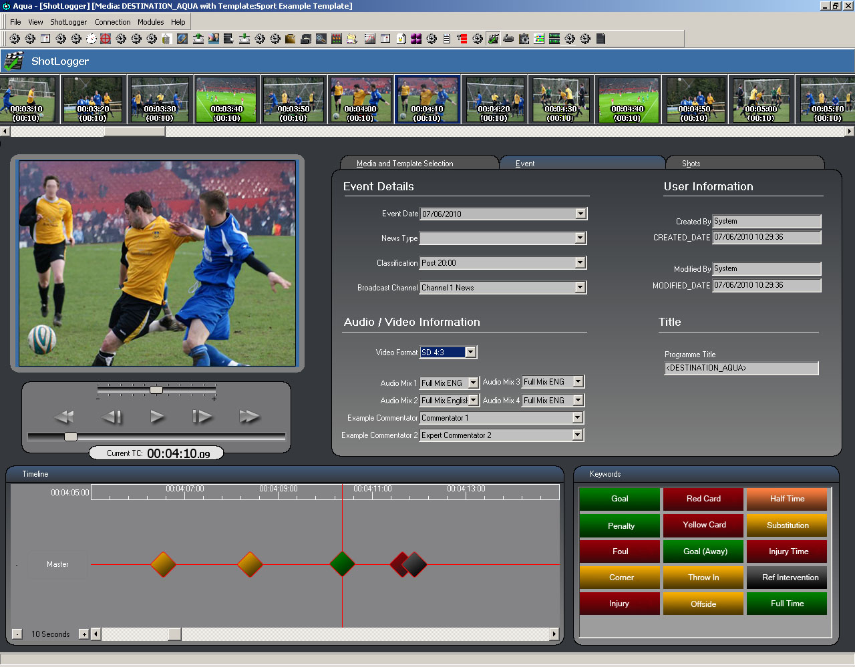
Questions

