Slide 1
AWS - Employee Directory Application

Slide 2
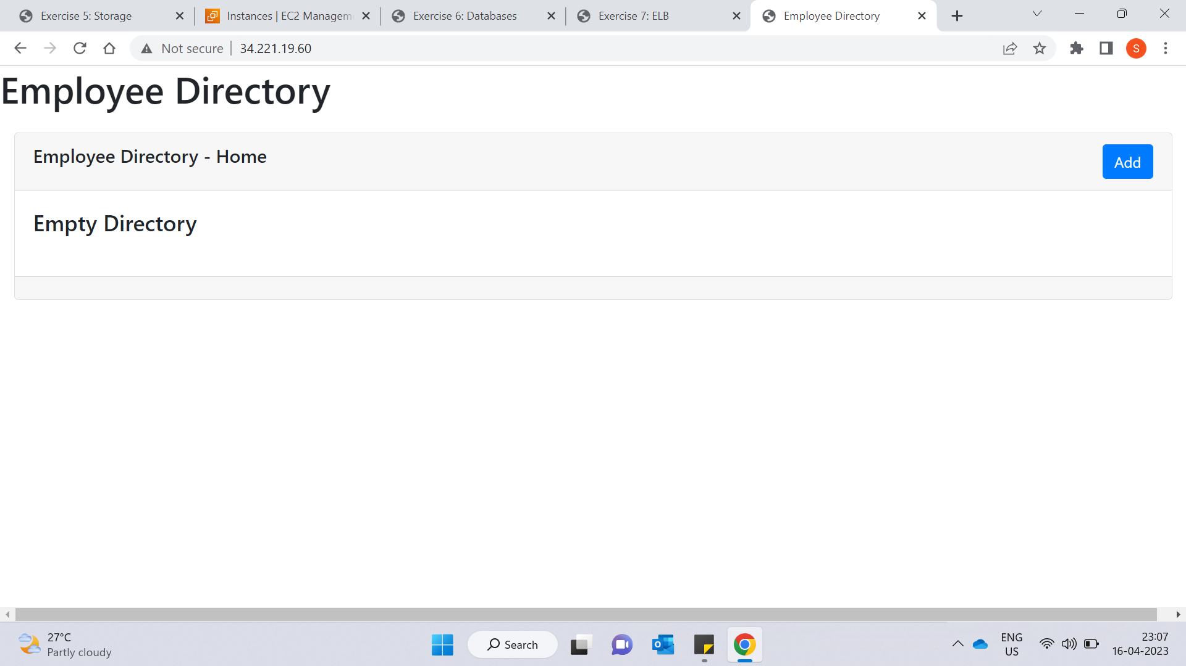
Placeholder

Slide 3
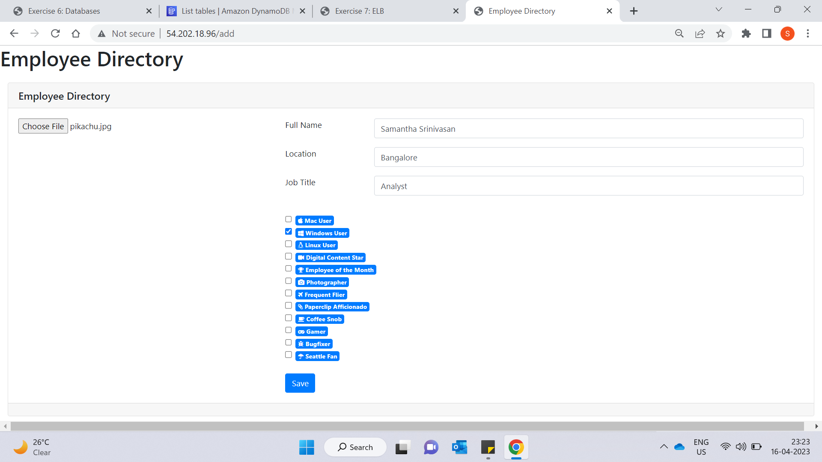
Form

Slide 4
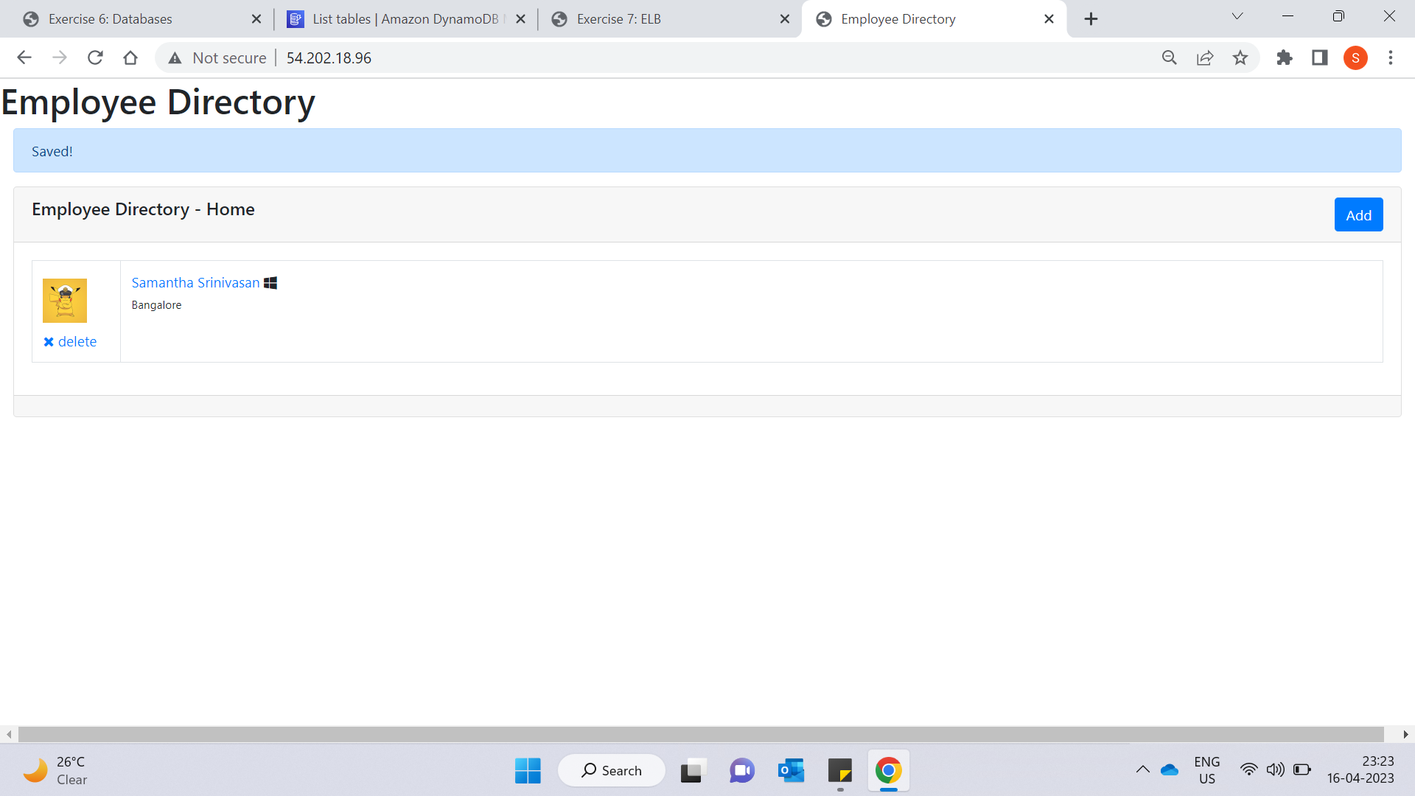
Add Values

Slide 5
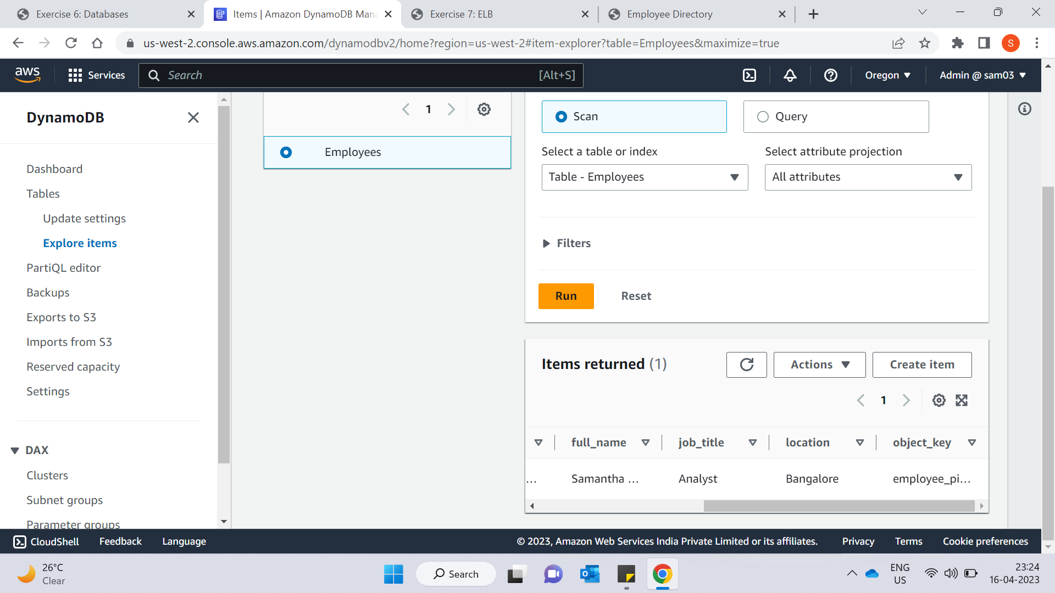
DynamoDB Values

Slide 6
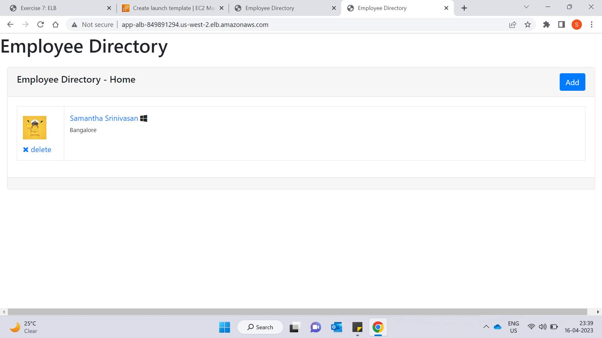
ELB View

Slide 7
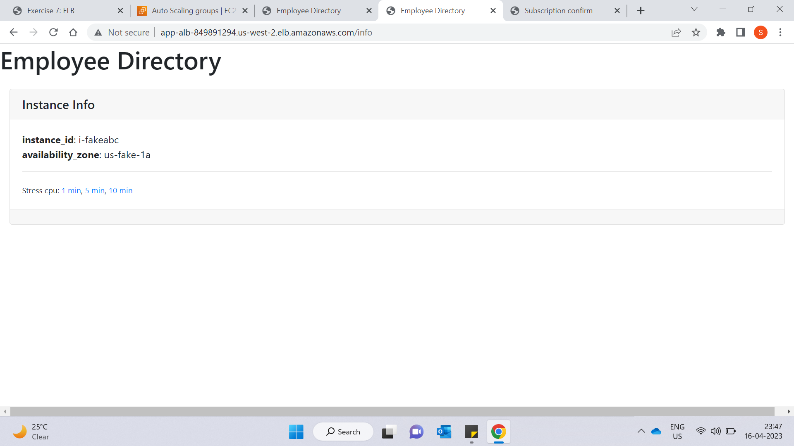
ELB Info

Slide 8
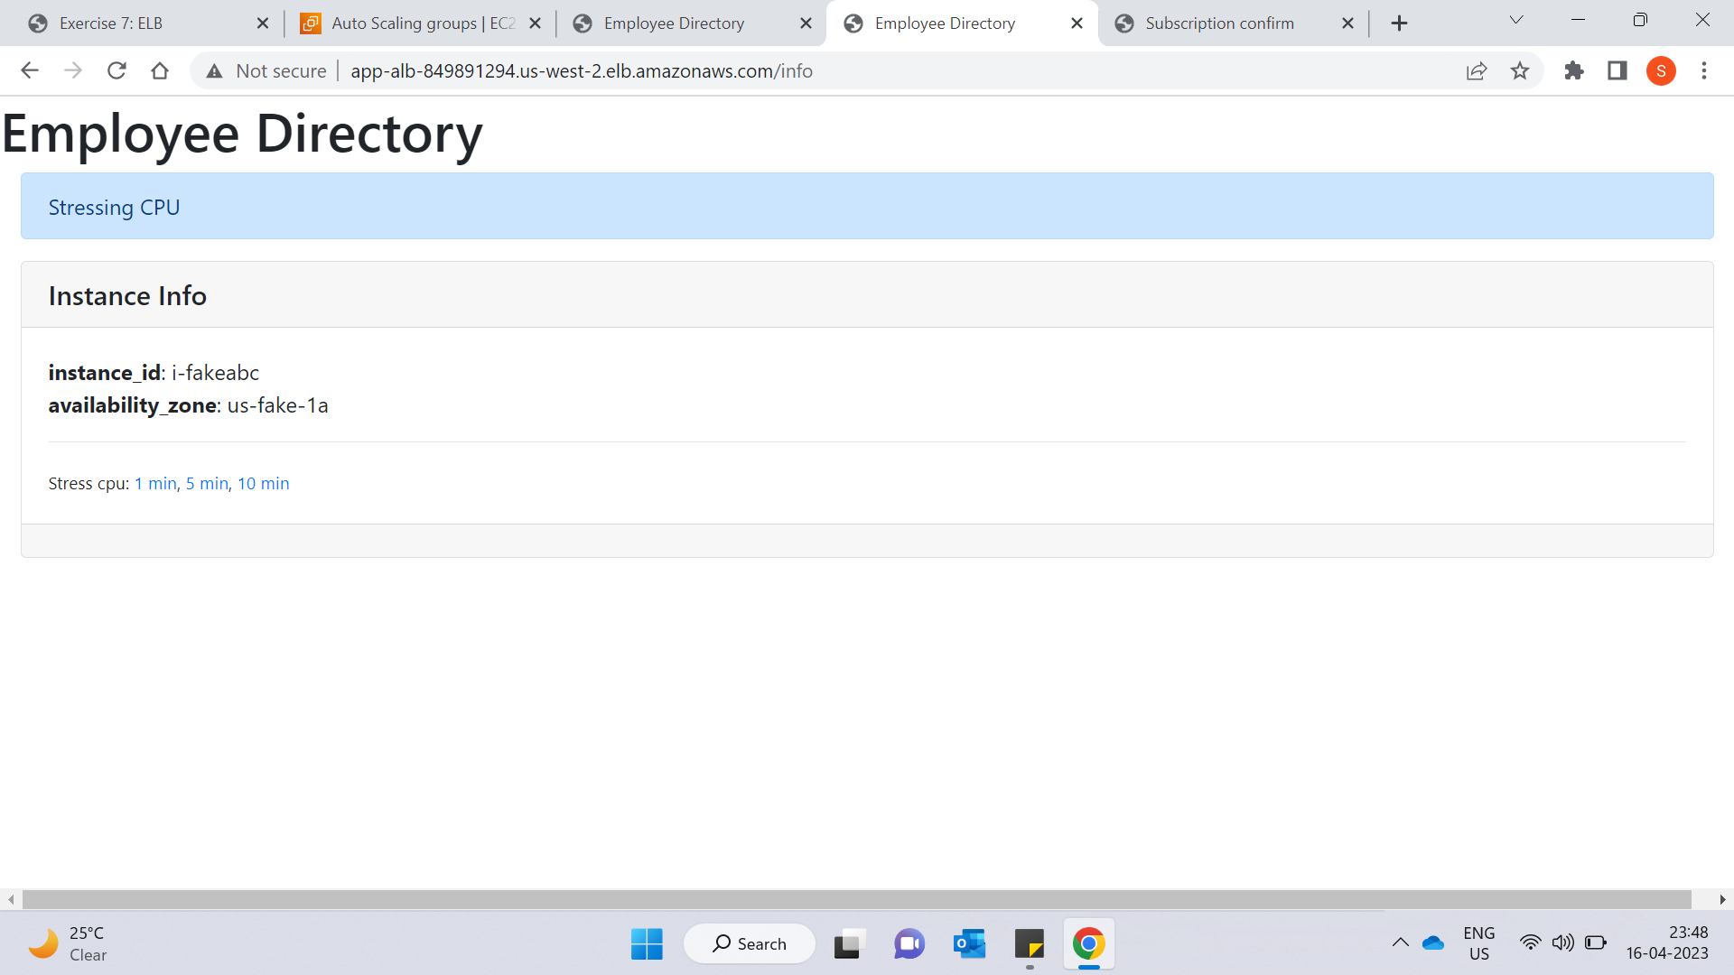
Stressing CPU

Slide 9
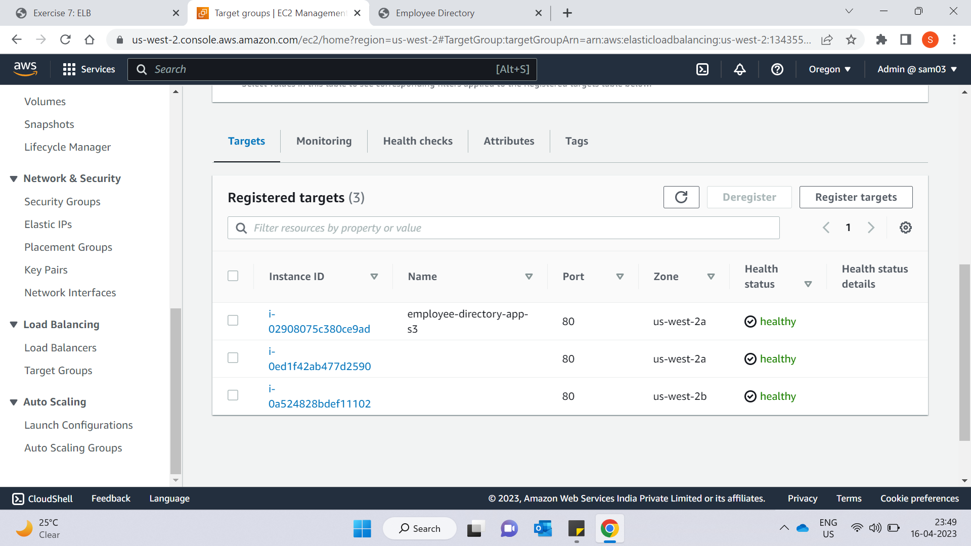
Autoscaling Instances

Slide 10
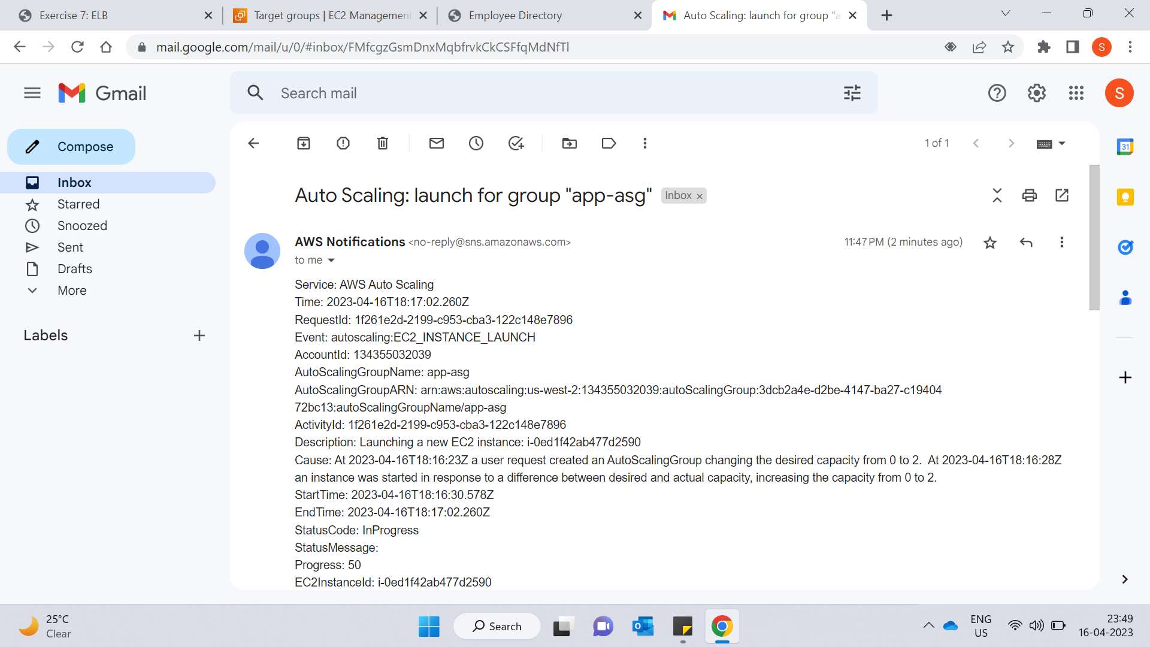
Email Notification Of New Instance

Slide 11
AWS Cloud & Python

Slide 12
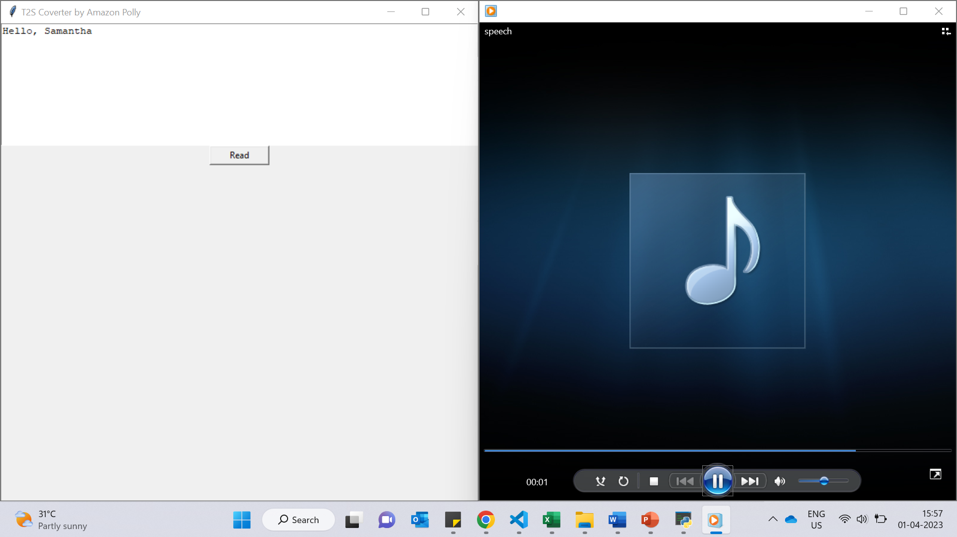
Text To Speech

Slide 13
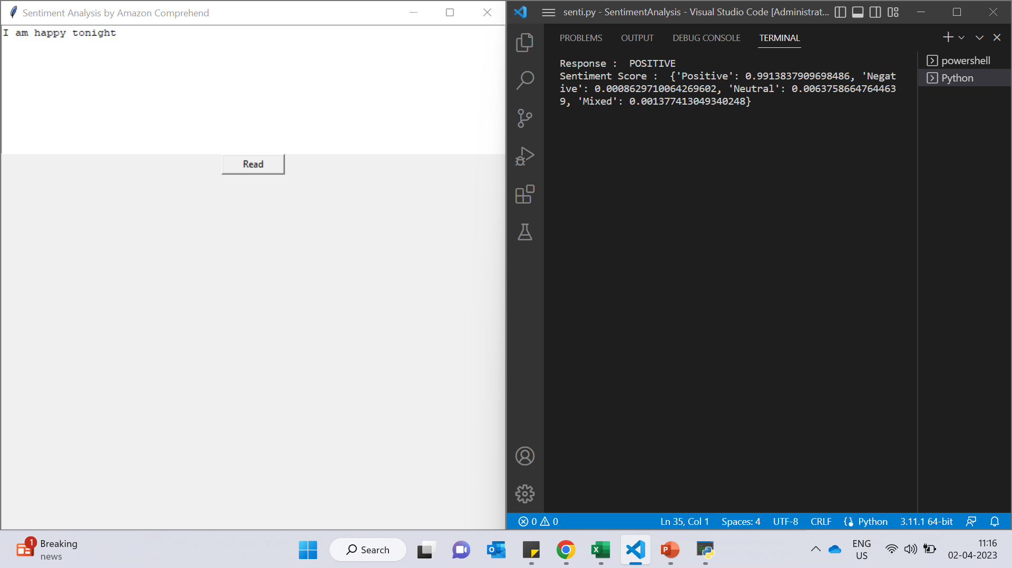
Sentiment Analysis

Slide 14
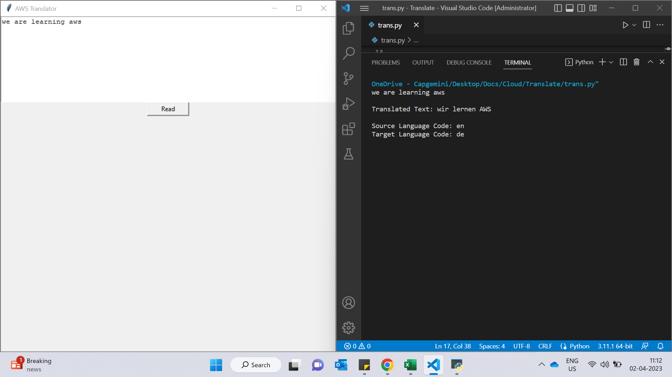
Translator

Slide 15
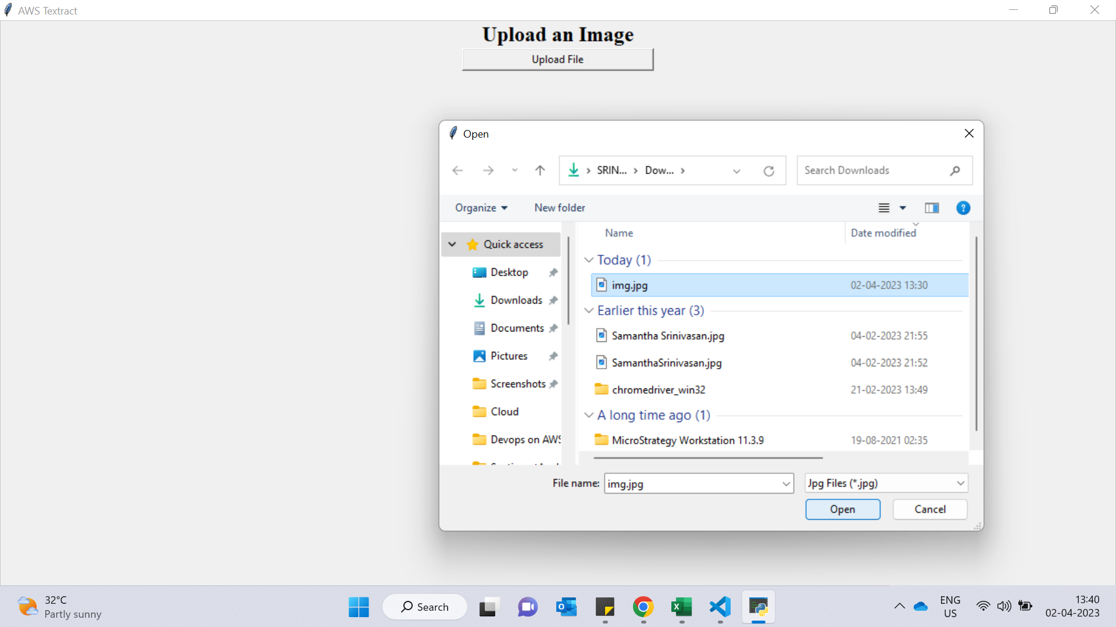
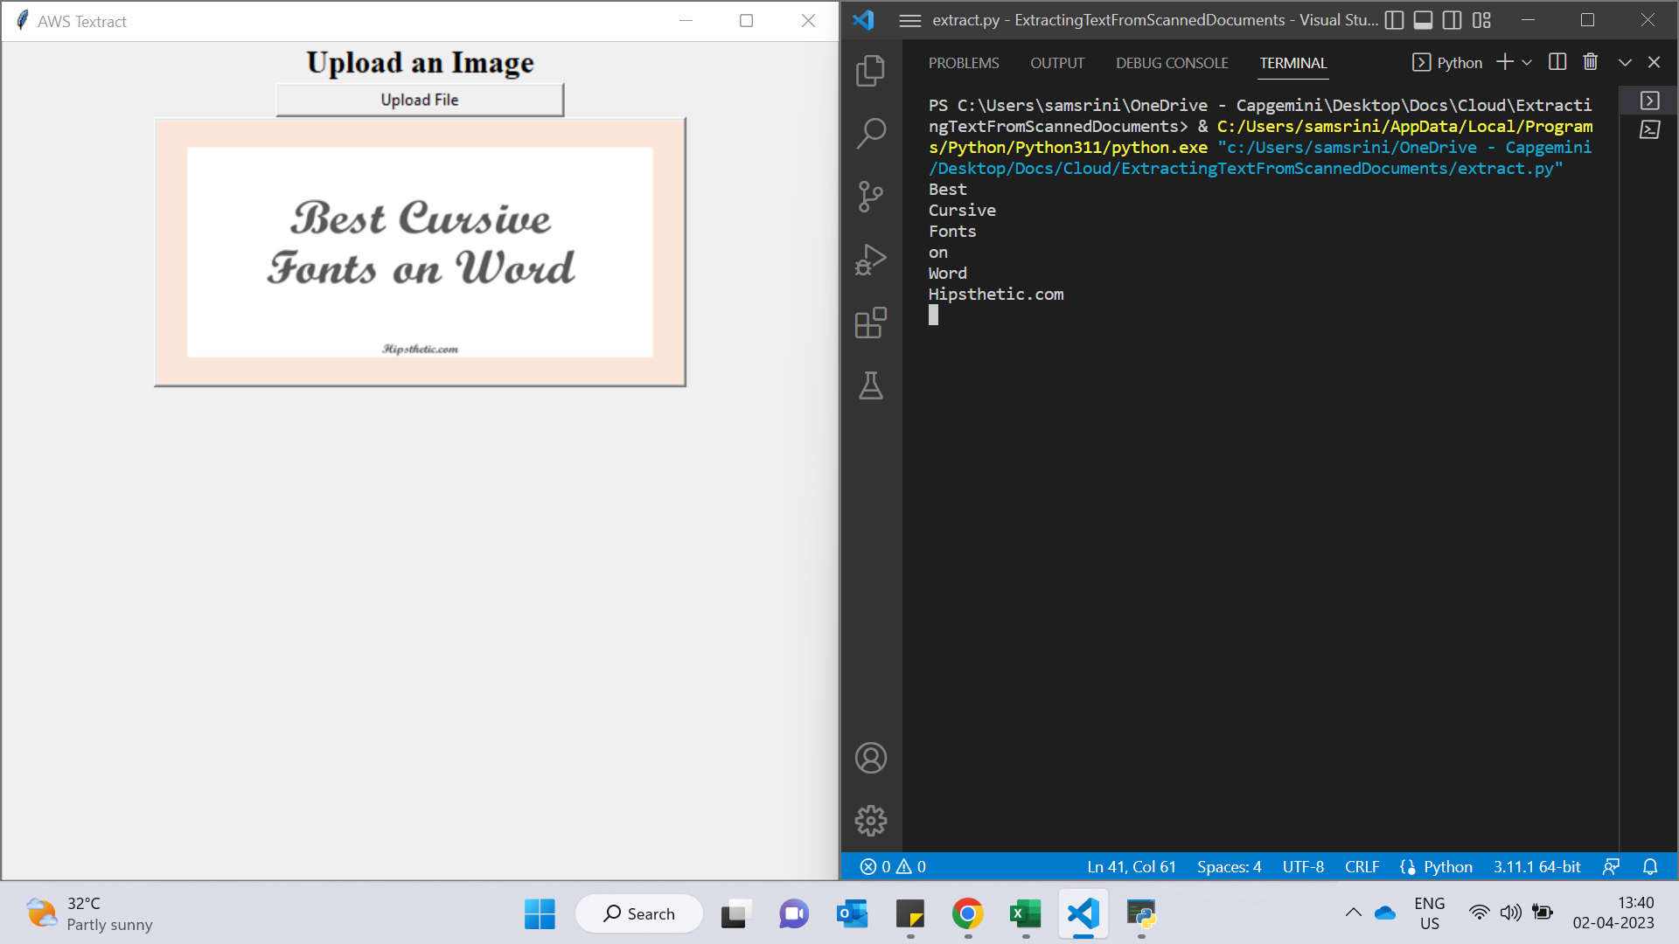
Extracting Text From Scanned Documents

