Slide 1
AWS - Employee Directory Application

Slide 3
AWS Cloud & Python

Slide 4
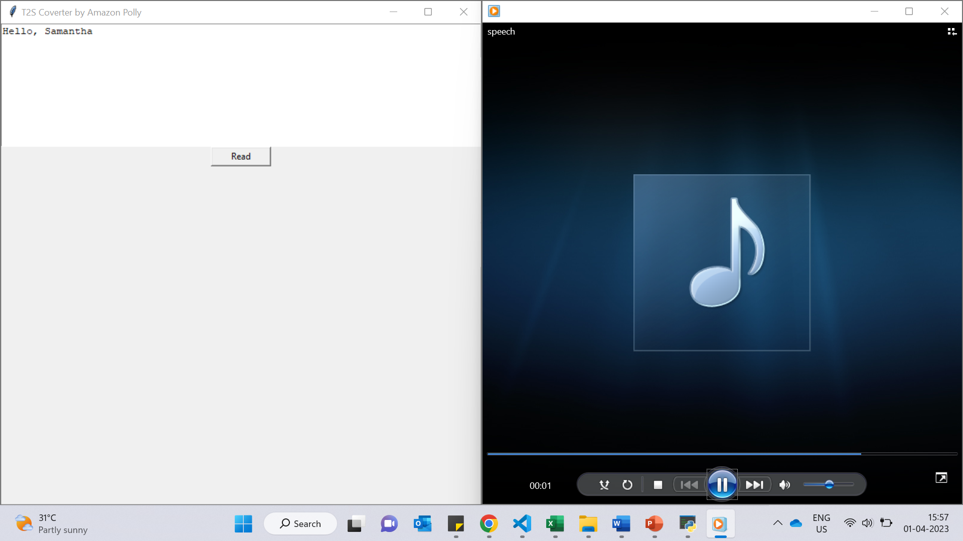
Text To Speech

Slide 5
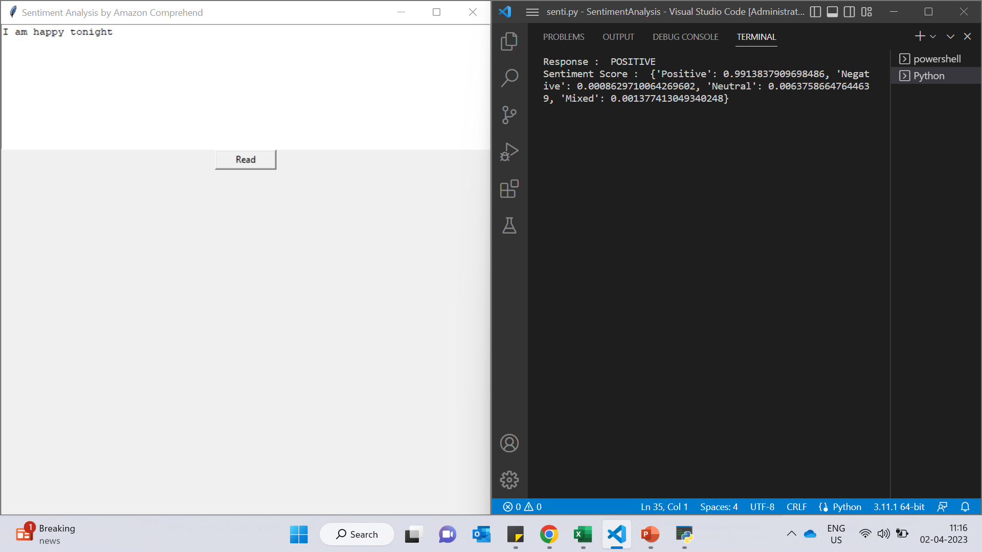
Sentiment Analysis

Slide 6
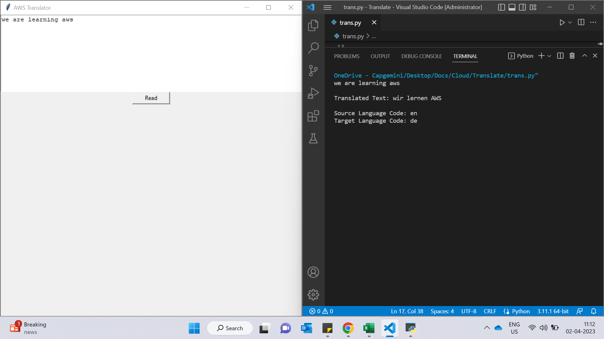
Translator

Slide 7
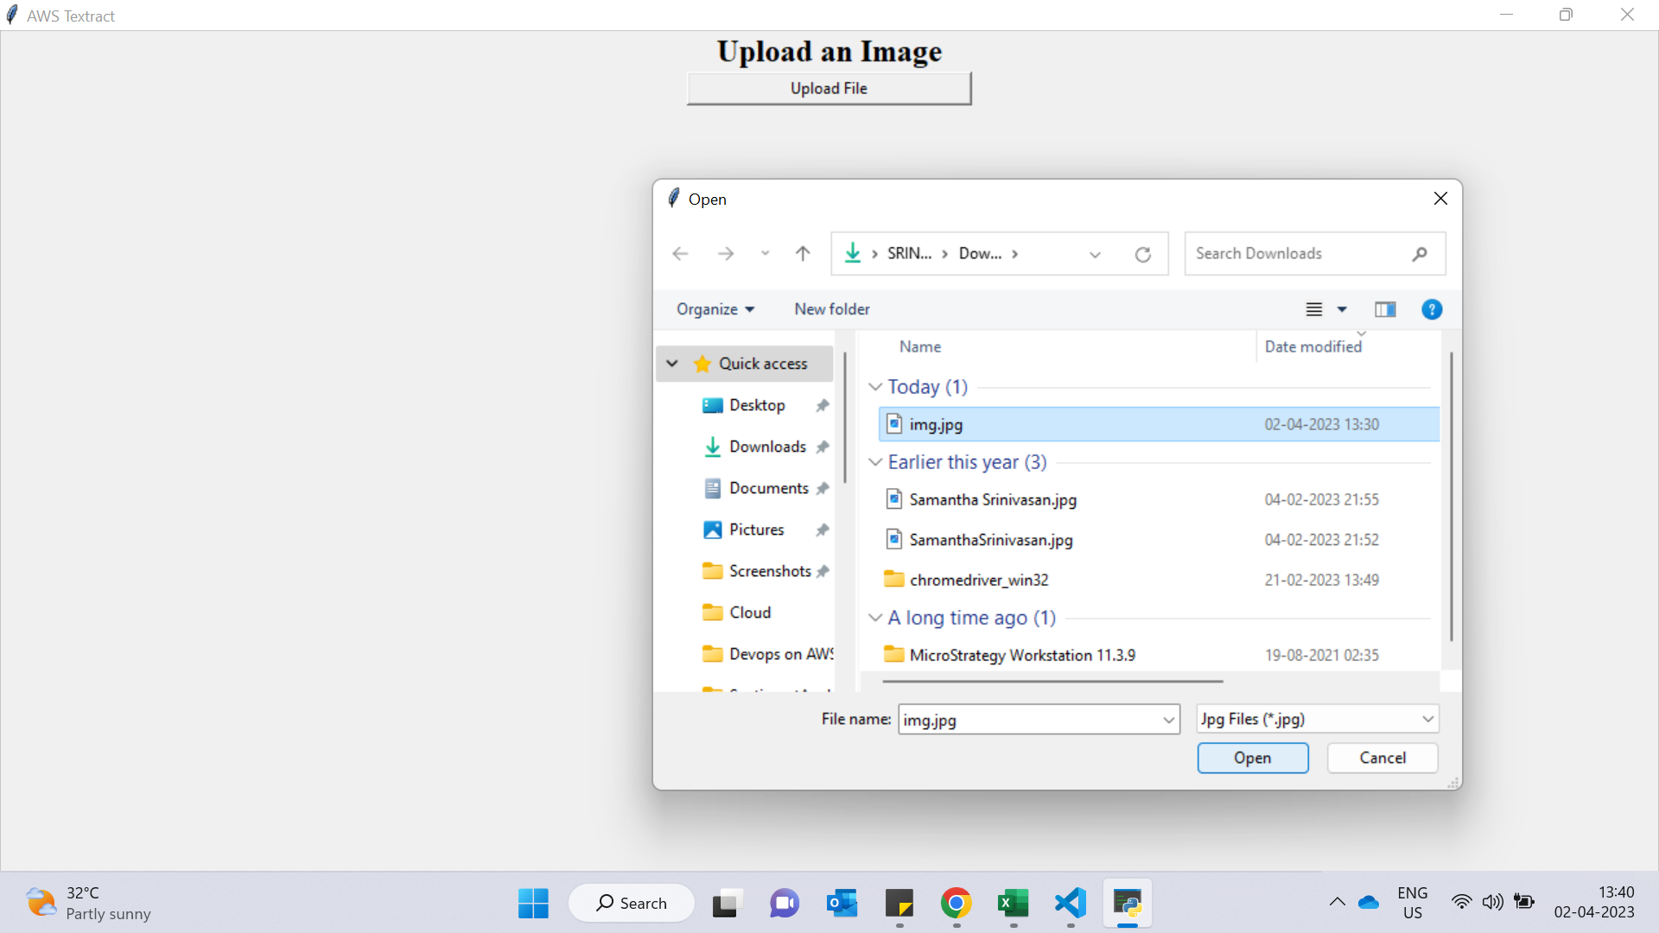
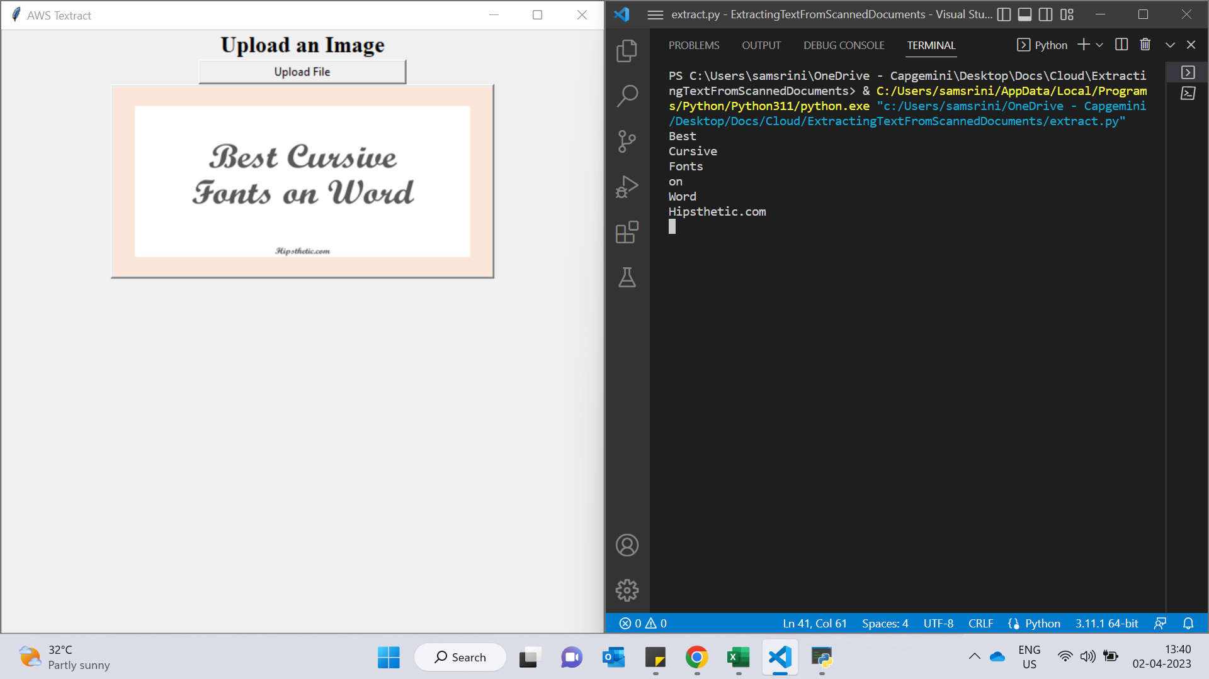
Extracting Text From Scanned Documents

