Slide 1
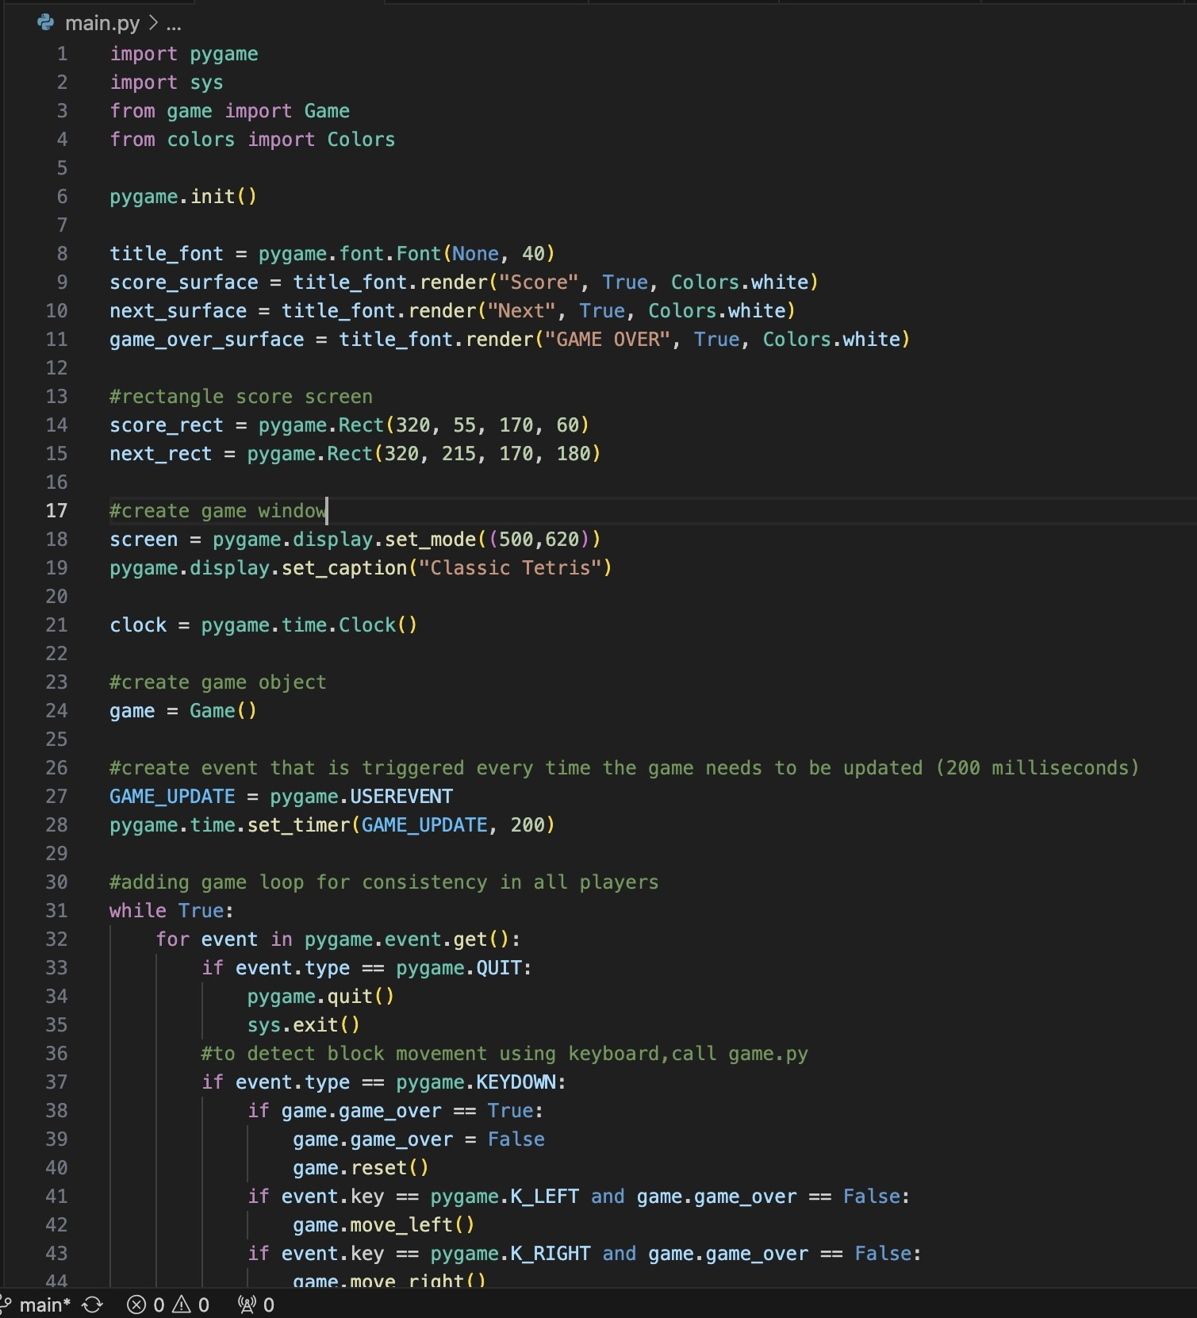
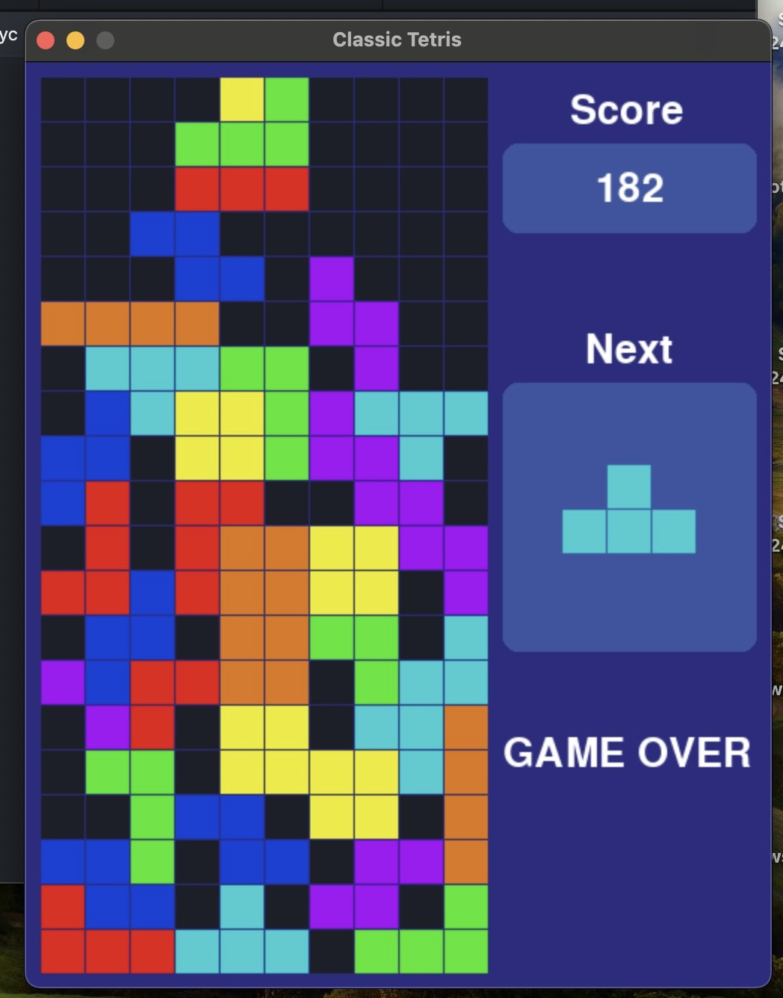
Classic Tetris Game BY: Samantha Julian
This is a small portion of the code used to make the game
This program allows users to play the classic Tetris game, with a scorecard on the side. The goal is to make complete rows using the game pieces. You can rotate each piece by clicking the right or left arrows. The down key will make pieces drop faster. The code was made using pygame.
https://github.com/Samanthajulian/classic-tetris

