Slide 1
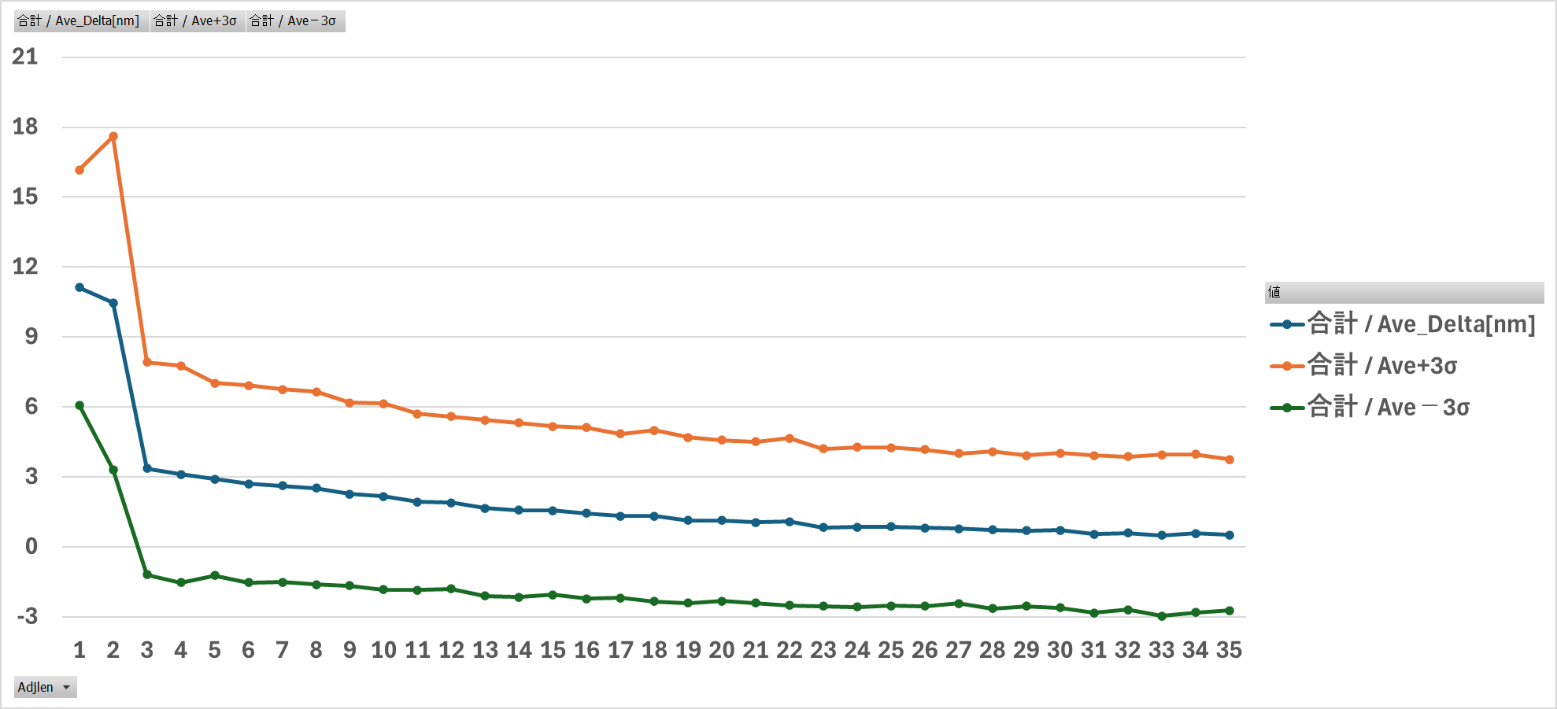
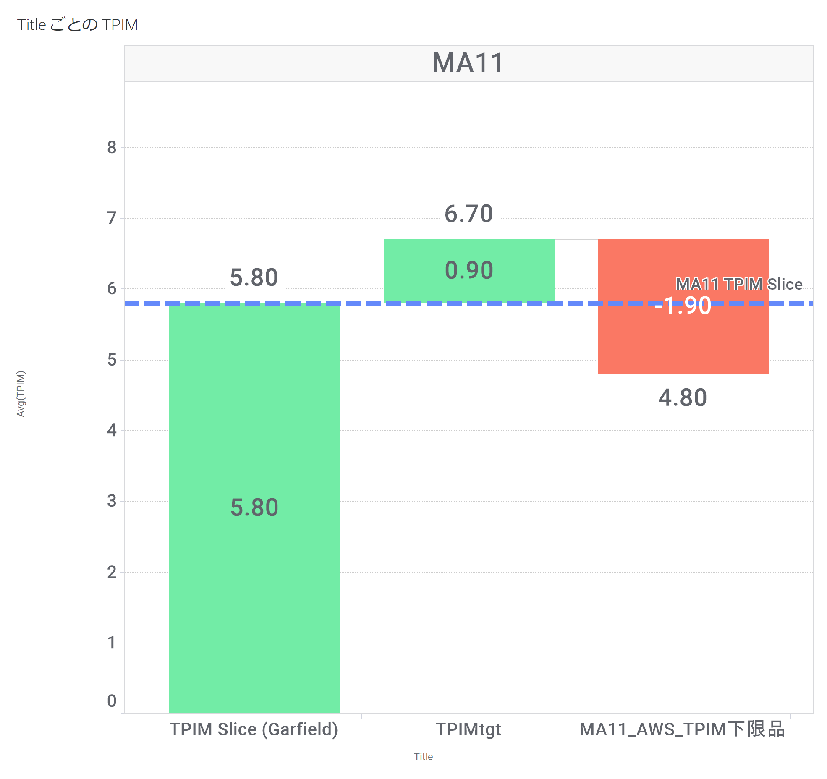
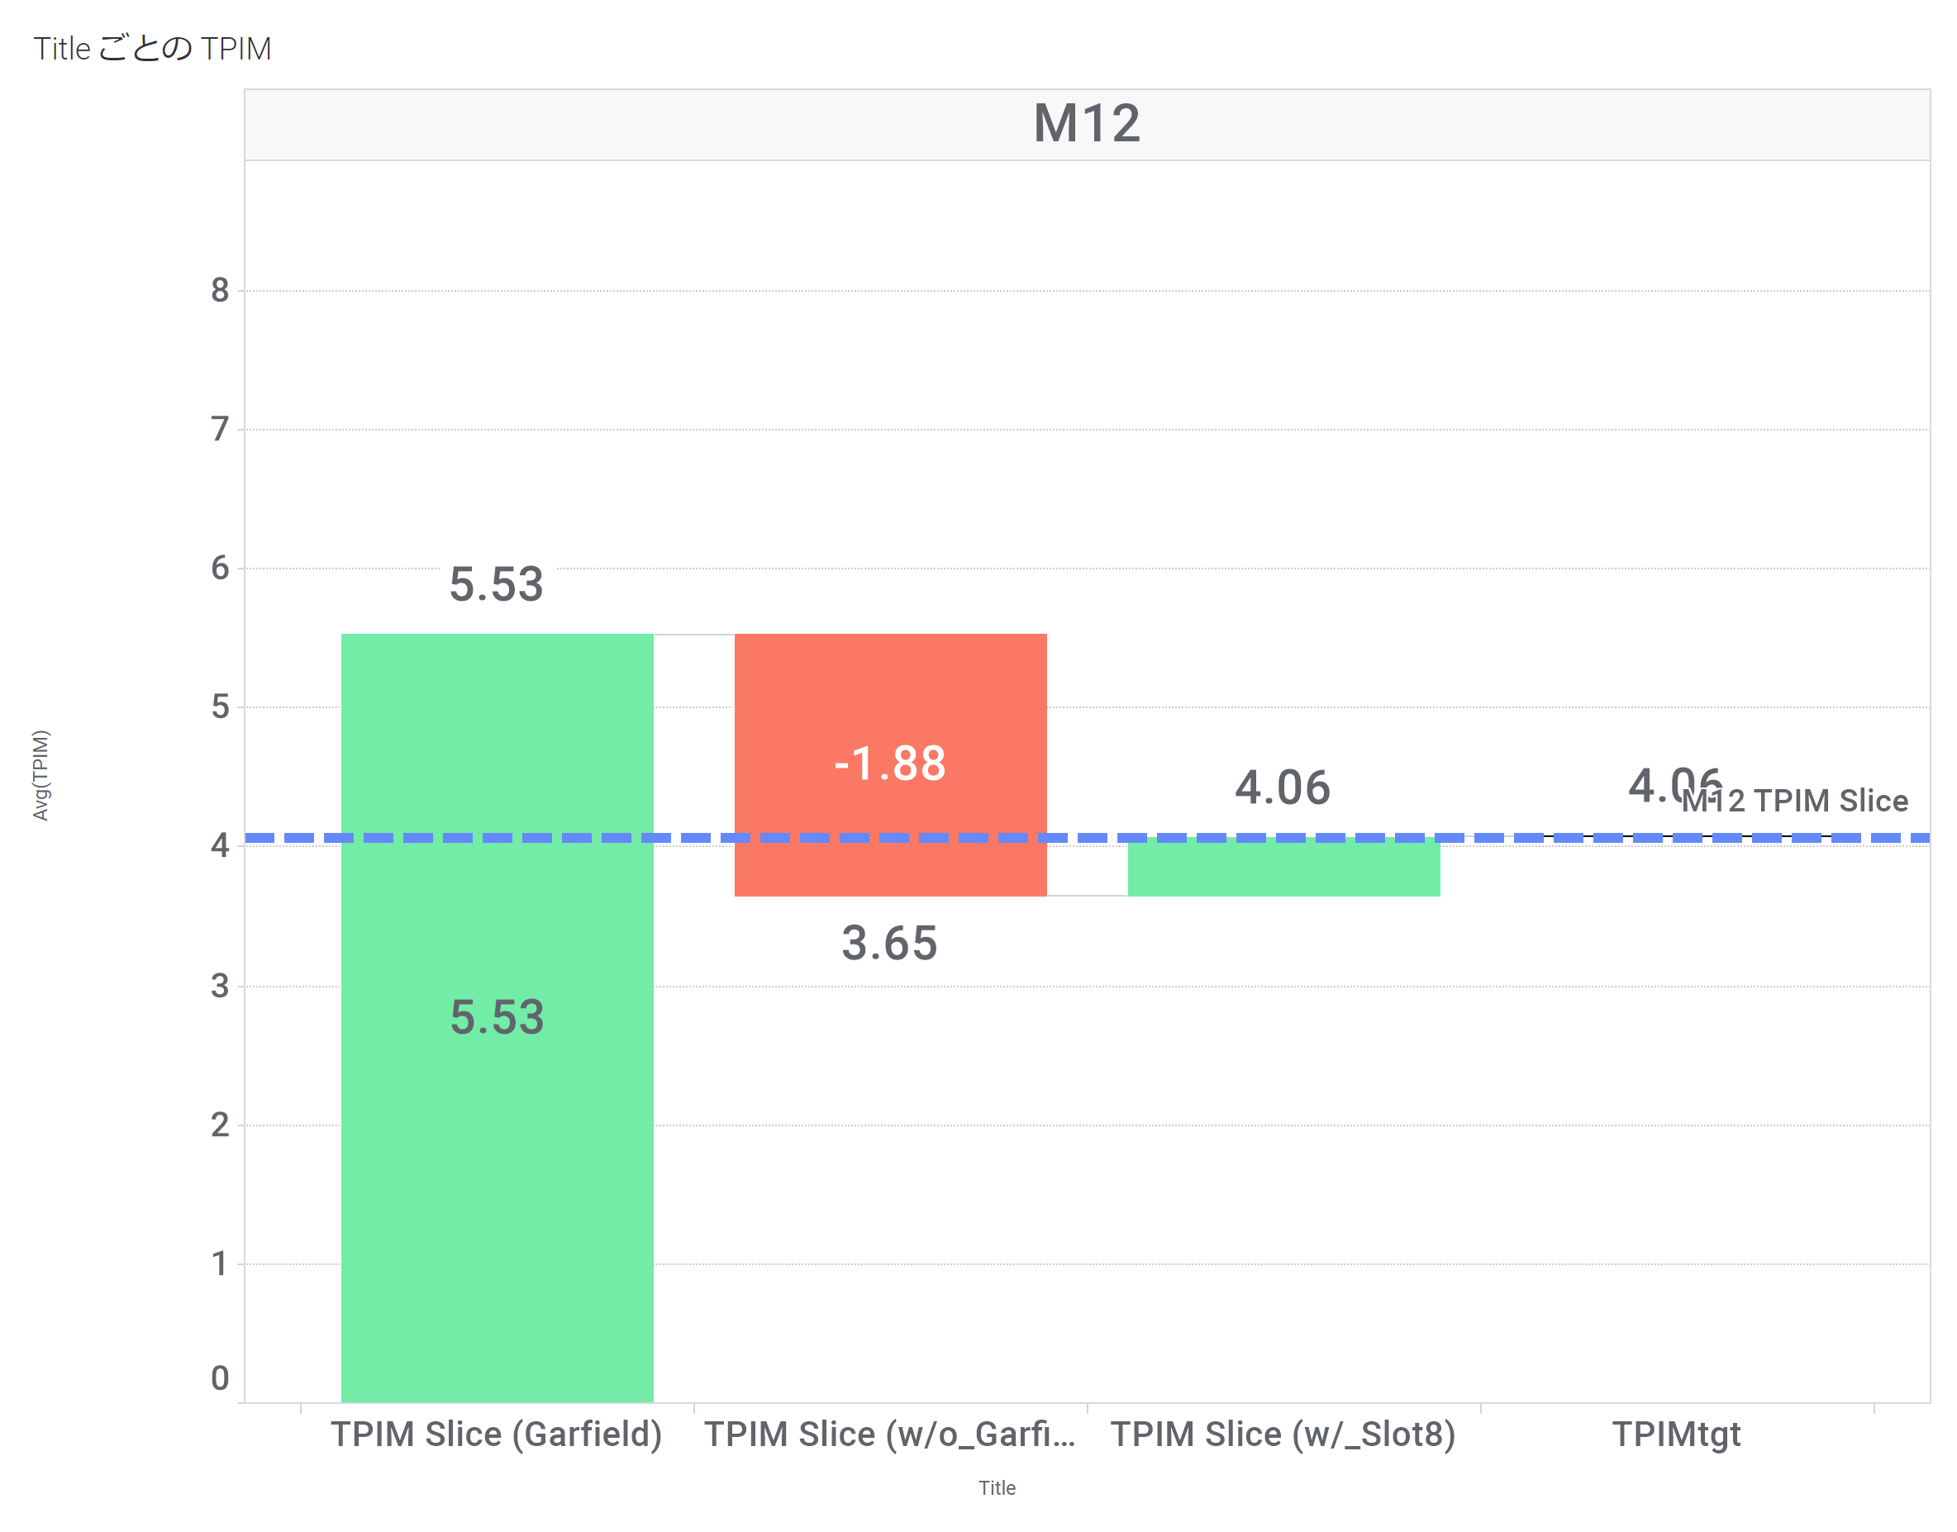
TPIM Exceed Slice/Actual TPIM Stand Position Diagram (-1.72 Power Standard)
TgtTPIM is designed to be 0.9nm for TPIM over-slice and ±0nm for MA11 and M12.
Actual TPIM Distribution
Guarantee Onthefly in PTS (during daytime)
Hd/Zn Variability Consideration
TPIM exceeds slices @ 10^-4
Hd/Zn Variability Consideration
TPIM exceeds the slice
TECC Correction Table
MA11
Final Design
Target
MA11
Minimum grade product
Trial
Rescue on Read Retry

