Slide 1
Unlocking the Language of Signs: Auslan Recognition through Machine Learning
By
Samanvaya Arava

Slide 2
Project Proposal

Slide 3
Project Proposal
Targeted Problem:
Building a machine learning model to recognize Australian Sign Language (Auslan) signs.
Justification: Educational and Assistive Technology, Such a model can be integrated into educational tools, communication devices, and assistive technologies to empower individuals who use Auslan as their primary means of communication.
Research question
Can we create a machine learning model for dataset that correctly decodes Auslan signs, and if so, how can we improve it?
Dataset
Australian Sign Language signs - UCI Machine Learning Repository
This dataset comprises 6,650 samples, representing 95 distinct Auslan signs.
Motivation
Developing a machine learning model for Auslan sign recognition involves complex sequence classification, which is a challenging problem in computer vision
The potential applications of such a model in assistive technology, education, and communication systems are significant.
Contributing to a project that promotes inclusivity and accessibility for the Deaf and Hard of Hearing community is a noble and motivating endeavor.The project offers an opportunity to work on a socially impactful and technically challenging problem.

Slide 4
Literature Review

Slide 5
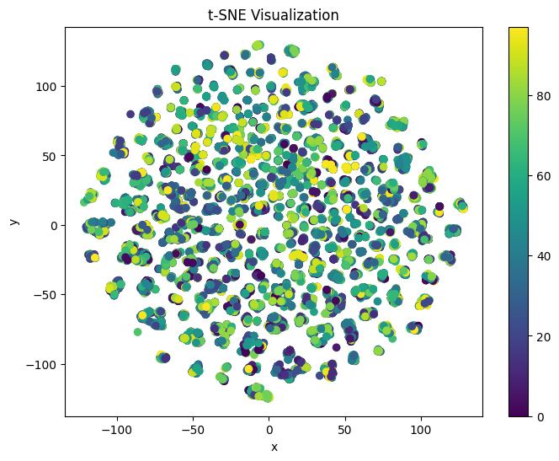
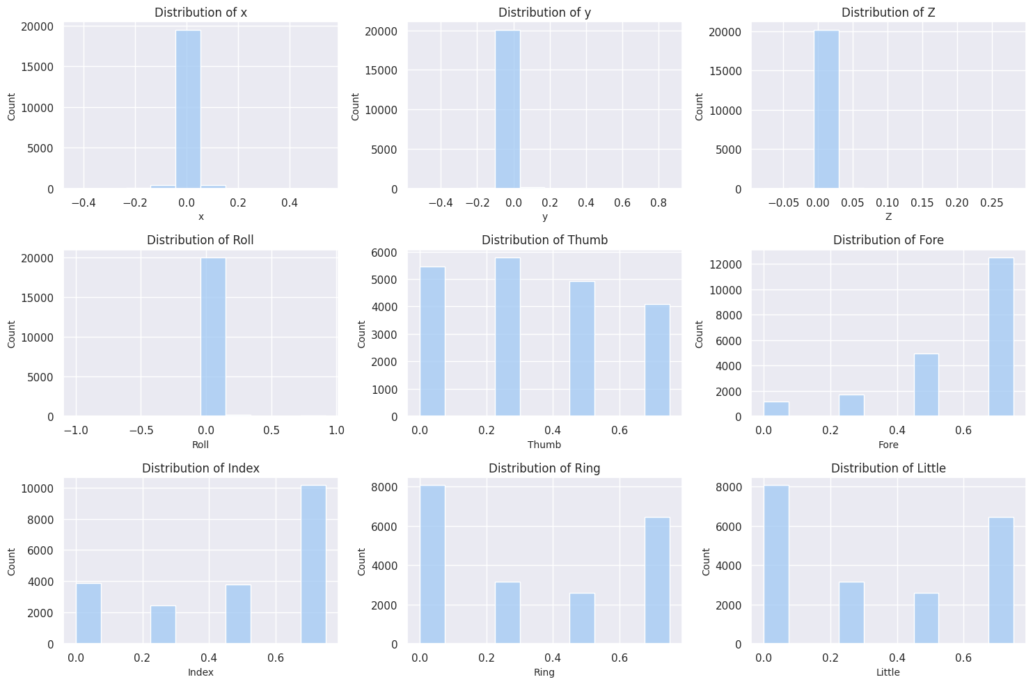
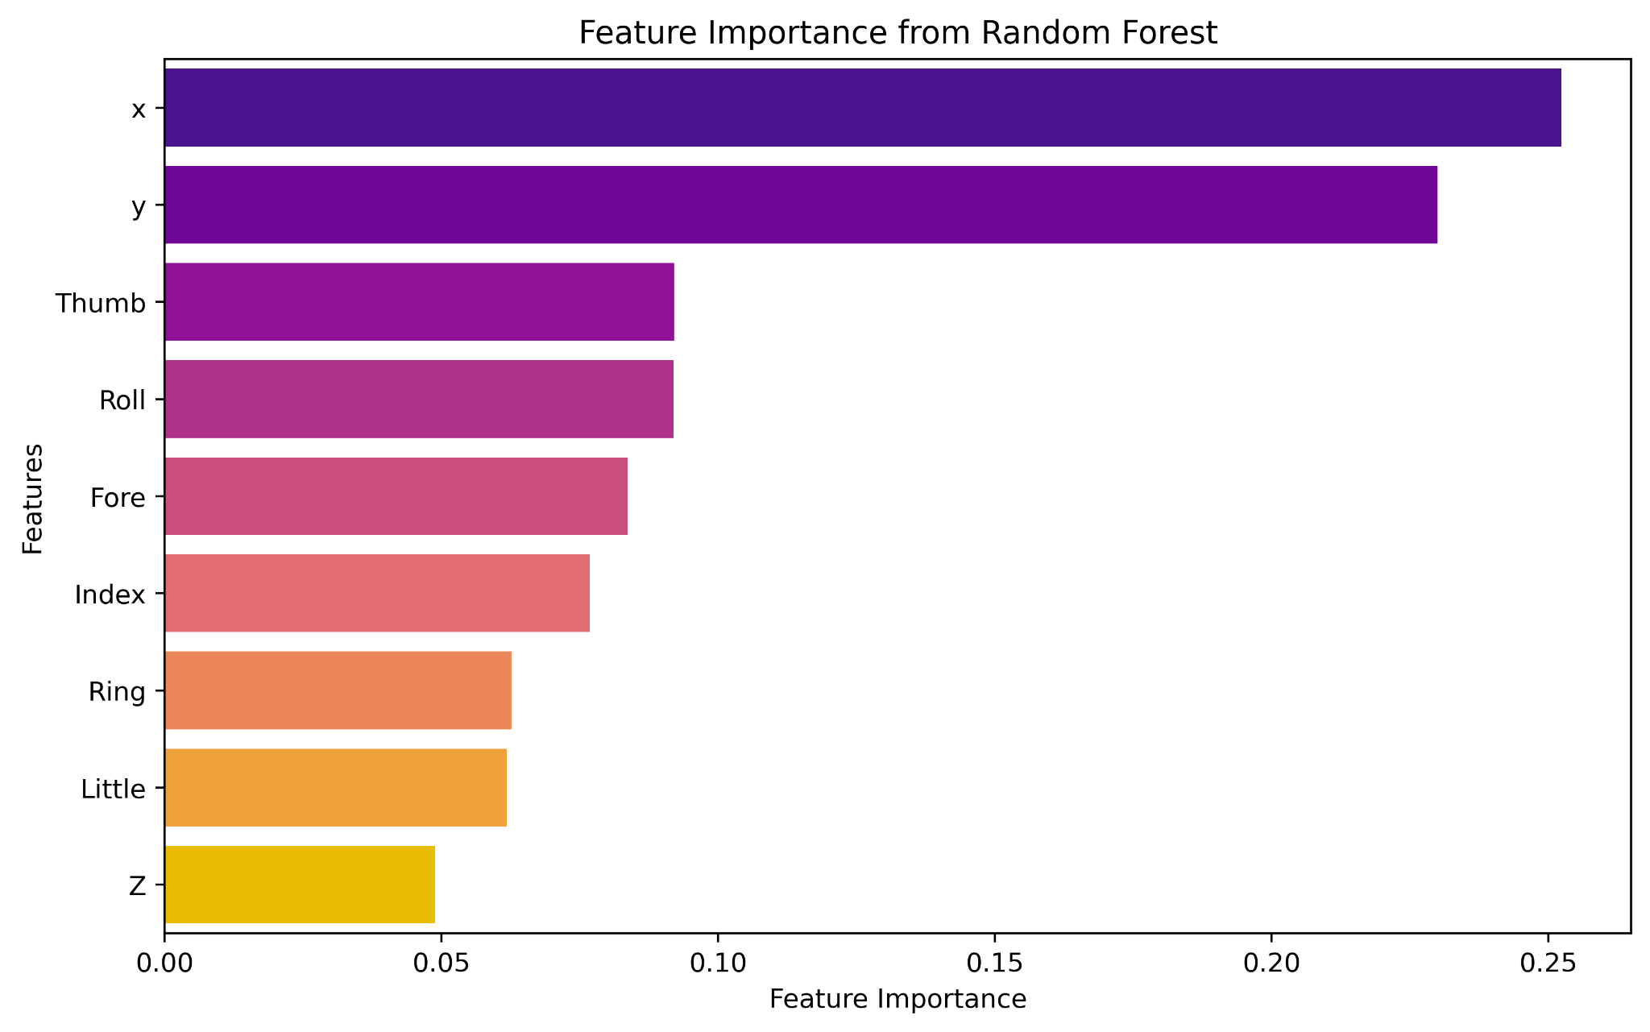
EDA

Slide 6
Methodology and Next steps
Data Preprocessing:
Feature Engineering: Identify crucial features for Auslan sign recognition.
Normalization: Ensure consistent feature scales.
Handle Missing Data: Use appropriate imputation techniques.
Feature Selection:
Statistical Methods: Use correlation analysis for relevant feature selection.
Dimensionality Reduction: Apply PCA for reduced feature space.
Model Selection:
Algorithm Choice: Experiment with Decision Trees, Random Forests, SVM, CNN, or RNN.
Hyperparameter Tuning: Use grid search or random search for optimal settings.
Ensemble Techniques: Explore Bagging or Boosting for improved accuracy.
Model Training and Validation:
Training and Validation: Split data, train models, and validate using accuracy metrics.
Model Evaluation and Fine-Tuning:
Evaluation Metrics: Assess models using key metrics like accuracy, precision, recall, and F1-score.
Fine-Tuning: Adjust models based on evaluation results.
Iterative Model Refinement:
Refinement: Iteratively refine models based on feedback.
Error Analysis:
Identify Patterns: Analyze misclassifications for improvement insights.
Address Class Imbalance:
Imbalanced Data: Implement oversampling, undersampling, or specialized algorithms.
Interpretability and Visualization:
Visualize Decisions: Use LIME for interpreting complex model predictions.
Documentation and Reporting:
Document Findings: Prepare detailed reports summarizing experiments and challenges.

Slide 7
Results
Initially the the model were train with TWO CLASSES, then THREE classes and so on.
Binary Classification:
XGBoost Outperforms DT and RF:
Accuracy for XGBoost: 90.00%
Accuracy for Decision Trees (DT): 89.22%
Accuracy for Random Forest (RF): 89.22%
Highlight the superiority of XGBoost in achieving the highest accuracy among the three models.

Slide 8
Literature Review (1)
The SVM, SimpSVM and RVM on Sign Language Recognition Problem
Research question(s) / Goal
Investigate the feasibility and effectiveness of vector machine learning methods, namely Support Vector Machine (SVM), Simplification of Support Vector Machine (SimpSVM), and Relevance Vector Machine (RVM) in solving the sign language recognition problem.
Dataset - Australian Sign Language signs - UCI Machine Learning Repository
Methodology
Support Vector Machines (SVM): SVMs were employed for binary-class classification. The decision function was calculated using kernel functions, and the parameters were determined through training.
Simplification of Support Vector Machine (SimpSVM): SimpSVM aims to reduce the number of support vectors, thus simplifying the classification model while maintaining accuracy. It selects a reduced set of vectors to approximate the original separating hyperplane.
Relevance Vector Machine (RVM): RVM relies on a Bayesian framework, where weights and hyperparameters follow Gaussian priors. It integrates weight parameters into an objective function and employs iterative re-estimation to optimize the model.
For multi-class classification, one-vs-one and one-vs-all strategies were used to combine multiple binary-class classifiers.
Results & Limitations
SVM, SimpSVM, and RVM achieved top-notch predictive performance in Auslan sign language recognition. These methods showed similar accuracy regarding feature changes and specific sign. SimpSVM and RVM outperformed SVM in testing speed due to fewer support vectors/basis functions. However, the research highlighted challenges in recognizing signs that subtly change over time despite high accuracy.
The study did not explore the performance of deep learning models, which have shown promising results in gesture recognition tasks.
The research did not address real-time recognition challenges, which are crucial for practical applications in sign language communication systems.

Slide 9
Literature Review (2)
Classification of Multivariate Time Series and Structured Data Using Constructive Induction
Research question(s) / Goal
Explore the effectiveness of constructive induction in classifying multivariate time series and structured data, with a focus on applications such as Auslan recognition.
Dataset - Australian Sign Language signs - UCI Machine Learning Repository
Methodology
Feature Engineering:
Extracting relevant features from both time series and structured data.
Possibly converting time series data into appropriate formats for analysis.
Constructive Induction:
Implementing constructive induction algorithms to build and refine classification models.
Fine-tuning parameters and algorithms for optimal performance.
Results & Limitations
Presenting the performance metrics obtained from the constructive induction models in classifying multivariate time series and structured data.
Comparing these results with other classification methods, if applicable.
Visualizations, such as confusion matrices or ROC curves, might be used to illustrate the model's performance.
Addressing potential biases in the dataset or methodology.
Considering the generalizability of the results to other datasets or real-world applications.

Slide 10
Literature Review (3)
Temporal Classification: Extending the Classification Paradigm to Multivariate Time Series
Research question(s) / Goal
explore how classification paradigms can be extended to effectively recognize and classify Auslan signs in multivariate time series data. Research questions could include inquiries about the challenges of interpreting Auslan gestures over time, especially considering the multivariate nature of sign language where multiple parameters (such as hand shape, movement, location, palm orientation, and facial expressions) change simultaneously.
Dataset - Australian Sign Language signs - UCI Machine Learning Repository
Methodology
Adapt classification algorithms for processing multivariate time series Auslan data.
Utilize feature extraction techniques to capture different signing parameters.
Implement temporal modeling methods to understand the sequential nature of signs.
Employ machine learning algorithms tailored for handling multivariate time series data.
Incorporate facial expression analysis as a significant aspect of sign language communication.
Results & Limitations
Present accuracy and effectiveness of adapted classification methods in recognizing Auslan signs.
Showcase success rates in identifying signs accurately, especially in cases with similar movements but differing facial expressions or subtle parameters.
Address complexities in capturing and interpreting facial expressions and other subtle parameters in signing.
Explore limitations concerning the generalization of the classification approach to various Auslan dialects and regional signing styles.

Slide 11
Literature Review (4)
American Sign Language Recognition Using RF Sensing | IEEE Journals & Magazine
Research question(s) / Goal
Investigate American Sign Language (ASL) recognition using RF (Radio Frequency) sensing technology. Specifically, the goal is to explore the feasibility and accuracy of recognizing ASL gestures through RF sensing techniques.
Dataset - ASL signs dataset
Methodology
RF Sensing Technology: The researchers utilized RF sensing, a technology that uses radio frequency signals to detect and analyze human gestures. This technology captures the subtle changes in RF signals caused by human movements, enabling the recognition of gestures without the need for cameras or physical contact.
Machine Learning Models: Machine learning algorithms, possibly including techniques like neural networks, random forests, or support vector machines, were employed to process the RF data and recognize patterns associated with different ASL gestures.
Training and Testing: The dataset was likely divided into training and testing subsets. The machine learning models were trained on a portion of the data and then tested on another portion to evaluate their accuracy and effectiveness in recognizing ASL gestures
Results & Limitations
Presented the results of the ASL gesture recognition using RF sensing technology. The outcomes could include accuracy rates, confusion matrices, and possibly comparisons with other recognition methods. The results would demonstrate the feasibility and effectiveness of using RF sensing for ASL recognition.
Accuracy Limitation: The accuracy of RF sensing technology might not be 100%, leading to occasional misinterpretation of gestures.
Environmental Factors: RF signals can be influenced by the surrounding environment, such as interference from other electronic devices, which might affect the recognition accuracy.

Slide 12
Literature Review (5)
Machine Recognition of Auslan Signs Using PowerGloves: Towards Large-Lexicon Recognition of Sign Language
Research question(s) / Goal
The research aims to explore machine recognition of Auslan (Australian Sign Language) signs using PowerGloves, a wearable technology. Specifically, the goal is to work towards achieving large-lexicon recognition of sign language, focusing on Auslan signs in particular.
Dataset - Australian Sign Language signs - UCI Machine Learning Repository
Methodology
PowerGloves Technology: The study involves the use of PowerGloves, which are equipped with sensors to capture hand movements and gestures. These gloves allow for precise tracking of finger movements and hand gestures, providing detailed data for sign language recognition.
Feature Extraction: Features are extracted using bounding box, histograms,x, y and z position, Wrist rotation and nger bend, Distance and energy and Time division.
Machine Learning Models: Machine learning algorithms, Instance-based learning and Decision tree building, have been used to process the extracted features and recognize patterns associated with different Auslan signs.
Results & Limitations
Presented the results of Auslan sign recognition using PowerGloves technology. Results would include accuracy rates, possibly categorized based on the complexity of signs, as well as comparisons with other recognition methods. The research might also demonstrate the capability of recognizing a large lexicon of Auslan signs using PowerGloves.
Variability in Signing: Different signers might perform the same sign slightly differently. Variability in signing styles and speeds can pose challenges to recognition systems.
Limited Lexicon: While the study might aim for large-lexicon recognition, there could still be limitations in the size of the lexicon covered, potentially limiting the practical applications of the system.

Slide 13
Literature Review (6)
SIGN LANGUAGE RECOGNITION USING MACHINE LEARNING
Research question(s) / Goal
How can machine learning techniques be effectively utilized for accurate sign language recognition across diverse sign languages?
Developed a robust and accurate sign language recognition system using machine learning algorithms that can interpret gestures from various sign languages with high precision and recall.
Dataset - ASL Alphabet
Methodology
Feature Extraction:
Use pre-trained CNNs (e.g., VGG, ResNet) for image features.Employ 3D CNNs or RNNs for capturing spatial and temporal features.
Model Development:
Experiment with 2D CNNs for images, 3D CNNs, or RNNs for videos.Implement models in TensorFlow or PyTorch.Utilize categorical cross-entropy loss, Adam/RMSprop optimization.
Validation and Fine-Tuning:
Split data into train, validation, and test sets.Tune hyperparameters: learning rates, dropout, regularization.
Optional Post-Processing:
Apply Hidden Markov Models (HMMs) for sequential sign refinement.Establish a feedback loop for continuous model improvement.
Results & Limitations
Present the accuracy, precision, recall, and F1-score achieved by the models on the test dataset. Include visualizations like confusion matrices to illustrate model performance. Compare your results with existing state-of-the-art systems if available.
Challenges in handling variations in sign gestures, lighting conditions, or the need for a large and diverse dataset. Address any ethical considerations, biases, or fairness issues that might have affected the results. Also, acknowledge computational limitations and areas where the model can be further improved.

Slide 14
Literature Review (7)
ML Based Sign Language Recognition System
Research question(s) / Goal
Proposing a basic automated Sign Language Recognition (SLR) system utilizing vision-based isolated hand gesture detection and recognition, employing convex hull for feature extraction and KNN (K-Nearest Neighbors) for classification, in interpreting and recognizing sign language gestures.
Dataset - ASL Dataset
Methodology
Feature Extraction:Feature extraction reduces computational costs by reducing the dimensionality of preprocessed images. Principal Component Analysis (PCA) and Convex Hull methods are employed to extract relevant features from hand gestures. Convex hulls are particularly effective for capturing finger and palm movements, crucial in sign language recognition.
Classification: Different classification algorithms such as lazy learner category, the K-Nearest Neighbors (KNN) algorithm. KNN classifies images based on feature vectors extracted from training images. The choice of distance metrics significantly impacts the algorithm's performance, with Euclidean Distance being the most widely used.Eager Learning Classifiers, These classifiers form a model before the training data is fed into it. As a result, the model requires a large amount of training time and less time to predict. The most common examples of eager learning algorithms include SVM, Decision Tree,and Naïve Bayes, and ANN .
Results & Limitations
Present the accuracy and performance metrics achieved by the sign language recognition system. Compare the results with existing literature or systems to showcase the effectiveness of the proposed approach.
Address challenges faced during model training and potential areas of improvement. Acknowledge any biases present in the dataset and their impact on the system's performance.

Slide 15
Literature Review (8)
Indian sign language recognition system using new fusion based edge operator
Research question(s) / Goal
To generate a basis for sign language recognizer under simple backgrounds. Complications arise in extracting shapes of hands and head using traditional segmentation models due to non-uniform lighting.
Dataset - KINECT dataset of chinese sign language
Methodology
Edge Detection using Morphological Operations: Apply morphological operations, specifically dilation and erosion, to enhance the edges of the sign language gesture images. Perform subtraction of the dilated and eroded images to obtain enhanced edge information.
Wavelet Transform-based Feature Extraction: Utilize wavelet transforms to decompose the preprocessed images into different frequency bands. Extract features from the wavelet-transformed images to capture important frequency components of the gestures.
Fusion Techniques: Implement fusion methods to combine the features obtained from the wavelet-transformed images. Fusion can be performed using techniques such as combining corresponding wavelet coefficients from different images to create a fused feature set.
Gesture Recognition Model: Specify the machine learning or deep learning model for gesture recognition. Input the fused features into the recognition model for training and evaluation.
Results & Limitations
Discuss the accuracy and effectiveness of the proposed system in recognizing Indian Sign Language gestures. Compare the performance of your system with existing methods. Include visualizations or charts to illustrate the results, such as confusion matrices or accuracy graphs.
Algorithmic Limitations:
Edge Detection Sensitivity: The effectiveness of morphological operations for edge detection and their subsequent fusion might be sensitive to noise and variations in gesture articulation.
Wavelet Transform Selection: The choice of wavelet basis and decomposition levels can significantly impact feature extraction. Selecting an inappropriate wavelet may lead to loss of important information or introduce noise.

Slide 16
Mid Term Presentation

Slide 17
Unlocking the Language of Signs: Auslan Recognition through Machine Learning
By
Samanvaya Arava

Slide 18
Research question
Building a machine learning model to recognize Australian Sign Language (Auslan) signs.

Slide 19
Literature Review
[K Amrutha, et.al 2021 ] The literature review provides a comprehensive overview of various approaches to sign language recognition using different technologies and methodologies. The first set of studies focuses on computer vision-based techniques, using methods such as edge detection, wavelet transforms, and machine learning algorithms like K-Nearest Neighbors (KNN) to recognize sign language gestures.
These studies emphasize the challenges posed by factors like non-uniform lighting, gesture articulation variations, and the need for effective feature extraction methods. While they achieve promising results, limitations such as sensitivity to noise, the impact of wavelet selection, and biases in datasets are acknowledged, indicating areas for further research and improvement.
[Sevg, et.al 2021 ] The second set of studies explores innovative technologies like PowerGloves and RF sensing for sign language recognition. PowerGloves, equipped with sensors, offer precise hand movement tracking, while RF sensing technology captures gestures without cameras or physical contact.
Both studies utilize machine learning models to process the captured data, showcasing the potential of these technologies in recognizing sign language gestures. However, challenges such as signer variability, limited lexicon coverage, and accuracy limitations in RF sensing technology due to environmental factors are highlighted.
These studies demonstrate the ongoing efforts to explore diverse technological avenues for improving sign language recognition systems, addressing specific limitations unique to each approach.

Slide 20
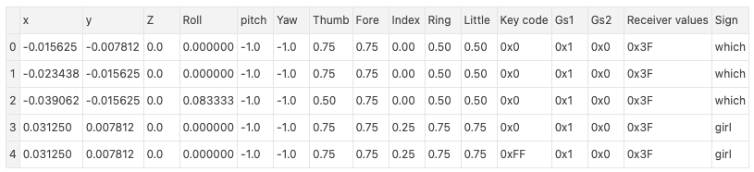
Dataset
Link - Australian Sign Language signs
Description
The data was captured over nine weeks from a native Auslan signer using sophisticated equipment, including Fifth Dimension Technologies (5DT) gloves and Ascension Flock-of-Birds magnetic position trackers.
The setup included two gloves, two position trackers, and a PC with specific hardware specifications. The Flock system provided high-quality data with six degrees of freedom for each hand, accurate to 14-bit resolution, including finger bend measurements.
Size -The data set contains 95 different signs, each with 27 samples, making a total of 2565 signs.
Parameters - Total of 15 parameters are there.
For example x position expressed relative to a zero point set slightly below the chin. Expressed in meters. y position expressed relative to a zero point set slightly below the chin. Expressed in meters. z position expressed relative to a zero point set slightly below the chin. Expressed in meters. roll expressed as a value between -0.5 and 0.5 with 0 being palm down.
Snapshot of the data (screenshot or other)

Slide 21
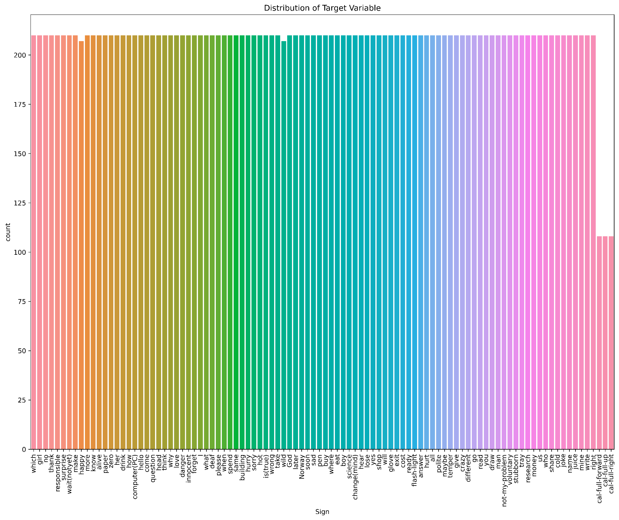
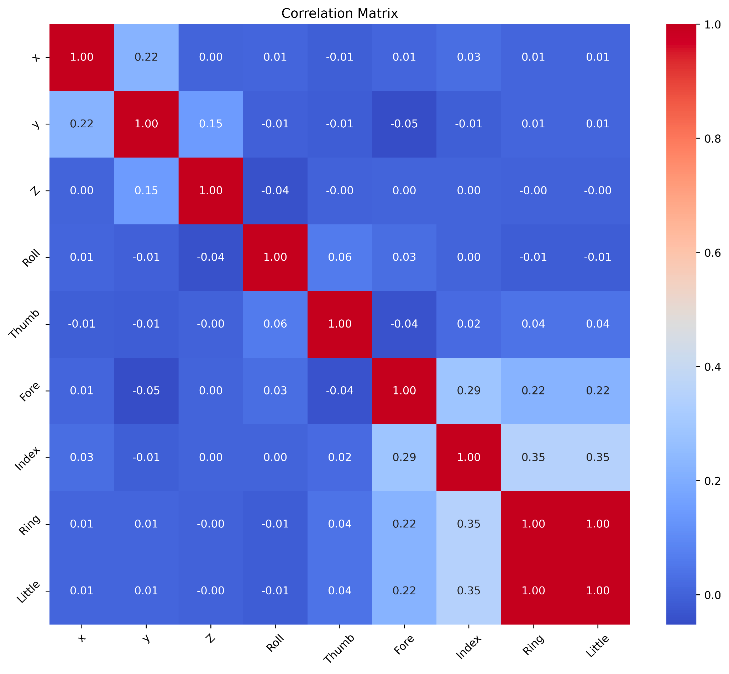
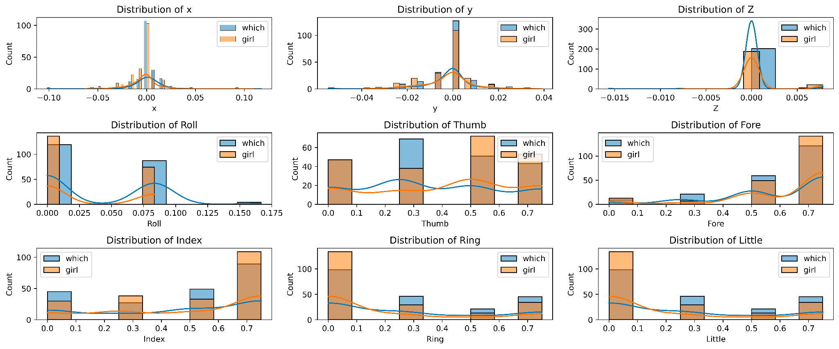
EDA

Slide 22
EDA

Slide 23
Methodology and Next steps
Data Preprocessing:
Feature Engineering: Identify crucial features for Auslan sign recognition.
Normalization: Ensure consistent feature scales.
Handle Missing Data: Use appropriate imputation techniques.
Feature Selection:
Statistical Methods: Use correlation analysis for relevant feature selection.
Dimensionality Reduction: Apply PCA for reduced feature space.
Model Selection:
Algorithm Choice: Experiment with Decision Trees, Random Forests, SVM, CNN, or RNN.
Hyperparameter Tuning: Use grid search or random search for optimal settings.
Ensemble Techniques: Explore Bagging or Boosting for improved accuracy.
Model Training and Validation:
Training and Validation: Split data, train models, and validate using accuracy metrics.
Model Evaluation and Fine-Tuning:
Evaluation Metrics: Assess models using key metrics like accuracy, precision, recall, and F1-score.
Fine-Tuning: Adjust models based on evaluation results.
Iterative Model Refinement:
Refinement: Iteratively refine models based on feedback.
Error Analysis:
Identify Patterns: Analyze misclassifications for improvement insights.
Address Class Imbalance:
Imbalanced Data: Implement oversampling, undersampling, or specialized algorithms.
Interpretability and Visualization:
Visualize Decisions: Use LIME for interpreting complex model predictions.
Documentation and Reporting:
Document Findings: Prepare detailed reports summarizing experiments and challenges.

Slide 24
References
Kadous, M.W., Sammut, C. Classification of Multivariate Time Series and Structured Data Using Constructive Induction. Mach Learn 58, 179–216 (2005). https://doi.org/10.1007/s10994-005-5826-5
P. Q. Thang, N. T. Thuy and H. T. Lam, "The SVM, SimpSVM and RVM on sign language recognition problem," 2017 Seventh International Conference on Information Science and Technology (ICIST), Da Nang, Vietnam, 2017, pp. 398-403, doi: 10.1109/ICIST.2017.7926792.
S. Z. Gurbuz et al., "American Sign Language Recognition Using RF Sensing," in IEEE Sensors Journal, vol. 21, no. 3, pp. 3763-3775, 1 Feb.1, 2021, doi: 10.1109/JSEN.2020.3022376.
Prasad, M.V.D. & Kishore, P.V.V. & Eepuri, Kiran & Anil Kumar, D.. (2016). Indian sign language recognition system using new fusion based edge operator. 88. 574-584.
K. Amrutha and P. Prabu, "ML Based Sign Language Recognition System," 2021 International Conference on Innovative Trends in Information Technology (ICITIIT), Kottayam, India, 2021, pp. 1-6, doi: 10.1109/ICITIIT51526.2021.9399594.
Kumar, Dr.S.Saravana. (2020). Sign Language Recognition Using Machine Learning. International Journal of Pure and Applied Mathematics.

Slide 25
Methodology and Experimentation

Slide 26
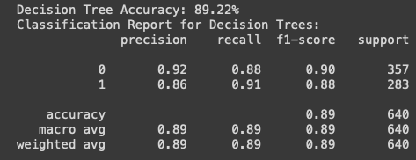
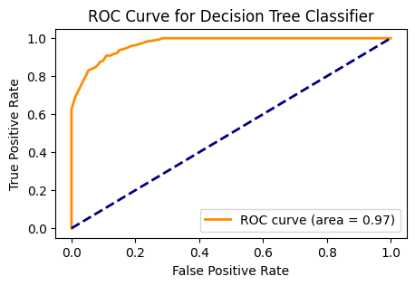
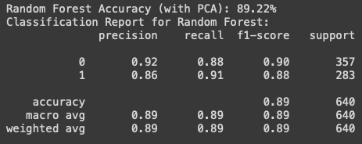
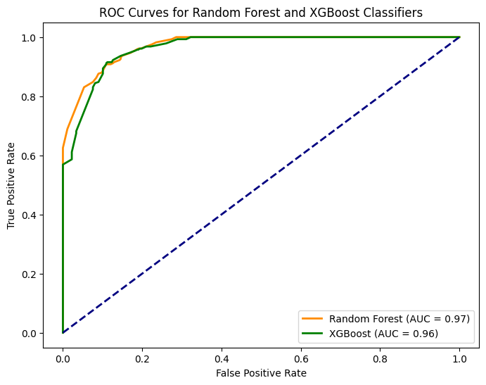
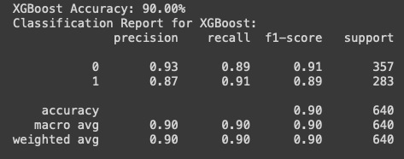
Methodology and Experimentation:/
Two Classes:

Slide 27
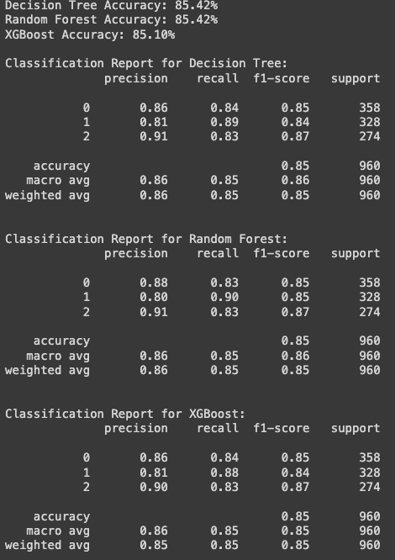
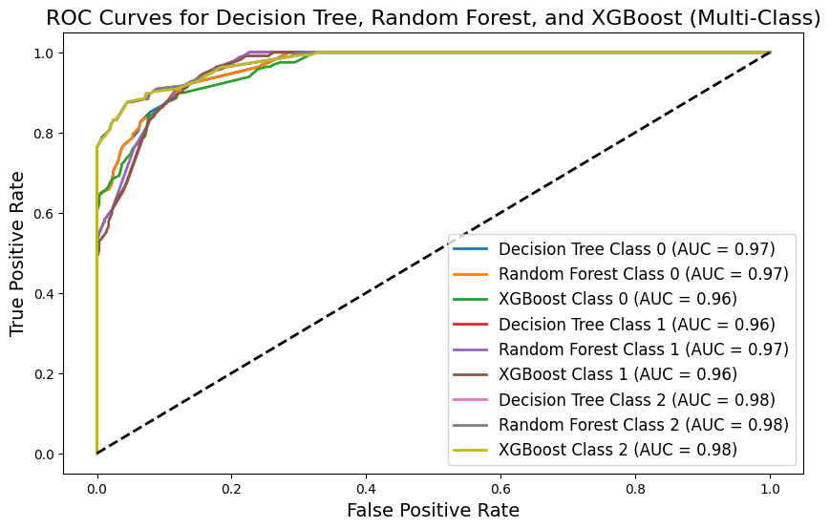
Methodology and Experimentation:
Three Classes:

Slide 28
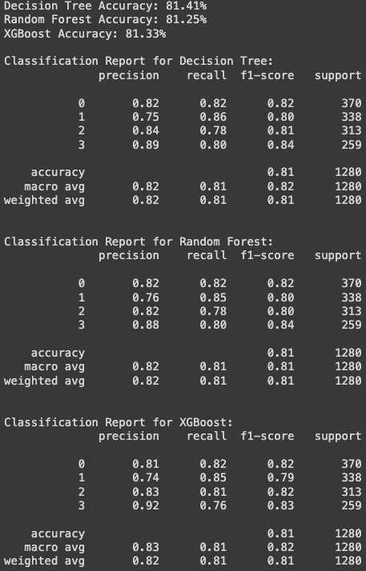
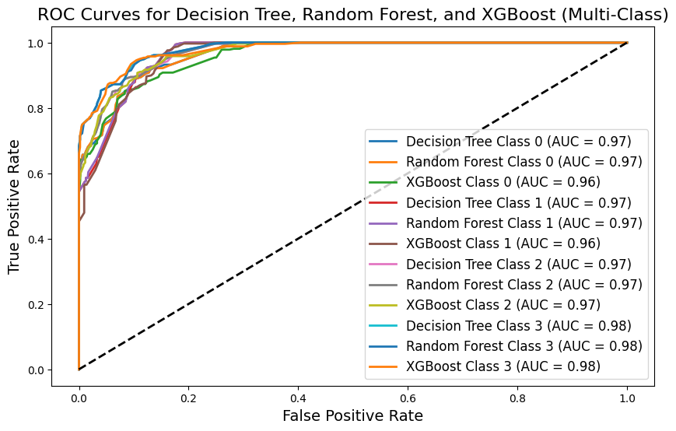
Methodology and Experimentation:
Four Classes:

Slide 29
Methodology and Experimentation:
All classes:
Decision Tree Accuracy: 26.95%
Classification Report for Decision Trees:
Class precision recall f1-score support
0 0.39 0.34 0.36 340
1 0.34 0.30 0.32 324
2 0.45 0.31 0.37 322
3 0.23 0.34 0.27 336
4 0.18 0.26 0.21 332
5 0.21 0.35 0.26 295
6 0.41 0.28 0.33 338
7 0.26 0.26 0.26 319
8 0.42 0.30 0.35 325
9 0.29 0.39 0.33 184
10 0.36 0.36 0.36 151
11 0.37 0.21 0.27 150
12 0.42 0.29 0.35 337
13 0.20 0.33 0.25 336
14 0.34 0.22 0.27 331
15 0.34 0.19 0.24 333
90 0.28 0.34 0.30 333
91 0.26 0.21 0.23 342
92 0.60 0.25 0.35 334
93 0.29 0.37 0.33 333
94 0.24 0.43 0.31 305
95 0.52 0.36 0.43 331
96 0.32 0.18 0.23 342
97 0.74 0.23 0.35 352
accuracy 0.27 32429
macro avg 0.34 0.27 0.28 32429
weighted avg 0.34 0.27 0.28 32429
Random Forest Accuracy: 26.97%
Classification Report for Random Forest:
Class precision recall f1-score support
0 0.43 0.29 0.35 340
1 0.37 0.28 0.32 324
2 0.47 0.31 0.37 322
3 0.24 0.34 0.28 336
4 0.18 0.24 0.21 332
5 0.21 0.32 0.25 295
6 0.41 0.28 0.33 338
7 0.31 0.25 0.28 319
8 0.40 0.29 0.34 325
9 0.28 0.39 0.32 184
10 0.44 0.35 0.39 151
11 0.37 0.21 0.27 150
12 0.50 0.28 0.36 337
13 0.21 0.32 0.25 336
14 0.39 0.20 0.26 331
15 0.40 0.18 0.25 333
90 0.27 0.35 0.30 333
91 0.26 0.22 0.24 342
92 0.47 0.28 0.35 334
93 0.29 0.39 0.33 333
94 0.24 0.43 0.31 305
95 0.48 0.37 0.42 331
96 0.29 0.19 0.23 342
97 0.65 0.24 0.35 352
accuracy 0.27 32429
macro avg 0.34 0.27 0.28 32429
weighted avg 0.35 0.27 0.28 32429
XGBoost Accuracy: 26.81%
Classification Report for XGBoost:
Class precision recall f1-score support
0 0.37 0.31 0.34 340
1 0.38 0.31 0.34 324
2 0.52 0.27 0.36 322
3 0.22 0.34 0.27 336
4 0.21 0.24 0.22 332
5 0.25 0.37 0.30 295
6 0.56 0.24 0.34 338
7 0.32 0.23 0.27 319
8 0.33 0.31 0.32 325
9 0.36 0.42 0.39 184
10 0.28 0.42 0.34 151
11 0.32 0.21 0.25 150
12 0.47 0.28 0.36 337
13 0.21 0.39 0.27 336
14 0.66 0.17 0.27 331
15 0.55 0.16 0.25 333
90 0.31 0.34 0.33 333
91 0.35 0.19 0.25 342
92 0.30 0.34 0.32 334
93 0.25 0.35 0.29 333
94 0.49 0.30 0.38 305
95 0.48 0.38 0.42 331
96 0.28 0.29 0.28 342
97 0.47 0.24 0.31 352
accuracy 0.27 32429
macro avg 0.35 0.27 0.28 32429
weighted avg 0.35 0.27 0.28 32429

Slide 30
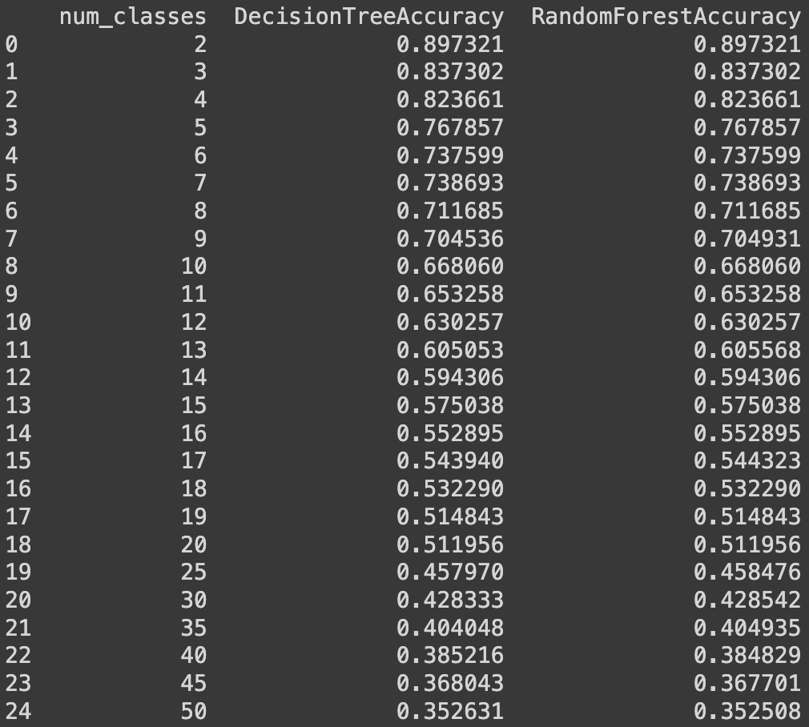
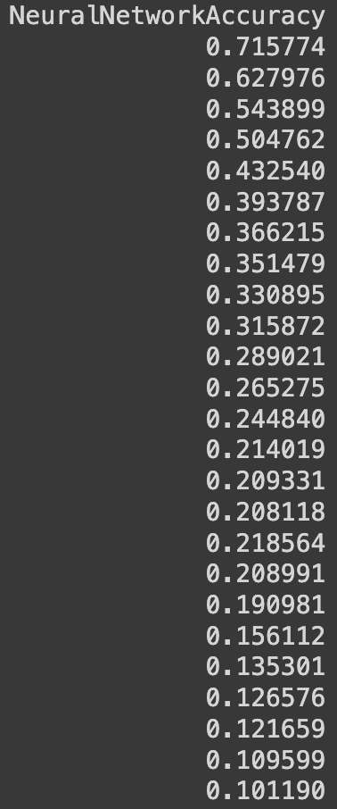
Methodology and Experimentation:
All classes:

Slide 31
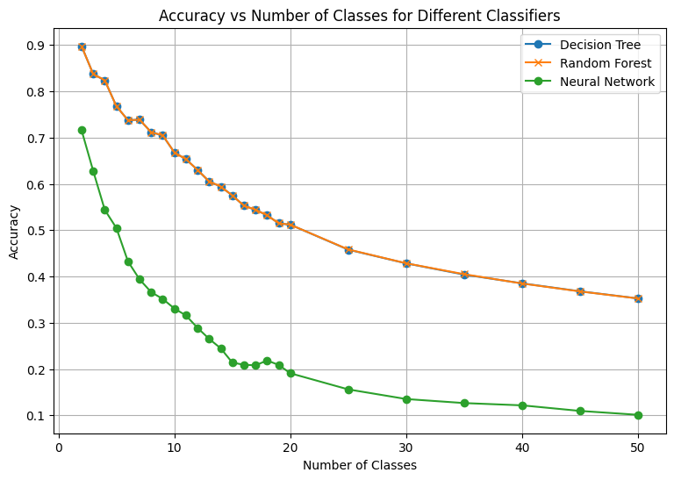
Methodology and Experimentation:
All classes:

Slide 32
Results

Slide 33
Results
Initially the the model were train with TWO CLASSES, then THREE classes and so on.
Binary Classification:
XGBoost Outperforms DT and RF:
Accuracy for XGBoost: 90.00%
Accuracy for Decision Trees (DT): 89.22%
Accuracy for Random Forest (RF): 89.22%
Highlight the superiority of XGBoost in achieving the highest accuracy among the three models.

Slide 34
Results
Three-Class Classification:
DT and RF Similar Performance, Outperform XGBoost:
Accuracy for Decision Trees (DT): 85.42%
Accuracy for Random Forest (RF): 85.42%
Accuracy for XGBoost: 85.10%
Emphasize the similarity in performance between Decision Trees and Random Forest and the notable performance drop for XGBoost in this scenario.
When all classes are trained the Decision Tree and Random Forest perform better than Neural Network

Slide 35
Conclusion and Future Work

Slide 36
Unlocking the Language of Signs: Auslan Recognition through Machine Learning
By
Samanvaya Arava

Slide 37
Project Proposal

Slide 38
Conclusion & Future Work
This study contributes to advancing the development of Auslan sign recognition using machine learning techniques. Through rigorous experimentation and analysis, it was observed that Decision Trees and Random Forests outperformed Neural Networks in recognizing Auslan signs when trained across all classes. However, the study acknowledges the complexity inherent in sign language recognition, with challenges such as noise sensitivity, dataset biases, and the impact of feature selection.
Future research should focus on refining models to mitigate these challenges and exploring hybrid approaches that combine the strengths of different machine learning techniques.

Slide 39
Conclusion & Future Work
This study contributes to advancing the development of Auslan sign recognition using machine learning techniques. Through rigorous experimentation and analysis, it was observed that Decision Trees and Random Forests outperformed Neural Networks in recognizing Auslan signs when trained across all classes. However, the study acknowledges the complexity inherent in sign language recognition, with challenges such as noise sensitivity, dataset biases, and the impact of feature selection.
Future research should focus on refining models to mitigate these challenges and exploring hybrid approaches that combine the strengths of different machine learning techniques.

Slide 40
References

Slide 41
References
Kadous, M.W., Sammut, C. Classification of Multivariate Time Series and Structured Data Using Constructive Induction. Mach Learn 58, 179–216 (2005). https://doi.org/10.1007/s10994-005-5826-5
P. Q. Thang, N. T. Thuy and H. T. Lam, "The SVM, SimpSVM and RVM on sign language recognition problem," 2017 Seventh International Conference on Information Science and Technology (ICIST), Da Nang, Vietnam, 2017, pp. 398-403, doi: 10.1109/ICIST.2017.7926792.
S. Z. Gurbuz et al., "American Sign Language Recognition Using RF Sensing," in IEEE Sensors Journal, vol. 21, no. 3, pp. 3763-3775, 1 Feb.1, 2021, doi: 10.1109/JSEN.2020.3022376.
Prasad, M.V.D. & Kishore, P.V.V. & Eepuri, Kiran & Anil Kumar, D.. (2016). Indian sign language recognition system using new fusion based edge operator. 88. 574-584.
K. Amrutha and P. Prabu, "ML Based Sign Language Recognition System," 2021 International Conference on Innovative Trends in Information Technology (ICITIIT), Kottayam, India, 2021, pp. 1-6, doi: 10.1109/ICITIIT51526.2021.9399594.
Kumar, Dr.S.Saravana. (2020). Sign Language Recognition Using Machine Learning. International Journal of Pure and Applied Mathematics.

