Slide 1
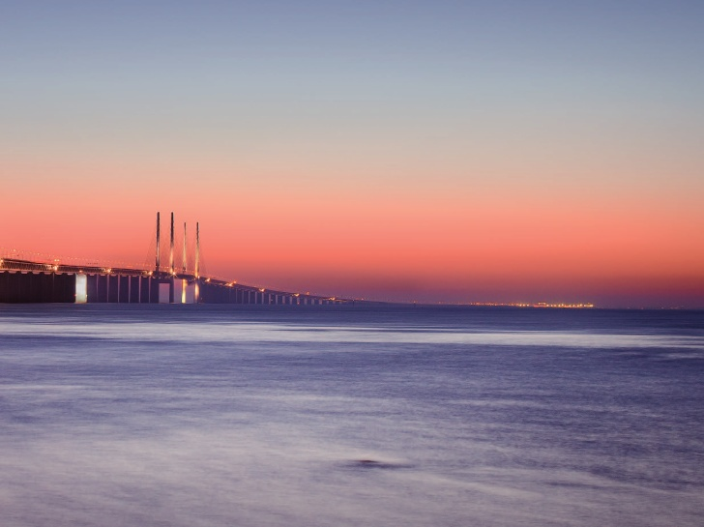
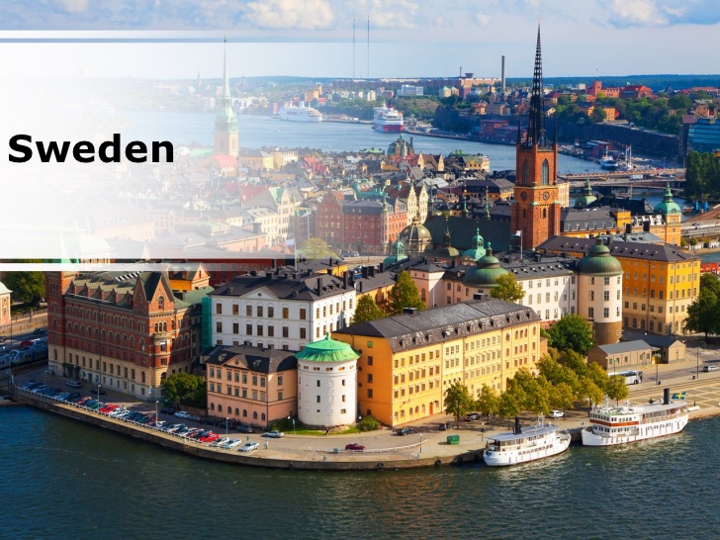
Sweden
Presented By:
Astha
Samanway Sahoo
Presented By:
Astha
Samanway Sahoo

Slide 2
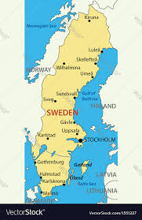
Capital - Stockholm
Currency – Swedish Krona
Population – 1.01 Cr (2018)

Slide 3
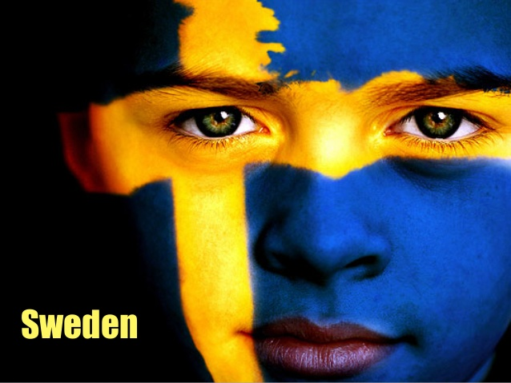
History

Slide 4
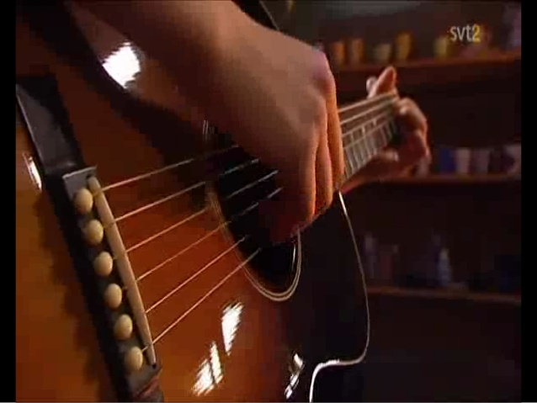
Visible Aspects
Climate
Influenced by Gulf stream
In summer 13 to 17 degree Celsius
Winter -22 to -3 degree Celsius
Language
Swedish
Geography
Scandinavian peninsula
Flat and gently rolling grounds
Mountain in west

Slide 5
Visible Aspects
Food
Pizza, kebabs, falafels, hamburgers
Breakfast - Milk products
Husmanskost – diet of potato, meat and fish
Dressing Style
Natural fibres
like – wool , linen, cotton and silk.
Black is very common
Swedish Fashion Council

Slide 6
Visible Aspects
Greeting
Firm handshake with direct eye contact
Hej
Hej da
Music
Eastern Europe
Folk song – Ballad and Kunning
Modern – jazz, pop, rock etc.
ABBA
Jenny Lind
Max Martin
Dance
Hambo
Polska

Slide 7
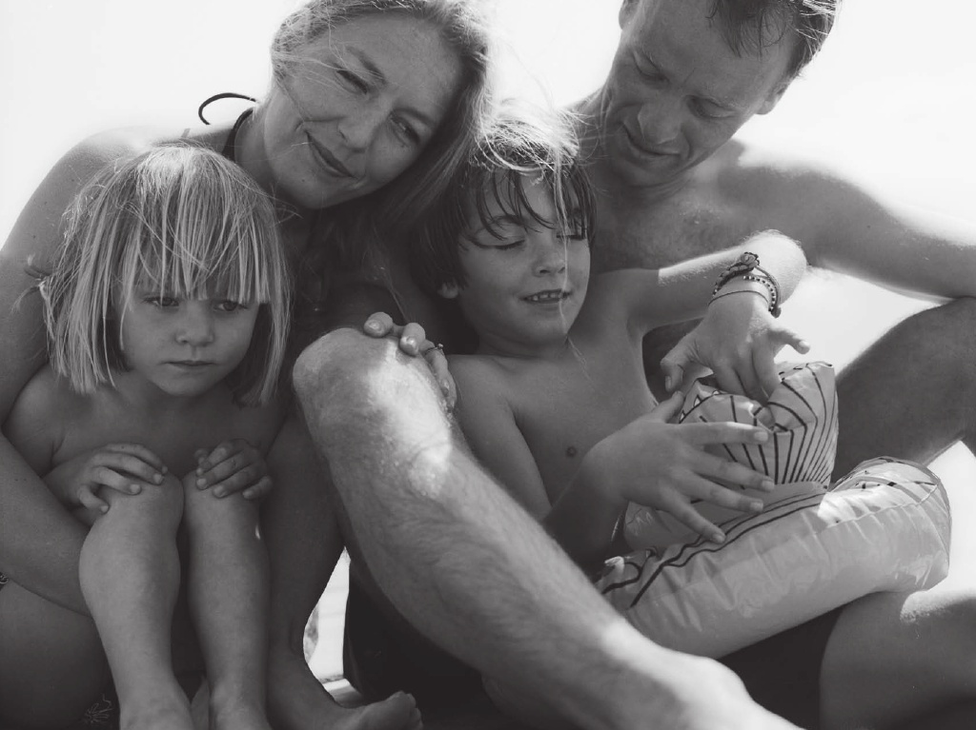
Education and Family insurance

Slide 8
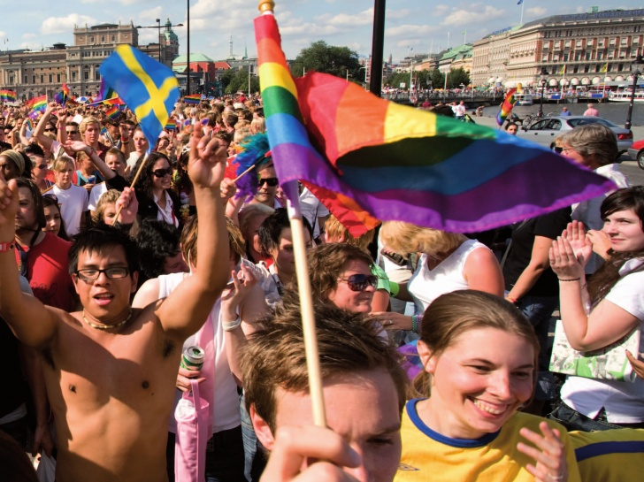
Equality

Slide 9


Slide 10
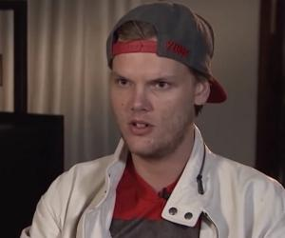

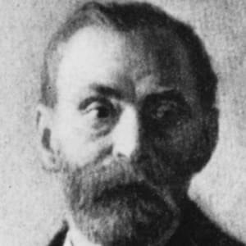


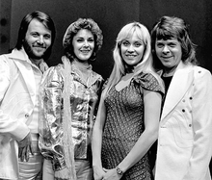
Few Famous People

Slide 11


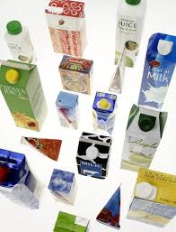
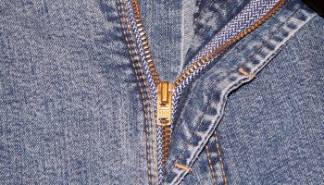

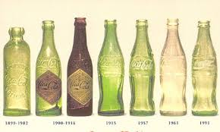
Inventions and Patents

Slide 12
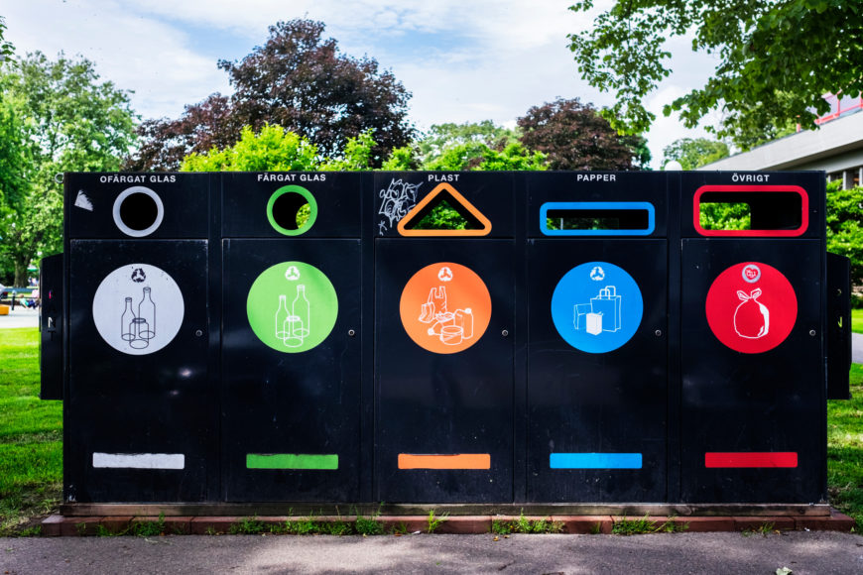
Environmental Practices

Slide 13
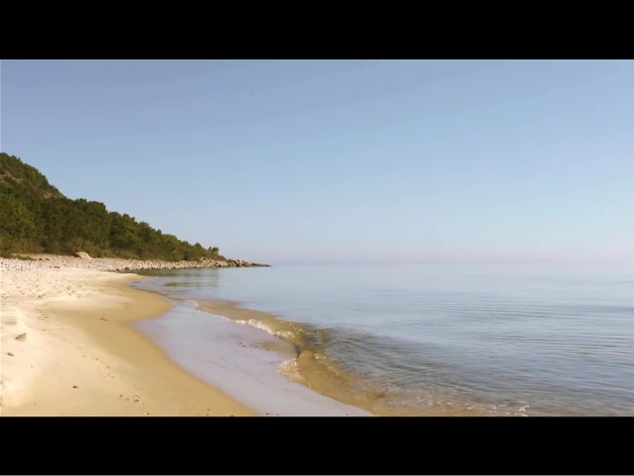
Tack!

