Slide 1
Recent Open-Source Project Lab
VoiceNote
B.E. INFORMATION TECHNOLOGY
Multi-Functional Voice Intelligence System
LISTEN. UNDERSTAND. ORGANIZE. ACT.
Privacy-First Hybrid Dual-Database & File Storage System
VOICE
→
TRANSCRIPT
→
KNOWLEDGE
Guided by
Prof. Omkar Dike
Team
Tejas Rawool • Samar Shetye • Atharv Pavar
SEMESTER VII
01 / 17

Slide 2
The Problem
02
Traditional recorders capture audio -but they do not understand it.
Traditional voice recorder applications only store audio files and do not help users quickly understand or retrieve the information they contain. Users often spend time replaying recordings, taking manual notes, and searching for important details.
Key Challenges
● Difficult to search recorded audio. ● No automatic summaries or task extraction.
● Time-consuming manual note-taking. ● Important information is hard to find.
● Poor organization of voice recordings.
VoiceNote • Open Source Project Lab • B.E. IT • Semester VII
02 / 14

Slide 3
Proposed Solution
03
VoiceNote transforms raw speech into structured, actionable, and conceptually searchable knowledge.
• Understand the Content - AI identifies important information from the transcript.
• Indic Multilingual Intelligence: Specialized Devanagari prompt chain restores Marathi and Hindi grammar nuances and formats Indian currency (₹).
• Actionable Productivity Extraction: Automatically structures discussions into executive summaries and interactive task boards with assignees and due dates.
• Concept-Based Semantic Retrieval: Sub-second vector queries match intent and meaning across all notes without requiring exact keywords or timestamps.
1. Capture
2. Transcribe
3. Diarize & AI
4. Structure
5. Vector Index
Mic + WASAPI Loopback
Faster-Whisper
Speaker Turns + Gemini 3.8 Flash
Tasks, Priorities, Summaries
ChromaDB for
semantic Search
VoiceNote • Open Source Project Lab • B.E. IT • Semester VII
03 / 17

Slide 4
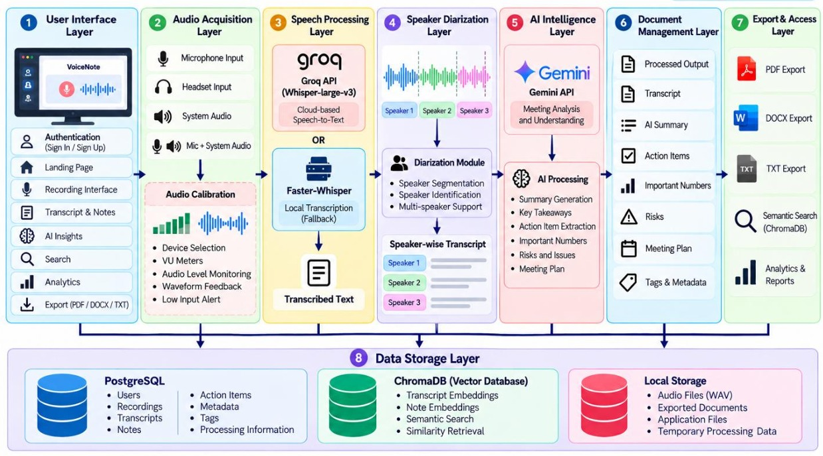
Layered Desktop System Architecture
05
VoiceNote • Open Source Project Lab • B.E. IT • Semester VII
05 / 17

Slide 5
Core Features
04
CAPTURE & HARDWARE TELEMETRY
SPEECH & AI INTELLIGENCE
STORAGE, SEARCH & DELIVERY
01
Dual-Source Capture
01
Faster-Whisper + Groq
01
Triple-Tier Storage
Microphone + WASAPI Loopback (Teams/Zoom)
GPU/CPU local CTranslate2 + cloud speed
PostgreSQL relational +ChromaDB vectors + WAV
02
Real-Time BFS Calibration
02
Devanagari Polish
02
Sub-Second Semantic Search
Dynamic VU meter: -60 dBFS to 0 dBFS
Regional verb forms & currency standardizer
Cosine distance similarity scoring with % match
03
Live Waveform Visualizer
03
Speaker Diarization
03
Multi-Format Export Engine
60 FPS animated QPainter audio display
Acoustic turn segmentation into distinct speakers
ReportLab PDF (with Indic fonts), DOCX & TXT
04
Gemini 3.8 Flash Analysis
04
Productivity Analytics
Executive summaries, key takeaways &
task boards
Duration trends, task velocity & time saved
VoiceNote • Open Source Project Lab • B.E. IT • Semester VII
04 / 17

Slide 6
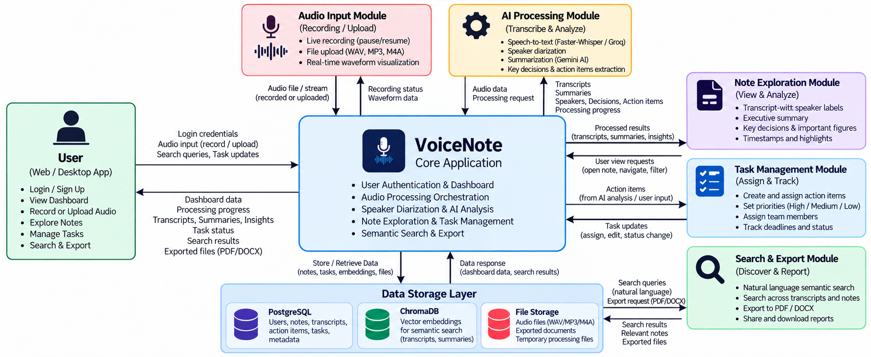
User Flow Diagram
06
VoiceNote • Open Source Project Lab • B.E. IT • Semester VII
06 / 17

Slide 7
Technology Stack & Production Components
07
Production-grade open-source and modern AI frameworks mapped to clear architectural responsibilities.
Frontend GUI
PySide6 (Qt6)
High-performance native desktop UI, Bento Grid layout & Lucide SVG icons
Audio Engine
PyAudioWPatch + SoundDevice
Hardware loopback for Zoom/Teams/Meet, mic capture & real-time dBFS visualizer
Relational DB
PostgreSQL 14+ (psycopg2)
ACID relational persistence, users, transcripts, tasks & cascading deletion constraints
Vector DB
ChromaDB (chromadb)
Local vector store with 384-dim dense embeddings (all-MiniLM-L6-v2) & cosine search
Speech-to-Text
Faster-Whisper + Groq API
GPU/CPU accelerated local CTranslate2 transcription + whisper-large-v3 cloud fallback
Generative AI
Gemini 3.8 Flash (Google GenAI)
Executive summaries, task extraction & resilient multi-tier fallback ladder (2.5/2.0/1.5)
Multilingual Polish
TranscriptCorrector (Gemini)
Devanagari Marathi/Hindi grammar restoration and Indian currency (₹) standardization
Export & Quality
ReportLab + DOCX + Test Runner
Multilingual PDF with Noto Sans Devanagari, Word DOCX & 9-module automated test gate
VoiceNote • Open Source Project Lab • B.E. IT • Semester VII
07 / 17

Slide 8
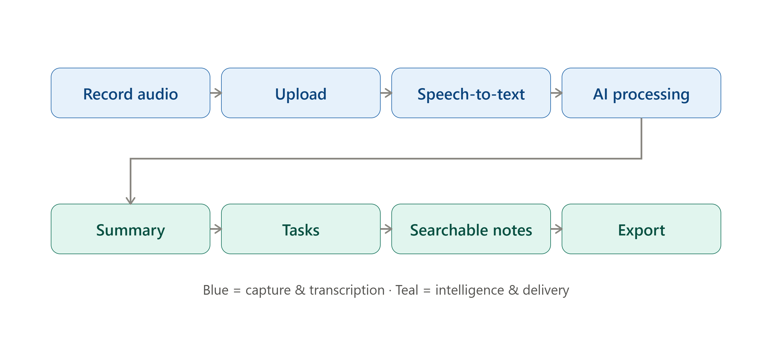
Production Workflows & Real-World Scenarios
08
VoiceNote adapts seamlessly across diverse corporate, hybrid, and bilingual environments.
Scenario A: Corporate Sprint Standup (English)
Scenario B: Hybrid Remote Meetings (WASAPI Loopback)
Scenario C: Multilingual Regional Discussions (Marathi)
• Input: Microphone captures fast-paced engineering team updates.
• Diarization: Separates Lead Engineer, QA, and Scrum Master.
• Outcome: Structured Jira-ready tasks with assignees and due dates.
• Input: PyAudioWPatch captures internal audio from Zoom/Teams/Meet.
• Processing: Zero external room echo or distortion.
• Outcome: Executive meeting minutes, key decisions, and ReportLab PDF.
• Input: Bilingual team meeting mixing Marathi, Hindi, and English.
• Processing: TranscriptCorrector fixes Devanagari grammar & ₹ amounts.
• Outcome: Accurate vernacular transcripts and searchable action items.
VoiceNote • Open Source Project Lab • B.E. IT • Semester VII
08 / 17

Slide 9
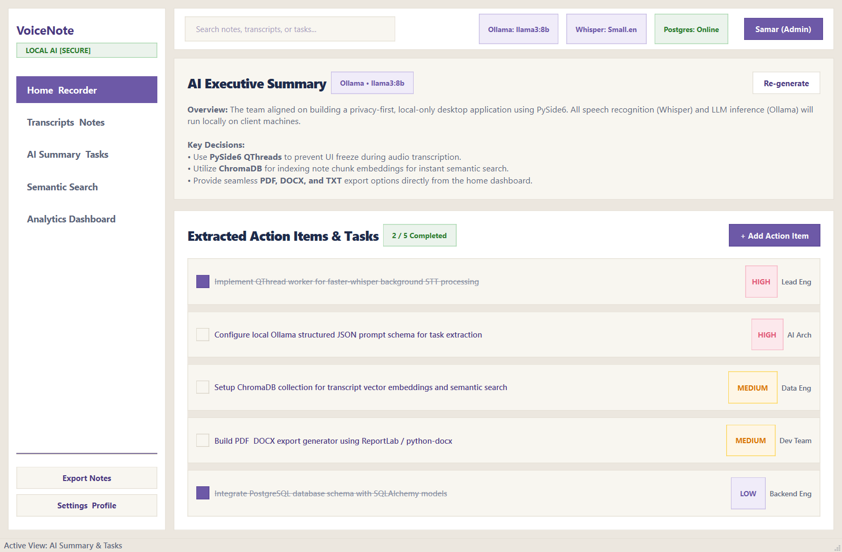
Home Dashboard & Live Audio Calibration
10
Dual-source audio capture, real-time dBFS VU meter, and instant session statistics.
PRODUCTION SCREEN 01
✦ Dual-Source Audio Switching
Seamlessly toggle between physical Microphone, WASAPI System Loopback (Teams/Zoom/Meet), or Both simultaneously.
✦ Real-Time dBFS & VU Meter
Precision audio calibration (-60 dBFS to 0 dBFS) with 60 FPS animated QPainter WaveformWidget visualizer.
✦ Live Session Telemetry
Instant productivity counters displaying total notes (24), recorded duration (4h 32m), and 100% offline status.
VoiceNote • Open Source Project Lab • B.E. IT • Semester VII
10 / 17

Slide 10
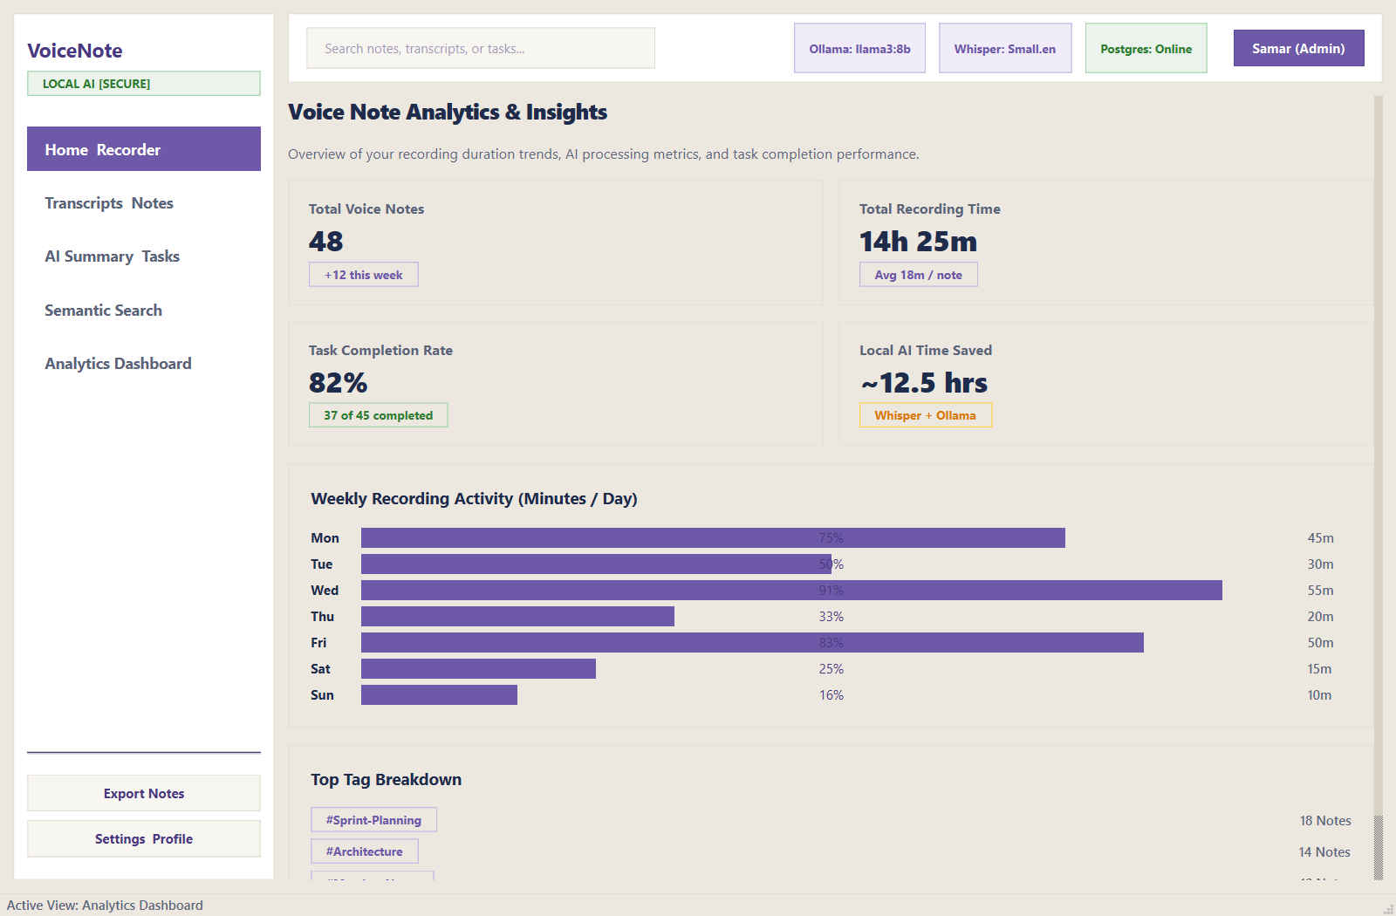
Multi-Speaker Diarized Transcripts
11
Acoustic turn segmentation, color-coded speaker bubbles, and millisecond timestamps.
PRODUCTION SCREEN 02
✦ Acoustic Speaker Diarization
Intelligent turn segmentation automatically attributes speech to distinct speakers (Samar, Lead Engineer, QA Lead).
✦ Millisecond Timestamps
Every dialogue turn is marked with start/end timestamps enabling instant one-click playback jumping.
✦ Indic Devanagari Accuracy
TranscriptCorrector ensures Marathi and Hindi conversations retain proper grammar and currency symbols (₹).
VoiceNote • Open Source Project Lab • B.E. IT • Semester VII
11 / 17

Slide 11
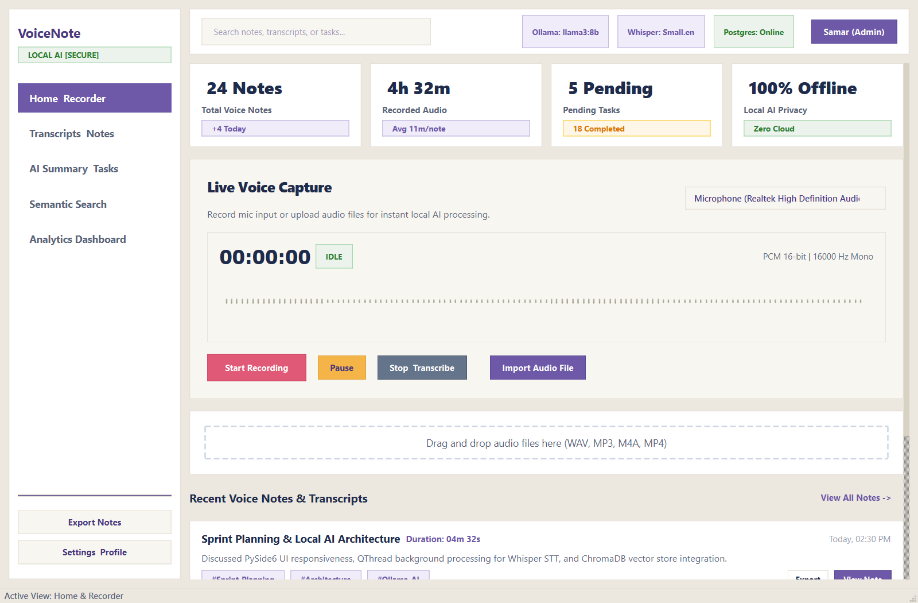
AI Executive Summary & Action Board
12
Gemini 3.8 Flash structured synthesis adhering to validated Pydantic JSON schemas.
PRODUCTION SCREEN 03
✦ Executive Narrative Synthesis
Extracts high-level summaries, key technical decisions, and strategic takeaways automatically.
✦ Prioritized Action Board
Identifies deliverables tagged with urgency pill badges (HIGH, MEDIUM, LOW), assignees, and due dates.
✦ Interactive Task Tracking
Interactive checkbox completion velocity tracking (e.g., 2 / 5 Completed) stored in PostgreSQL.
VoiceNote • Open Source Project Lab • B.E. IT • Semester VII
12 / 17

Slide 12
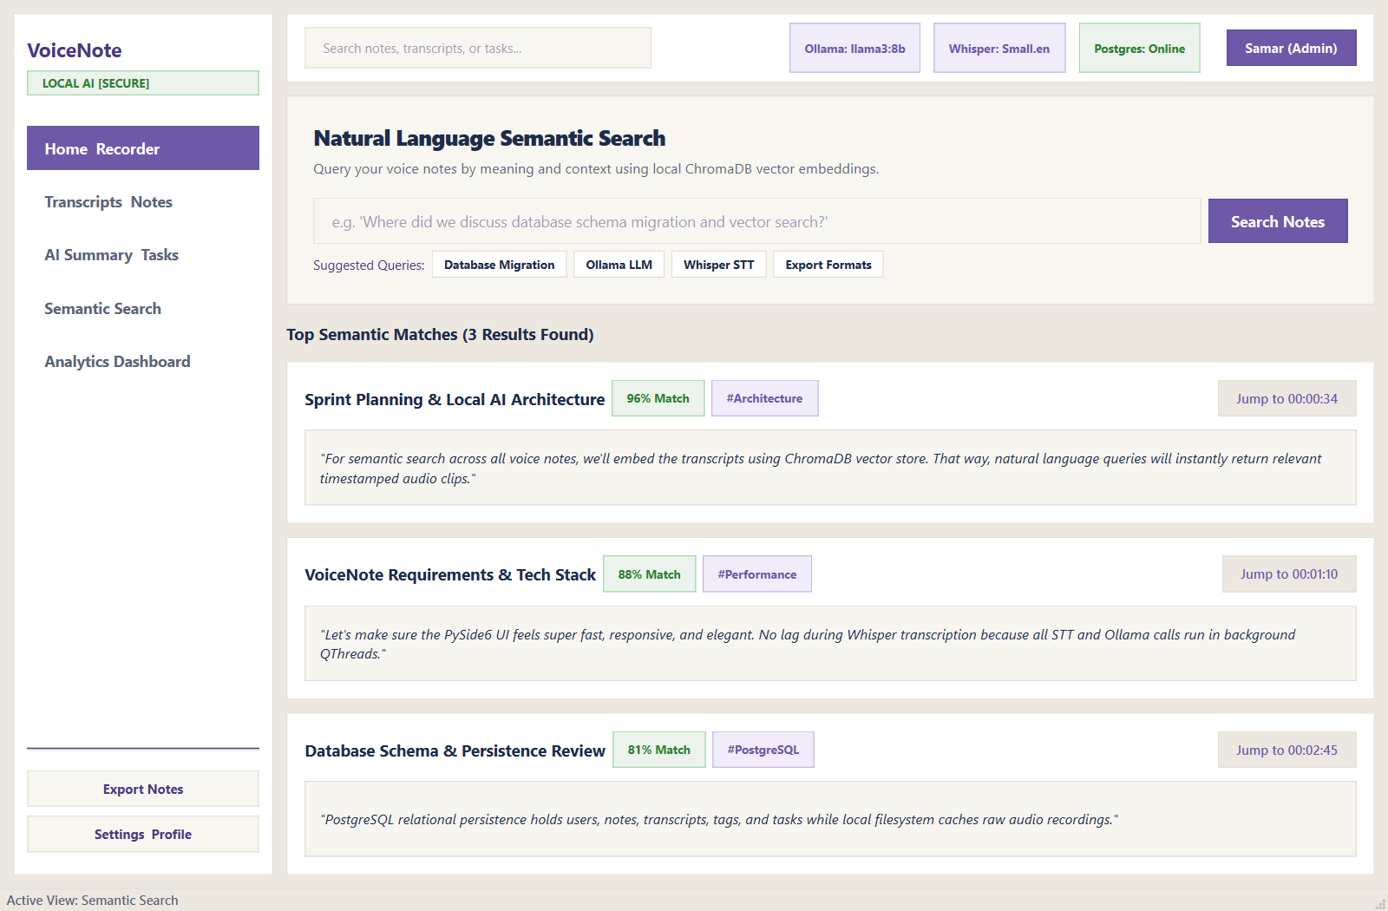
ChromaDB Sub-Second Semantic Search
13
Natural language conceptual search across all transcripts powered by 384-dim dense embeddings.
PRODUCTION SCREEN 04
✦ Intent-Based Query Matching
Search by concept rather than exact keywords (e.g., 'Where did we discuss database schema migration?').
✦ Ranked Relevance Confidence
Displays cosine similarity percentage badges (e.g., 96% Match, 88% Match, 81% Match).
✦ One-Click Audio Navigation
Direct 'Jump to [00:00:34]' button navigates straight to the exact second in the recording.
VoiceNote • Open Source Project Lab • B.E. IT • Semester VII
13 / 17

Slide 13
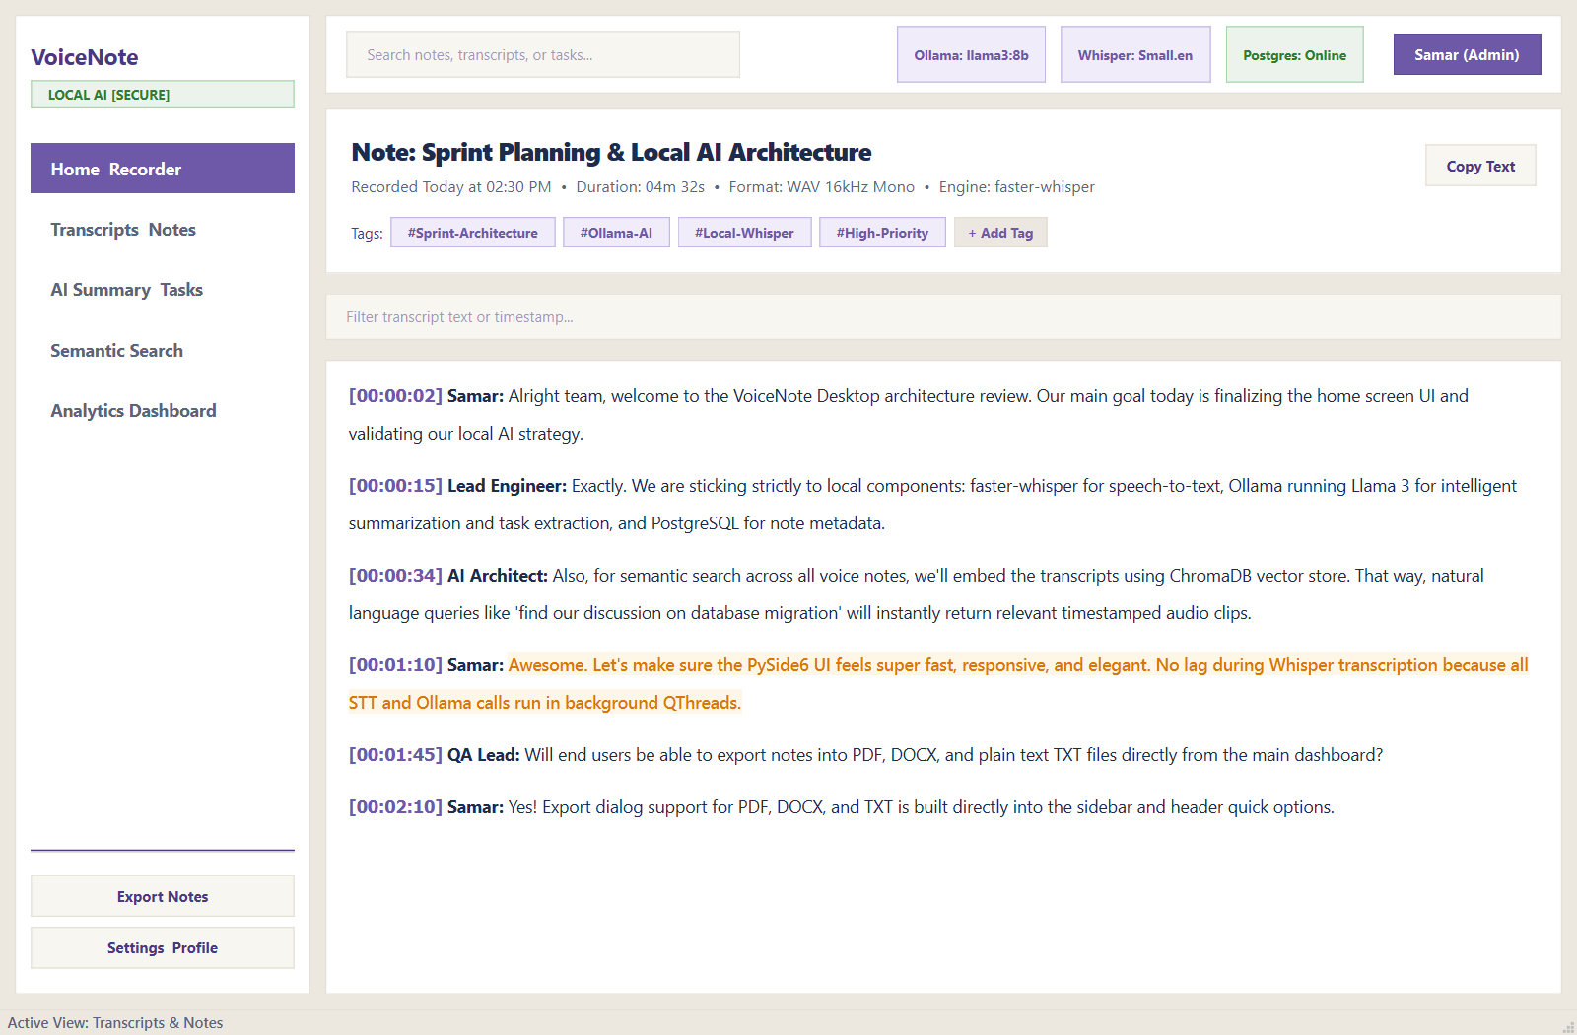
Productivity Analytics & Usage Insights
14
Visualizing meeting duration trends, task completion velocity, and estimated AI time saved.
PRODUCTION SCREEN 05
✦ Weekly Activity Trends
Visual bar chart tracking recording minutes per day (Mon–Sun) to measure team engagement.
✦ Task Velocity Metric
Overall completion rate monitor (82% completion velocity across 45 extracted deliverables).
✦ Estimated AI Time Saved
Quantified productivity gain counter (~12.5 hours saved by automated transcription & AI synthesis).
VoiceNote • Open Source Project Lab • B.E. IT • Semester VII
14 / 17

Slide 14
Engineering Team & Architectural Ownership
15
Specialized engineering roles and modular technical contributions across the VoiceNote system.
Tejas Rawool (@admin)
Samar Shetye
Atharv Pavar
System Architect & Backend Lead
UI/UX Lead & Presentation Architect
AI & Machine Learning Lead
✦ PostgreSQL Persistence Layer & Cascading Relational Schema
✦ ChromaDB Vector Engine & Cosine Similarity Search Engine
✦ Multi-Tier Resilient Gemini LLM Fallback Ladder (3.8 → 2.5 → 2.0 → 1.5)
✦ AudioEngine Calibration, Peak dBFS / RMS Telemetry & WASAPI Loopback
✦ Marathi Devanagari TranscriptCorrector & 9-Module Test Suite Runner
✦ PySide6 Bento Grid & Retro Warm Cream Design System
✦ WaveformWidget & 60 FPS Real-Time QPainter Audio Visualizer
✦ TranscriptViewWidget with Color-Coded Speaker Attributed Bubbles
✦ SummaryTaskWidget & Interactive Priority Task Board
✦ ReportLab PDF (with Embedded Indic Fonts) & DOCX Export Engine
✦ Initial Faster-Whisper (CTranslate2) & Groq Cloud STT Integration
✦ Prompt Engineering for Meeting Intelligence & Structured JSON Schemas
✦ Pydantic Data Validation Models (Note, Summary, Task, Sentiment)
✦ Speaker Diarization Acoustic Turn Segmentation Engine
✦ Pipeline Test Harness & Speech Recognition Benchmarking
VoiceNote • Open Source Project Lab • B.E. IT • Semester VII
15 / 17

Slide 15
Quality Assurance, Expected Outcomes & Future Roadmap
16
Rigorous automated test verification, measurable project impact, and next-phase deployment.
9-Module Automated Quality Gate
Key Expected Project Outcomes
Future Roadmap (Phase 5 Packaging)
Unified test suite in run_all_tests.py with 100% pass verification:
1. PostgreSQL Database Connectivity & Seeding
2. Text Cleaner Whitespace Normalization
3. Audio Recording WAV Buffering & Storage
4. Gemini AI Engine & JSON Schemas
5. ReportLab PDF & DOCX Export Engine
6. Analytics Engine Metric Calculations
7. ChromaDB Cosine Vector Queries
8. User Authentication & Password Hashing
9. PySide6 GUI Component Initialization
Measurable productivity transformation:
• Zero Meeting Information Loss: Automatically captures all decisions, numbers, and deadlines.
• 100% On-Device Privacy: Local-first architecture prevents enterprise compliance breaches.
• Vernacular Dialect Inclusivity: Accurate Marathi and Hindi Devanagari transcription.
• Instant Information Recall: Sub-second conceptual search replaces manual note browsing.
Path to standalone distribution:
• Standalone Windows Executable: Bundle Python runtime, PySide6, and CTranslate2 DLLs into a single VoiceNote.exe via PyInstaller.
• Inno Setup Windows Installer: Seamless installer wizard with desktop shortcuts and uninstaller logic.
• Local Neural Diarization: GPU-accelerated PyAnnote speaker separation.
• Encrypted Vault: Optional AES-256 resting encryption for local recordings.
VoiceNote • Open Source Project Lab • B.E. IT • Semester VII
16 / 17

Slide 16
VoiceNote
LISTEN. UNDERSTAND. ORGANIZE. ACT.
Multi-Functional Voice Intelligence System
Privacy-First Hybrid Dual-Database & File Storage Architecture
Thank You!
Questions & Open Discussion
GitHub Repository: https://github.com/Samar-365/VoiceNote
Project Team: Tejas Rawool • Samar Shetye • Atharv Pavar
Guided by: Prof. Omkar Dike

