Slide 1

Engineer Summer internship Social Network Sentiment Analysis : Esprit
1

Slide 2
Developed by : Samar Jberi supervised by: Mohammed Tlili
2

Slide 3
TABLE OF CONTENTS
01
02
03
General project context
Data Scraping
Text mining
04
05
Data visualization
Conclusion
3

Slide 4
01
General project Context
4

Slide 5
Host organization
5

Slide 6

Study of the existing
6

Slide 7
problematic
2015
1974
35.2%
2.6%
Growth of the higher education in Tunisia over the years
7

Slide 8
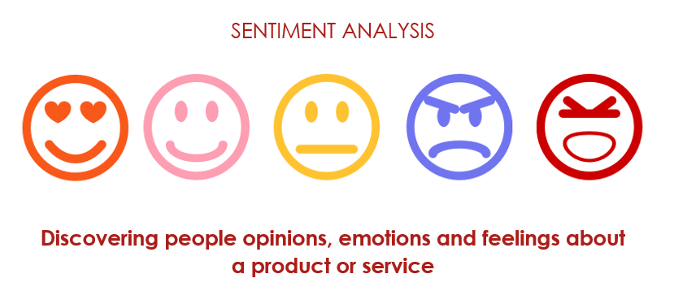
Proposed Solutions
8

Slide 9


Used tools
python
Microsoft power bi
9

Slide 10
02
data scraping
10

Slide 11

11

Slide 12
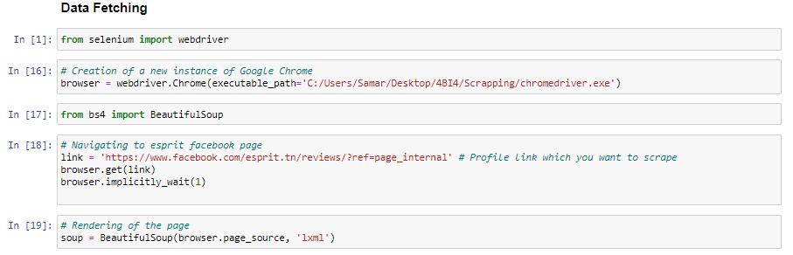
12

Slide 13
Data integration power bi
13

Slide 14
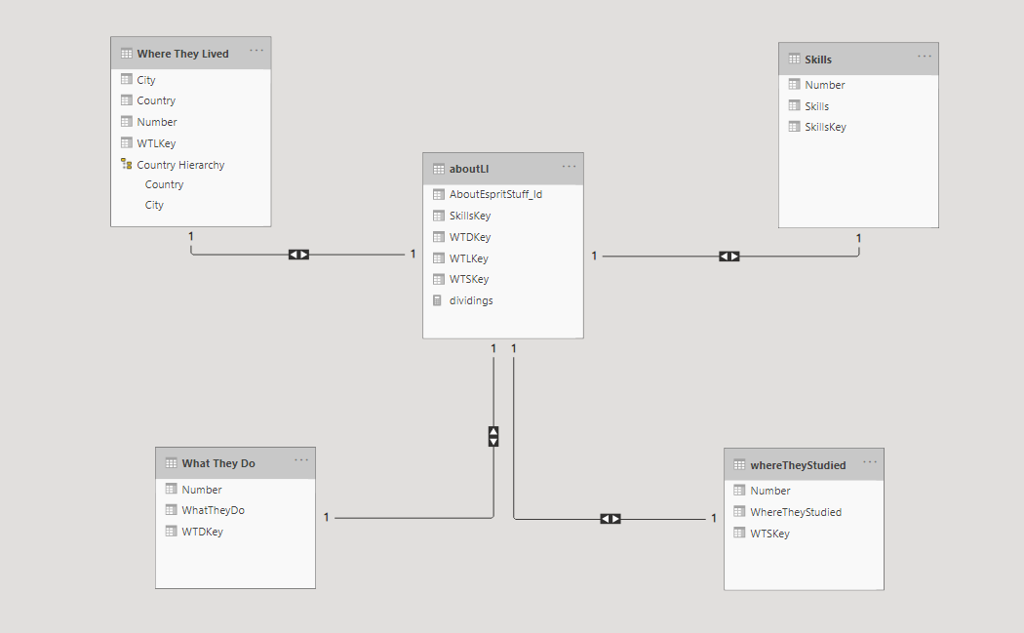
Linkedin datawarehouse
14

Slide 15
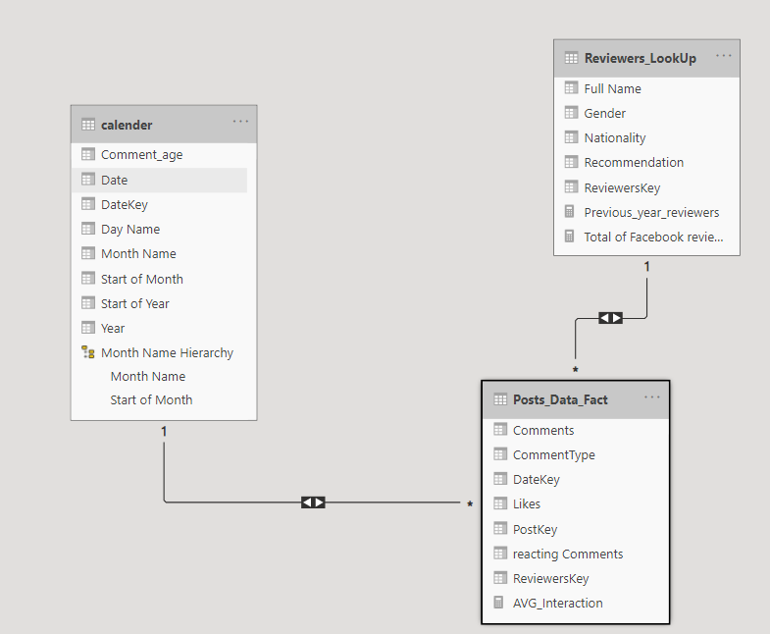
Facebook datawarehouse
15

Slide 16
03
Text mining
16

Slide 17
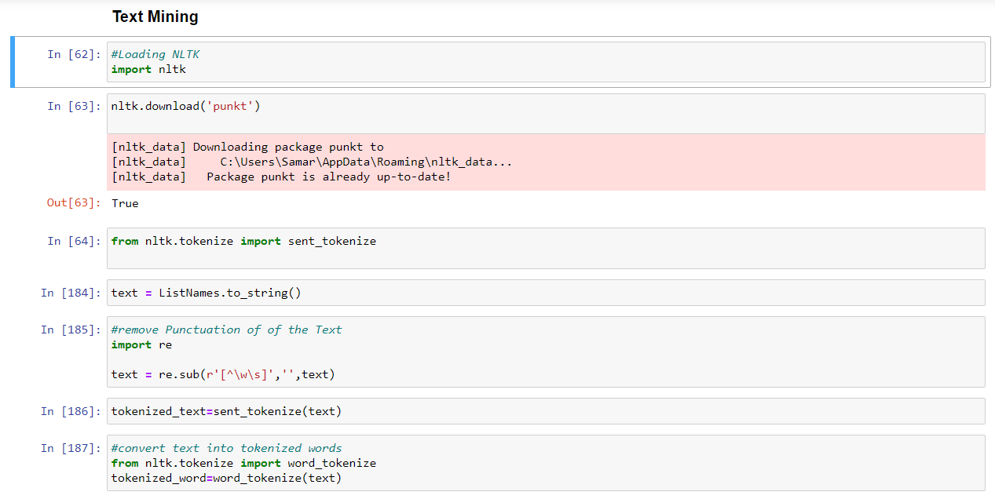
Text cleaning
17

Slide 18
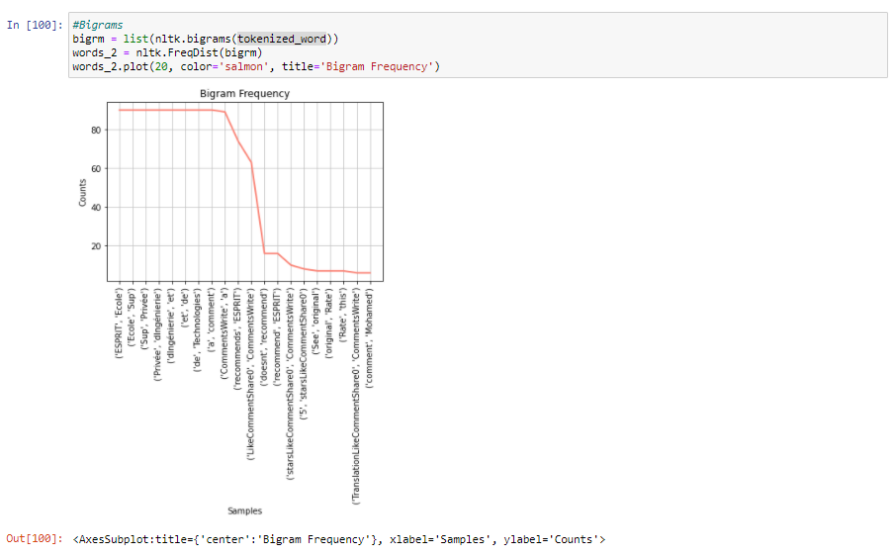
Frequency studying
18

Slide 19
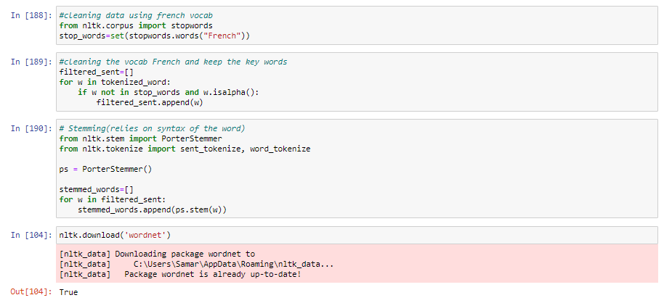
Stemming
19

Slide 20
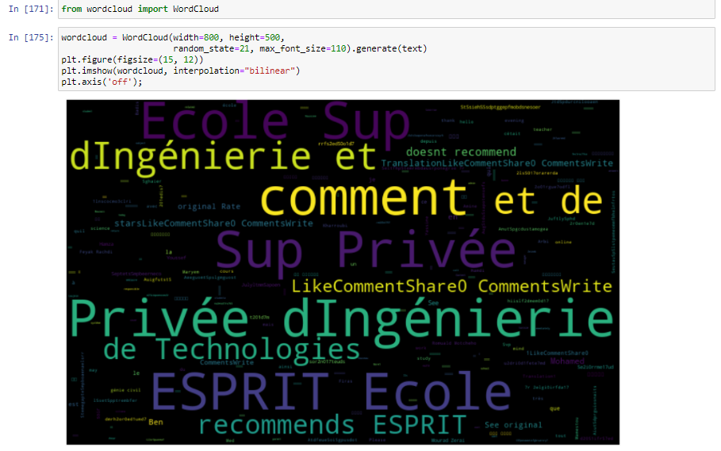
highlighting
20

Slide 21
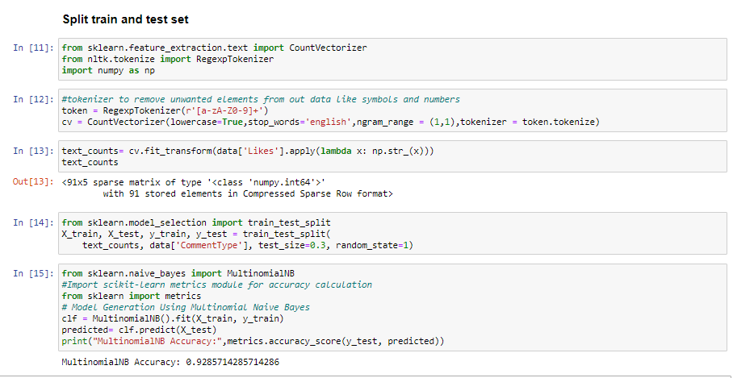
Data training
21

Slide 22
04
Data visulization
22

Slide 23
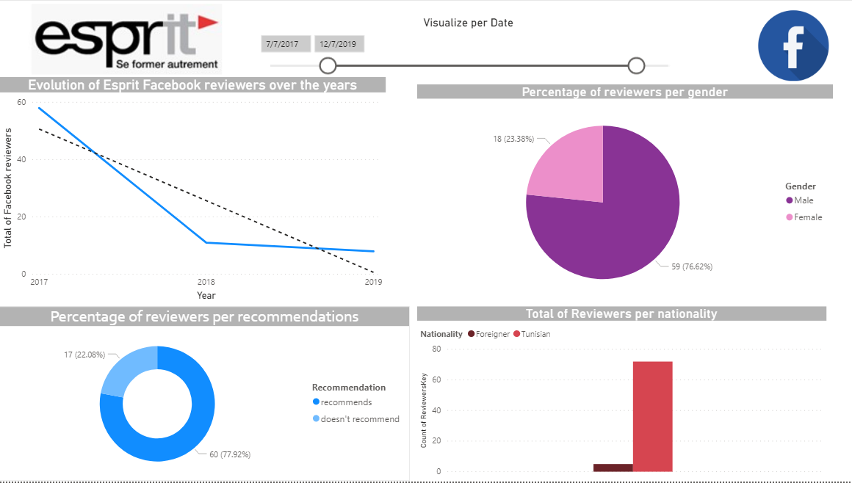
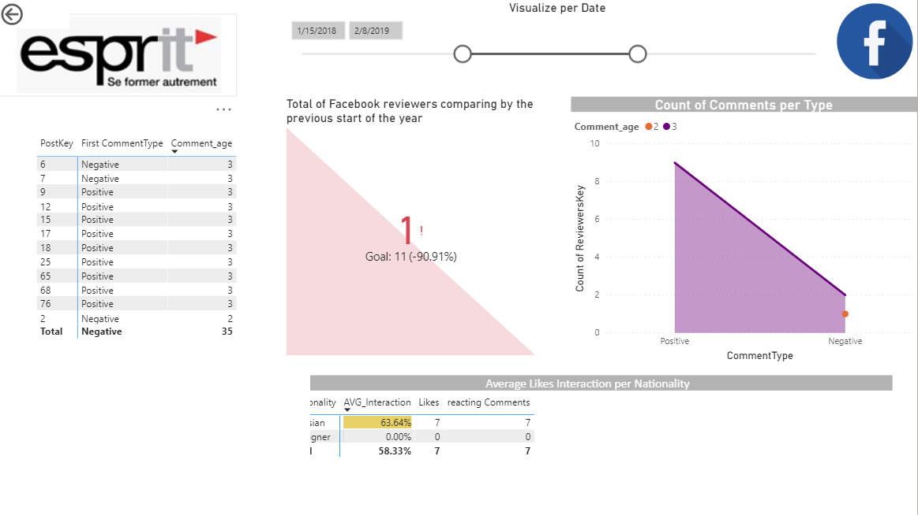
Facebook visuals
23

Slide 24
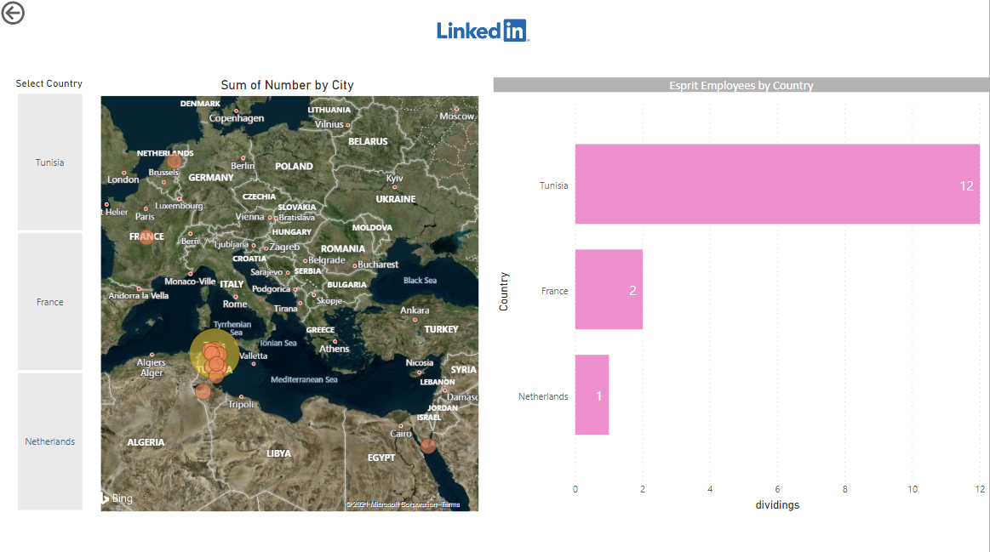
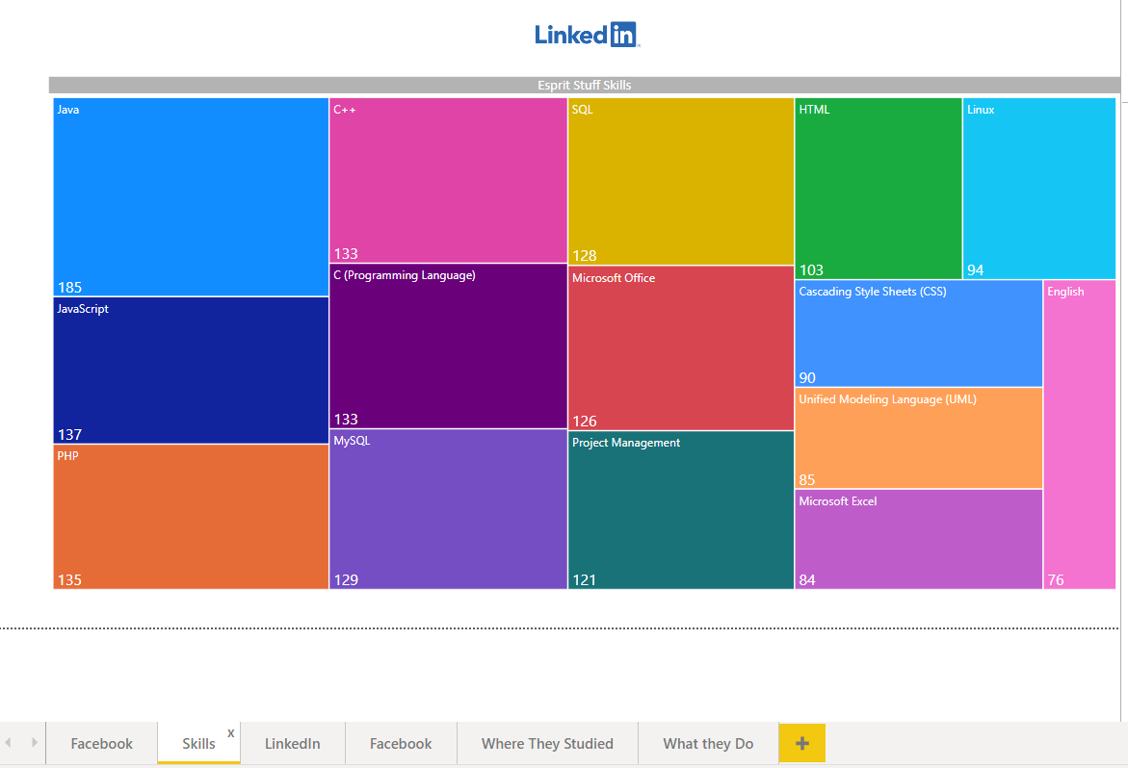
LinkedIn visuals
24

Slide 25
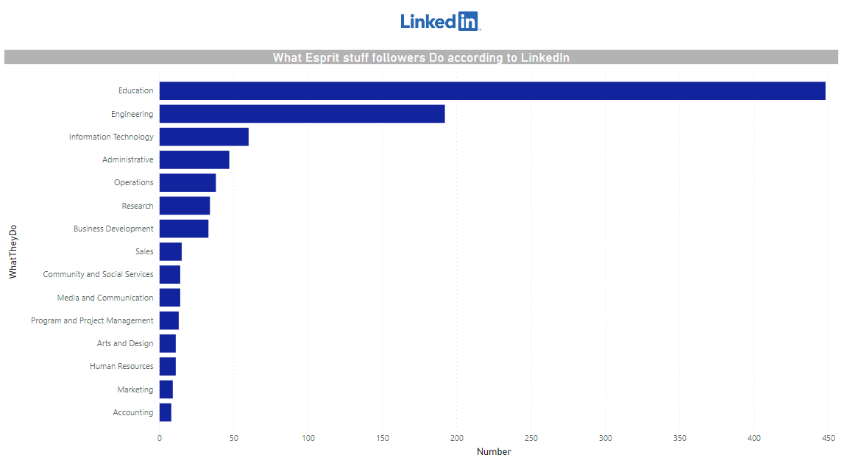
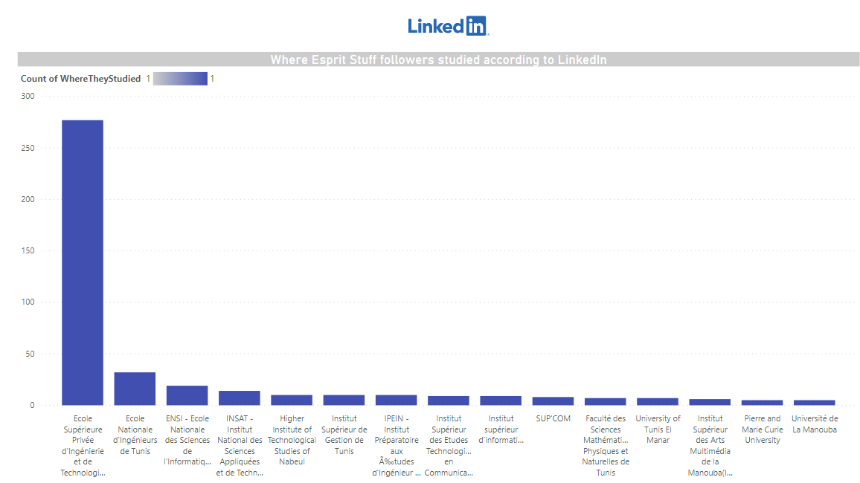
LinkedIn visuals
25

Slide 26
conclusion
26

