Slide 1


CHE F315
MACHINE LEARNING FOR CHEMICAL ENGINEERING PROJECT
HEAT EXCHANGER FOULING PREDICTION USING MACHINE LEARNING
Sarthak Srivastava - 2022A1PS0889G
Khusboo Jain - 2022A1PS1450G
Shaachi Khanna - 2022A1PS1477G
Balram Bhala - 2023A1PS0116G

Slide 2
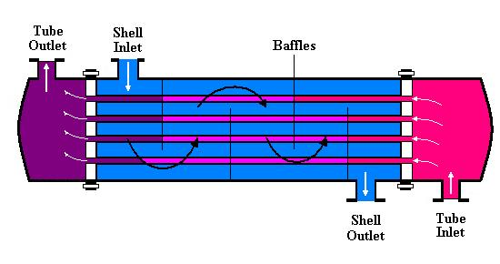
PROBLEM STATEMENT AND MOTIVATION
Heat exchanger fouling is one of the major operational issues in petroleum and chemical processing industries. With increasing run-time, tubes accumulate deposits, reducing heat transfer efficiency and increasing energy consumption.
Objective:
To develop machine learning models that can predict Heat Exchanger Performance Ratio (HEPR) using crude properties, process operating conditions, and engineered thermal features.
Why ML?
Process fouling is highly nonlinear
Difficult to predict analytically
ML enables early detection and schedule
optimization
Helps avoid shutdowns & improves refinery energy efficiency

Slide 3
DATA SET DESCRIPTION
Dataset:
Industrial dataset containing E-03 preheat train exchanger operating data:
~64,000 rows (Downsampled to every 10 hours)
Crude properties (API, TAN, Chlorides)
Crude & diesel temperature profiles
Mass flow rates
Heat capacities
Operating hours
Target Output:
HEPR = Actual Heat Duty / Design Heat Duty
Final Dataset → 14 input features + 1 output

Slide 4
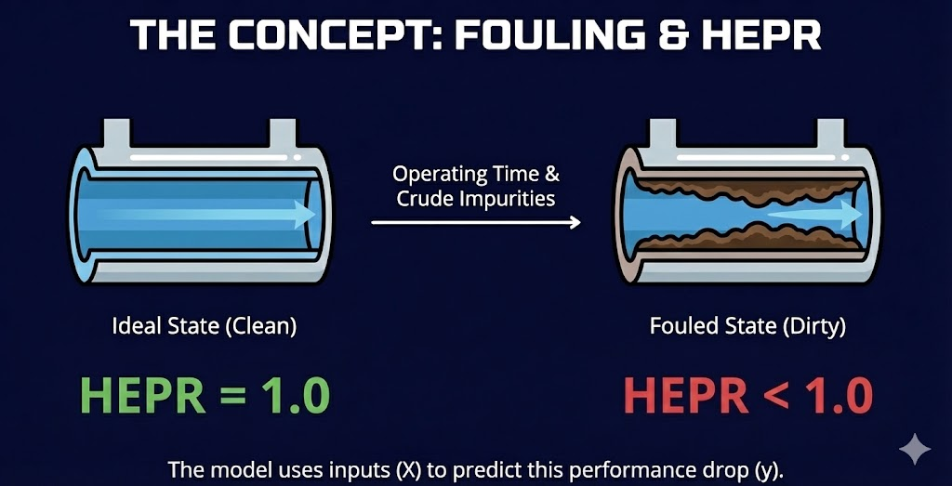
INPUT FEATURES & OUTPUT VARIABLE
Input Features (X):
Crude API gravity
Crude TAN
Crude chlorides
Tube-side temperatures (in/out)
Mass flow rate
Cp
Shell-side temperatures
Shell-side mass flow rate
ΔT (engineered)
Shell ΔT (engineered)
Operating time (hr and days)
Output Feature (y):
HEPR (Heat Exchanger Performance Ratio)
HEPR < 1 → fouling happens
HEPR ≈ 1 → ideal clean conditions

Slide 5
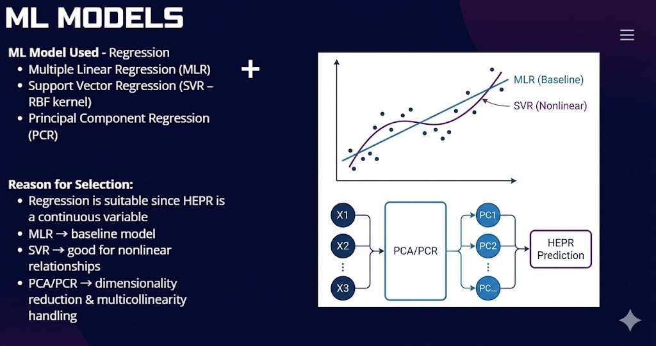
ML MODELS
ML Model Used - Regression
Multiple Linear Regression (MLR)
Support Vector Regression (SVR – RBF kernel)
Principal Component Regression (PCR)
Reason for Selection:
Regression is suitable since HEPR is a continuous variable
MLR → baseline model
SVR → good for nonlinear relationships
PCA/PCR → dimensionality reduction & multicollinearity handling

Slide 6
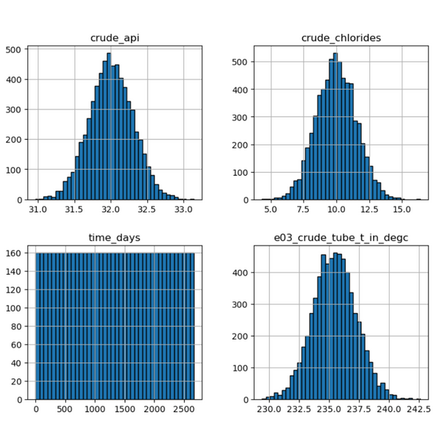
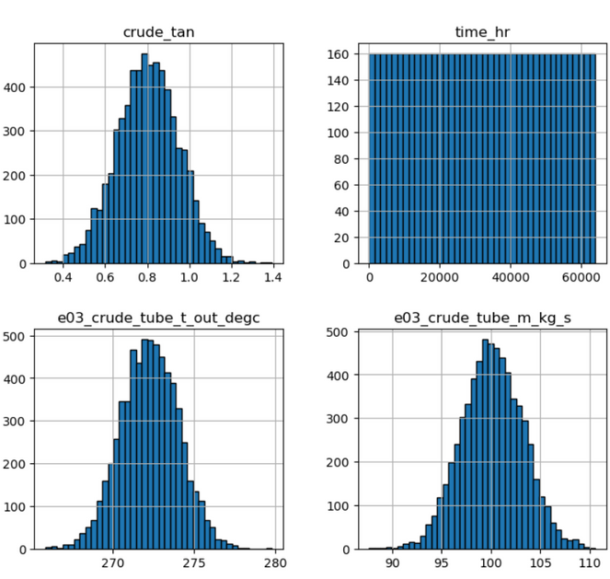
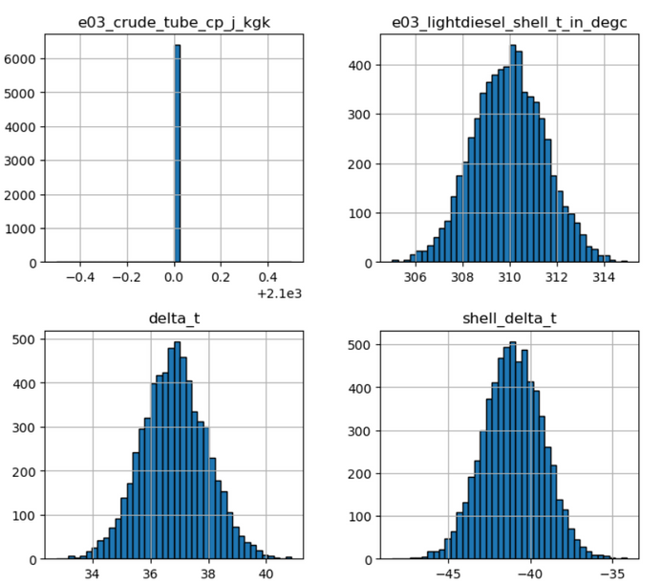
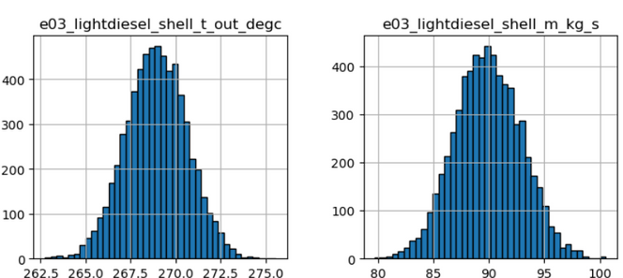
EDA - HISTOGRAMS OF INPUT FEATURES

Slide 7
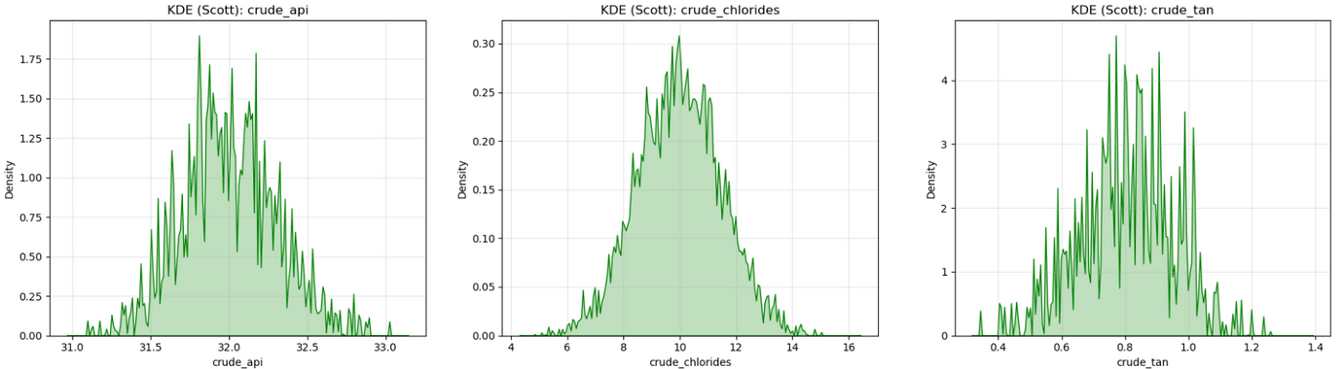
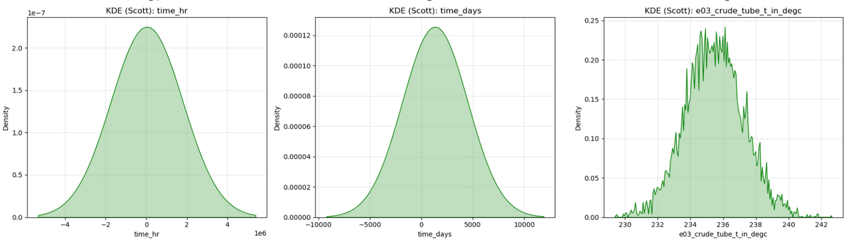
EDA - KDE PLOTS

Slide 8
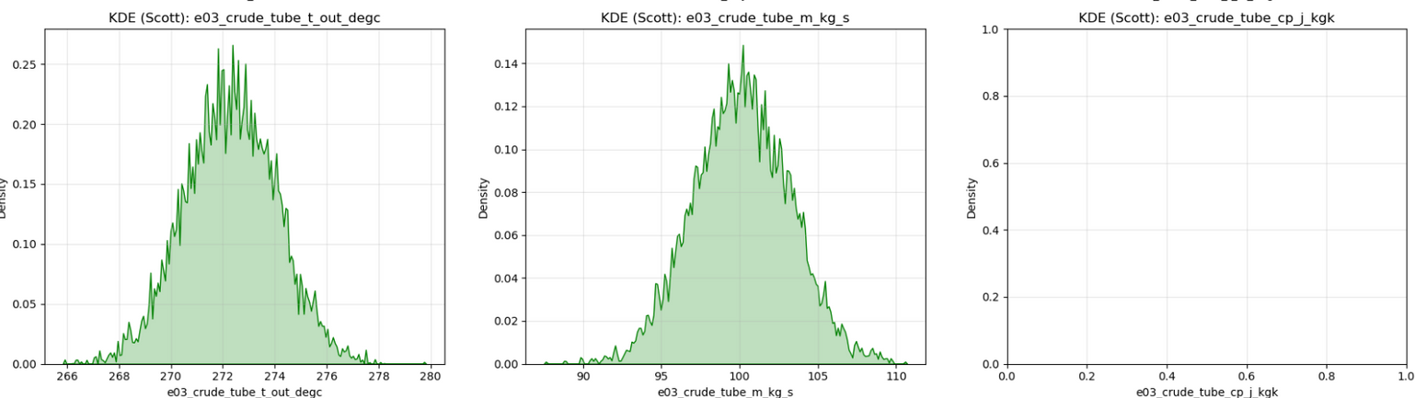
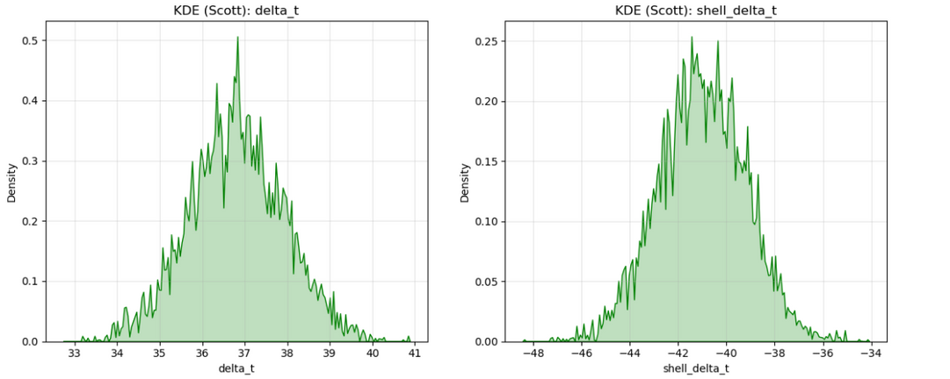
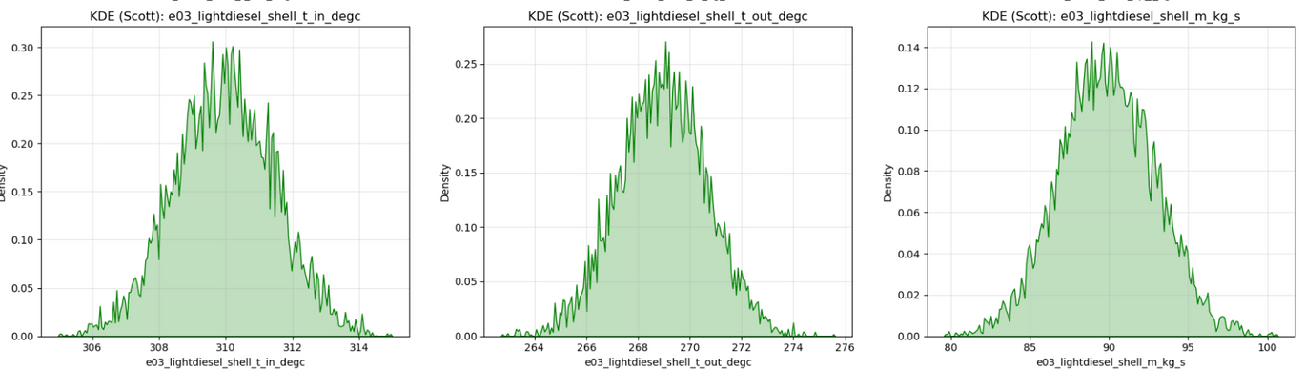
EDA - KDE PLOTS

Slide 9
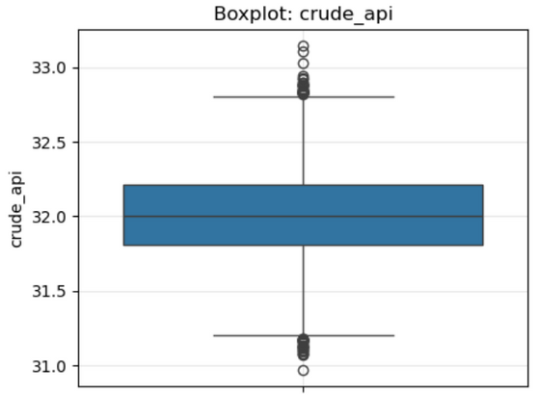
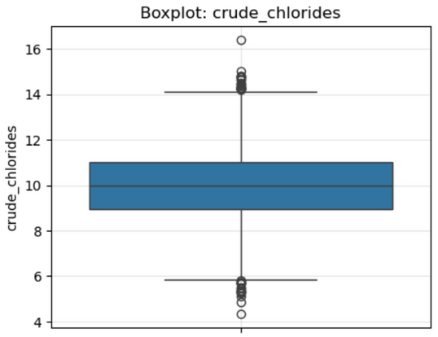
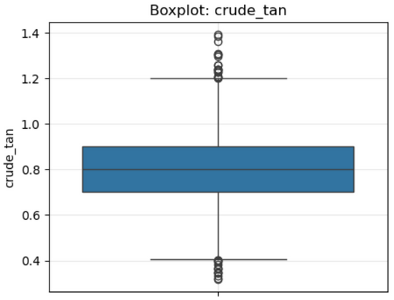
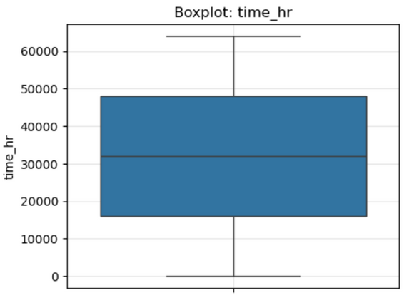
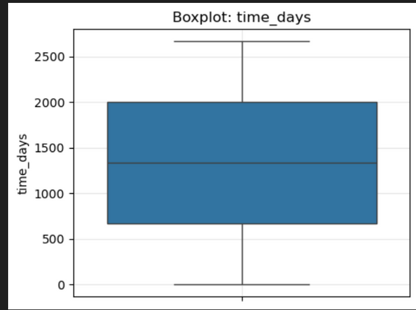
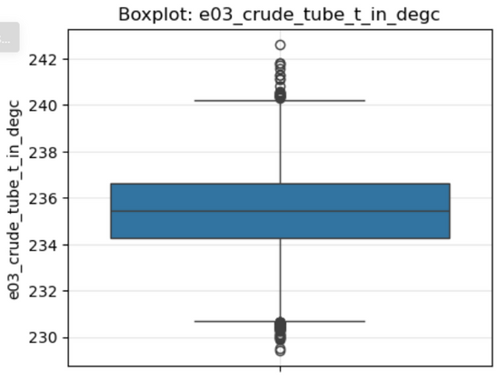
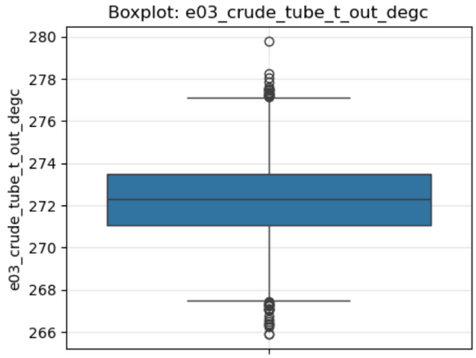
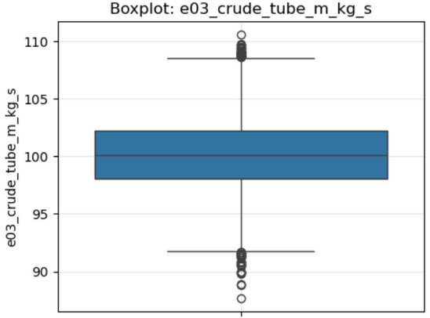
BOX PLOTS

Slide 10
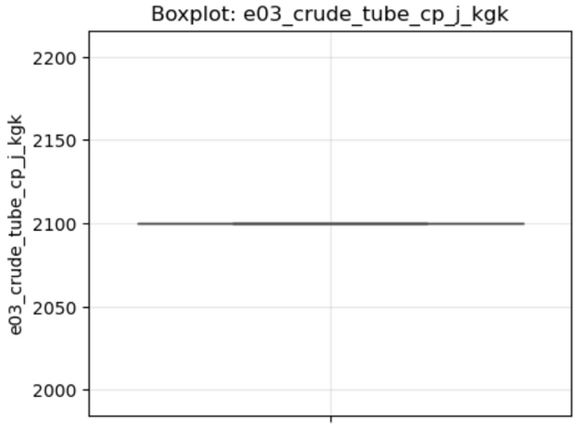
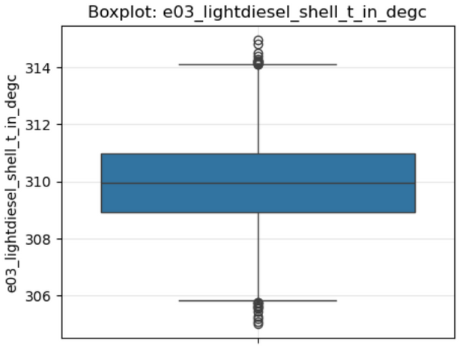
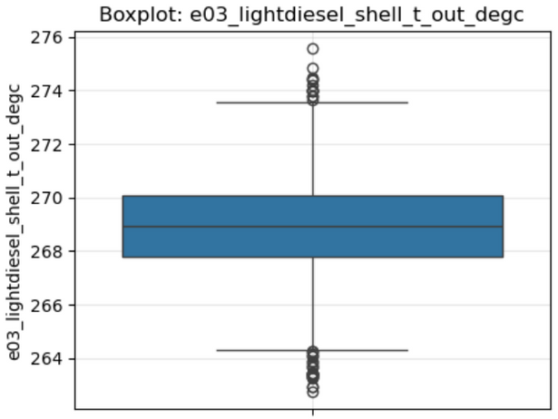
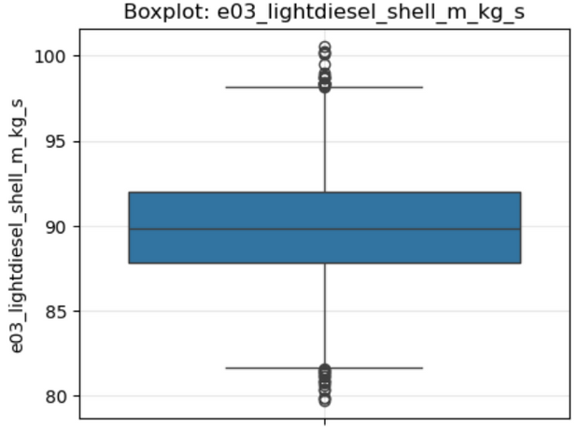
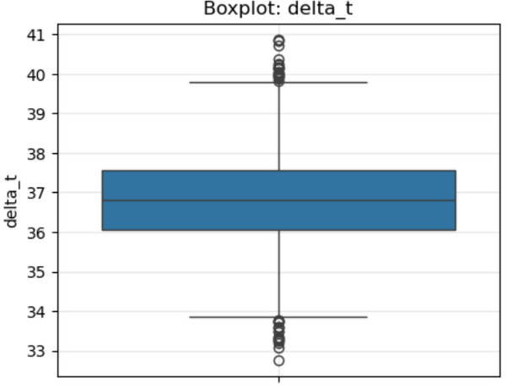
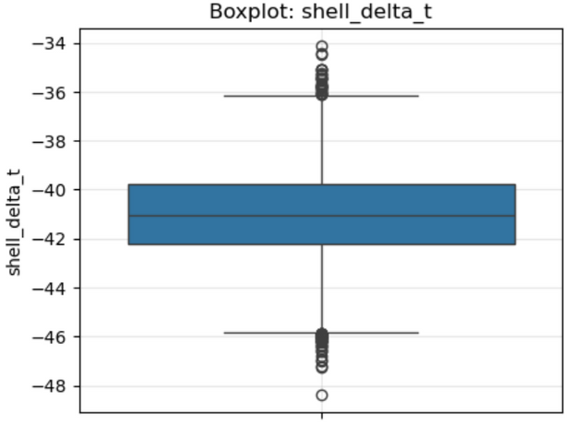
BOX PLOTS

Slide 11
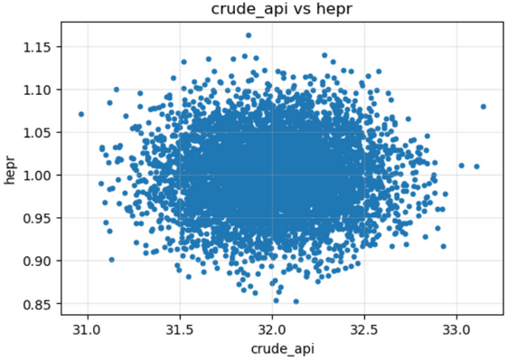
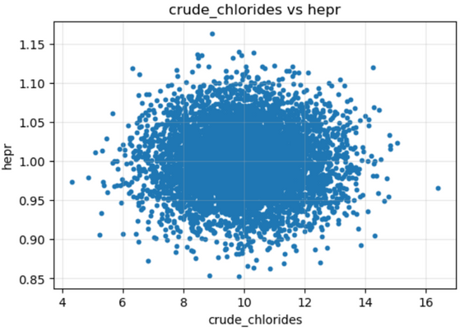
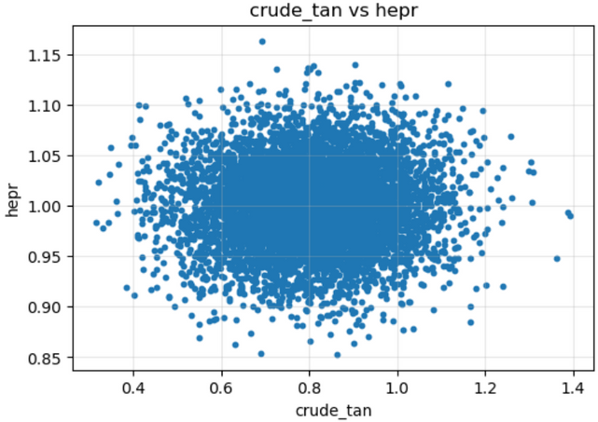
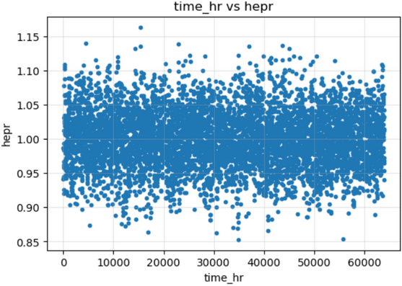
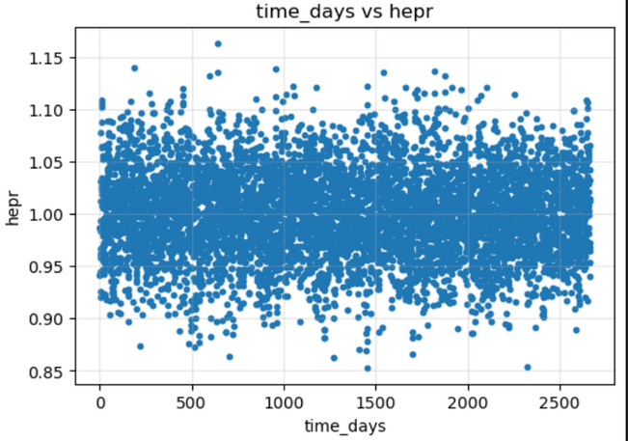
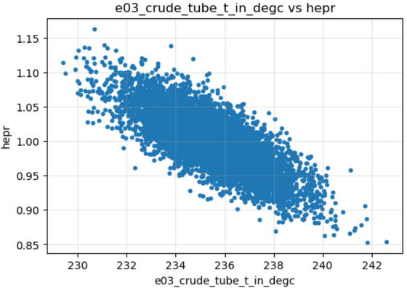
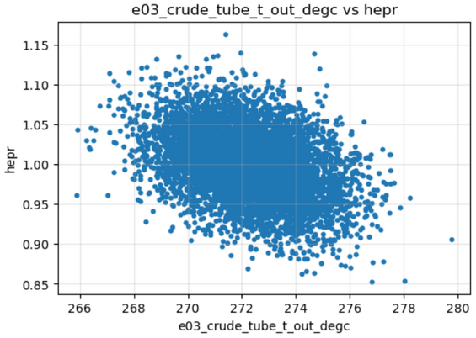
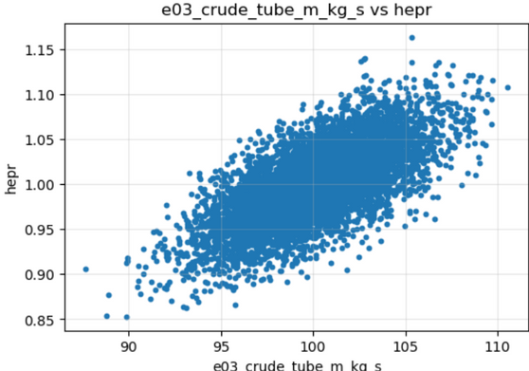
SCATTER PLOTS

Slide 12
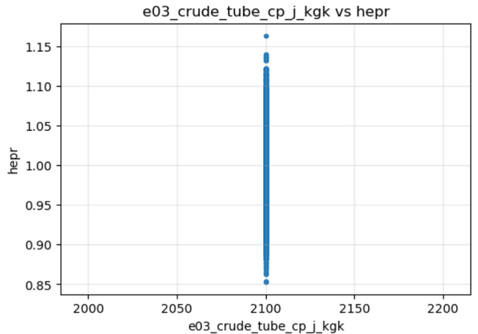
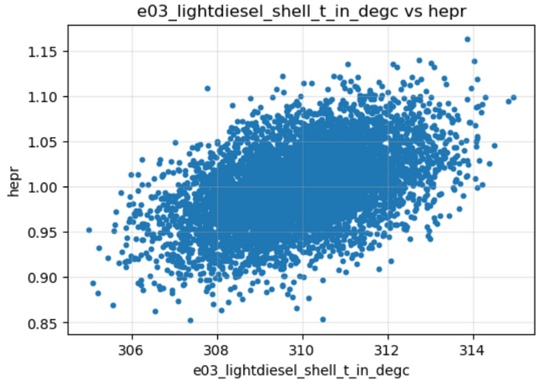
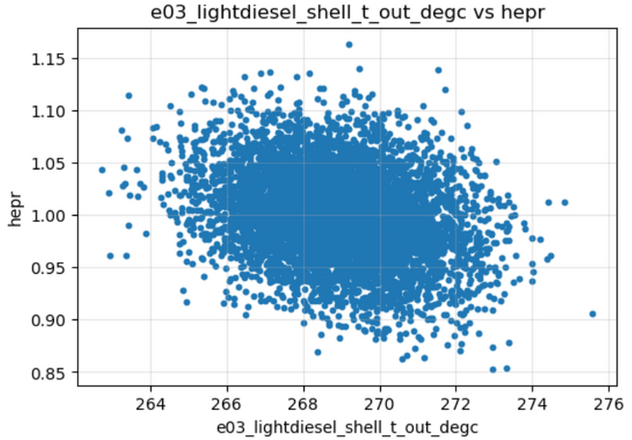
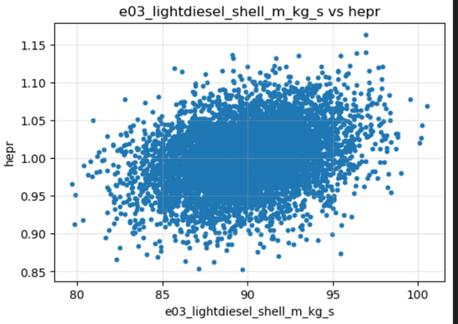
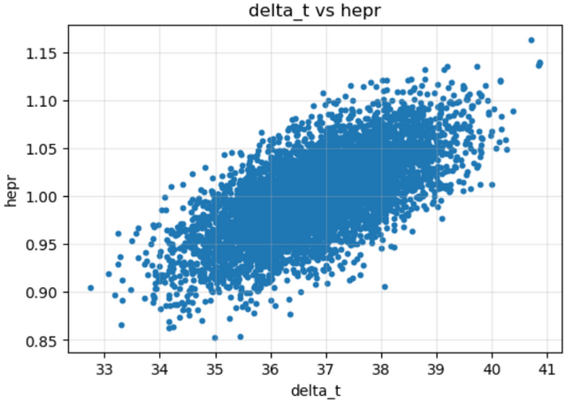
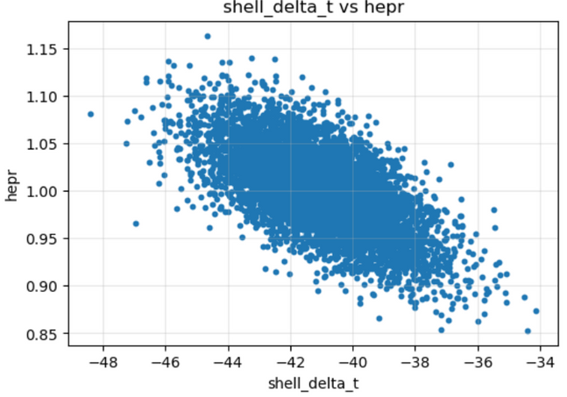
SCATTER PLOTS

Slide 13
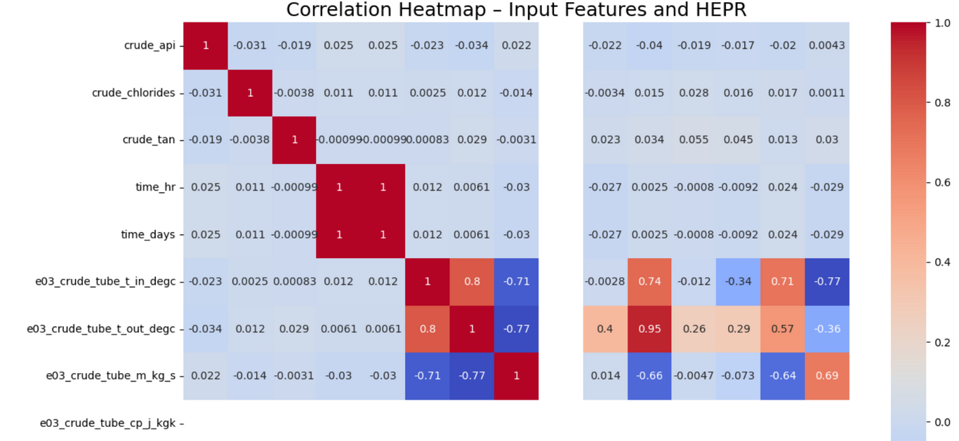
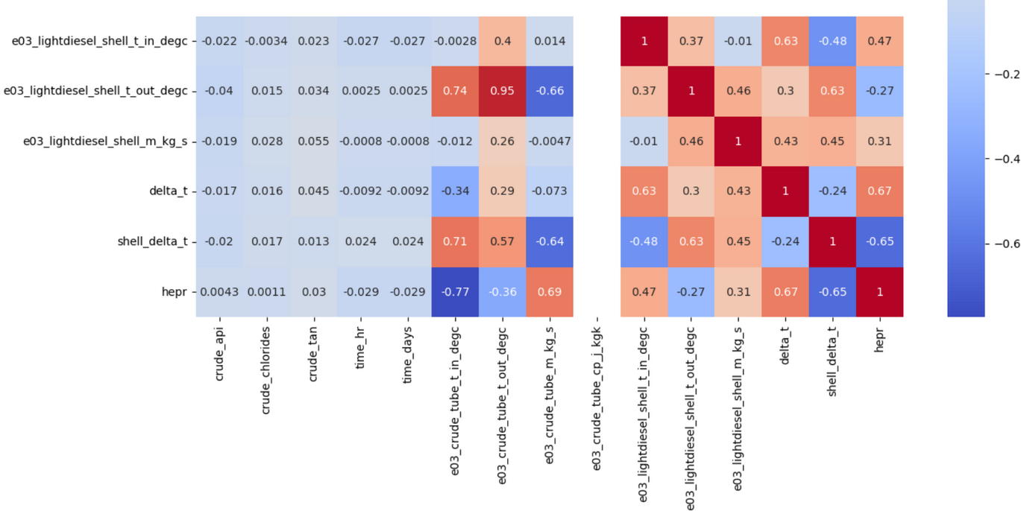
CORRELATION HEATMAP

Slide 14
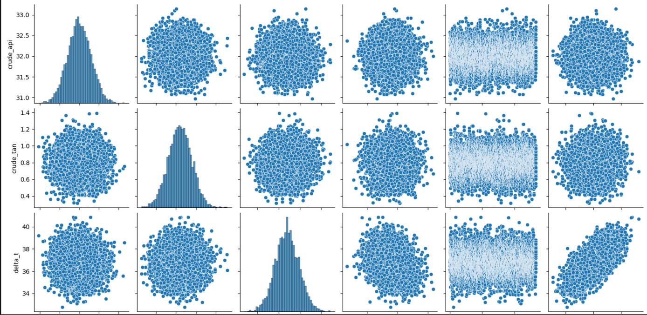
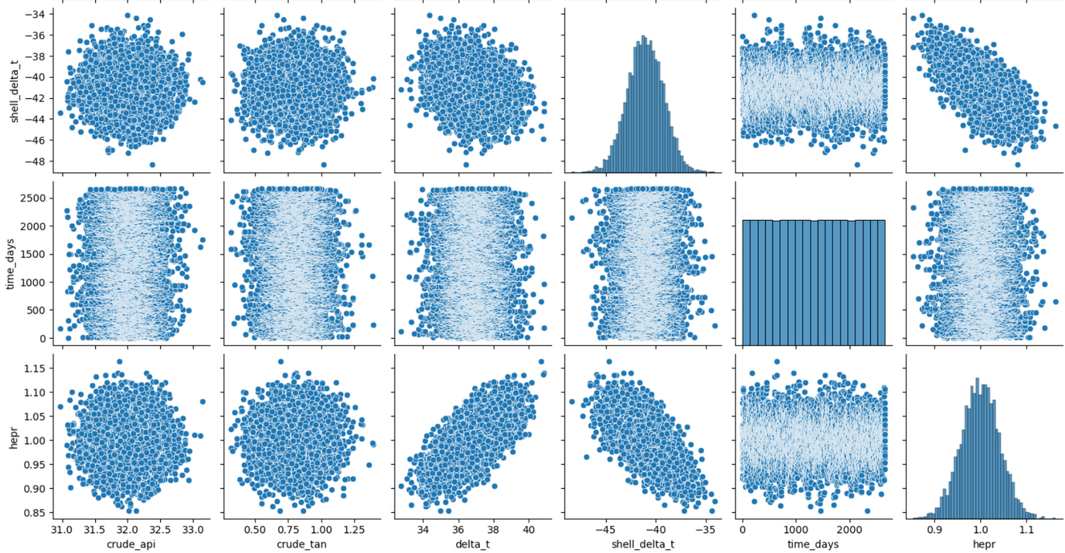
PAIR
PLOTS

Slide 15
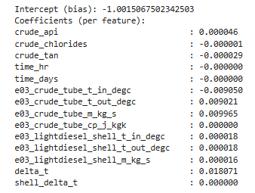
MLR - INTERCEPT & COEFFECIENTS

Slide 16
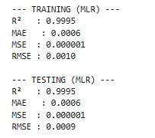
MLR - PERFORMANCE METRICS

Slide 17
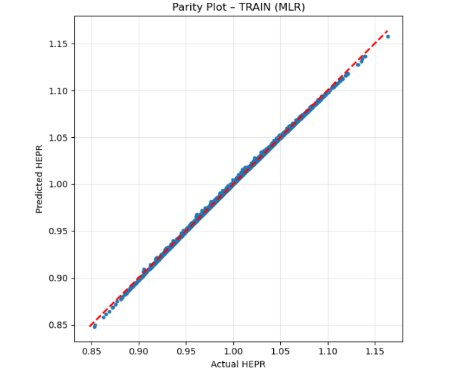
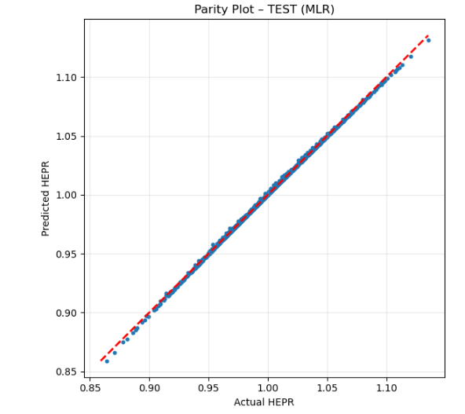
MLR - PARITY PLOTS

Slide 18
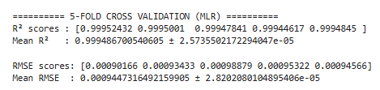
MLR - 5 FOLD CROSS VALIDATION

Slide 19
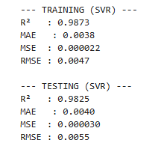
SVR - PERFORMANCE METRICS

Slide 20


SVR - PARITY PLOTS

Slide 21

SVR - 5 FOLD CROSS VALIDATION

Slide 22


PCA

Slide 23


PCA

Slide 24

PCR - PERFORMANCE METRICS

Slide 25


PCR - PARITY PLOTS

Slide 26

PCR - 5 FOLD CROSS VALIDATION

Slide 27
CONCLUSION
Among the three models (MLR, SVR, PCR), the Support Vector Regression (SVR) model provides the most reliable and realistic performance.
SVR achieved a Test R² of 0.9825 with an RMSE of 0.0055, indicating excellent predictive accuracy and strong generalization.
While MLR shows extremely high R² values (~0.999), this is largely due to strong linear dependencies introduced by engineered features and does not fully capture the nonlinear fouling behavior.
PCR performs well (Test R² = 0.955), but SVR outperforms both models and is therefore identified as the best model for predicting heat exchanger fouling (HEPR).

Slide 28
THANK YOU

