Slide 1

Introduction to Resnet
By Samar Jelassi
Notes:
Hi everyone,
Today, I'm going to talk to you about Residual Neural Networks, or ResNets.

Slide 2
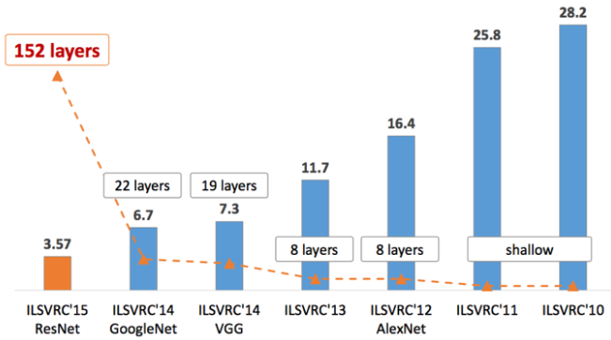
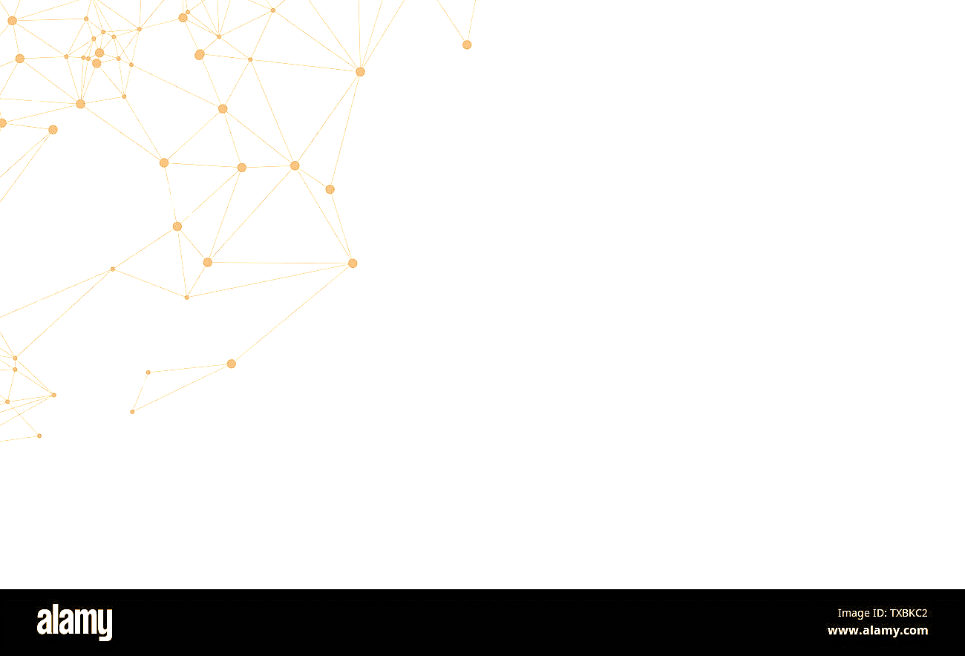
What is a ResNet?
Proposed on 2015 by Kaiming He et al.
Achieves a top-5 error rate of 3.57%
Notes:
ResNets are a type of artificial neural network (ANN) that was introduced in 2015 by He et al. They have revolutionized the field of deep learning by enabling neural networks to learn complex tasks on large datasets.

Slide 3
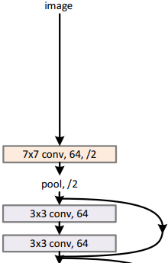
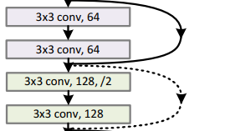
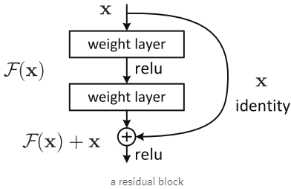
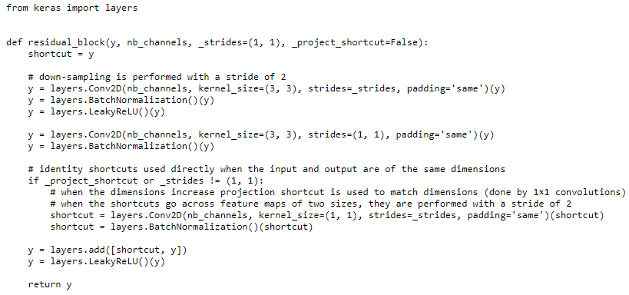

What is a ResNet?
Consist of many residual block
Given input map $x$
Example: $x→CONV→RELU→CONV→y$
This case: $ℱ\left(x\right)=y$
Finally: $x+y$ and apply activate function
Notes:
A ResNet is a type of deep neural network that uses residual connections to allow information to be passed directly from one layer to the next. This allows ResNets to train on large datasets without suffering from the vanishing gradient problem.
x and y must be same size (height, width, depth)
If not same depth → add extra 0 matrices.

Slide 4
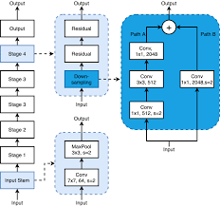
How does a ResNet work?
Notes:
A ResNet is composed of multiple layers, each composed of neurons. Each neuron in a layer receives inputs from the neurons in the previous layer. The inputs are then combined and transformed by an activation function. The output of the neuron is then passed to the neurons in the next layer.
The residual connections in a ResNet allow information to be passed directly from one layer to the next. This is done by adding the output of one layer to the output of a previous layer

Slide 5
Why are ResNets so effective?
ResNets are effective for several reasons. First, they use residual connections that allow information to be passed directly from one layer to the next. This allows ResNets to train on large datasets without suffering from the vanishing gradient problem.
Second, ResNets typically use deep convolutional layers. Convolutional layers are effective at extracting features from data. ResNets use deep convolutional layers to extract complex features from data.
Third, ResNets are typically pre-trained on large datasets. This means that they have already learned the features of the data before being used for a specific task. This allows ResNets to train faster and achieve better results.
Notes:
.

Slide 6

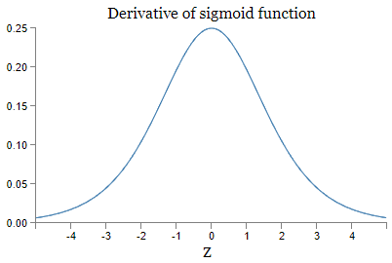
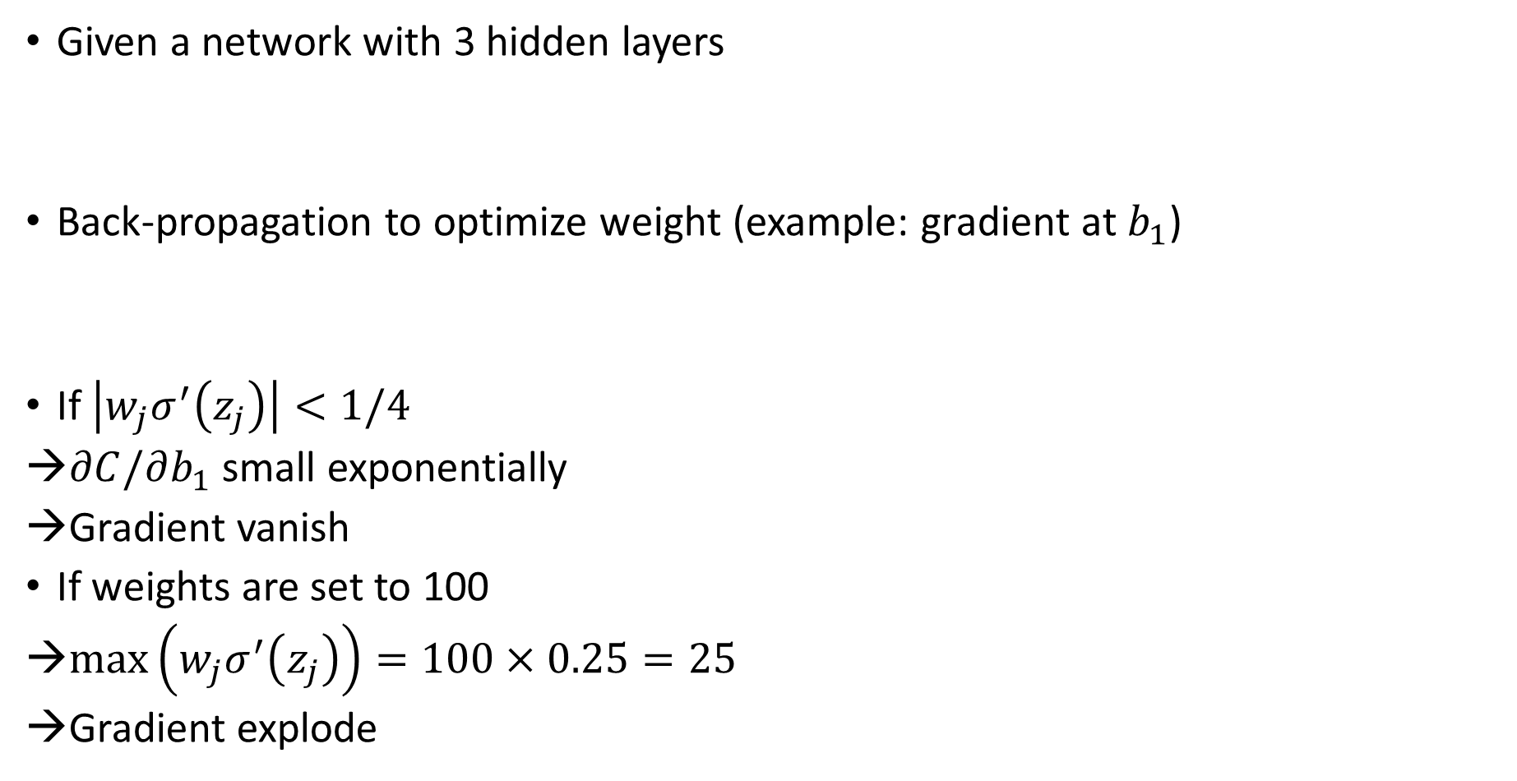
What is the Vanishing Gradient Problem?
Given a network with 3 hidden layers
Back-propagation to optimize weight (example: gradient at $b_{1}$)
If $\left|w_{j}σ^{′}\left(z_{j}\right)\right|<1/4$
$∂C/∂b_{1}$ small exponentially
Gradient vanish
If weights are set to 100
$\max\left(w_{j}σ^{′}\left(z_{j}\right)\right)=100×0.25=25$
Gradient explode
Notes:
In deep neural networks, the vanishing gradient problem occurs when the gradients calculated during backpropagation become very small as they flow through the network. This makes it difficult for the network to learn from the training data, especially for the earlier layers.
Imagine a deep neural network as a long chain of interconnected neurons. When the network makes a prediction, it compares it to the actual output and calculates the error. This error is then propagated back through the network, layer by layer, to update the weights of the neurons. However, as the error propagates back through the network, it can become exponentially smaller due to the multiplication of small gradients. This makes it difficult for the earlier layers to learn from the training data.
w1,w2,…w1,w2,… are the weights, b1,b2,…b1,b2,… are the biases, and C is some cost function.
Assume σ is sigmoid activation function

Slide 7
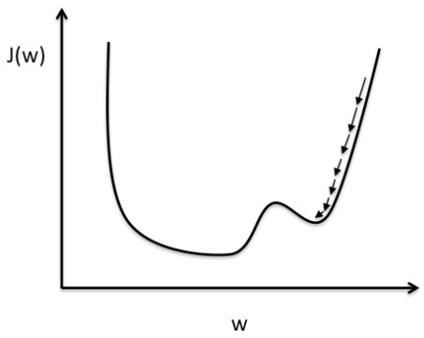
How do ResNets solve the Vanishing Gradient Problem?
Gradient vanish
Long time to get the convergence point, sensible to get the local minima.
Gradient explode
→ Hard to converge to the minimum value of loss function.
Notes:
ResNets address the vanishing gradient problem by introducing skip connections. These skip connections allow information to bypass some of the layers in the network and flow directly from earlier layers to later layers. This helps to preserve the gradients and prevents them from vanishing entirely.
Think of the skip connections as shortcuts that allow information to flow more easily through the network. By bypassing some of the layers, the gradients are not subject to as many multiplications, and they can reach the earlier layers with more strength. This allows the earlier layers to learn more effectively from the training data.
Think of the skip connections as shortcuts that allow information to flow more easily through the network. By bypassing some of the layers, the gradients are not subject to as many multiplications, and they can reach the earlier layers with more strength. This allows the earlier layers to learn more effectively from the training data.

Slide 8
Benefits of ResNets
ResNets have several benefits over traditional deep neural networks:
Improved accuracy: By addressing the vanishing gradient problem, ResNets can achieve better accuracy on a variety of tasks.
Deeper networks: ResNets can be trained with more layers than traditional deep neural networks without suffering from the vanishing gradient problem.
Reduced training time: The skip connections in ResNets can help the network to learn faster, reducing the training time.

Slide 9
Applications of ResNets
ResNets have been successfully used in a variety of applications, including:
Image recognition
Object detection
Image segmentation
Video classification
Natural language processing

Slide 10
Conclusion
ResNets are a powerful type of deep neural network that has significantly improved the performance of deep learning models. By addressing the vanishing gradient problem, ResNets have made it possible to train deeper and more accurate neural networks for a wide range of tasks.
Notes:
Overall, ResNets are a powerful type of deep neural network that has significantly improved the performance of deep learning models. By addressing the vanishing gradient problem, ResNets have made it possible to train deeper and more accurate neural networks for a wide range of tasks.

Slide 11
References
CHAPTER 5: Why are deep neural networks hard to train?, Michael Nielsen, http://neuralnetworksanddeeplearning.com/chap5.html#discussion_why
Residual Net, Agustinus Kristiadi's Blog, https://wiseodd.github.io/techblog/2016/10/13/residual-net/
He, Kaiming, et al. "Deep residual learning for image recognition." Proceedings of the IEEE conference on computer vision and pattern recognition. 2016.
He, Kaiming, et al. "Identity mappings in deep residual networks." European Conference on Computer Vision. Springer, Cham, 2016.

