Slide 1
AI Mental Health
Assistance
Team Members - Rushay Gopani || Samar Markande Anurag Chawla || Maya

Slide 2
PROJECT OVERVIEW
Three Clinical Questions
The NHS Mental Health service faces three core unknowns. Our pipeline answers all three with reproducible, evidence-based data science.
01
02
03
WHO are our patients?
WHEN will demand peak?
WHERE is need going unmet?
K-Means clustering segments 775 patients into 6 distinct risk profiles — enabling targeted care pathways.
Prophet + ARIMA models forecast monthly IAPT referrals 3 months ahead with 95% confidence intervals.
Geo-spatial IMD × IAPT access analysis identifies 7 high-deprivation ICBs with below-average access rates.

Slide 3
SLIDE 03 · DATA SOURCES
Datasets Used Across the Pipeline
Datasets Used Across the Pipeline
Dataset
Size / Scope
Key Features Used
Scripts
APMS 2014
9 regional XLS chapters
CMD, PTSD, Psychosis, PD, ADHD, Bipolar, Alcohol, Drug, Suicide
W1-DS1, W1-DS2 ,W1-DS3
MHSDS
771,626 patients
Primary Level, Measure Id, Measure name, Measure value, etc.
W4-DS2
depression_anxiety_data.csv
775 patients
PHQ, GAD, BMI, Age, Gender, Epworth Sleep Score
W2-DS1, W2-DS2
referrals_past_data.csv
Monthly IAPT referrals
Referrals received, time-series 2023–2025
W3-DS1
mental_health_proxy_timeseries.csv
CSEW 2002–2019
Crime worry, safety perception — mental health proxy indicators
W2-DS3
NHS Prescribing (CCG spend)
CCG-level monthly
Actual cost, items, quantity, list size — per patient ratios
W3-DS2
NHS Talking Therapies + IMD + ICB Shapefile
42 ICBs
Referrals, access rate, recovery, wait times, IMD decile
W3-DS3

Slide 4
End-to-End Data Science Workflow — Weeks 1 to 4
Week 1
Foundations
Week 2
Modelling
Week 3
Forecasting
Week 4
Reproducibility
Scripts
Scripts
Scripts
Scripts
DS1: Statistical Baseline
DS1: Regression (GAD)
DS1: IAPT Forecasting
DS1: Full Pipeline Run
DS2: Hypothesis Testing
DS2: Clustering (K-Means)
DS2: Anomaly Detection
DS2: MHSDS Integration
DS3: Distribution Analysis
DS3: Temporal Detection
DS3: Geo-Spatial IMD
DS3: NHS methodology compliance
DS4: Data documentation
DS4: Model interpretability
DS4: DS pipeline documentation
DS4: Demo
Key Outputs
Key Outputs
Key Outputs
Key Outputs
→ APMS prevalence map
→ Regression R²=0.46
→ Prophet 3-month forecast
→ All 9 scripts: pass
→ Hypo test CSV
→ 6 patient segments
→ 5% CCG anomaly rate
→ 771K MHSDS rows loaded
→ 5 distribution PNGs
→ Chow test breakpoints
→ 7 underserved ICBs
→ End-to-end 57s

Slide 5
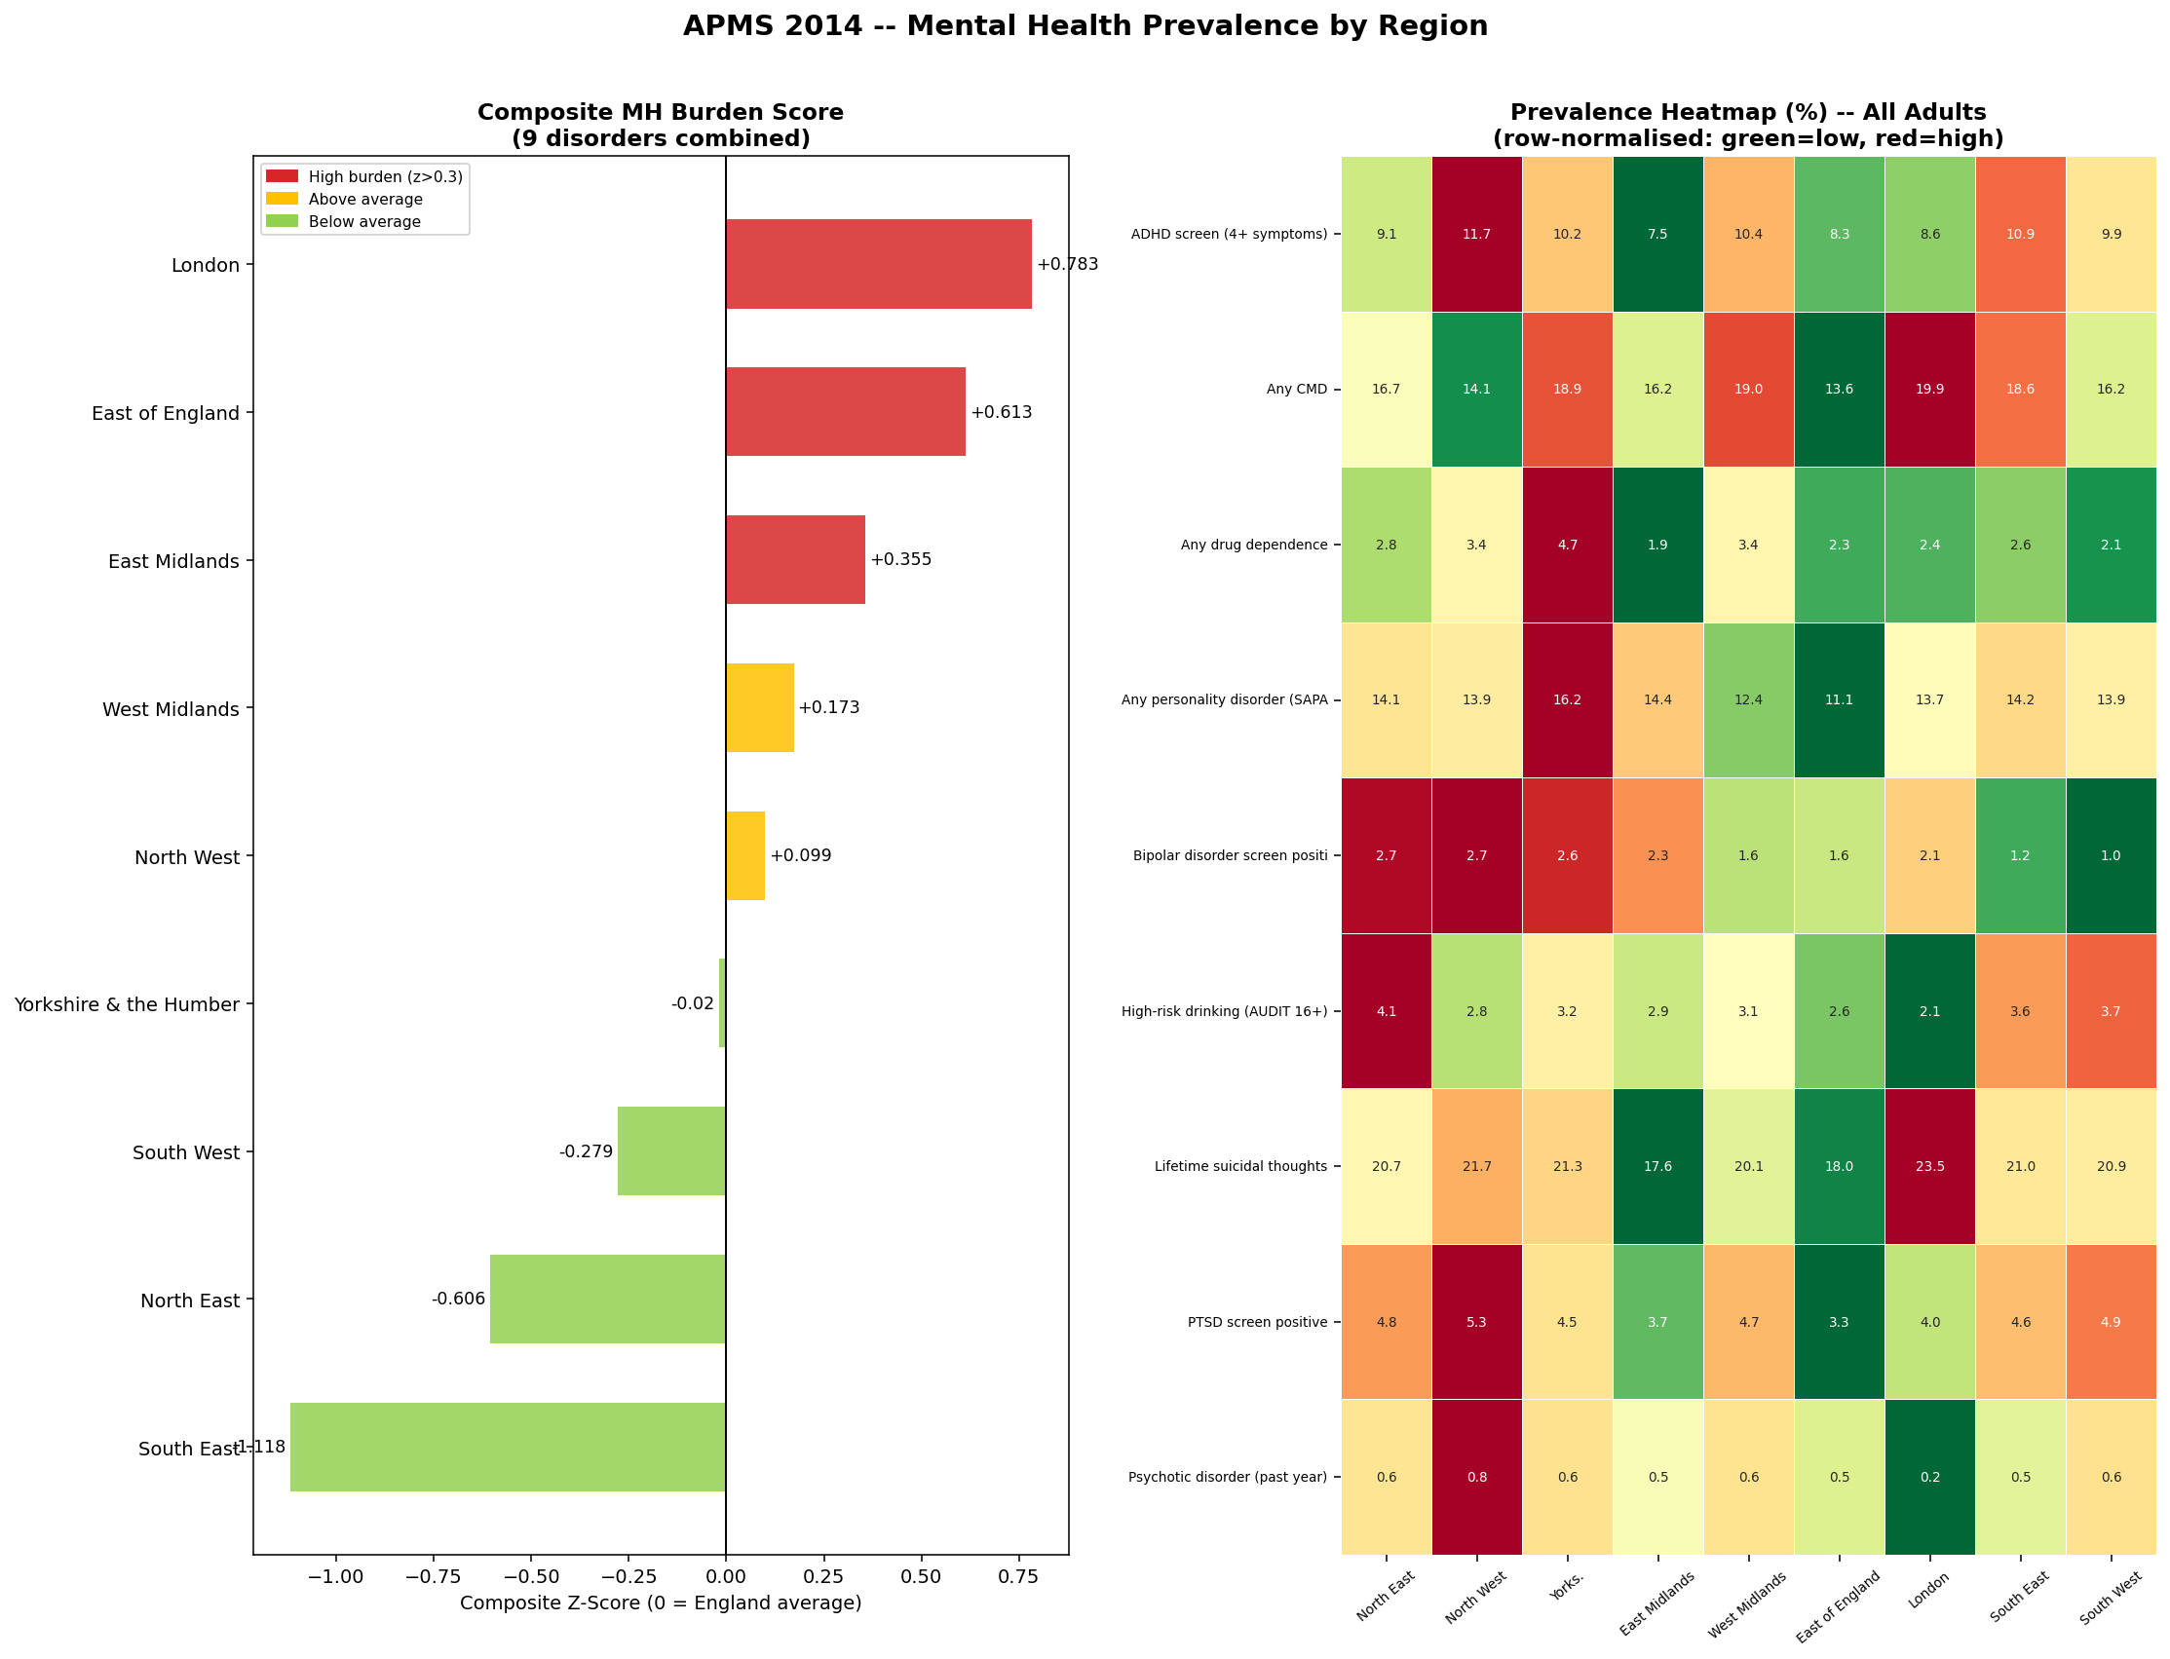
Statistical Baseline Model
Output
Top burden: London · East Of England
Avg : West Midlands · Yorkshire
Lowest burden: SouthWest · SouthEast
Dataset
APMS 2014
9
Disorders analysed
9
Place in UK
3
Sex groups (Male ,Female and All)
Wilson CI
Confidence method
Z-score
Composite burden

Slide 6
Hypothesis Testing
Three null hypotheses tested on APMS 2014 CMD data (7 age groups, 9 regions):
H₀: No association between gender and CMD
REJECT H₀
Chi-square · χ²= 69.28 · p < 0.001
→ Women are significantly more likely to have CMD than men at every age group.
H₀: No association between age group and CMD
REJECT H₀
Chi-square · χ²= 100.54 · p < 0.001
→ CMD prevalence varies significantly by age — peak at 25–34 for women, 25–34 for men.
H₀: Male and female CMD rates are equal
REJECT H₀
Independent t-test · t = −2.81 · p = 0.016
→ Female CMD rates are 8–10 percentage points higher than male rates across all age bands.

Slide 7
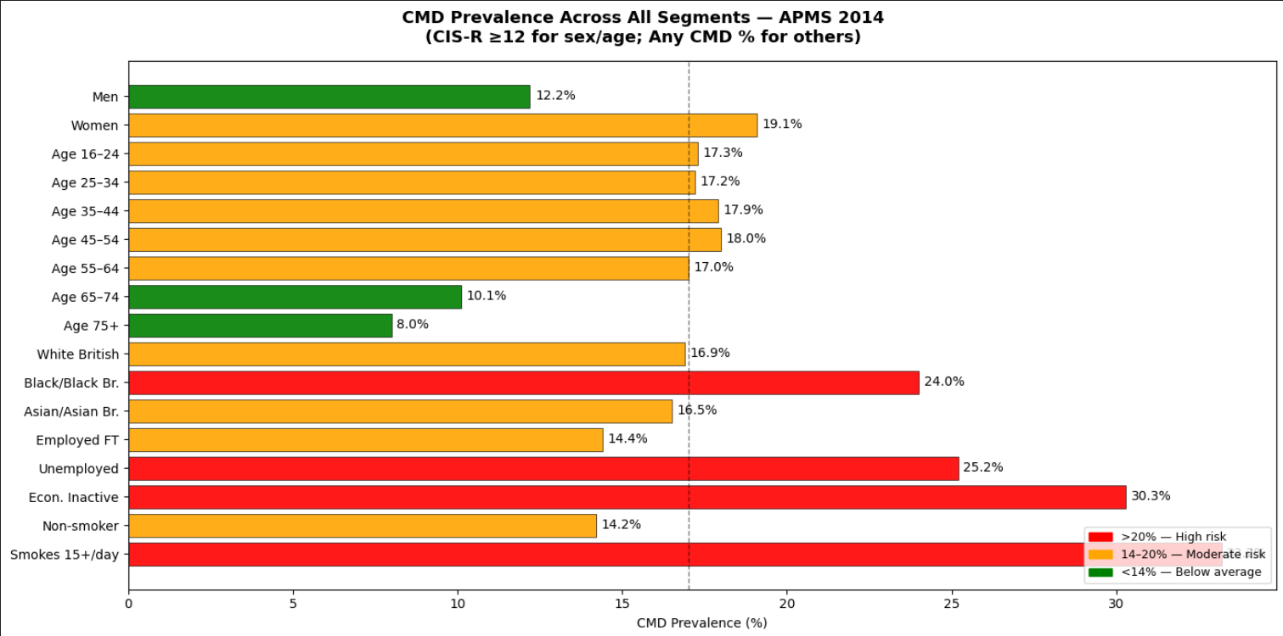
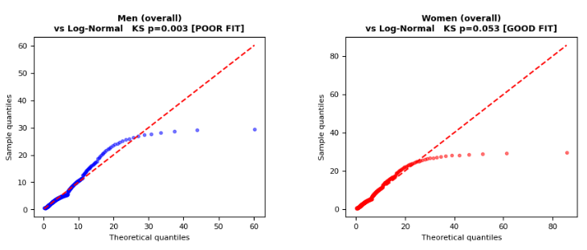
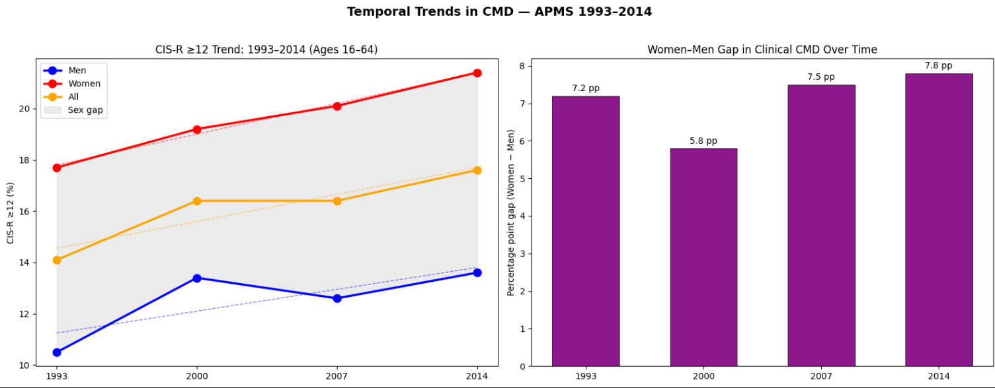
Distribution Analysis
Output
DISTRIBUTION SHAPE
CIS-R is strongly right-skewed. Log-Normal fits better than Normal.
2. SEX DIFFERENCES
Men CIS-R ≥12: 12.2%
Women CIS-R ≥12: 19.1%
3. AGE PATTERN
Age 16–24: 17.3% score CIS-R ≥12 Age 45–54: 18.0% score CIS-R ≥12 Age 75+: 8.0% score CIS-R ≥12
4. HIGHEST RISK SEGMENTS (Any CMD) Smokes 15+/day : 33.2%
Econ. Inactive : 30.3%
Unemployed : 25.2%
Black/Black Br. : 24.0%
Women : 19.1 .
6. TEMPORAL TREND
Women: 17.7% (1993) → 21.4%[+3.7 pp] Men: 10.5% (1993) → 13.6%[+3.1 pp]
Sex gap has widened over 20 years.
QQ Plot – CIS-R Score Distribution vs Theoretical Distribution

Slide 8
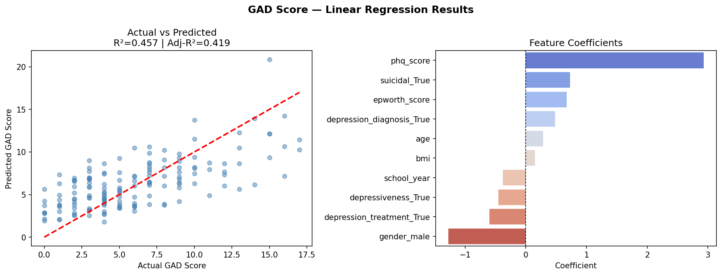
Predicting GAD Score — Linear Regression (PHQ, BMI, Age, Sleep, Gender)
0.458
0.419
9.45
PHQ
R² Score
(test set)
Adjusted R²
(11 features)
MSE
(mean sq error)
Top Predictor
Coeff = +2.93
Variance explained
Penalised for complexity
GAD score units²
PHQ score drives GAD

Slide 9
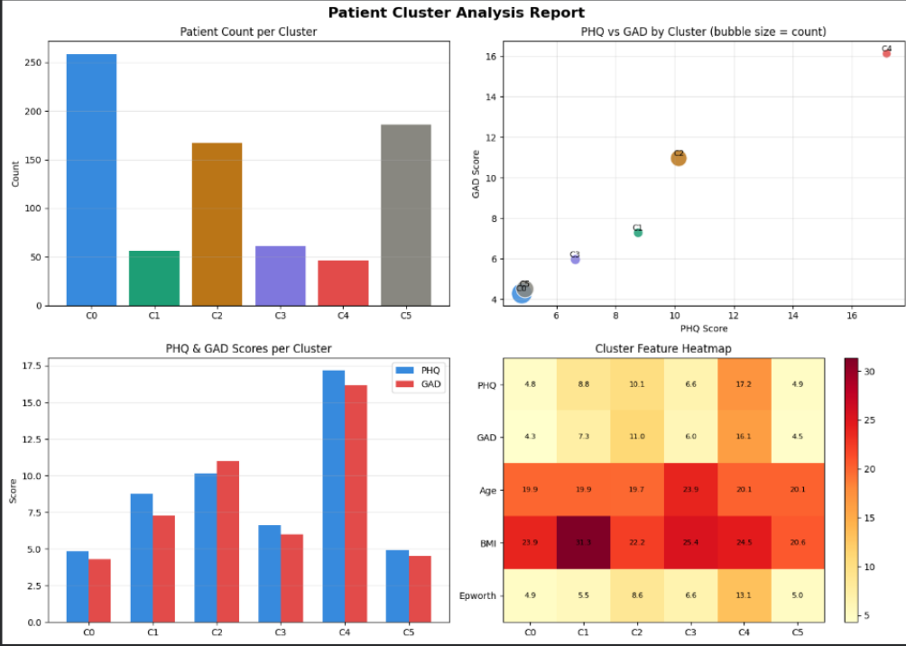
K-Means on PHQ · GAD · BMI · Age · Epworth Sleep Score
6 Patient Segments
Silhouette validated · k=6 optimal
C0 - Low-Risk Male
n=259 · Mild / Mild
C1 - Obesity-Mild Distress
n=56 · Mild / Mild
C2 - Moderate Mixed+Sleep
n=167 · Mod / Mod
C3 – Older Adult – Mild Distress
n=61 · Mild / Mild
C4 - High-Risk Severe ⚠
n=46 · Severe / Severe
C5 - Low-Risk Female
n=186 · Mild / Mild

Slide 10
RESULT 1
CLUSTER DEEP DIVE :- HIGH-RISK SEVERE
Cluster 4 - High-Risk Severe (n=46) - Immediate Clinical Priority
17.2
16.2
13.1
PHQ Score
(Depression)
GAD Score
(Anxiety)
Epworth Score
(Sleepiness)
Severe threshold ≥15
Severe threshold ≥15
Pathological ≥11
24.5
20.1
46
BMI
(Normal weight)
Average Age
(years)
Patients
(smallest cluster)
Not weight-driven
Young adult cohort
6% of total cohort
CLINICAL PRIORITY ACTION
These 46 patients score in the Severe range on both PHQ and GAD simultaneously and report pathological sleepiness. They require immediate escalation to a Step 3/4 pathway — fast-track referral for combined CBT + sleep clinic assessment.

Slide 11
RESULT 1
CLUSTER DEEP DIVE -SECONDARY PRIORITIES
Clusters 1 & 2 - Obesity-Distress & Moderate Mixed+Sleep
Cluster 1 - Obesity-Mild Distress
Cluster 2 - Moderate Mixed + Sleep
n = 56 | 6% of cohort
n = 167 | 22% of cohort - largest priority group
PHQ Score
8.75
Mild range
PHQ Score
10.1
Moderate range
GAD Score
7.30
Mild range
GAD Score
11.0
Moderate range
BMI
31.3
Obese Class I
BMI
22.2
Normal
Age
19.9
Young adult
Age
19.7
Young adult
Epworth
5.6
Normal
Epworth
8.6
Borderline high
Pathway: Integrated mental-physical health clinic - combined weight management + low-intensity CBT (Step 2 IAPT)
Pathway: Step 2 IAPT(NHS Talking Therapies) with sleep hygiene component — group CBT referral + Epworth monitoring every 6 weeks

Slide 12
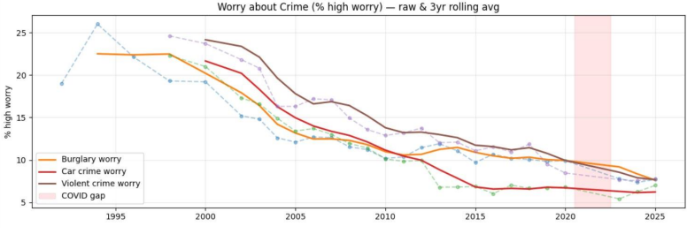
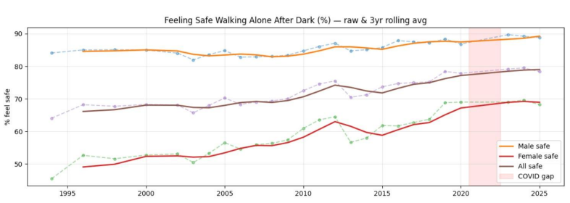
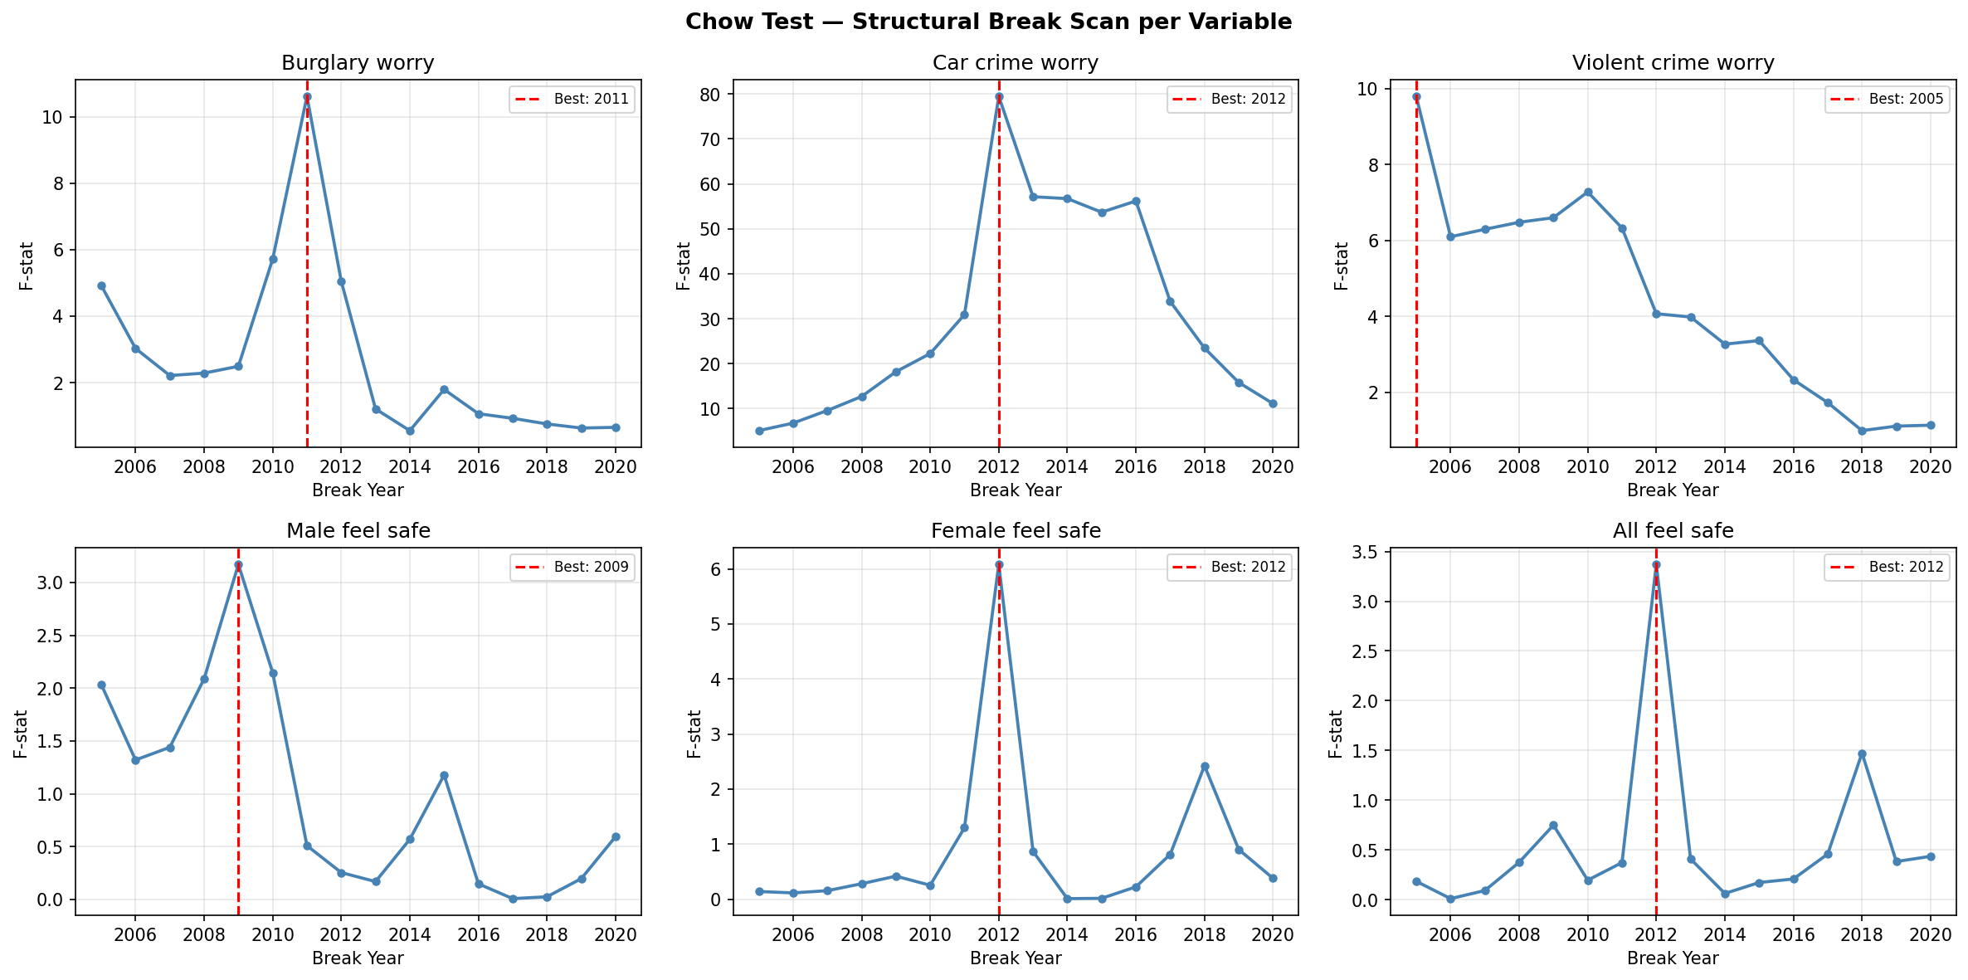
CSEW Proxy Timeseries — Crime Worry & Safety Perception 2002–2019
Results
✔ Significant
Violent crime worry- Break: 2005 / 2013
Car crime worry - Break: 2012
Female feel safe - Break: 2012
✘ Not significant
Burglary worry - Break: 2011
Male feel safe - Break: 2009

Slide 13
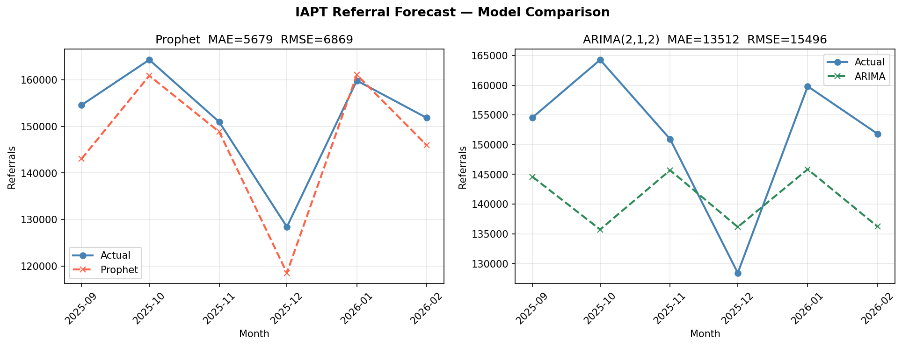
Prophet vs ARIMA(2,1,2) - Test-Set Accuracy on 6-Month Hold-Out
5,679
13,512
6,869
15,496
Prophet MAE
(referrals/month)
ARIMA MAE
(referrals/month)
Prophet RMSE
(referrals/month)
ARIMA RMSE
(referrals/month)
Lower = better
57% worse than Prophet
Penalises outliers
2.25× Prophet RMSE
Prophet selected as production model — MAE 5,679 vs ARIMA 13,512. Prophet handles NHS seasonal patterns (Christmas, Easter, summer dips) automatically via Fourier terms.

Slide 14
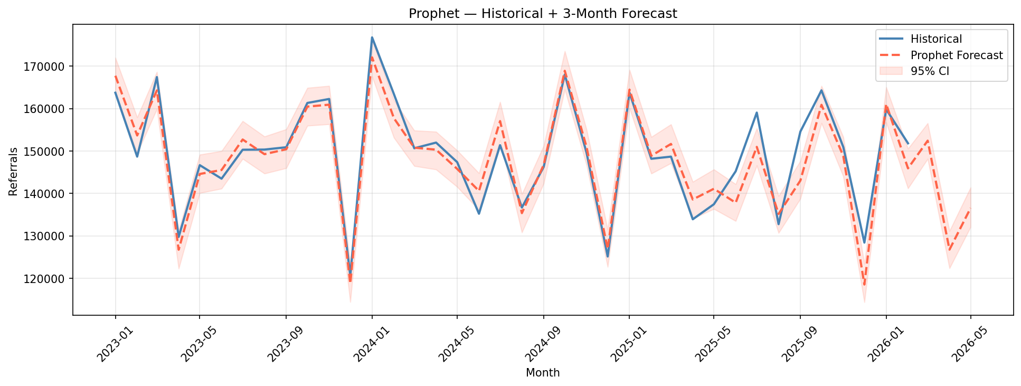
Prophet Forecast: March - April - May 2026 with 95% Confidence Intervals
March 2026
April 2026
May 2026
152,424
126,767
136,547
CI: 148,135 – 156,540
CI: 122,373 – 131,151
CI: 132,101 – 141,397
Peak month — demand surge
Post-March dip
Partial recovery
March 2026 surge of ~152K referrals (vs April dip of ~127K) = 20% swing. Recommend pre-commissioning bank clinician sessions for Q1 and extended evening appointments in high-demand ICBs.

Slide 15
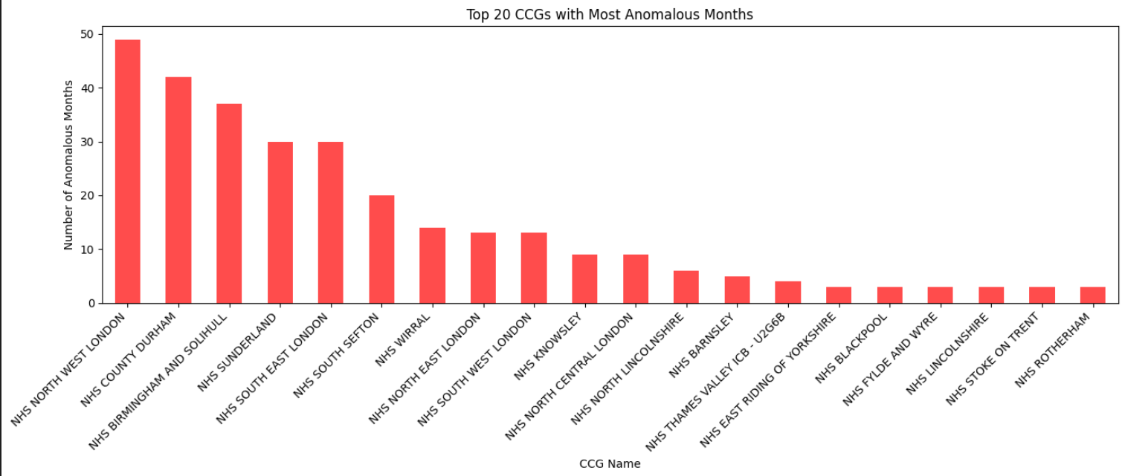
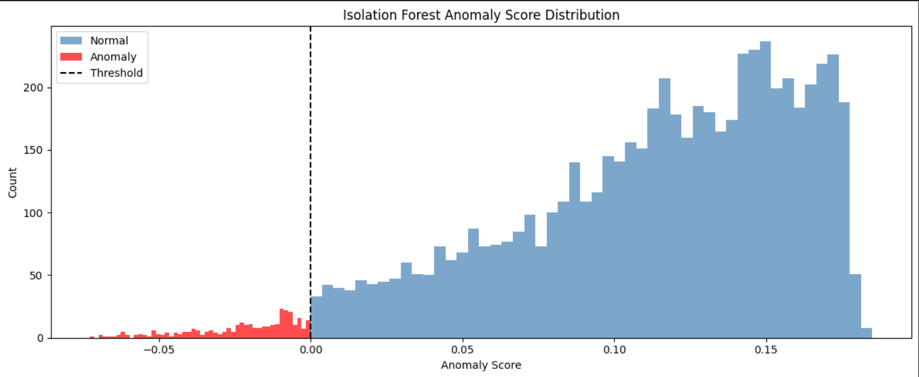
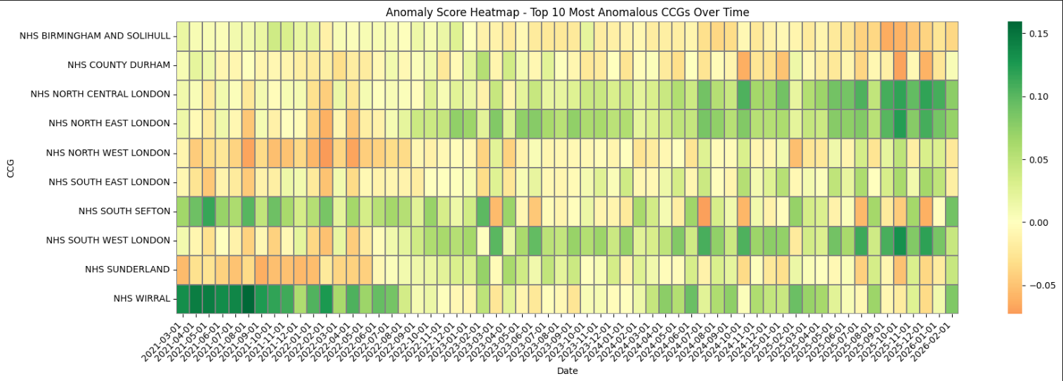
Isolation Forest — NHS CCG Prescribing Spend Anomalies
5%
IF-100
5 Features
Top 10
Contamination Rate
(model parameter)
Isolation Forest
(n_estimators=100)
Per-patient cost, items
quantity, cost/item, qty/item
CCGs flagged for
clinical audit review
Industry-standard setting
Random state=42 (reproducible)
Engineered from raw CCG data
Most anomalous months

Slide 16
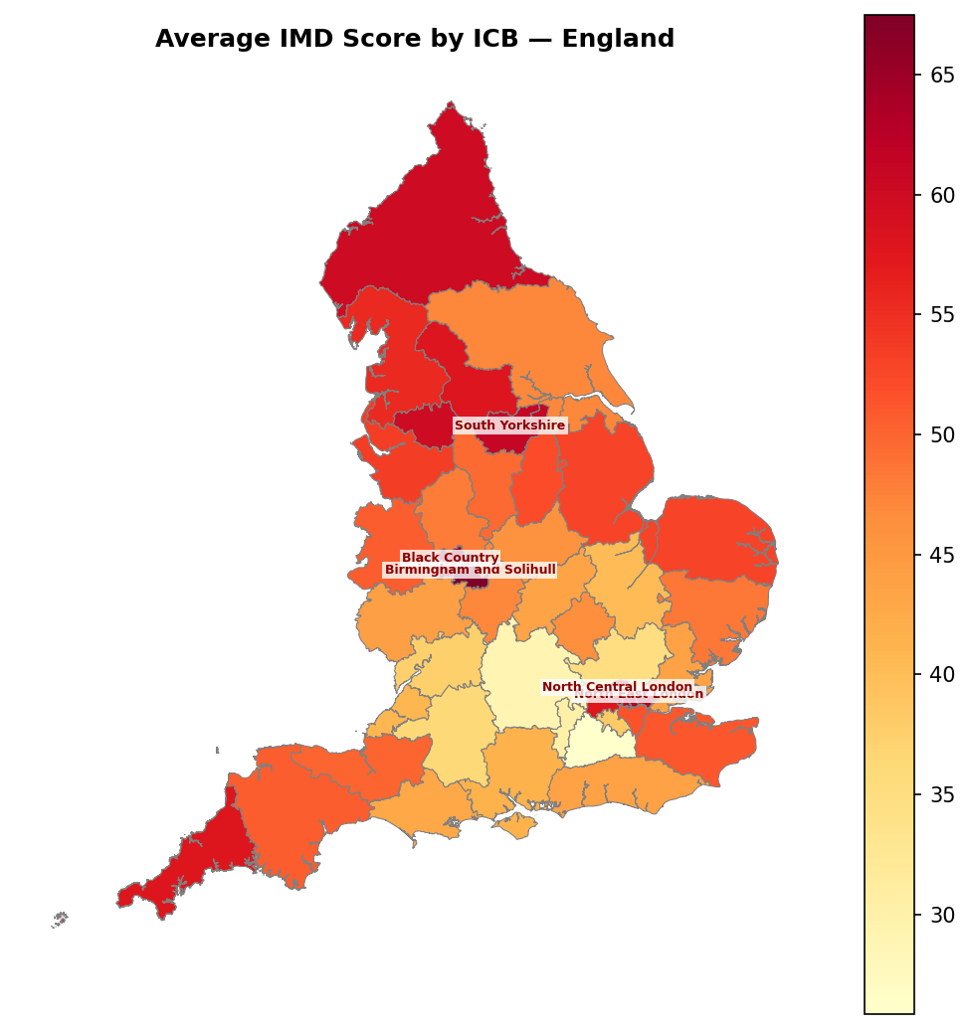
Index of Multiple Deprivation (IMD) by ICB - England (42 ICBs)
What is IMD?
The Index of Multiple Deprivation (IMD) scores Lower Super Output Areas across 7 domains: income, employment, education, health, crime, housing, and environment. Higher score = more deprived.
Highest-Deprivation ICBs
Birmingham & Solihull
67.5
Black Country
64.5
North East London
62.8
Greater Manchester
60.1
Buckinghamshire / Oxon
29.0
South Yorkshire
55.0
Darker red = higher deprivation. Northern England and parts of London dominate the top quintile.

Slide 17
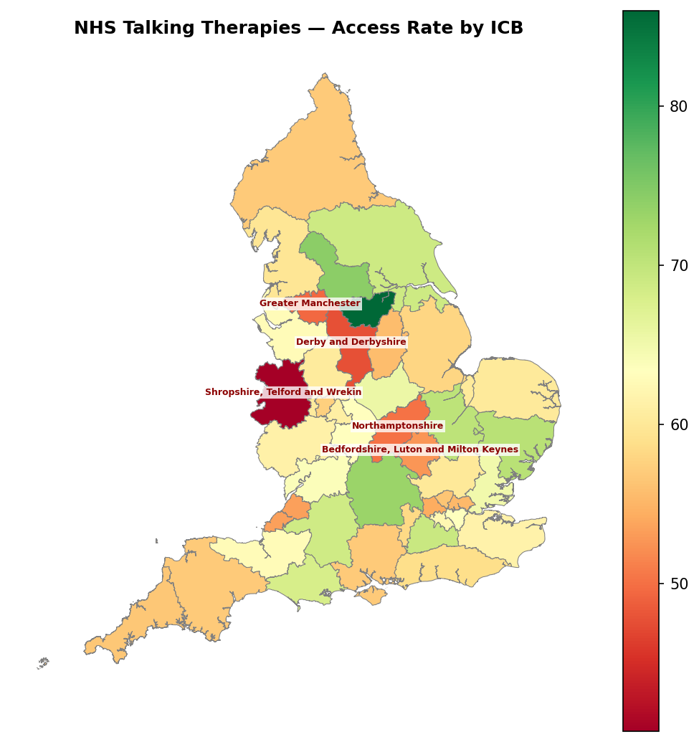
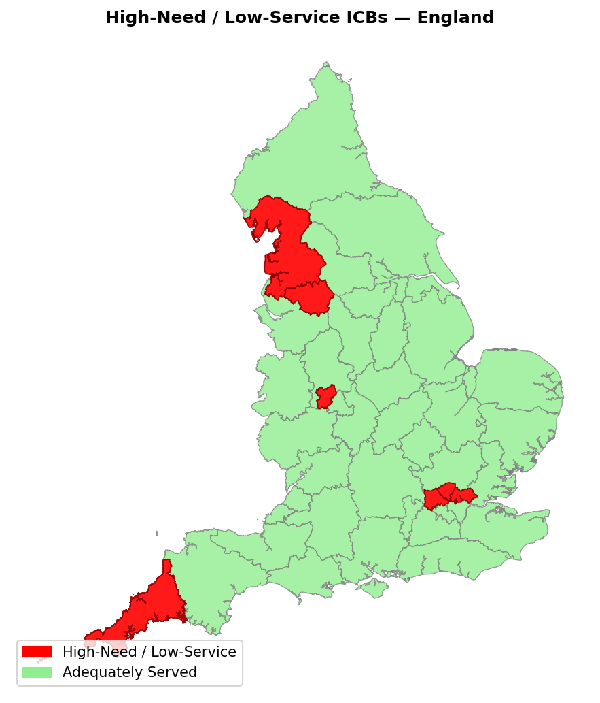
NHS Talking Therapies Access Rate vs High-Need / Low-Service ICBs
IAPT Access Rate by ICB
High-Need / Low-Service ICBs
Access rate range: 40.7% (Shropshire, Telford & Wrekin) to 86.0% (South Yorkshire). Green = adequately served. Red = high deprivation + low access = unmet need. 7 ICBs flagged.

Slide 18
Priority ICBs - High Deprivation | Low Access | Low Recovery
ICB
IMD Score
Access Rate
Unmet Need Score
Avg Wait (days)
Greater Manchester
60.1
49.5%
74.4
39.0
Black Country
64.5
57.5%
73.4
49.2
North East London
62.8
55.3%
62.7
N/A
North Central London
60.2
56.4%
62.5
N/A
North West London
57.7
54.2%
61.4
N/A
Lancashire & South Cumbria
55.6
59.7%
60.3
N/A
Cornwall & Isles of Scilly
57.8
56.6%
50.4
25.3
EQUITY ACTION: Redirect NHS Talking Therapies ring-fenced development funding to these 7 ICBs. Commission additional low-intensity IAPT sessions (Step 2 online CBT) for Greater Manchester and Black Country in Q1 2026 — highest unmet need scores in England (74.4 and 73.4).

Slide 19
From Pipeline
to Insight
The three core findings — with clinical actions for your teams
01 Patient Clustering — 6 segments, 1 urgent
02 IAPT Demand Forecasting — March 2026 surge
03 Geo-Spatial Equity — 7 underserved ICBs

Slide 20
One Command - Full Pipeline - All Outputs Auto-Saved
▶
python run_all.py
Single command triggers everything
$ python run_all.py
NHS Mental Health DS Pipeline - Full Run
↓
1
Week 1 — Foundations
--> Week 1 DS-1,2,3 (statistical_baseline...)
DS1 · DS2 · DS3 → 13 outputs
Done in 13.4s -> APMS2014_regional_prevalence.png
--> Week 2 DS-1,2,3 (hypothesis_testing...)
↓
Done in 2.0s -> hypothesis_test_results.csv
2
Week 2 — Modelling
--> Week 3 DS-1,2,3 (clustering...)
DS1 · DS2 · DS3 → 8 outputs
Done in 10.6s -> cluster_analysis.png
↓
--> Week 4 DS-1,2 (iapt_forecasting...)
Week 3 — Forecasting
Done in 5.9s -> forecast_3month_ahead.png
3
DS1 · DS2 · DS3 → 9 outputs
↓
9/9
57s
30+
100%
📁
outputs/ folder
Scripts
passed
Total
runtime
Output
files saved
Reproducible
results
All PNGs · CSVs · Excel auto-saved
▶ To reproduce all results: clone repo → place datasets/ folder → run: python run_all.py — outputs appear in outputs/ automatically.

Slide 21
Loading Monthly NHS Mental Health Data - Auto-Detection & Append Pipeline
01
02
03
04
05
Auto-Detect
Latest Month
→
Download
ZIP from NHS
Extract &
Load CSV
→
Clean &
Suppress
Append to
Master CSV
→
→
Script checks today's date, tries current month → walks back until a valid NHS URL is found
Fetches MHSDS ZIP from digital.nhs.uk - e.g. Feb 2026 (4.1 MB downloaded in 8s)
Extracts CSV from ZIP - loads 771,626 rows × 11 cols into pandas DataFrame
Removes suppressed values (619,013 flagged) Standardises column names ·
Appends to mhsds_master.csv grows incrementally each month.
📊 Master Dataset — February 2026
2026-05-16 23:11:37 INFO Trying March 2026...
Total rows:
771,626
Total columns:
15
2026-05-16 23:11:37 WARN No URL for 2026-03 — skip.
2026-05-16 23:11:37 INFO Trying February 2026...
File size:
203.5 MB
Unique measures:
378
2026-05-16 23:11:45 INFO Downloaded 4.1 MB
2026-05-16 23:11:46 INFO Loaded 771,626 rows × 11
Unique orgs:
1,149
Date range:
Mar 2025 → Feb 2026
2026-05-16 23:11:53 INFO Appended → master 203.5 MB
2026-05-16 23:11:53 INFO ✅ Feb 2026 added to master!
🔄 Pipeline is incremental — run monthly to auto-detect latest NHS publication, download, clean, and append to master. No manual steps required.

Slide 22
3 Clinical Recommendations
Derived from 9 scripts · 6 datasets · 20 outputs across 4 weeks of data science work
Targeted Care Pathways - Patient Clustering
01
46 patients in Cluster 4 (PHQ≥17, GAD≥16, Epworth=13) need immediate Step 3/4 escalation. Embed cluster labels in clinical notes. Clusters 1 & 2 (n=223) route to integrated physical-mental and sleep-aware Step 2 pathways.
Pre-Emptive Capacity Planning :- March 2026 Surge
02
Prophet model (MAE 5,679) forecasts 152,424 IAPT referrals in March 2026 - 20% above April. Pre-commission bank clinician hours and extended evening sessions in Q1 2026. Review rotas by end of November 2025.
Equity-Led Resource Reallocation - 7 ICBs
Greater Manchester (unmet score 74.4) and Black Country (73.4) are the most under-resourced. Redirect NHS Talking Therapies development funding immediately. Add Step 2 online CBT capacity across all 7 flagged ICBs.
03

