Slide 1
Digital Signal Processing
Lab2: MatLab Graphs and scripts
Instructor: Eng\ Samar Shaaban
E-mail: ssa10@fayoum.edu.eg
Github Repo: https://github.com/SamarShabanCS/DSP
Slack workspace: https://fayoum-university-fci.slack.com

Slide 2
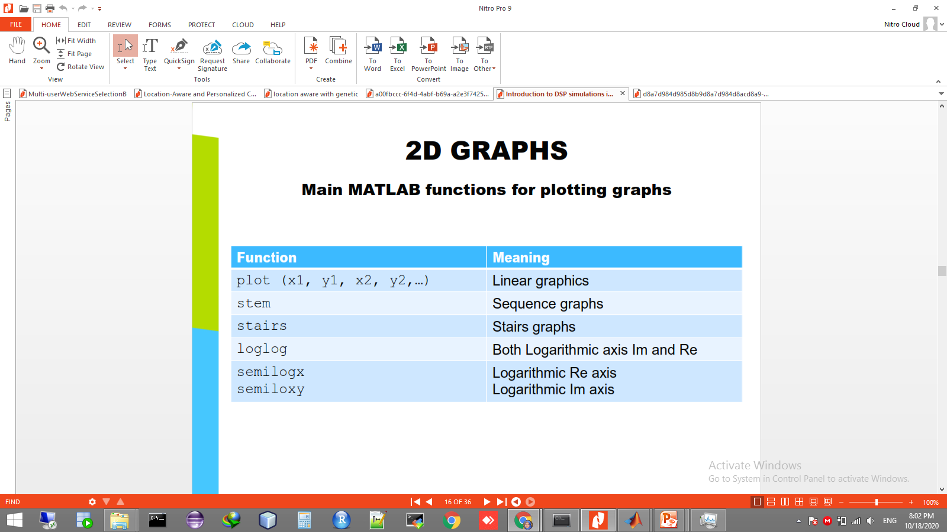
MATLAB Graphics
Main MATLAB functions for plotting graphs
For more information help graph2d

Slide 3
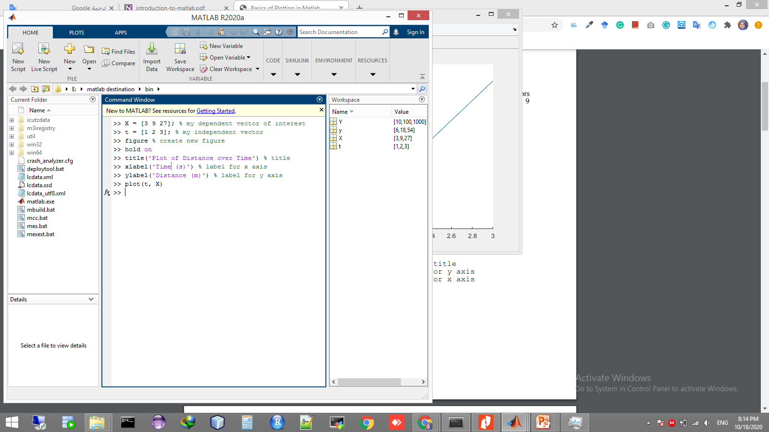
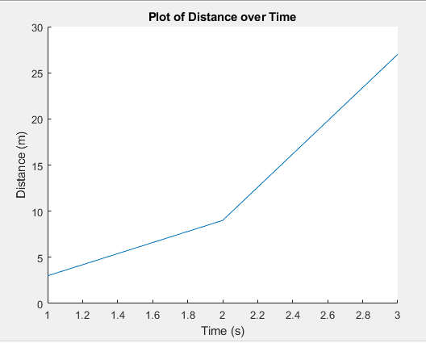
example

Slide 4
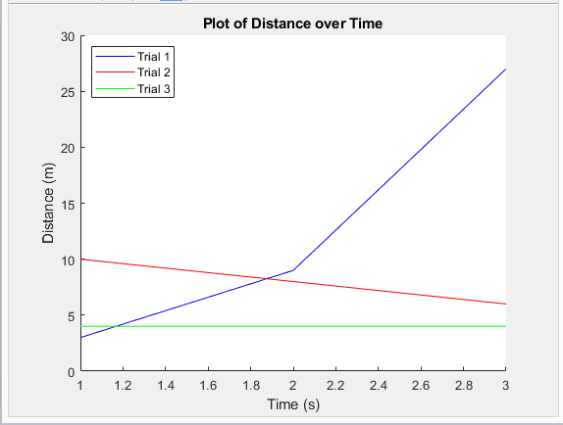
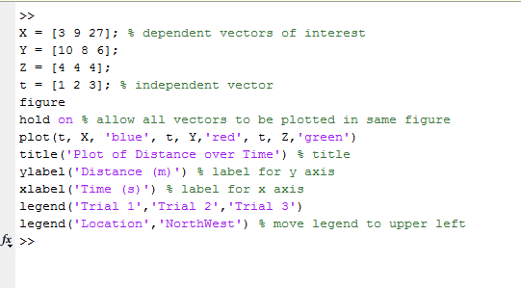
Legends

Slide 5
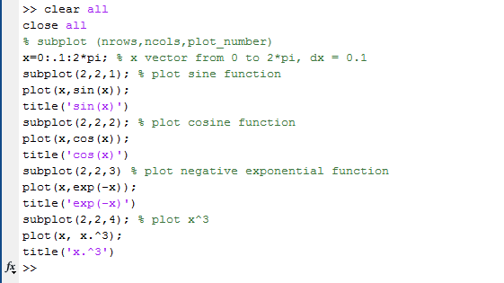
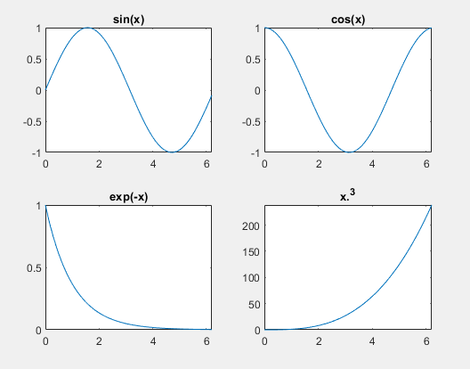
Subplots

Slide 6
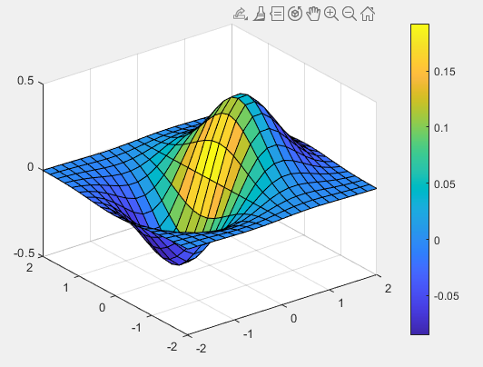
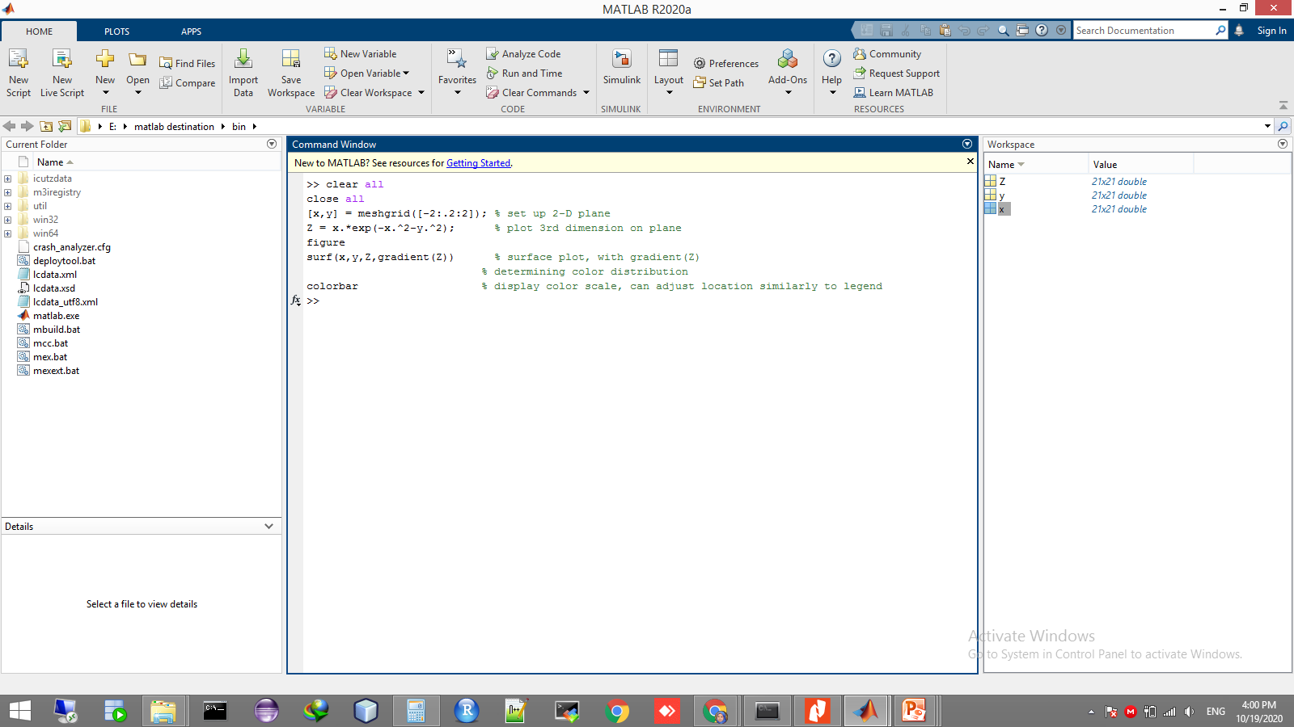
Plotting in 3-D
There are also ways to plot in multiple dimensions in Matlab*. One type of 3D plot that may be useful is a surface plot, which requires you to generate some kind of x-y plane and then apply a 3rd function as the z dimension.

Slide 7
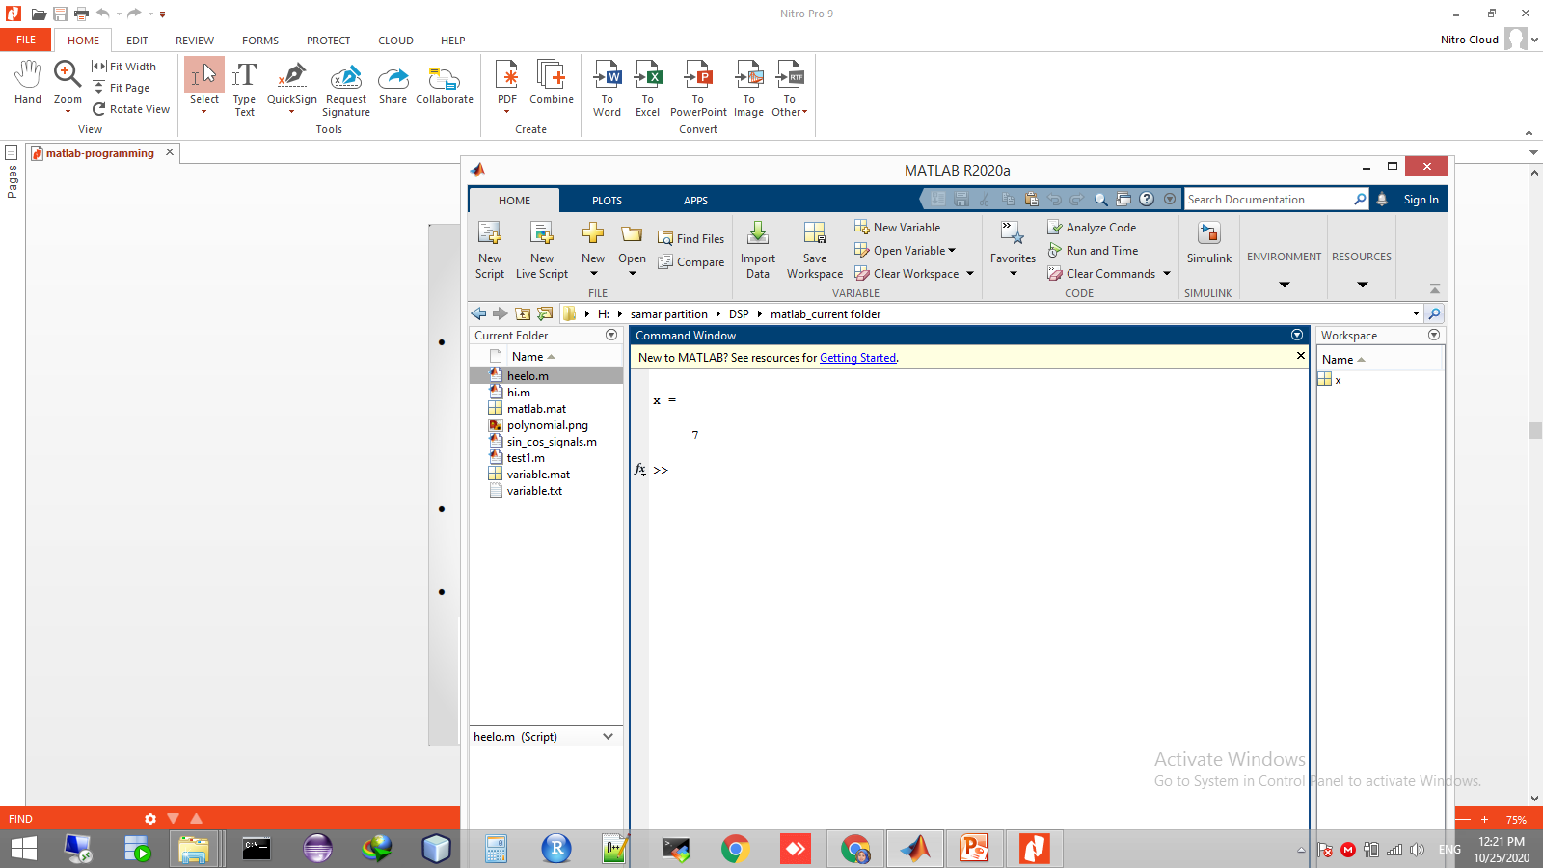
Programming Considerations Scripts
Scripts are
o collection of commands executed in sequence
o written in the MATLAB editor
o saved as MATLAB files (.m extension)
To create an MATLAB file from command-line
»edit helloWorld.m.
or click

Slide 8
All variables created and modified in a script exist in the workspace even after it has stopped running
Just type the script name on the comand window without extension .m to run

Slide 9
Task
Generate random vector to represent the salaries of 10 employees that in range of 700-900 L.E. Then present some statistic about these employees salaries :
o Max. Salary
o Empl. Max_ID
o Min. Salary
o Empl. Min_ID

Slide 10
Task: Sol
clear;
clc;
close all;
Salaries =randi([700,900],1,10);
MaxSalary = max(Salaries); % Max. Salary
EmplMax_ID = find(Salaries==MaxSalary); %Empl. Max_ID
MinSalary = min(Salaries); %Min. Salary
EmplMin_ID = find(Salaries==MinSalary); %Empl. Min_ID

Slide 11
String
Any variable defined as string is considered a vector of
characters, dealing with it as same as dealing with vectors.
>> str = ‘hello matlab’;
>> disp(str)
>> msgbox(str)
>> Num = input(‘Enter your number:’)
>> str = input(‘Enter your name:’,’s’)
-----------------------------------------------------------------------------
>> str = ‘7234’
>> Num = str2num(str)
>> number = 55
>> str = num2str(number)

Slide 12
Matlab programming Relational Operators:
relational operators
equal ==
notequal ~=
greater than >
less than <
greater or equal >=
less or equal <=
Logical operators
And &&
Or ||
Not~
Xor xor
Boolean values: zero is false, nonzero is true

Slide 13
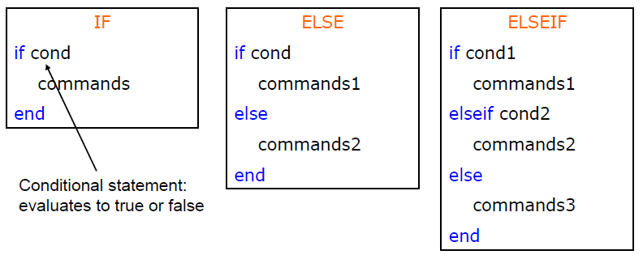
Matlab programming If / else / elseif :
Basic flow-control, common to all languages
No need for parentheses : command blocks are between reserved words

Slide 14
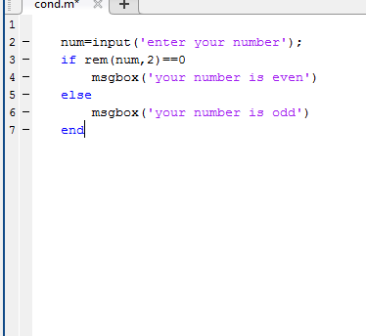
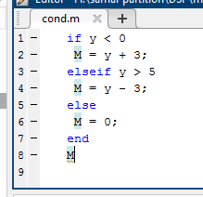
Matlab programming Examples

Slide 15
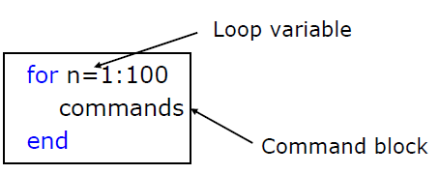
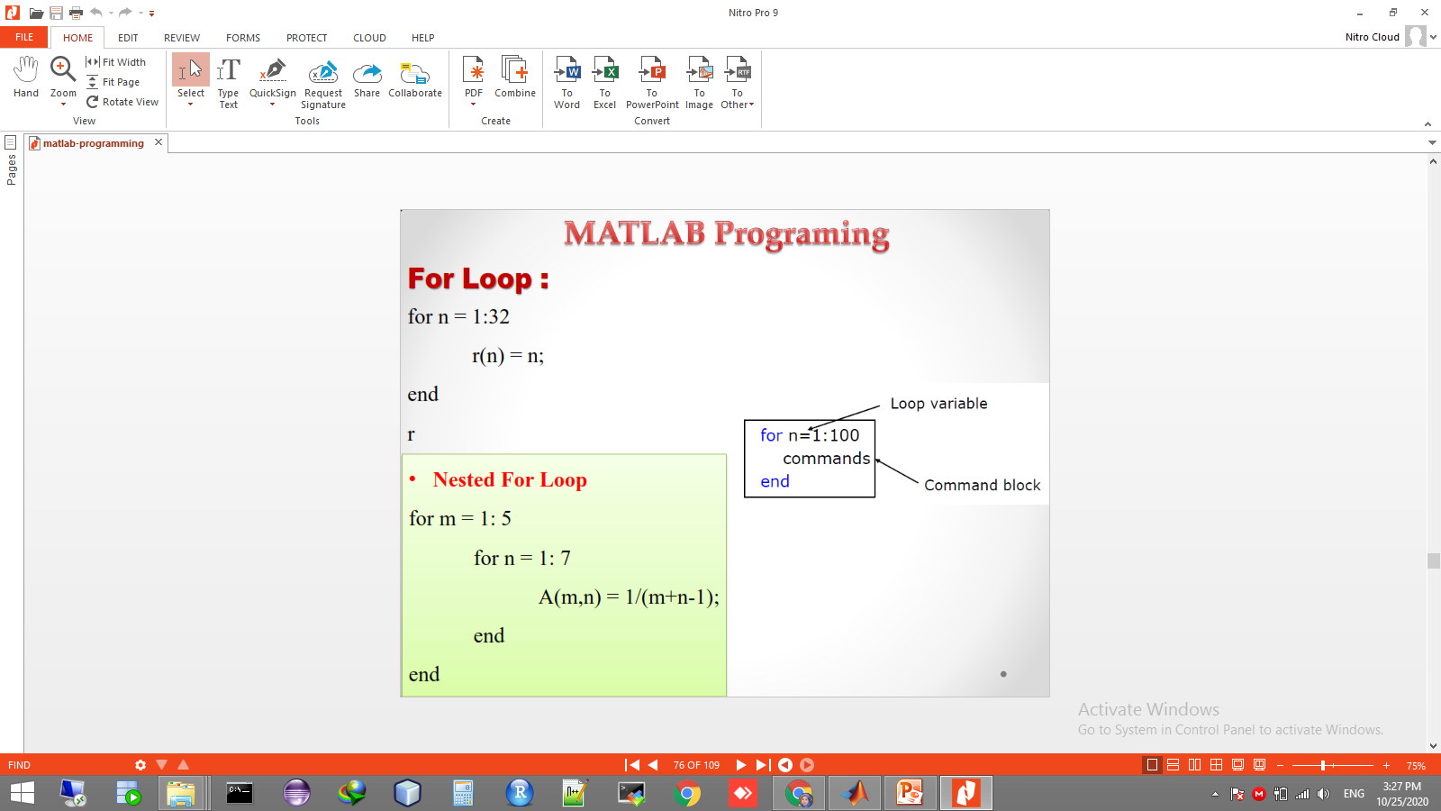
Matlab programming For loop
The command block is anything between the for line and the end

Slide 16
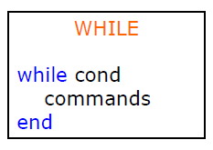
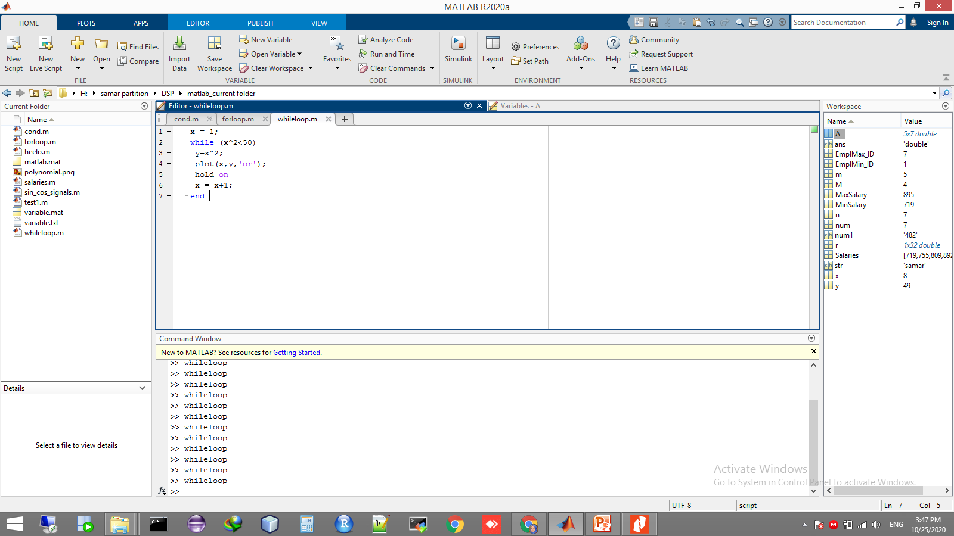
Matlab programming While loop:
The while is like a more general for loop
Don't need to know number of iterations
The command block will execute while the conditional expression is true
Beware of infinite loops!

Slide 17
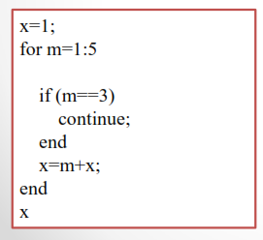
Matlab programming Continue:
The continue statement passes control to the next iteration of the loop
Skipping any remaining statements in the body of the loop.
In nested loops, continue passes control to the next iteration of the loop enclosing it.
Example

Slide 18
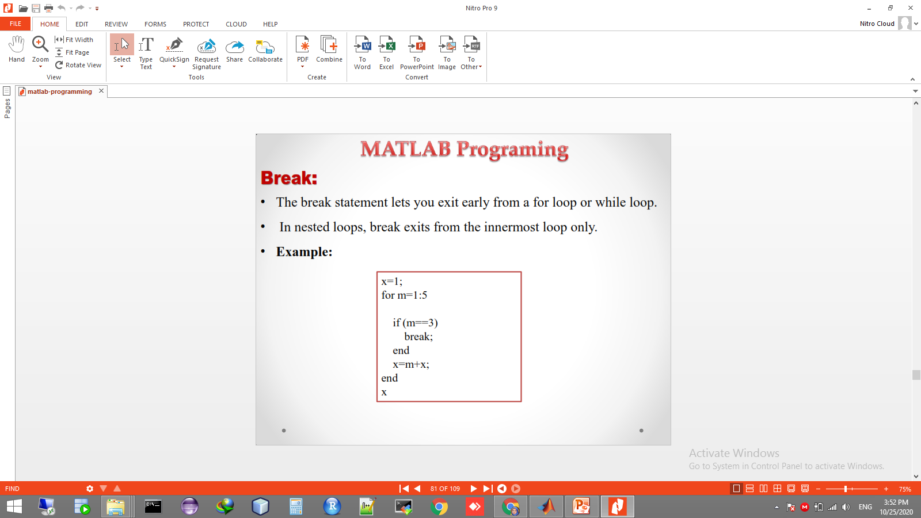
Matlab programming Break:
The break statement lets you exit early from a for loop or while loop.
In nested loops, break exits from the innermost loop only.
Example:

Slide 19
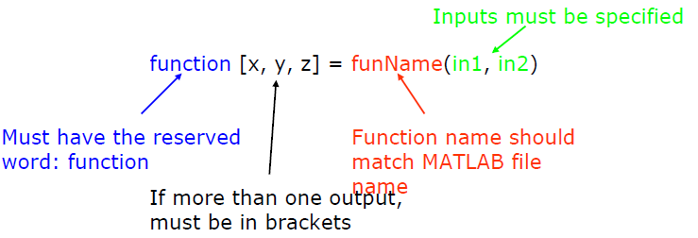
Matlab programming User-defined Functions:
Functions look exactly like scripts, but for ONE difference Functions must have a function declaration.
No need for return : MATLAB 'returns' the variables whose names match those in the function declaration.

Slide 20
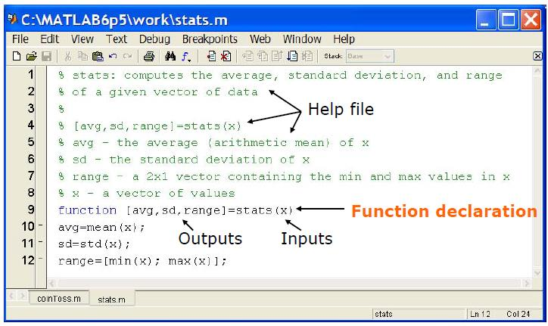
Matlab programming User-defined Functions:

