Slide 1
Digital Signal Processing
Lab1: Introduction to MatLab
Instructor: Eng\ Samar Shaaban
E-mail: ssa10@fayoum.edu.eg
Github Repo: https://github.com/SamarShabanCS/DSP
Slack workspace: https://fu-fci-2nd-year.slack.com

Slide 2
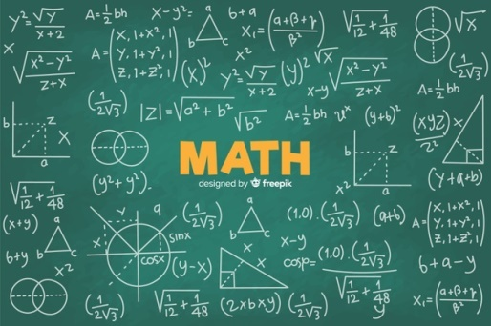


Matlab is developed by The Mathworks, Inc. (http://www.mathworks.com)
It is an interactive, integrated, environment
for numerical/symbolic, scientific computations and other apps.
slow (compared with FORTRAN or C) because it is interpreted.
automatic memory management; no need to declare arrays.
intuitive, easy to use.
Modeling, simulation Data analysis and visualization

Slide 3
INSTALLATION
Follow the steps in following video link to download, install and activate MatLab2020 successfully:
https://www.youtube.com/watch?v=YJ3MGvBd47U&fbclid=IwAR01gkO_IcfDvu027Q4gqB9ZPJZxMZ1pDDU6AX1gRMYte0WgqcWLWlVHWDA

Slide 4
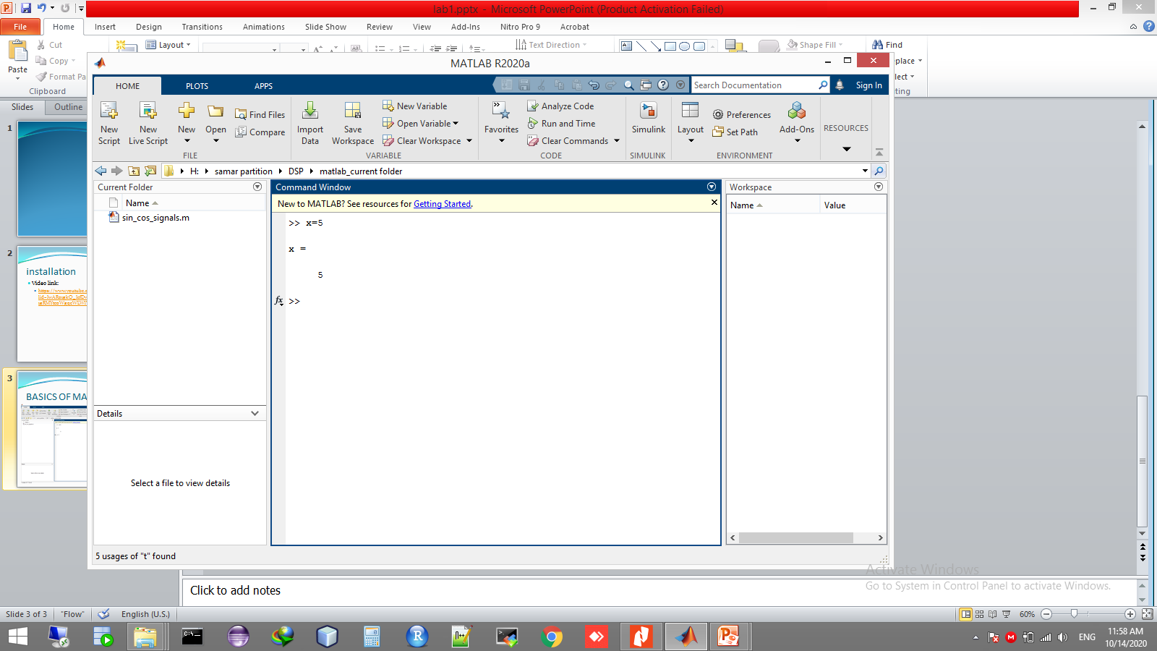
BASICS OF MATLAB

Slide 5
Rules on Variable and File Names
Variables
case sensitive, e.g., NAME and Name are 2 distinct names.
variable begins with a letter, e.g., A2z or a2z
can be a mix of letters, digits, and underscores (e.g., vector_A)
reserved characters: % = + – ~ ; : ! ' [ ] ( ) , @ # $ & ^
up to 63 characters
Functions/scripts
performs specific tasks; same naming rules as for variables
File names
MATLAB command files should be named with a suffix of ".m", e.g., myfile.m. An m-file typically contains a sequence of MATLAB commands that will be executed in order
A file may contain a collection of commands, functions
Note: To run, enter m-file, without .m, e.g.,
>> myfile

Slide 6
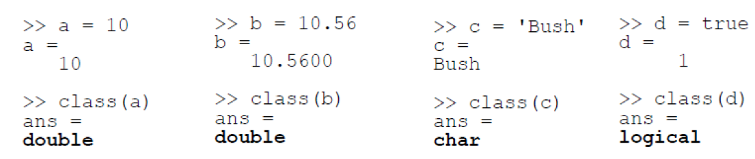
Variables and Data types
Variable | Data type
‘a’ | Char
‘ahmed’ | Char
“a” | String
“ahmed” | String
0.2 | Double
2.0 | Double
Class(a)
Return Data type of variable (a)

Slide 7
Some basic hints
help <name> (for example: >> help cos)
; blocks automatically output of the variables
% makes a comment
to comment a few rows hold Ctrl+R
to uncomment a few rows Ctrl+T
Always use: clc,clear; close all;
TASK
Type in Editor:
===============
My MATlab program
===============
• Use CTRL+R to comment it

Slide 8
Main MATLAB objects
Commands (clc, help, demo)
Constants (10, -17.28, 5+3j, 1e-6, 10^2)
Standard const (pi, 1i or 1j, eps,inf, nan)
Variables – MATlab object, which might change it’s value during simulation. All variables are MATRIXES in MATlab
Functions (sin(X), exp(X), log10(X), sqrt(X), abs(X), real(X), imag(X))
Expressions – is a sum of constants, functions, variables, which are summed by operational symbols (x+sin(a)-sqrt(pi);)

Slide 9
Main operation symbols
Symbol | Operation
+ | Summation
- | Difference
* | Multiplication of matrixes
.* | Multiplication of elements
/ | Right division
. ‘ | Transposing

Slide 10
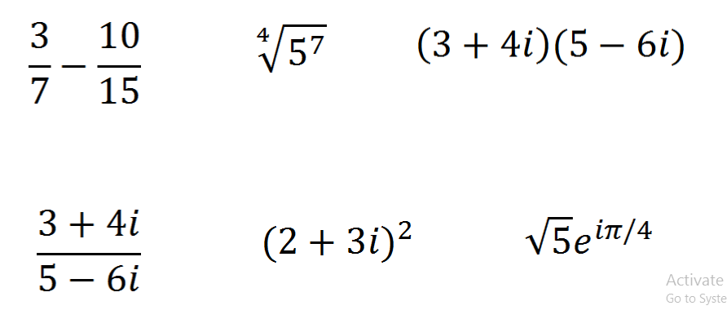
Use MATLAB as calculator to find answers
TASK
Notes:
nthroot(number, root)
e=exp()

Slide 11
Type and simulate
TASK
z=3+4i
r=abs(z)
fii=angle(z)
r*exp(i*fii)
zk=conj(z)
z*zk-r^2
What the command format does?

Slide 12
Vectors
Type
a=[2 4 5 7]
b=[-1 4 -2 1]
Find
a+b
2*a-2*b
a*b
a’*b
a*b’
a’*b’
Try: -1:10; 0:2:100; 1:-0.25:-2
Form vectors: a=(7,8,9,…,22); b=(0,2,4,…,100); c=(100,95,90,…,35)
What did you get: a(3)? a([3 5 7])? a(3:7)? a(3:end)?

Slide 13
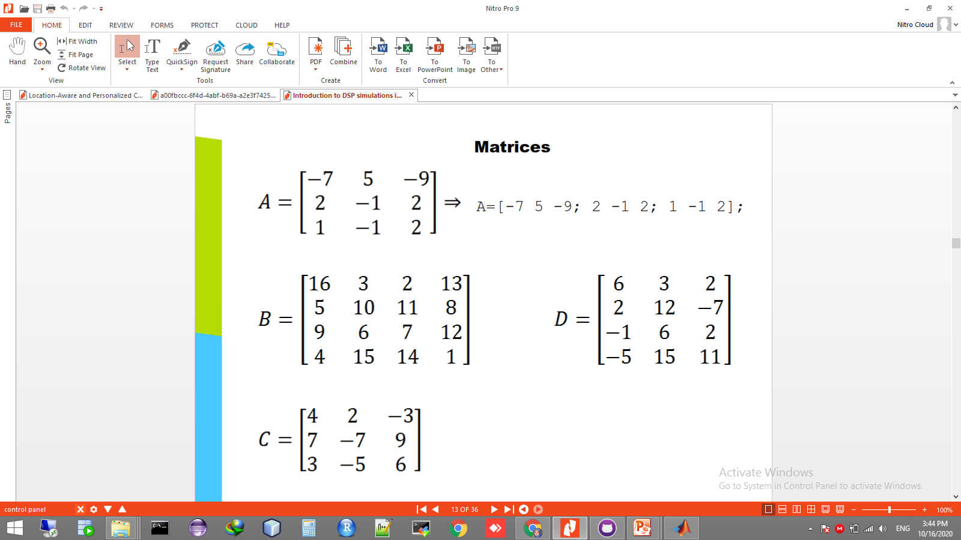
Matriсes
A=[-7 5 -9; 2 -1 2; 1 -1 2];
Generate Matrix B & D.

Slide 14
TASK
Calculate: 3A-5C, 7A+2B, CA, CD’
Find out commands: zeros(n), zeros(m,n), ones(n), ones(m,n), size(D), zeros(size(D)), diag([1 2 3 4]), eye(n)
What happens [A,B] and [A;B]?
Try to find an easy way to build a 7*8-matrix whose other entries are zeros, but in its diagonal and its last column are 5s
Output of: A(i,:) and column with A(:,j)

