Slide 1
Digital Signal Processing
Lab3: signal convolution
Instructor: Eng\ Samar Shaaban
E-mail: ssa10@fayoum.edu.eg
Github Repo: https://github.com/SamarShabanCS/DSP
Slack workspace: https://fayoum-university-fci.slack.com

Slide 2
Sheet2 Discussion

Slide 3
Sinusoidal Wave Signal
Why is it so Important?
Sinusoidal signals are important in both electrical and electronic engineering domains. According to Fourier Series Theory, any signal (Periodic Signal) can be written in terms of only sine and cosine Signals of different frequencies. Therefore a complex signal can be broken-down into simple sine and cosine signals and mathematical analysis becomes easy. Hence it is widely used in electrical and electronic analysis.

Slide 4
Generate Sinusoidal Signal (matlab): Beep sound
General form :
x=A cos (2*pi*fm*t)
Where A→signal amplitude
Fm→signal fequency

Slide 5
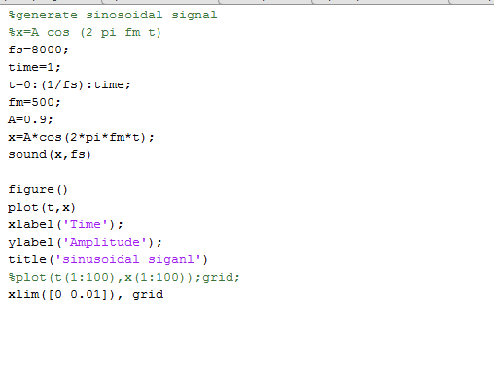
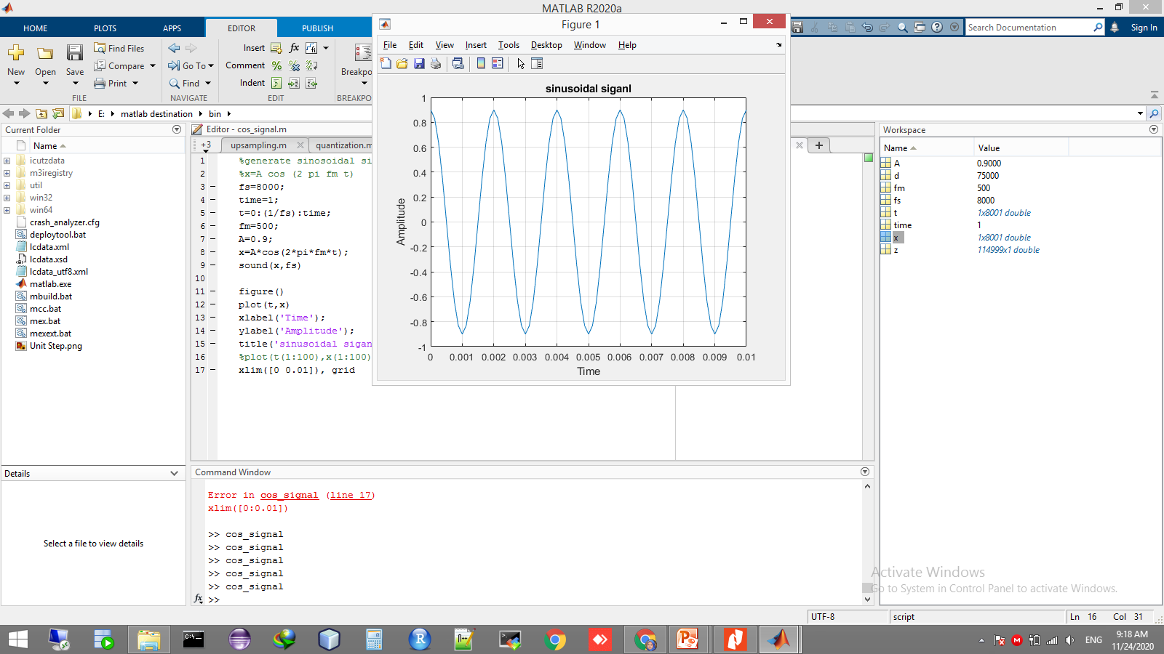

Slide 6
Generate random Signal (matlab): sh sound
Use rand function to generate random signal follow the uniform distribution.
values range [0,1].
to generate the white noise use this form:
x=A rand(1,N)*2-1
Where N→signal length or samples number during signal duration N=fs*time.

Slide 7
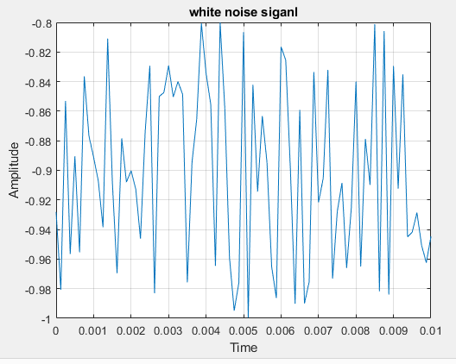
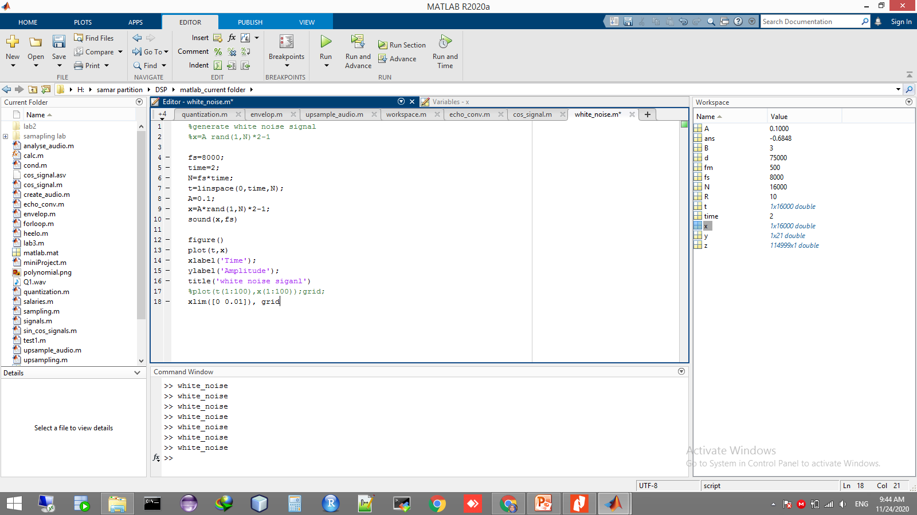

Slide 8
Convolution Effect on Audio Processing
simulate the reverberation effect of a particular area
merge two sounds
Use matlab conv() function to do convolution

Slide 9
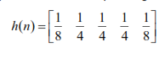
Filtering a random signal by direct convolution
Generate a random input signal of 50 samples whose amplitude is uniformly distributed between -2 and 3.
Process the input signal by direct convolution with the filter impulse repose
Plot the input and output signals on the same graph and explain what the filtering effect is

Slide 10
