Slide 1
Operating System lab7
multithreading

Slide 2
Multithreading program
A multithreaded program contains two or more parts that can run concurrently and each part can handle different task at the same time making optimal use of the available resources specially when your computer has multiple CPUs.
By definition multitasking is when multiple processes share common processing resources such as a CPU. Multithreading extends the idea of multitasking into applications where you can subdivide specific operations within a single application into individual threads. Each of the threads can run in parallel. The OS divides processing time not only among different applications, but also among each thread within an application.

Slide 3
Multithreading enables you to write in a way where multiple activities can proceed concurrently in the same program.
Each thread is associated with a process.
A thread is an entity that executes by relying on the code and resources, holding by the associated process.
What differentiates threads from normal processes is the shared memory (objects), which is visible to all threads in a multi-threaded program.
A thread has much less overhead than a process so is sometimes called as light-weight process.

Slide 4
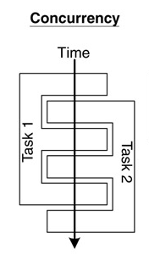
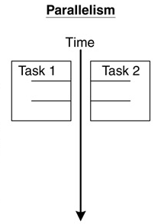
Concurrent multithreading systems give the appearance of several tasks executing at once, but these tasks are actually split up into chunks that share the processor with chunks from other tasks.
In parallel systems, two tasks are actually performed simultaneously. Parallelism requires a multi-CPU system.

Slide 5
Thread creation
A process will start with a single thread which is called main thread or master thread.
pthread_create() creates a new thread and take 4 parameters.
pointer to a pthread_t. // thread handle
pointer to a pthread attributes. Can be a null pointer if the default attributes are to be used.
The routine/function to be executed.
A value or pointer to be passed into the new thread as a parameter.

Slide 6
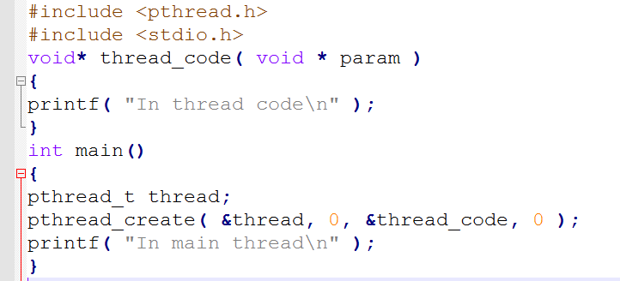
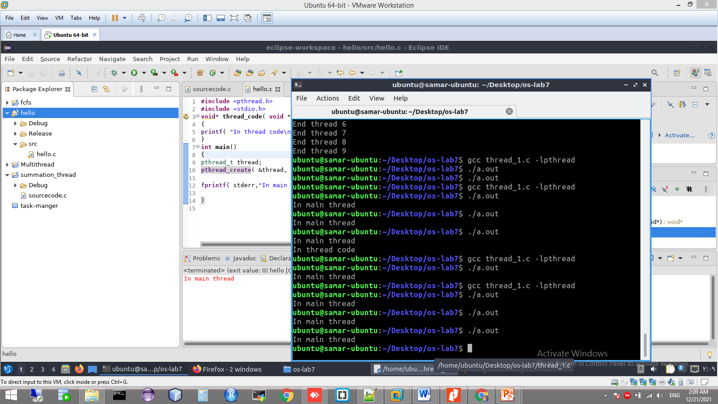
Example 1
The message of “In thread code” May not appear.

Slide 7
Threads termination & gathering
Child threads terminate when they complete the routine they were assigned to run. Or using pthread_exit().
The value returned by the thread function can be available in the main thread when calling pthread_join().
The pthread_join() call takes 2 parameters.
The first : thread handle
The second: is either zero or the address of a pointer to a void, which hold the value returned by the child thread
If the thread has not yet terminated, this call will wait until the thread terminates
Notes:
A pointer of type void * represents the address of an object, but not its
type. For example, a memory allocation function void *malloc(size_t
size); returns a pointer to void which can be casted to any data type.

Slide 8
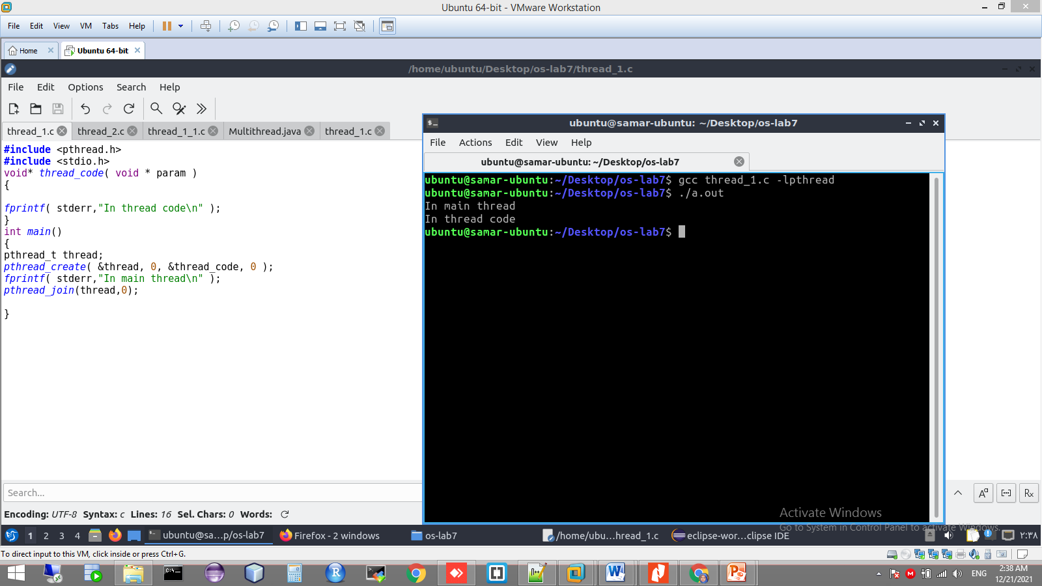
Example 2

Slide 9
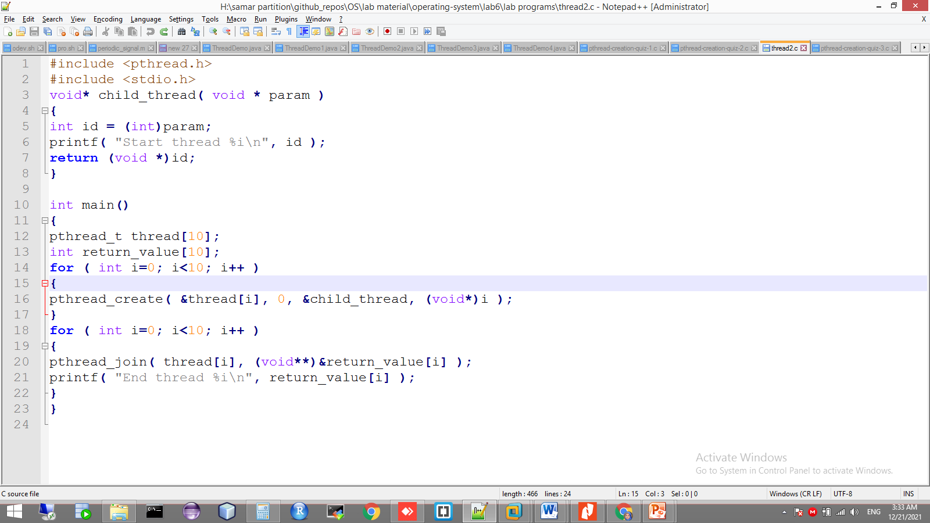
Passing data to-from child threads

Slide 10
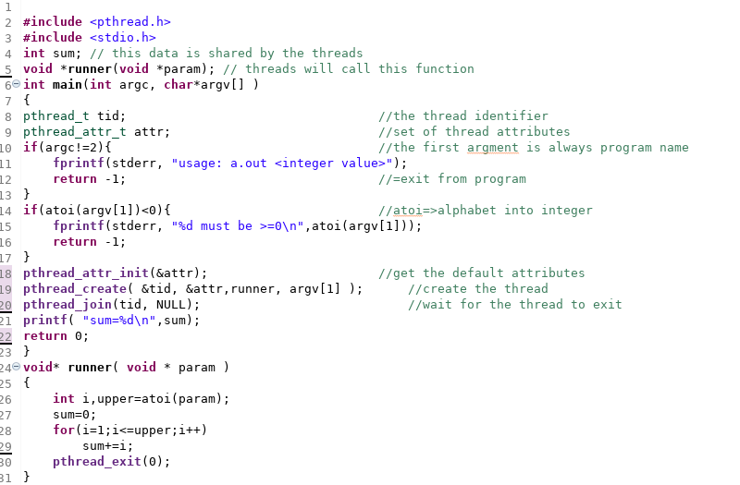
Example 3

Slide 11
Run through command line
Gcc program_name.c –lpthread
Install eclipse:
sudo apt install default-jre
sudo snap install --classic eclipse
sudo apt-get install eclipse eclipse-cdt g++

Slide 12
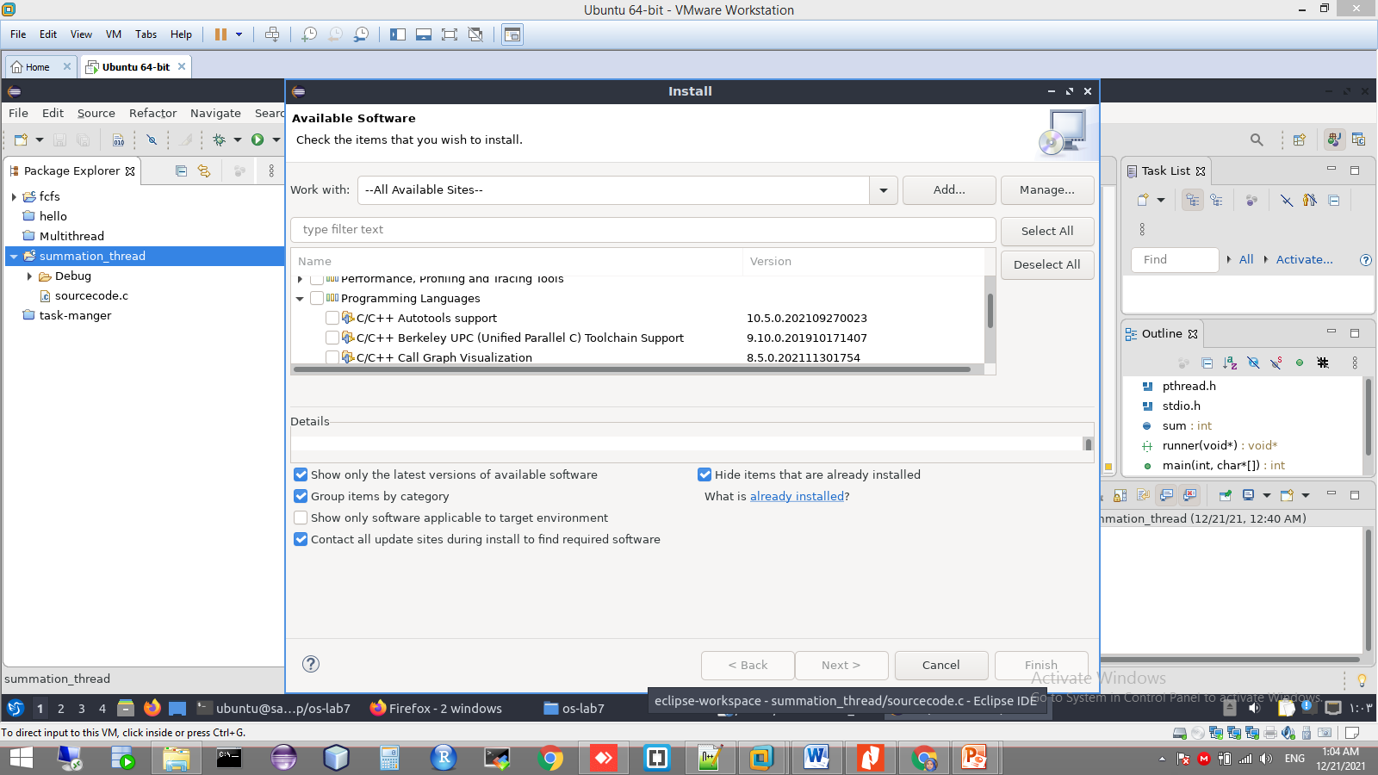
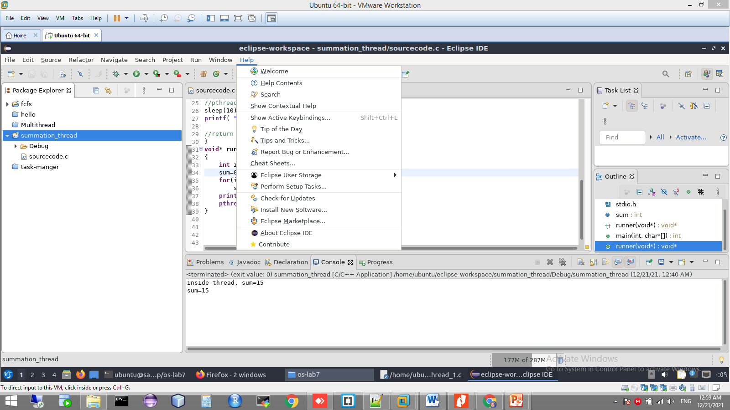
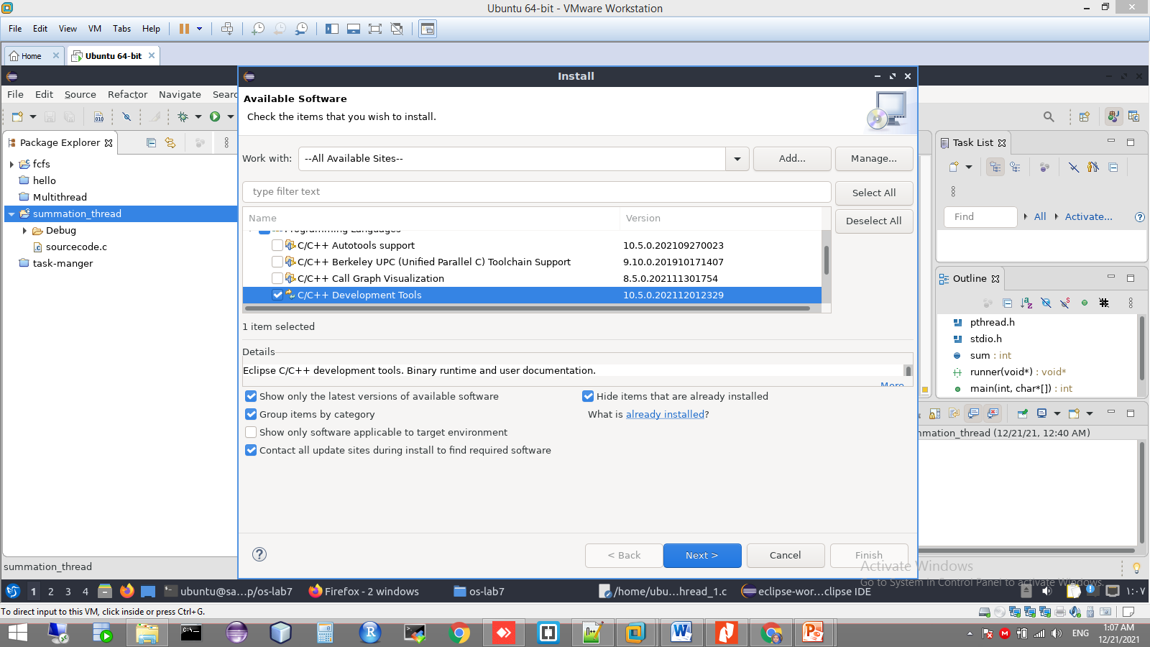

Slide 13
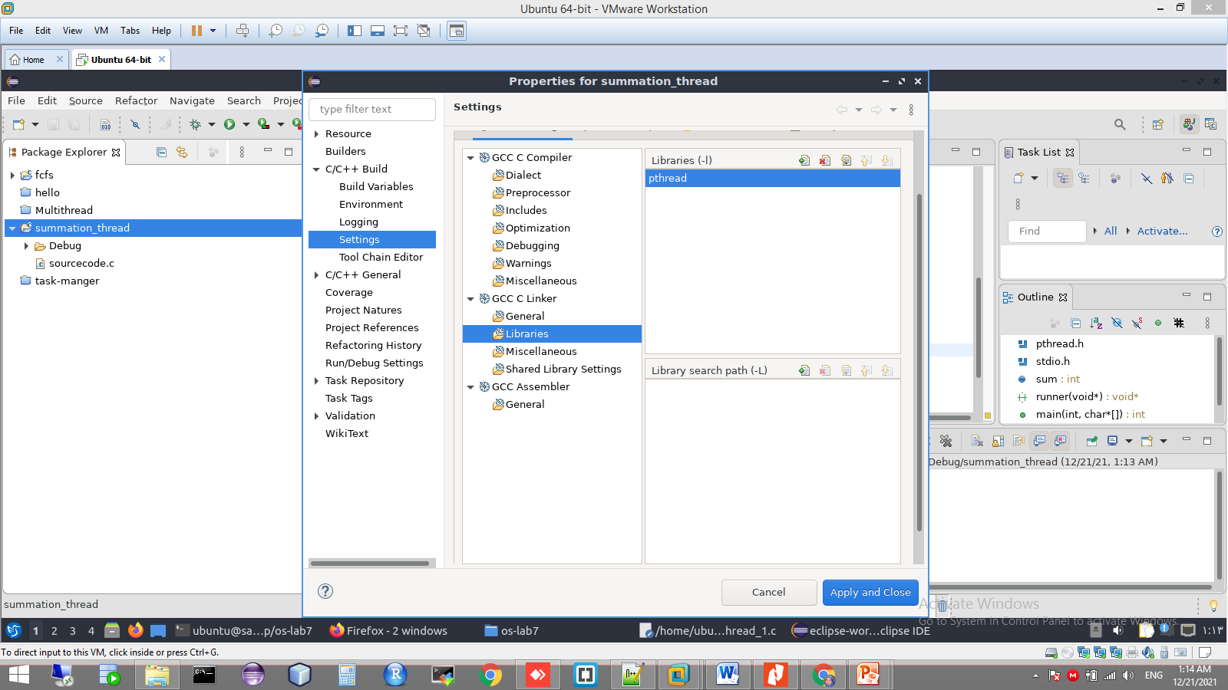
Adding pthread to linker setting

