Slide 1

Demonstrator, CS Department
Samar Abdelghani

Slide 2
Forms: how they work
We need to know..
How forms work.
How to write forms in XHTML.
How to access the data in PHP.

Slide 3


Slide 4


User requests a particular URL
XHTML Page supplied with Form
User fills in form and submits.
Another URL is requested and the
Form data is sent to this page either in
URL or as a separate piece of data.
User
Web Server
XHTML Response

Slide 5


Slide 6
<form action = ".."
method = "...">
...
</form>
action = URL
method = get | post
http://www.w3schools.com/tags/tag_form.asp

Slide 7
XHTML Form
The form is enclosed in form tags..
<form action=“path/to/submit/page”
method=“get”>
<!–- form contents -->
</form>

Slide 8
Form tags
action=“…” is the page that the form should submit its data to.
method=“…” is the method by which the form data is submitted. The option are either get or post. If the method is get the data is passed in the url string, if the method is post it is passed as a separate file.

Slide 9
Form fields: text input
Use a text input within form tags for a single line freeform text input.
<label for=“fn">First Name</label>
<input type="text"
name="firstname"
id=“fn"
size="20"/>

Slide 10
Form tags
name=“…” is the name of the field. You will use this name in PHP to access the data.
id=“…” is label reference string – this should be the same as that referenced in the <label> tag.
size=“…” is the length of the displayed text box (number of characters).

Slide 11
Form fields: password input
Use a starred text input for passwords.
<label for=“pw">Password</label>
<input type=“password"
name=“passwd"
id=“pw"
size="20"/>

Slide 12
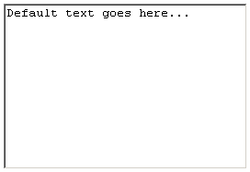
Form fields: text input
If you need more than 1 line to enter data, use a textarea.
<label for="desc">Description</label>
<textarea name=“description”
id=“desc“
rows=“10” cols=“30”>
Default text goes here…
</textarea>

Slide 13
Form fields: text area
name=“…” is the name of the field. You will use this name in PHP to access the data.
id=“…” is label reference string – this should be the same as that referenced in the <label> tag.
rows=“…” cols=“..” is the size of the displayed text box.

Slide 14
Form fields: drop down
<label for="tn">Where do you live?</label>
<select name="town" id="tn">
<option value="swindon">Swindon</option>
<option value="london”
selected="selected">London</option>
<option value=“bristol">Bristol</option>
</select>

Slide 15
Form fields: drop down
name=“…” is the name of the field.
id=“…” is label reference string.
<option value=“…” is the actual data sent back to PHP if the option is selected.
<option>…</option> is the value displayed to the user.
selected=“selected” this option is selected by default.

Slide 16
Form fields: radio buttons
<input type="radio"
name="age"
id="u30“
checked=“checked”
value="Under30" />
<label for="u30">Under 30</label>
<br />
<input type="radio"
name="age"
id="thirty40"
value="30to40" />
<label for="thirty40">30 to 40</label>

Slide 17
Form fields: radio buttons
name=“…” is the name of the field. All radio boxes with the same name are grouped with only one selectable at a time.
id=“…” is label reference string.
value=“…” is the actual data sent back to PHP if the option is selected.
checked=“checked” this option is selected by default.

Slide 18
Form fields: check boxes
What colours do you like?<br />
<input type="checkbox"
name="colour[]"
id="r"
checked="checked"
value="red" />
<label for="r">Red</label>
<br />
<input type="checkbox"
name="colour[]"
id="b"
value="blue" />
<label for="b">Blue</label>

Slide 19
Form fields: check boxes
name=“…” is the name of the field. Multiple checkboxes can be selected, so if the button are given the same name, they will overwrite previous values. The exception is if the name is given with square brackets – an array is returned to PHP.
id=“…” is label reference string.
value=“…” is the actual data sent back to PHP if the option is selected.
checked=“checked” this option is selected by default.

Slide 20
Submit button..
A submit button for the form can be created with the code:
<input type="submit"
name="submit"
value="Submit" />

Slide 21


Slide 22
In PHP…
Data stored in a variable
Depends on submission method:
  GET
  POST
The variables are available in two superglobal arrays created by PHP called $_POST and $_GET.

Slide 23
GET and POST Method
A form data can be submitted using POST and GET method
Both are used for same purpose but stand apart for some specifications
GET and POST create an array which holds key/value pairs, where keys are the name of the form controls and values are the input data by the user

Slide 24
GET and POST Method
Both GET and POST method are treated as $_GET and $_POST in PHP
These methods are superglobals, which means that they are always accessible, and they can be accessed using any function, class or file
The $_GET method is an associative array of variables passed to the current script via the URL parameters

Slide 25
GET and POST Method
The $_POST method is an array of variables passed to the current script via the HTTP POST method
In this method the information is transferred in a hidden manner
A form that submits information is appended to the URL in the form of Query String which consists of name = value pairs in URL known as URL Encoding

Slide 26
GET and POST Method
This string contains user values/data, which are joined using equal (=) signs, separated by ampersand (&), and spaces are removed and replaced with plus (+) sign
  Name1=value1&name2=value2&name3=value3

Slide 27

Get Method
http://localhost/welcome.php?name=ahmed&email=aa@yahoo.com
The code below is a client-side HTML form using method=“get” for user to fill the information
The action attribute of the form element indicates that when the user clicks SUBMIT, the form data will be posted to welcome.php.
A unique name (e.g., email) is assigned to each of the form’s input fields. When SUBMIT is clicked, each field’s name and value are sent to the Web server.

Slide 28
Access data
Access submitted data in the relevant array for the submission type, using the input name as a key.
<form action=“path/to/submit/page”
method=“get”>
<input type=“text” name=“email”>
</form>
$email = $_GET[‘email’];

Slide 29


Get Method
The code below is the server-side PHP script (welcome.php) where, $_GET associative array is used to receive sent information from server end
Output:

Slide 30

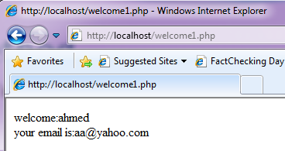
Post Method
<form action="#" method="post">
....
</form>
Below is a server-side PHP script where $_POST associative array is used to receive sent information at server end
Output:

Slide 31
Is it submitted?
We also need to check before accessing data to see if the data is submitted, use isset() function.
if (isset($_POST[‘username’])) {
// perform validation
}

Slide 32
Is it submitted?
Ex:
if (isset($_POST['myCheckbox2']))
echo "Option 2 was selected";
else
echo "Option 2 wasn't selected.";

Slide 33
2. Check which button was pressed
Same as above
if (isset($_POST['button1']))
echo "Button 1 was pressed";
elseif (isset($_POST['button2']))
echo "Button 2 was pressed";
else
echo "no button pressed";

Slide 34
A useful tip..
I find that storing the validated data in a different array to the original useful.
I often name this array ‘clean’ or something similarly intuitive.
I then *only* work with the data in $clean, and never refer to $_POST/$_GET again.

Slide 35
Example
$clean = array();
if (ctype_alnum($_POST['username']))
{
$clean['username'] = $_POST['username'];
}

Slide 36
Filter example
$clean = array();
if (ctype_alnum($_POST['username']))
{
$clean['username'] = $_POST['username'];
}
$clean = array();
Initialise an array to store filtered data.

Slide 37
Filter example
$clean = array();
if (ctype_alnum($_POST['username']))
{
$clean['username'] = $_POST['username'];
}
if (ctype_alnum($_POST['username']))
Inspect username to make sure that it is alphanumeric.

Slide 38
Filter example
$clean = array();
if (ctype_alnum($_POST['username']))
{
$clean['username'] = $_POST['username'];
}
$clean['username'] = $_POST['username'];
If it is, store it in the array.

Slide 39
Lab Activity

Slide 40
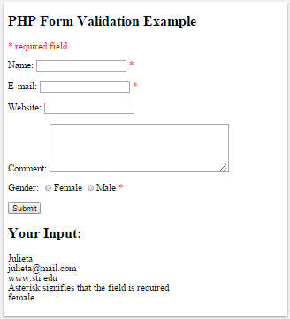
Form validation

Slide 41
Form validation
The form consists of the following elements:
  Name (required field - must contain letters and whitespaces)
  E-mail (required field - must contain valid email address)
  Website (optional field - if present, must contain valid website URL)
  Comments (optional field - a multi-line text field)
  Gender (required field - must select a radio button )

Slide 42

Form Elements
The Name, E-mail, Website are input elements
Input elements, in particular, used text and submit values for its types attribute in order to create text fields and buttons
The HTML code:

Slide 43

Form Elements
Radio button shows several options to the users from which the user may select one
HTML Code:

Slide 44

Form Elements
The text area is typically a large text field with multiple rows
The textarea element has three attributes – name, rows, and cols attribute
HTML code:

Slide 45

Form Element
The HTML code of the form element:
when the form is submitted, the form data is sent with method=”post”
So, the $_SERVER["PHP_SELF"] sends the submitted forms data to the page itself, instead of jumping to a different page

Slide 46
Form Element
The $_SERVER["PHP_SELF"] is a super global variable that returns the filename of the currently executing script
Htmlspecialchars() function converts special characters to HTML entities
Cross-site scripting (XSS) is a type of computer security vulnerability typically found in Web application

Slide 47


Form Element
Example: test_form.php
if a user enters the normal URL in the address bar like "http://www.example.com/test_form.php", the above code will be translated to:

Slide 48

Form Element
consider that if a user enters the following URL in the address bar:
  http://www.example.com/test_form.php/%22%3E%3Cscript%3Ealert('hacked')%3C/script%3E
will be translated to:

Slide 49

Form Element
be aware that any JavaScript code can be added inside the <script> tag
A hacker can redirect the user to a file on another server, and that file can hold malicious code that can alter the global variables or submit the form to another address to save the user’s data

Slide 50

how to avoid $_SERVER[“PHP_SELF”] exploit?
The $_SERVER[“PHP_SELF”] exploit can be avoided using the htmlspecialchars() function
if the user tries to exploit the PHP_SELF variable, it will result:

Slide 51


Validate Form Data with PHP
The very first thing to do to validate form data with PHP is to pass all variables through PHP’s htmlspecialchars() function
For example:
With htmlspecialchars() function it would not be executed, because it would be saved as HTML escaped code like this:

Slide 52
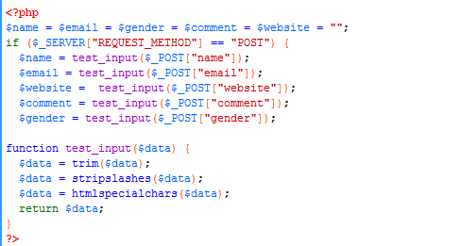
test_input()

Slide 53
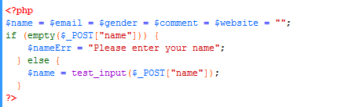
Form Required Fields
In the previous slide, all input fields were optional, meaning no required fields to be filled in by the user
Here is a simple PHP script that checks the name for empty input and throws an error message if the input is empty:

Slide 54

Form Required Fields
To display the error message in the HTML form (this will be generated if the user tries to submit the form without filling in the required fields) use the code below:

