Slide 1
INTRODUCTION TO PHP
SESSIONS AND COOKIES

Slide 2
What you Benefit ???
By the end of this session you will learn
How to use Sessions and Cookies to maintain the state among multiple requests.

Slide 3
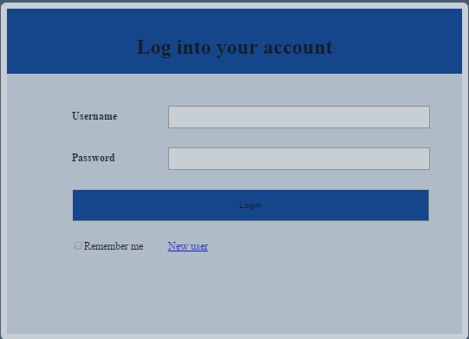
TASK OF THE DAY
Create a session when a user log in to his account. When user logout from his account the session should expire
LOGIN PAGE

Slide 4
INTRODUCTION TO PHP SESSIONS AND COOKIES

Slide 5

Introduction To PHP Sessions And Cookies
We had already tried passing data to a server .
But..how the server knows the user from which the requests are received…?

Slide 6
COOKIES

Slide 7
Cookies
HTTP is a stateless protocol; this means that the web server does not know (or care) whether two requests comes from the same user or not; it just handles each request without regard to the context in which it happens.
Cookies are used to maintain the state in between requests—even when they occur at large time intervals from each other.
Cookies allow your applications to store a small amount of textual data (typically,4-6kB) on a Web client browser.
There are a number of possible uses for cookies, although their most common one is maintaining state of a user

Slide 8
Creating A Cookie
setcookie(“userid", "100", time() + 86400);
This simply sets a cookie variable named “userid” with value “100” and this variable value will be available till next 86400 seconds from current time
Cookie variable name
Expiration time.
variable value

Slide 9
Accessing a Cookie
echo $_COOKIE[’userid’]; // prints 100
Cookie as array
setcookie("test_cookie[0]", "foo");
setcookie("test_cookie[1]", "bar");
setcookie("test_cookie[2]", "bar");
var_dump($_COOKIE[‘test_cookie’]);

Slide 10
Destroying A Cookie
There is no special methods to destroy a cookie, We achieve it by setting the cookie time into a past time so that it destroys it
Eg : setcookie(‘userid’,100,time()-100);

Slide 11
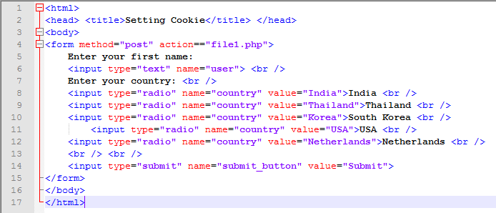
cookies.html
Form data is posted to file1.php.

Slide 12
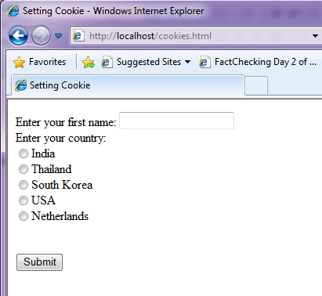

Slide 13
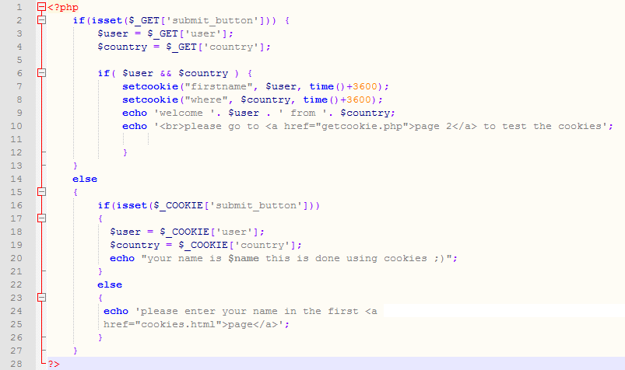
File1.php
Function setcookie takes the name of the cookie to be set as the first argument, followed by the value to be stored in the cookie. The optional third argument specifies the expiration date of the cookie.
Hyperlink to getCookies.php.

Slide 14

output

Slide 15
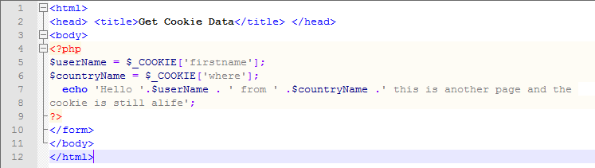

getcookie.php
output

Slide 16
SESSIONS

Slide 17
WHY PHP – Sessions ?
Whenever you want to create a website that allows you to store and display information about a user, determine which user groups a person belongs to, utilize permissions on your website or you just want to do something cool on your site, PHP's Sessions are vital to each of these features.
Cookies are about 30% unreliable right now and it's getting worse every day. More and more web browsers are starting to come with security and privacy settings and people browsing the net these days are starting to frown upon Cookies because they store information on their local computer that they do not want stored there.
PHP has a great set of functions that can achieve the same results of Cookies and more without storing information on the user's computer. PHP Sessions store the information on the web server in a location that you chose in special files. These files are connected to the user's web browser via the server and a special ID called a "Session ID". This is nearly 99% flawless in operation and it is virtually invisible to the user.

Slide 18
Creating and accessing session
Once session is started you can create and access session variables like any other arrays in PHP
$_SESSION[‘userid’] = 100;
echo $_SESSION[‘userid’]; //prints 100
Session variable name
variable value

Slide 19
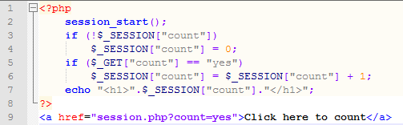
PHP - Sessions
Sessions store their identifier in a cookie in the client’s browser
Every page that uses session data must be proceeded by the session_start() function
Session variables are then set and retrieved by accessing the global $_SESSION[]
Save it as session.php

Slide 20
Comparison
Cookies
Sessions are stored in server
A session is available as long as the browser is opened. User cant disable the session. It will be destroyed if you close the browser
Can store not only strings but also objects
session cant be.
Cookies are stored in the user's browser
A cookie can keep information in the user's browser until deleted by user or set as per the timer. It will not be destroyed even if you close the browser.
Cookies can only store string
We can save cookie for future reference
Session

