Slide 1
Introduction to MySQL & PHP
Samar Abdelghani

Slide 2
An Overview of SQL
SQL
SQL stands for Structured Query Language.
Communicate with databases
Used to created and edit databases.
Also used to create queries, forms, and reports
Notes:
In your opening, establish the relevancy of the topic to the audience. Give a brief preview of the presentation and establish value for the listeners. Take into account your audience’s interest and expertise in the topic when choosing your vocabulary, examples, and illustrations. Focus on the importance of the topic to your audience, and you will have more attentive listeners.

Slide 3
You can create, populate, modify, update and delete a mysql database directly from the command line.
There is an alternative method, and that is to use a GUI, such as phpMyAdmin. phpMyAdmin allows you to maintain MYSQL databases from your browser, with more clicking and less typing.

Slide 4
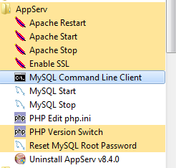
MySQL Monitor
Let's open MySQL monitor from the Start menu on Windows.

Slide 5
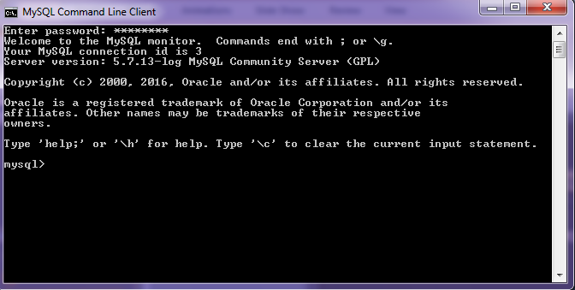
MySQL Monitor
After type in the password, MySQL prompt window should look like this.

Slide 6
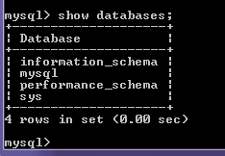
MySQL Monitor
The name of all databases on the MySQL server can be displayed with the show databases;

Slide 7
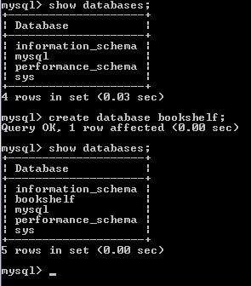
Creating a Database
To begin, you must first CREATE a database using the following SQL statement:
CREATE DATABASE database_name

Slide 8

If a database already exists when we try to create the database, it will give us the error message:

Slide 9
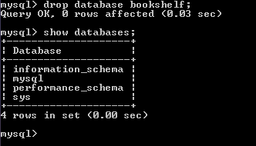
Dropping(Deleting) a Database
To delete/remove a database, we use drop command. So, use drop database bookshelf; to remove bookshelf from the database.

Slide 10

Creating a Database Table
Before we create a database table we need to select the database to which it is to be added. The command for this is use database_name;. This requires one of the existing database names.

Slide 11
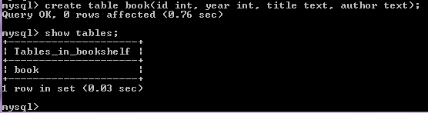
Creating a Database Table
We create a new table using create table table_name; with a comma-separated list of column names.

Slide 12
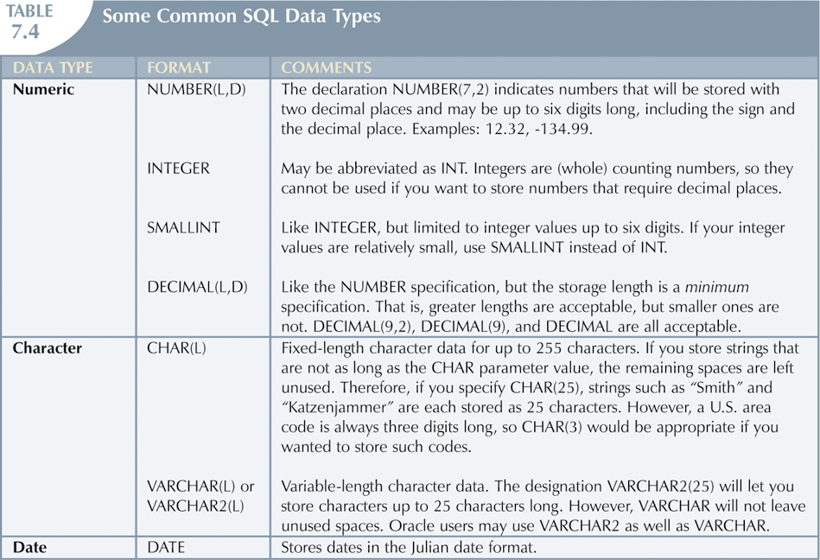
Data Types

Slide 13
Column Modifier
The modifiers in the table below can be selected to control how a column should be used.
Modifier | Description
not null | Each record should include data entry in this column
unique | Records may not duplicate any entry in this column
auto_increment | A variable only for numeric columns to automatically generate a number that is one more than the previous value in that column
primary key() | Specifies as its argument the name of the column to be used as the primary key for that table, i.e., primary key(id).

Slide 14
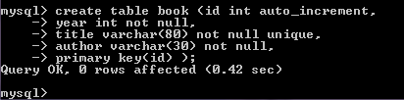
Creating a Database Table
The create table table_name command displayed in the example below can automatically number the primary key id column. Each record should include data in the year, title, and author columns. No duplicate entries are permitted in the title column.

Slide 15
Table Data - Primary Key
A PRIMARY KEY is a constraint that is applied to a column to uniquely identify each row of that database table. It ensures that the values in each row of that column are unique and never change, so those values can be used to reference any specified row.
By setting the PRIMARY KEY constraint it is possible to manipulate data on specific rows of the database table.
Any column can be set as the PRIMARY KEY but is often the first column that is used to provide a unique identifying number.

Slide 16
Table Data - Primary Key
Any column set as the PRIMARY KEY must meet the following criteria:
Each field in that column must have a value - it should not be empty or have a NULL value.
Each value in that column must be unique - there must be no duplications.
Each value in that column never be modified or updated.
Each value in that column cannot be re-used - when a row is deleted its PRIMARY KEY value cannot be re-assigned as the PRIMARY KEY value of a new row.

Slide 17

Table Data - Inserting
After a table created, data can be entered into it with insert into command:
The data values are entered as comma-separated arguments to the value() function; the list must correspond to the number of table columns and each value must be of the correct data type.

Slide 18

Table Data - Inserting
Another way to insert data into a table is to specify the names of the columns where the data is to be added.

Slide 19
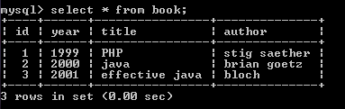
Entire table can be viewed with
select * from table_name;

Slide 20
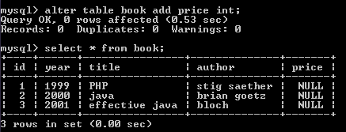
Table Data - Altering
New columns can be added to an existing table using alter table and add.
alter table table_name add field_name type modifier

Slide 21
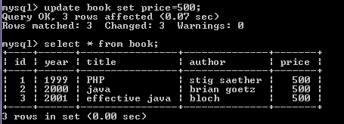
Table Data - Updating
all data values in a table column can be changed using update command with set: update table_name set field_name = new_value;

Slide 22
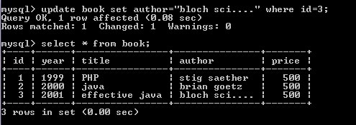
Table Data - Updating
Individual column values can be changed by adding a qualifier to the syntax with where: update table_name set field_name = new_value where id = int;

Slide 23
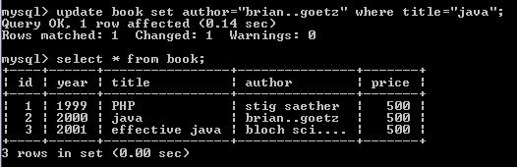
Table Data - Updating

Slide 24
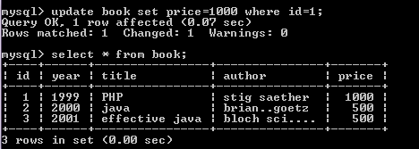
Table Data - Updating

Slide 25
Table Data - Query
SELECT <attributes>
FROM <one or more relations>
WHERE <conditions>;

Slide 26
Simple SQL Query(select all columns)
id | author | title | year
1 | Orson Scott card | Ender’s game | 1985
2 | Frank Herbert | dune | 1965
3 | Isaac Asimov | foundation | 1951
4 | Douglas Adams | galaxy | 1979
5 | George Orwell | 1984 | 1949
6 | Orson Scott card | land | 1961
book
SELECT * FROM book;
id | author | title | year
1 | Orson Scott card | Ender’s game | 1985
2 | Frank Herbert | dune | 1965
3 | Isaac Asimov | foundation | 1951
4 | Douglas Adams | galaxy | 1979
5 | George Orwell | 1984 | 1949
6 | Orson Scott card | land | 1961

Slide 27
Simple SQL Query
id | author | title | year
1 | Orson Scott card | Ender’s game | 1985
2 | Frank Herbert | dune | 1965
3 | Isaac Asimov | foundation | 1951
4 | Douglas Adams | galaxy | 1979
5 | George Orwell | 1984 | 1949
6 | Orson Scott card | land | 1961
book
SELECT * FROM book WHERE author=‘Orson Scott card’;
id | author | title | year
1 | Orson Scott card | Ender’s game | 1985
6 | Orson Scott card | land | 1961
“selection”

Slide 28
Simple SQL Query
id | author | title | year
1 | Orson Scott card | Ender’s game | 1985
2 | Frank Herbert | dune | 1965
3 | Isaac Asimov | foundation | 1951
4 | Douglas Adams | galaxy | 1979
5 | George Orwell | 1984 | 1949
6 | Orson Scott card | land | 1961
book
SELECT id, author, title FROM book WHERE year > 1960;
id | author | title
1 | Orson Scott card | Ender’s game
2 | Frank Herbert | dune
4 | Douglas Adams | galaxy
6 | Orson Scott card | land

Slide 29
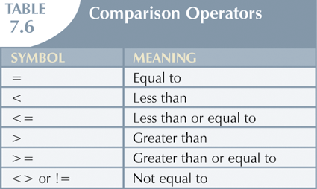
Selecting Rows with Conditional Restrictions

Slide 30
Simple SQL Query
id | author | title | year
1 | Orson Scott card | Ender’s game | 1985
2 | Frank Herbert | dune | 1965
3 | Isaac Asimov | foundation | 1951
4 | Douglas Adams | galaxy | 1979
5 | George Orwell | 1984 | 1949
6 | Orson Scott card | land | 1961
book
SELECT author, title,year FROM book order by year;
author | title | year
George Orwell | 1984 | 1949
Isaac Asimov | foundation | 1951
Orson Scott card | land | 1961
Frank Herbert | dune | 1965
Douglas Adams | galaxy | 1979
Orson Scott card | Ender’s game | 1985

Slide 31
Simple SQL Query
id | author | title | year
1 | Orson Scott card | Ender’s game | 1985
2 | Frank Herbert | dune | 1965
3 | Isaac Asimov | foundation | 1951
4 | Douglas Adams | galaxy | 1979
5 | George Orwell | 1984 | 1949
6 | Orson Scott card | land | 1961
book
SELECT author, title,year FROM book order by year desc;
author | title | year
Orson Scott card | Ender’s game | 1985
Douglas Adams | galaxy | 1979
Frank Herbert | dune | 1965
Orson Scott card | land | 1961
Isaac Asimov | foundation | 1951
George Orwell | 1984 | 1949

Slide 32
Simple SQL Query
id | author | title | year
1 | Orson Scott card | Ender’s game | 1985
2 | Frank Herbert | dune | 1965
3 | Isaac Asimov | foundation | 1951
4 | Douglas Adams | galaxy | 1979
5 | George Orwell | 1984 | 1949
6 | Orson Scott card | land | 1961
book
SELECT id, author, title FROM book WHERE year between 1970 and 1990;
id | author | title
1 | Orson Scott card | Ender’s game
4 | Douglas Adams | galaxy

Slide 33
Simple SQL Query
id | author | title | year
1 | Orson Scott card | Ender’s game | 1985
2 | Frank Herbert | dune | 1965
3 | Isaac Asimov | foundation | 1951
4 | Douglas Adams | galaxy | 1979
5 | George Orwell | 1984 | 1949
6 | Orson Scott card | land | 1961
book
SELECT id, author, title FROM book WHERE year in (1965, 1979, 1985);
id | author | title
1 | Orson Scott card | Ender’s game
2 | Frank Herbert | dune
4 | Douglas Adams | galaxy

Slide 34
Values Matching or Not Matching
id | author | title | year
1 | Orson Scott card | Ender’s game | 1985
2 | Frank Herbert | dune | 1965
3 | Isaac Asimov | foundation | 1951
4 | Douglas Adams | galaxy | 1979
5 | George Orwell | 1984 | 1949
6 | Orson Scott card | land | 1961
book
SELECT id, author, title FROM book WHERE author like "%Orson%";
id | author | title
1 | Orson Scott card | Ender’s game
6 | Orson Scott card | land

Slide 35
Values Matching or Not Matching
id | author | title | year
1 | Orson Scott card | Ender’s game | 1985
2 | Frank Herbert | dune | 1965
3 | Isaac Asimov | foundation | 1951
4 | Douglas Adams | galaxy | 1979
5 | George Orwell | 1984 | 1949
6 | Orson Scott card | land | 1961
book
SELECT id, author, title FROM book WHERE author like "%Or%";
id | author | title
1 | Orson Scott card | Ender’s game
5 | George Orwell | 1984
6 | Orson Scott card | land

Slide 36
Values Matching or Not Matching
id | author | title | year
1 | Orson Scott card | Ender’s game | 1985
2 | Frank Herbert | dune | 1965
3 | Isaac Asimov | foundation | 1951
4 | Douglas Adams | galaxy | 1979
5 | George Orwell | 1984 | 1949
6 | Orson Scott card | land | 1961
book
SELECT id, author, title FROM book WHERE title like "%____%";
id | author | title
2 | Frank Herbert | dune
5 | George Orwell | 1984
6 | Orson Scott card | land
Notes:
While the "%" represents zero, one, or more characters, the underscore, "_", represents just a single character in a search pattern. In the example, we used 4 underscores to search for a title with 4-characters:

Slide 37
Values Matching or Not Matching
id | author | title | year
1 | Orson Scott card | Ender’s game | 1985
2 | Frank Herbert | dune | 1965
3 | Isaac Asimov | foundation | 1951
4 | Douglas Adams | galaxy | 1979
5 | George Orwell | 1984 | 1949
6 | Orson Scott card | land | 1961
book
SELECT id, author, title FROM book WHERE author !="Orson Scott card";
id | author | title
2 | Frank Herbert | dune
3 | Isaac Asimov | foundation
4 | Douglas Adams | galaxy
5 | George Orwell | 1984
Notes:
While the "%" represents zero, one, or more characters, the underscore, "_", represents just a single character in a search pattern. In the example, we used 4 underscores to search for a title with 4-characters:

Slide 38
Table Data - Deleting
Records can be deleted from a table using delete from command followed by the table name. So, the command delete from book; would remove all the records from the book table.
Delete FROM book WHERE id=5;
id | author | title | year
1 | Orson Scott card | Ender’s game | 1985
2 | Frank Herbert | dune | 1965
3 | Isaac Asimov | foundation | 1951
4 | Douglas Adams | galaxy | 1979
6 | Orson Scott card | land | 1961

Slide 39
Table Data - Deleting
Specific columns can be deleted from a table using alter table command with drop keyword.
Alter table book drop year;
id | author | title
1 | Orson Scott card | Ender’s game
2 | Frank Herbert | dune
3 | Isaac Asimov | foundation
4 | Douglas Adams | galaxy
6 | Orson Scott card | land

Slide 40
Table - Deleting
The whole table can be deleted from a database using drop table command.
drop table book;

Slide 41
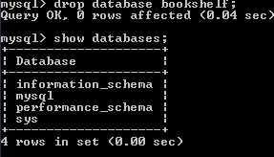
database - Deleting
drop database bookshelf;

Slide 42
Setting UP Users and Privileges
A MySQL system can have many users. The root should be used.
One of the best features of MySQL is that it supports a sophisticated privilege system. Aprivilege is the right to perform a particular action on a particular object and is associated with a particular user. The concept of privilege is similar to file permission. When we create a user within MySQL, we grant the user a set of privileges to specify what the user can and cannot do within the system. for administration purposes only for security reasons.

Slide 43

Setting UP Users and Privileges
The GRANT and REVOKE commands enable you to give rights to and take them from MySQL users at these four levels of privilege: (Global, Database, Table, Column).
We can add a user by entering a grant statement into MySQL monitor as the root user.
This will create a new user with root status. The new user ahmed was created in the localhost domain with a password ahmedpass.

Slide 44
Privileges for Users
Privilege | Column | Context
CREATE | Create_priv | databases, tables, or indexes
DROP | Drop_priv | databases, tables, or views
GRANT OPTION | Grant_priv | databases, tables, or stored routines
REFERENCES | References_priv | databases or tables
ALTER | Alter_priv | tables
DELETE | Delete_priv | tables
Index | Index_priv | tables
INSERT | Insert_priv | tables or columns
SELECT | Select_priv | tables or columns
UPDATE | Update_priv | tables or columns

Slide 45
Privileges for Users
Privilege | Column | Context
CREATE TEMPORARY TABLES | Create_tmp_table_priv | tables
LOCK TABLES | Lock_tables_priv | tables
CREATE VIEW | Create_view_priv | views
SHOW VIEW | Show_view_priv | views
ALTER ROUTINE | Alter_routine_priv | stored routines
CREATE ROUTINE | Create_routine_priv | stored routines
EXECUTE | Execute_priv | stored routines
FILE | File_priv | file access on server host
CREATE USER | Create_user_priv | server administration
PROCESS | Process_priv | server administration

Slide 46
Privileges for Users
Privilege | Column | Context
RELOAD | Reload_priv | server administration
REPLICATION CLIENT | Repl_client_priv | server administration
REPLICATION SLAVE | Repl_slave_priv | server administration
SHOW DATABASES | Show_db_priv | server administration
SHUTDOWN | Shutdown_priv | server administration
SUPER | Super_priv | server administration
ALL[PRIVILEGES] | - | server administration
USAGE | - | server administration
RELOAD | Reload_priv | server administration

Slide 47
Connection to MySQL
To connect to MySQL, we use mysql_connect() function. This function requires three arguments: domain name, user name, and password. It returns true at successful connection. The example below shows how to write a confirmation after the successful connection.

Slide 48
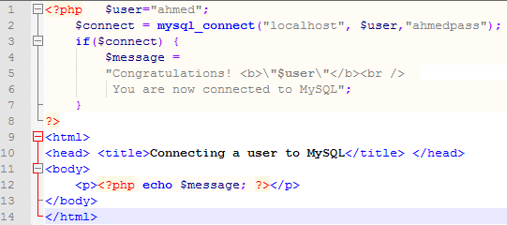
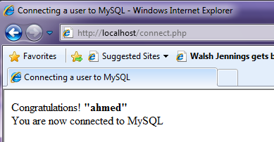
Connection to MySQL
connect.php

Slide 49
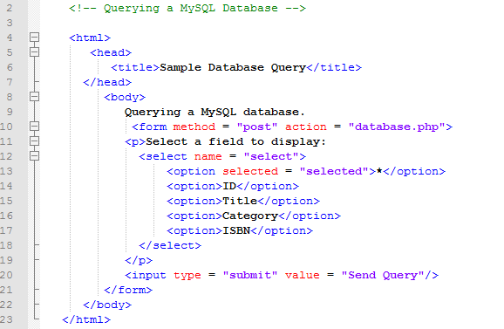
PHP & SQL
Data.html
Select box containing options for a SELECT query.

Slide 50
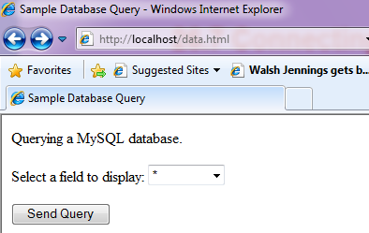

Slide 51
Function | Description
mysqli_affected_rows() | Returns the number of affected rows in the previous MySQL operation
mysqli_close() | Closes a previously opened database connection
mysqli_connect() | Opens a new connection to the MySQL server
mysqli_errno() | Returns the last error code for the most recent function call
mysqli_error() | Returns the last error description for the most recent function call
mysqli_fetch_all() | Fetches all result rows as an associative array, a numeric array, or both
mysqli_fetch_array() | Fetches a result row as an associative, a numeric array, or both
mysqli_fetch_assoc() | Fetches a result row as an associative array
mysqli_fetch_row() | Fetches one row from a result-set and returns it as an enumerated array
mysqli_free_result() | Frees the memory associated with a result
mysqli_num_rows() | Returns the number of rows in a result set
mysqli_query() | Performs a query against the database
mysqli_real_escape_string() | Escapes special characters in a string for use in an SQL statement
mysqli_select_db() | Changes the default database for the connection

Slide 52
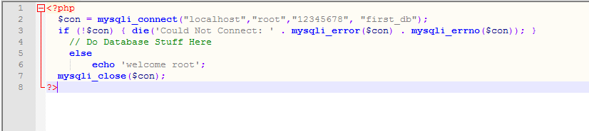
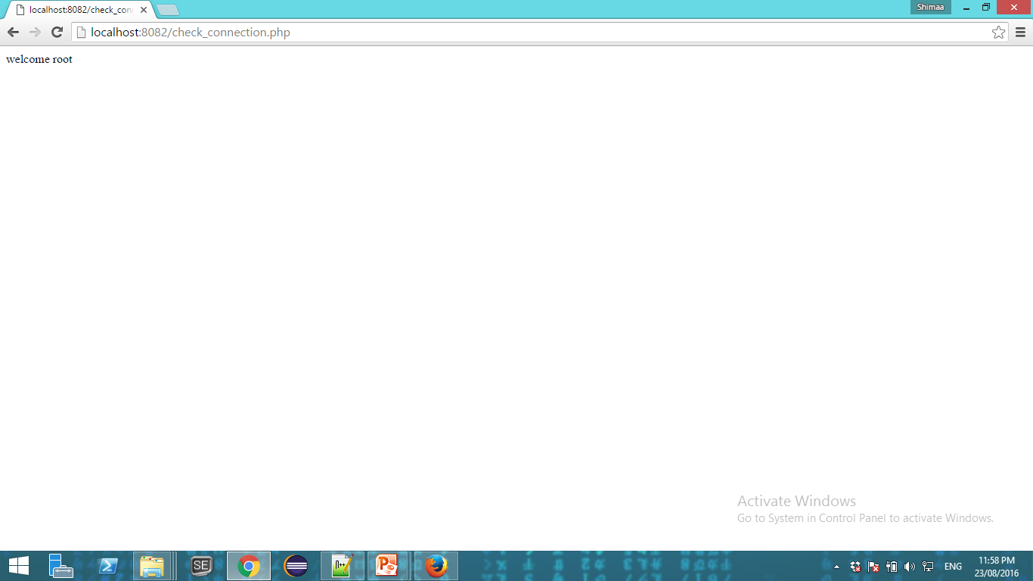
MYSQL Connect & Close
The mysqli_connect() function is used to connect. It requires four parameters, in the following order: mysqli_connect(servername, username, password, databasename)

Slide 53
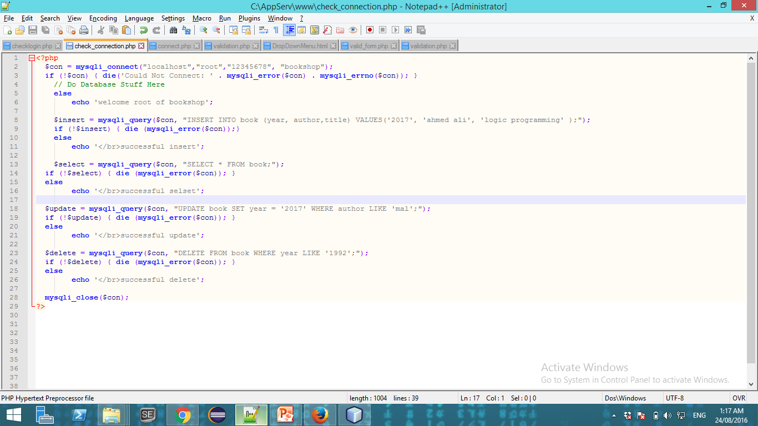
Running MYSQL Queries In PHP
mysqli_query() function can run any MYSQL query that you give it

Slide 54
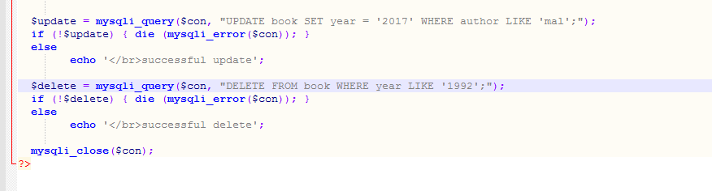
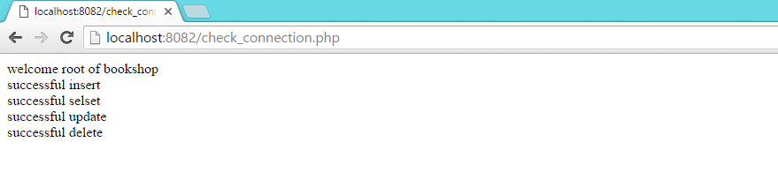
Running MYSQL Queries In PHP
Die() print an error message and exit if errors occurred during execution of the statement.

Slide 55
Handling MYSQL Query Results In PHP
mysqli_num_rows() return the number of rows that will be returned of SELECT or SHOW statement.
mysqli_affected_rows() return how many rows were affected by the execution of the last statement of INSERT, UPDATE, REPLACE or DELETE query . For SELECT statements it work as mysqli_num_rows().

Slide 56
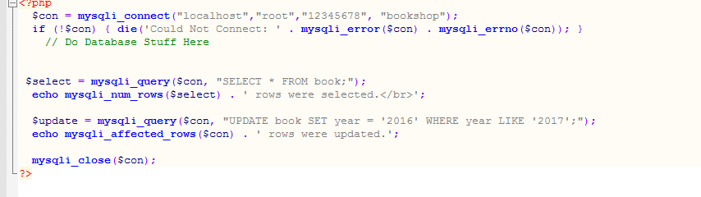
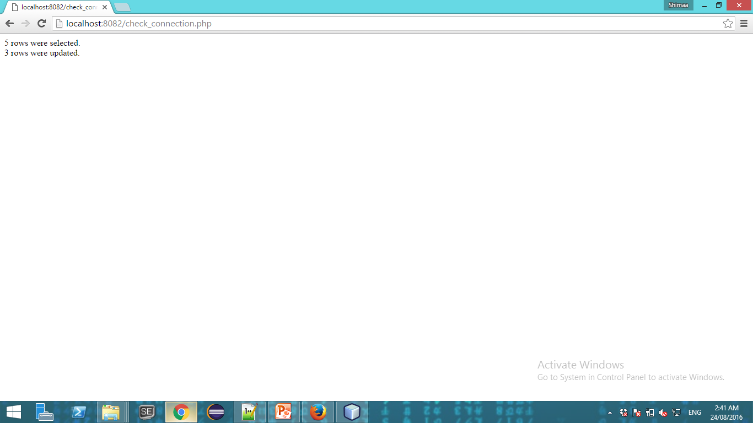

Slide 57
mysqli_fetch_assoc() function, return an array which is 'associated' with the name of each column of the database.
mysqli_fetch_array() , return an array which is 'associative' or numberic

Slide 58
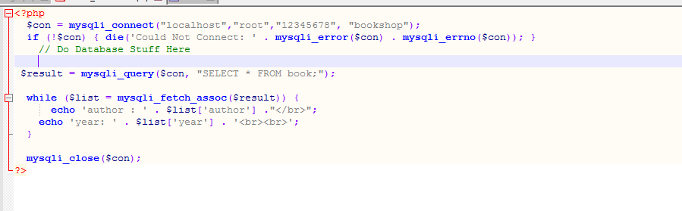
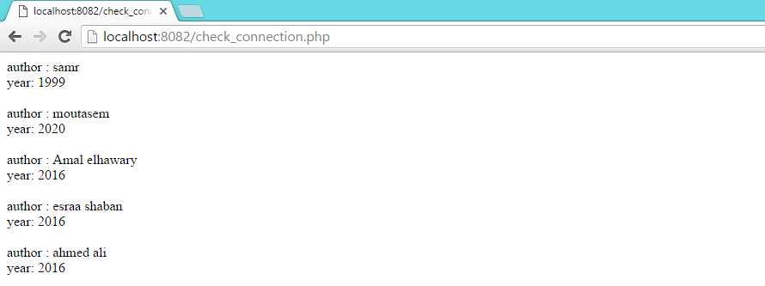

Slide 59
MYSQL Security & Handling User Input
mysqli_real_escape_string() function should always be used when entering data into a MYSQL query.
escape any characters that may cause the query to be used maliciously.
➔’SQL injection attack’

Slide 60
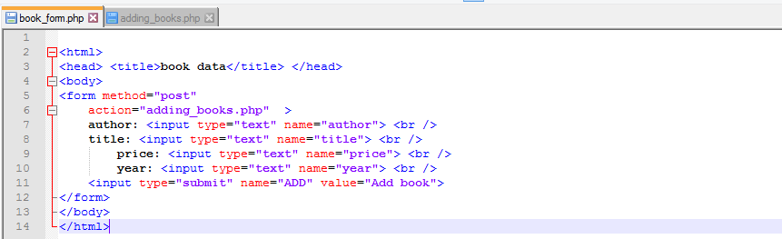
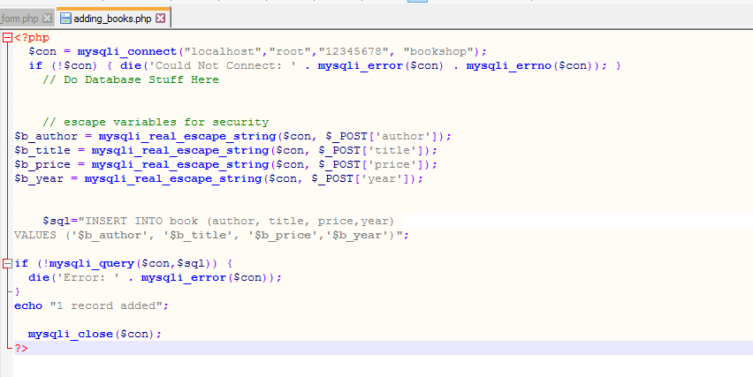

Slide 61
