Slide 1
Compiler design Lexical generator
Eng: Samar Shaban

Slide 2
Examples:
Describe the languages denoted by the following regular expressions:
a(a|b)*a
((ε|a)b*)*
(a|b)*a(a|b)(a|b)
a*ba*ba*ba*
(aa|bb)*((ab|ba)(aa|bb)*(ab|ba)(aa|bb)*)*
Notes:
String of a's and b's that start and end with a.
String of a's and b's.
String of a's and b's that the character third from the last is a.
String of a's and b's that only contains three b.
String of a's and b's that has a even number of a and b.

Slide 3
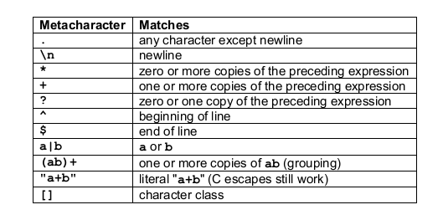
Lex RE

Slide 4
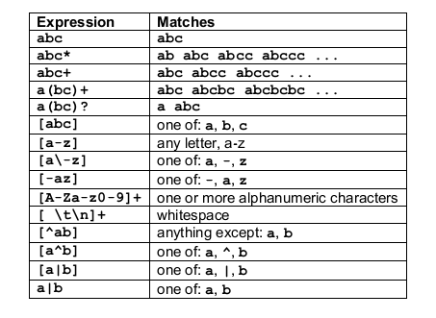
Lex RE
Notes:
If r and s are two LEX regular expressions then r/s is another LEX regular expression. It matches r if and only if it is followed by an s.
It is called a trailing context.
After use in this context, s is then returned to the input before the action is executed.

Slide 5
Most languages are case sensitive, so keywords can be written only one way, and the regular expressions describing their lexeme is very simple. However, some languages, like SQL, are case insensitive, so a keyword can be written either in lowercase or in uppercase, or in any mixture of cases. Thus, the SQL keyword SELECT can also be written select, Select, or sElEcT, for instance. Show how to write a regular expression for a keyword in a case­ insensitive language. Illustrate the idea by writing the expression for "select" in SQL.
Notes:
[Ss][Ee][Ll][Ee][Cc][Tt]

Slide 6
FLEX generator

Slide 7
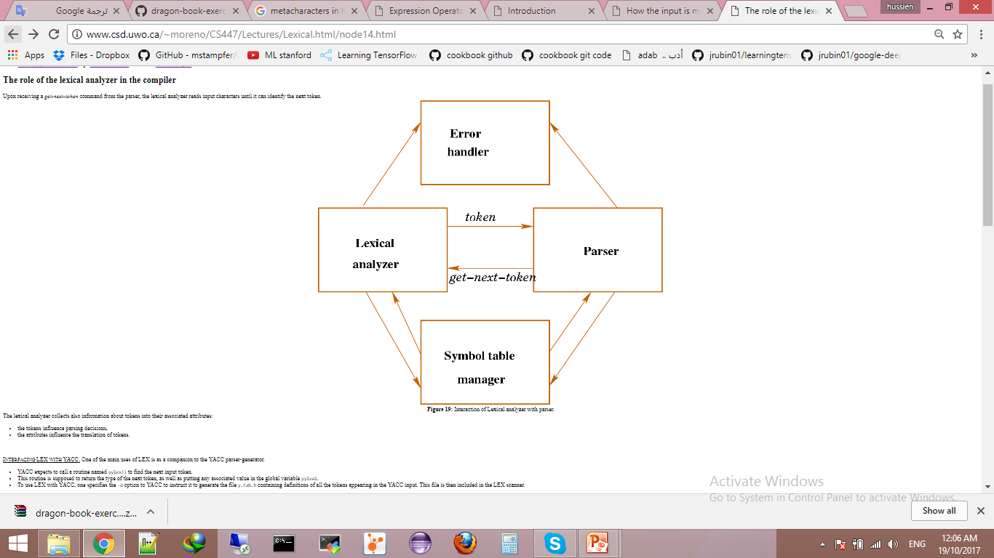
Lexical analyzer – parser interaction

Slide 8
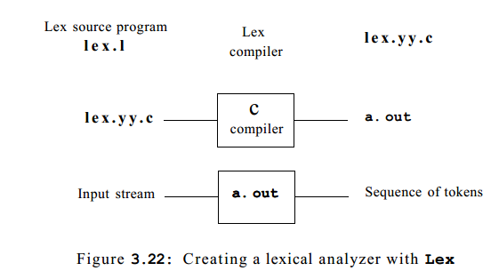

Slide 9
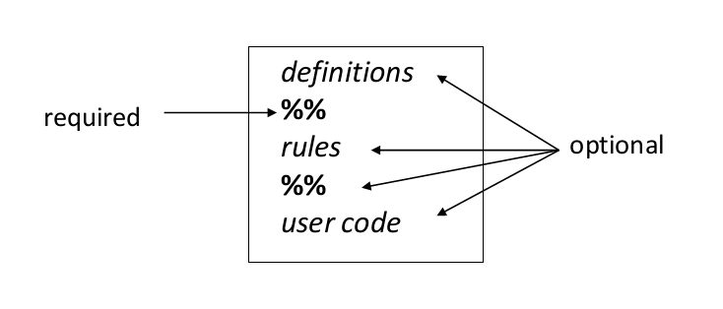
An input file has the following structure:

Slide 10
Definitions part
A serious of:
Name definitions eg: DIGIT [0-9] ID [a-zA-Z] [a-zA-Z0-9]*
Staff to be copied into the flex output eg. Declarations, #includes It has to be enclosed in %{ … %}

Slide 11
Rules Part
The rules portion of the input contains a sequence of rules.
Each rule has the form pattern action where:
Pattern describes a pattern to be matched on the input
Action must begin on the same line.(version dependent), for multi lined action : use {}

Slide 12
Running the file
First go to the file place, Or put the file in the root of terminal. Make your file with extention l;
Run code “flex fileName.l”. It will compile you file and add necessary code to it. A new file will be generated with the name “lex.yy.c”.
Run code “gcc lex.yy.c”. This will generate the executable file. Now your ready to run it.

Slide 13
When more than one pattern can match the input, the scanner behaves as follows:
The longest match is chosen;
If multiple rules match, the rule listed first in the flex input file is chosen;
if no rule matches, the default is to copy the next character to stdout;

Slide 14
Sample example
%{
int num_lines = 0, num_chars = 0;
%}
%%
[a-zA-Z] ++num_chars;
\n ++num_chars; num_lines++;
.
%%
int main()
{
yyin = fopen( "in.txt", "r" );
yyout = fopen( "out.txt", "w" );
while (yylex()>0){}
fprintf( yyout,"\r# of lines = %d, # of chars = %d\n",
num_lines, num_chars );
fclose(yyin);
fclose(yyout);
}
Notes:
Don’t forget
%option noyywrap

Slide 15
ex1
Program to count the no. of 'scanf' and 'printf' statement in a c program. Replace them with 'readf' and 'writef' statements respectively.

Slide 16
ex2
Write a flex program that copies a file, replacing each nonnull sequence of white space by a single blank.

Slide 17
ex3
Write a fLex program that counts characters, words, and lines in a text file and reports the counts. Define a word to be any sequence of letters and/or digits, without punctuation or spaces. Punctuation and white space do not count as words.

Slide 18
ex4
Write a flex program to count the number of comment lines in a given C program .Also eliminate them and copy that program into separate file.

Slide 19
ex5
Program to count no. of a) Positive and negative integers b) Positive and negative fractions

