Slide 1
scanner

Slide 2
Quiz
Consider the string
abaabaabababbaaabaab
and its tokenization
abaa ba ababa bba aa ba a b
Give a flex specification with the minimum number of rules that produces this tokenization. Each flex
rule should be as simple as possible as well. You may not use regular expression union (i.e., R1 + R2 )
in your solution. Do not give any actions; just assume that the rule returns the string that it matches.
Notes:
%option noyywrap
%{
%}
%%
b*a?|(ab)*a+ {fprintf(yyout,"<%s >", yytext);}
%%
int main()
{
yyin = fopen( "in.txt", "r" );
yyout = fopen( "out.txt", "w" );
while (yylex()>0){}
fclose(yyin);
fclose(yyout);
}

Slide 3
Provide transition diagrams to recognize:
a(a|b)*a

Slide 4
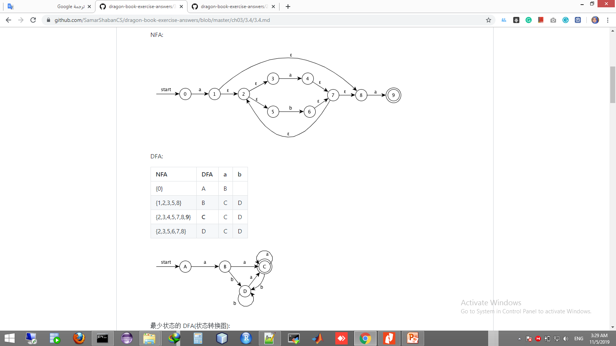

Slide 5
Construct a syntax-directed translation scheme that translates postfix arithmetic expressions into equivalent prefix arithmetic expressions.

Slide 6
production:
expr -> expr expr op | digit
translation scheme:
expr -> {print(op)} expr expr op | digit {print(digit)}

