Slide 1
DATABASE REATION BY
Samara Becerra

Slide 2
BUSINESs Purpose of my model.​
My drums database is based on the Drums on Sale online store . Its business purpose is to organize the products, customers, orders and staff data. In this way, the managers can successfully run the transaction queries and keep up with the inventory among other essential tasks of an e-commerce illustrated in this project.

Slide 3
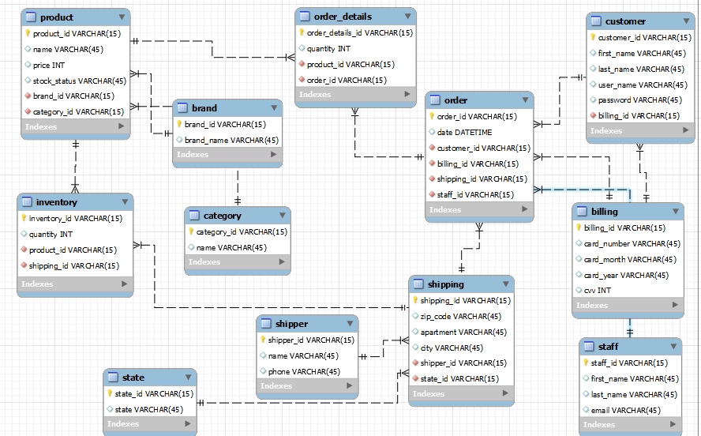
ERD MODEL

Slide 4
CRUD EXPLAINED + TEST CASES

Slide 5
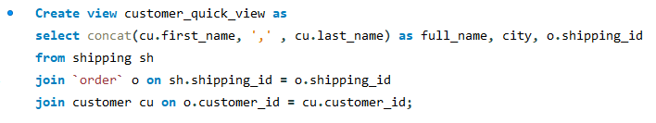
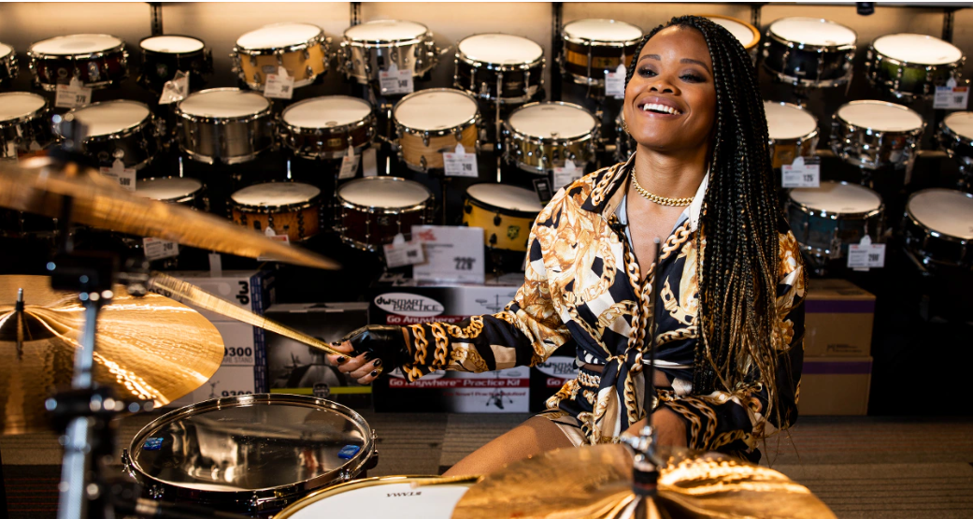
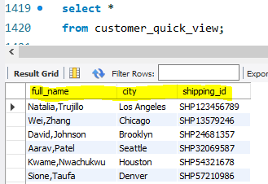
CREATE
Create a view for a quick view on the customers' information for an order including full name, city, and shipping. For the full name I use concat to combine first and last name. Finally, I joined the order to the customer table to get this result:
When it’s run the view is this:

Slide 6
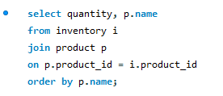
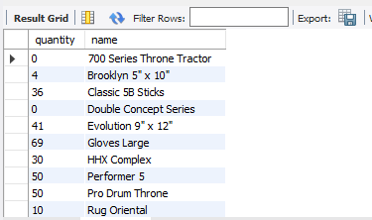
Select/ READ
SELECT using product and inventory tables to see the quantity of products on inventory to know what the store needs to supply more. To achieve this, I joined the inventory to the product table and ordered by product name.

Slide 7

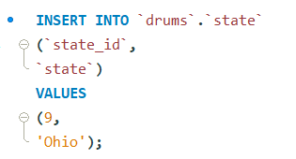

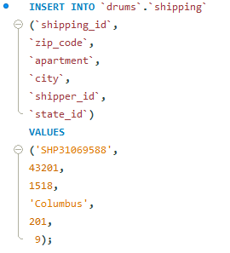
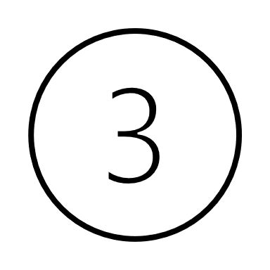
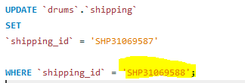
UPDATE
UPDATE a customer's shipping address because they moved to a state we don’t have on the database:
First insert the state in the corresponding table.
Second, insert a new shipping address.
Last, update the old shipping id with the new one.

Slide 8
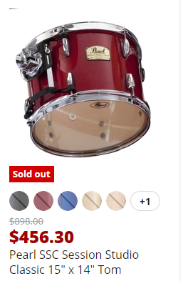

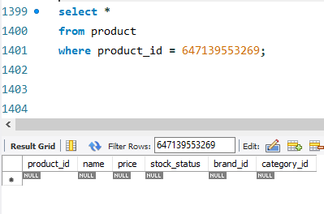
DELETE
Delete the tom drum product because it sold out and the manufacturer
no longer provides it
No longer in the database when looking for it.

Slide 9
UI MOCKUPS + TEST CASES

Slide 10
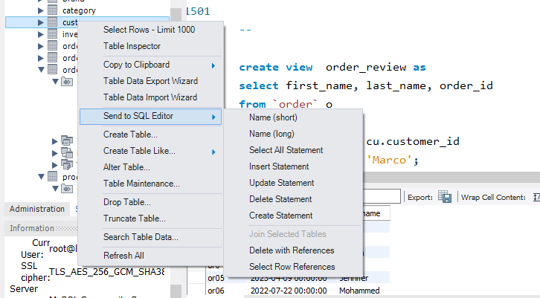
rationale and design of UI forms.
The UI forms are taken from the website. The rationale is based on examples with sakila and w3schools databases. I also researched on ideas to create my queries. Using SQL Editor was useful as well.

Slide 11
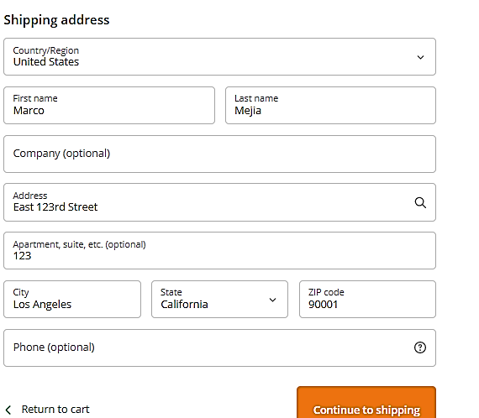
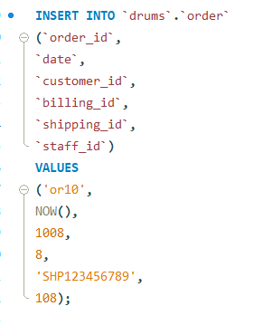
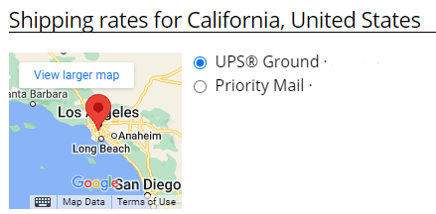
placing AN ORDER
Our existing customer Marco Mejia is placing an order. When he created his profile, he added his billing and shipping information. In the database he is assigned an order id, a shipper and a staff member who takes care of his order.
Our existing customer Marco Mejia places an order, so I first insert the order information.

Slide 12
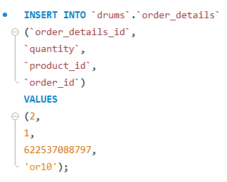
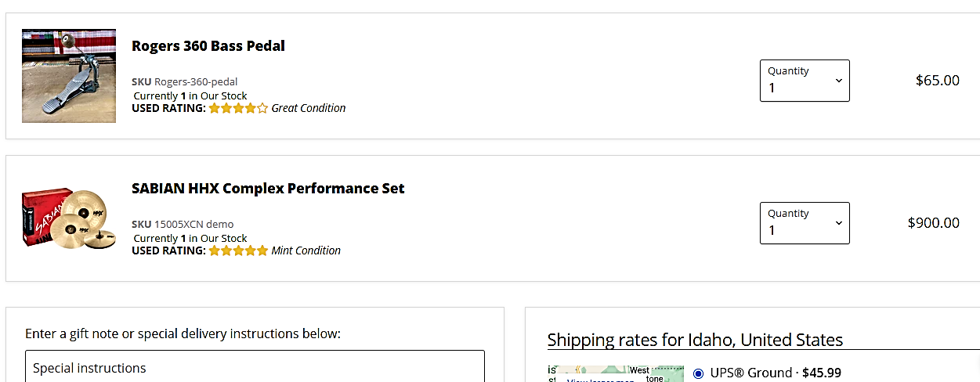
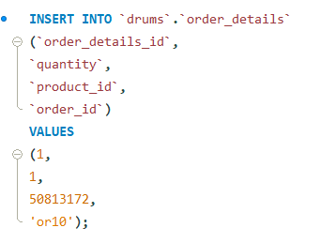
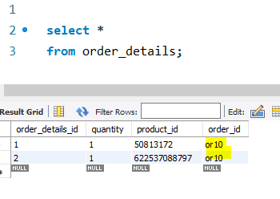
adding ITEMS TO THE ORDER
Second, when the customer selects the items and the quantity they want, the items are added to the same order in the order details table.

Slide 13
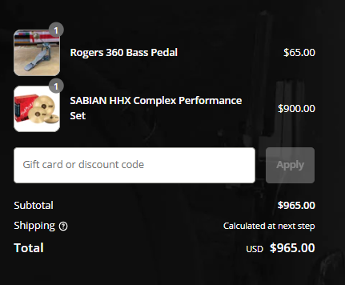
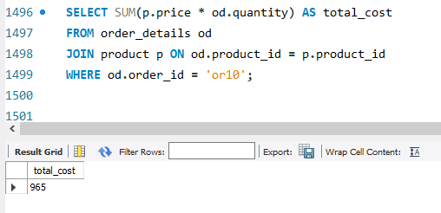
Check out
This UI illustrates the customer’s order ready to check out
with the total to pay. To get the total amount I use SUM then multiply the quantity by the price, then joined order details and product tables where the order was #10.

Slide 14
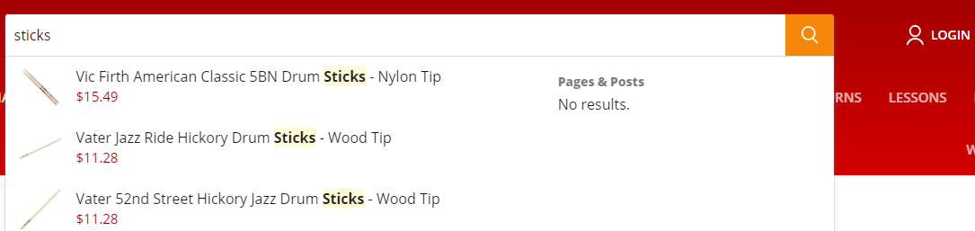
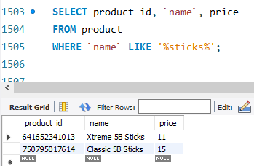
Look for a product
When a customer looks for an item in the search bar, they are shown the product name and price. In the database that is a select statement to find the product id, name and price where the name is guided by a LIKE command depending on the keyword typed.

Slide 15
BUSINESS SCENARIOS

Slide 16
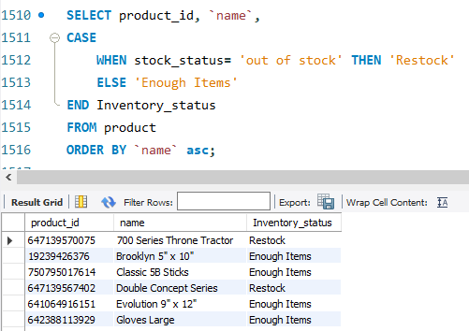
ASSIGN A STATUS TO INVENTORY ITEMS
I want to know what items need to be restock to check inventory. Using a conditional CASE WHEN query I can
have a column that indicates what product needs to be restock based on the stock status, if it was out of stock now it shows restock. This makes it easier to identify the products at a glance.

Slide 17
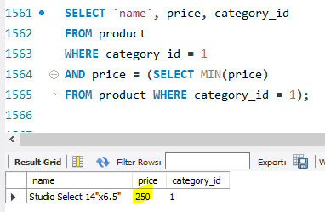
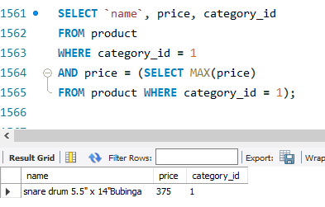
FIND MIN/ MAX PRICE BY CATEGORY
A customer wants to know what’s the most affordable snare drum (category 1) we have.
Another customer would like to know what is the most expensive snare drum we have.
By using a subquery that selects the MAX or MIN price within category 1 we retrieve both customers’ requests.

Slide 18
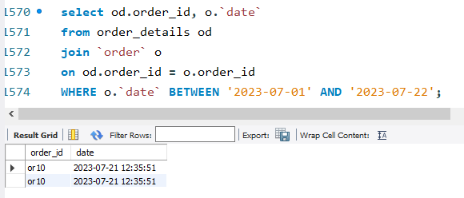
SEE ALL ORDERS FROM LAST MONTH
The staff wants to know how many orders have been placed this month to make a report .
to get the data I joined the order details and order table and set a time frame using BETWEEN from the
beginning to the last day of July this year.

Slide 19
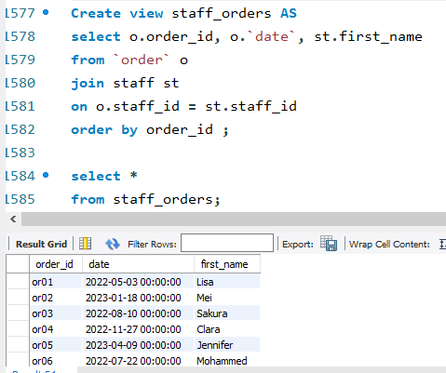
STAFF MEMBERS AND ORDER
To stay on top of orders I want to see who is working on what order and when the order was placed.
By creating a view I can quickly see the order id when it was placed and the staff first name who is responsible to follow up with it.

Slide 20
THANK YOU

