Slide 1

Neural Network with Attention Mechanisms and t-SNE
Understanding Attention through Dimensionality Reduction

Slide 2
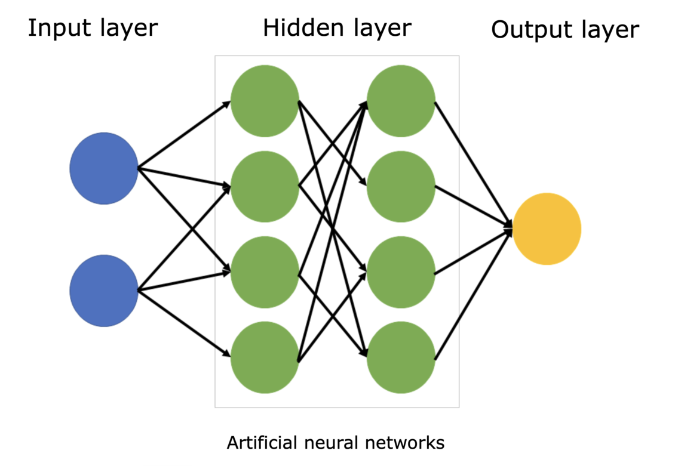
Neural Network:
A neural network is a computational model inspired by the structure and function of the human brain. It consists of interconnected nodes (neurons) organized into layers. Neural networks are used to solve complex problems in various domains, such as image recognition, natural language processing, and decision-making.

Slide 3
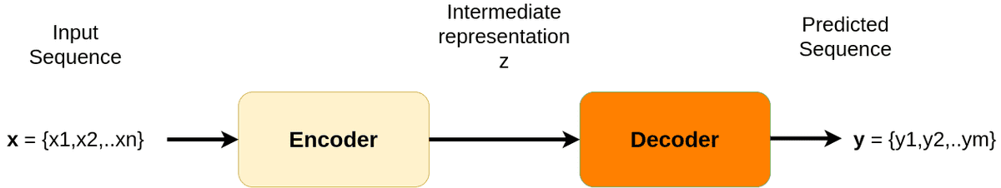
Attention mechanisms:
Attention mechanisms are techniques used in neural networks to focus on specific parts of input data that are most relevant to the task at hand. For example, in machine translation, attention mechanisms help the model focus on specific words in a sentence while translating.
Attention in Encoder-Decoder
The attention mechanism emerged naturally from problems that deal with time-varying data (sequences). So, since we are dealing with “sequences”, let’s formulate the problem in terms of machine learning first. Attention became popular in the general task of dealing with sequences.

Slide 4
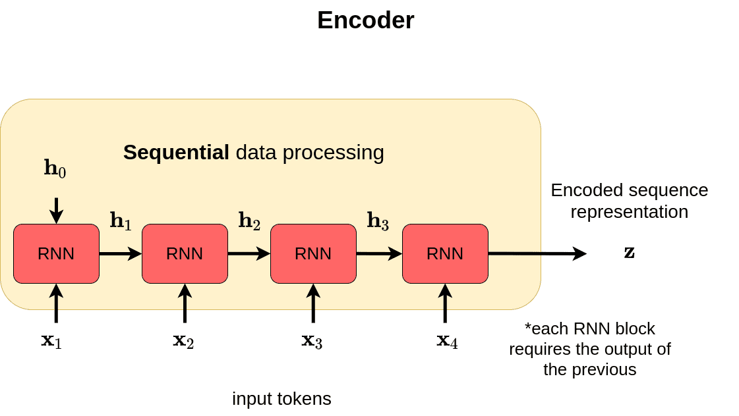
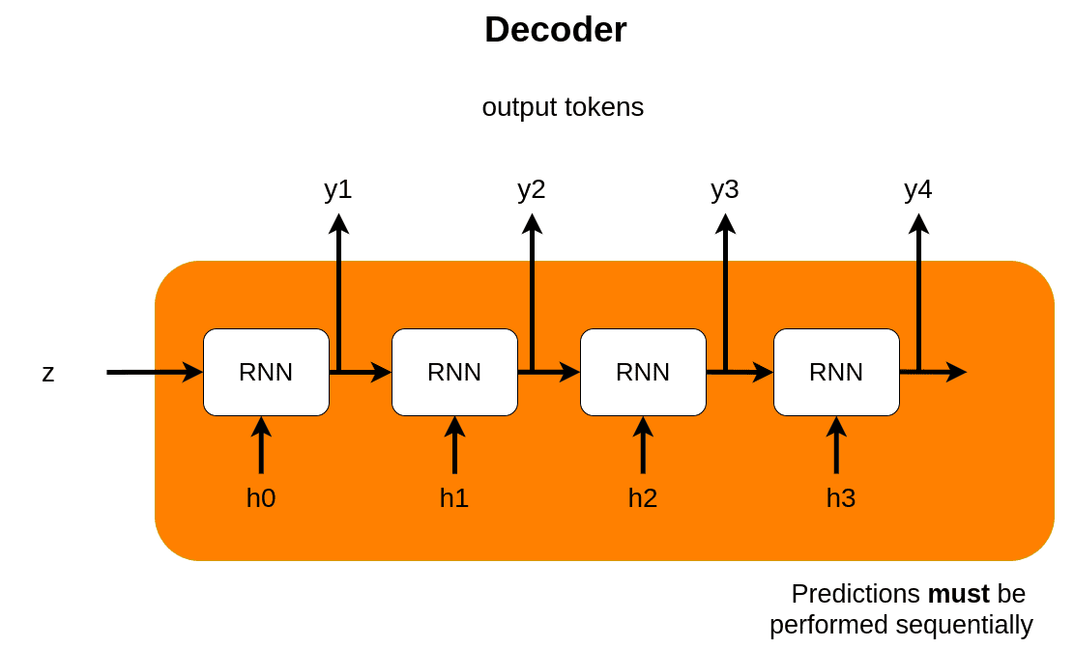
Encoder:
The encoder processes the input and produces one compact representation, called z, from all the input timesteps. It can be regarded as a compressed format of the input.
Decoder:
The decoder receives the context vector z and generates the output sequence. The most common application of Seq2seq is language translation

Slide 5
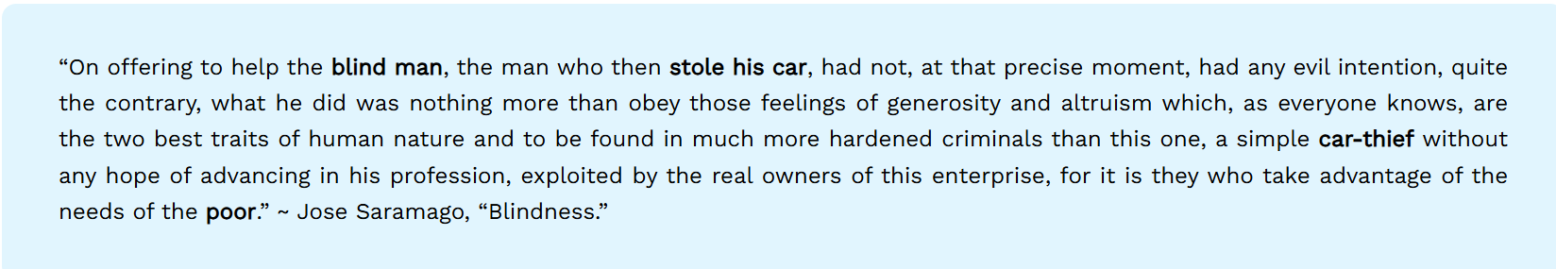
Why attention mechanism?
It’s because of RNN limitations. The intermediate representation z cannot encode information from all the input timesteps. This is commonly known as the bottleneck problem. The vector z needs to capture all the information about the source sentence.
Let’s see a concrete example. Imagine a sentence of 97 words:
Notice anything wrong? Hmmm… The bold words that facilitate the understanding are quite far!
In most cases, the vector z will be unable to compress the information of the early words as well as the 97th word. Eventually, the system pays more attention to the last parts of the sequence. However, this is not usually the optimal way to approach a sequence task, and it is not compatible with the way humans translate or even understand language.

Slide 6
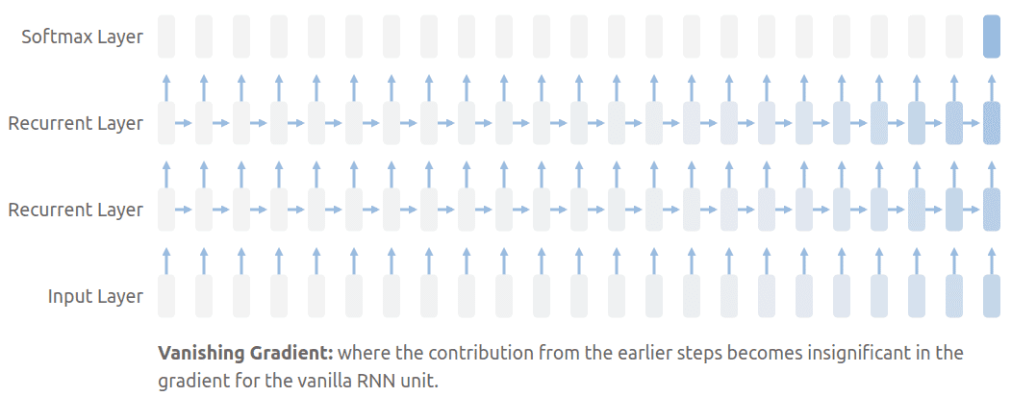
Furthermore, the stacked RNN layer usually create the well-know vanishing gradient problem.
Attention to the rescue!
Attention was born to address these two things on the Seq2seq model. But how?
The core idea is that the context vector z should have access to all parts of the input sequence instead of just the last one.

Slide 7
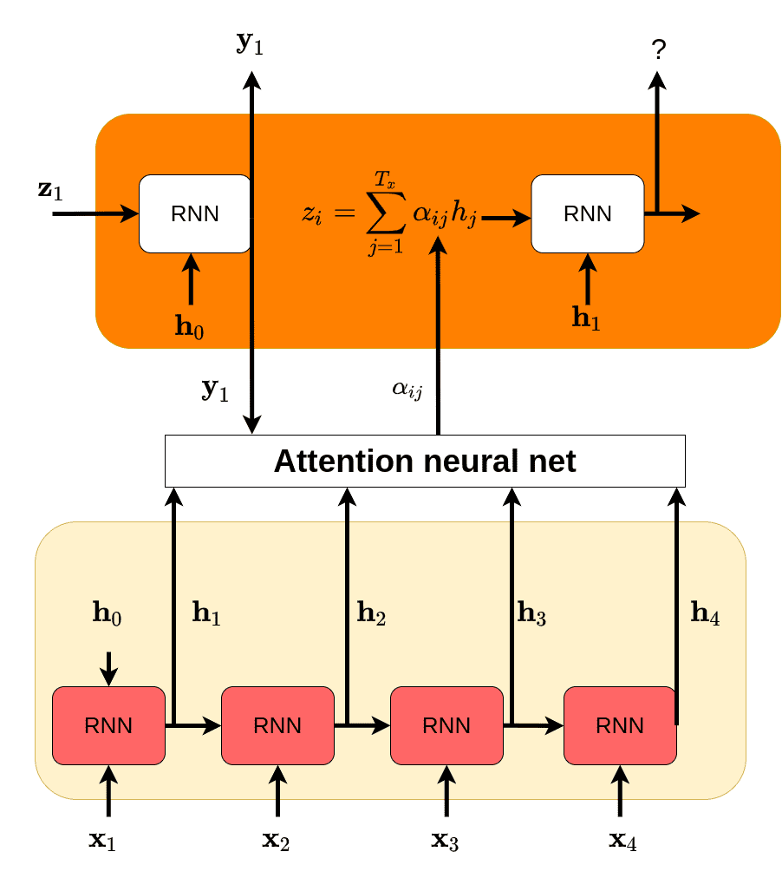
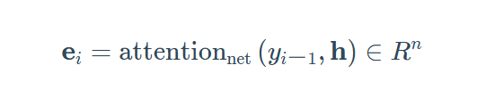

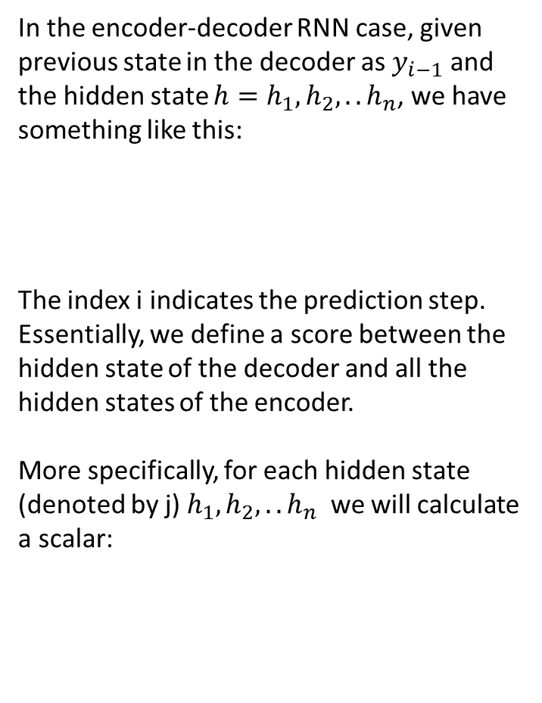
In the encoder-decoder RNN case, given previous state in the decoder as $y_{i−1}$​ and the hidden state $h=h_{1}, h_{2}, ..h_{n}$​, we have something like this:
The index i indicates the prediction step. Essentially, we define a score between the hidden state of the decoder and all the hidden states of the encoder.
More specifically, for each hidden state (denoted by j) $h_{1}, h_{2}, ..h_{n}$​ we will calculate a scalar:

Slide 8
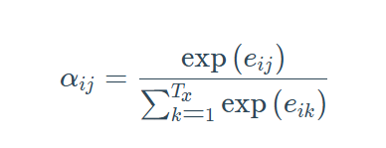
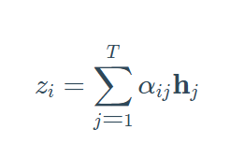
I used the symbol e in the equation and α in the diagram! Why? Because we want some extra properties: a) to make it a probability distribution and b) to make the scores to be far from each other.

Slide 9
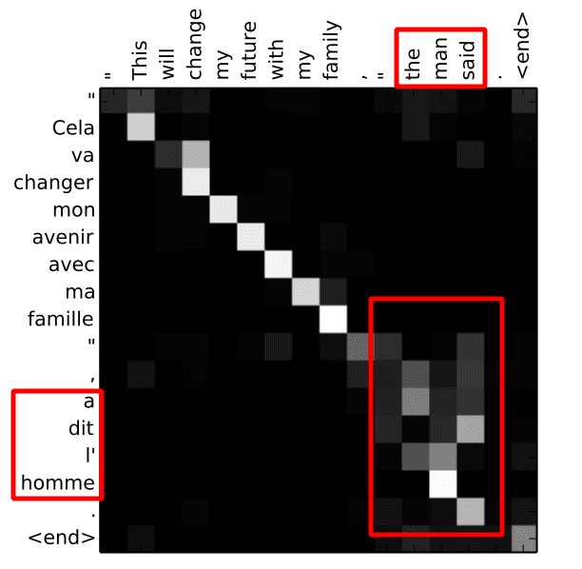
Attention as a trainable weight mean for machine translation:
In machine translation, we can visualize the attention of a trained network using a heatmap such as below. Note that scores are computed dynamically.
Notice what happens in the active non-diagonal elements. In the marked red area, the model learned to swap the order of words in translation. Also note that this is not a 1-1 relationship but a 1 to many, meaning that an output word is affected by more than one input word (each one with different importance).

Slide 10
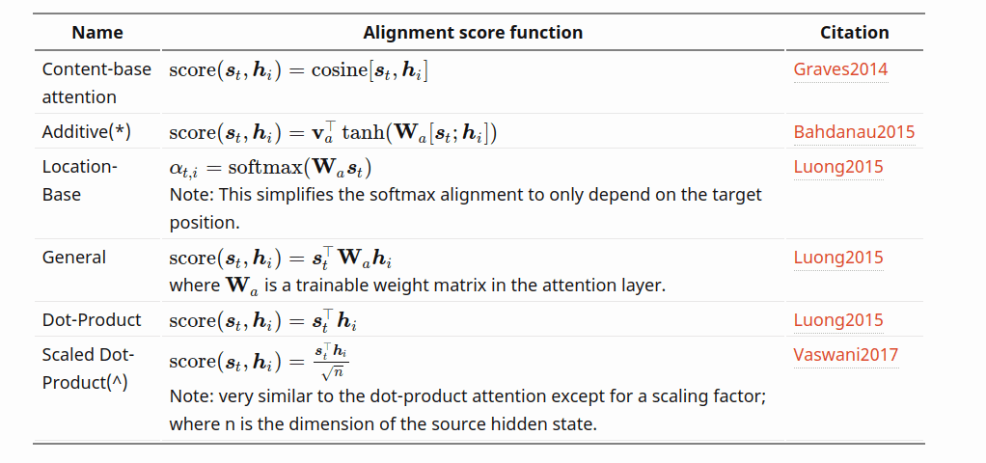
How do we compute attention?

Slide 11
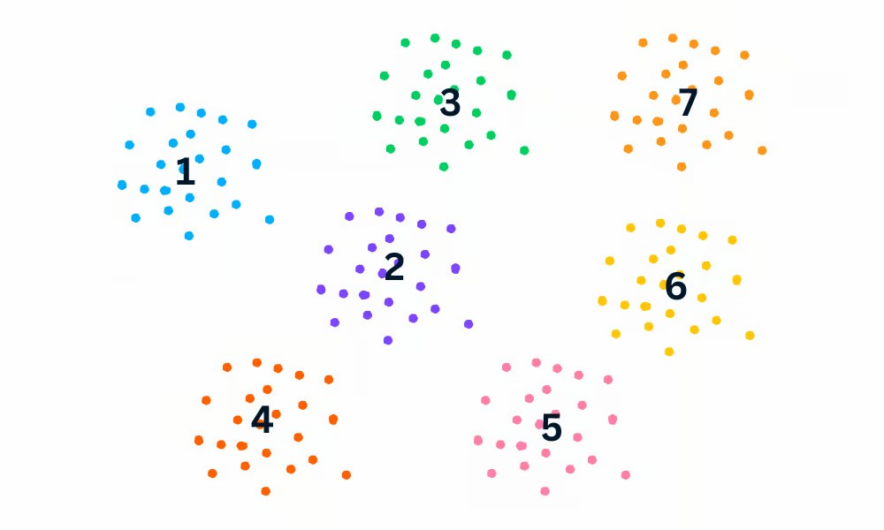
t-SNE (t-Distributed Stochastic Neighbour Embedding) Visualization:
t-SNE (t-distributed Stochastic Neighbour Embedding) is an unsupervised non-linear dimensionality reduction technique for data exploration and visualizing high-dimensional data. Non-linear dimensionality reduction means that the algorithm allows us to separate data that cannot be separated by a straight line.

Slide 12
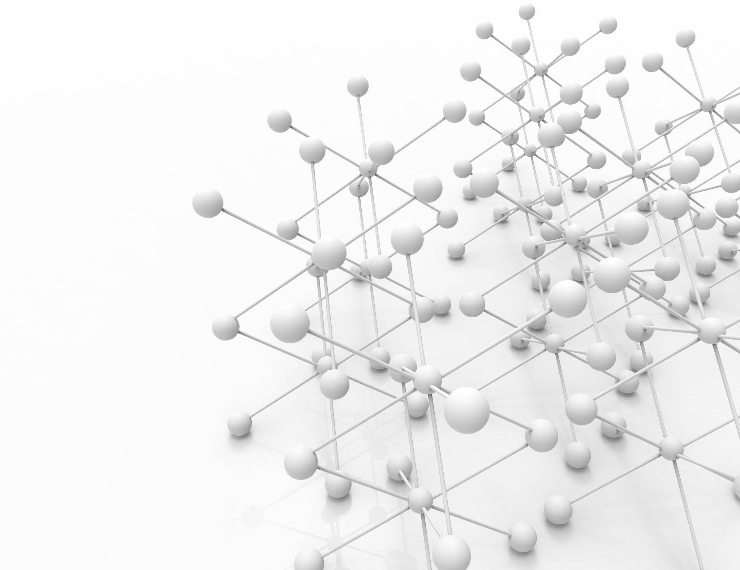
Twitter Sentiment140 for Visualizing Attention Mechanisms with t-SNE in Neural Networks
Objective:
Train a neural network with an attention mechanism on the Twitter Sentiment140 dataset.
Use t-SNE to visualize attention weights to understand how the model focuses on key words in the tweets for sentiment prediction.

Slide 13
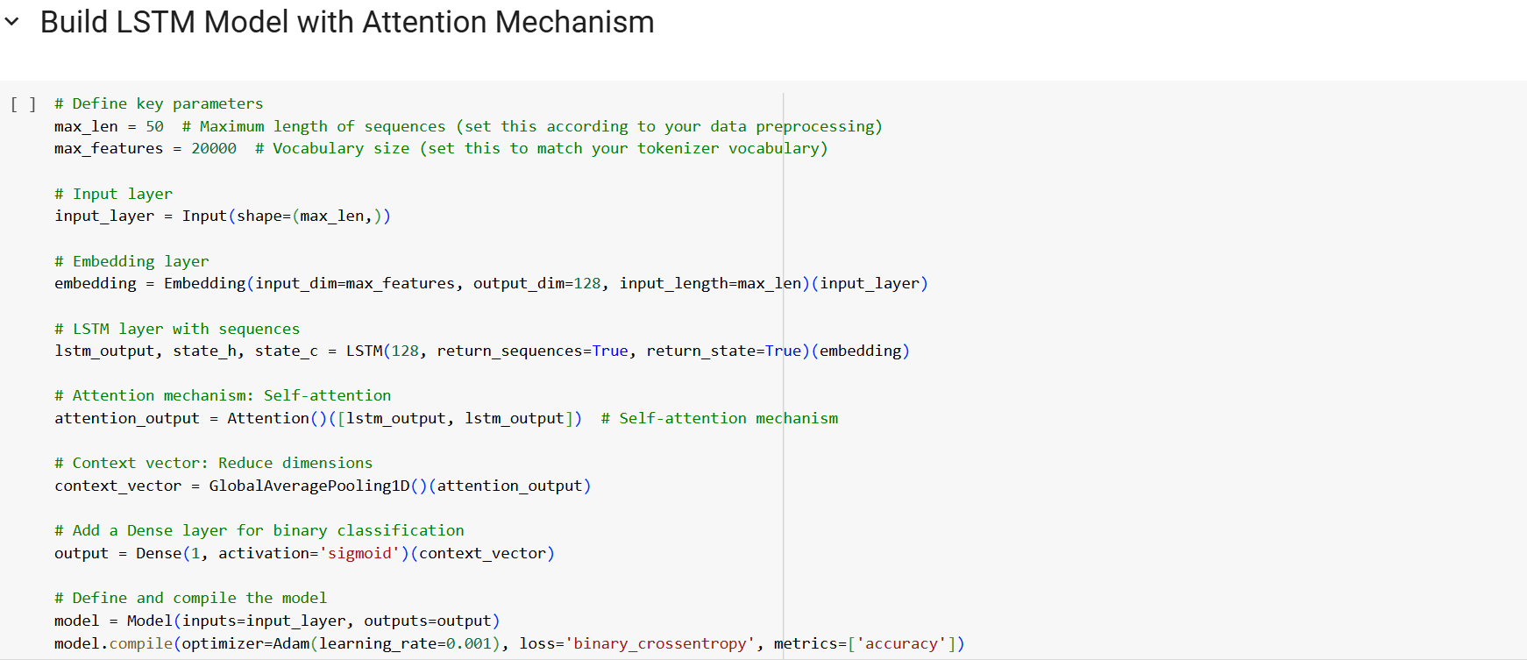
Data Overview
Contains 1.6 million tweets.

Slide 14
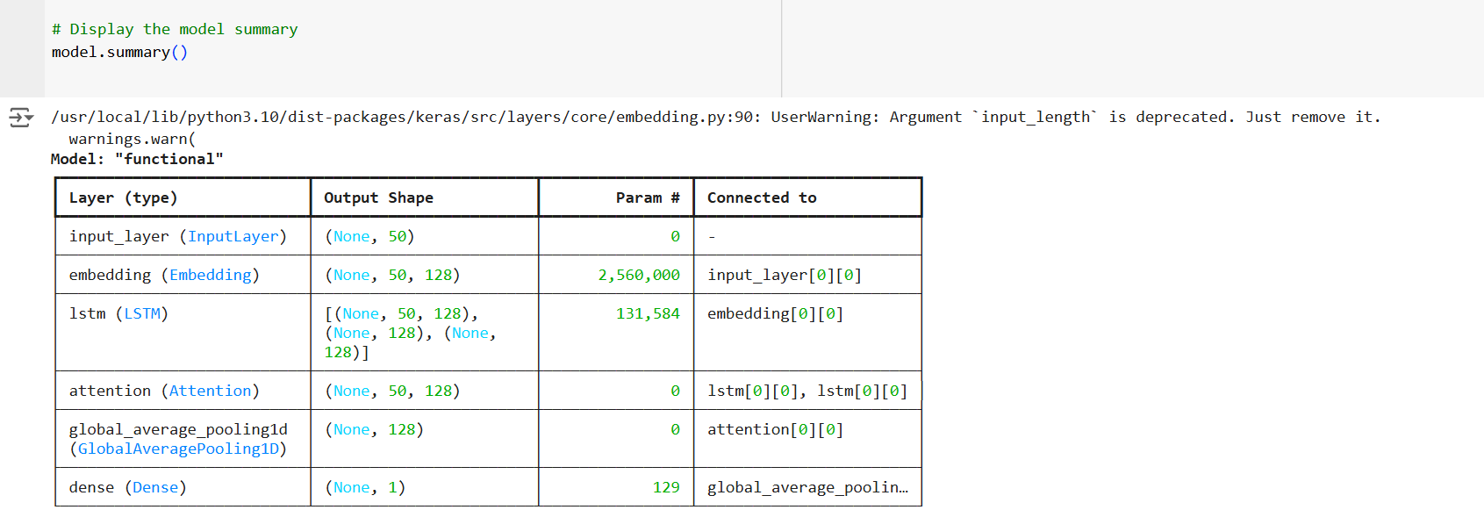
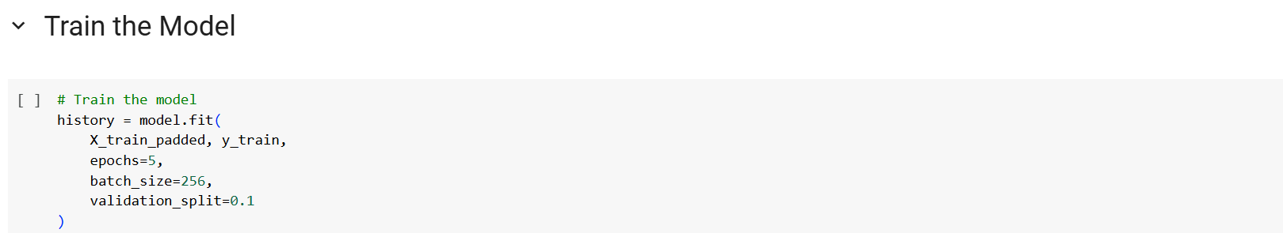
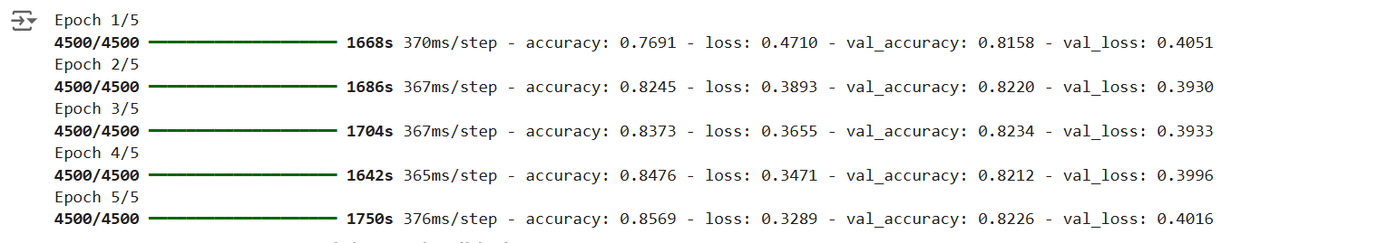

Slide 15
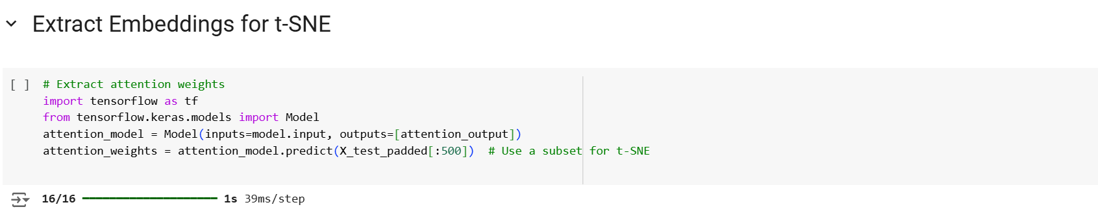
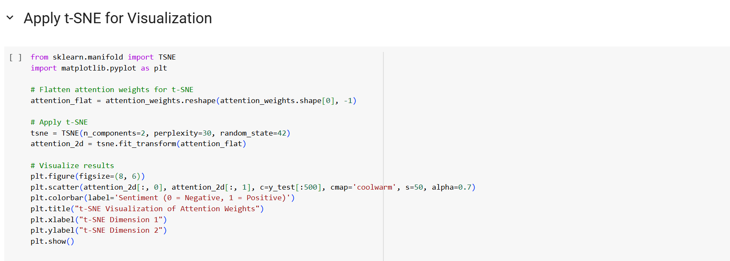

Slide 16
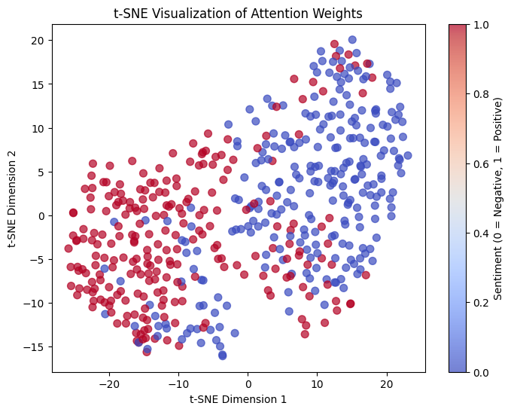

Slide 17
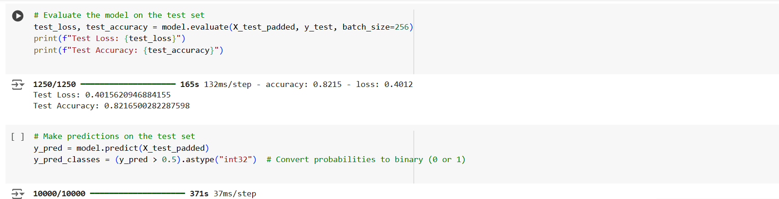
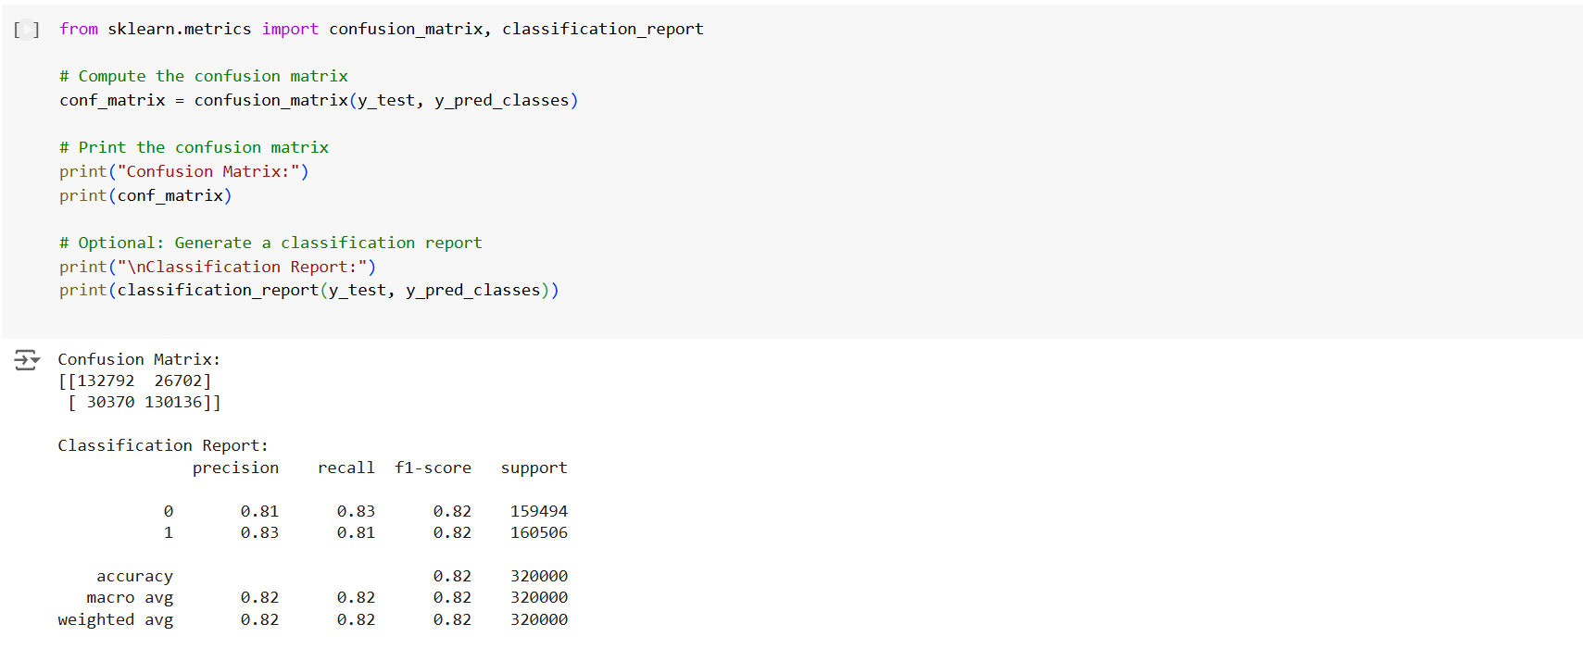

Slide 18
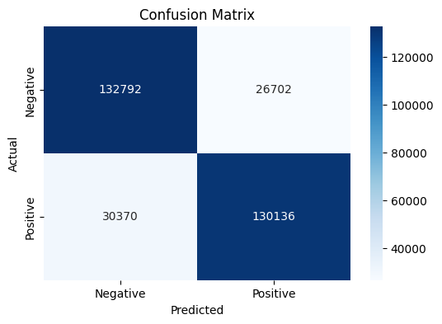
Conclusion
Combining attention mechanisms with t-SNE has proven to be a powerful tool for understanding neural network behaviour in sentiment analysis tasks. This work demonstrates how such techniques can bridge the gap between model performance and interpretability, paving the way for more trustworthy and transparent AI systems.

Slide 19
References
https://theaisummer.com/attention/
https://www.sciencelearn.org.nz/images/5156-neural-network-diagram
https://www.datacamp.com/tutorial/introduction-t-sne
https://www.kaggle.com/datasets/kazanova/sentiment140

Slide 20

Thanks

