Slide 1
Turkey, No Matter What
A presentation by Glenn G. Winsor, reseacher in Advanced Turkey Studies
Notes:
Seed: Turkey Generator: Title slide Context: {'topic': 'Turkey', 'presenter': 'Glenn G. Winsor', 'seed': 'Turkey', 'seed_title': 'Turkey'} Generated Elements: ['Turkey, No Matter What', 'A presentation by Glenn G. Winsor,\nreseacher in Advanced Turkey Studies']

Slide 2
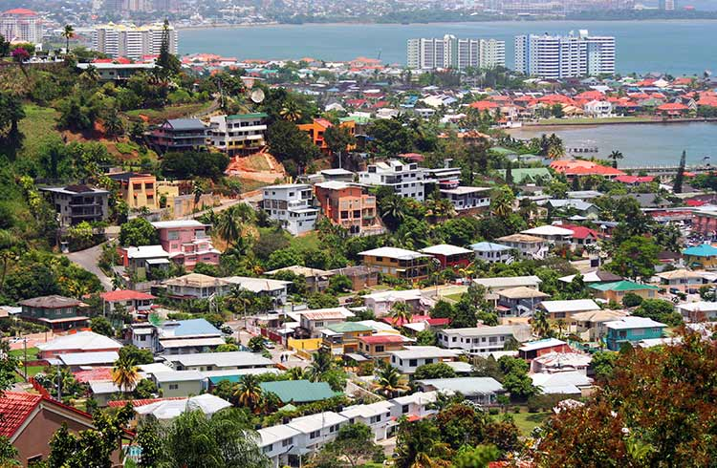
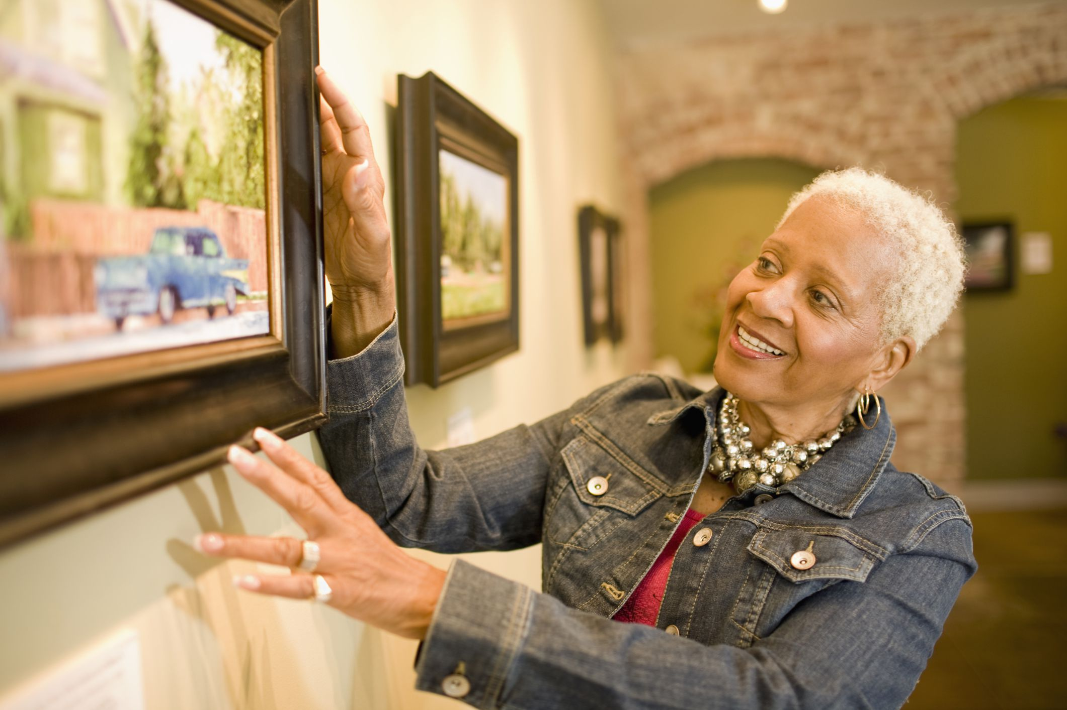
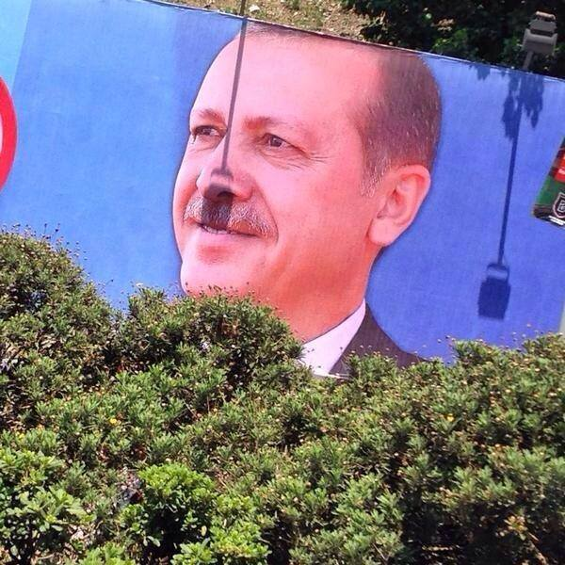
My background
Trinidad & Tobago
Daytime job: Curator
Favourite Turkey Memory
Notes:
Seed: Turkey Generator: About Me: Location-Job-WeirdHobby Context: {'topic': 'Turkey', 'presenter': 'Glenn G. Winsor', 'seed': 'Turkey', 'seed_title': 'Turkey'} Generated Elements: ('My background', 'Trinidad & Tobago', '/downloads/google_images/Trinidad & Tobago/trinidad-and-tobago-crime-port-of-spain.jpg', 'Daytime job: Curator', '/downloads/google_images/Curator/curator-56a2f2df5f9b58b7d0cfd84c.jpg', 'Favourite Turkey Memory', '/app/talkgenerator/schema/../../downloads/reddit/hmmm+hmm+wtf+wtfstockphotos+photoshopbattles+confusing_perspective+cursedimages+HybridAnimals+EyeBleach+natureismetal/osged8yni0y01.jpg', True)

Slide 3
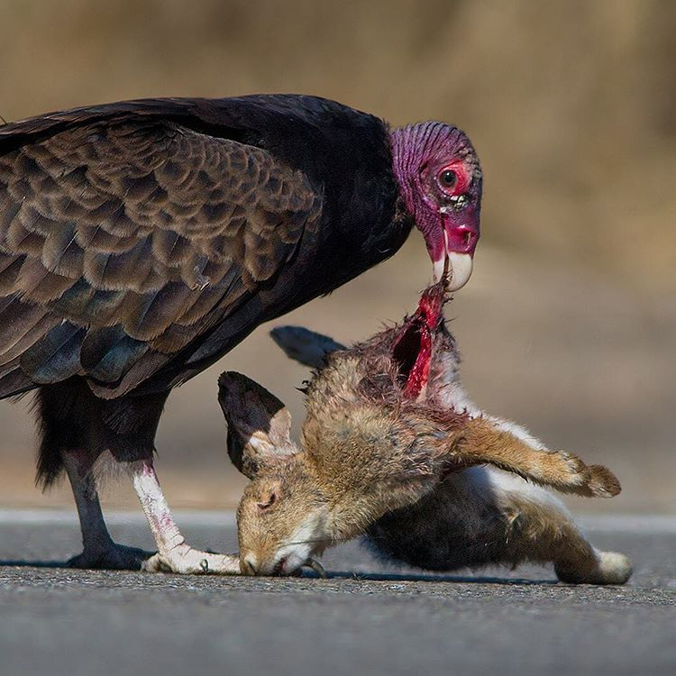
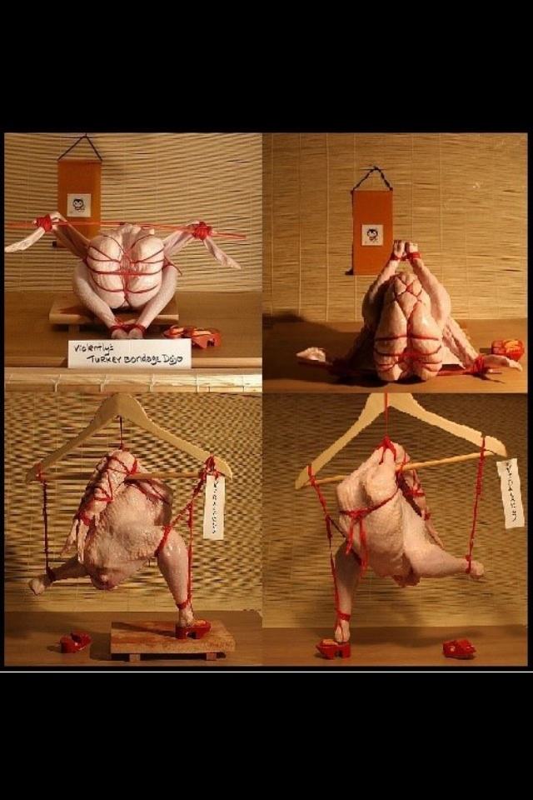
Let's look at Turkeys
How I see Turkeys:
What Turkeys actually are:
Notes:
Seed: Turkey Generator: Two Captions Weird Reddit Context: {'topic': 'Turkey', 'presenter': 'Glenn G. Winsor', 'seed': 'Turkey', 'seed_plural': 'Turkeys', 'seed_is_noun_plural_title': 'Turkeys'} Generated Elements: ("Let's look at Turkeys", 'How I see Turkeys:', '/app/talkgenerator/schema/../../downloads/reddit/hmmm+hmm+wtf+wtfstockphotos+photoshopbattles+confusing_perspective+cursedimages+HybridAnimals+EyeBleach+natureismetal/GG1VIhH.jpg', 'What Turkeys actually are:', '/app/talkgenerator/schema/../../downloads/reddit/hmmm+hmm+wtf+wtfstockphotos+photoshopbattles+confusing_perspective+cursedimages+HybridAnimals+EyeBleach+natureismetal/Xu08X.jpg', True)

Slide 4
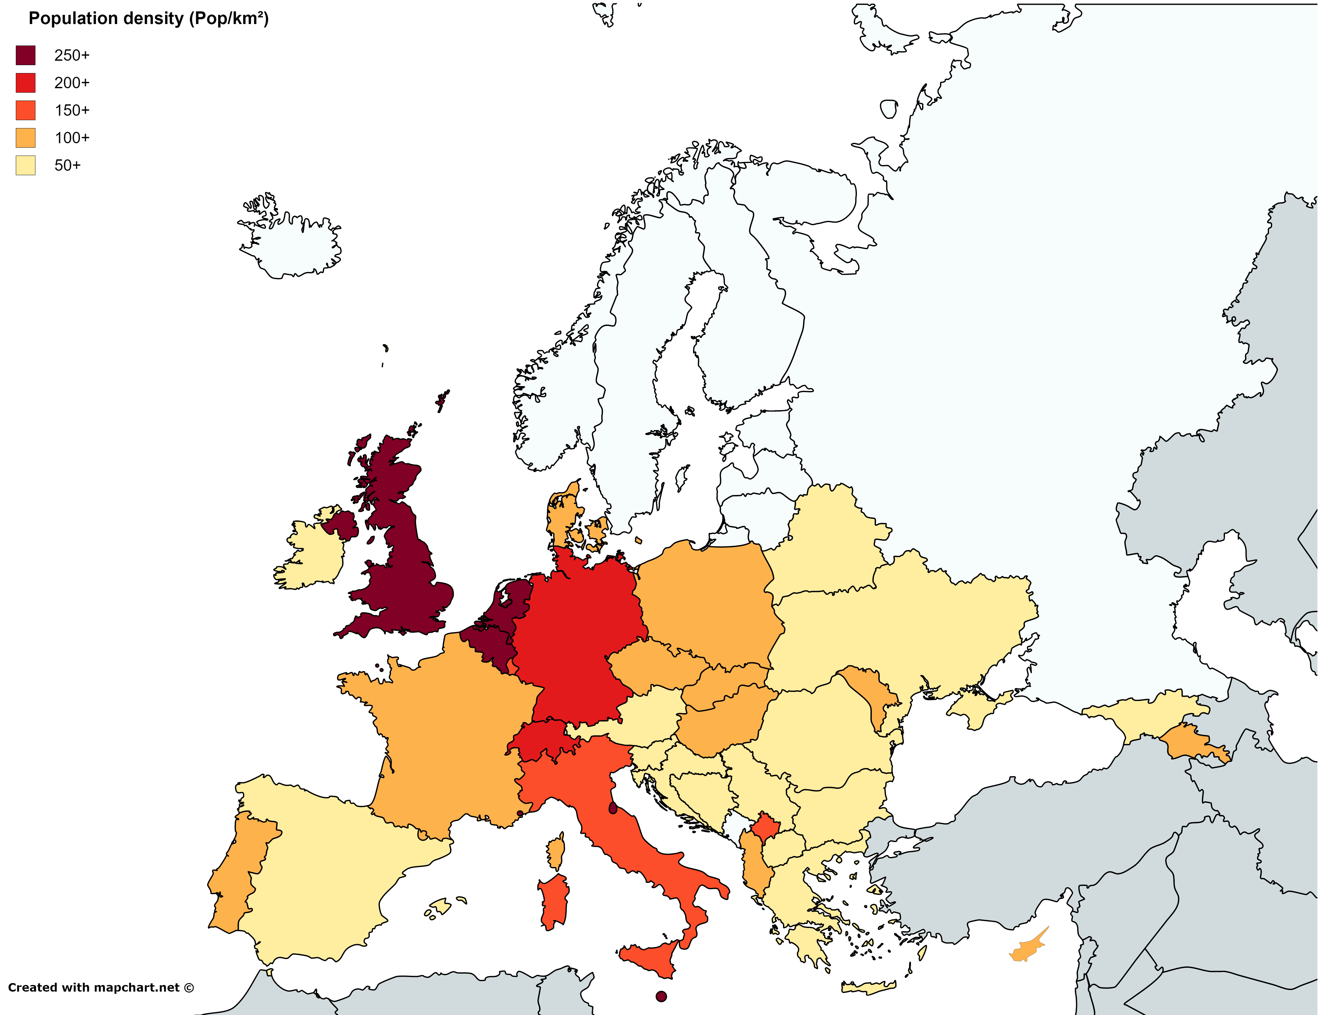
Notes:
Seed: Turkey Generator: Reddit Chart Context: {'topic': 'Turkey', 'presenter': 'Glenn G. Winsor', 'seed': 'Turkey'} Generated Elements: [None, '/app/talkgenerator/schema/../../downloads/reddit/dataisbeautiful+funnycharts+charts/z803p6y7xuox.png', True]

Slide 5
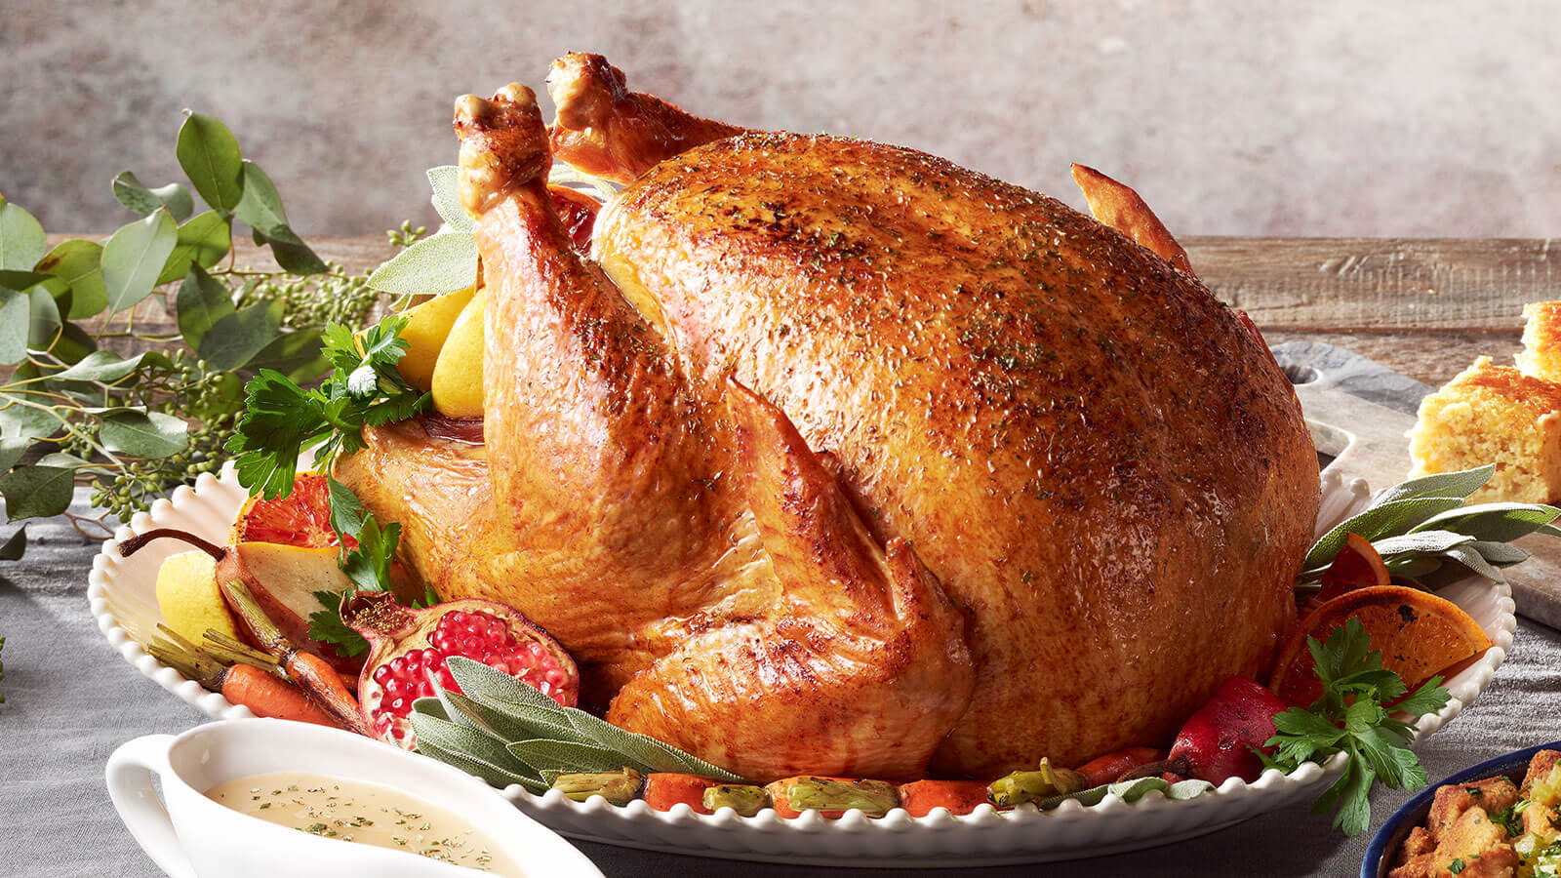
Notes:
Seed: Turkey Generator: Full Screen Google Images Context: {'topic': 'Turkey', 'presenter': 'Glenn G. Winsor', 'seed': 'Turkey'} Generated Elements: [None, '/downloads/google_images/Turkey/classic-roast-turkey.jpg', True]

Slide 6
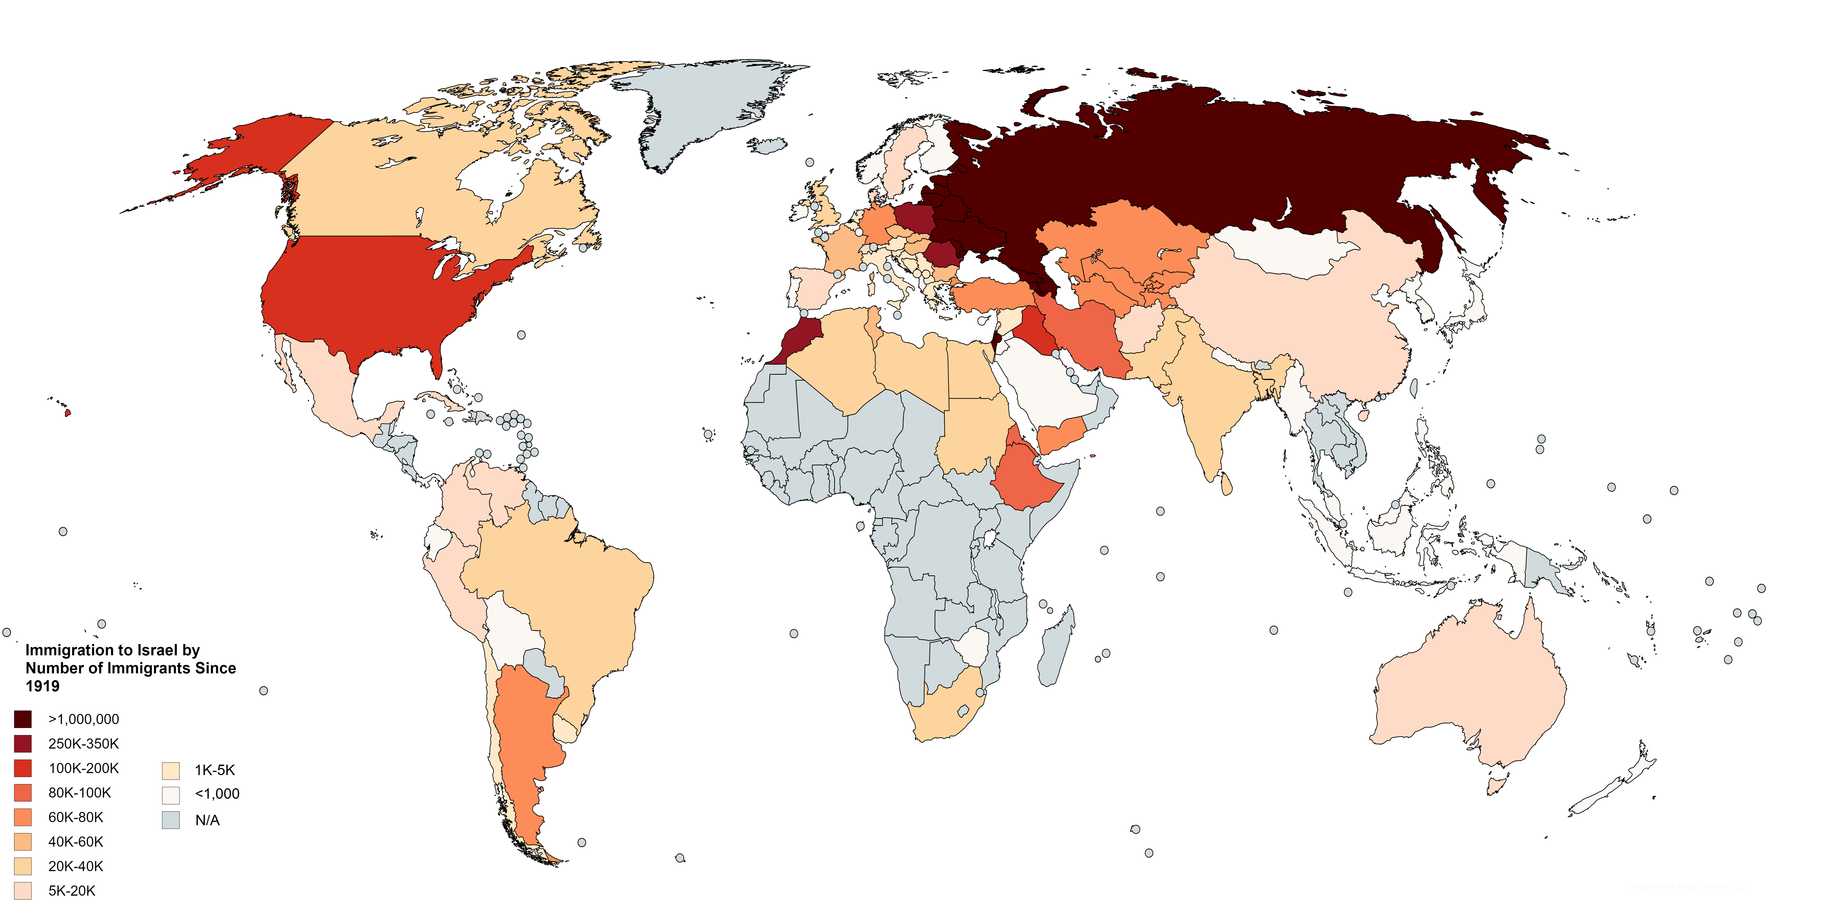
Notes:
Seed: Turkey Generator: Reddit Chart Context: {'topic': 'Turkey', 'presenter': 'Glenn G. Winsor', 'seed': 'Turkey'} Generated Elements: [None, '/app/talkgenerator/schema/../../downloads/reddit/dataisbeautiful+funnycharts+charts/odpxdtc7dszx.png', True]

Slide 7
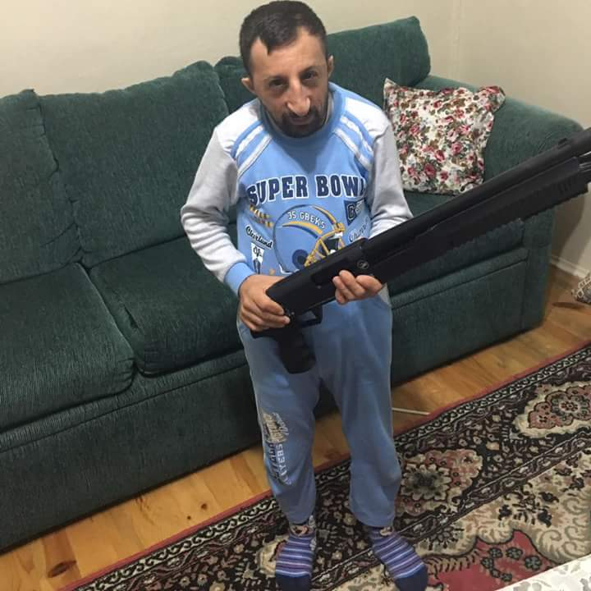
Let's Discuss Turkeys
True
Good
Better
/app/talkgenerator/schema/../../downloads/shitpostbot/turkey-guy-smol-57b510c3a788f.jpeg
Notes:
Seed: Turkey Generator: Three Captions Weird Context: {'topic': 'Turkey', 'presenter': 'Glenn G. Winsor', 'seed': 'Turkey', 'seed_is_noun_plural_title': 'Turkeys'} Generated Elements: ("Let's Discuss Turkeys", 'Good', '/app/talkgenerator/schema/../../downloads/shitpostbot/turkey-guy-smol-57b510c3a788f.jpeg', 'Better', '/app/talkgenerator/schema/../../downloads/shitpostbot/turkey-guy-smol-57b510c3a788f.jpeg', '/app/talkgenerator/schema/../../downloads/shitpostbot/turkey-guy-smol-57b510c3a788f.jpeg', True)

Slide 8
Do you want to learn how to bake turkey bacon?
Notes:
Seed: Turkey Generator: Yes/No/Funny Chart Context: {'topic': 'Turkey', 'presenter': 'Glenn G. Winsor', 'seed': 'Turkey', 'seed_a': 'a Turkey', 'seed_wikihow_action_lower': 'bake turkey bacon', 'chart_title': 'Do you want to learn how to bake turkey bacon?', 'chart_title_get_last_noun_and_article_2_to_1_pronouns_lower': 'bacon'} Generated Elements: ('Do you want to learn how to bake turkey bacon?', 5, <pptx.chart.data.ChartData object at 0x7fc6ff5113c8>, <function set_pie_properties at 0x7fc70c911840>)

Slide 9
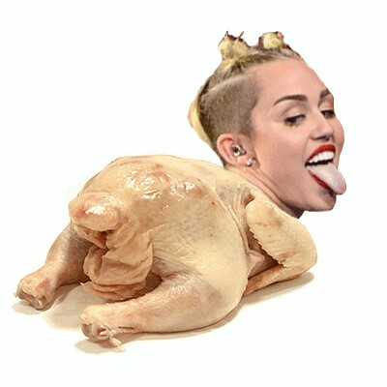
What about Turkeys?
Notes:
Seed: Turkey Generator: Single Image Giphy Context: {'topic': 'Turkey', 'presenter': 'Glenn G. Winsor', 'seed': 'Turkey', 'seed_is_noun_plural_title': 'Turkeys'} Generated Elements: ['What about Turkeys?', '/app/talkgenerator/schema/../../downloads/reddit/gifs+gif+gifextra+nonononoYES/4B6oSvj.jpg', True]

Slide 10
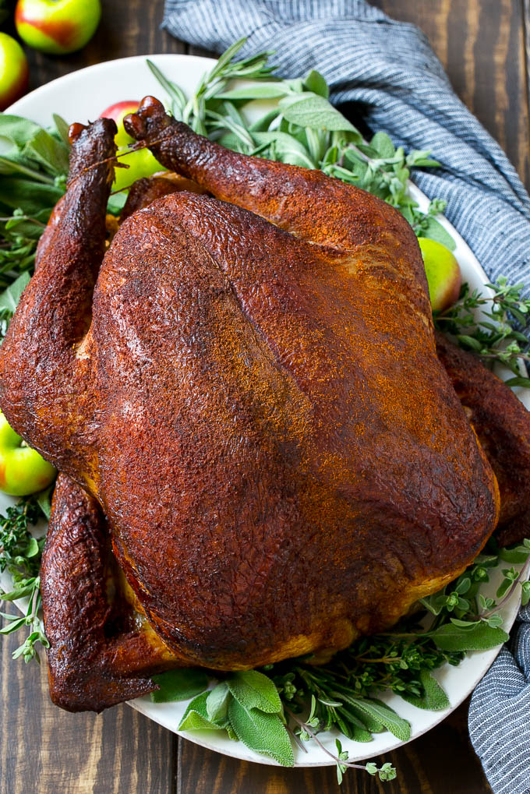
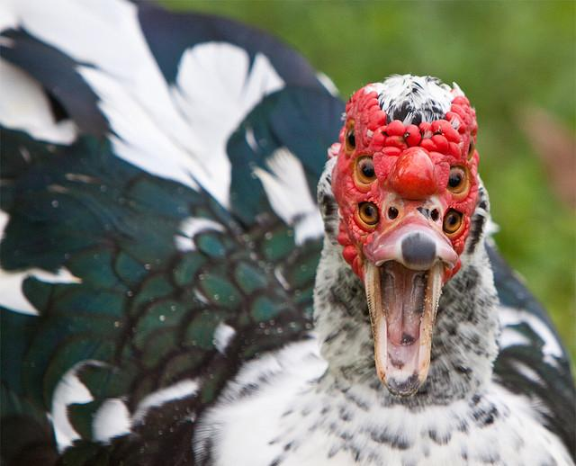
Conclusions
Conclusion 1
Conclusion 2
Notes:
Seed: Turkey Generator: Conclusion Context: {'topic': 'Turkey', 'presenter': 'Glenn G. Winsor', 'seed': 'Turkey'} Generated Elements: ['Conclusions', 'Conclusion 1', '/downloads/google_images/Turkey/smoked-turkey-4.jpg', 'Conclusion 2', '/app/talkgenerator/schema/../../downloads/reddit/hmmm+hmm+wtf+wtfstockphotos+photoshopbattles+confusing_perspective+cursedimages+HybridAnimals+EyeBleach+natureismetal/KGzE1lx.jpg?1', True]

