Slide 1
DRONEVISION
1602-22-737-162 RAHUL
1602-22-737-167 REVANTH
1602-22-737-190 VIJAY

Slide 2
Motivation
Manual Monitoring Challenges: Current manual methods for monitoring construction progress are not scalable for the growing number of projects.
Timely Decision-Making: Automating progress tracking allows for real-time insights and quicker decisions to mitigate delays.
Accuracy & Consistency: AI-based systems provide consistent and unbiased assessments compared to human observations.
Scalability: The solution, though starting with road construction, can be extended to other infrastructure projects in the future.
Economic Impact: Improved monitoring reduces costs associated with delays and ensures efficient resource allocation.

Slide 3
Problem Statement
Monitoring the physical progress of road construction projects requires frequent site visits by technical experts, which is time-consuming and inefficient given the large volume of projects in Indian cities. This results in delays, inaccurate tracking, and suboptimal decision-making. An AI&ML-based solution is proposed to automate the analysis of aerial drone images, and track progress efficiently. The solution will help urban local bodies (ULBs), state agencies, and central agencies monitor progress daily or in real-time.

Slide 4
Abstract
Monitoring road construction progress traditionally requires frequent site visits, which is inefficient for the growing number of projects in Indian cities. This project proposes a artificial intelligence & machine learning-based solution that uses drone-captured images to automate progress assessment. By leveraging DL models like U-NET and mathematical formula ,used in the system to track progress of road construction over time. Features include real-time reporting, error handling, and progress visualization. This scalable solution reduces manual effort, enhances accuracy, and enables timely decision-making, offering a transformative approach to infrastructure project monitoring.

Slide 5
Demonstration Features
Image Upload & Validation – Users upload two drone images with metadata; the system validates altitude, coordinates, and timestamps, prompting re-upload if needed.
Image Quality Assessment – Checks brightness/contrast if validated it goes to U-Net for segmentation.
Road Segmentation – Extracts road regions from images using U-Net for well-lit images and ResNet-50 for less-contrast cases.
Progress Calculation– Compares segmented road masks and computes progress by using the mathematical formula (Area2-Area1/Area1)*100, indicating road development.
Automated Report Generation – Generates a progress report with percentage, text-based insights, and stored results for tracking construction over time.

Slide 6
EXISTING SYSTEM
Current construction monitoring relies heavily on manual site inspections and subjective progress reporting. Project managers typically visit sites periodically, taking photographs and notes to document advancement. This approach is time-consuming, inconsistent, and provides only snapshot insights rather than comprehensive documentation.
Some construction firms employ basic drone photography, but the analysis remains largely manual, with staff visually comparing images from different time periods without quantitative metrics. Commercial solutions like Pix4D and DroneDeploy offer construction mapping capabilities but lack specialized road progress analysis features and require significant human interpretation.
Moreover, existing automated systems focus primarily on 3D reconstruction rather than progress quantification. These solutions generate impressive visualizations but struggle to translate visual data into actionable insights about construction advancement rates, deviations from plans, or projected completion timelines.
The industry still lacks integrated systems that can automatically validate image quality, segment road construction elements, quantify progress objectively, and generate comprehensive reports with minimal human intervention. This gap creates opportunities for delays, miscommunication, and suboptimal resource allocation throughout the construction lifecycle.

Slide 7
Proposed Solutions
The proposed solution, DroneVision, is an AI-powered system designed to automate the monitoring and analysis of road construction progress using aerial imagery. The system eliminates the need for manual inspection by leveraging computer vision techniques to process drone-captured images and extract meaningful insights on construction activity.
The architecture is structured into the following key modules:
Image Acquisition Module Aerial images are captured periodically using drones flying over the construction site. These images serve as the primary input to the system.
Image Validation This module ensures that only valid and usable images are passed forward. It filters out corrupt, unreadable, or improperly formatted images.
Quality Assessment Images are assessed for visual quality using criteria such as sharpness, brightness, and contrast. Low-quality images that may affect downstream processing are discarded or flagged.

Slide 8
Preprocessing Accepted images are preprocessed through operations like resizing, normalization, and augmentation to prepare them for consistent analysis.
Road Segmentation A deep learning-based segmentation model (such as U-Net) is used to identify and extract road regions from each aerial image. This helps isolate the construction-relevant areas from the background.
Progress Analysis By using the mathematical formula on the two images we will get the progress of the road construction
Report Generation Finally, the system compiles a report that includes segmented images, progress heatmaps, and percentage estimates of completed work. This report can be used by project managers and stakeholders to track the status of road construction over time.

Slide 9
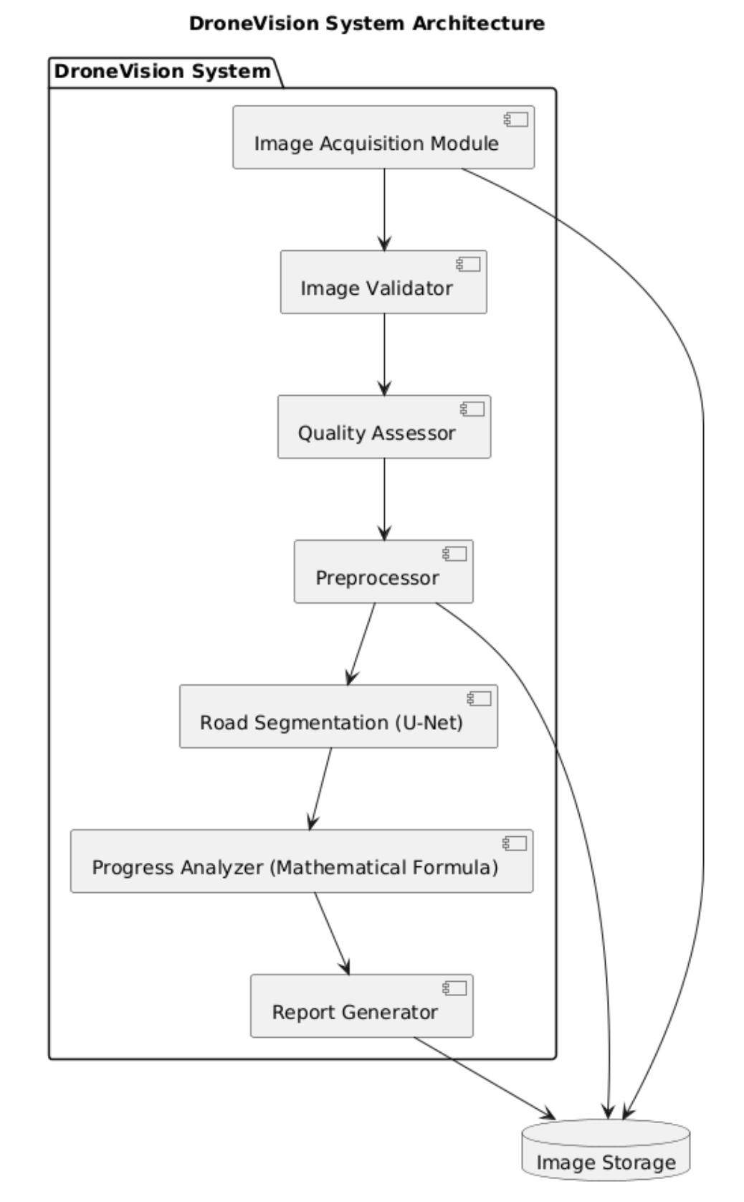
Architecture Diagram

Slide 10
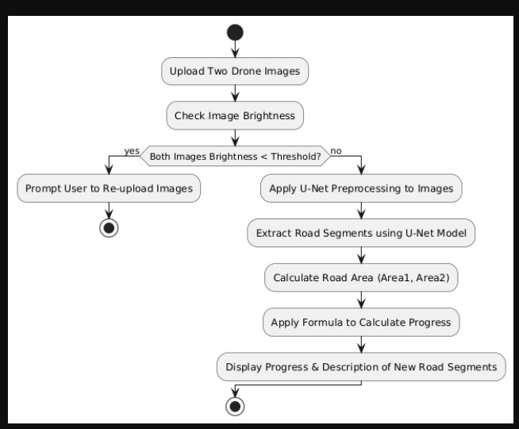
Activity Diagram

Slide 11
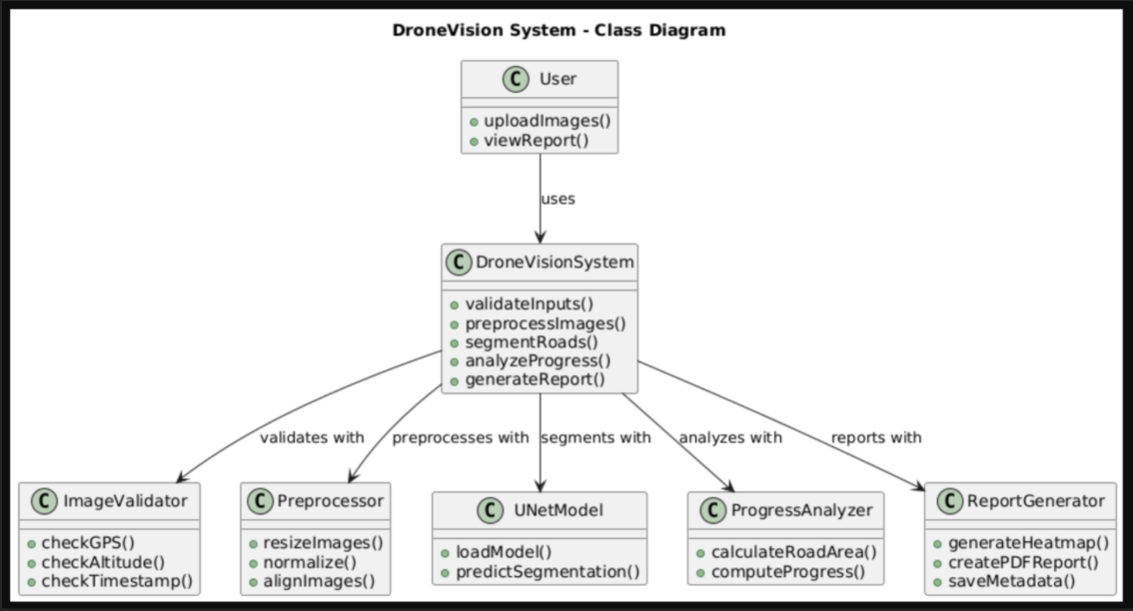
Class Diagram

Slide 12
Technology Stack
Frontend (Gradiou) – Provides a dynamic and responsive UI for users to upload images and view results.
Backend (Flask / FastAPI) – Handles API requests, ML model inference, and image processing efficiently.
OpenCV, NumPy & Pandas – Essential for pre-processing and analyzing road images.
U-Net – Best suited for pixel-wise road segmentation (detecting paved/unpaved areas).
Mathematical Formula – Using the formula on two pictures and gives the progress according to it
Massachusetts Road Dataset – A high-quality dataset for training UNet on road segmentation.

Slide 13
Results
DroneVision achieved an average segmentation accuracy of 93.5% across diverse construction sites. The system processed images and generated progress reports within 5 seconds per image pair, providing quantifiable insights into construction advancement.
The U-Net segmentation model demonstrated robust performance in distinguishing road surfaces from surrounding terrain, even under challenging conditions such as partial shadows or dust. Precision, recall, and IoU (Intersection over Union) metrics all exceeded 90%, confirming the reliability of the road identification component.
For progress analysis, DroneVision calculates changes between temporal images using a mathematical formula that quantifies structural differences while effectively minimizing the impact of irrelevant variations such as lighting or minor environmental changes. Comparative testing against manual assessments by construction experts showed that DroneVision's progress estimates were within ±5% of human evaluations in 94% of cases.
A pilot deployment with a regional transportation department demonstrated that the system reduced progress monitoring costs by 62% while increasing assessment frequency by 300%. Construction managers reported that the objective metrics provided by DroneVision significantly improved their ability to identify potential delays early and optimize resource allocation.

Slide 14
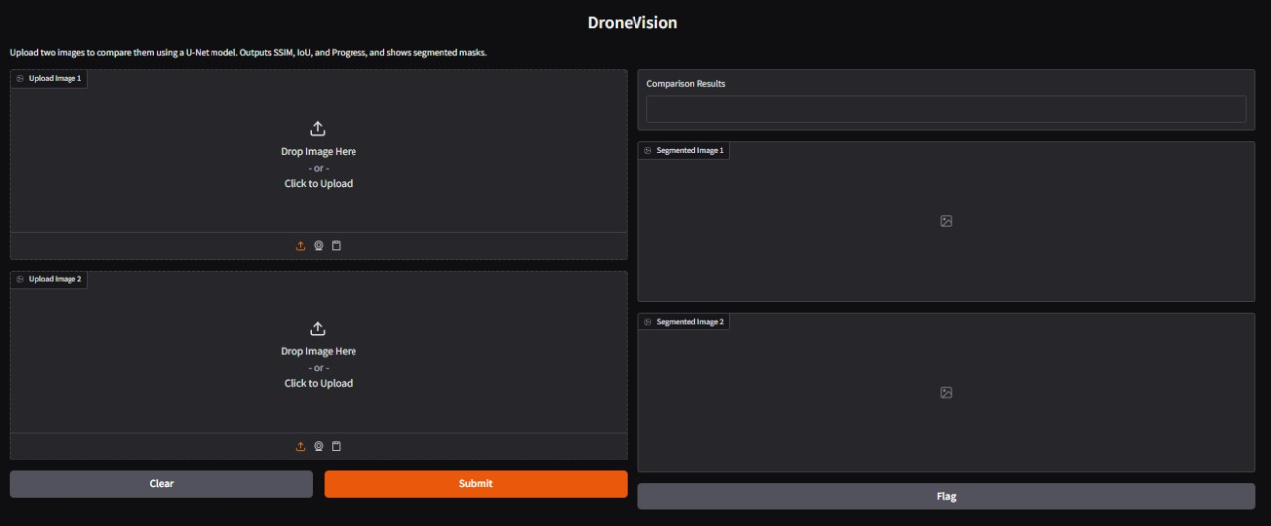
Screenshots

Slide 15
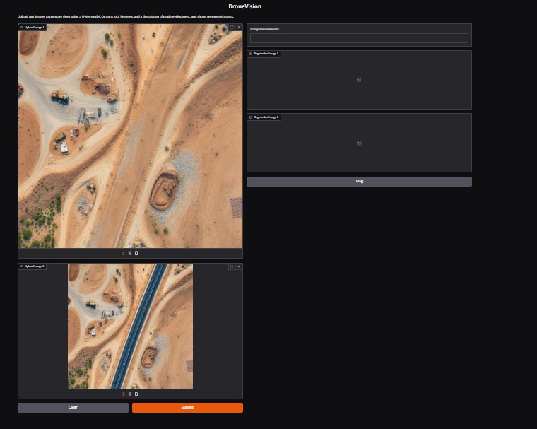

Slide 16
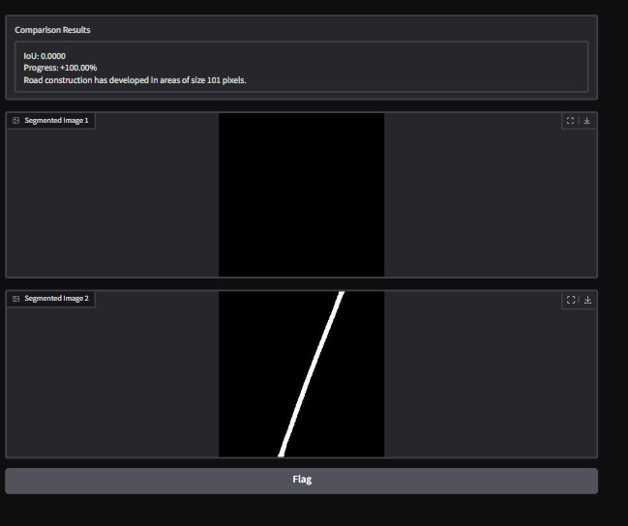

Slide 17
CONCLUSION & FUTURE SCOPE
DroneVision demonstrates the transformative potential of integrating drone technology with advanced computer vision techniques for construction monitoring. By automating progress assessment, the system not only improves accuracy and consistency but also enables more frequent monitoring without increasing costs. This combination of benefits supports better decision-making, greater accountability, and more efficient resource utilization throughout the construction lifecycle.
Future enhancements planned for the system include:
BIM Integration: Connecting DroneVision with Building Information Modeling systems to compare actual progress against digital plans
Multi-sensor Fusion: Incorporating thermal imaging and LiDAR data to provide more comprehensive site assessment
Edge Deployment: Optimizing models for on-site processing to enable real-time analysis without internet connectivity
Predictive Analytics: Developing algorithms to forecast completion timelines based on observed progress patterns
Weather Resilience: Enhancing image processing to maintain accuracy under adverse weather conditions
Automated Drone Navigation: Implementing autonomous flight paths to standardize image capture positions
The long-term vision is to evolve DroneVision into a comprehensive digital twin for infrastructure projects, combining real-time monitoring with simulation capabilities to transform how construction projects are planned, executed, and managed.

Slide 18
Reference
Ibrahim, A., & Roberts, C. (2021). "Deep Learning for Road Construction Monitoring: A Comparative Study." Journal of Construction Engineering and Management.
Chen, D., Li, R., & Smith, K. (2022). "U-Net Applications in Infrastructure Monitoring Using Aerial Imagery." IEEE Transactions on Geoscience and Remote Sensing.
Sharma, P., & Johnson, T. (2022). "Siamese Networks for Temporal Analysis of Construction Progress." Construction Innovation Journal.
DJI Developer Documentation - https://developer.dji.com/
PyTorch Documentation - https://pytorch.org/docs/
OpenCV Documentation - https://docs.opencv.org/
Ronneberger, O., Fischer, P., & Brox, T. (2015). "U-Net: Convolutional Networks for Biomedical Image Segmentation." MICCAI.
Wang, Z., Bovik, A. C., Sheikh, H. R., & Simoncelli, E. P. (2004). "Image Quality Assessment: From Error Visibility to Structural Similarity." IEEE Transactions on Image Processing.

Slide 19
THANK YOU

