Slide 1
K-Nearest Neighbors
KNN (ML Algorithm) by Shantanu Shubham

Slide 2
Topics
Introduction and Geometric Intuition
Working with a real world dataset
Advanced topics related to KNN

Slide 3
Assumptions
KNN assumes data is in metric space and there is a notion of distance
Each of the training data consists of a label data associated with it, wither + or -. Although KNN also supports multiclass classification.
We are also given a single number k. This number decides how many neighbors influence the classification. This is usually an odd number.

Slide 4
Geometric Inutuition
S.No. | Age | Salary (in Thousands) | Purchased
1 | 25 | 20 | N
2 | 63 | 120 | Y
3 | 33 | 75 | N
4 | 42 | 100 | Y
… | … | … | …

Slide 5
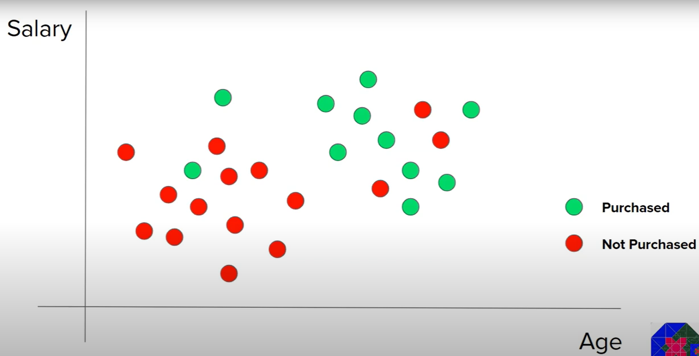

$$d= \sqrt{{(x_{2} − x_{1})}^{2}+{(y_{2} − y_{1})}^{2}}$$

Slide 6
Points to consider
Although in this example we are talking about a 2D example but the concept holds true for higher dimensions as well.
In this example we have taken the Euclidian distances into consideration but other distances are used as well like Manhattan distance or Minkowski distance.
KNN is suitable for low noise data.
KNN is a lazy learner.
KNN is a good algorithm for making a Recommender System.
KNN is used alongside NLP in Document Retrieval System.
KNN is used in Gene Expression.

Slide 7

How to find K?
Method 1: K = $\sqrt{(No of data rows in the training set)}$
Method 2: Trial and Error

