Slide 1
Marketing Performance Dashboard
Data Analytics Capstone Project
Prepared by: Samarpan Pandit
SkillOrbit-2026
Marketing Performance Dashboard | 1/10

Slide 2
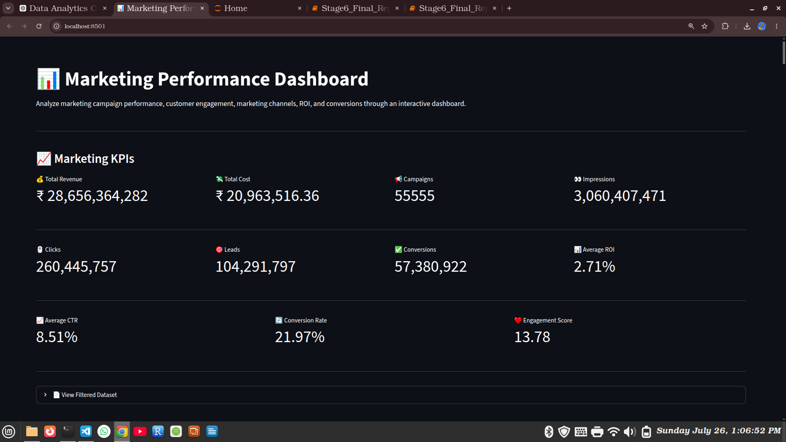
Project Overview
• Analyze campaign performance
• KPI tracking
• Interactive dashboard
• Data-driven insights
Marketing Performance Dashboard | 2/10

Slide 3
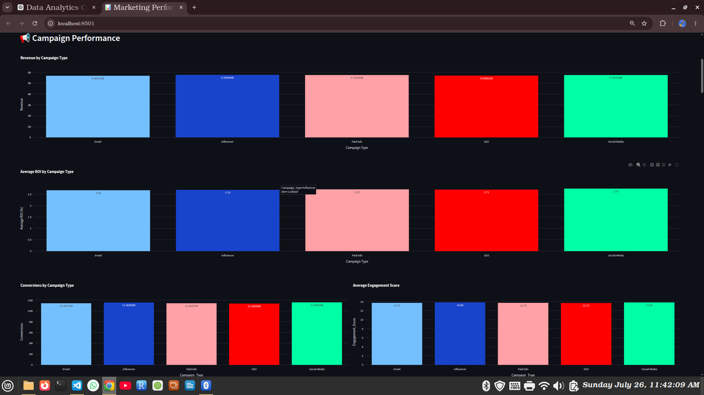
Campaign Performance
• Revenue by campaign
• ROI comparison
• Engagement
• Conversions
Marketing Performance Dashboard | 3/10

Slide 4
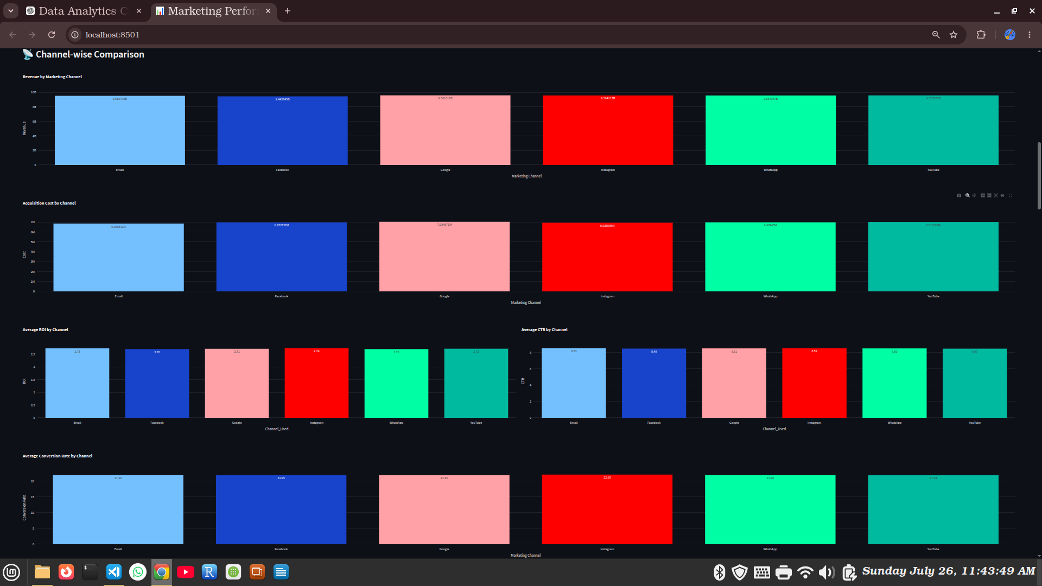
Channel-wise Comparison
• Revenue by channel
• Cost, ROI, CTR
• Conversion Rate
Marketing Performance Dashboard | 4/10

Slide 5
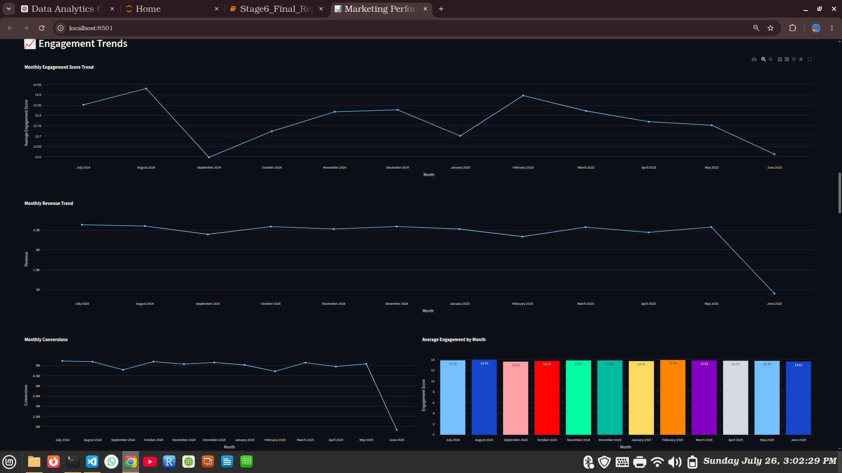
Engagement Trends
• Monthly engagement
• Revenue trend
• Conversion trend
Marketing Performance Dashboard | 5/10

Slide 6
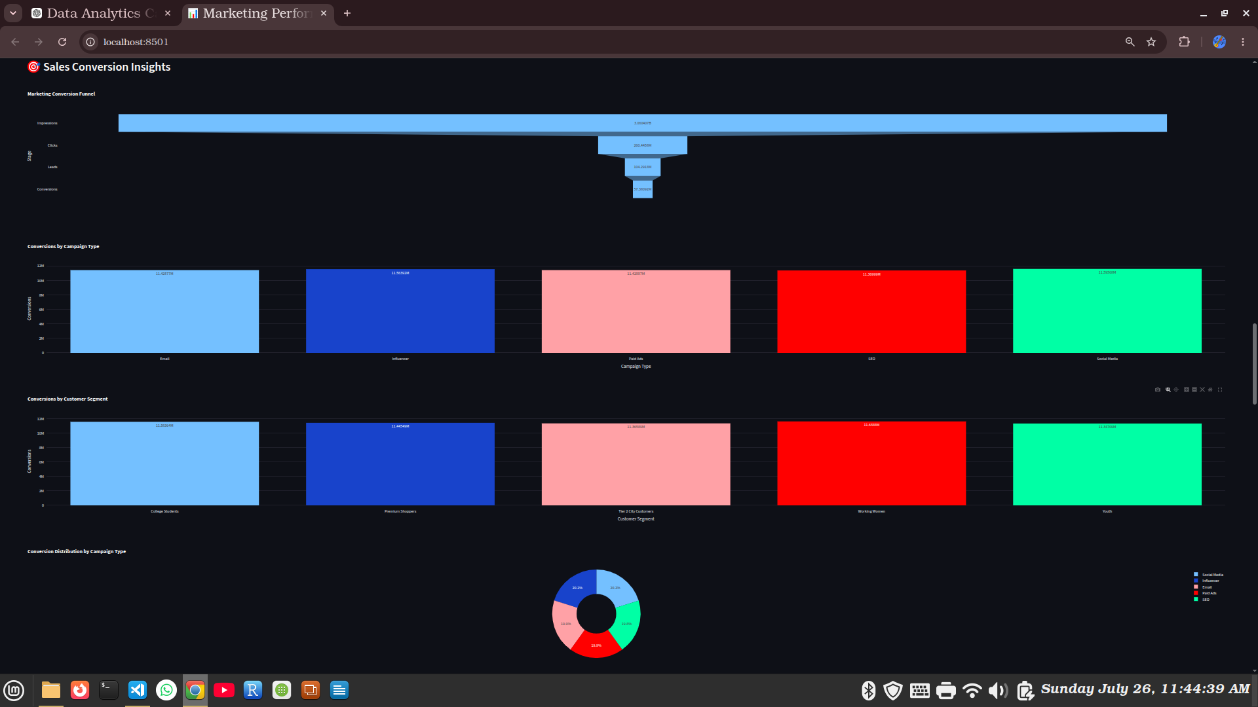
Sales Conversion Insights
• Marketing funnel
• Campaign conversions
• Customer conversions
Marketing Performance Dashboard | 6/10

Slide 7
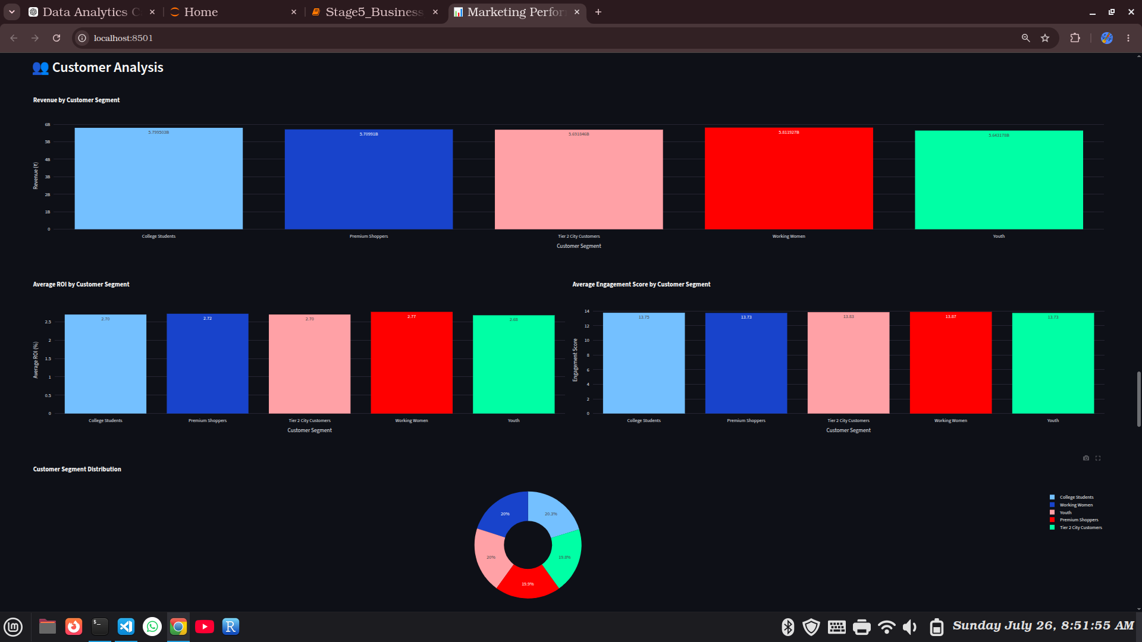
Customer Analysis
• Customer segments
• Revenue & ROI
• Engagement
Marketing Performance Dashboard | 7/10

Slide 8
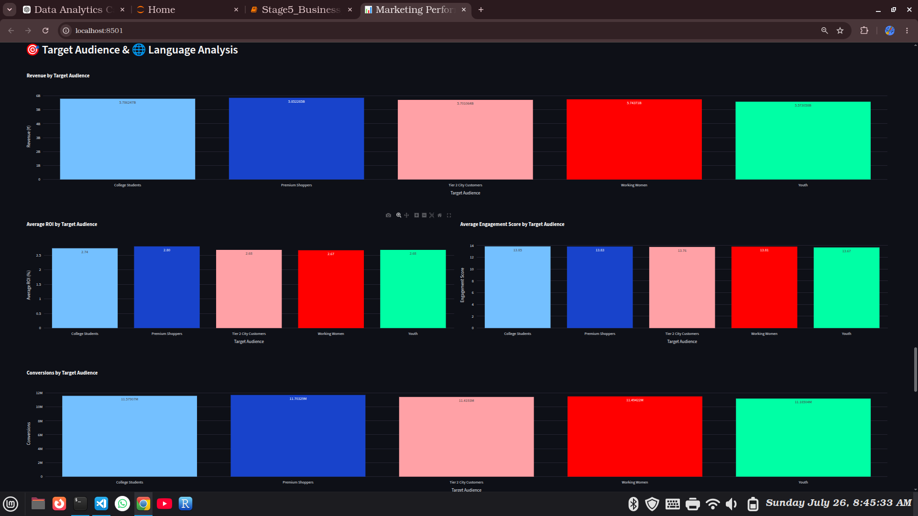
Target Audience & Language
• Target audience
• Language performance
Marketing Performance Dashboard | 8/10

Slide 9
Deployment & Technologies
Live App:
https://marketing-performance-dashboard.streamlit.app/
GitHub Link:
https://github.com/Samarpan-Pandit/Marketing-Performance-Dashboard
Technologies:
Python, Pandas, Plotly, Streamlit, GitHub
Marketing Performance Dashboard | 9/10

Slide 10
Conclusion
• Dashboard successfully developed
• Interactive analytics
• Business insights generated
Thank You!
Marketing Performance Dashboard | 10/10

