Slide 1
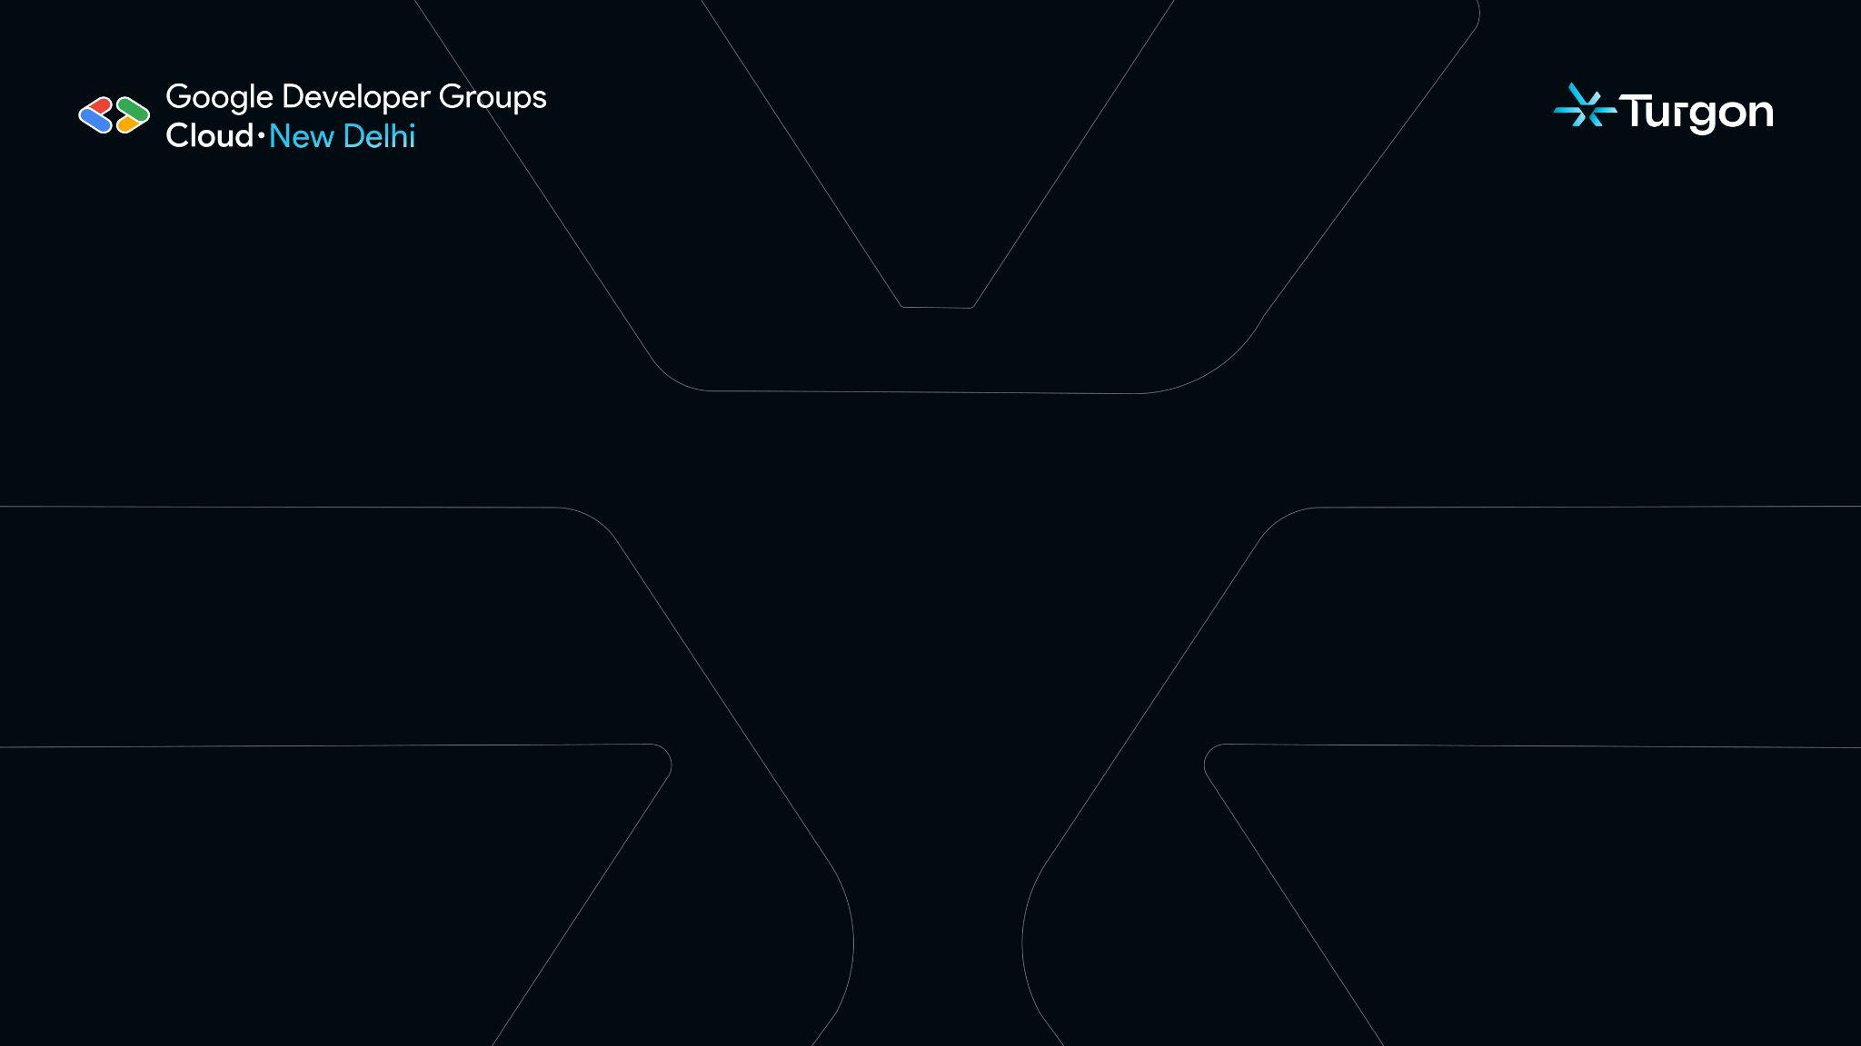

ORION
Round I
IDEA SUBMISSION

Slide 2
Team Details:
S no. | Team Member Name | Team Member Role | Team Member Mail ID
1. | Aashi Agarwal | Frontend Developer | mail.aashiagr@gmail.in
2. | Samarpita Das | Backend Developer | samarpitabdas@gmail.com
3. |  | ML Engineer | ujjawalbisht@gmail.coujjawalbisht@gmail.comm
Ujjawal Bisht
ujjawalbisht@gmail.com

Slide 3
Track Chosen:
Track Chosen: Business Requirements Document (BRD) Generation Agent
Problem Description:
Teams waste days gathering requirements from fragmented communications across Gmail, Slack, and documents. Critical details get lost, conflicts go undetected, and traceability is nearly impossible.

Slide 4
Proposed Solution :
Our platform handles the entire BRD lifecycle with six core capabilities powered by transformer models and intelligent algorithms.
Multi-Source Integration Connect Gmail, Slack, and upload documents with full OAuth2 security | Intelligent Noise Filtering BERT-based classification removes irrelevant content automatically | Smart Requirement Extraction Transformer models categorize and structure requirements with confidence scoring
Structured BRD Generation BART and T5 models create comprehensive documents with all standard sections | Conflict Detection Semantic similarity analysis identifies contradictions and incompatibilities | Natural Language Editing T5-powered interface lets users refine documents conversationally

Slide 5
Technical Architecture
Intelligent Processing Layer | Backend | Frontend
Noise Filtering (DistilBERT + Hybrid Scoring): 60% keyword + 40% semantic analysis removes low-relevance content (<0.4 threshold). Zero-Shot Classification (BART-large-MNLI): Automatically categorizes requirements without training data. Conflict Detection Engine: Embedding-based similarity (>0.7) detects contradictions and priority/resource conflicts with efficient pairwise comparison (O(n log n)). | Django REST API (Modular 3-Layer Design) ML Layer: RequirementExtractor, BRDGenerator, ConflictDetector (cached model loading) Integrations Layer: Gmail OAuth2 & Slack Bot authentication with rate limiting Data Layer: SQLite (dev), PostgreSQL (prod) with full audit logging | PyQt5 Desktop App Project management, data configuration, requirement review, BRD generation, and real-time conflict analysis.

