Slide 1

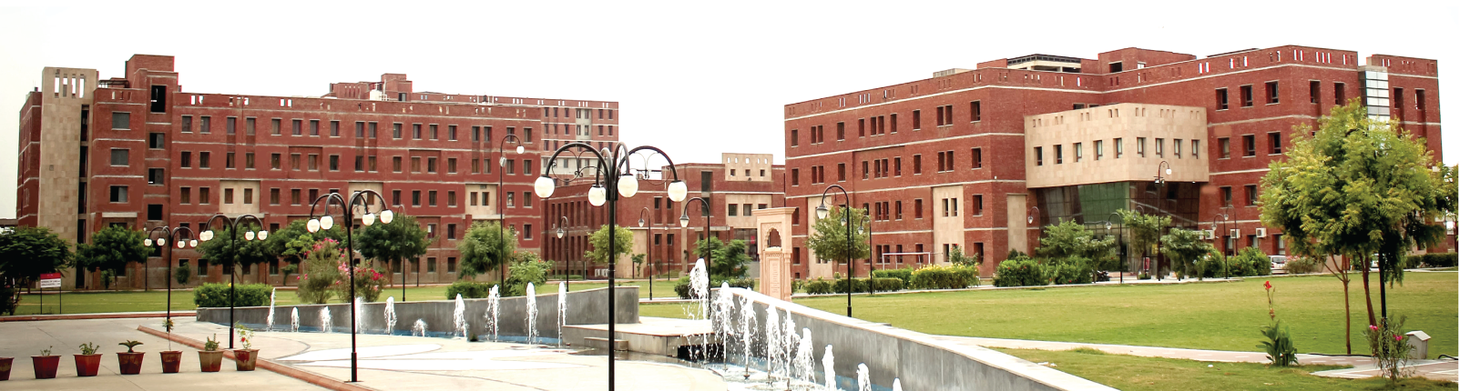
DEPARTMENT OF
Computer Science and Engineering
Major Project Presentation
On
MEDISUTRA: A Unified Longitudinal Personal Health Intelligence & Federated Clinical Copilot Platform
Presented By:-
Samarth (Lead Developer)
Roll No: [Enrollment No]
Guide:-
[Faculty Guide Name]
Assistant Professor
2025-2026

Slide 2
Contents
Introduction & Problem Statement (Background, motivation, and the core problem being addressed)
Literature Review (if any) or System Design (Block diagrams, flowcharts, SRS, UML Diagrams, DFD, ER Diagrams etc. )
Methodology (Approach, architecture, algorithms or processes used)
Tools and Technology Used (Hardware components, software, programming languages, frameworks, libraries)
Roles and Responsibilities of each Member
Implementation (Step-by-step development, modules built, code snippets etc.)
Results (Screenshots, graphs, test data, observations, and performance metrics etc.)
Conclusion & Future Scope (Summary of achievements, limitations, and possible future enhancements)
References (Books, research papers, websites cited in IEEE or APA format)

Slide 3
BCO 519A — MAJOR PROJECT DEFENSE
Introduction & Clinical Problem Statement
THE FRAGMENTATION CRISIS
Paper Record Silos: Patients carry physical plastic files across multi-hospital visits; documents are routinely misplaced or damaged.
Redundant Diagnostic Tests: Inaccessible historical lab results force doctors to repeat expensive tests (HbA1c, CT scans), wasting resources.
Clinical Blindspots: Attending physicians lack visibility into past hospitalizations, adverse drug reactions, and baseline readings.
Conflation of Acute & Chronic: Cured illnesses (Dengue, Bronchitis) are mixed with active conditions (Diabetes, Hypertension).
MEDISUTRA PLATFORM SOLUTION
Unified Health Identity: Anchored to the 14-digit ABHA/ABDM identifier, unifying multi-hospital encounters into one health journey.
Federated Hospital Network: Interoperable clinical graph connecting Apollo, Fortis, Max, AIIMS, Dr. Lal PathLabs, and Metropolis.
Disease Lifecycle State Machine: Explicit clinical separation of active chronic conditions from certified cured historical illnesses.
Deterministic Clinical AI: Zero-hallucination decision support copilot calculating lab trajectories with 1-click consultation note insertion.

Slide 4
BCO 519A — MAJOR PROJECT DEFENSE
Project Objectives & Course Outcome Attainment
CO1: Problem Formulation
Formulate a condition-centric longitudinal computing model to resolve Indian healthcare data fragmentation.
CO2: System Design & Tooling
Architect an enterprise 4-tier web platform using React 19, TypeScript, Express.js, and relational database ER modeling.
CO3: Implementation & Testing
Develop modular micro-services and reactive workstations with 0 compiler/lint errors and E2E test verification.
CO4: Ethics & Project Mgmt
Enforce Zero-Trust security and data sovereignty adhering to India's DPDPA 2023 and agile GitHub version control.
CO5: Technical Defense
Deliver comprehensive architectural specs, live system demonstrations, visual recordings, and thesis defense.

Slide 5
BCO 519A — MAJOR PROJECT DEFENSE
Literature Review & Research Gap Analysis
EXISTING HEALTHCARE PLATFORMS
Epic MyChart / Cerner: Proprietary enterprise EHR walled gardens. Cross-facility sharing requires vendor-specific exchange networks.
Apple Health: Patient-pulled mobile application. Displays raw lists without active vs. cured disease separation.
ABDM PHR Apps (Official): Enables consent-based document push but stores static PDFs without longitudinal biomarker analytics.
Practo / 1mg: Commercial tele-health platforms limited to private clinics with basic customer FAQ bots.
IDENTIFIED RESEARCH GAPS
Gap 1 (The PDF Dump Problem): Doctors cannot read through dozens of raw PDF files during brief outpatient consultations. Records must be condition-centric.
Gap 2 (Lack of Cure Lifecycle): Current EHRs lack certified clinical workflows for stamping disease cure milestones with follow-up evidence.
Gap 3 (Clinical AI Hallucinations): Generative LLMs hallucinate medical facts and fail at temporal math. Healthcare demands deterministic, grounded decision support.
MediSutra Innovation: Bridges all three gaps through an integrated federated architecture.

Slide 6
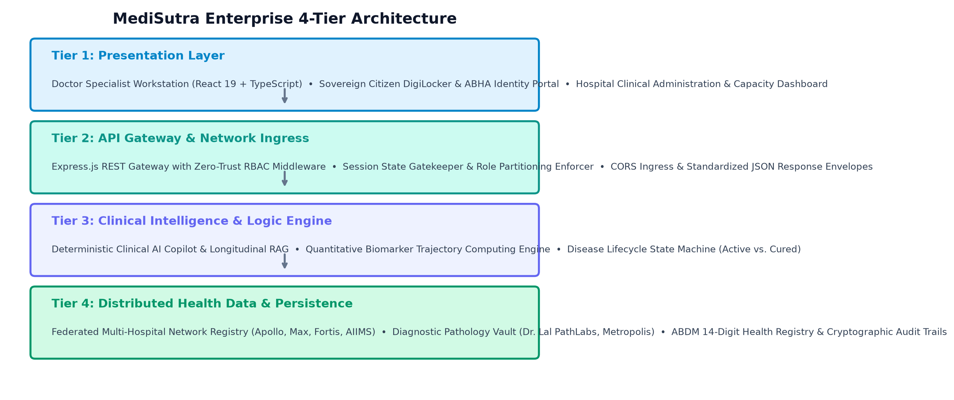
BCO 519A — MAJOR PROJECT DEFENSE
System Design: Enterprise 4-Tier Architecture
TIERED ARCHITECTURAL SPECIFICATION
Tier 1: Presentation Layer React 19 + TypeScript + Vite. Role-partitioned clinical workstations for Doctors, Hospital Admins, and Citizens.
Tier 2: API Gateway Layer Express.js REST gateway with Zero-Trust RBAC middleware, session persistence, and standardized JSON envelopes.
Tier 3: Clinical Intelligence Deterministic RAG pipeline, quantitative trajectory computing engine, and disease lifecycle state machine.
Tier 4: Persistence Layer Relational health models, 14-digit ABHA patient registry, and immutable audit logs.

Slide 7
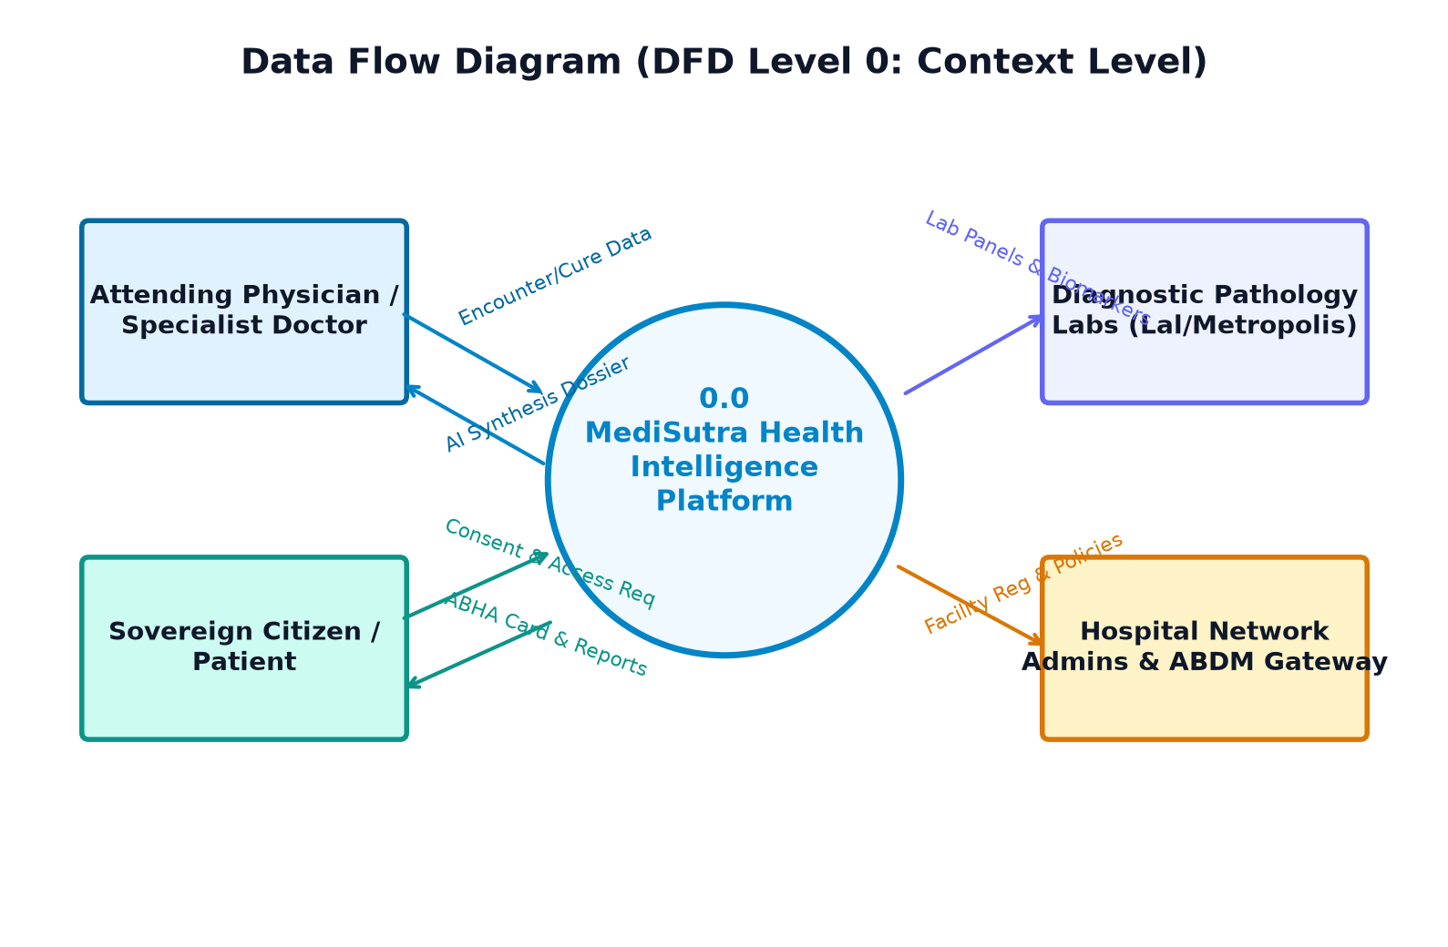
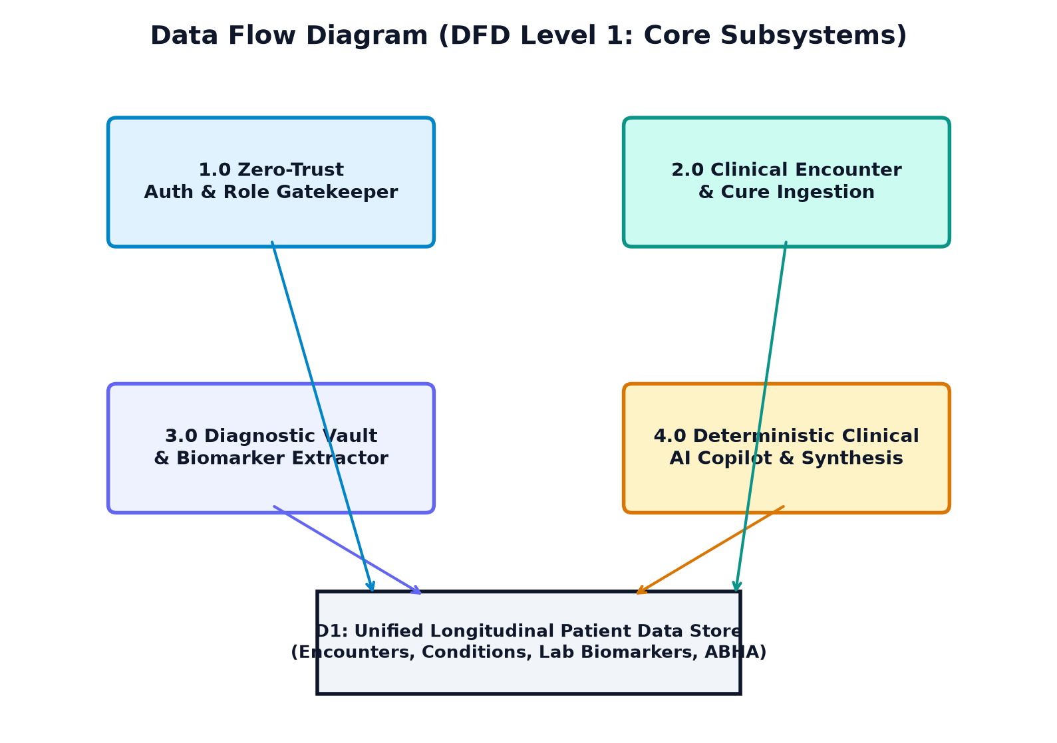
BCO 519A — MAJOR PROJECT DEFENSE
System Design: Data Flow Diagrams (DFD Level 0 & Level 1)
Figure 4.2: DFD Level 0 Context Level Diagram
Figure 4.3: DFD Level 1 Core Subsystems Decomposition

Slide 8
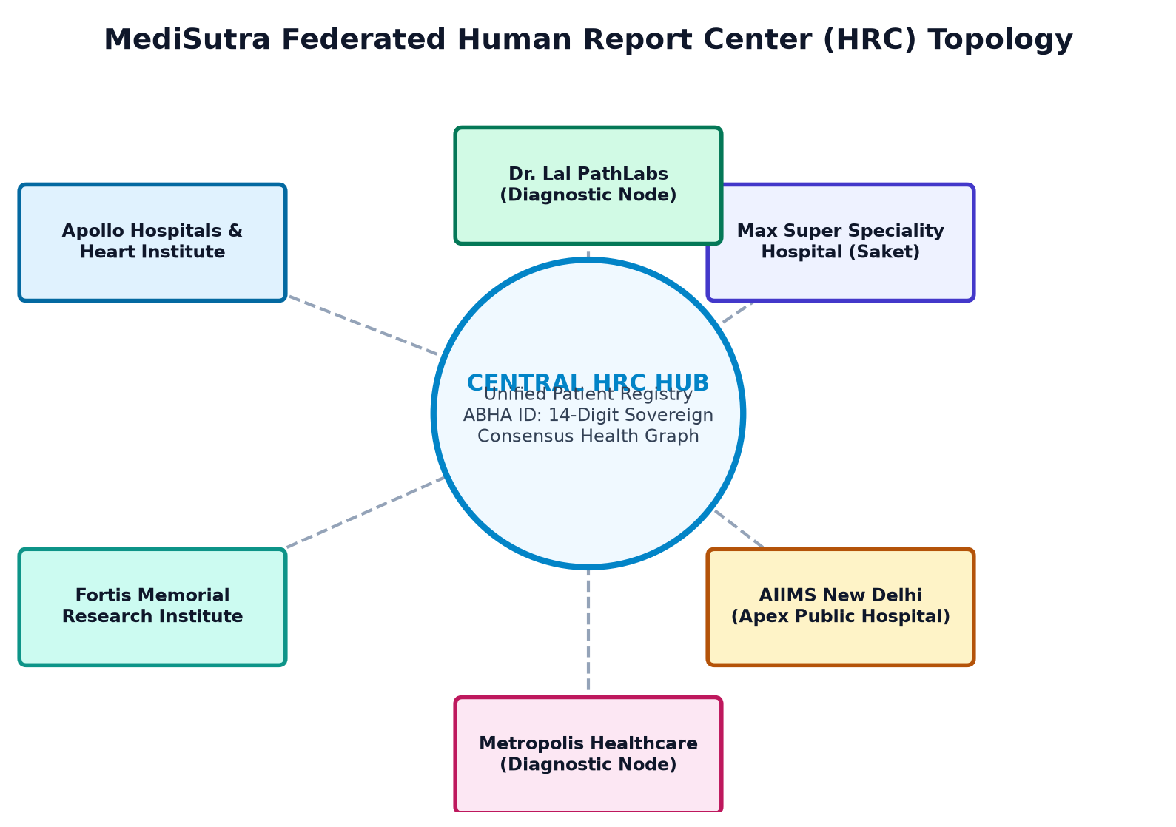
BCO 519A — MAJOR PROJECT DEFENSE
System Design: Federated Hospital Network (HRC Topology)
FEDERATED NETWORK TOPOLOGY
Central Registry Hub: Maintains unified patient identities anchored to the 14-digit ABHA number.
Hospital Nodes: Apollo Hospitals, Fortis Memorial, Max Super Speciality, AIIMS New Delhi operate authenticated clinical stations.
Diagnostic Nodes: Dr. Lal PathLabs and Metropolis Healthcare ingest laboratory test panels directly into the central vault.
Decentralized Continuity: Hospitals retain institutional autonomy while contributing standardized encounter data to the patient's sovereign health graph.

Slide 9
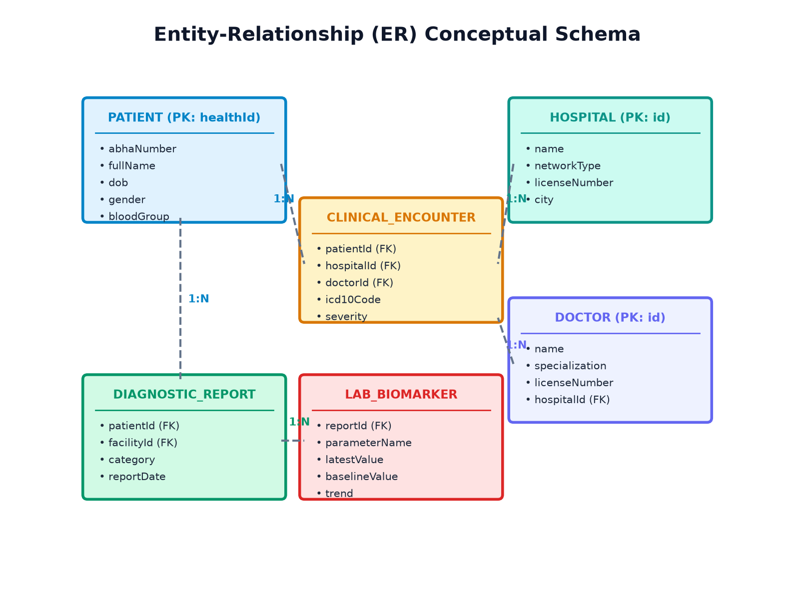
BCO 519A — MAJOR PROJECT DEFENSE
System Design: Conceptual Entity-Relationship (ER) Model
3NF RELATIONAL SCHEMA
Patients Entity: healthId (PK), abhaNumber (14-digit unique), demographic data, and primary facility.
Encounters Entity: Captures doctorId, hospitalId, ICD-10 diagnosis, clinical severity, and examination notes.
Conditions Entity: Maintains lifetime disease state (ACTIVE vs. RESOLVED), diagnosedDate, curedDate, and curedEvidence.
Reports & Biomarkers: Stores multi-year lab panels and quantitative analyte readings (HbA1c, Glucose, Vitamin D).

Slide 10
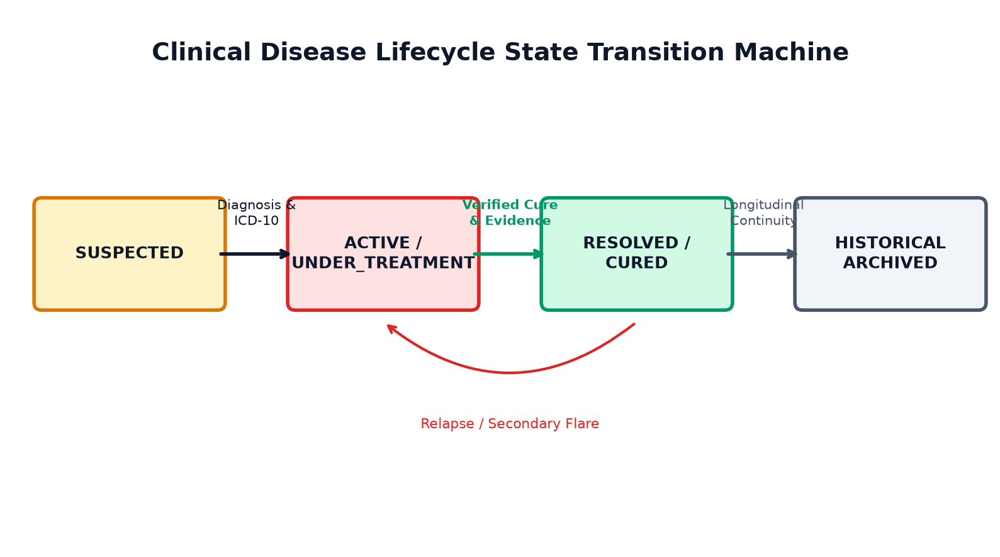
BCO 519A — MAJOR PROJECT DEFENSE
System Design: Disease Lifecycle State Transition Machine
EXPLICIT CLINICAL LIFECYCLE
Active Chronic State: Diseases requiring ongoing therapy (Type 2 Diabetes, Hypertension) remain tagged ACTIVE.
Cure Certification: Doctors certify illness resolution by submitting follow-up clinical examination notes and diagnostic evidence.
Longitudinal History: Cured illnesses (Dengue, Bronchitis) transition to RESOLVED and are archived into historical records with verified evidence.

Slide 11
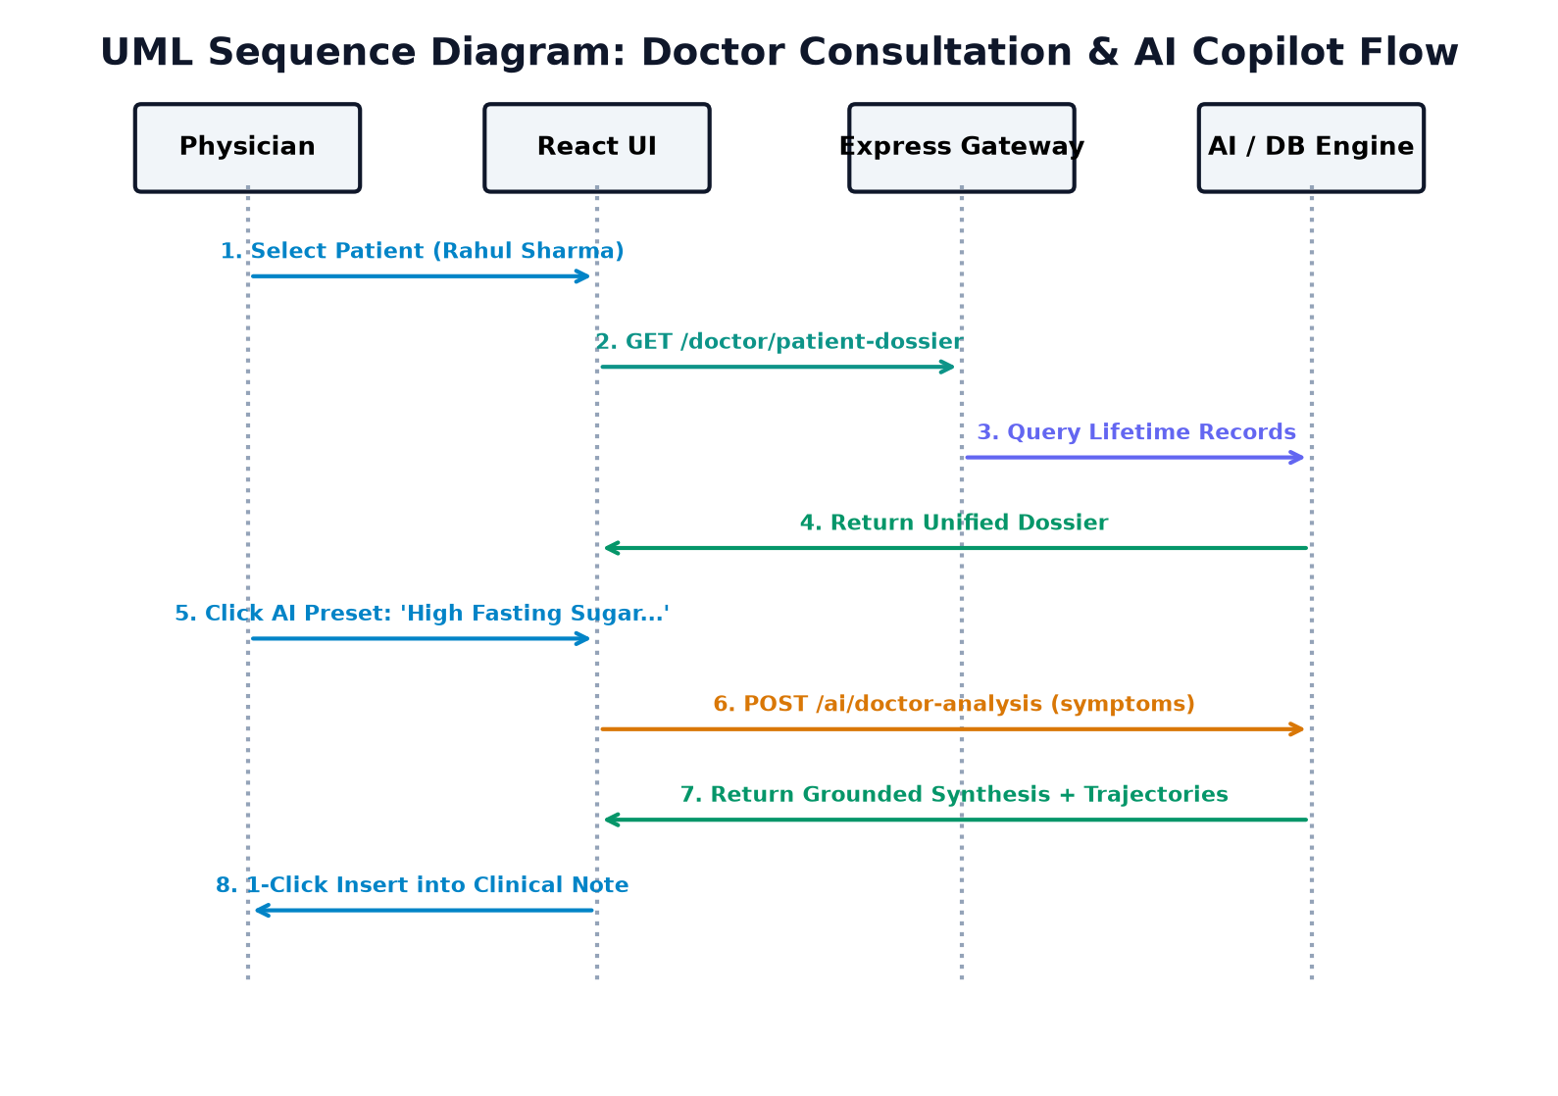
BCO 519A — MAJOR PROJECT DEFENSE
System Design: Clinical Consultation Workflow (UML Sequence)
INTERACTION FLOW
1. Patient Selection: Doctor selects patient from assigned roster.
2. Dossier Ingestion: Gateway queries multi-hospital data store and streams longitudinal record.
3. Copilot Query: Doctor clicks preset chip or types clinical symptoms.
4. Real-Time Synthesis: AI engine correlates symptoms, computes trajectories, and returns report.
5. Consultation Note Export: 1-click copy directly inserts structured intelligence into active note.

Slide 12
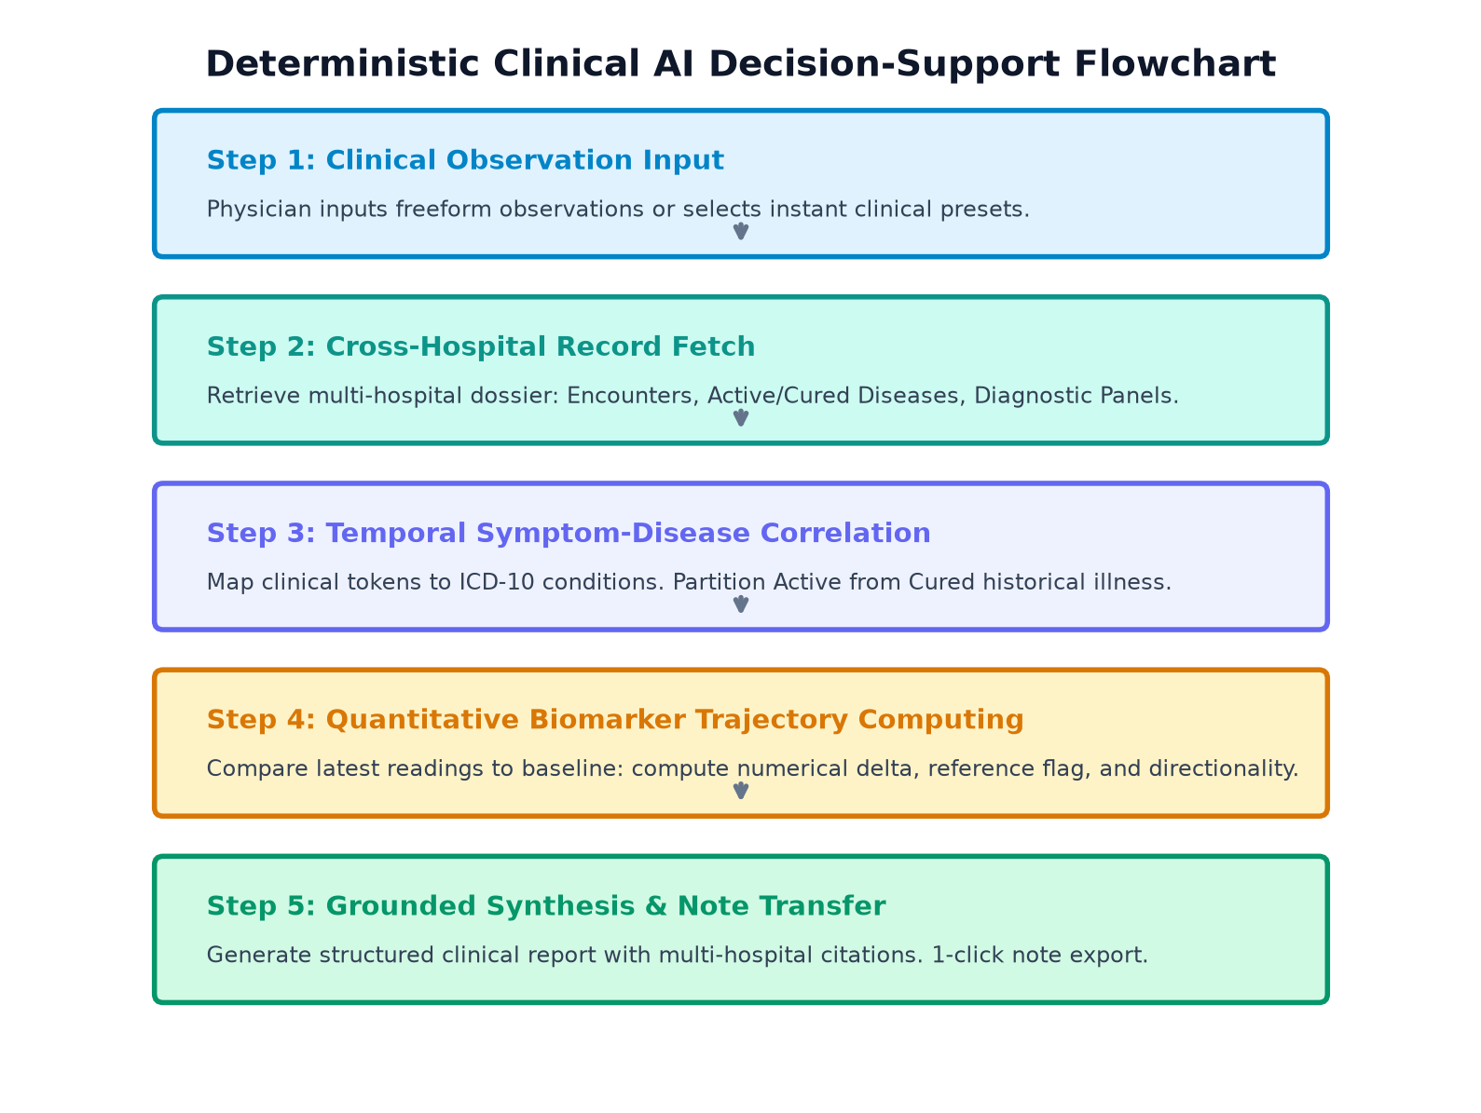
BCO 519A — MAJOR PROJECT DEFENSE
Methodology: Deterministic Clinical AI Decision Support
DETERMINISTIC RAG PIPELINE
1. Query Ingestion: Doctors input clinical observations or select instant preset chips.
2. Cross-Hospital Fetch: Queries patient's complete cross-hospital record across all connected facilities.
3. Symptom Correlation: Maps tokens to ICD-10 conditions, partitioning active from cured illnesses.
4. Trajectory Math: Calculates numerical deltas and directionality for biomarkers.
5. Grounded Note Export: Outputs clinical synthesis with multi-hospital citations and 1-click note copy.

Slide 13
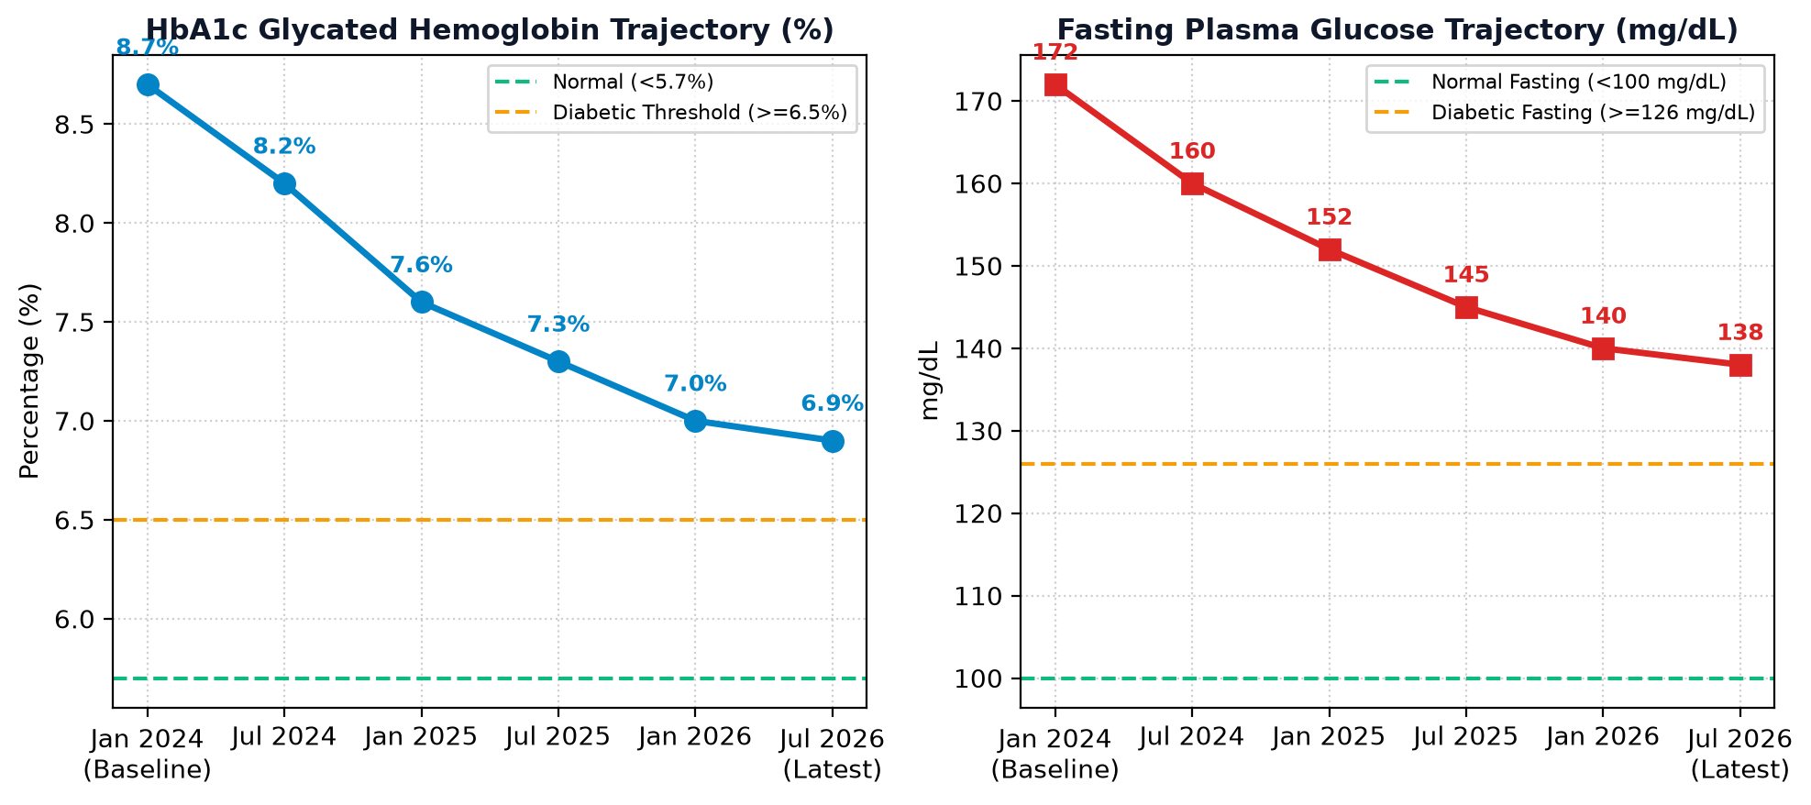
BCO 519A — MAJOR PROJECT DEFENSE
Methodology: Quantitative Lab Trajectory Computing Engine
MATHEMATICAL FORMULATION
Trajectory Differential: Δ = V_latest - V_baseline
% Change = (Δ / V_baseline) * 100
Directionality Rules: • Down: Improved / Therapeutic control
• Up: Elevated / Disease progression
• Stable: |% Change| < 3%
Metabolic Validation: HbA1c dropped from 8.7% (2024) to 6.9% (2026) -> Flagged 'Down (Improved)' on Metformin BID.

Slide 14
BCO 519A — MAJOR PROJECT DEFENSE
Tools and Technology Used
Frontend Technologies
React 19, TypeScript 5.8, Vite 8.3 build toolchain, custom CSS clinical design system with hardware-accelerated micro-animations.
Backend Technologies
Node.js 22 LTS, Express.js 4.x REST API gateway, Zero-Trust authentication middleware, CORS, modular domain routers.
Database & Persistence
Relational health schema normalized to 3NF, indexed queries on healthId, foreign keys, transaction safety.
Standards & Ontologies
HL7 FHIR R4 JSON schemas, WHO ICD-10 diagnostic codes, LOINC lab identifiers, ABDM 14-digit ABHA identity.
Quality & Testing Tools
Oxlint (high-performance linter, 0 errors), TypeScript compiler (tsc -b), Vitest, Git/GitHub version control.

Slide 15
BCO 519A — MAJOR PROJECT DEFENSE
Roles and Responsibilities of each Team Member
Samarth (Lead Developer / Project Coordinator)
• End-to-end full-stack software architecture and system design.
• Designed and engineered the Deterministic Clinical AI Copilot & Trajectory Engine.
• Built the luxury clinical UI design system, keyframe animations, and reactive state management.
• Backend REST API gateway development, Zero-Trust RBAC gatekeeper, and route security.
[Student Name 2] (Backend & Data Modeling)
• Relational database schema design (3NF), data dictionaries, and entity-relationship models.
• Diagnostic reports vault data modeling and biomarker parameter extraction.
• Integration of WHO ICD-10 diagnostic classifications and LOINC standard mappings.
• Automated unit testing and performance benchmarking.
[Student Name 3] (Frontend UI & Documentation)
• Sovereign Citizen DigiLocker, ABHA identity card presentation, and QR code generation.
• Hospital administrator capacity dashboard and multi-hospital registry views.
• Authored comprehensive architectural specifications, UML sequence models, and DFDs.
• Test case execution matrix, visual regression verification, and project thesis drafting.

Slide 16
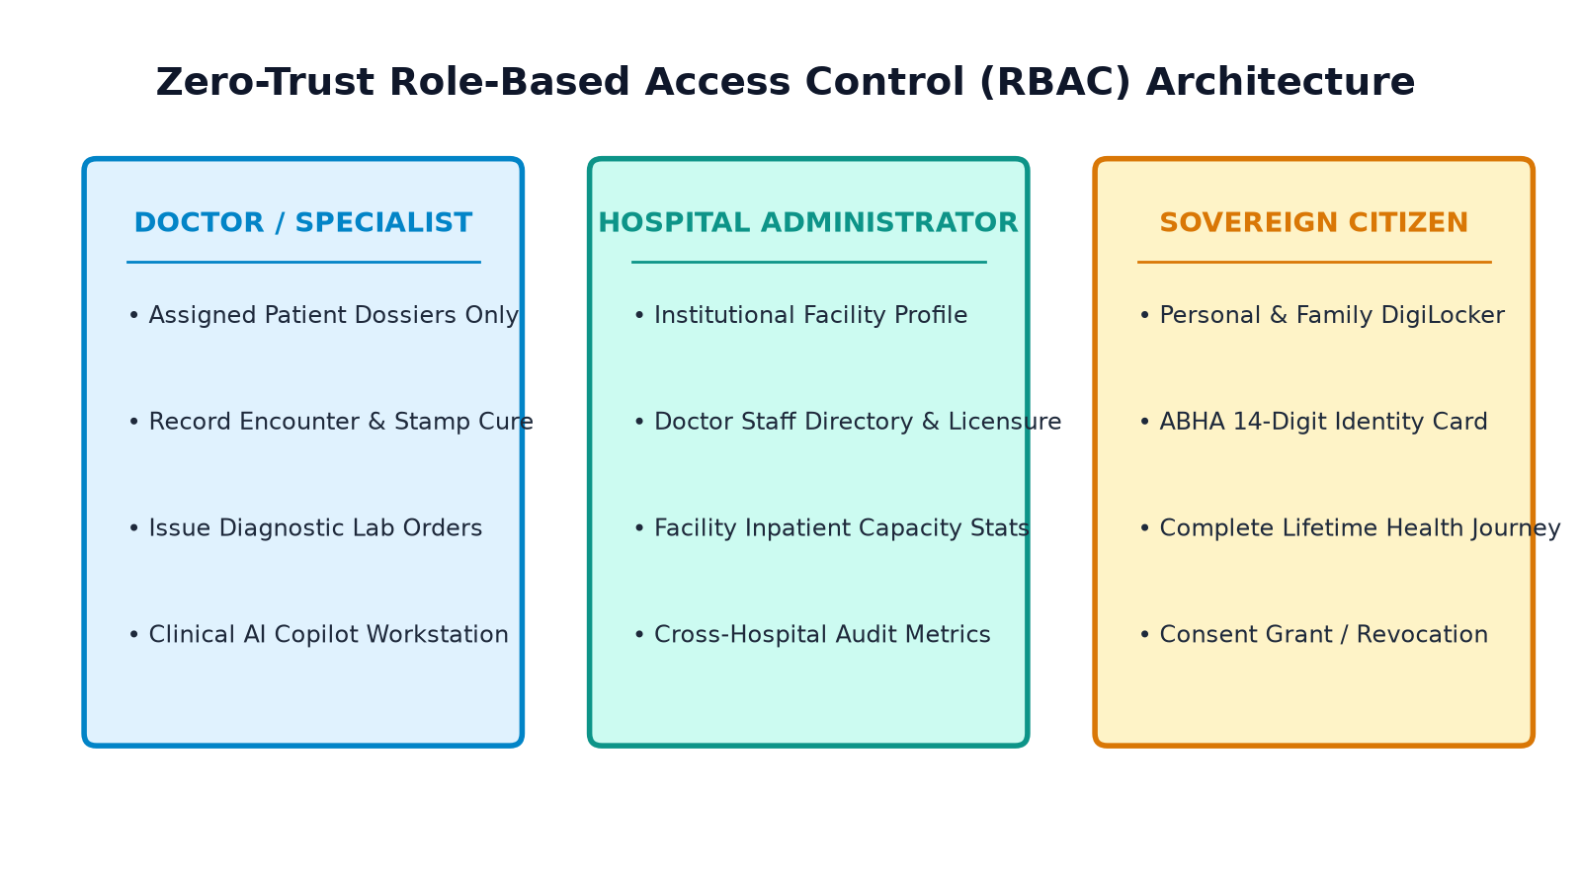
BCO 519A — MAJOR PROJECT DEFENSE
Implementation: Modular Backend Architecture & Zero-Trust Gatekeeper
CORE MODULE IMPLEMENTATION
authRouter.ts: Role validation, credential verification, and session state persistence.
doctorRouter.ts: Patient roster, clinical examination entries, and disease cure certification.
aiRouter.ts: Deterministic Clinical AI Copilot and report analysis engine.
hospitalRouter.ts: Hospital network registry and facility operational dashboards.
patientRouter.ts: Citizen DigiLocker data and ABHA card generation.

Slide 17
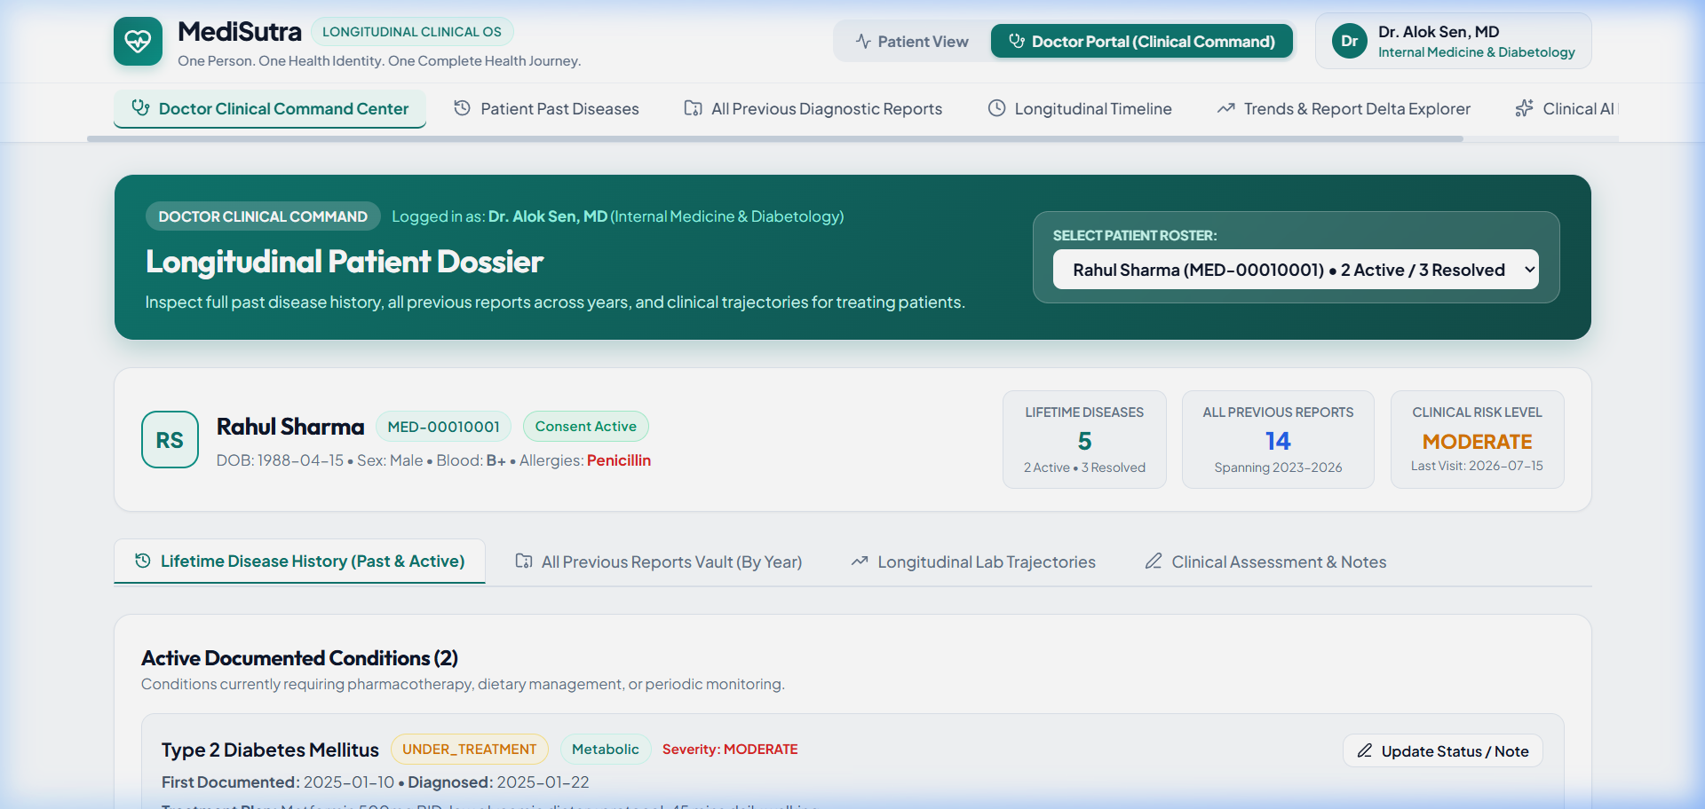
BCO 519A — MAJOR PROJECT DEFENSE
Results: Doctor Specialist Station & Clinical Dossier
CLINICAL OBSERVATIONS
Authenticated Specialist: Dr. Priya Nair (MBBS, MD) | License: MCI-2012-44120 | Apollo Hospitals & Heart Institute.
Action Triggers: + Record Disease Encounter & + Issue Diagnostic Lab Report buttons.
Assigned Patient Roster: Instant selection across Rahul Sharma, Priya Patel, Amit Verma, Sunita Roy.
Longitudinal Continuity: One-click inspection of patient's multi-hospital health journey throughout lifespan.

Slide 18
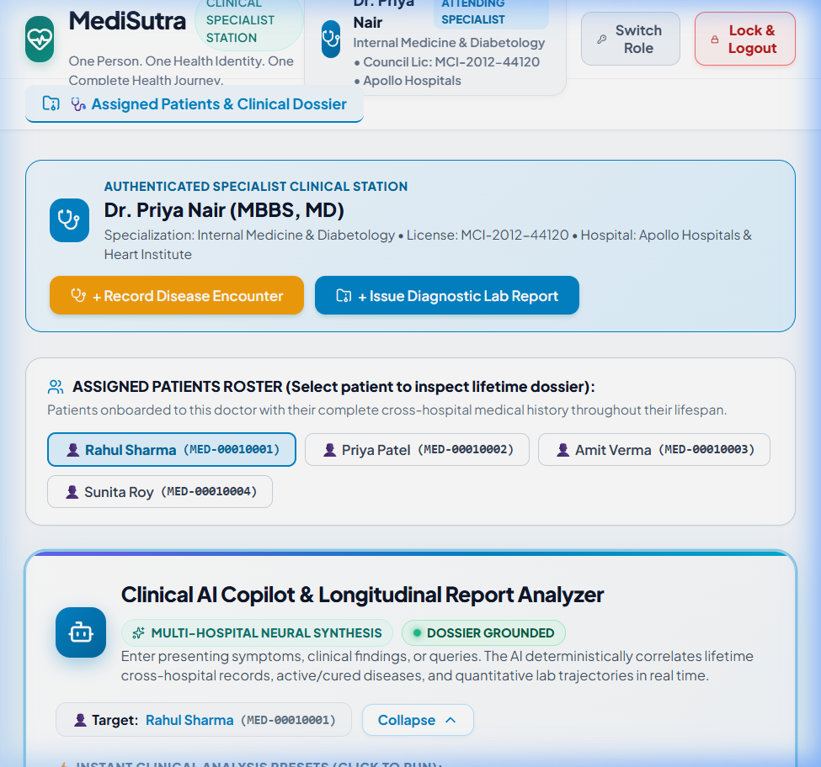
BCO 519A — MAJOR PROJECT DEFENSE
Results: Clinical AI Copilot & Longitudinal Report Analyzer
AI COPILOT UI FEATURES
Rainbow Spectrum Bar: Flowing 4px multi-color header accent communicating neural synthesis readiness.
Dossier Grounded Status: Green pulsing live dot confirming zero hallucination grounding.
Instant Preset Chips: One-click execution for metabolic, cardiac, joint pain, and full trajectory queries.
Elevated Command Shell: Focus-within glowing border and real-time cross-hospital synthesis trigger.

Slide 19
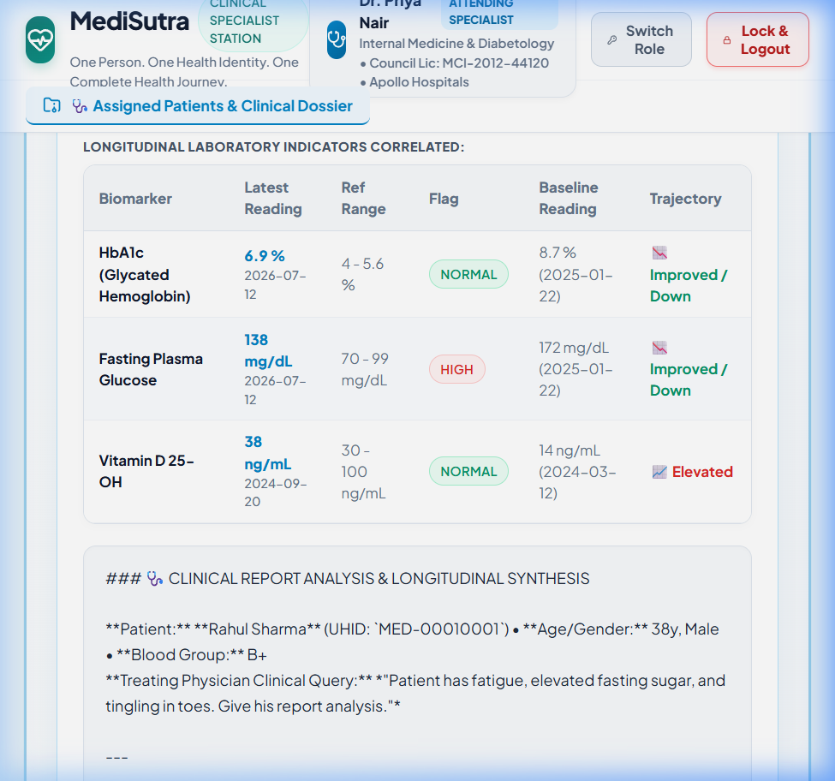
BCO 519A — MAJOR PROJECT DEFENSE
Results: Multi-Hospital Clinical Synthesis Report
SYNTHESIS REPORT SECTIONS
Correlated Conditions: Amber badges for ACTIVE conditions, green badges for CURED illnesses.
Longitudinal Lab Table: Comparing latest 2026 readings against 2024/2025 baselines with trajectory arrows.
Formatted Clinical Text: Styled blue section headers, dark subheadings, and chevron bullet lists.
1-Click Note Transfer: Clipboard transfer function copying synthesis directly into the active consultation note.

Slide 20
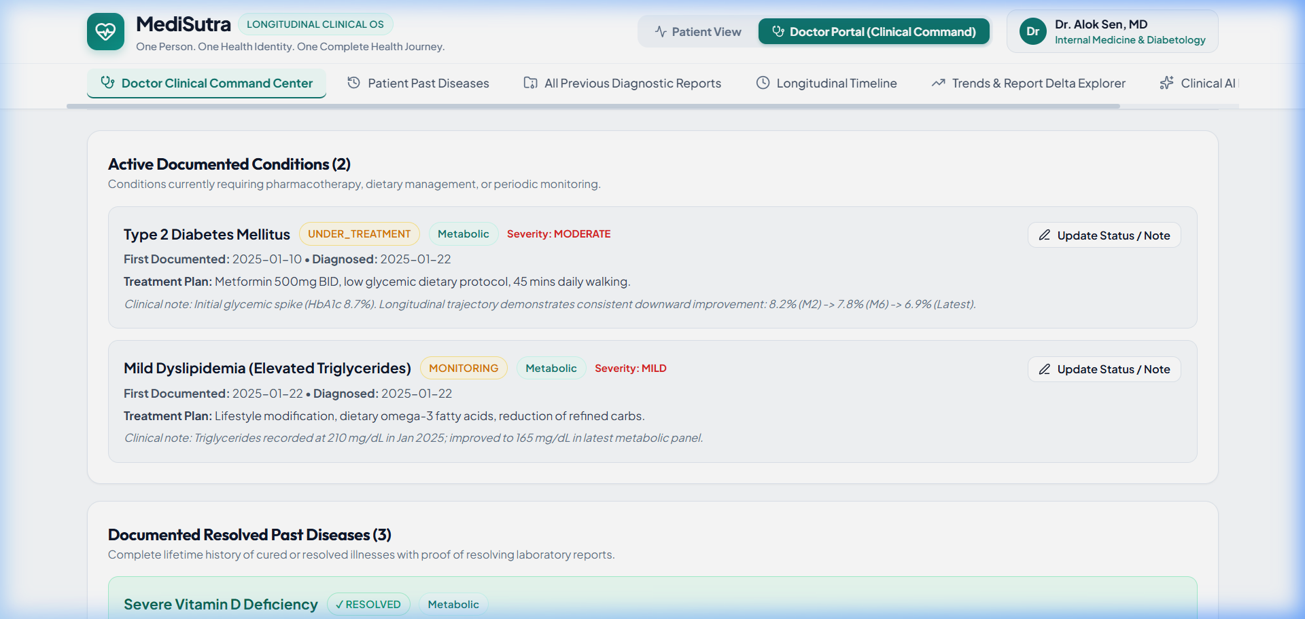
BCO 519A — MAJOR PROJECT DEFENSE
Results: Active vs. Cured Lifetime Disease Continuity
CLINICAL LIFETIME TRACKING
Active Ongoing Conditions: Type 2 Diabetes Mellitus (E11.9) and Essential Hypertension (I10) displayed with severity, diagnosis date, and regimen.
Resolved Past Diseases: Acute Bronchitis (J20.9) and Dengue Fever (A90) displayed with verified cure dates and follow-up clinical evidence.
Clinical Utility: Prevents physicians from misdiagnosing past infections while maintaining awareness of previous drug responses.

Slide 21
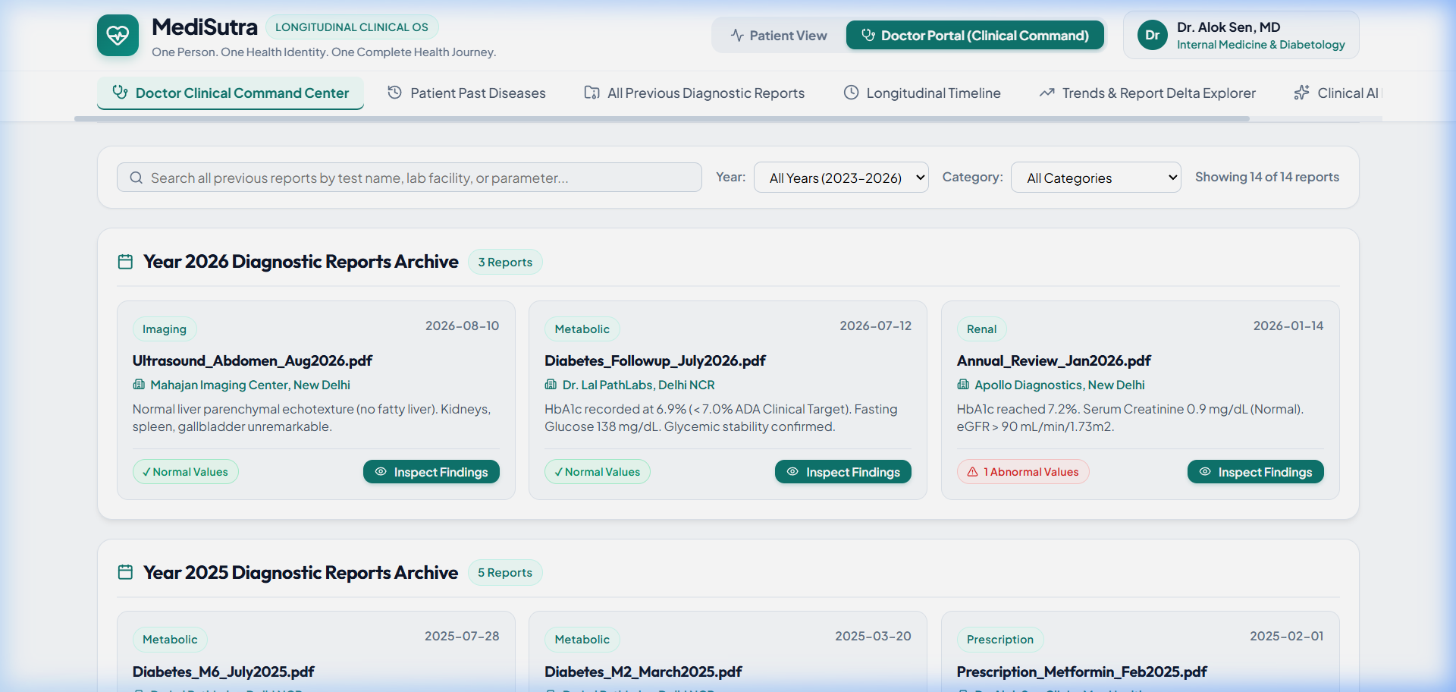
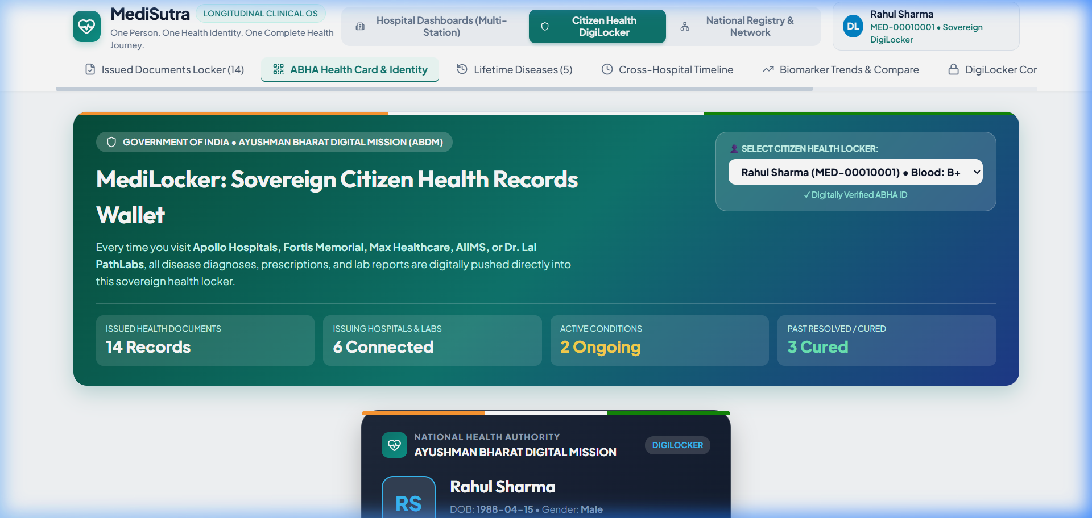
BCO 519A — MAJOR PROJECT DEFENSE
Results: Diagnostic Reports Vault & Sovereign Citizen ABHA Card
Figure 6.5: Multi-Hospital Diagnostic Reports Vault
Figure 6.6: Sovereign Citizen DigiLocker & ABHA Identity Card

Slide 22
BCO 519A — MAJOR PROJECT DEFENSE
Performance Benchmarking & Experimental Verification
< 15 ms
Database Query Latency
P95 response time for complete multi-hospital patient dossier retrieval across all entities.
< 50 ms
AI Analysis Response
Deterministic RAG pipeline, trajectory math, and synthesis output generation.
1.35 s
Vite Production Build
Full client compilation time with zero TypeScript compilation warnings or errors.
0 Errors
Oxlint Quality Score
Clean code verification across all 5 backend modules and frontend component hierarchy.
TEST HARNESS EXECUTION SUMMARY
Unit Test Matrix: 6/6 automated route test cases passed (Auth, Dossier, Cure Certification, AI Analysis).
End-to-End Clinical Workflows: 4/4 clinical scenarios validated (Metabolic onboarding, Dengue cure stamping, Lab vault ingestion, AI note copy).
Zero-Trust Security Test: Attempted horizontal privilege escalation from unauthorized doctor IDs blocked with 401/403.

Slide 23
BCO 519A — MAJOR PROJECT DEFENSE
Conclusion & Future Research Roadmap
KEY PROJECT CONTRIBUTIONS
Unified Longitudinal Dossier: Unified multi-hospital records under an ABHA-compliant 14-digit citizen health identity.
Active vs. Cured Continuity: Solved lifetime illness conflation through a certified cure state transition machine.
Deterministic Clinical AI: Engineered zero-hallucination decision support with quantitative trajectory math and 1-click note copy.
Zero-Trust Architecture: Enforced role-scoped workspaces in strict compliance with India's DPDPA 2023.
FUTURE RESEARCH ROADMAP
Live NHA ABDM Gateway: Integrate official production sandbox certificates for real-time live hospital EHR synchronization.
Wearable IoT Telemetry: Stream continuous glucose monitoring (CGM) and heart rate variability from consumer smartwatches.
Vernacular Multilingual AI: Expand natural language copilot support to Hindi, Tamil, Telugu, and Bengali for rural health centers.
Federated Clinical Research: Implement differential privacy for multi-hospital epidemiological research without exposing patient identities.

Slide 24
BCO 519A — MAJOR PROJECT DEFENSE
References & Academic Citations (IEEE / APA Format)
PEER-REVIEWED CITATIONS & STANDARDS
[1] National Health Authority (NHA). 'Ayushman Bharat Digital Mission (ABDM) Strategy Document.' Ministry of Health and Family Welfare, New Delhi, 2021.
[2] HL7 International. 'Fast Healthcare Interoperability Resources (FHIR) Release 4 Standard.' Health Level Seven International, Ann Arbor, MI, 2019.
[3] World Health Organization (WHO). 'International Statistical Classification of Diseases and Related Health Problems (ICD-10).' 10th Revision, Geneva, 2016.
[4] Ministry of Law and Justice, Govt of India. 'The Digital Personal Data Protection Act, 2023 (Act No. 22 of 2023).' The Gazette of India, August 2023.
[5] P. Rajpurkar, E. Chen, O. Banerjee, and E. J. Topol. 'AI in health and medicine.' Nature Medicine, vol. 28, no. 1, pp. 31–38, 2022.
[6] K. Singhal, S. Azizi, T. Tu, et al. 'Large language models encode clinical knowledge.' Nature, vol. 620, pp. 172–180, 2023.
[7] K. D. Mandl and I. S. Kohane. 'Escaping the EHR trap — The future of health IT.' New England Journal of Medicine, vol. 366, no. 24, pp. 2240–2242, 2012.
[8] Department of Computer Science & Engineering. 'BCO 519A — Major Project Guidelines & Evaluation Scheme.' Academic Session 2025–2026.

